Slide 2
DR of the Kongo

Slide 3
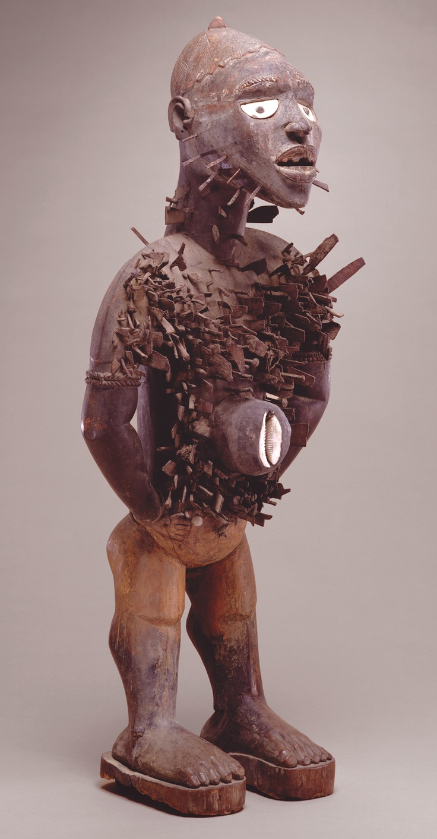
172. Power figure (Nkisi n’kondi)
Kongo Peoples (Democratic Republic of the Congo)
1890 CE
Wood and metal

Slide 4
UMFA Examples
click for more info

Slide 5
https://www.youtube.com/watch?v=fVC0EAEuJSo

Slide 6
Form | Function | Content | Context
Hard wood; human, though sometimes animal figures | spirits can be called upon to bless/harm; cause death and give life | alert pose- eyes and mouth open | Spirits/Medicine embedded in the image
size ranges from 4-5 feet tall to 8 inches | in order to prod the image to action, nails and blades are often inserted into the work or removed from it | medical properties are inserted into the body cavity
 |  | nails pounded into the figure

Slide 7
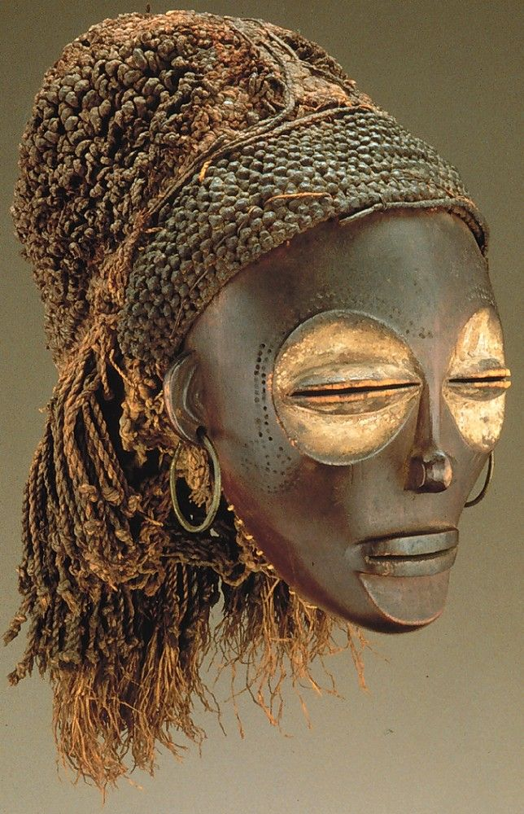
173. Female (Pwo) mask.
Chokwe People
(Democratic Republic of the Congo)
1900 CE
Wood, fiber, metal

Slide 8
https://www.youtube.com/watch?v=wUOrPtOsQOE

Slide 9
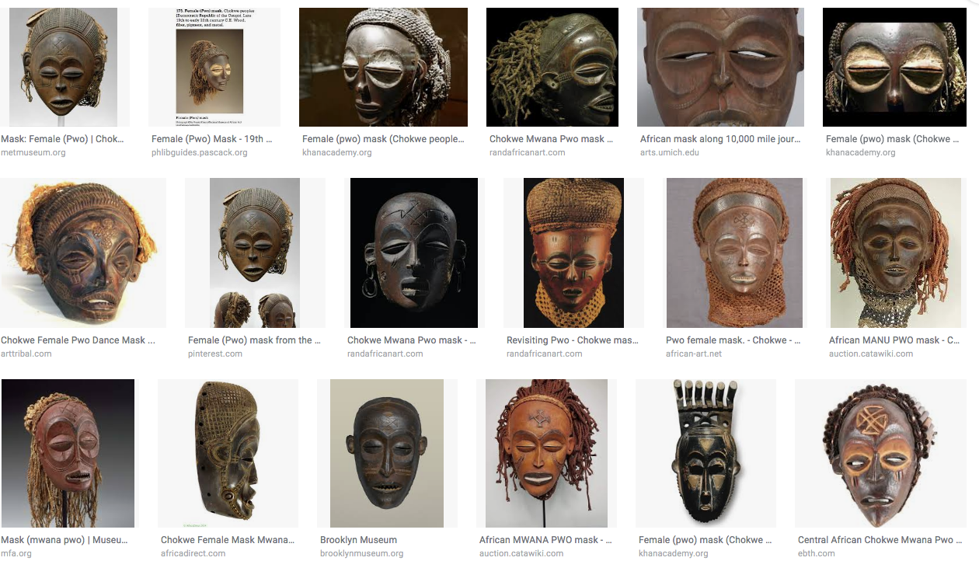
Pwo Masks

Slide 10
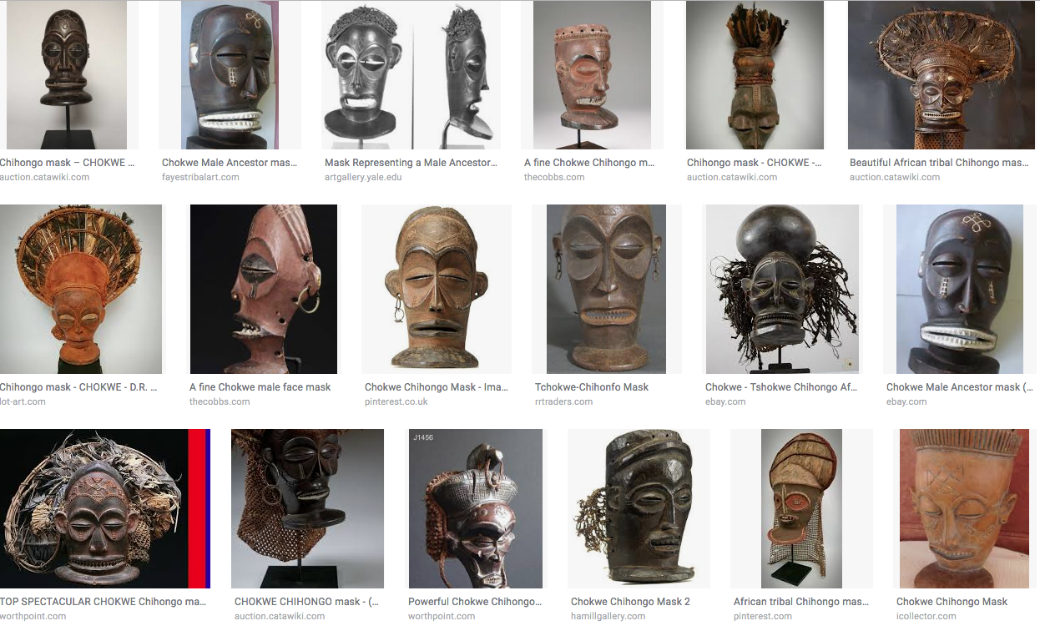
Chihongo Masks

Slide 11
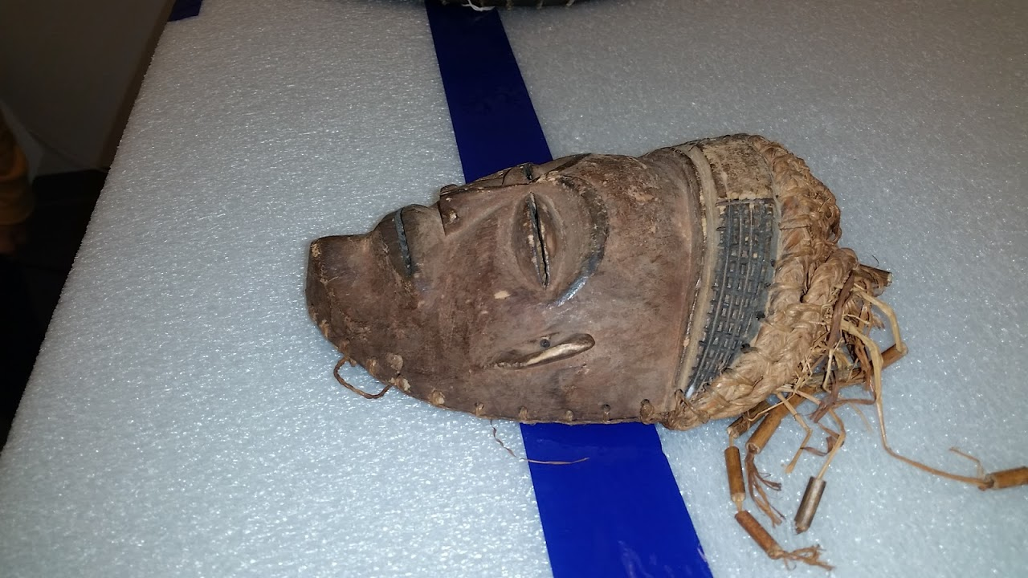
UMFA Examples

Slide 12
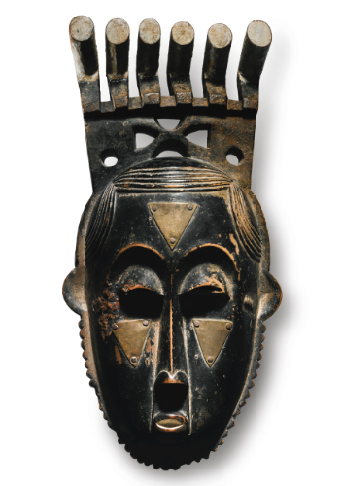
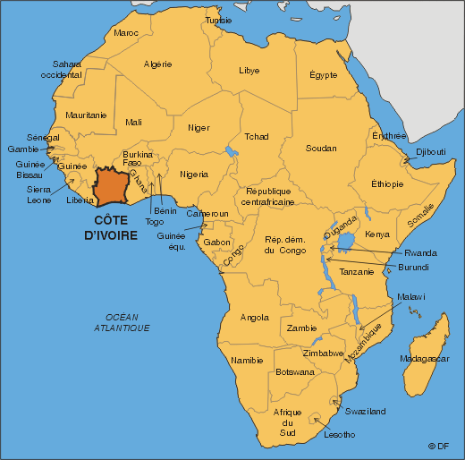
174. Portrait mask (Mblo). Baule peoples (Côte d’Ivoire). Early 20th century C.E. Wood and pigment.

Slide 13
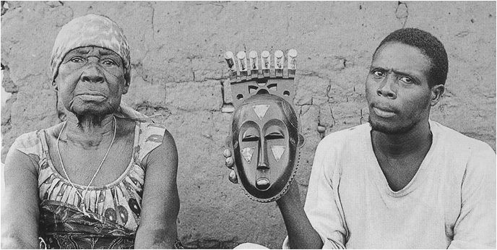

Slide 14
https://www.youtube.com/watch?v=2VXiPSJsJIM

Slide 17
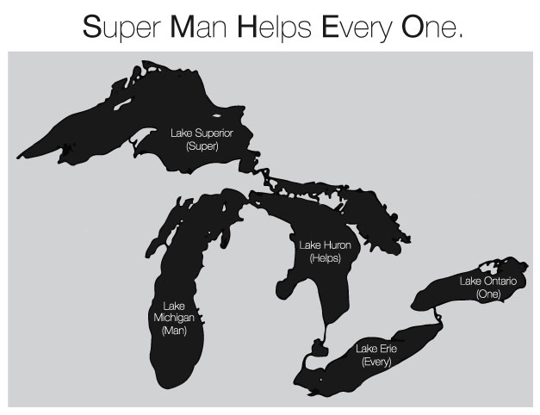

Slide 19
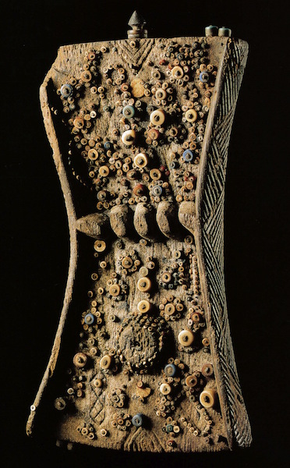
177. Lukasa (memory Board)
Luba People (Democratic Republic of the Congo
19th-20th Century
Wood, beads, metal

Slide 20
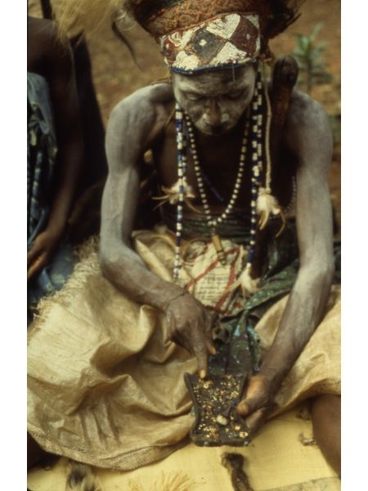

Slide 21
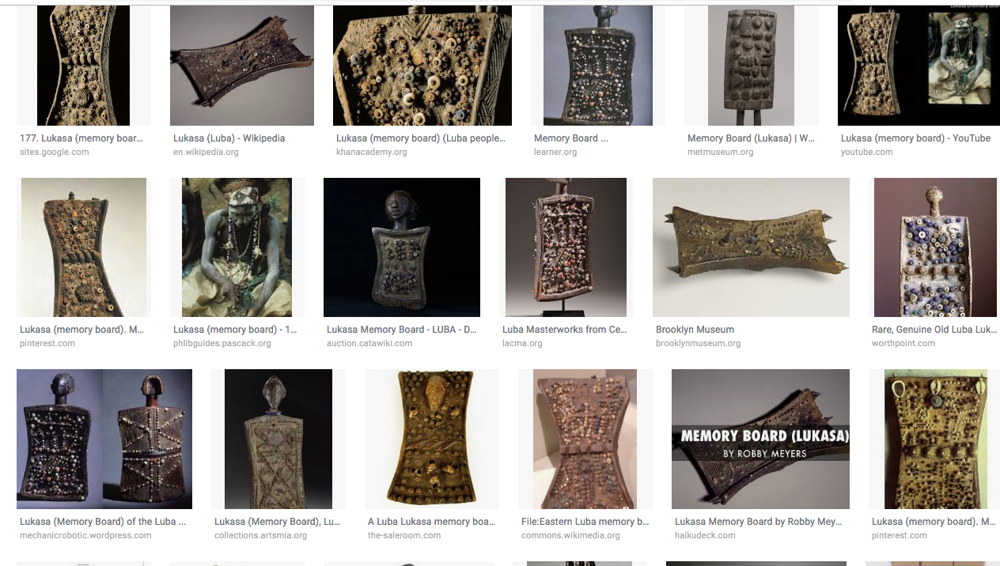

Slide 22
https://www.youtube.com/watch?v=NqmMQjf8XLY

Slide 23
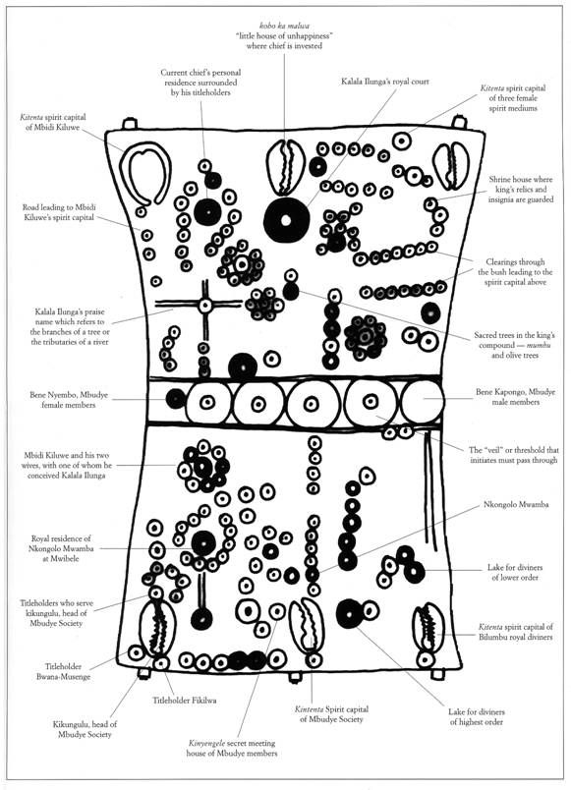

Slide 24
Form | Function | Content | Context
carved from wood in an hourglass shape, decorated with shells, beads, or metal | Helps the reader remember key elements of a story: Court ceremonies, migration, heroes, kinship, genealogy, royal lists | Reading example: one colored bead can stand for an individual; a large bead surrounded by small ones could be a king & court; lines of beads could be journeys | reader holds the lukasa in the left hand and traces it with the right
 |  |  | only a few people can actually read them
 |  |  | each board has a unique design
 |  |  | mbudye society control the lukasa

Slide 25
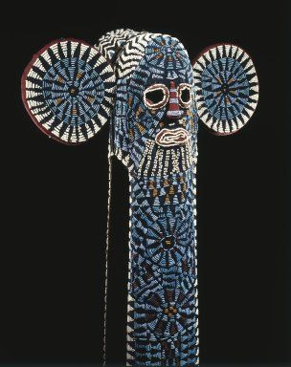
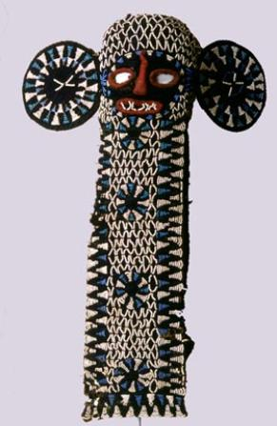
178. Aka elephant mask. Bamileke (Cameroon, western grassfields region). c. 19th to 20th century C.E. Wood, woven raffia, cloth, and beads.

Slide 26
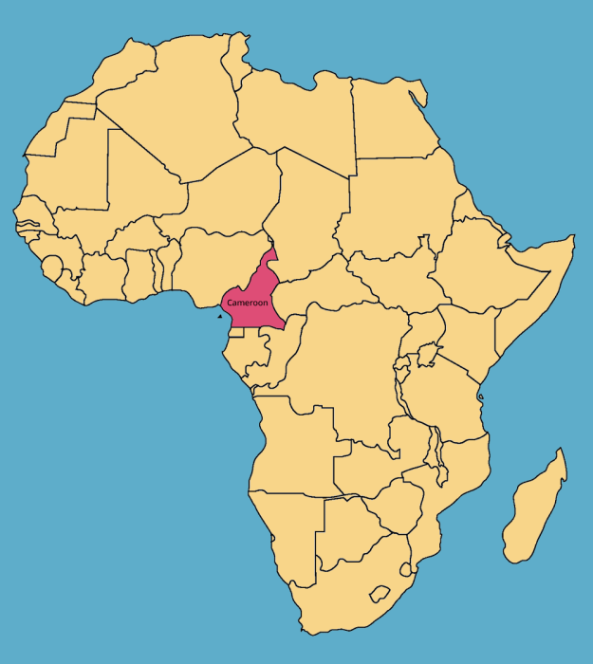
178. Aka elephant mask. Bamileke (Cameroon, western grassfields region). c. 19th to 20th century C.E. Wood, woven raffia, cloth, and beads.

Slide 27
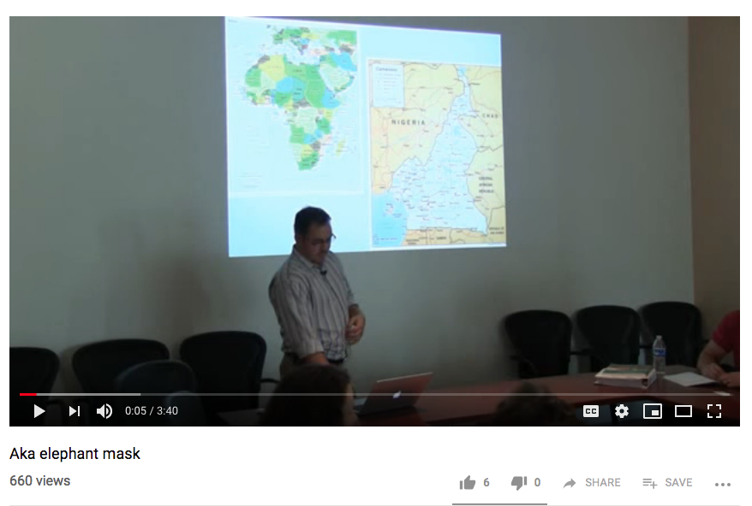
https://www.khanacademy.org/humanities/art-africa/central-africa/cameroon1/v/elephant-mask
https://www.youtube.com/watch?v=o3hyg_ldgaE

Slide 28
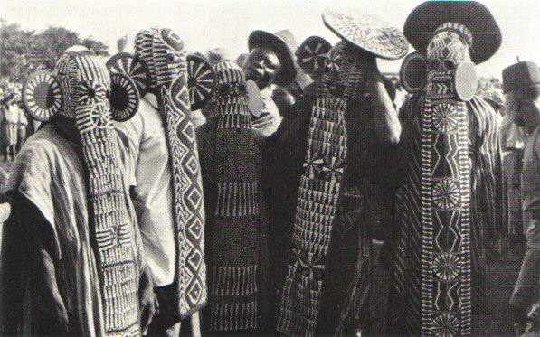

Slide 29
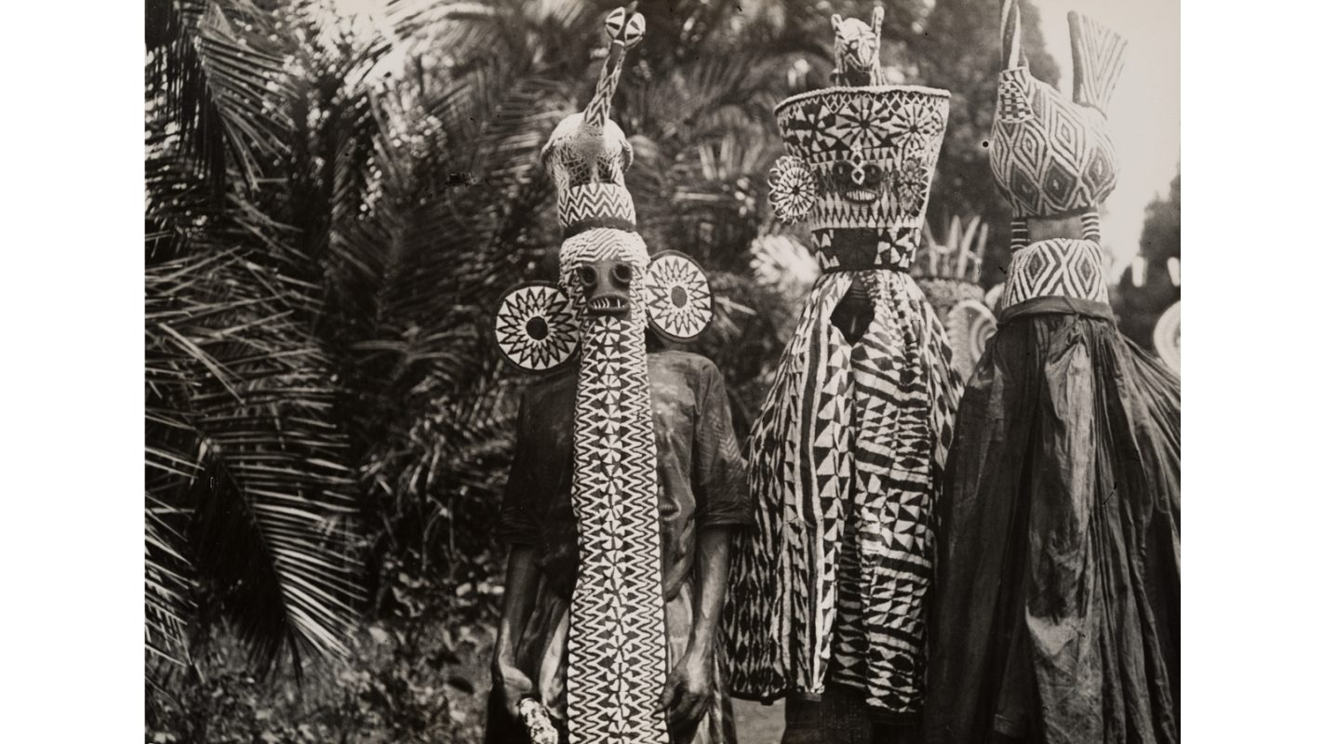

Slide 30
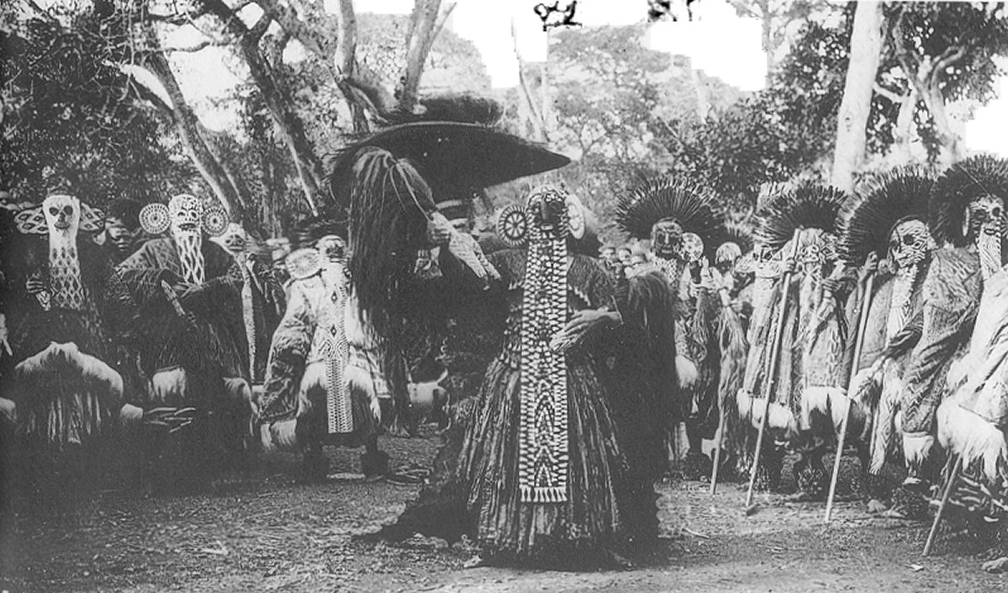

Slide 31
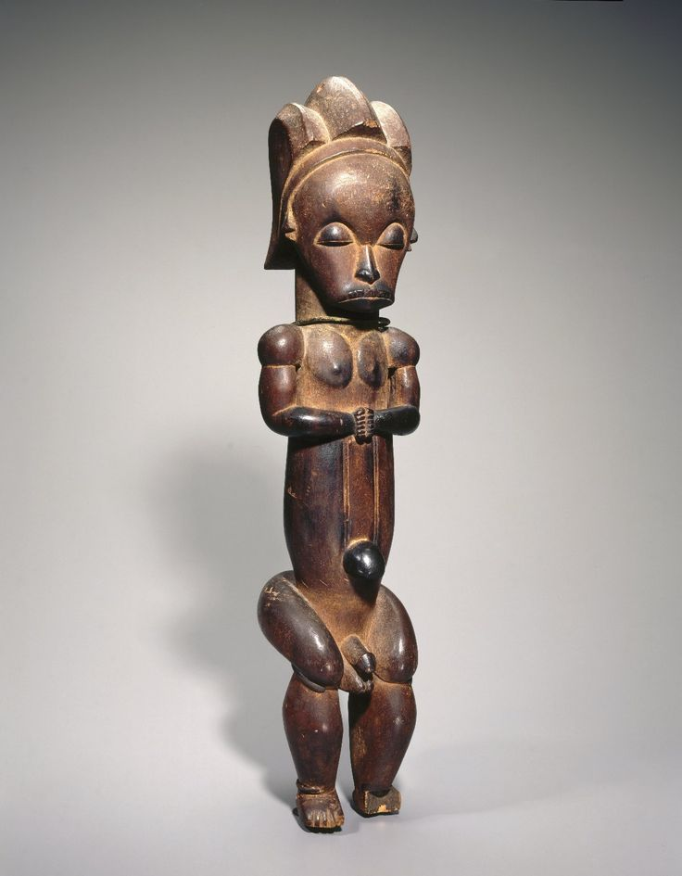
179. Reliquary Figure (byeri)
Fang People, Cameroon
19th-20th Century
Wood

Slide 32
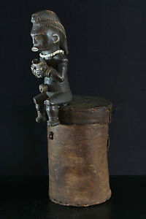
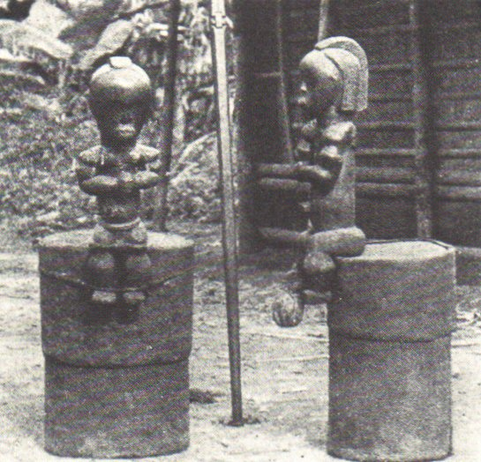
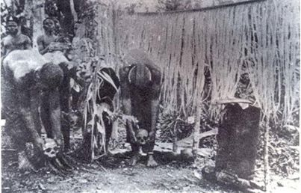

Slide 33
https://www.youtube.com/watch?v=M5pM4rxVAc
https://www.khanacademy.org/humanities/art-africa/central-africa/gabon-art/v/fang-reliquaryo

Slide 34
Form | Function | Content | Context
elongated torso, enlarged head | figures placed on top of cylinder-like containers made of bark that hold skulls and other bones of important leaders | feet dangle over the edge of the container in a gesture of protection | figures rubbed with oil for protection against insects, and to add shine
 | puppets for young mens’ initiation | Bieri figures are composed of characteristics the Fang people place a high value upon: tranquility, vitality, introspection | prominent belly button/genitals emphasize life; prayerful pose emphasizes death
 | guards the contents against the gaze of the uninitiated

