Slide 2
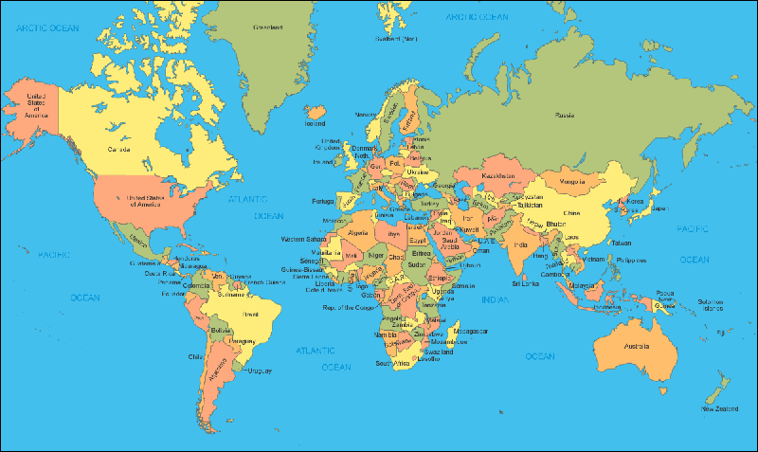
How big is Africa?

Slide 3
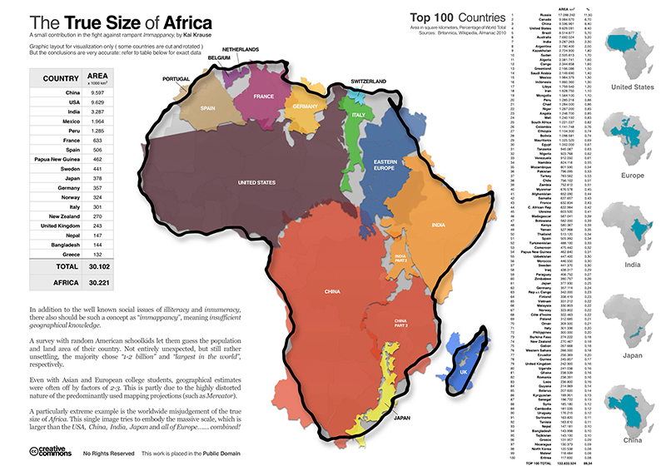

Slide 4
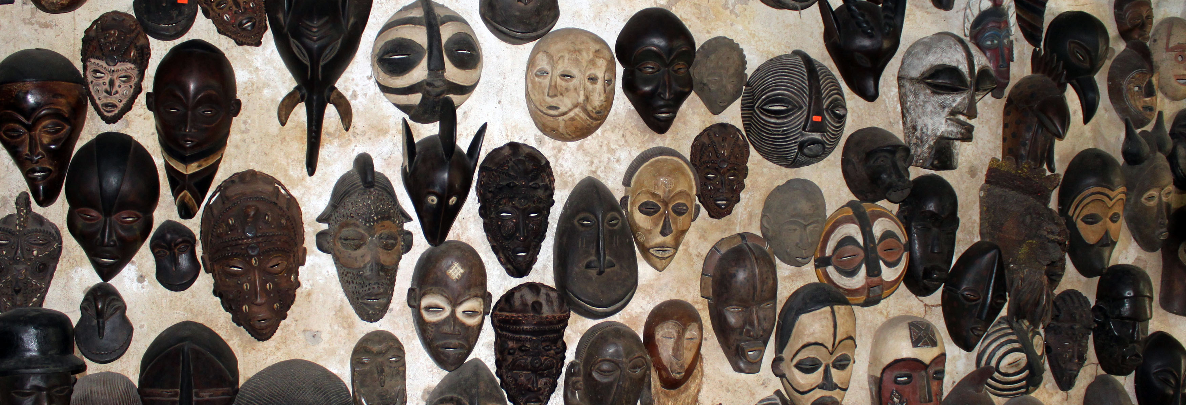
Attributes of African Art
ABSTRACTION
Abstract forms for Abstract Ideas

Slide 5
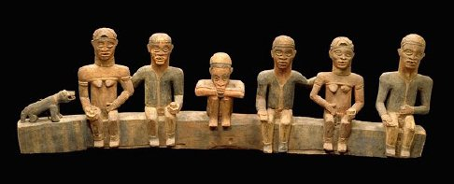
Attributes of African Art
2) SCULPTURAL PRIMACY
3D Art works are more common

Slide 6
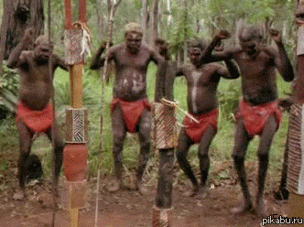
Attributes of African Art
3) PERFORMANCE ART
Movement is a key form of communication

Slide 7
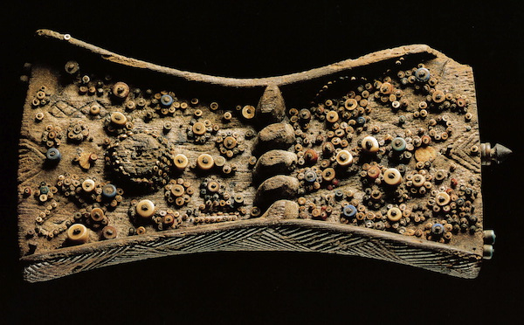
Attributes of African Art
4) MULTIPLICITY OF MEANING
Knowledge is privileged and must be earned

Slide 8
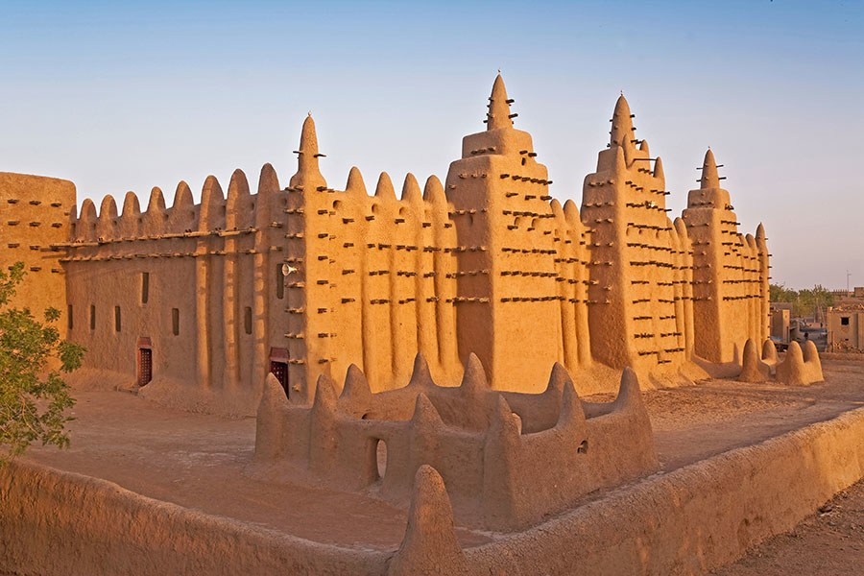
Attributes of African Art
5) INNOVATION OF FORM

Slide 9
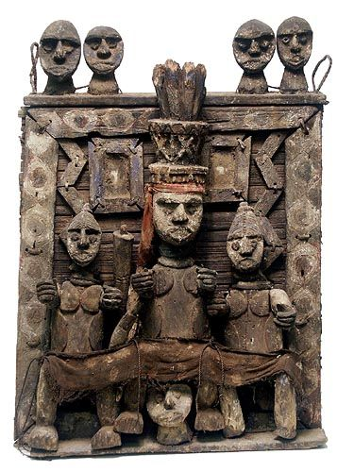
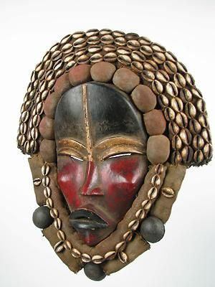
Attributes of African Art
6) ASSEMBLEDGE

Slide 10
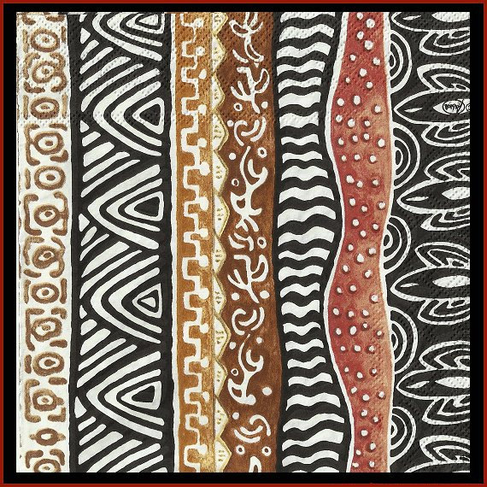
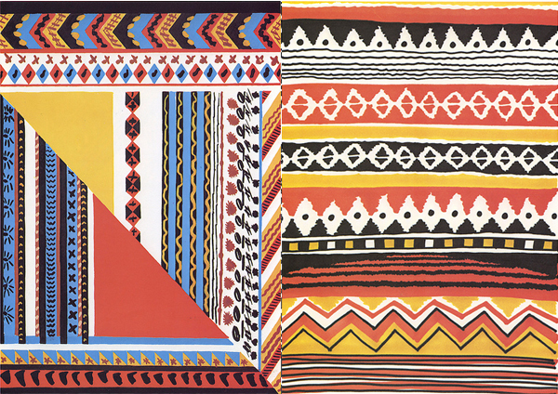
Attributes of African Art
7) PARALLEL ASYMMETRIES

Slide 11
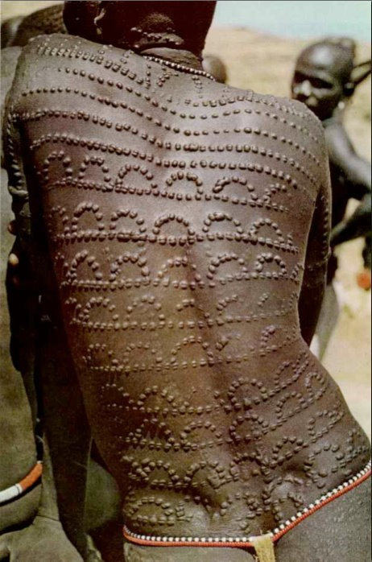
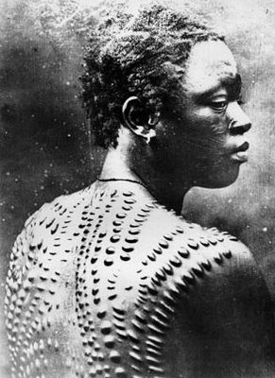
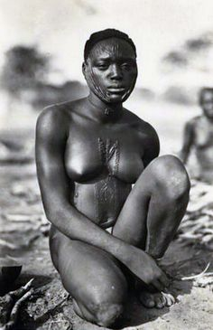
Attributes of African Art
8) HUMANISM

Slide 12
Over 680 million people live in Africa
Although some regions remain sparsely inhabited, others are densely populated. The West African nation of Nigeria, for example, has one-fifth of the entire continent’s population
About a third of all Africans live in large cities such as Lagos (Nigeria), the continent’s most populous city with 13.5 million people
It is estimated that there are well over 1,000 distinct languages in Africa, making it the most linguistically varied of all the continents
In Nigeria alone, more than 250 different languages are spoken
Culturally, Africans define themselves in many different ways: by occupational caste, village, kinship group, regional origin, and nationality. “Peoples” or “cultures” are the preferred terms when referring to ethnic identities
“tribe”—a word sometimes applied to African peoples or societies—is an inappropriate, even inaccurate term, and should be avoided

Slide 13
What does it mean to come of age?

Slide 14
Mende People

Slide 15
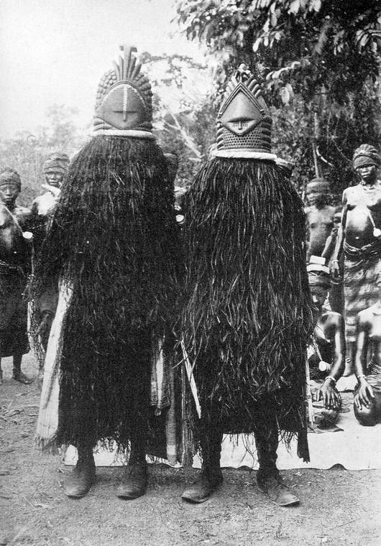
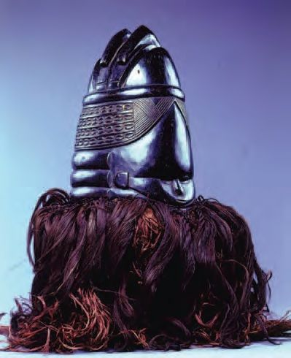
175. Bundu Mask
Mende People (Liberia/ Sierra Leone)
19th-20th Century CE
Wood
cloth,fiber

Slide 16
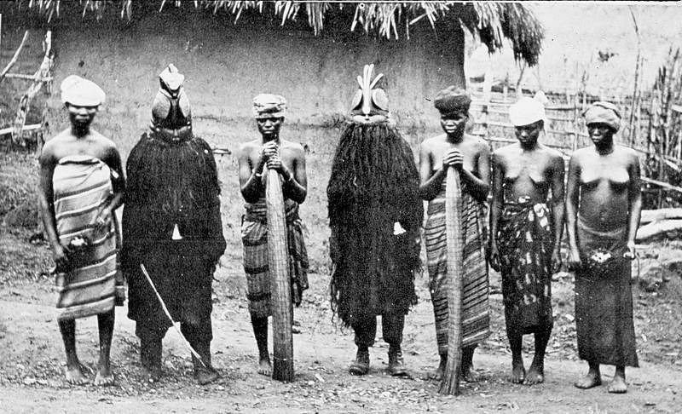

Slide 17
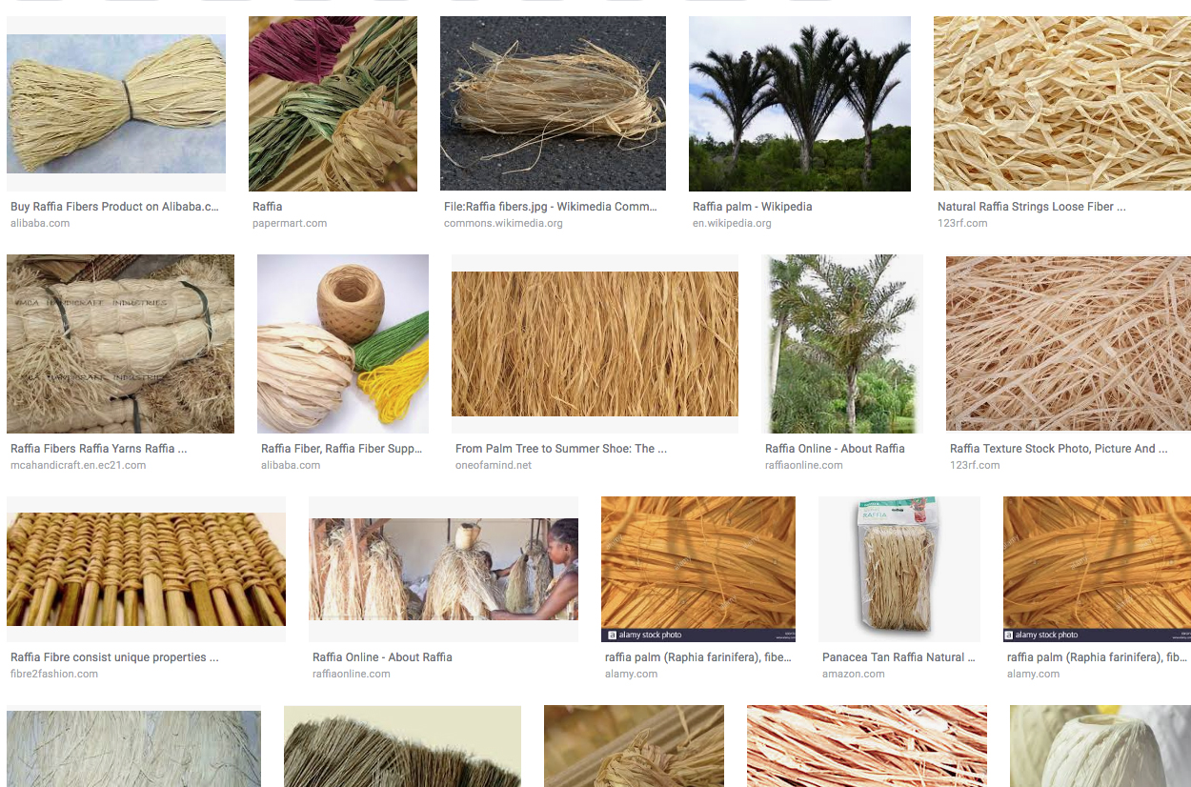
Raffia Fibers

Slide 18
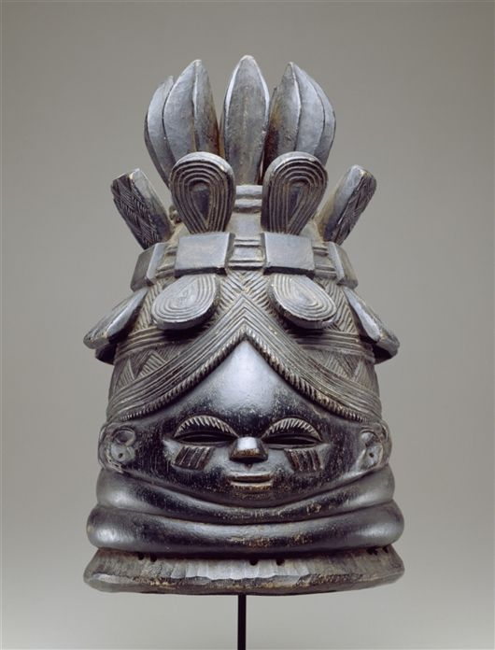
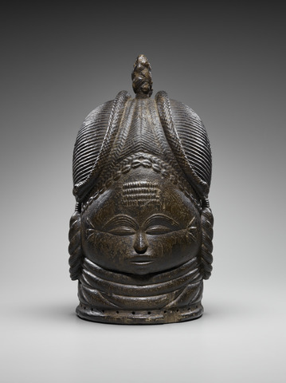

Slide 19
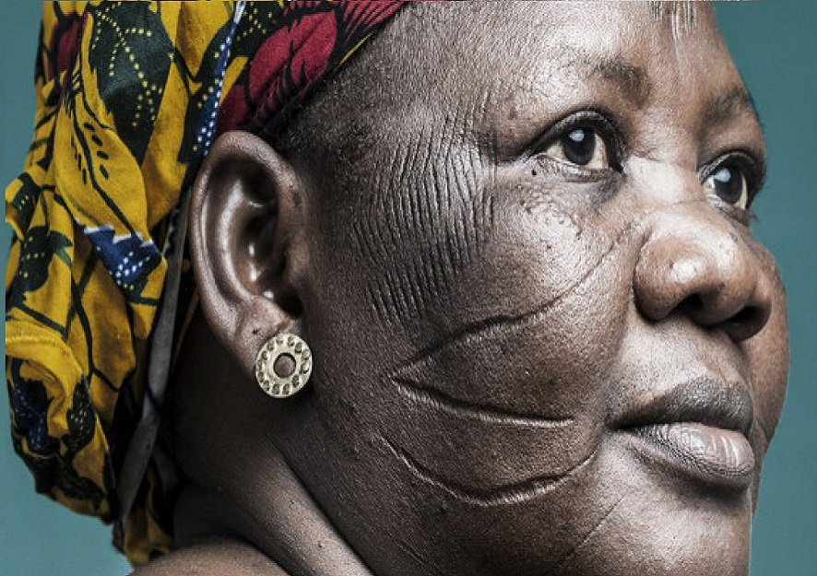

Slide 20
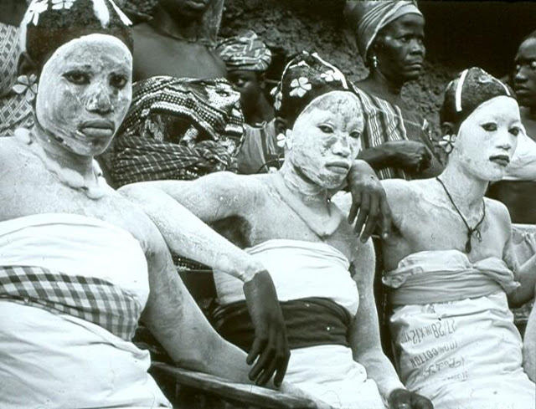

Slide 21
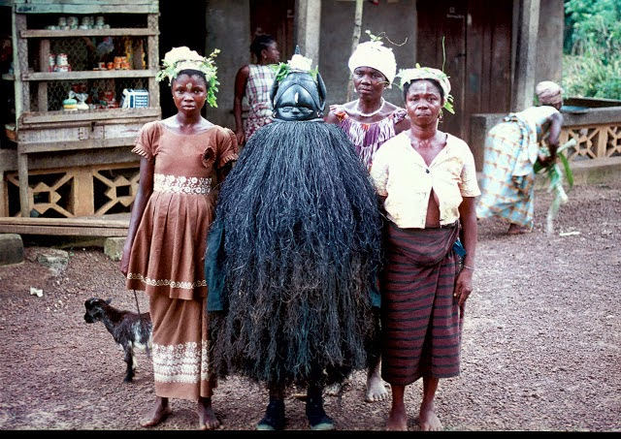

Slide 22
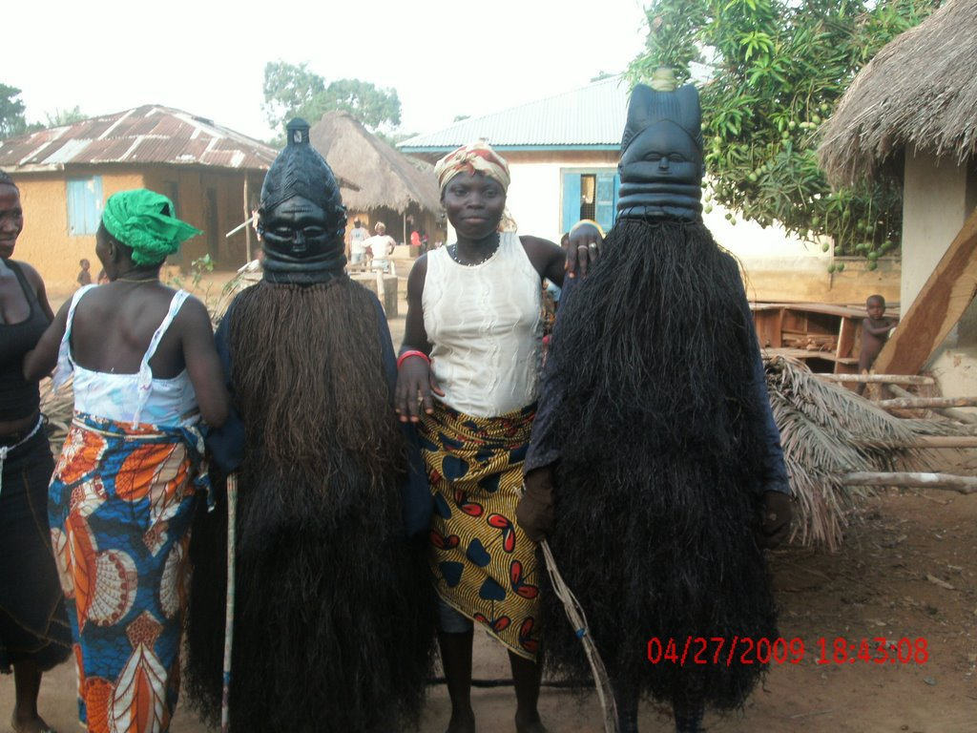

Slide 23
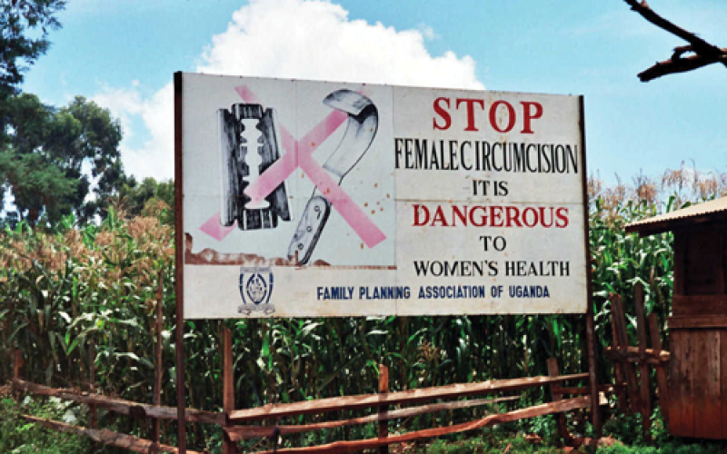

Slide 24
https://www.youtube.com/watch?v=x7Zvz8MZXKU

Slide 25
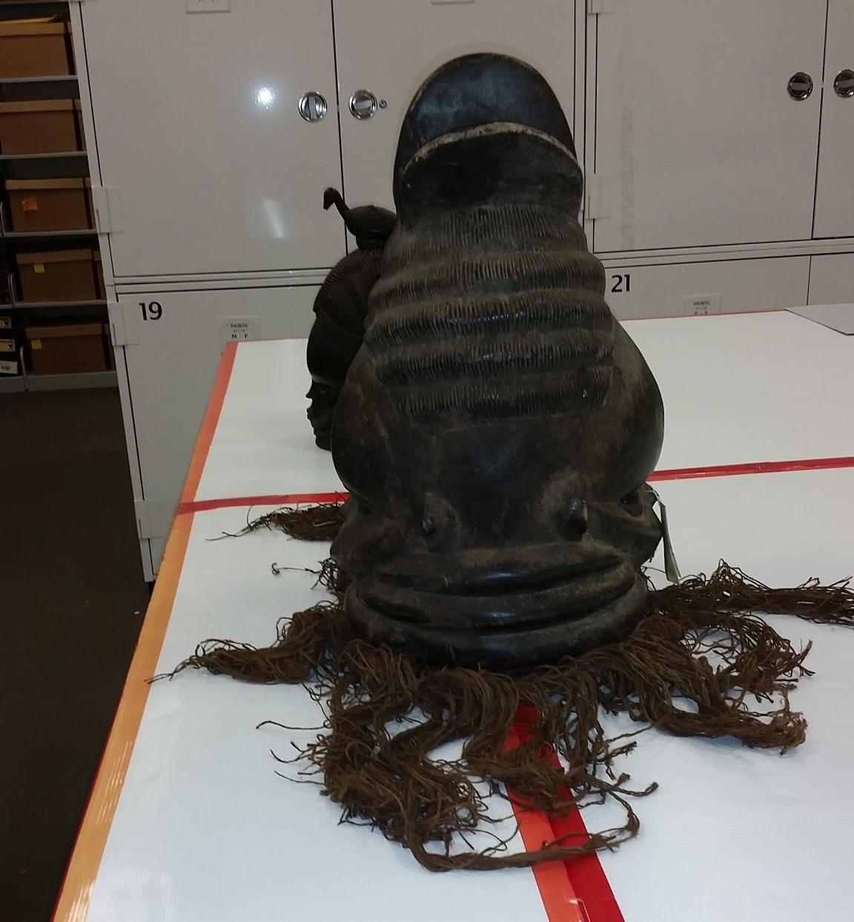
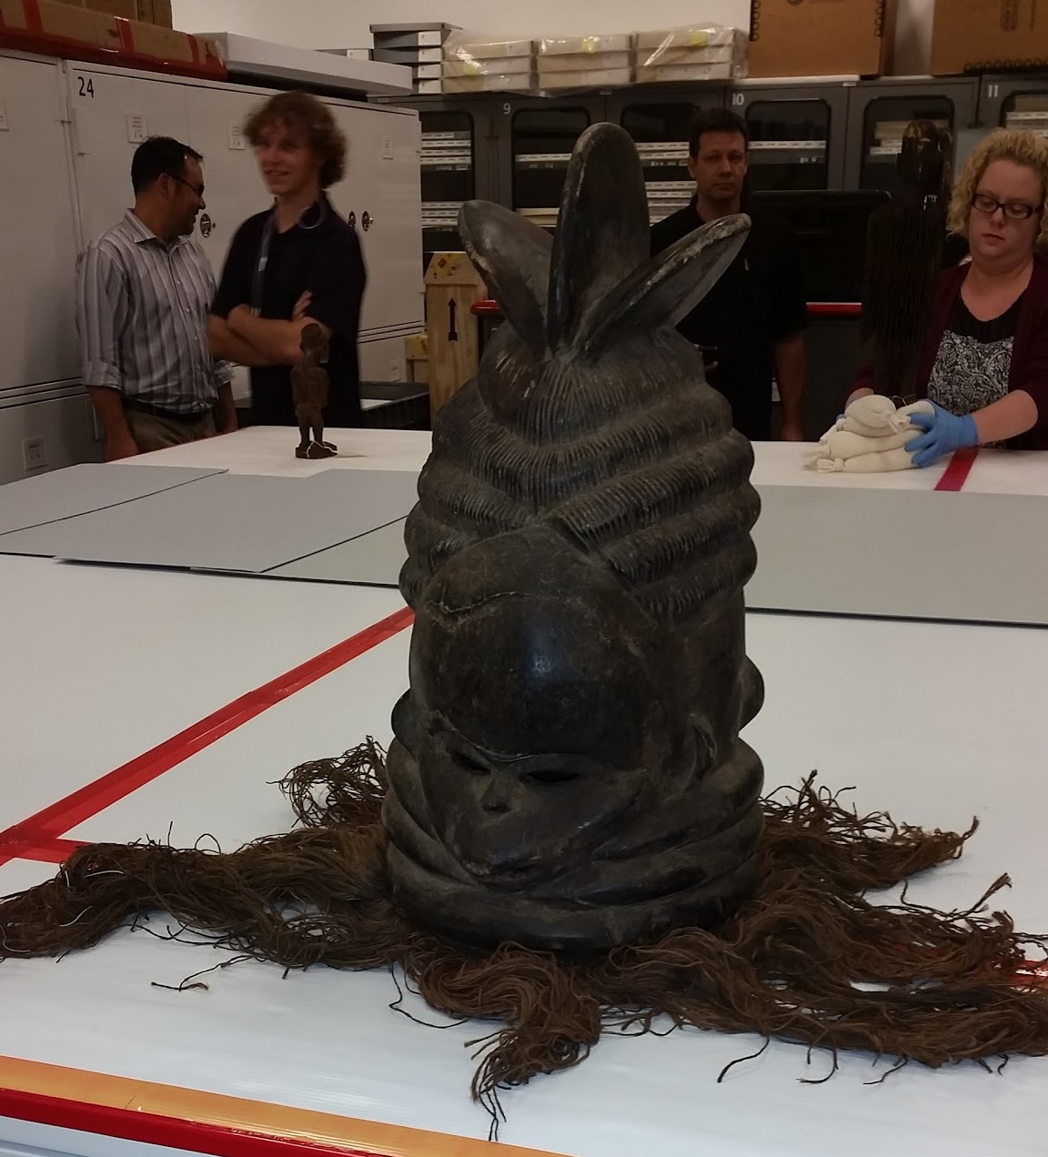

Slide 26
Form | Function | Content | Context
the shape of the stylized hair is revealed in a dream, varies from mask to mask | wear the mask with raffia that completely covers the body | idealized female beauty | Only African mask worn by women
individuality of each mask emphasized | mask rests on head not over it | Large forehead, small slit eyes, small mouth (good for keeping secrets) | Sande Society (a secret female society) prepare girls for adulthood and their role in society
 |  | black color symbolizes water, coolness and humanity; shines from being covered in palm oil | represents Sowei, the water spirit; the neck rings represent the emergence of Sowei from the water

Slide 27
Igbo People

Slide 28
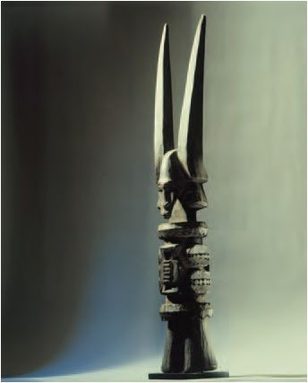
176. Ikenga (Shrine Figure).
Igbo People (Nigeria)
19th-20th Century CE
Wood

Slide 29
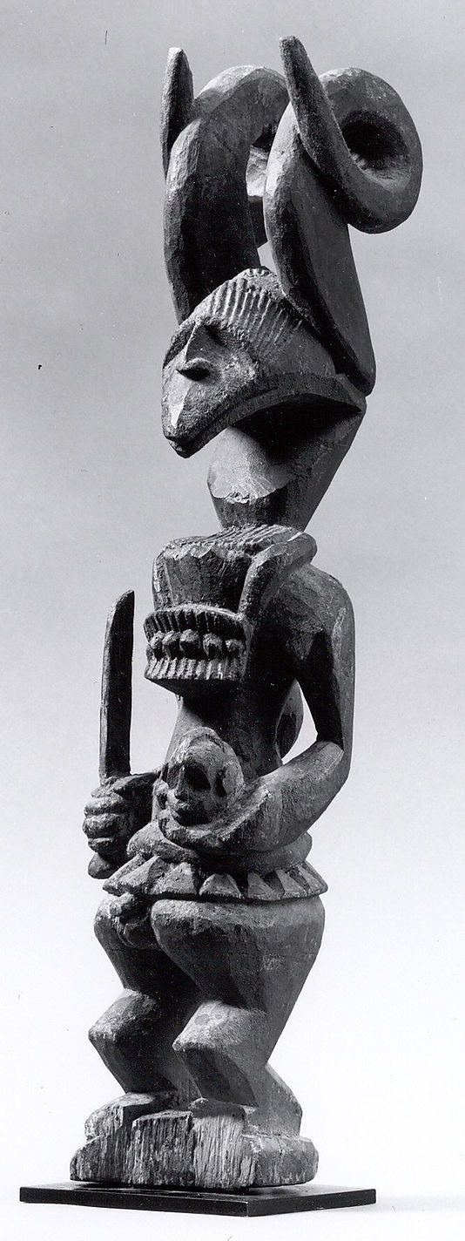
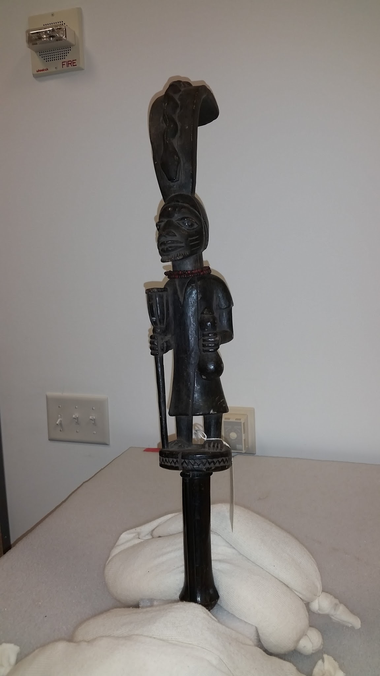
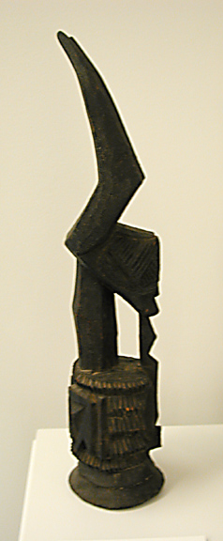

Slide 30
https://www.youtube.com/watch?v=ubN9qH_QUA4

Slide 31
Form | Function | Content | Context
always has horns that change style with each figure | personal god of achievement and success | horns symbolize power | Ikenga means “strong right arm” thus physical prowess
 | masculine associations of strength and potency; tells of the owners morality, prosperity, achievements, genealogy, social rank | as a man achieves more success, he might commission a more elaborate figure | honors the right hand which holds the tools or weapons, makes sacrifices, conducts rituals, and alerts to speak at public forums.
 |  |  | must be blessed before use- consecrated with offerings before kinsmen
 |  |  | maintained in the man’s home; destroyed when the owner dies, because it could be used by someone else if it is not destroyed

Slide 32
Benin People

Slide 33
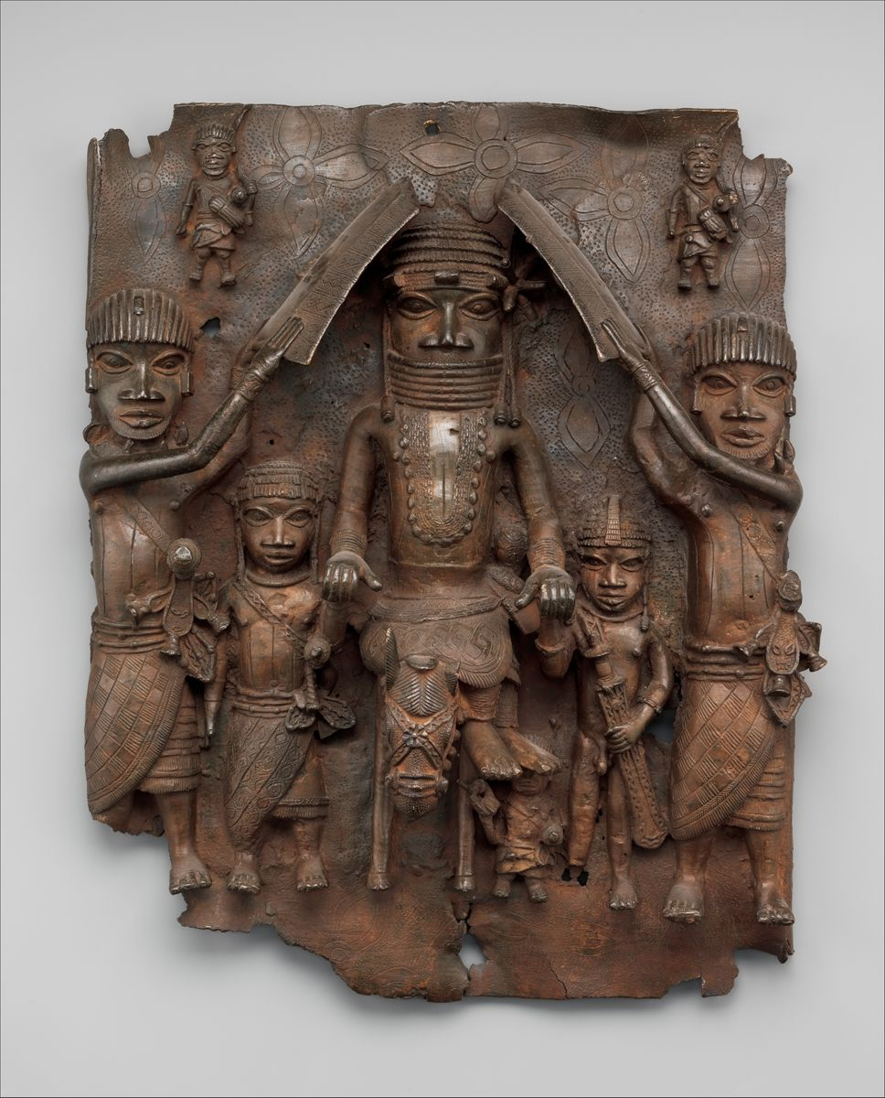
169. Wall Plaque, from the Oba’s palace
Edo Peoples
Benin (Nigeria)
1500 CE
Cast Bronze

Slide 34
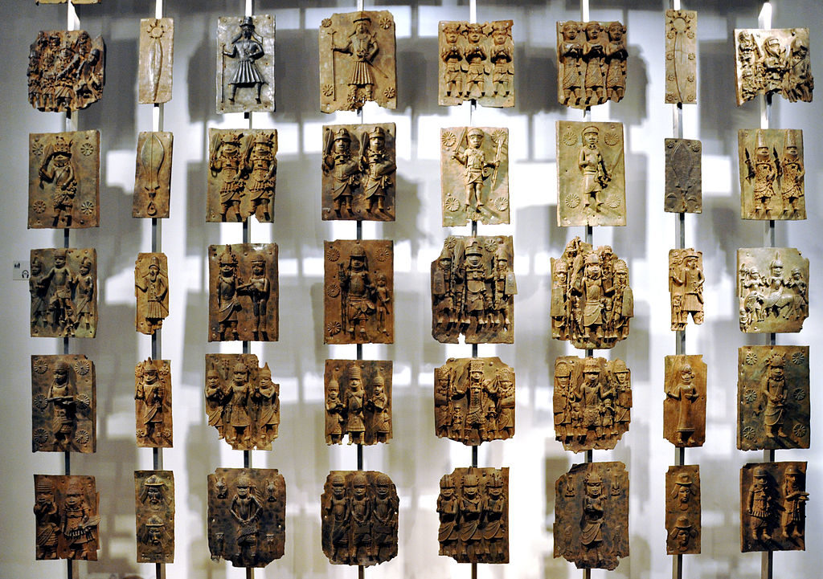

Slide 35
What are some art terms, or symbolism that we can identify?

Slide 36
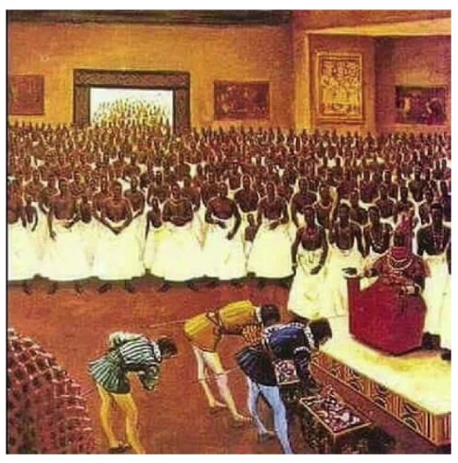
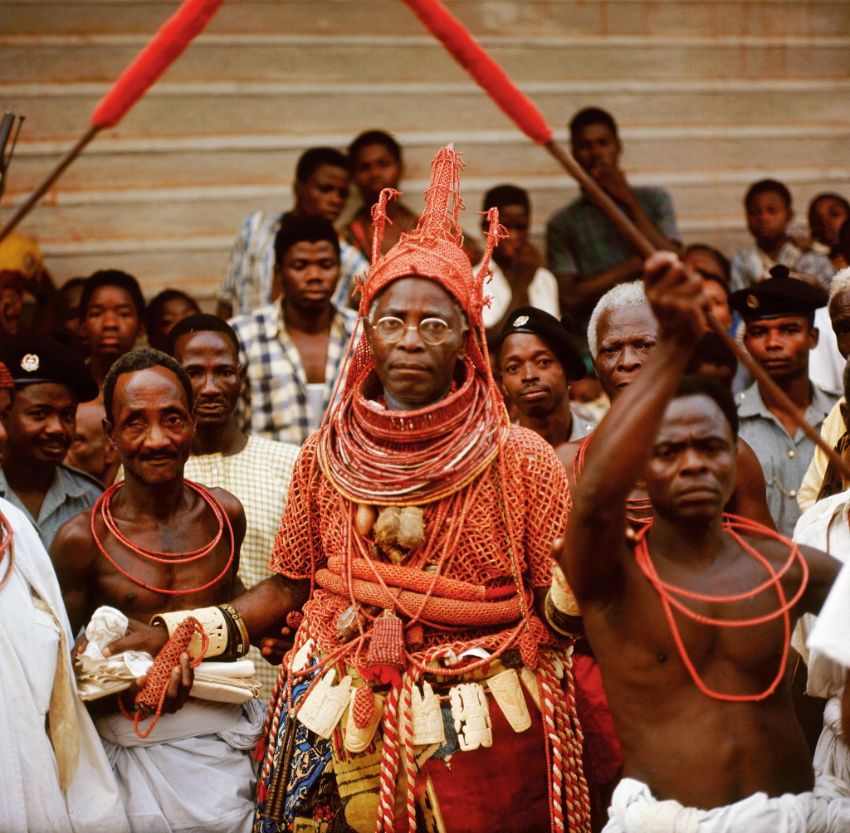

Slide 37
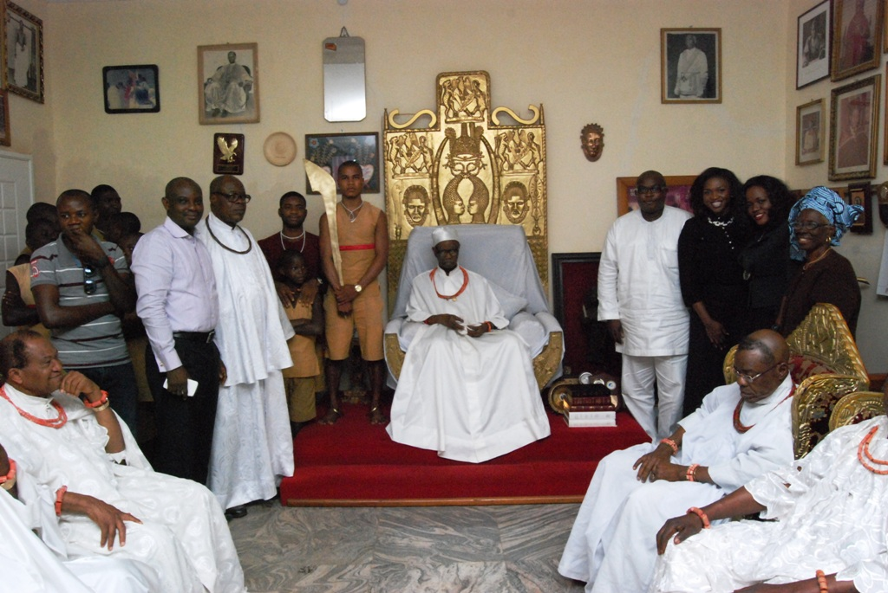

Slide 38
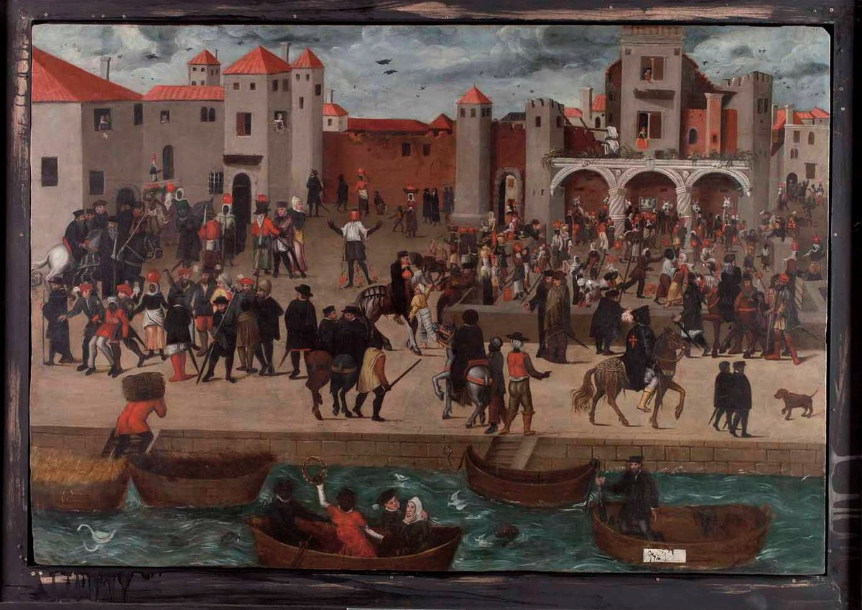
“The Kings Court” – Lisbon, Portugal

Slide 39
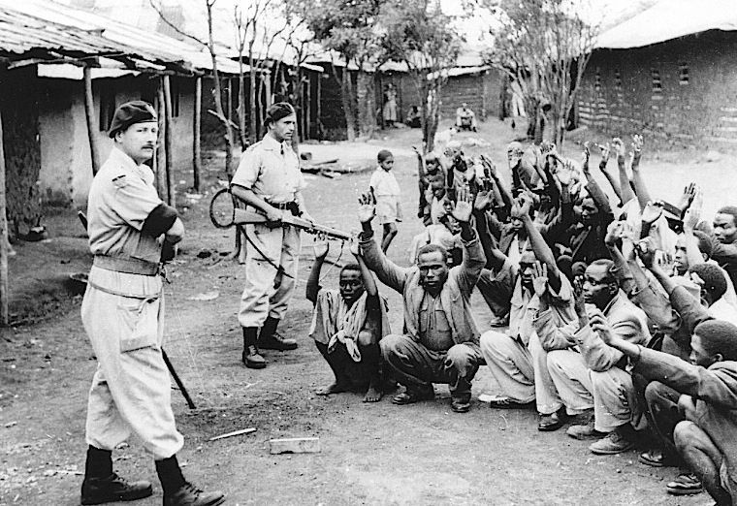
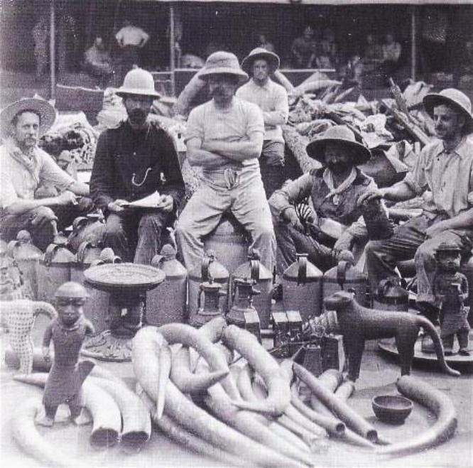
Why do you guess the Benin wall plaques are in the British Museum? (1890’s)

Slide 40
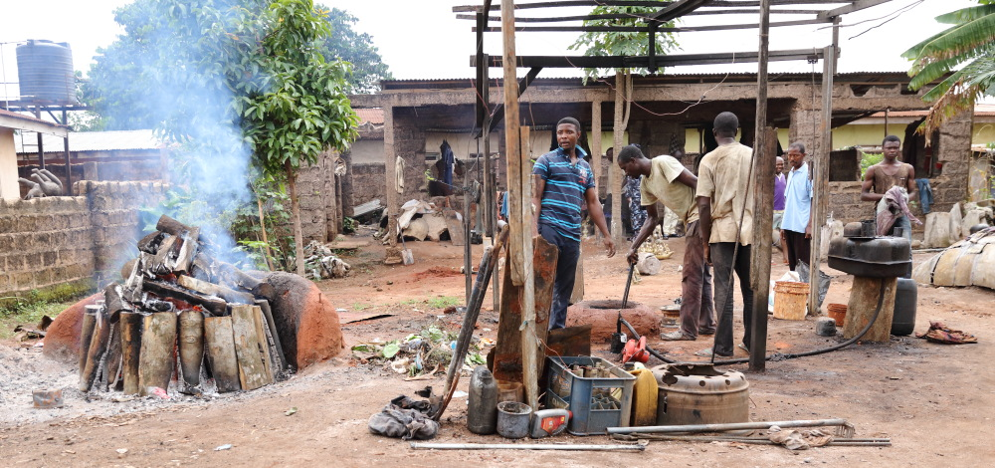

Slide 41
https://www.youtube.com/watch?v=QFj6UWyltps

Slide 42
Form | Function | Content | Context
hierarchical scaling | decorated walls of the royal palace | show aspects of court life in Benin culture | 900 Brass plaques produced 16-18 inches tall
emphasis on the head- Oba is known as the Great Head | part of a sprawling palace complex; wooden pillars covered in brass plaques | symbols of rank are emphasized | Oba (king) believed to be direct descendant of Oranmiyan, the legendary founder of the dynasty
high relief |  |  | only the Oba could be shielded
 |  |  | lost wax technique

Slide 43
Ashanti People

Slide 44
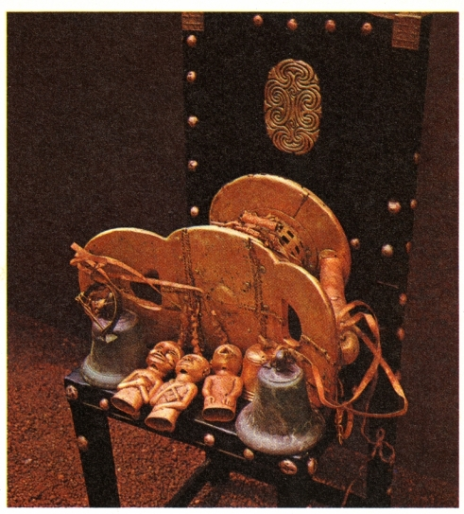
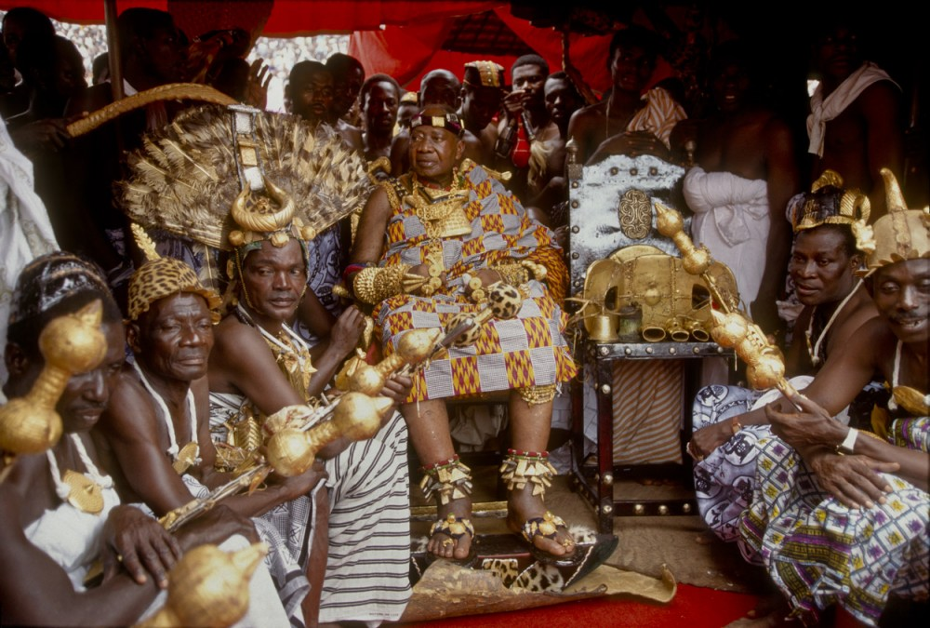
170. Sika Dwa Kofi (Golden Stool)
Ashanti People (Ghana)
1700 CE
Gold over wood

Slide 45
https://www.youtube.com/watch?v=6bsWW4Ke_Hs
https://www.youtube.com/watch?v=oDSJAKrNeZs

Slide 46
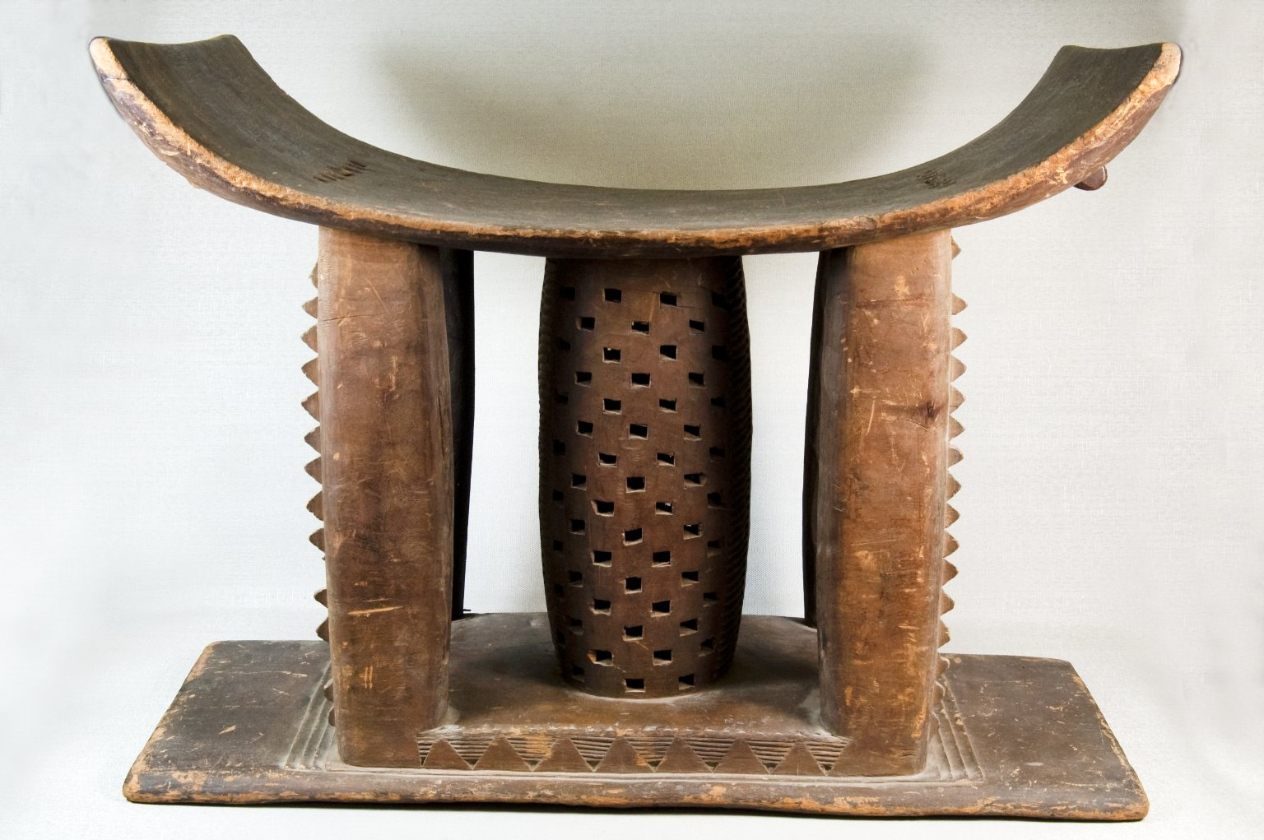
170. Sika Dwa Kofi (Golden Stool)
Ashanti People (Ghana)
1700 CE
Gold over wood

Slide 48
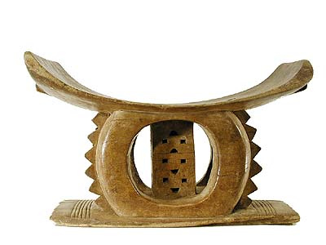
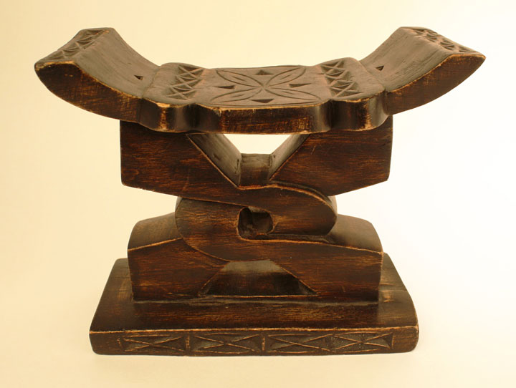
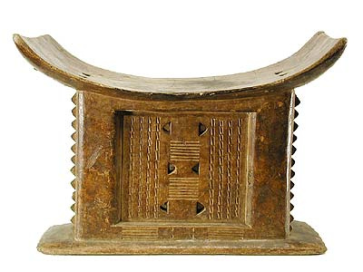

Slide 49
Form | Function | Content | Context
rectangular base; curved saddle seat | represents the soul of the Ashanti people- contains the soul of the nation | entire surface covered in gold | NEVER SAT ON- ALWAYS PUT ON ITS SIDE; never put on the ground- sits on a chair
 | only carried out on special occasions | bells hang from the side to warn the king of danger | new king is raised over the stool; carried to the king on a pillow- only he can tough it
 |  |  | people could own their own stools; they absorb your essence, and are turned on their side to prevent others from sitting on it

Slide 50
Kuba People

Slide 51
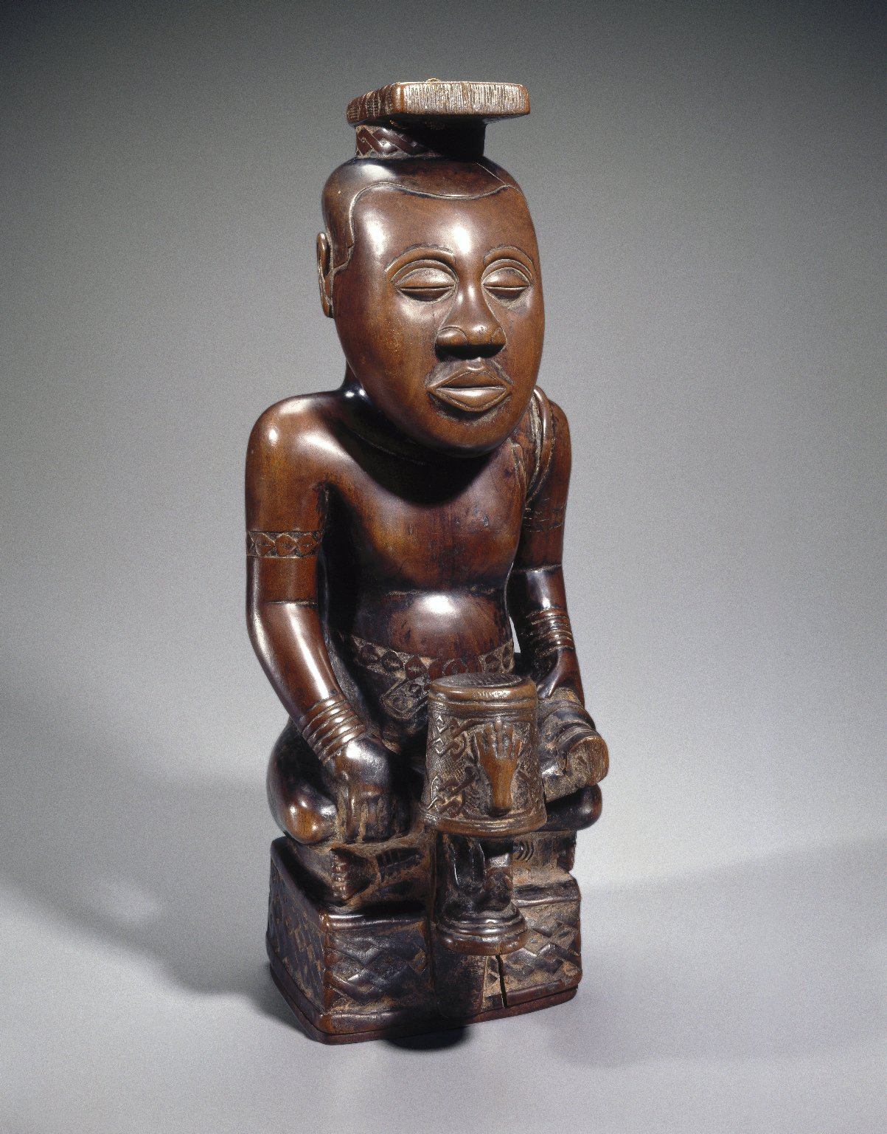
171. Ndop (Portrait figure) of King Mishe miShyaang maMbul
Kuba People (Democratic Republic of the Congo)
1760 CE
Wood

Slide 52
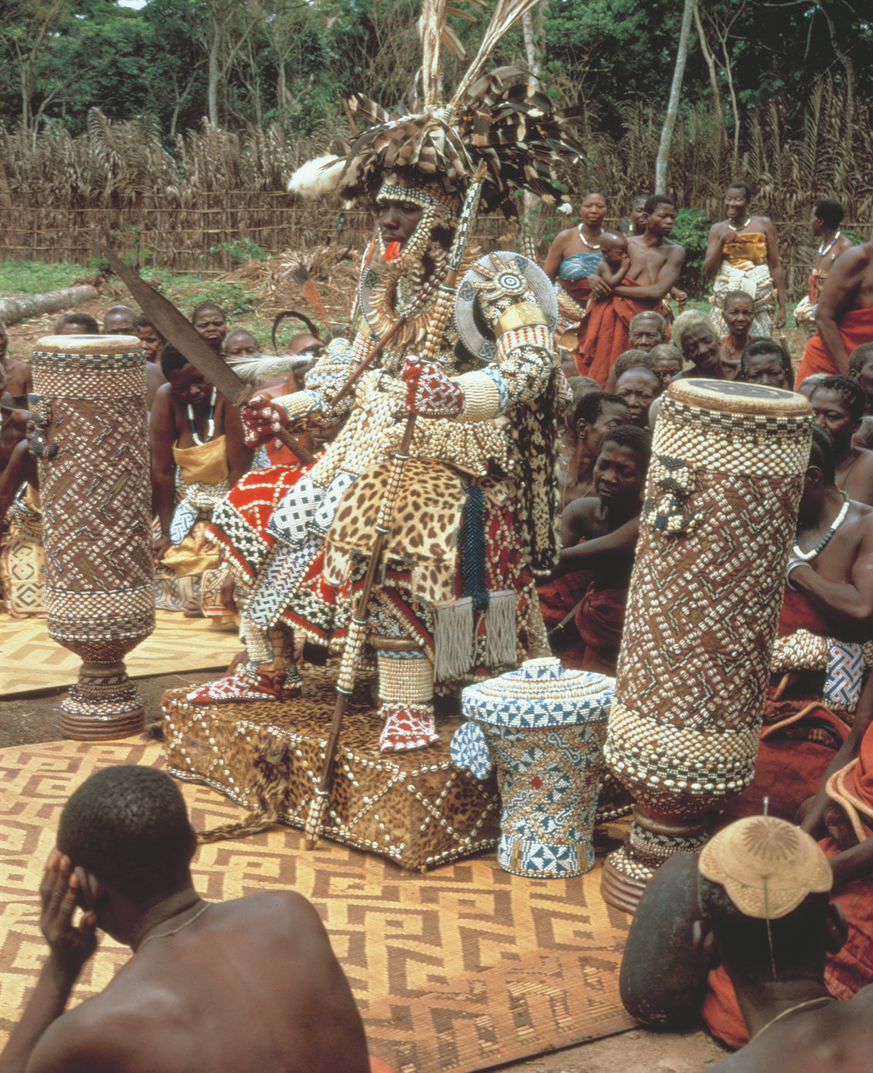

Slide 53
https://www.youtube.com/watch?v=Cdsn4uC9dlk

Slide 54
Form | Function | Content | Context
characteristics: cross legged pose, sits on a base, face seems uninvolved; above mortal affairs | commemorative portraits of Kuba rulers presented in the ideal state; acts as a surrogate for the king | each king is commemorated by symbols on the base of the figure; holds a sword ,in his left hand- non aggressive | made after the king is dead
 | not an actual portrait- rather the portrait of his soul | wears royal regalia- bracelets, belts, arm bands, headdress | oldest ndop figure
 | kept in the king’s shrine with other works called a set of “royal charms” |  | rubbed with oil to protect it from insects

Slide 55
Shona People

Slide 56
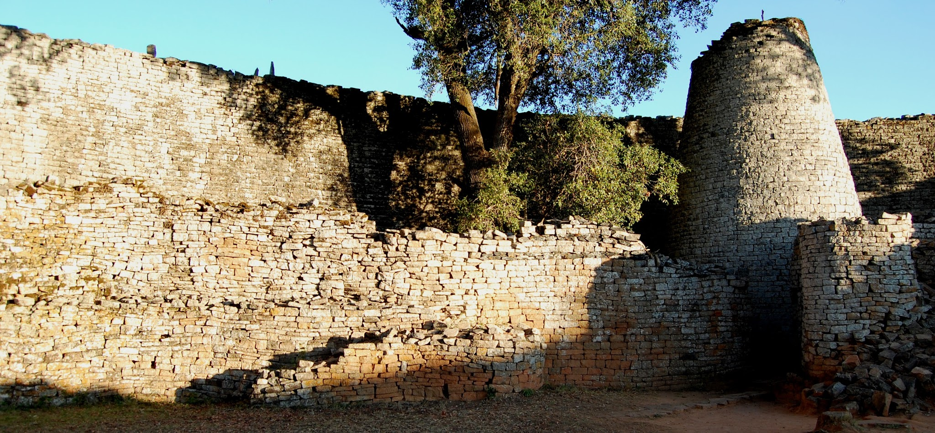
167. Conical Tower and circular wall of Great Zimbabwe
Zimbabwe, Shona People
1000-1400 CE
granite

Slide 57
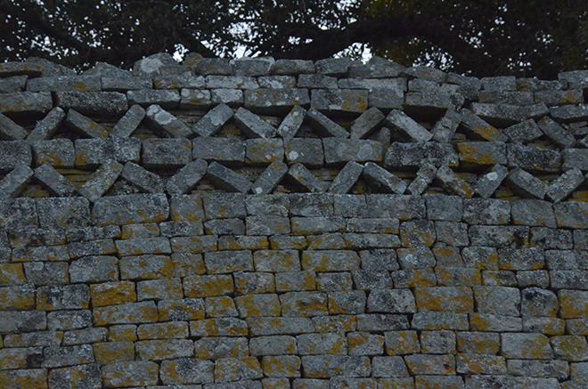
167. Conical Tower and circular wall of Great Zimbabwe
Zimbabwe, Shona People
1000-1400 CE
granite

Slide 60
https://www.youtube.com/watch?v=Hk0-cCggHbQ

Slide 61
https://www.youtube.com/watch?v=L8D7zODaYas

Slide 62
Form | Function | Content | Context
walls: 800 ft long; 17 ft thick at base | prosperous trading center and royal complex | stone enclosure probably a royal residence | Zimbabwe derives from a Shona term meaning “center of authority”
walls slope inward toward the top made of granite |  | internal/external passageways are tightly bounded, narrow, long and forces occupants to walk in single file, which parallels experiences in the African bush | the most spectacular part of 200 local ruins
Chevron patterns (represents lightning/rain?), and black stripes |  | conical tower modeled on traditional shapes of grain silos; control over food symbolized wealth, power and royal greatness | chinese porcelain, indian beads, imported gold and metals found at the site
 |  | no mortar

Slide 63
Yoruba People

Slide 64
180. Veranda post of Enthroned king and senior wife (Opo Ogoga)
Olowe of Ise (Yoruba people, Nigeria)
1910
Wood

Slide 66
https://www.youtube.com/watch?v=3iW08SSprgo

Slide 68
Form | Function | Content | Context
cleverly arranged negative space creates an openness in the composition | One of 4 carved veranda posts for the palace at Ikere | king becomes the focal point in the relationship between his figure and others represented on this post | Olowe of Ise carved posts for the rulers of the Yoruba kingdom
Most veranda posts were painted; traces of paint remain |  | behind him his large scale senior wife supporting the throne
 |  | she crowns him during the coronation and protects him during his reign
 |  | small figures: junior wife; flute player is Esu, the trickster god

