Slide 2
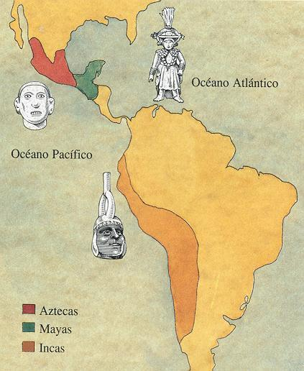
The Empires of Central and Southern Americas
Aztec: 1200 CE -1520 CE
Mayan: 400 BC - 1515 CE
Inca: 1200 CE – 1570 CE

Slide 3
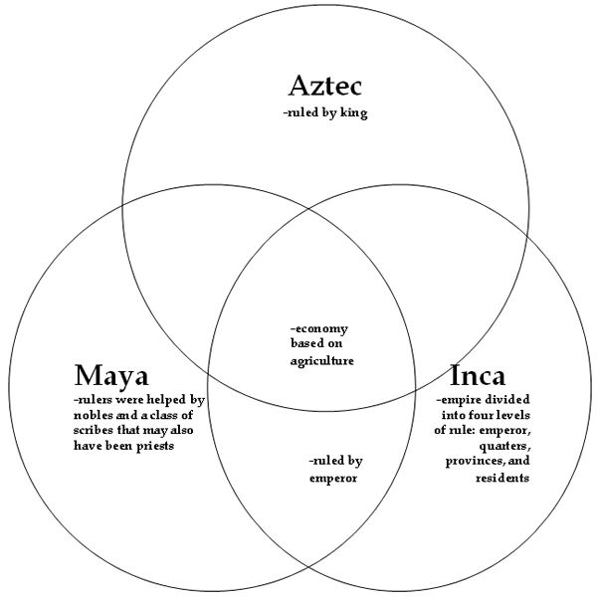

Slide 4
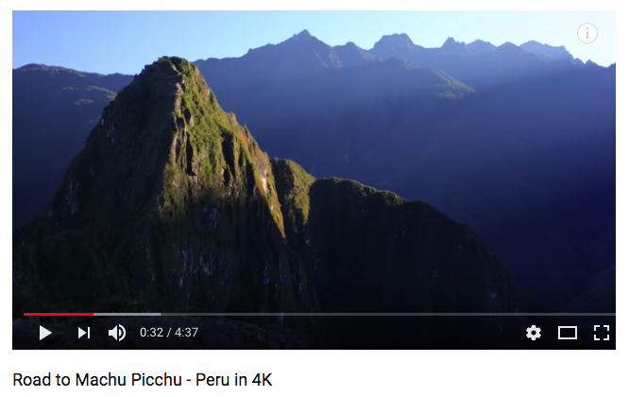
https://www.youtube.com/watch?v=Zk9J5xnTVMA 4:30

Slide 5
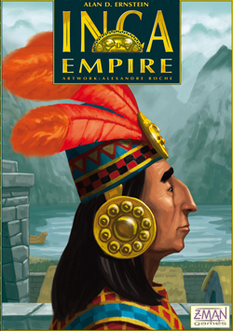
The Incas were a civilization in South America formed by ethnic Quechua people also known as Amerindians.
In 1400 AD they were a small highland tribe,
In the early 16th century the Incas rose to conquer and control the largest empire ever seen in the Americas forming the great Inca Empire.
The Inca Civilization was an agrarian civilization and at its height in 1500 AD reached more than 10 million people.
They worshipped the sun and his son as Sapa Inca

Slide 6
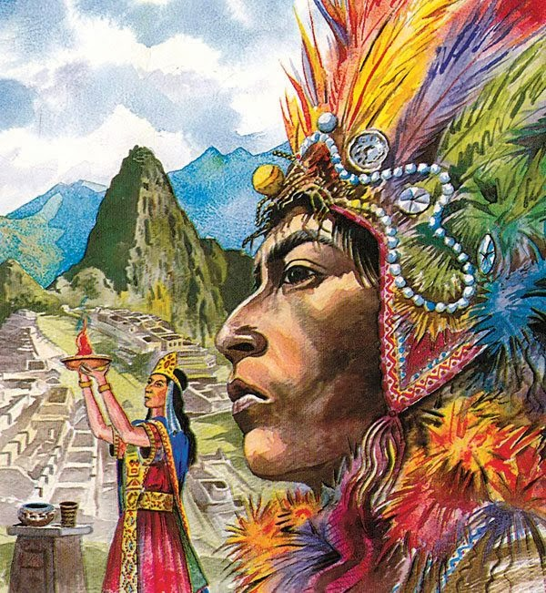
Capital City of Cuzco –
Center of the Inca World
From the center of the city 4 main roads stretched to the 4 corners of the empire
The empire was over 2400 miles long following the length of the Andes mountain range
The supreme head of the state was the King.
The king was considered a living God ruling by divine right
The economy was based upon farming and herding. The empire taxed the labor of the people storing surpluses in warehouses called “tambos.”

Slide 7
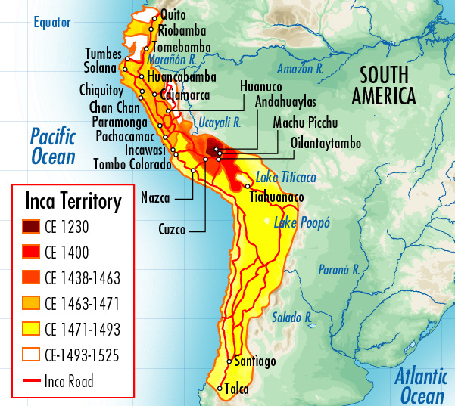

Slide 8
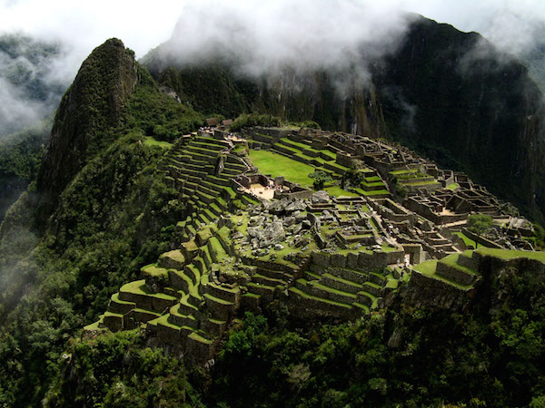
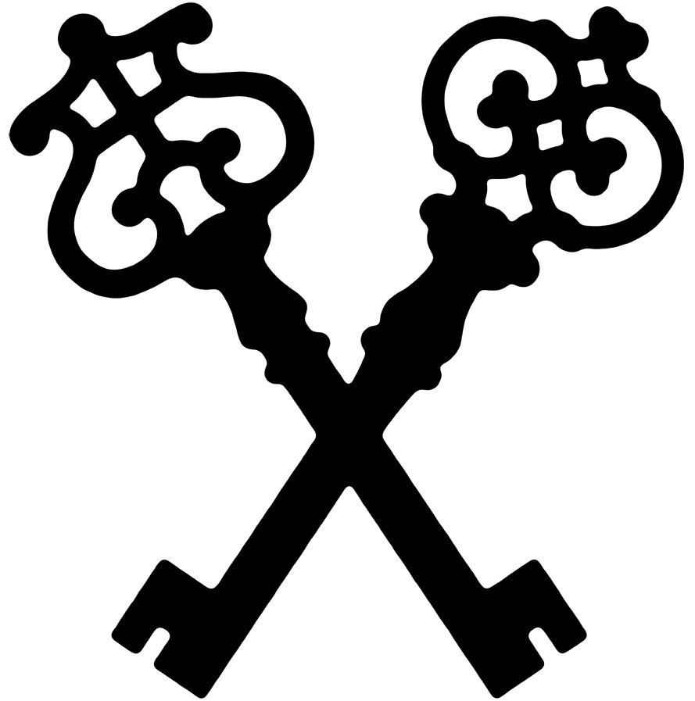
161. Machu Picchu
Central highlands Peru, Inka, 1450 CE, Granite

Slide 9
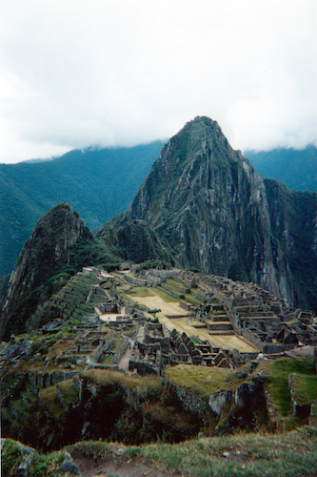
One of the new 7 wonders of the world (2007)
7970 ft about sea level
Constructed around 1450 CE
Nestled in a tropical mountain range
600 terraces, 200 structures
Discovered by Hiram Bingham in 1911
Most famous attraction in Peru

Slide 10
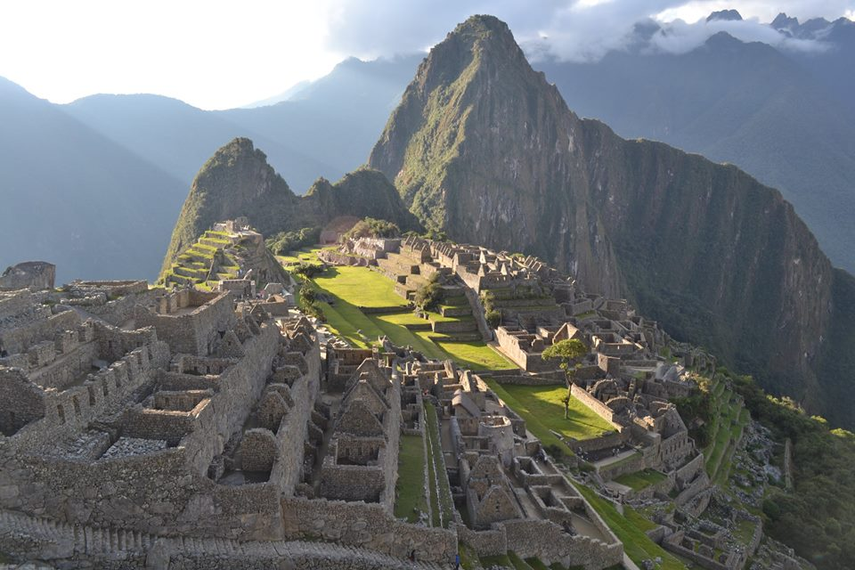
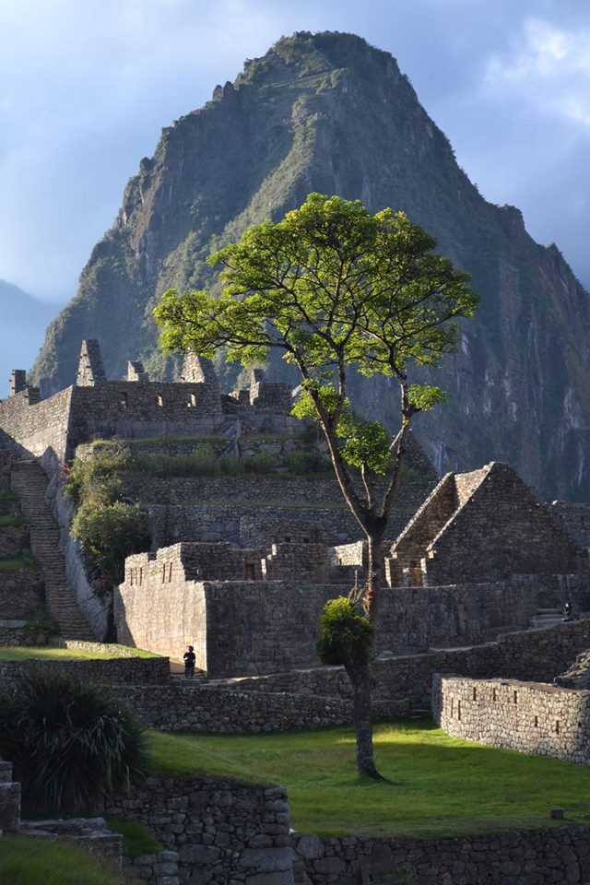
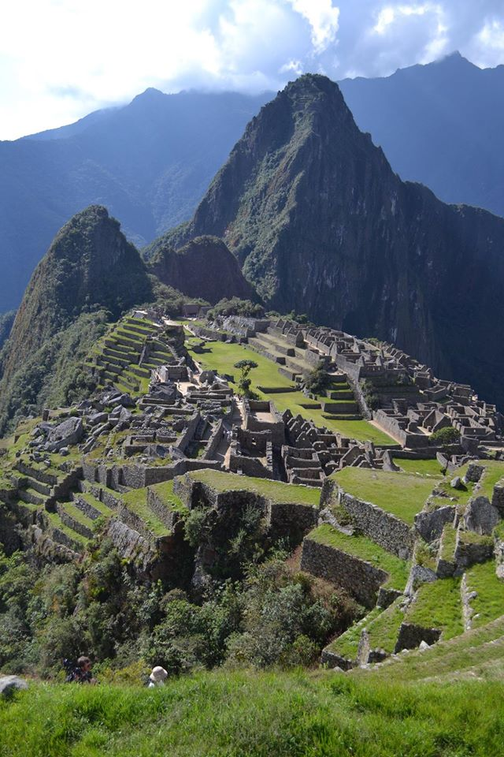

Slide 11
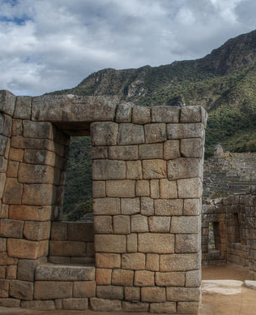
Built as a Royal Estate for the first Inka
Emperor Pachacuti Inka Yupanqui
Overlooks the Urubamba River
Sits approximately a three days walk from the Inka Capital of Cusco
At the Location the Inka Emperor would host feats, perform religious ceremonies, and administer the affairs of the empire
Unique stone masonry – little to no “mortar” used
Unique Inka style door ways Trapezoid

Slide 12
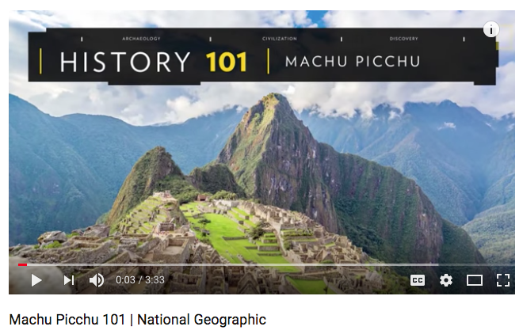
https://www.youtube.com/watch?v=cnMa-Sm9H4k 3:30

Slide 13
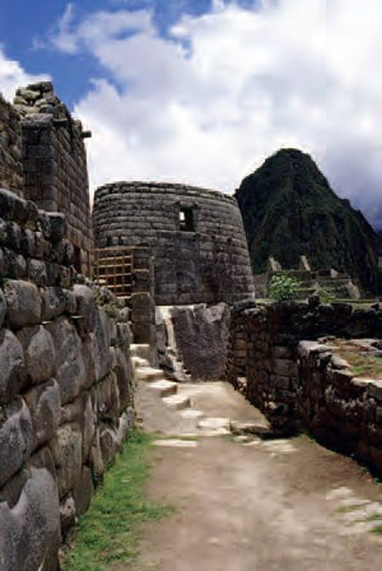
161. Machu Picchu
Central highlands Peru
Inka, 1450 CE, Granite
Observatory

Slide 14
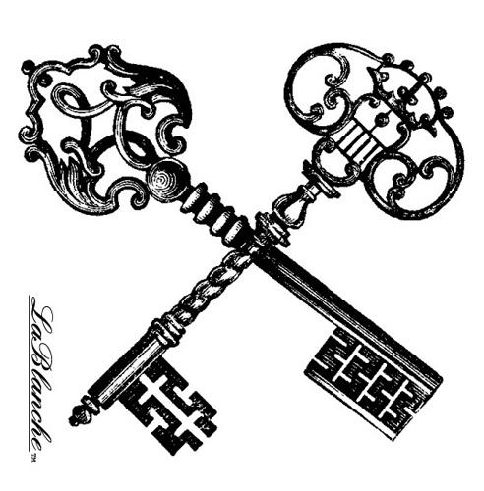
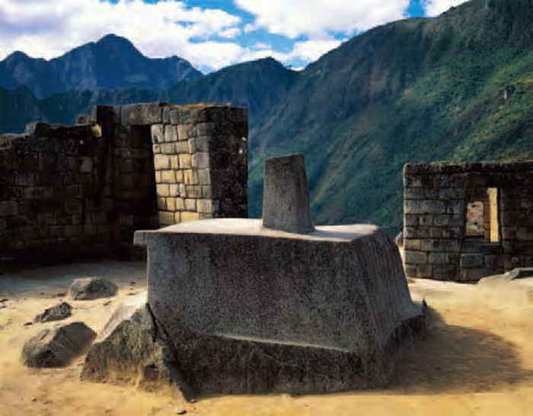
161. Machu Picchu
Central highlands Peru
Inka, 1450 CE, Granite
Intihuatana Stone

Slide 15
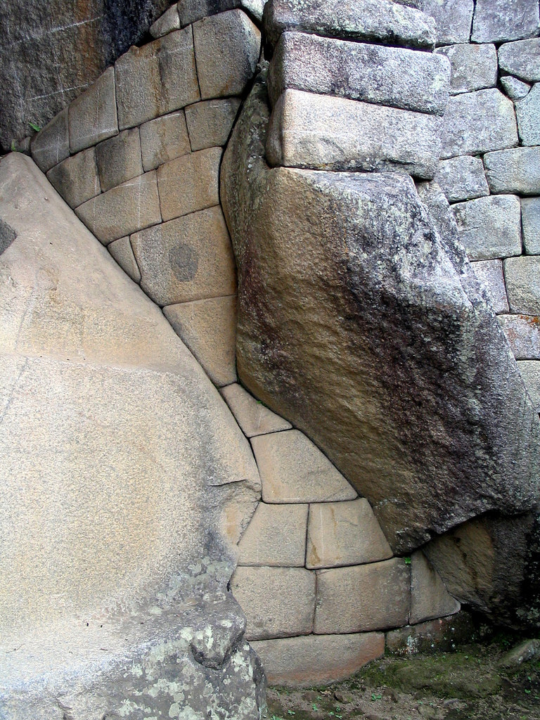
The Inka were abstract thinkers and were connected to stone in a very unique way.
As part of their architectural tradition the Inka would leave areas of unfinished stone as part of the overall finished design
Many areas contained a very unique harmonization of finished and unfinished stone work to create of unified design.

Slide 16
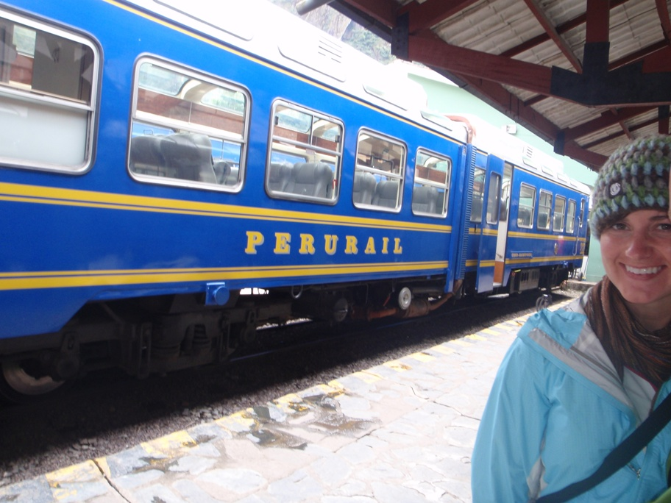
My Brother and His wife Travel to Machu Picchu

Slide 17
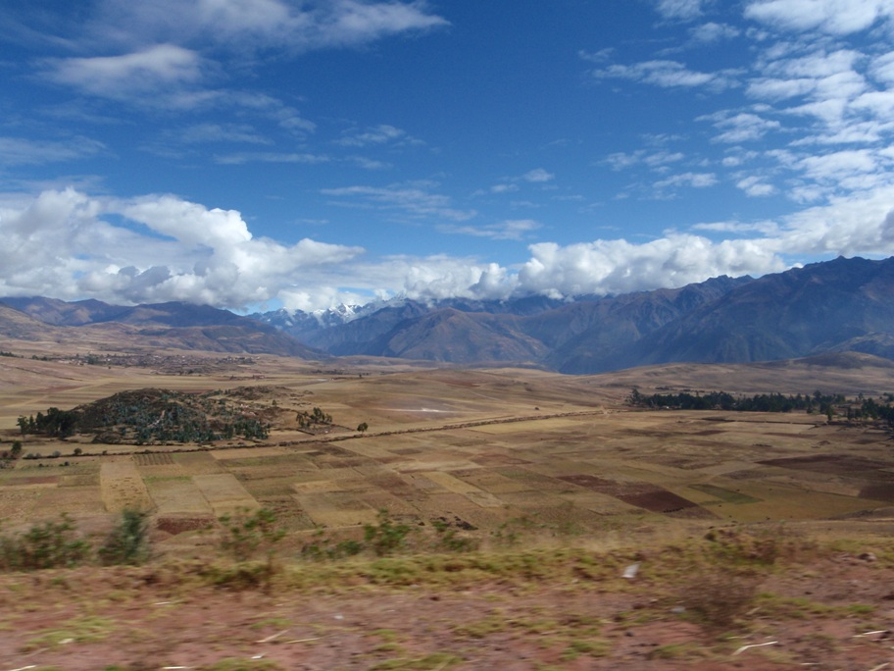
The high plains of peru, on route to machu picchu

Slide 18
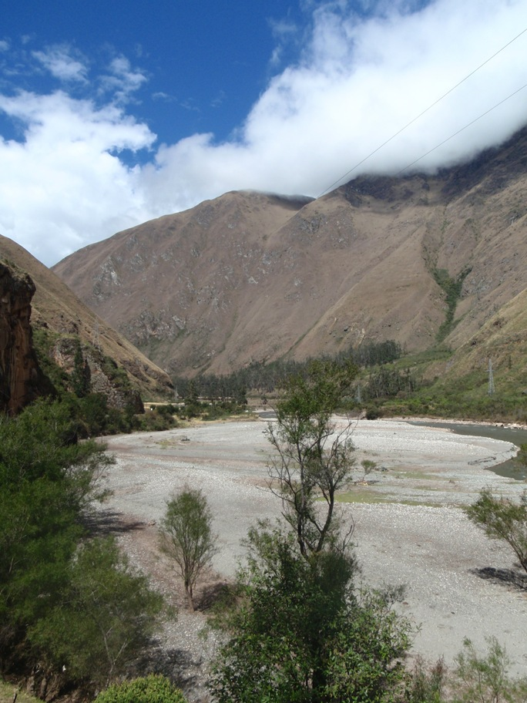
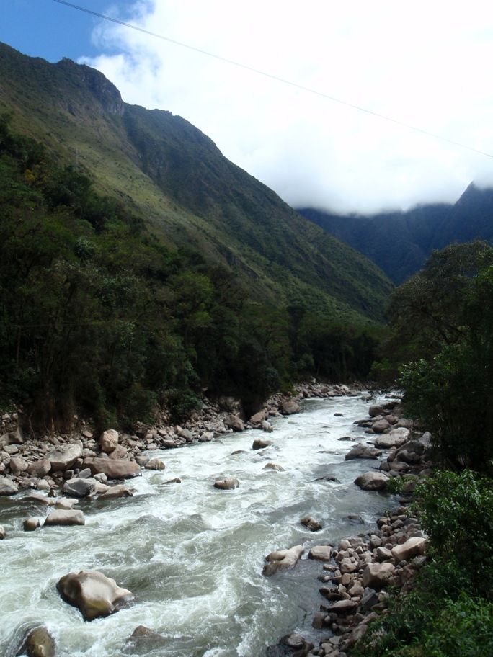
Pictures taken from their train!

Slide 19
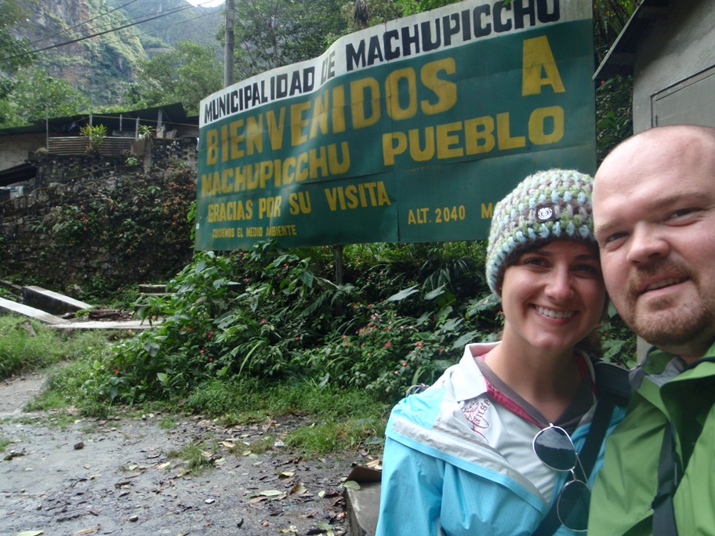
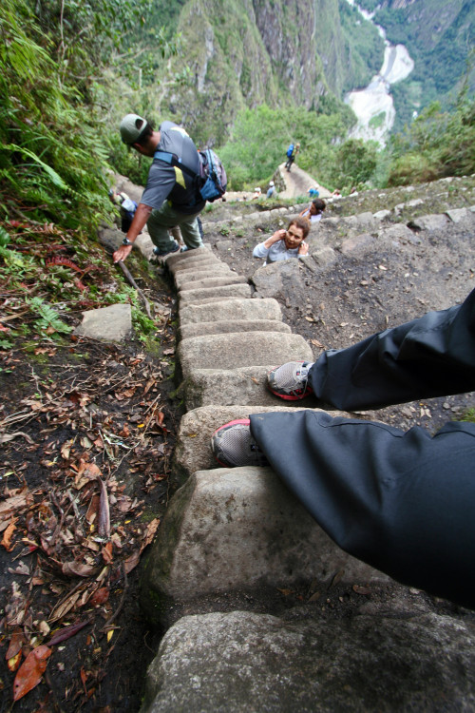
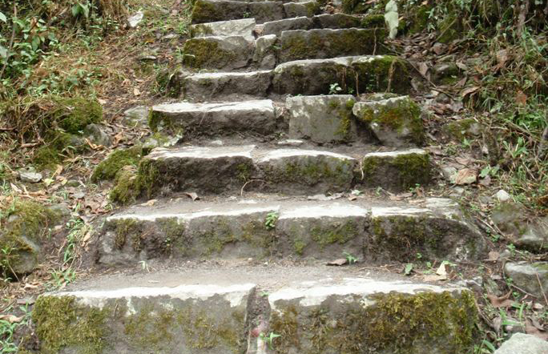

Slide 20
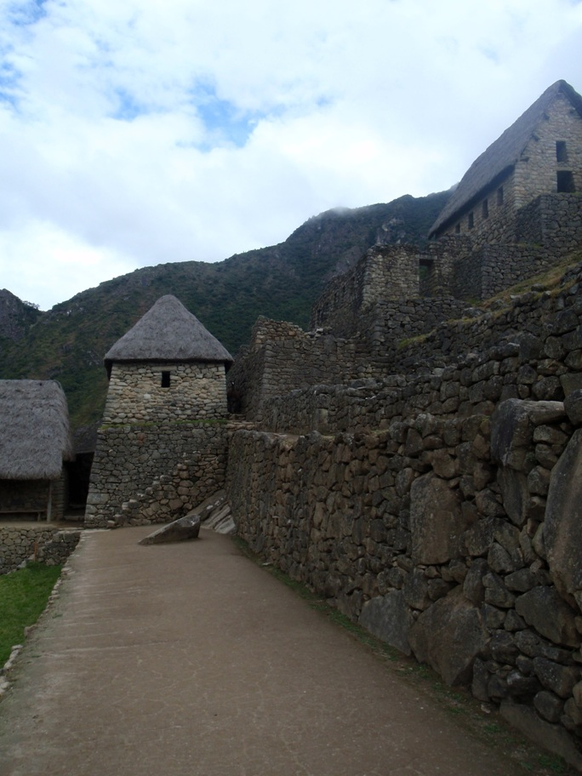
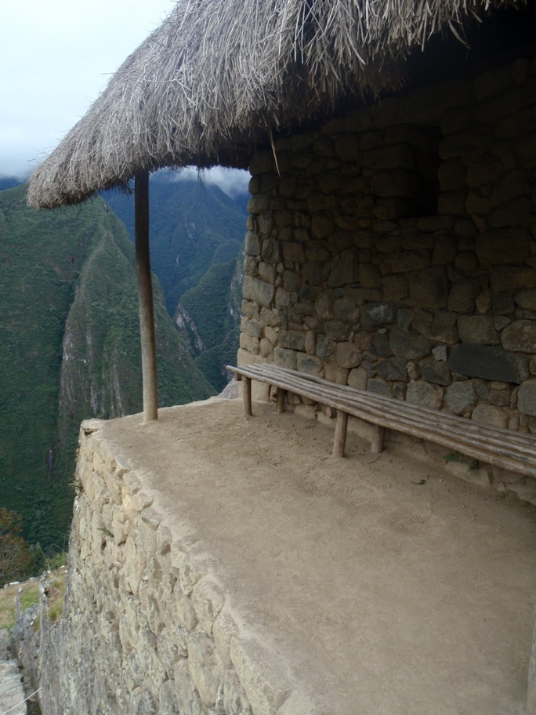

Slide 21
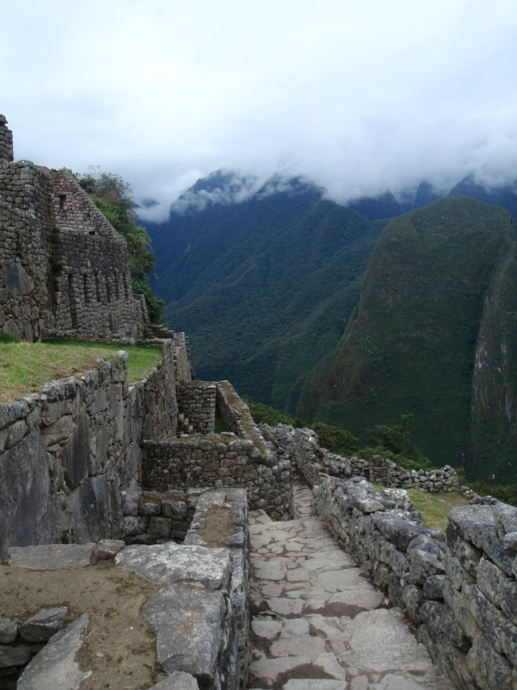
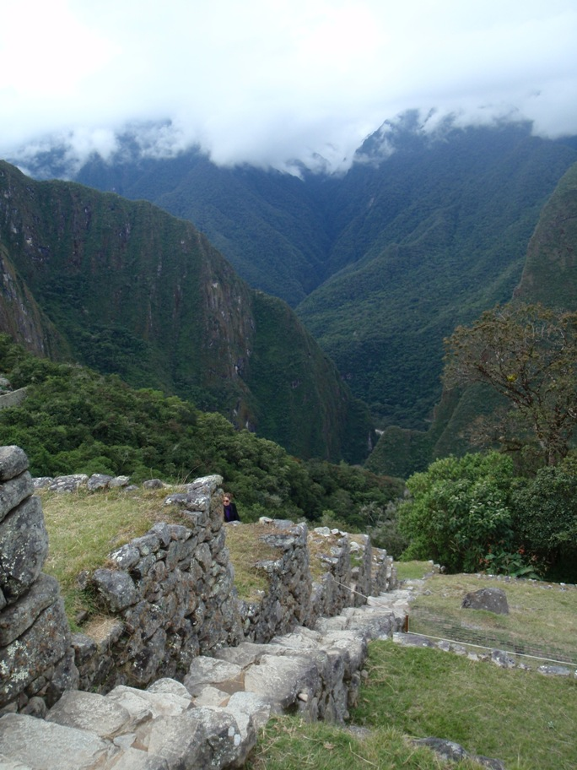

Slide 22
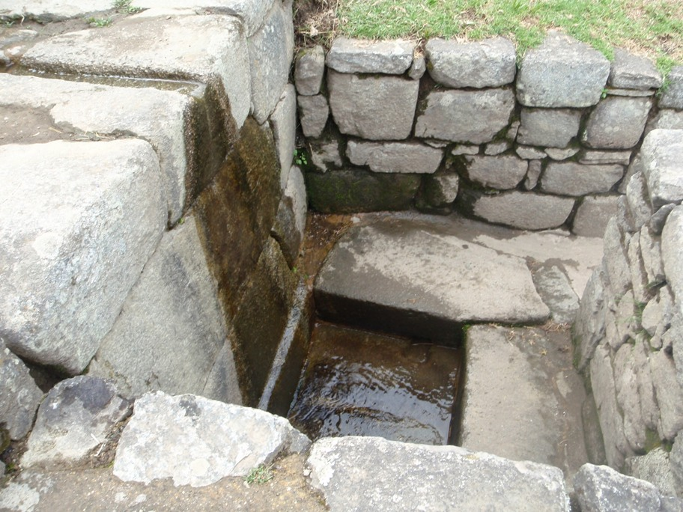

Slide 23
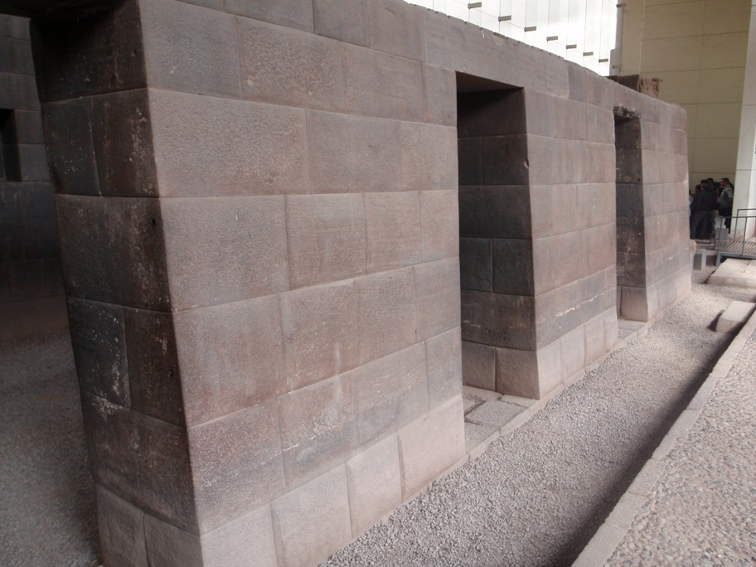

Slide 24
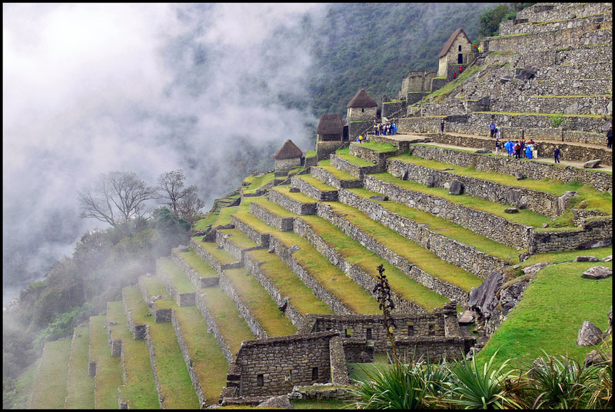
Terrace farming made life at Machu Picchu sustainable

Slide 25
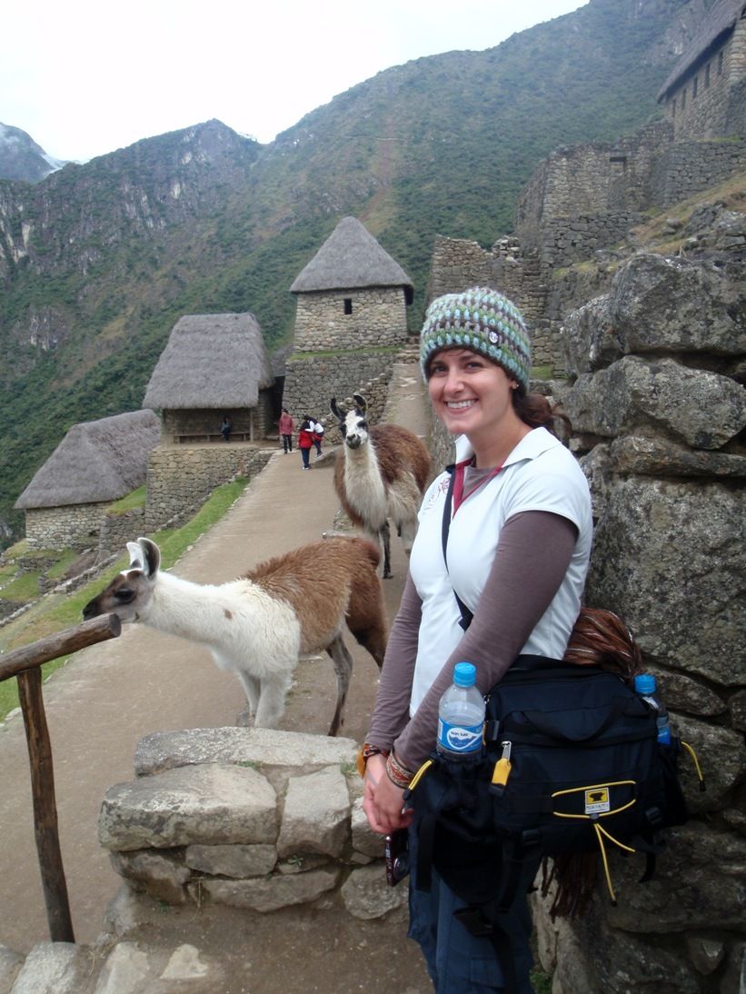

Slide 26
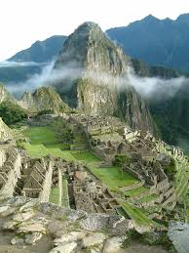
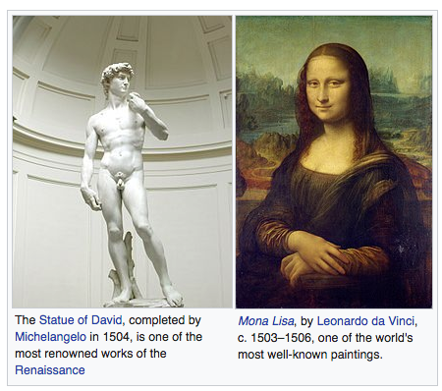
Historical Context: Machu Picchu was flourishing around the time of the Italian Renaissance, which spanned from the 14th to 17th century

Slide 27
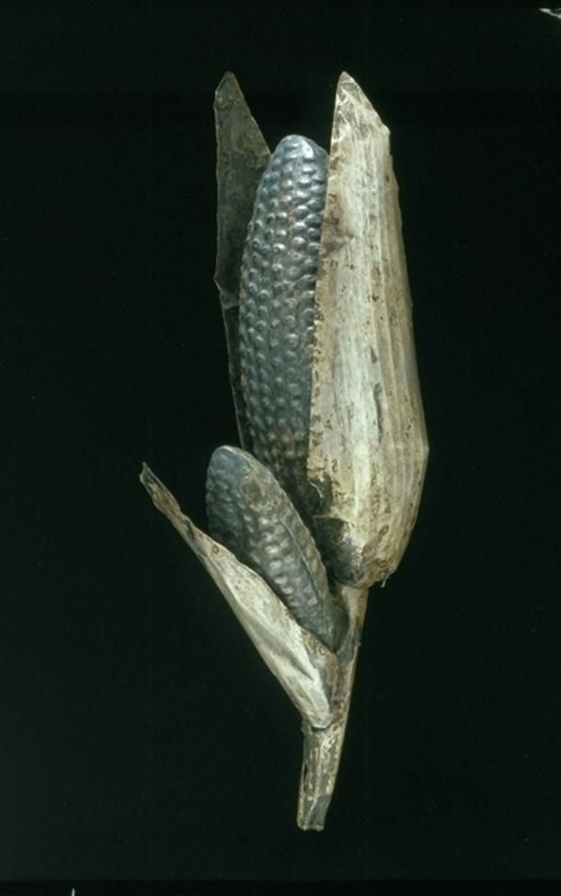
160. Maize Cobs.
Inka, 1440 CE
Sheet metal/repousse, metal alloys

Slide 28
160. Maize Cobs.
Inka, 1440 CE
Sheet metal/repousse, metal alloys
The Incas Created a life size garden in the
Qorikancha, a significant temple of the inca
This life sized garden was made of Gold & Silver
Within the garden golden sculptures of corn, flowers, animals, and people

Slide 29
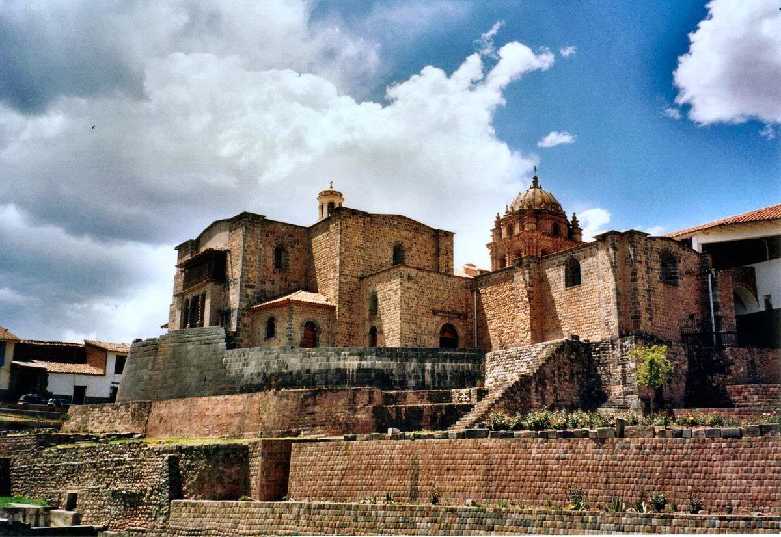
Coricancha, Qurikancha or Quri Kancha, originally named Inti Kancha or Inti Wasi, was the most important temple in the Inca Empire, dedicated primarily to Inti, the Sun God. It was one of the most revered temples of the capital city of Cuscoa

Slide 30
“The life-size garden was a significant offering within the Qorikancha where it became part of a compact version of the cosmos controlled by the Inka state. It also represented the vast range of ecosystems encompassed by the empire and the most important agricultural products cultivated in them. The empire reached from the desert coasts to over 6000 feet above sea level. Plants and animals represented in the golden garden cannot grow and survive at every point in the empire, but only at specified altitudes. For example maize grows up to a mid-range altitude, and llamas graze at the highest points of the empire. The metallic maize cobs would have represented one of the most important imperial foodstuffs, used for making the chicha (maize beer) consumed at political feasts, which cemented the obligations of local political leaders to the Inka state.”

Slide 31
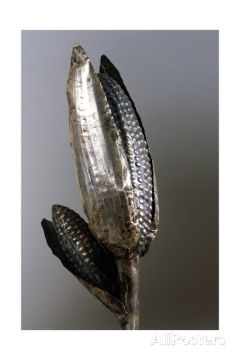
160. Maize Cobs.
Inka, 1440 CE
Sheet metal/repousse, metal alloys
The use of gold is an indication of the previous resource that maize was to this people
The cobs are life sized and highly detailed
They created a cobs using repousse which is modern French term to describe metal work. Pressing in from the front and pressing out from the back

Slide 32
160. Maize Cobs.
Inka, 1440 CE
Sheet metal/repousse, metal alloys
At your table…
1 Minute…
Why is this one of our
250 pieces?

Slide 33
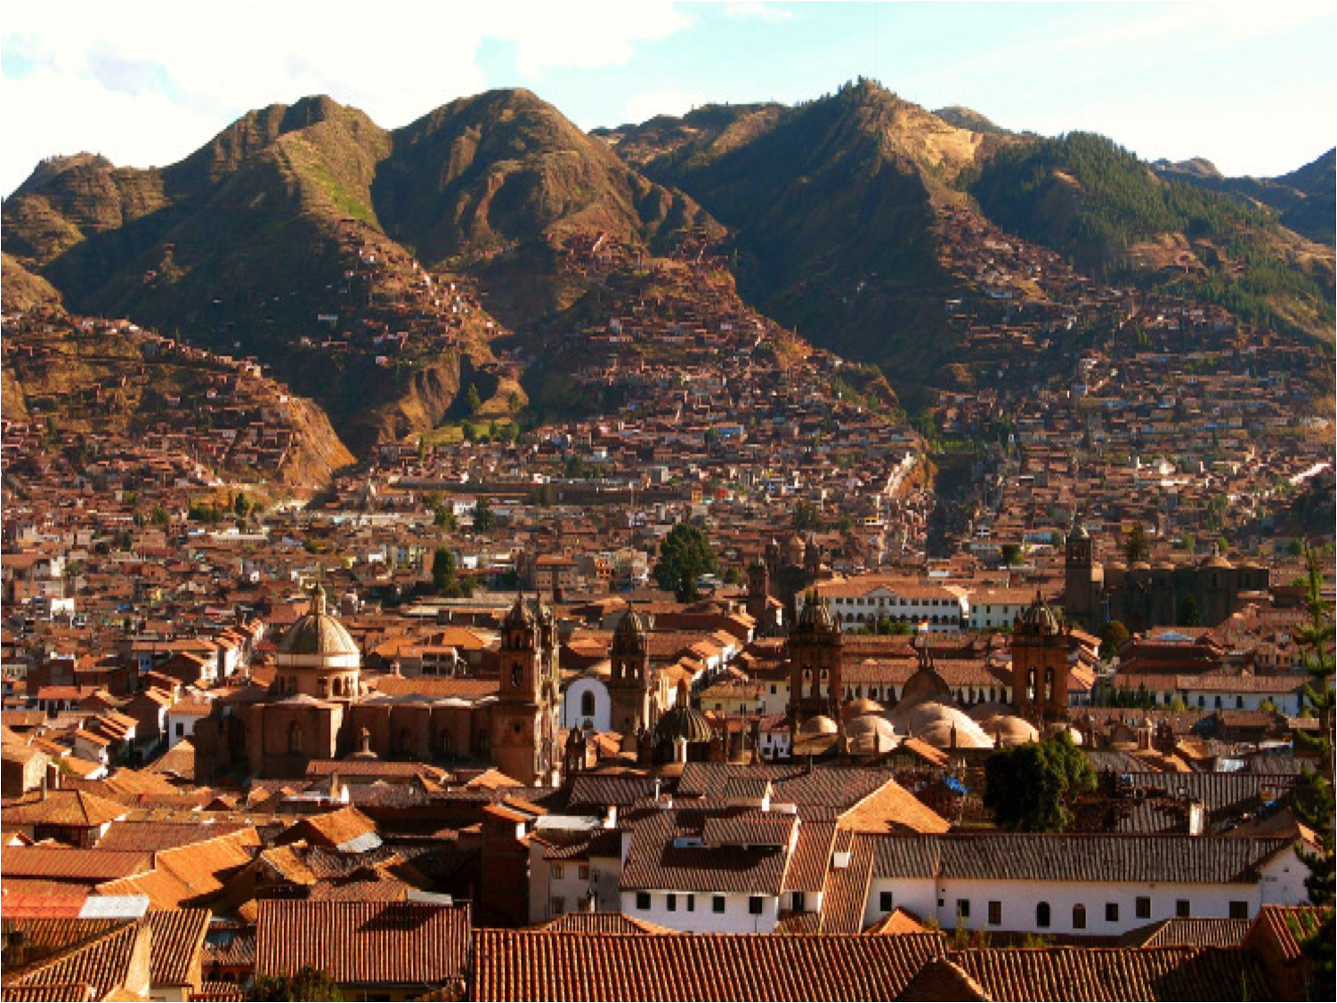
159. City of Cusco
Peru, Inka, 1440 CE

Slide 34
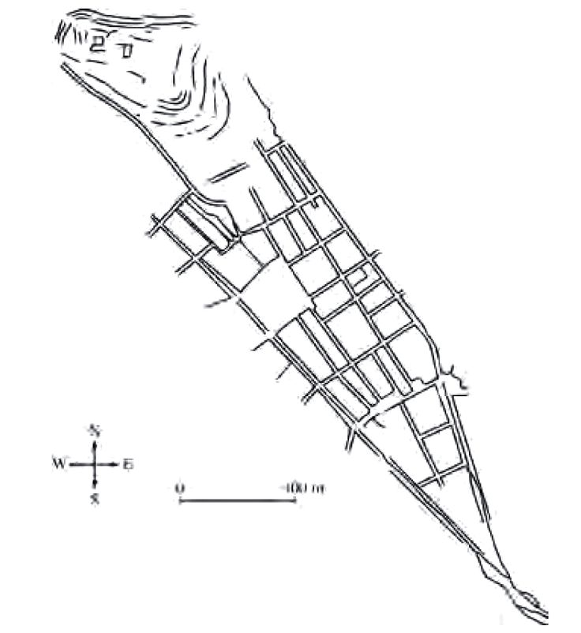
159. City of Cusco
Peru, Inka, 1440 CE

Slide 35
159. City of Cusco
Peru, Inka, 1440 CE
In the shape of a puma, a royal animal
head of the puma is a fortress; the heart is the city’s central square
Capital of the Inka Empire

Slide 36
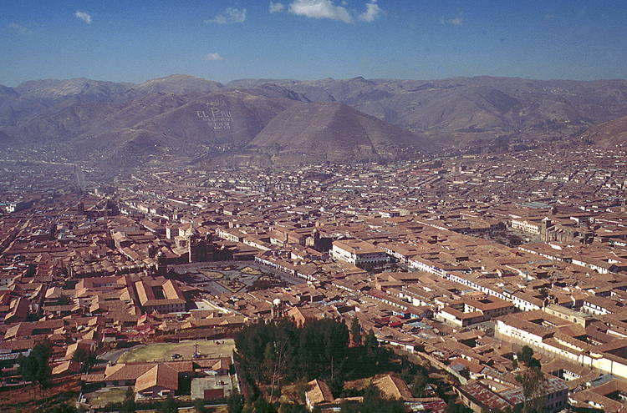

Slide 38
https://www.youtube.com/watch?v=H9Dd3hZVqMU 3:00

Slide 39
“The city of Cusco was not just the capital of Tawantinsuyu
(“Land of the Four Quarters,” the Inka name for their empire in their native language, Quechua). It was an axis mundi—the center of existence—and a reflection of Inka power.”
“The city was divided into two sections, hanan (upper or high) and hurin (lower), which paralleled the social organization of Inka society into upper and lower moieties (social divisions).”
“Cusco was further divided into quarters that reflected the four divisions of the empire, and people from those sections inhabited their respective quarters of the city. In this way, the city was a map in miniature of the entire Inka empire, and a way for the Inka rulers to explicitly display their power to shape and order that empire.”

Slide 40
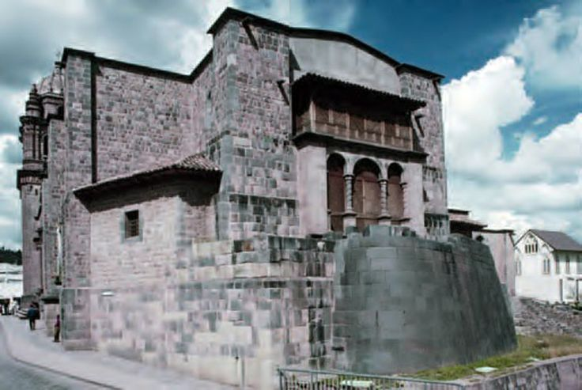
159. City of Cusco
Curved Inka wall of Qorinkancha with Santo Domingo Convent (Spanish Colonial)
Peru, Inka, 1440
(Convent Added 1650 CE)

Slide 41
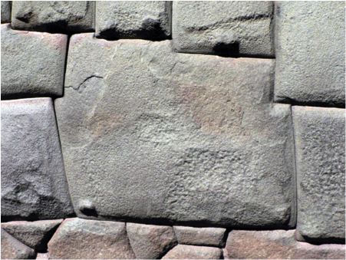

Slide 42
“The masonry of Cusco displays an understanding of stones as being like people, in that many different ones may fit together if they are properly organized.”
“Each individual stone was pecked with tools and fitted to the one next to it, with the result that blocks will have a varied number of sides, such as the famous Twelve-Sided stone in the walls of Hatun Rumiyoq Street.”
“Some sides of each stone were made to curve outward slightly, others to be slightly concave, so that the stones slotted together, while still allowing a small amount of movement.”
“The ability to move a little was important in an area that is seismically active, protecting the walls from earthquakes.”

Slide 43
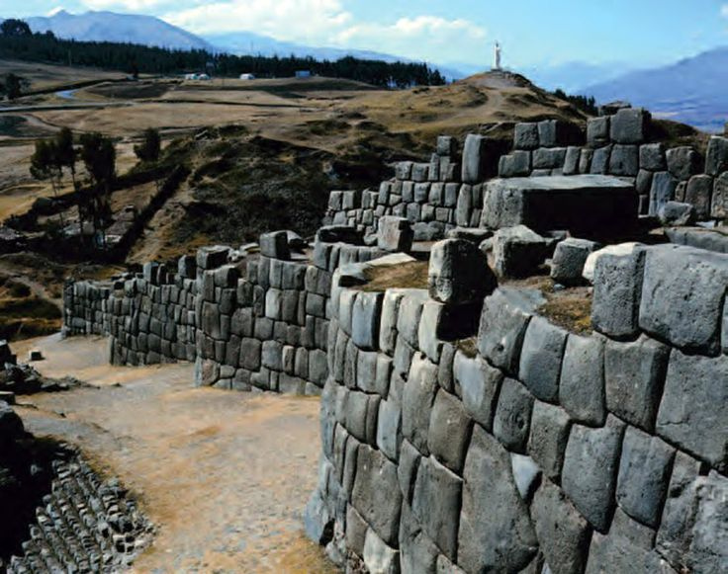
159. City of Cusco
Walls of Saqsa Wayman
Peru, Inka, 1440

Slide 44
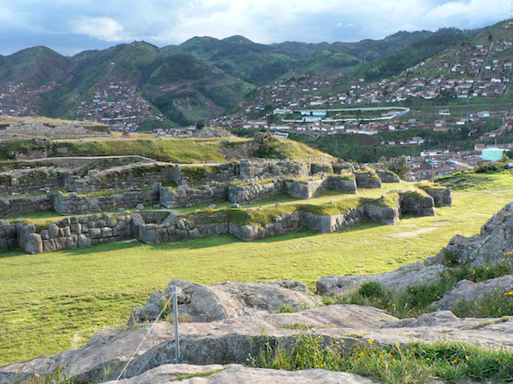

Slide 45
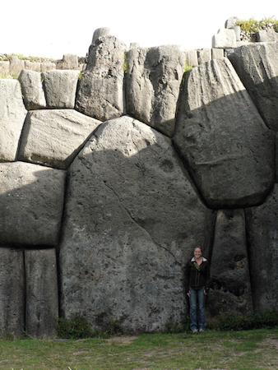

Slide 46
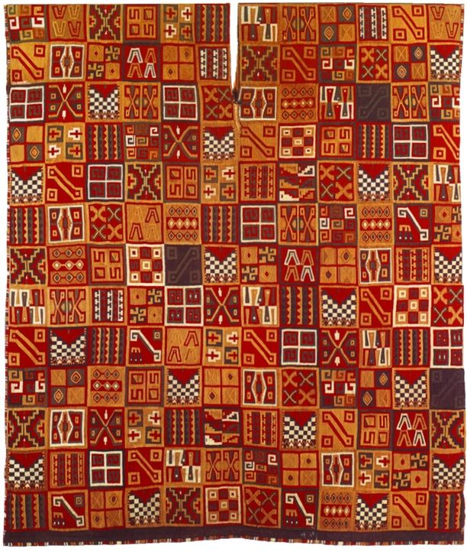
162. All-T’oqapu tunic
Inka, 1450 CE
Camelid fiber and cotton

Slide 47
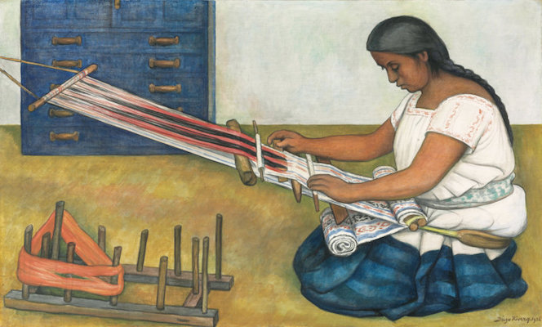
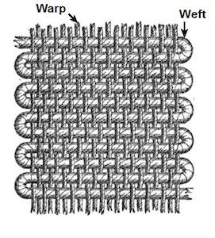

Slide 48
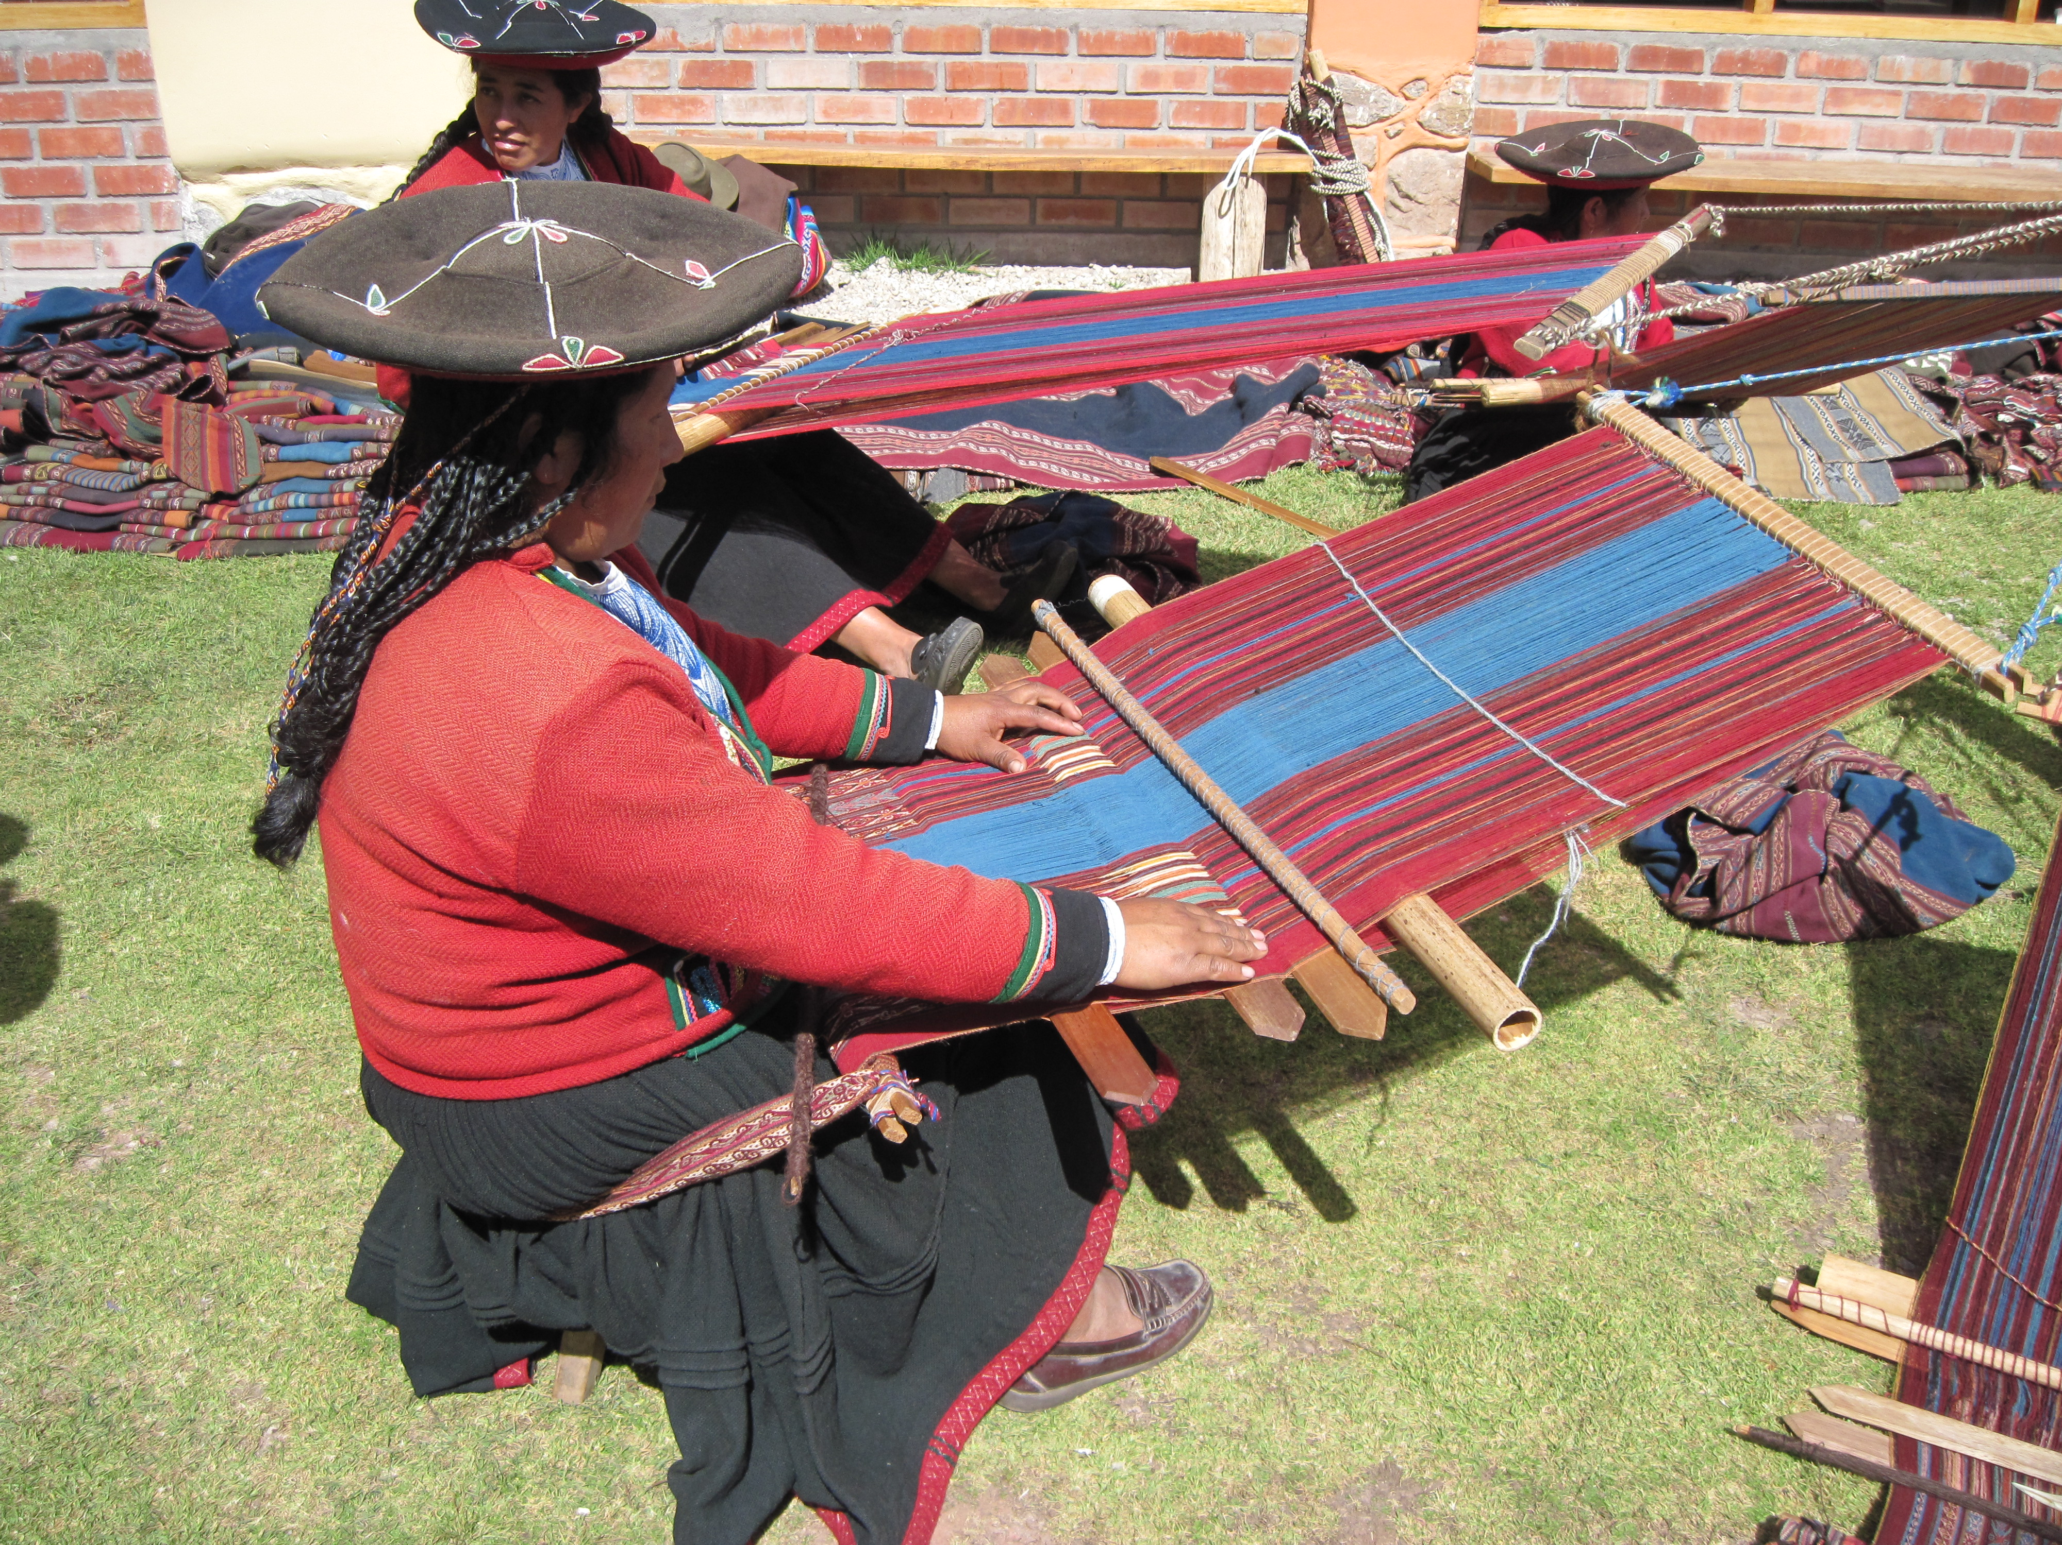

Slide 50
“Collecting, spinning, and dyeing the fibers for a textile represented a huge amount of work from numerous people before a weaver even began their task. Some dyes, like cochineal red or indigo blue, were especially prized and reserved for high-status textiles. Cochineal dye comes from the bodies of small insects that live on cacti, and it takes thousands of them to make a small amount of dye. Indigo dyeing requires a high level of technical skill and a large investment in time. Red- and blue-dyed textiles were not only beautiful, they also represented the apex of the resources needed to produce them and the social and political power that commanded those resources.”

Slide 51
ICONOGRAPHY
The decoration of the tunic is where its name derives from.
T’oqapu are the square geometric motifs that make up the entirety of this tunic.
These designs were only allowed to be worn by those of high rank in Inka society.
Individual t’oqapu designs appear to have been related to various peoples, places, and social roles within the Inka empire.
Covering a single tunic with a large variety of t’oqapu, as seen in this example, likely makes it a royal tunic, and symbolizes the power of the Inka ruler

Slide 52
The Manifest Power of this Tunic
Its fine thread & Expert weave
Bright colors signify his ability to command the taxation of the empire,
Access to luxury goods like rare and difficult dyes, and the weaving expertise of the acllas.
Secondly, among the t’oqapu in the tunic is one pattern than contains a black and white checkerboard. This was the tunic pattern worn by the Inka army, and shows the Sapa Inka’s military might.
Lastly, the collection of many patterns shows that the Sapa Inka (which means “unique Inka” in Quechua) was a special individual who held claim to all t’oqapu and therefore all the peoples and places of his empire. It is a statement of absolute dominion over the land, its people, and its resources, manifested in an item that is typically Andean in its material and manufacture.

