Slide 2
Essential question
How/why do indigenous Americans use the natural environment to create works of art?

Slide 3
Local products are going to form the basis of most north American art forms; wood in the PNW; plant fibers, wool and clay in the American SW; hided in areas dominated by bison and deer.

Slide 4
Geometric designs on ceramics and other utilitarian objects
Highly decorated fabrics with beading and weaving mark their art.

Slide 5
As the influence of European settlers spread throughout North America, native artists were keen to adapt their traditional forms to new media and new markets.

Slide 6
Europeans had an appetite for native art forms and acted as collectors and patrons for works that appealed to them.
Native American artists like Cadzi Cody and Maria Martinez began serving an emerging tourist industry that appreciated their artistry

Slide 7
Ask yourself...
What is the specific geographic and cultural context in which the work was created?
What does the imagery symbolize?
To what extent did European contact change the materials and imagery used by Native American artists?
Which of these works do not demonstrate influence of European contact? Why?
Which were created for a tourist audience? How can you tell?

Slide 8
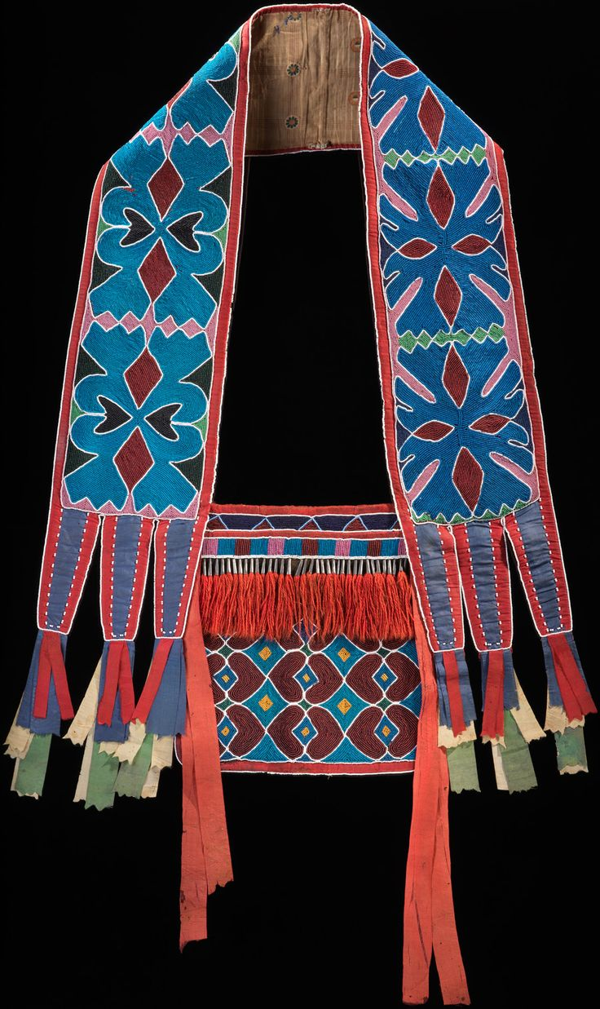
163. Bandolier Bag
Lenape (Delaware Tribe)
1850 CE
Beadwork on Leather

Slide 9
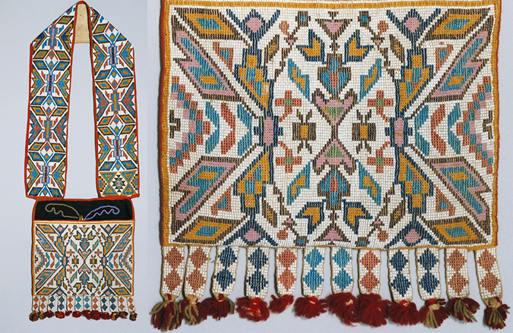

Slide 10
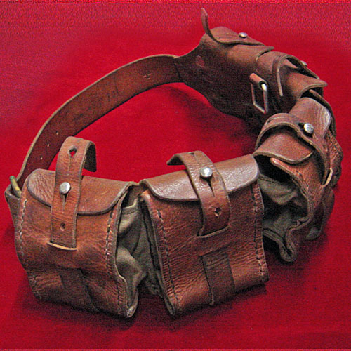
Bandolier Bags are based on bags carried by European soldiers armed with rifles, who used the bags to store ammunition cartridges.

Slide 11
Ojibwe language they are called Aazhooningwa'on, or
“worn across the shoulder”
Made by different tribes across the Great Lakes and Prairie regions. Differences in appearance & style are the result of personal preference and contact with Europeans and
Euro-Americans, goods acquired in trade, and travel.
While men most commonly wore these bags, women created them
Beads and other materials were embroidered on the trade cloth and hide. The tiny glass beads, called seed beads, were acquired from European traders along with silk ribbons, and these were prized for their brilliant colors

Slide 12
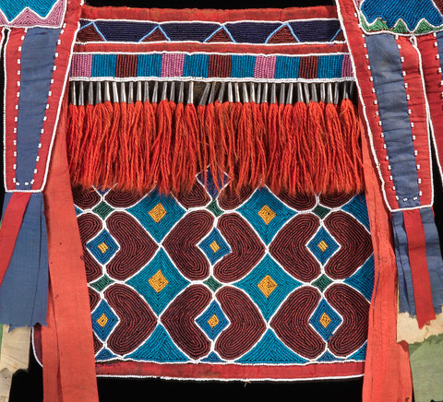

Slide 13
The designs on the bag are abstracted and symmetrical. White beads act as contour lines to help make the designs more visible to the naked eye

Slide 14
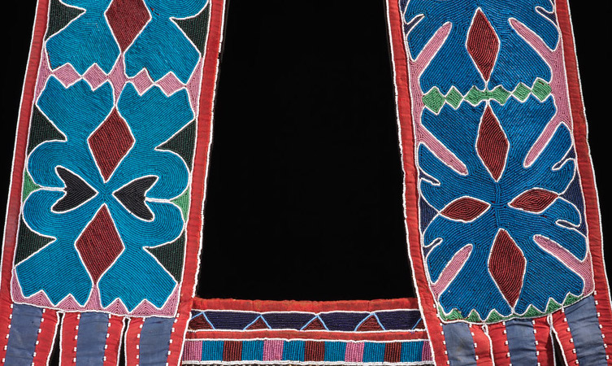

Slide 15
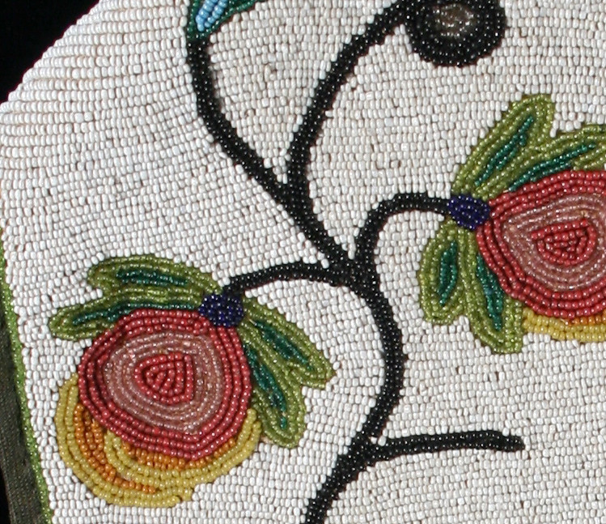

Slide 16
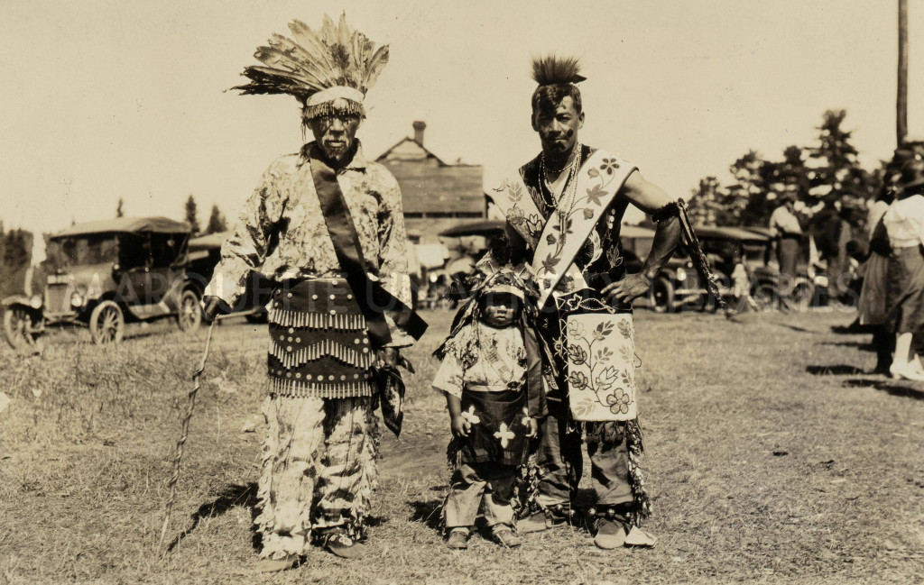

Slide 17
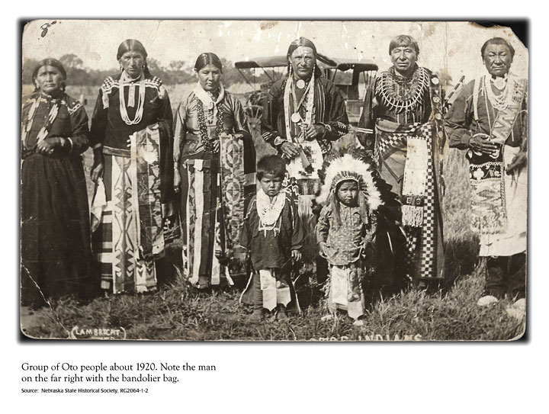

Slide 18
Form | Function | Content | Context
bright colors, geometric designs | made for men, as they were objects of prestige | has a large heavily beaded pouch with a slit on top. | bag held at hip level; strap across the chest; made of leather, cotton or wool
 | functional as a bag, but also beautiful |  | bead work not in in the Americas before European contact
 |  |  | beads imported from Europe

Slide 19
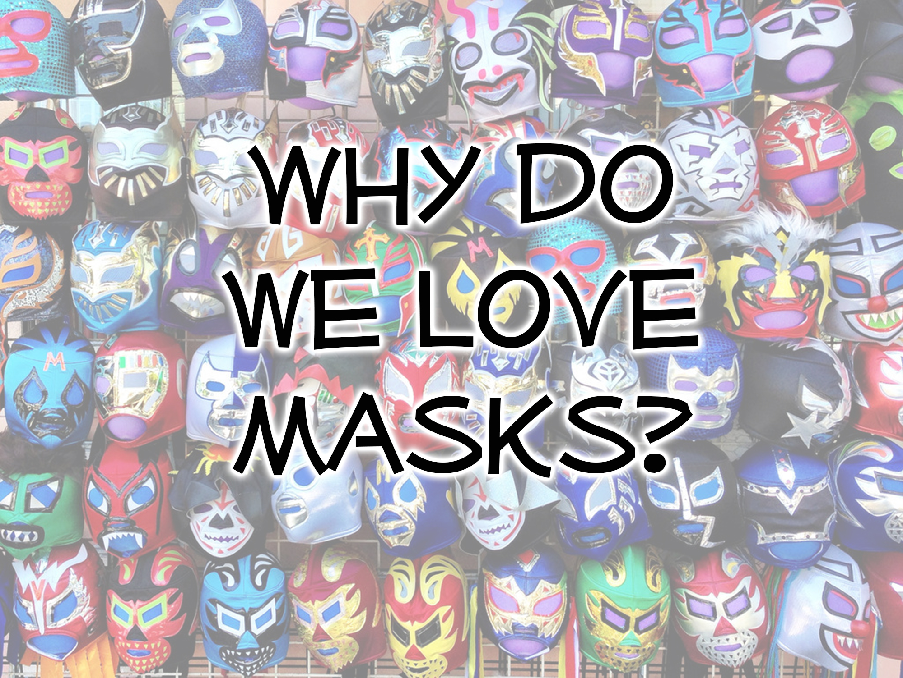

Slide 20
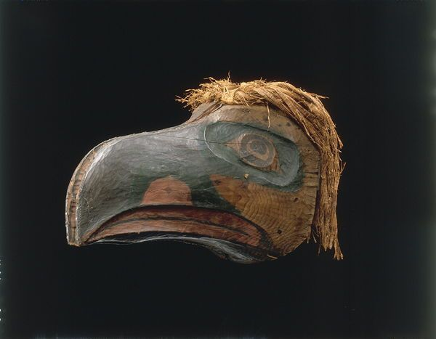
164. Transformation Mask
Kwakwaka’wakw
NW coast of Canada
1890
Wood

Slide 21
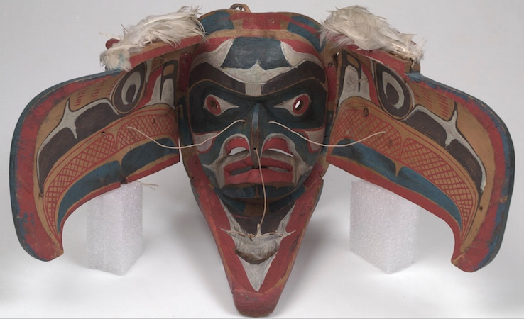
164. Transformation Mask
Kwakwaka’wakw
NW coast of Canada, 1890, Wood

Slide 22
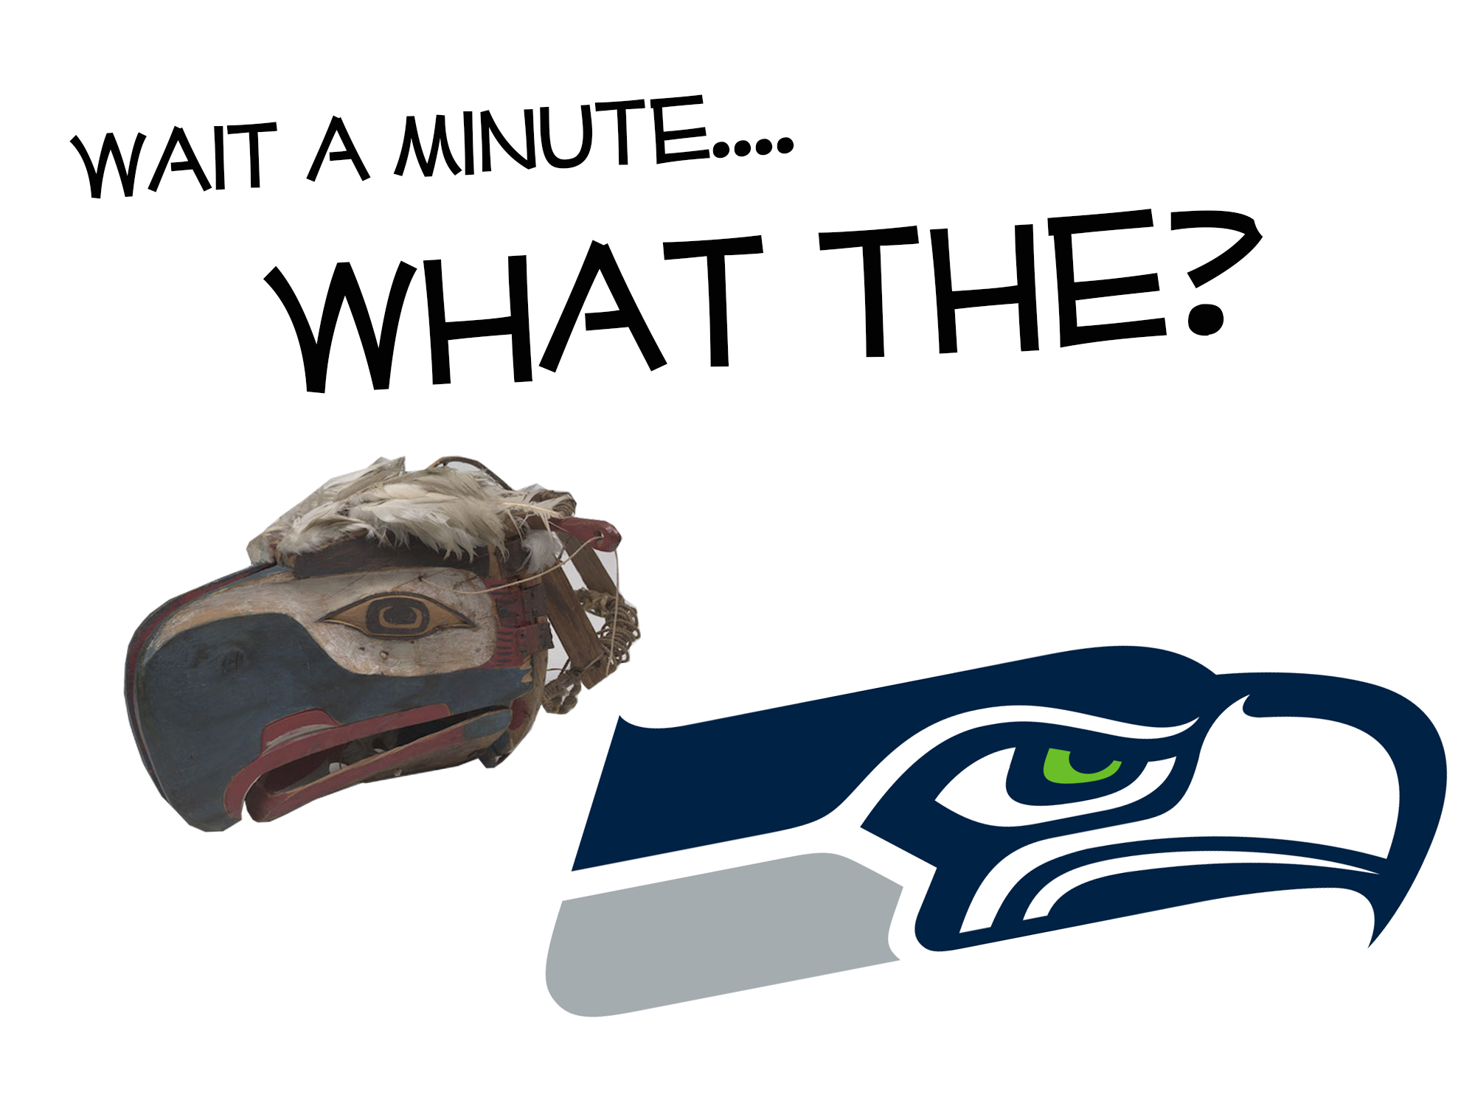

Slide 23
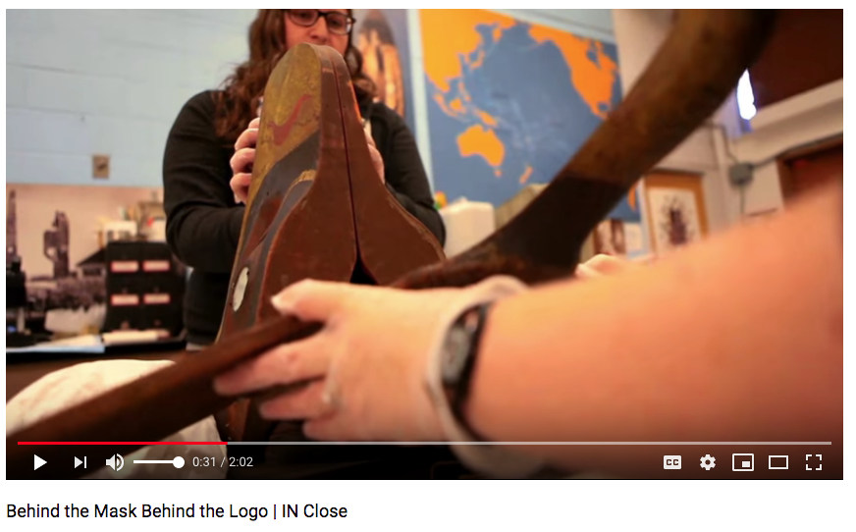
https://www.youtube.com/watch?v=8zxJkpBnOUU

Slide 24
Masks passed between family members of a specific clan (they could be inherited or gifted)
They were just one sign of a person’s status and rank, which were important to demonstrate within Kwakwaka’wakw society
A Potlatch was an opulent ceremonial feast at which possessions are given away or destroyed to display wealth or enhance prestige. Transformation masks were a central part to these rituals

Slide 25
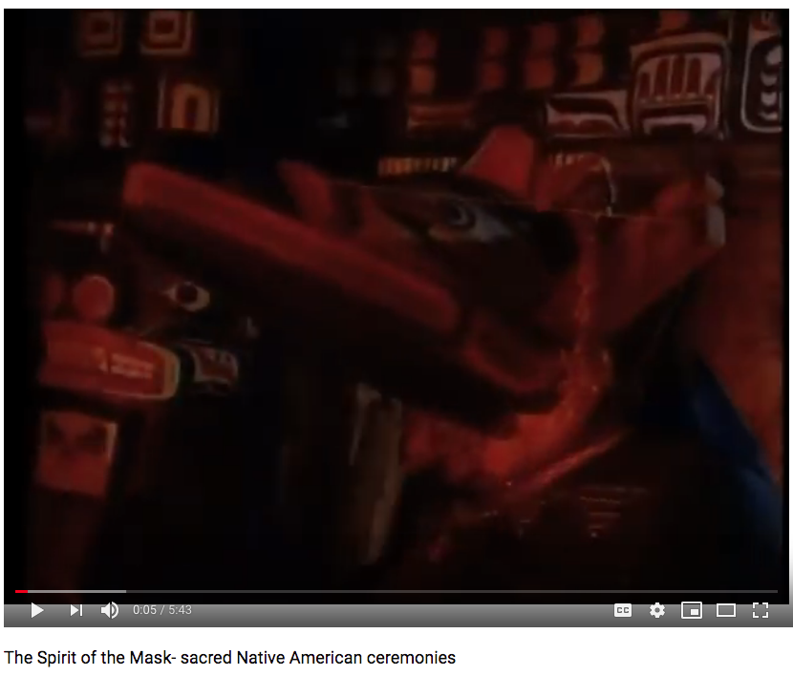
https://www.youtube.com/watch?v=f8WREmWxggU

Slide 26
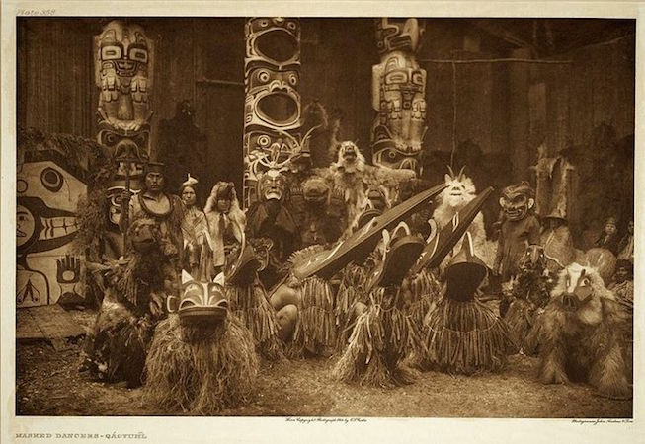

Slide 27
Potlatches were banned in 1885 until the 1950s because they were considered immoral by Christian missionaries who believed cannibalism occurred (for its part, the Canadian Government thought potlatches hindered economic development because people ceased work during these ritual celebrations). With the prohibition of potlatches, many masks were confiscated. Those that weren’t destroyed often made their way into museums or private collections. When the ban against potlatches was removed by the Canadian government, many First Nations have attempted to regain possession of the masks and other objects that had been taken from them. Potlatches are still practiced today among Northwest Coast peoples.

Slide 28
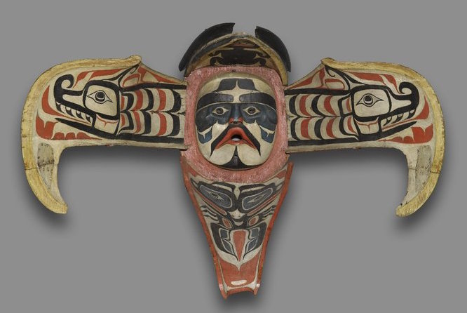

Slide 29
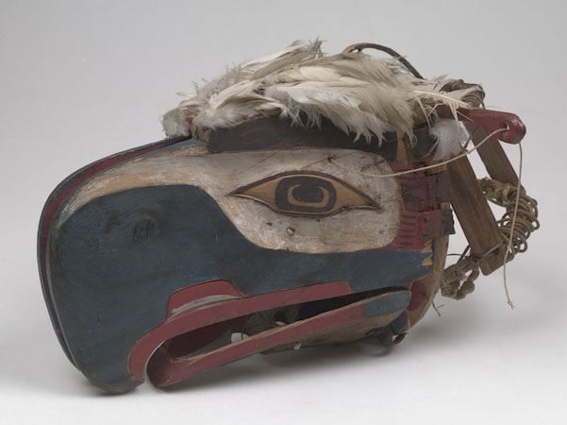

Slide 30
Form | Function | Content | Context
Large wooden mask that opens to reveal a human face; draped with raffia, to hide the shoulders of the wearer | worn over the head as part of a complete body costume | bird head exterior opens to reveal a human face on the inside | masks worn by native people of the Pacific Northwest, western Canada, Alaska
 |  | At the moment of transformation, the performer turns his back to the audience to conceal the action and heighten the mystery | During the ritual performance, the wearer opens and closes the transformation mask using string

Slide 32
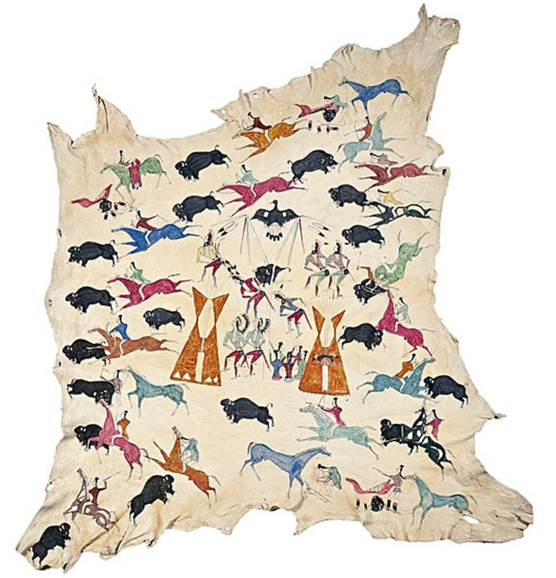
165. Painted Elk Hide
attributed to Cotsiogo
Eastern Shoshone
1890 CE
Painted Elk Hide

Slide 33
Painting on animal hides is a longstanding tradition of the Great Basin and Great Plains people of the United States
This would include the Kiowa, Lakota, Shoshone, Blackfeet, Crow, Dakota, and Osage.
While the earliest surviving hide paintings date to around 1800, this tradition was undoubtedly practiced much earlier along with other forms of painting like petroglyphs (rock engravings).
Painting, in tandem with oral traditions, functioned to record history.
Artists decorated the hides with geometric or figural motifs. By the later nineteenth century certain hide artists began depicting subject matter that “affirmed native identity” and appealed to tourists. The imagery placed on the hide was likely done with a combination of
free-hand painting and stenciling.

Slide 34
165. Painted Elk Hide
attributed to Cotsiogo
Eastern Shoshone
1890 CE
Painted Elk Hide
Men and women both painted on hides, but men usually produced the scenes on tipis (tepees), clothing, and shields. Many of these scenes celebrated battles and other biographical details.

Slide 35
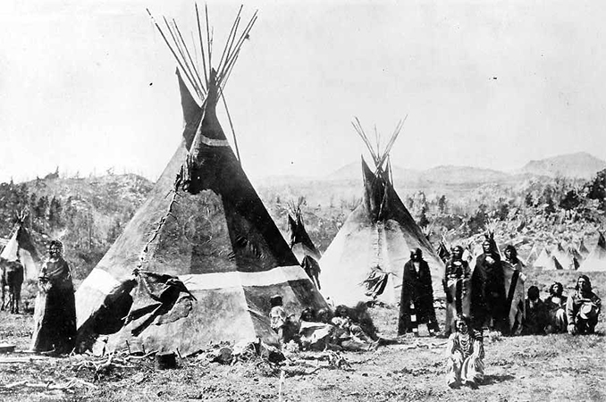

Slide 36
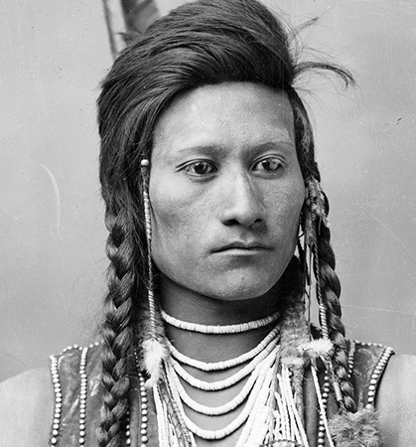
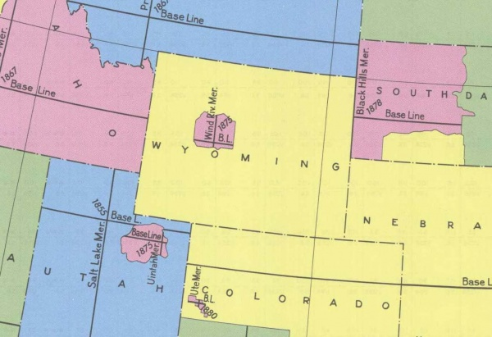
Cotsiogo
Eastern Shoshone; pronounced “co SEE ko”
Also known by his Euro-American name, Cadzi Cody
A member of the Eastern Shoshone tribe
Painted on elk, deer, or buffalo hides using natural pigments like red ochre and chalk, and eventually paints and dyes obtained through trade

Slide 37
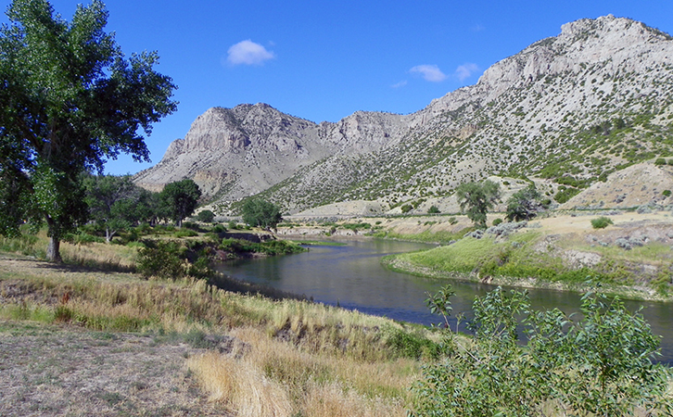

Slide 38
Cotsiogo was placed on the Wind River Reservation in central western Wyoming.
The Wind River Reservation is the size of Rhode Island and Delaware combined and had been established by the Fort Bridger Treaty of 1868.
Prior to their placement on the Wind River Reservation, the Shoshone moved with the seasons and the availability of natural resources.

Slide 39
Form | Function | Content | Context
 | Traditional: Worn over the shoulders of a warrior as a robe | Traditional: Warrior’s deeds are celebrated on the hides; convey biographical information: personal accomplishments, heroism and battles | men painted the hides to narrate an event
 | Later: Eventually painted hides for European/ American markets | Later: depicted traditional aspects of the Plains People culture that were nostalgic rather than practical eg- bison hunt with bow and arrow; nomadic hunting was gone and bison nearly extinct | Bison considered to be gifts from the Creator; horses in common use by 1750
 |  | Depicts a Sun dance- around the head of bison (outlawed by the US gov’t); Sun Dance: men dance, others sing, prepare the feast, teepees- made of hide stretched over poles; the exterior poles were meant to reach the sky or the spirit world

Slide 40
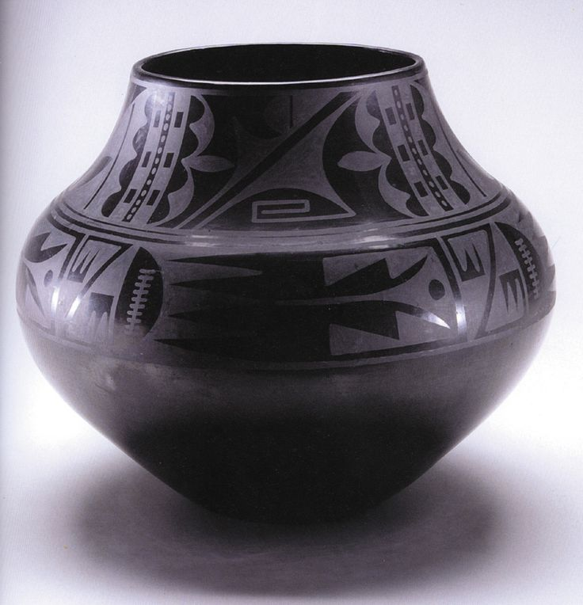
166. Black-on-black ceramic vessel
Maria Martinez and Julian Martinez
Pueblo, New Mexico, 1950 CE, Blackware ceramic

Slide 41
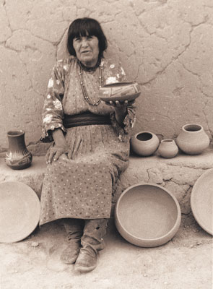
Maria Martinez
1887-1980
Pueblo of San Ildefonso, about 20 miles north of Santa Fe, New Mexico
one of the best-known Native potters of the twentieth century
Know as an excellent ceramic craftswoman and for her connections with a larger, predominantly non-Native audience.
Before the arrival of the railroad to the area in the 1880s, pots were used in the Pueblos for food storage, cooking, and ceremonies
Her work and her life had a wide reaching importance to the Native art world by reframing Native ceramics as a fine art.

Slide 42
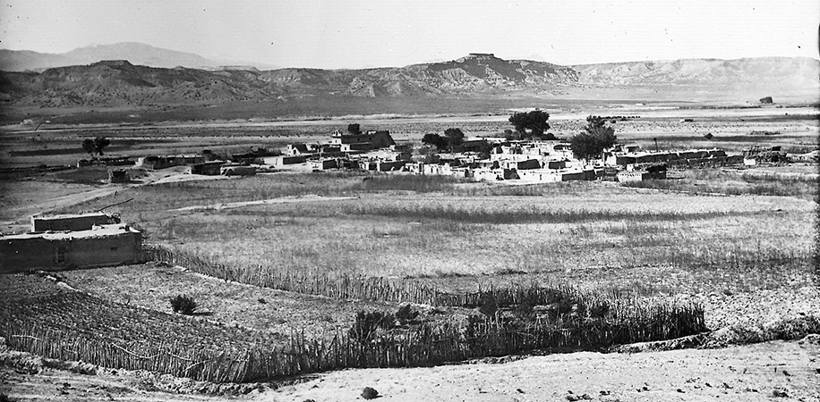

Slide 43
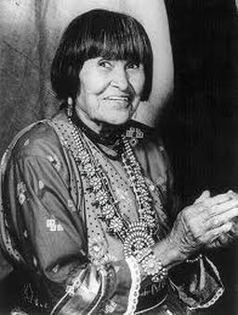
Maria Martinez
Even at a young age Maria was noted for being a skilled potter
She learned techniques that were used in the southwest for several millennia
All of the raw materials for her pottery are gathered locally and carefully processed by the community – They make their own clay!

Slide 44
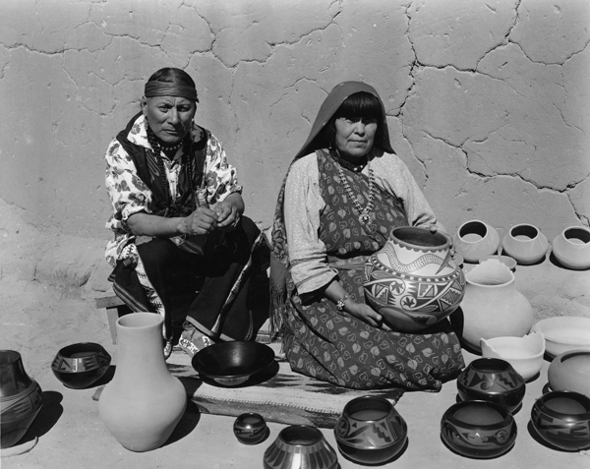

Slide 45
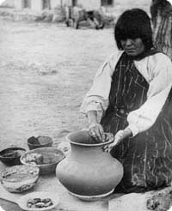
Making ceramics in the Pueblo was considered a communal activity, where different steps in the process were often shared. The potters helped each other with the arduous tasks such as mixing the paints and polishing the slip.

Slide 46
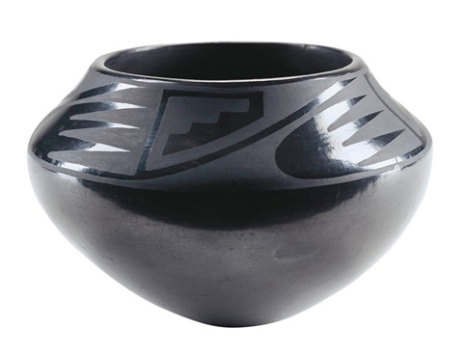
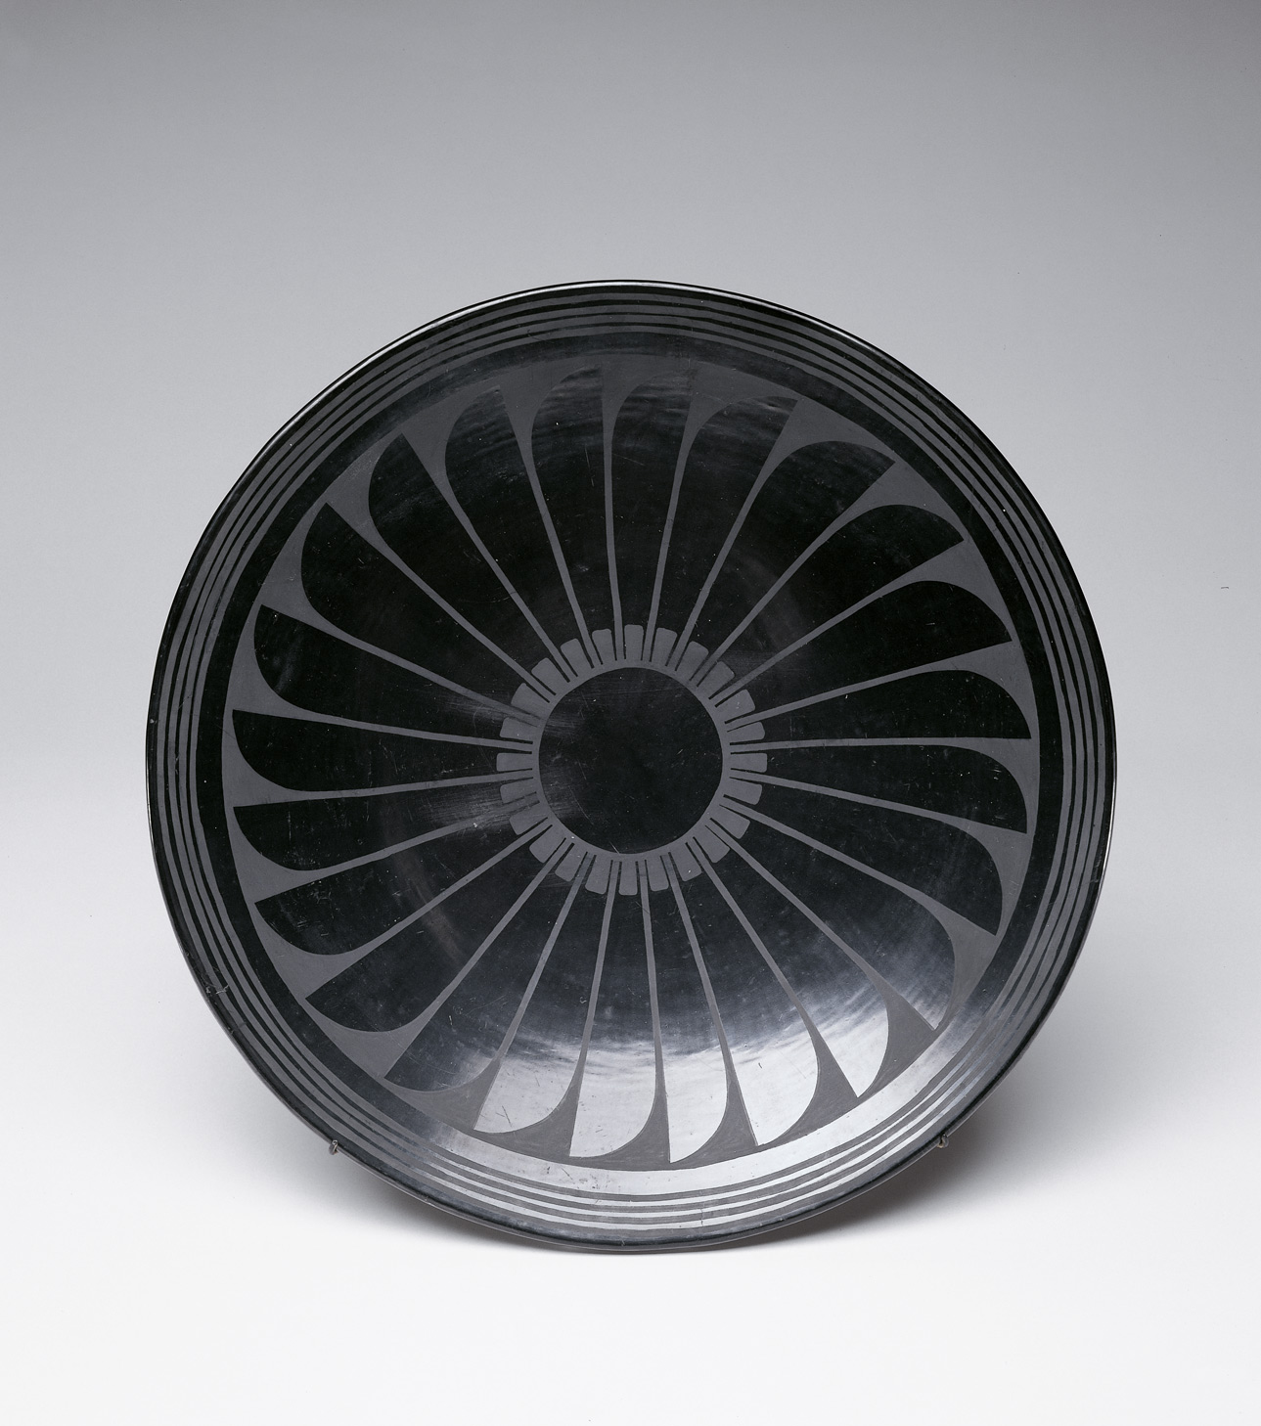
What do you think her ceramics are worth?

Slide 47
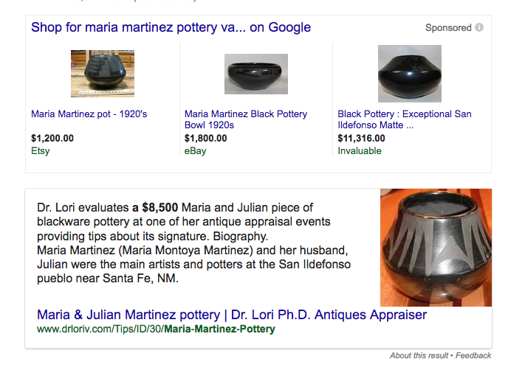

Slide 48
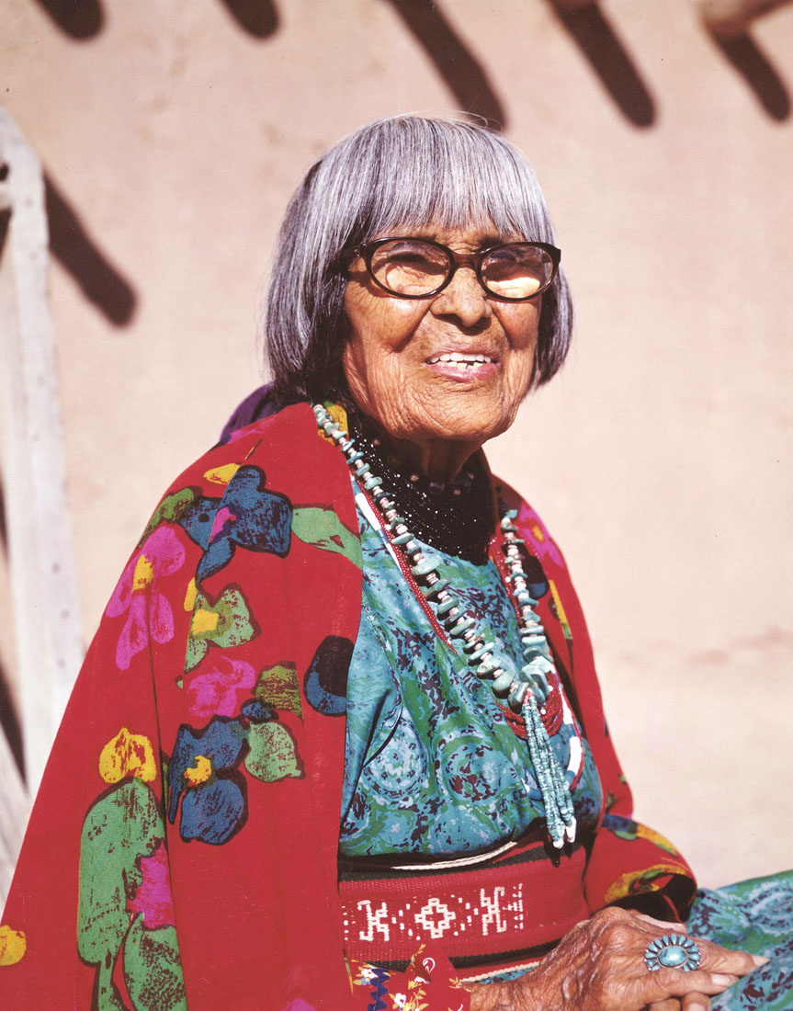
Helping her Pueblo (community) was of extremely important to Ms. Martinez. She lived as a proper Pueblo woman, avoiding self-aggrandizement and insisting to scholars that she was just a wife and mother even as her reputation in the outside world increased.
To help other potters in the Pueblo, Ms. Martinez was known to have signed the pots of others, lending her name to help the community….
What do you think of that?
Is that okay?

Slide 49
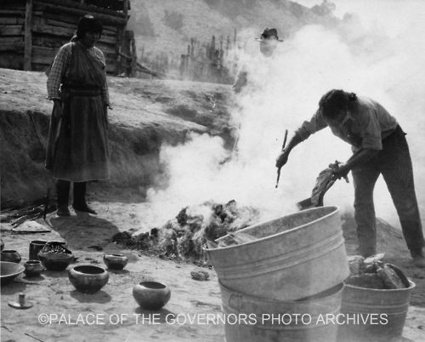

Slide 50
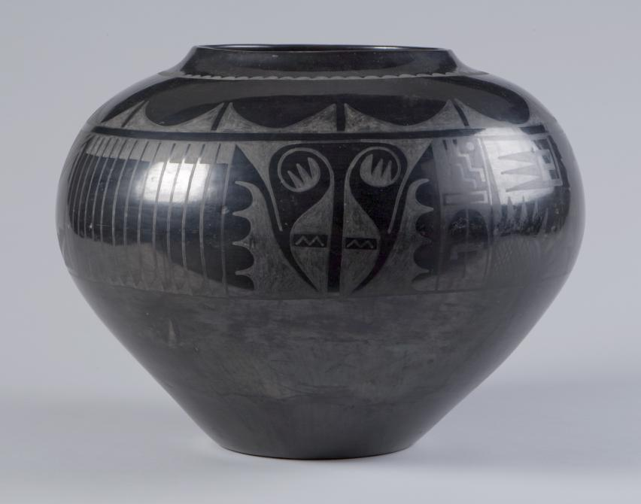

Slide 51
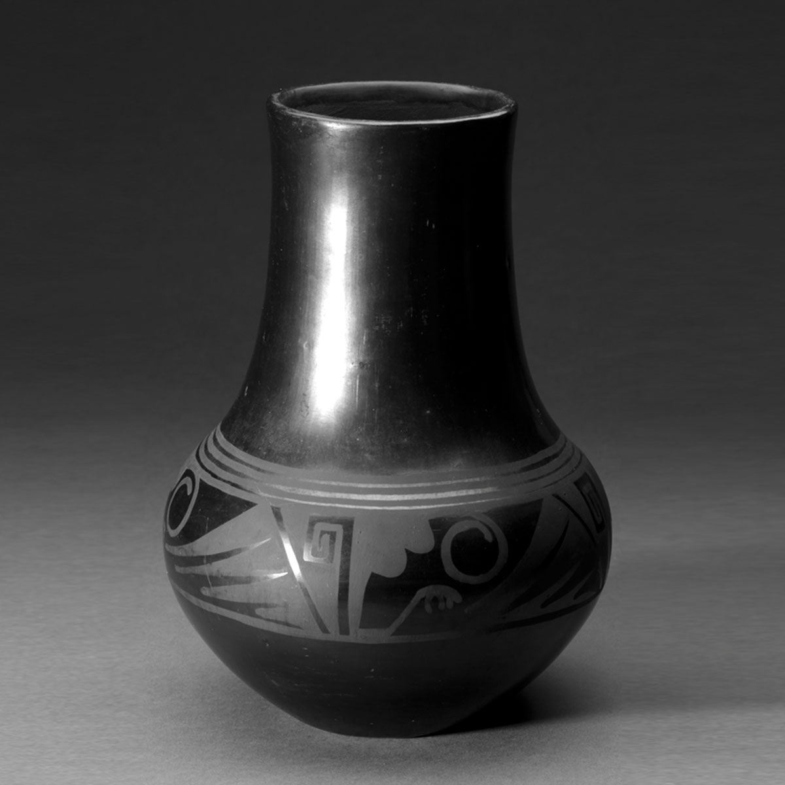

Slide 52
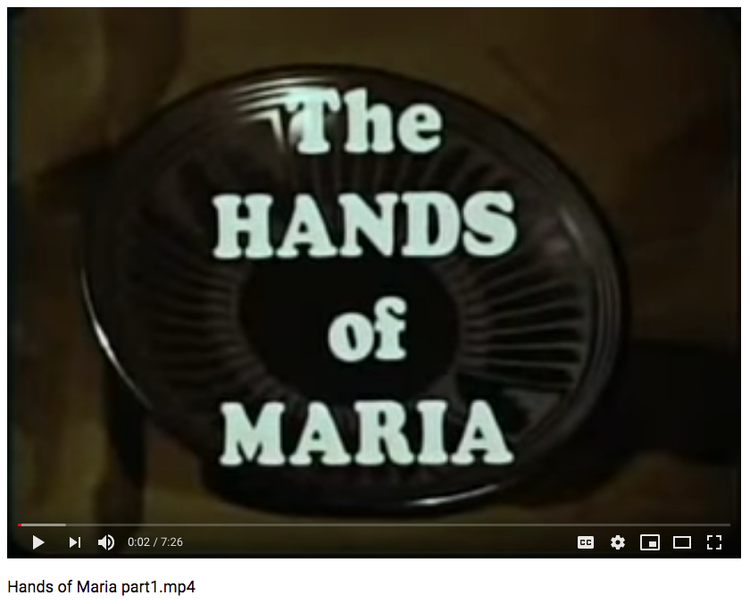
https://www.youtube.com/watch?v=7AhX1MhvAG8

Slide 53
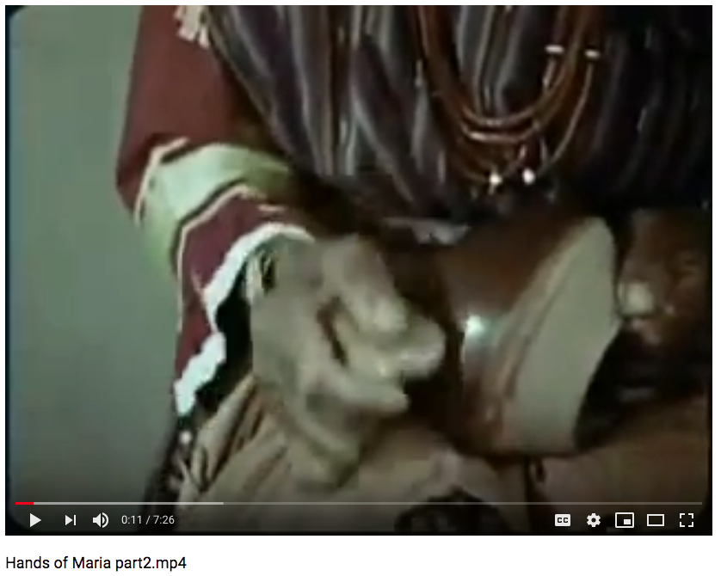
https://www.youtube.com/watch?v=1zrTO1KYhQs

Slide 54
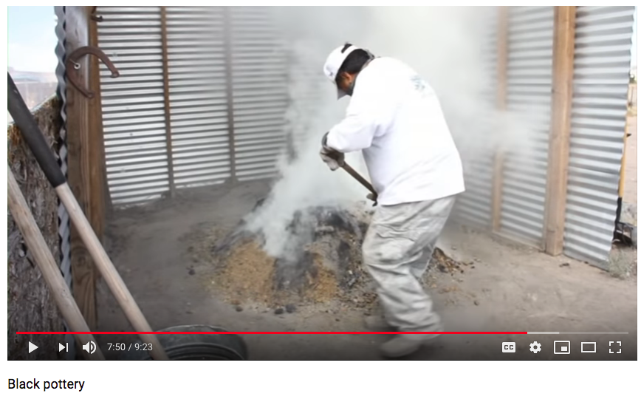
https://www.youtube.com/watch?v=nyHL7kF_c0o

Slide 55
Form | Function | Content | Context
Black on black; highly polished surfaces; | Sparks a revival of Pueblo techniques | Exceptional symmetry; walls of even thickness; surfaces are free of imperfections | Comes from the 1000 year old tradition of pottery making in the SW
contrast matte and shiny black finishes |  |  | At the time of production, Pueblos were in decline; modern life replacing traditional life
 |  |  | Maria made the pots; developed/ invented more shapes than traditional pueblos used
 |  |  | Julian painted the pots; used a revival of ancient mythic figures and designs

