Slide 2
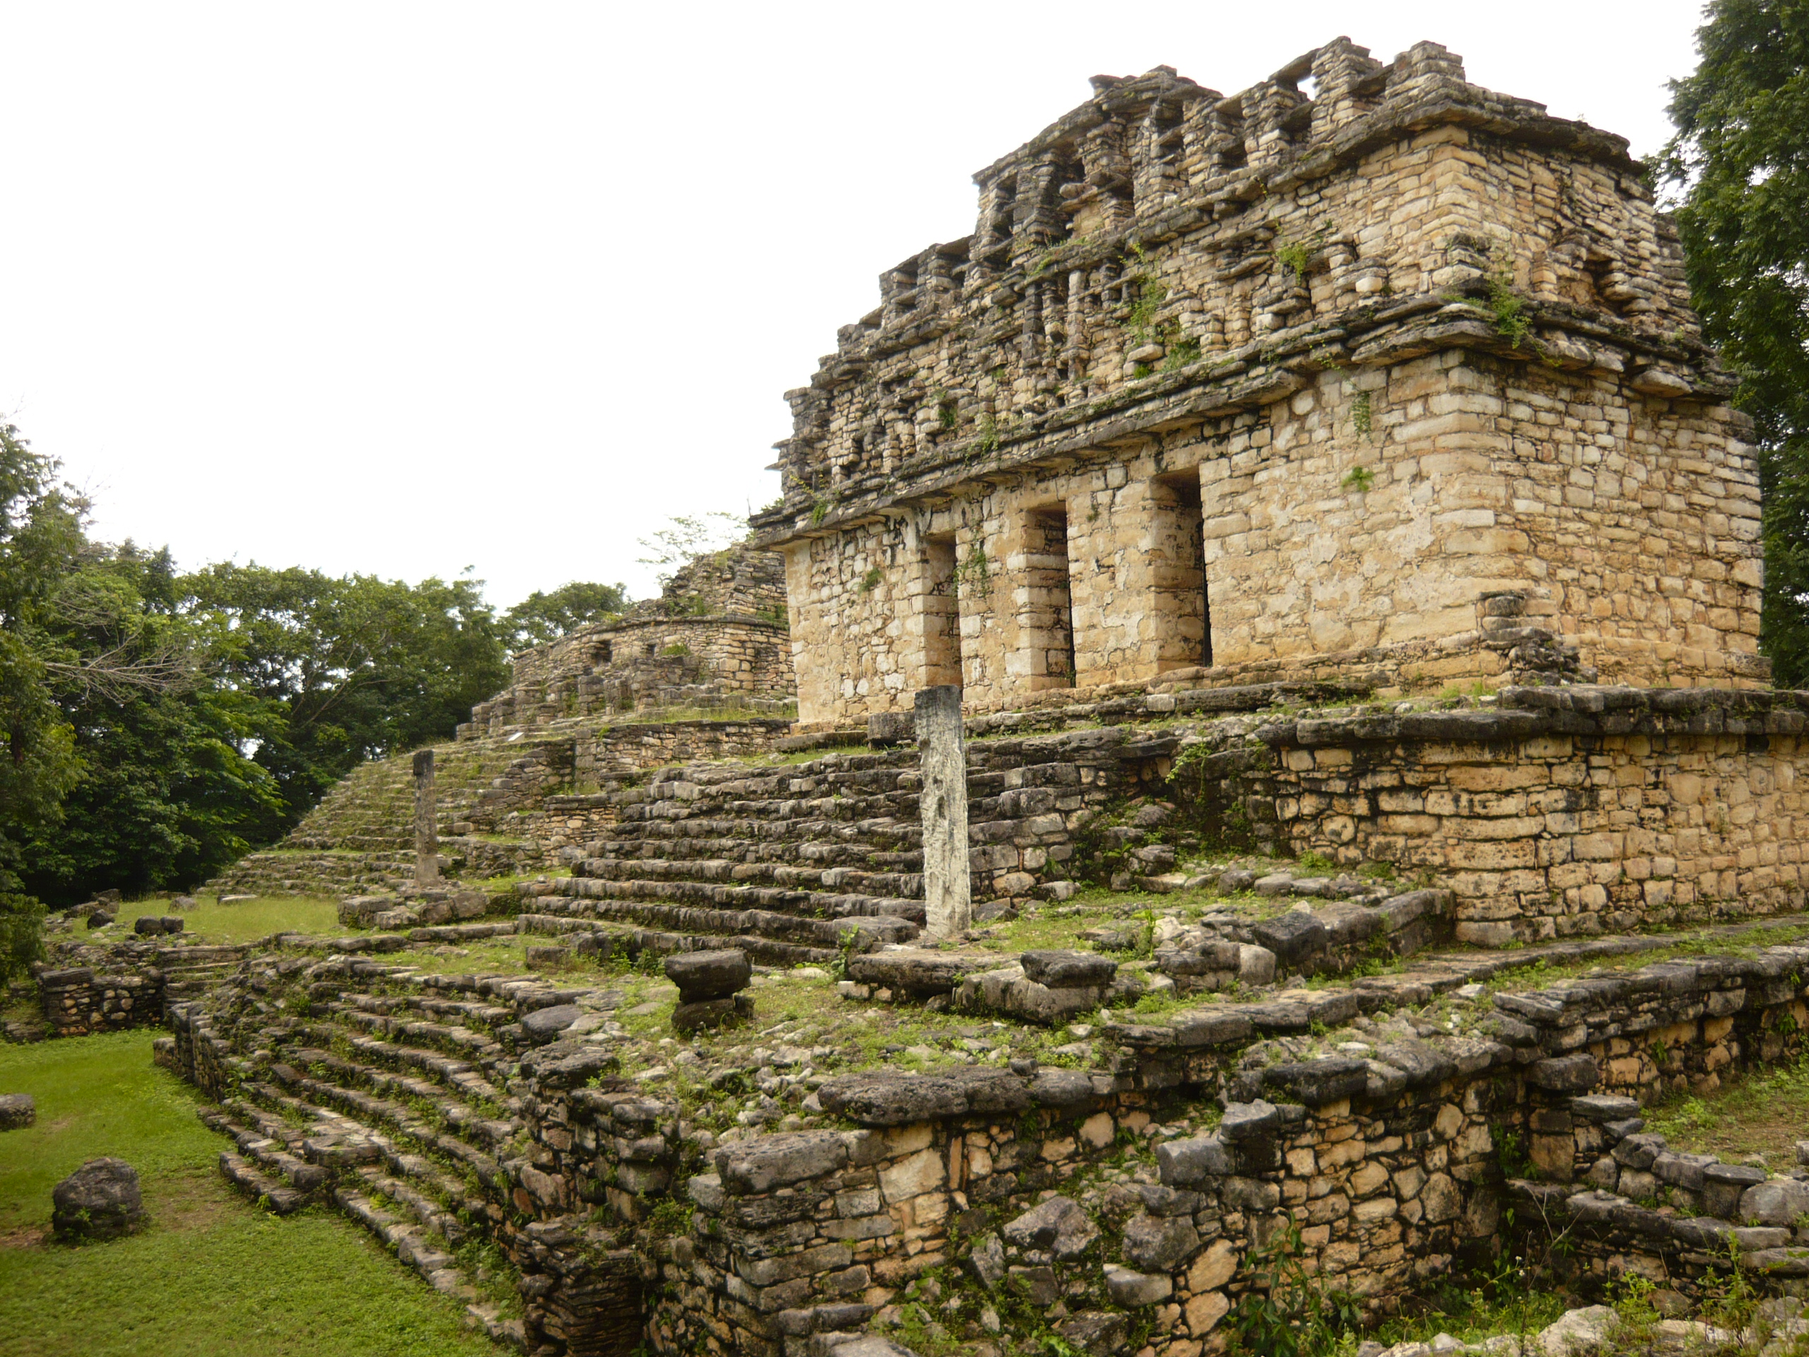
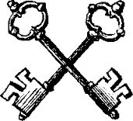
155. Yaxchilán. Chiapas, Mexico. Maya. 725 C.E. Limestone (architectural complex)

Slide 3
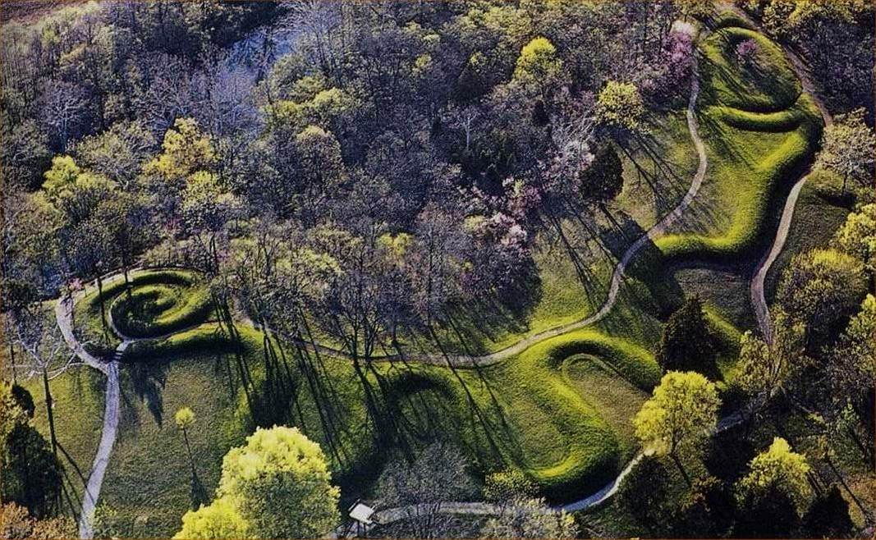
156. Great Serpent Mound. Adams County, southern Ohio. Mississippian (Eastern Woodlands) 1070 C.E. Earthwork/effigy mound.

Slide 4
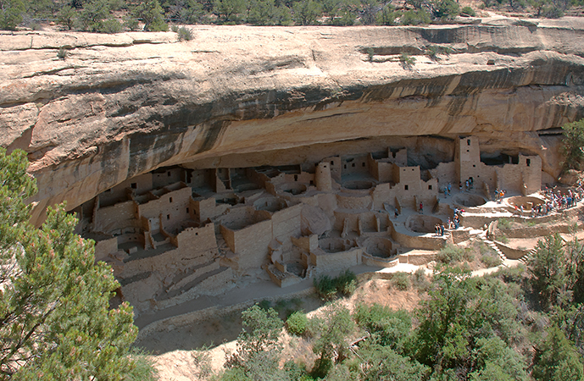
154. Mesa Verde cliff Dwellings. Montezuma County, Colorado.
Ancestral Puebloan (Anasazi). 450–1300 C.E. Sandstone

Slide 5
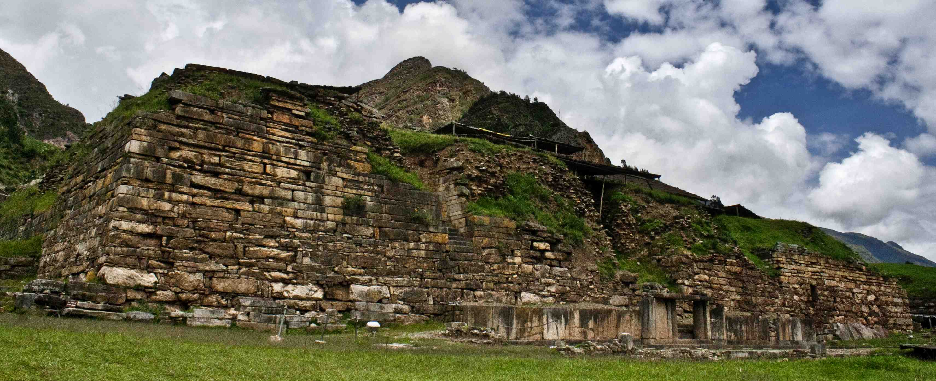
153. Chavín de Huántar. Northern highlands, Peru. Chavín. 900–200 B.C.E. Stone (architectural complex)
granite (Lanzón and sculpture)
hammered gold alloy (jewelry)

Slide 6
TEAM WORK!
We need 3 groups of at least 3 people. Amongst your group members pick one of the following monumental sites. You will then team up with other students assigned your same piece. Together you will do research and fill out as much information on our note taking sheet as possible. Once filled out you will return to your original group and share what information you have learned.
1) Mesa Verde cliff dwellings 2) Yaxchilán 3) Great Serpent Mound
What are the similarities and differences of each of the monuments with each other?
Consider context and materials used.
What symbolism is employed in each site?
Why were they abandoned?

Slide 7
153. Chavín de Huántar. Northern highlands, Peru. Chavín. 900–200 B.C.E. Stone (architectural complex)
granite (Lanzón and sculpture)
hammered gold alloy (jewelry)

Slide 8
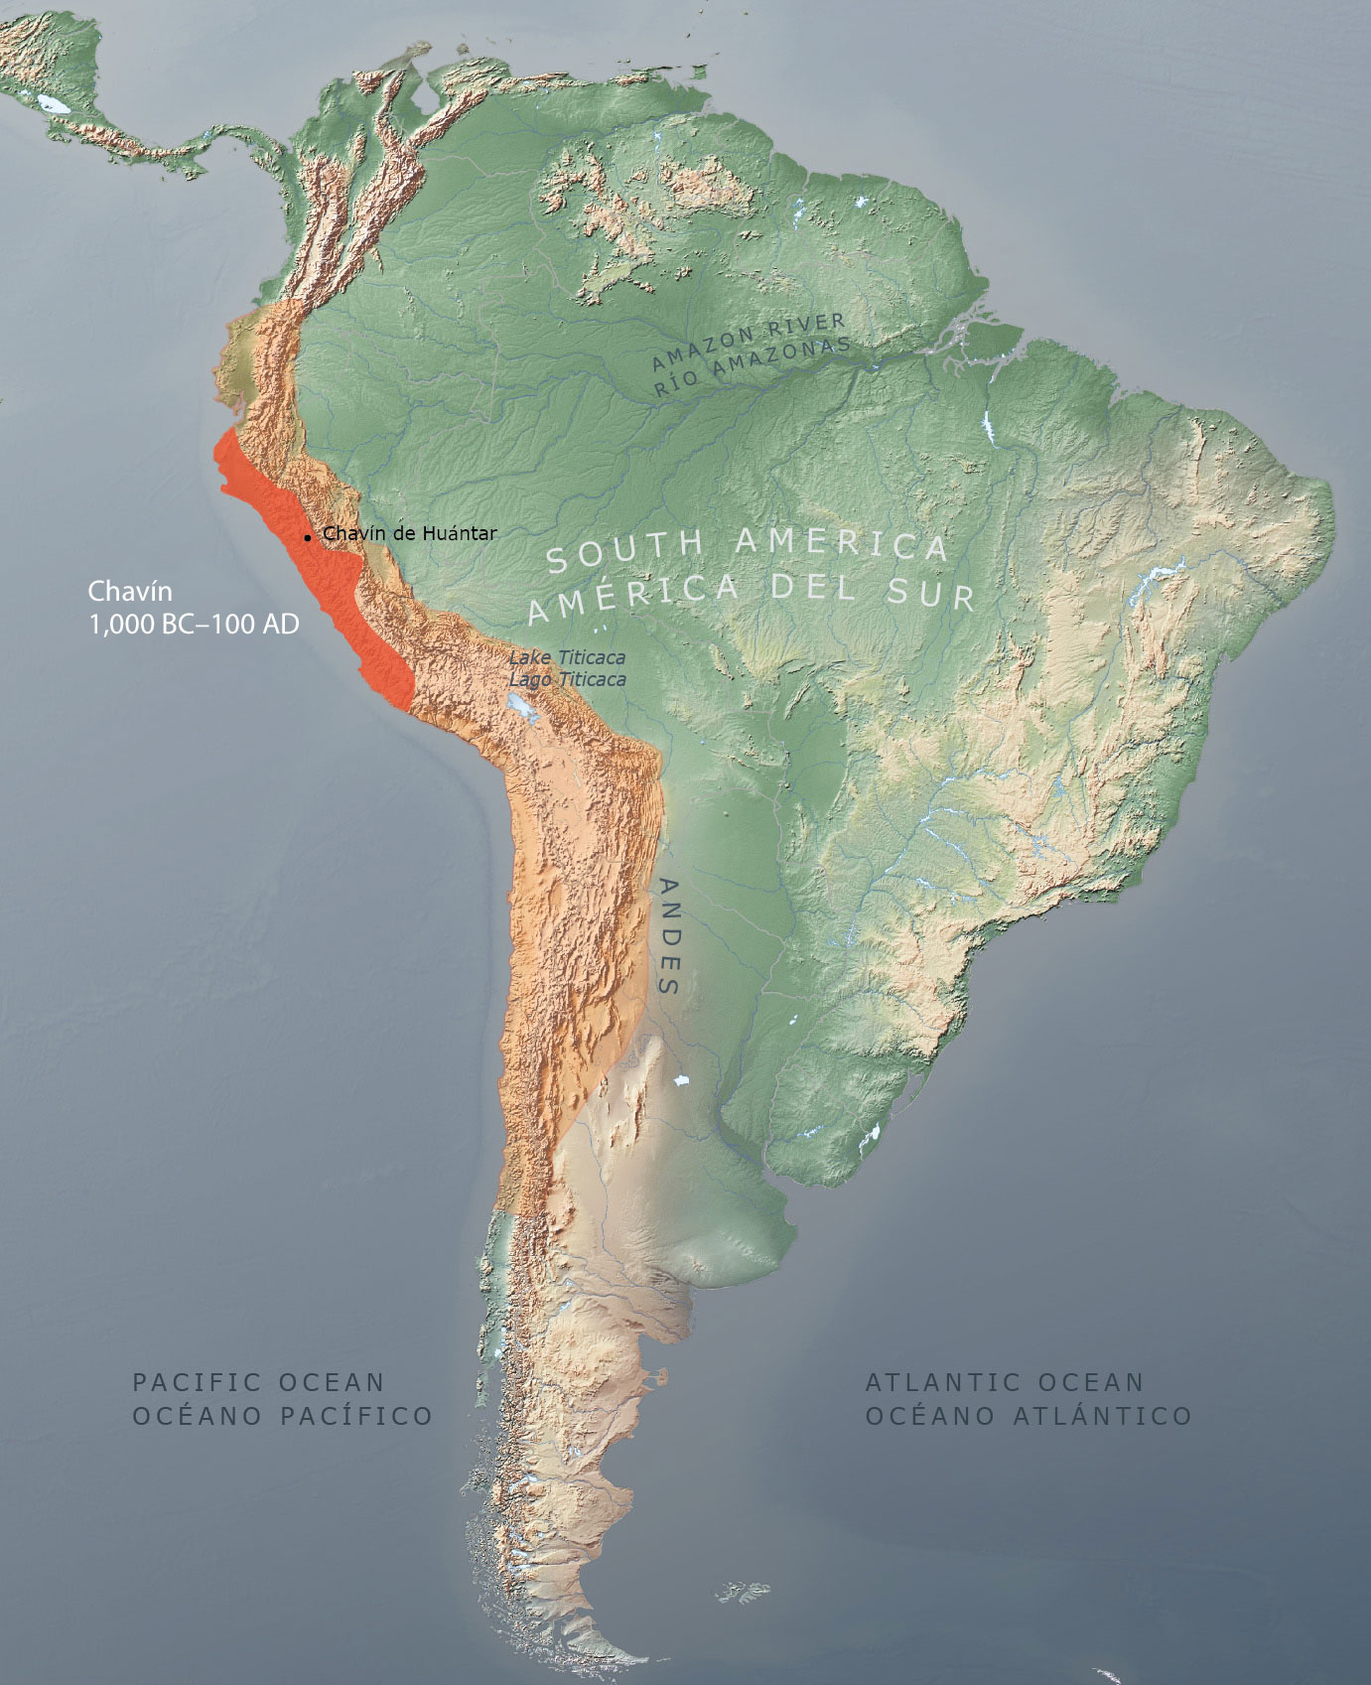
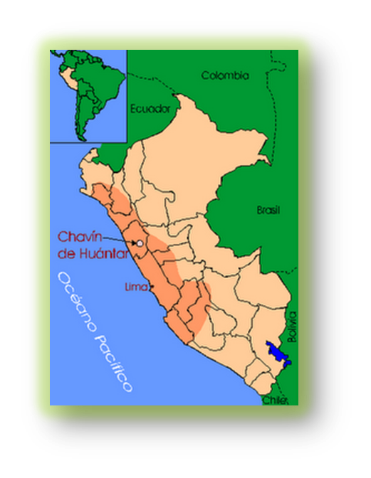
Andean highlands of Peru
Pilgrimage site of ancient peoples
Near a “confluence,” which is a joining of two rivers. These two rivers are the Huachesca & Mosna. Probably seen as a spiritual powerful phenomenon

Slide 9
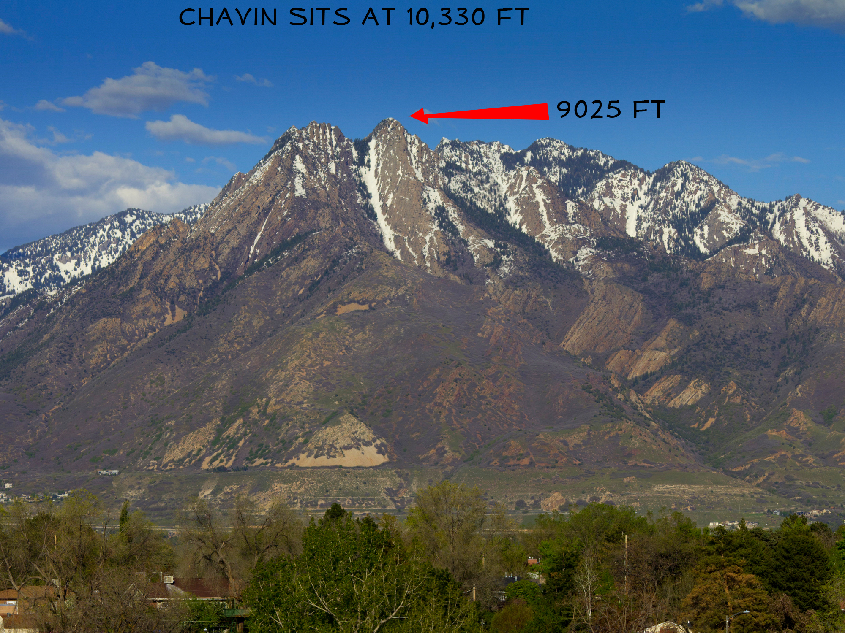

Slide 10
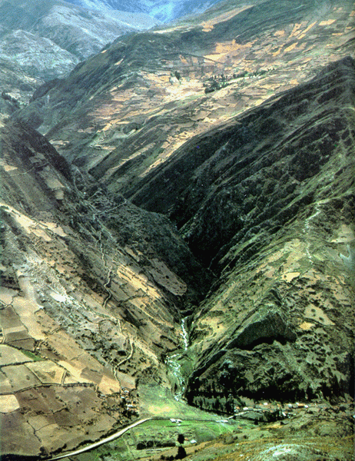
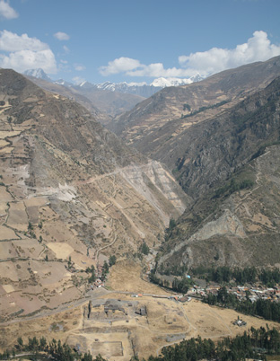

Slide 11
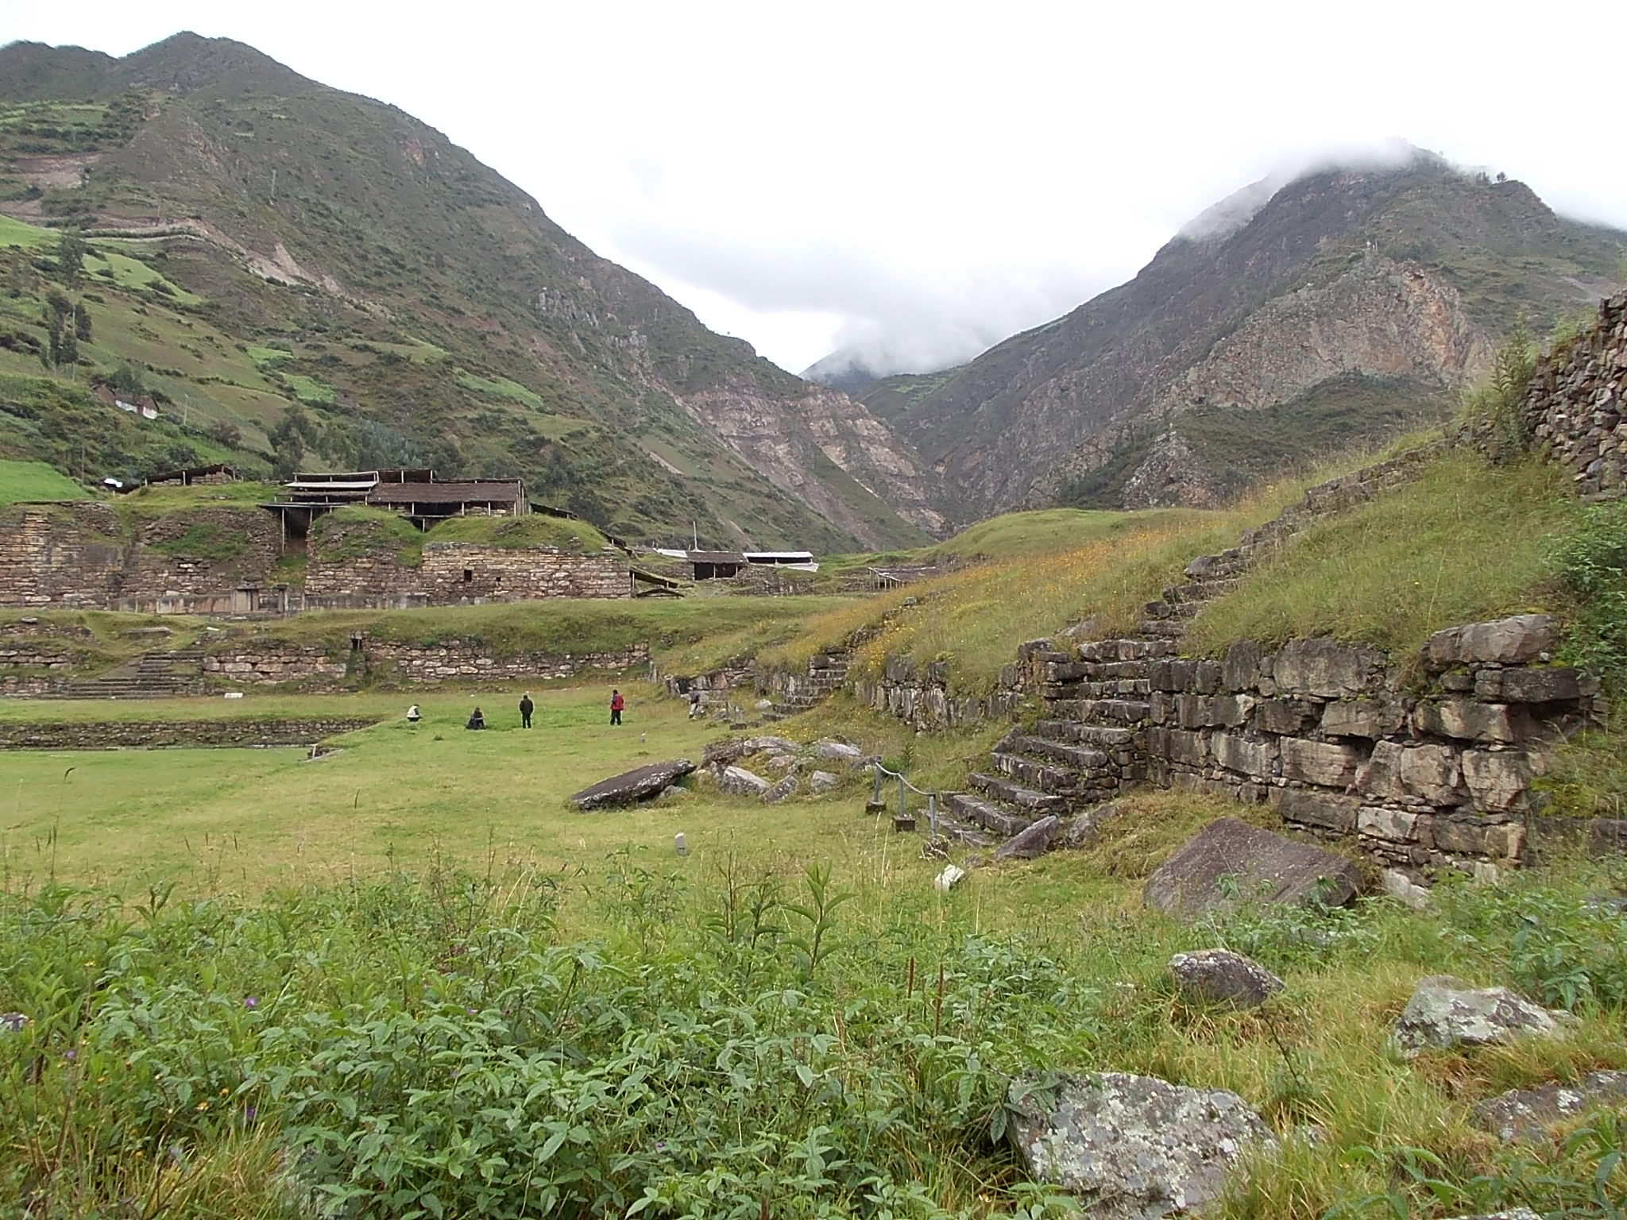

Slide 12
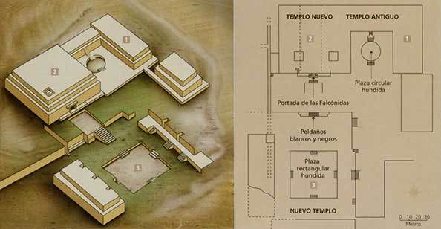
The temple complex that stands today is comprised of two building phases: the U-shaped Old Temple, built around 900 B.C.E., and the New Temple built approximately 500 B.C.E.
interior of the temple was riddled with a multitude of tunnels, called galleries
The galleries all existed in darkness—there are no windows in them

Slide 13
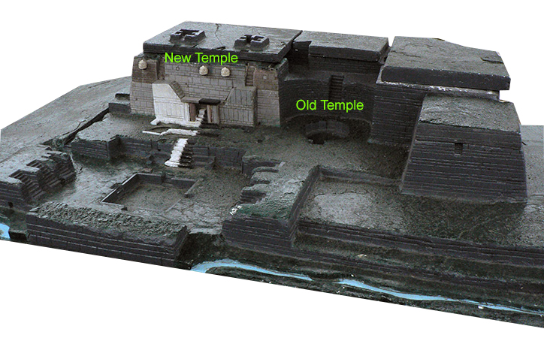
The temple complex that stands today is comprised of two building phases: the U-shaped Old Temple, built around 900 B.C.E., and the New Temple built approximately 500 B.C.E.
interior of the temple was riddled with a multitude of tunnels, called galleries
The galleries all existed in darkness—there are no windows in them

Slide 14
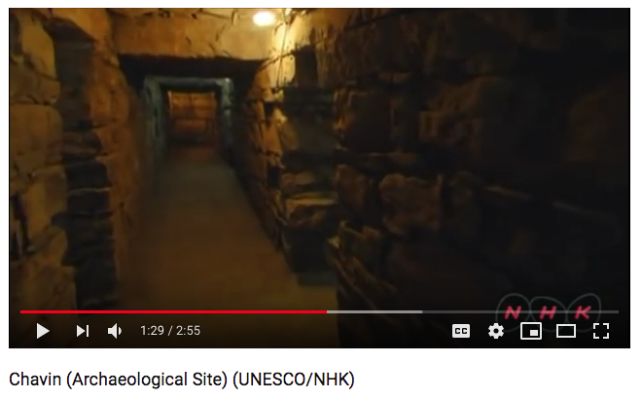
https://www.youtube.com/watch?v=PnIoffCCyBI

Slide 15
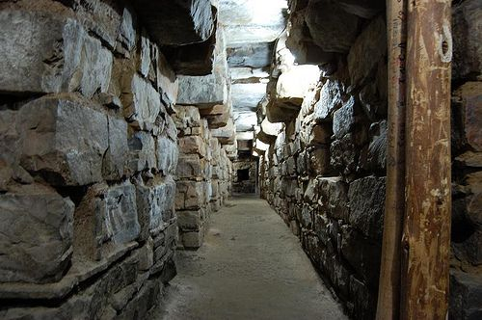

Slide 16
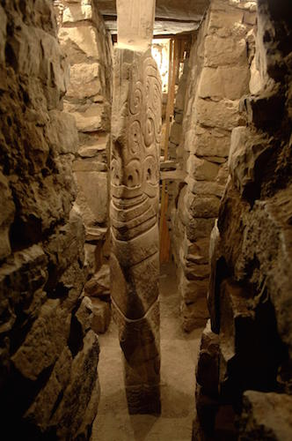
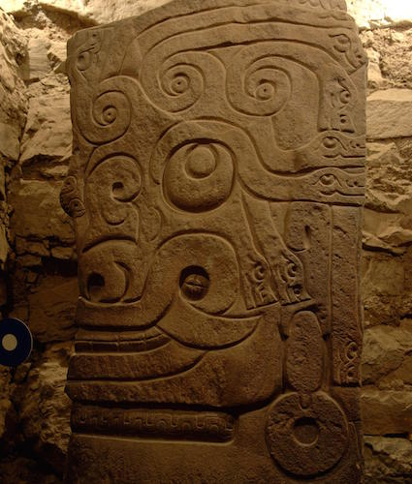
The god for whom the temple was constructed was represented in the Lanzón a notched wedge-shaped stone over 15 feet tall, carved with the image of a supernatural being, and located deep within the Old Temple, intersecting several galleries.
Lanzón means “great spear” in Spanish

Slide 17
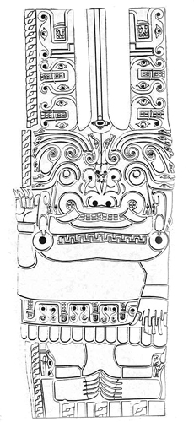
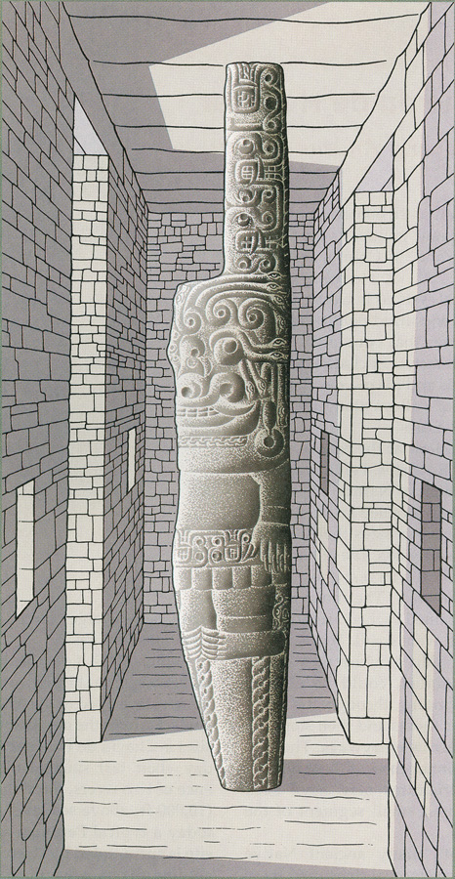
Two key elements characterize the Lanzón deity: it is a mixture of human and animal features, and the representation favors a complex and visually confusing style.
The fangs and talons most likely indicate associations with the jaguar and the caiman—apex predators from the jungle lowlands that are seen elsewhere in Chavín art and in Andean iconography.
The eyebrows and hair of the figure have been rendered as snakes, making them read as both bodily features and animals.

Slide 18
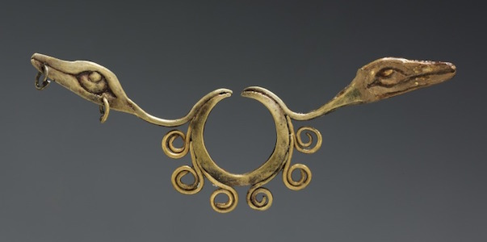
This kind of nose ornament, which pinches or passes through the septum, is a common form in the Andes.
The two serpent heads flank right and left, with the same upward-looking eyes as the Lanzón. The swirling forms beneath them also evoke the sculpture’s eye shape.
An ornament like this would have been worn by an elite person to show not only their wealth and power but their allegiance to the Chavín religion.

