Slide 2
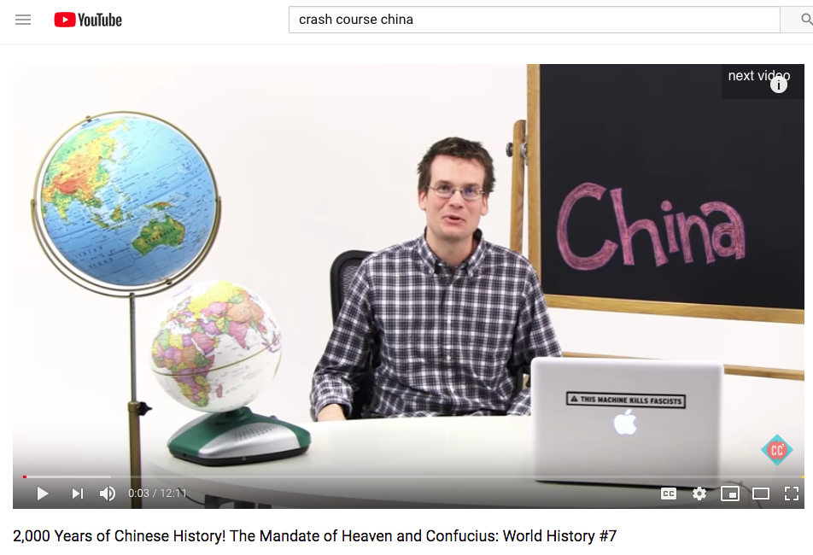
https://www.youtube.com/watch?v=ylWORyToTo4 12:00

Slide 3
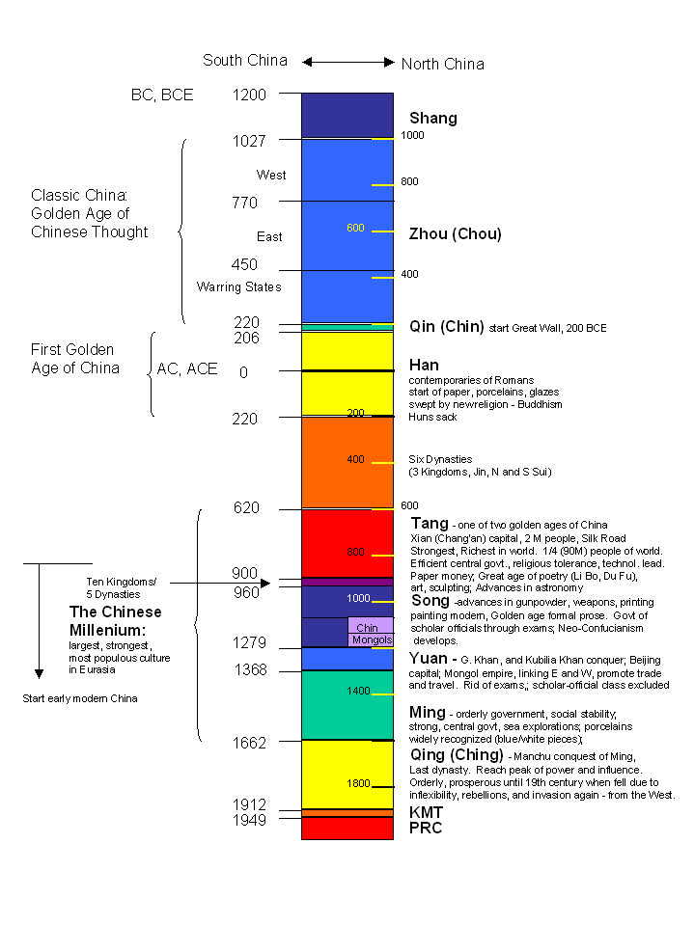
Chinese Dynastic History

Slide 4
Enduring Understandings
South/ East Asia have ancient artistic traditions
Great religions were established in Asia
Asian Art is a reflection of Asian aesthetics
Asian art spreads throughout the world through trade

Slide 5
Chinese Art
China has the distinction of having the oldest continuous culture in the world
China has long been broken into various warring states, that, once unified, began to absorb the lands, and cultures that surrounded them.
Trying to collapse 5000 years of history into 1 hour is impossible... So what we will be looking at is a BRIEF survey of what has been produced in China during that time.

Slide 6
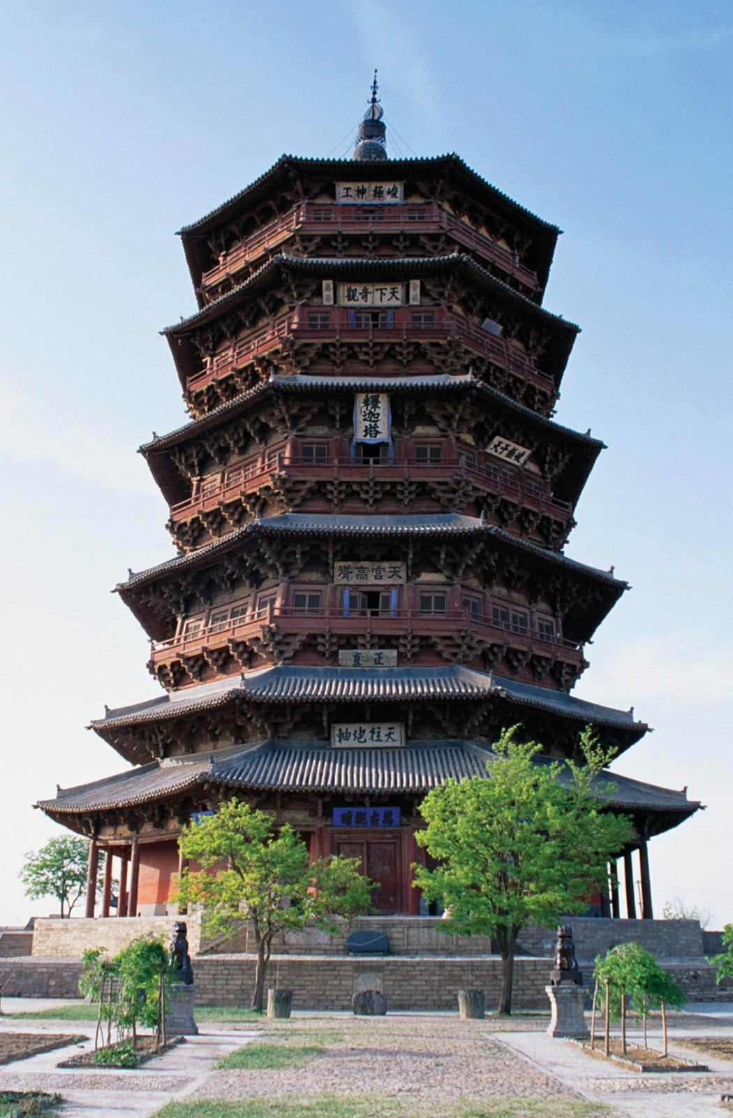
Pagoda
Based on stupas
Repeated vertical design
Ancestor worship
Shrine to deity and ancestors inside
Wood
Curved roof for drainage and to ward off negativity and evil spirits

Slide 7
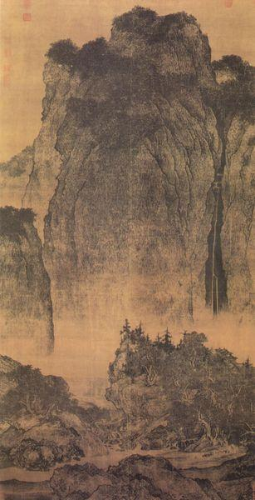
Chinese Painting
Scrolls
Not decoration, but to study
Watercolor and ink Painted on silk
Acceptable to write on scrolls
Beauty found in balance & harmony
Philosophical/mediation
Balance ying yang positive and negative space
Calligraphy high form of art

Slide 8
Calligraphy
In ancient China just like painting, Calligraphy was one of the most appreciated works of art.
Amateurs, school officials, and aristocrats had the leisure to perfect the technique and sensibility necessary for great brushwork.
The equipment for painting Calligraphy are a brush pen, made of animal hair, and black inks, made from pine soot and animal glue.
Writing and painting was originally done on silk, but with the invention of paper in the 1st century, silk was quickly replaced.
Wang Xizhi was a renowned Chinese Calligrapher in the 4th century AD. His most famous work of art is the Lanting Xu, which is the preface for a collection of poems written by numerous poets.
Notes:
8

Slide 9
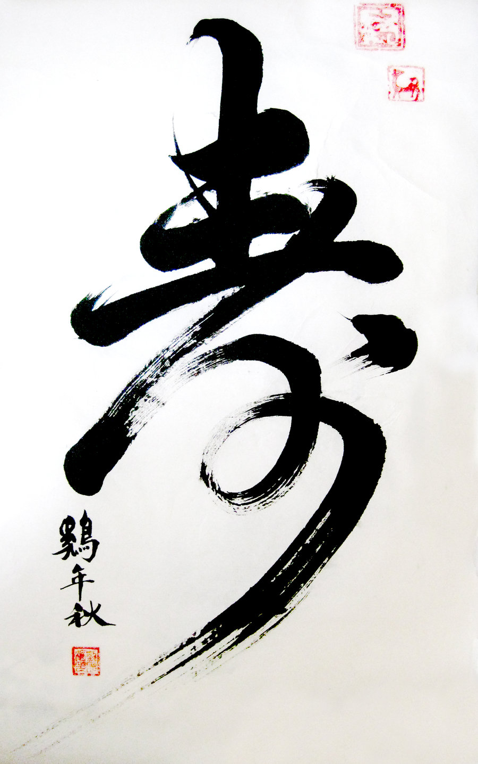
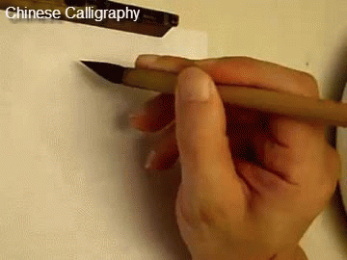

Slide 10
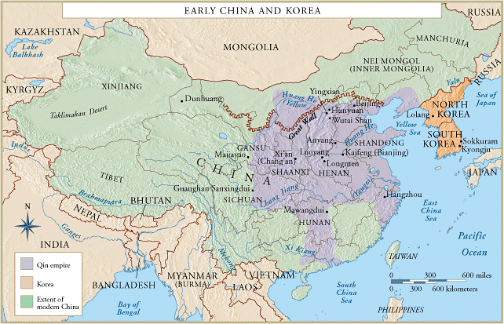

Slide 11
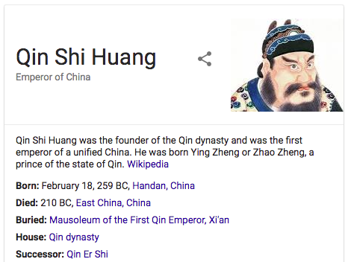
China is born!
Unified 7 Warring states
Standardized Money, Measuring Units
Unified the Written language
Forged a new social contract:
The harmony of society is more important than the desires of the individual
A bit of an ego-maniac…

Slide 12
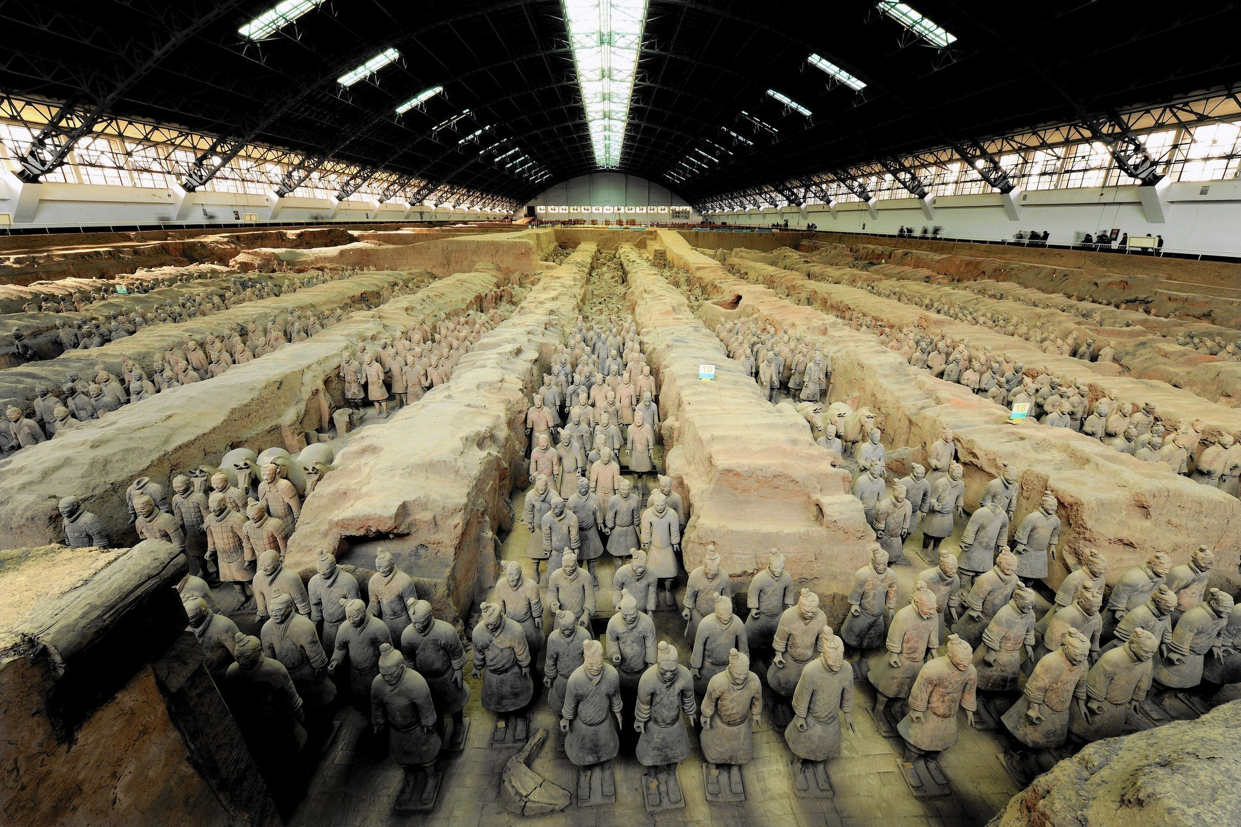

Slide 13
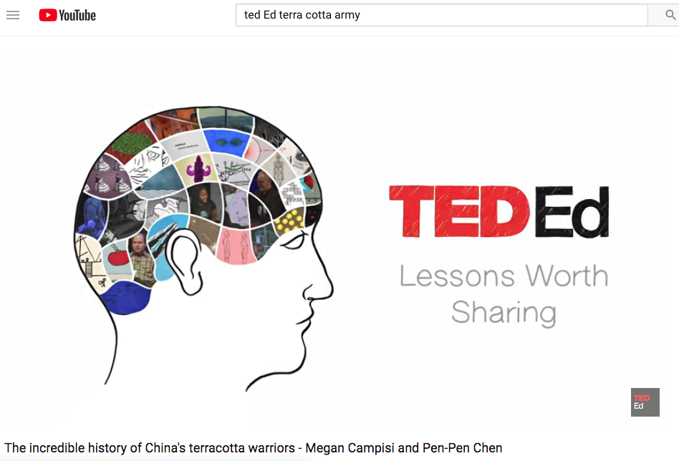
https://www.youtube.com/watch?v=mP5p4QbvPtc 4:00

Slide 14
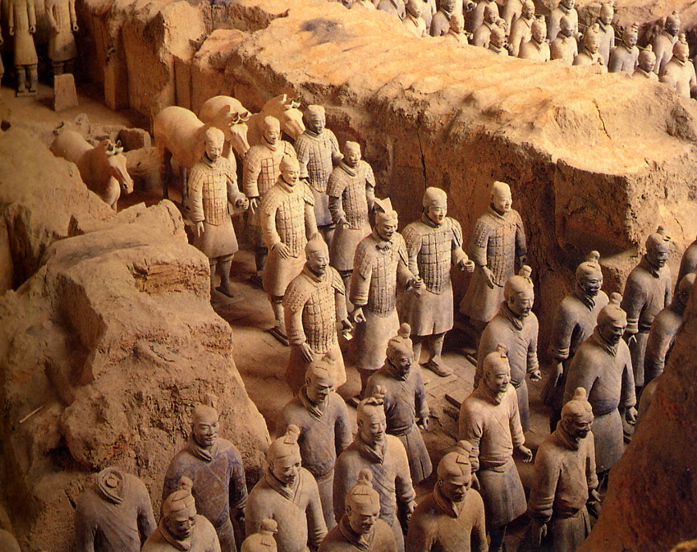
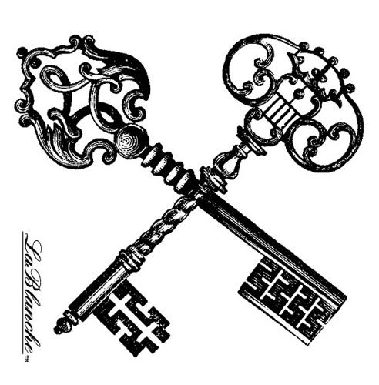
193. Terra Cotta warriors from the mausoleum of the first Qin emperor of China
Qin Dynasty
220 BCE
Painted terra cotta
Notes:
Slide concept by William V. Ganis, PhD FOR EDUCATIONAL USE ONLY For publication, reproduction or transmission of images, please contact individual artists, estates, photographers and exhibiting institutions for permissions and rights.

Slide 15
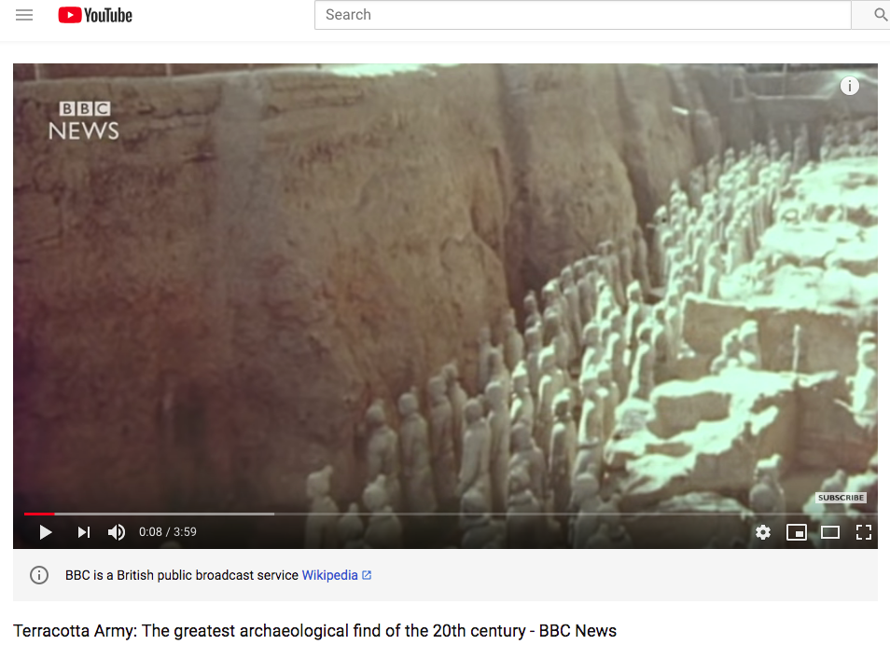
https://www.youtube.com/watch?v=4c_ADqshdSA

Slide 17
Form | Function | Content | Context
Soldiers are 6 ft tall, each with a different face, taller than the average person at the time | A representation of the Chinese army marching into the next world to conquer death as the emperor conquered the whole of China | About 8000 terra cotta warriors, 100 wooden chariots, 2 bronze chariots, 30,000 weapons buried as part of the emperor's tomb | Qin Shi Huangdi was the first Qin emperor of China The name of China comes from this dynastic name
 |  | Individualization of each soldier, despite their numbers | discovered in 1974
 |  | Originally colorfully painted | The individualization is a further demonstration of the control that the emperor had in the creation of the clay army

Slide 18
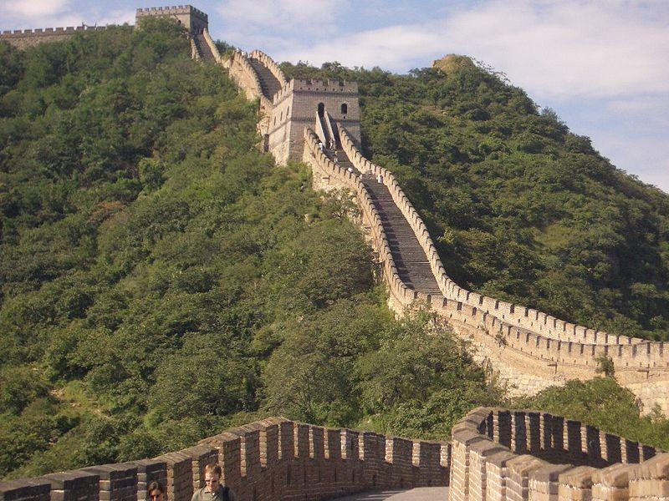
The Great Wall of China 220-206 BCE Qin dynasty
Not visible from Space
Is a series of stone and earthen fortifications to protect the northern borders of the Chinese Empire
Begun by the first emperor, Qin Shi Huangdi, and added to later by other dynasties
The entire wall with all of its branches stretches for 5500.3 miles
Communication between the army units along the length of the Great Wall including the ability to call reinforcements and warn garrisons of enemy movements
Signal towers are built upon hill tops or other high points along the wall for their visibility
Constructed with peasant labor, was utilized after the harvest and it was owed to the emperor

Slide 19
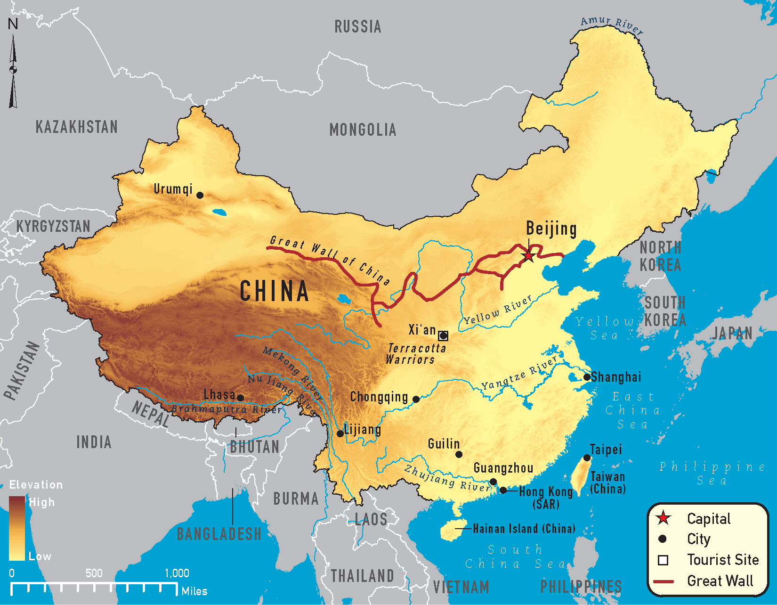

Slide 20
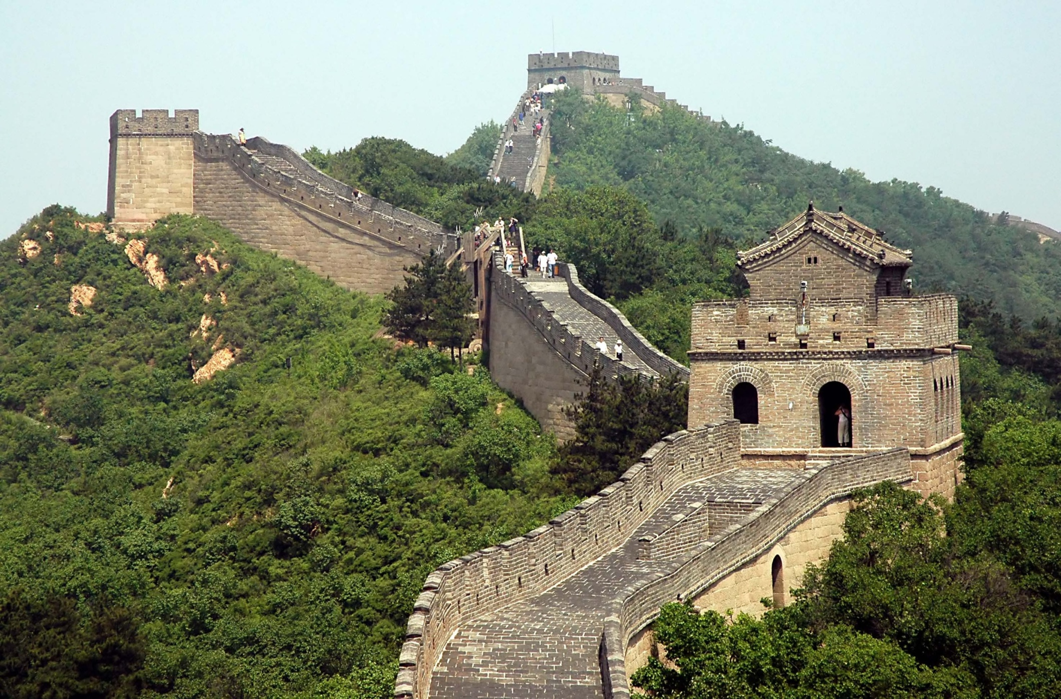

Slide 21
Notes:
Slide concept by William V. Ganis, PhD FOR EDUCATIONAL USE ONLY For publication, reproduction or transmission of images, please contact individual artists, estates, photographers and exhibiting institutions for permissions and rights.

Slide 22
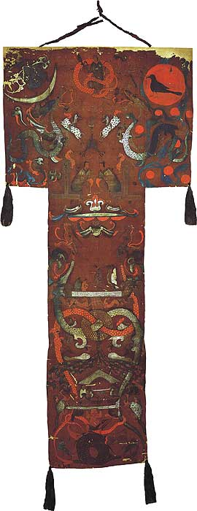
194. Funeral Banner of Lady Dai
(Xin Zhui)
Han Dynasty
180 BCE
Painted Silk
Notes:
Slide concept by William V. Ganis, PhD FOR EDUCATIONAL USE ONLY For publication, reproduction or transmission of images, please contact individual artists, estates, photographers and exhibiting institutions for permissions and rights.

Slide 23
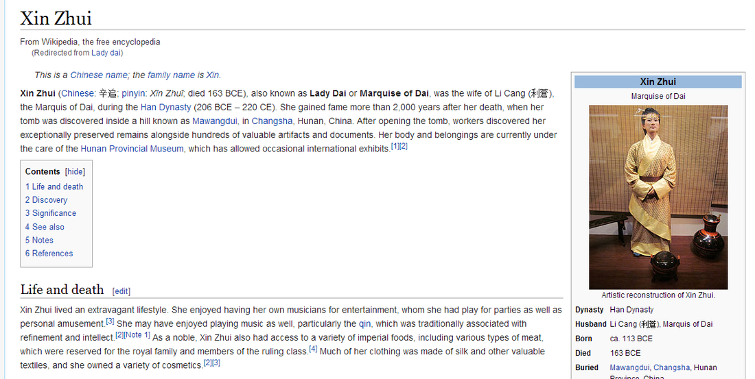

Slide 24
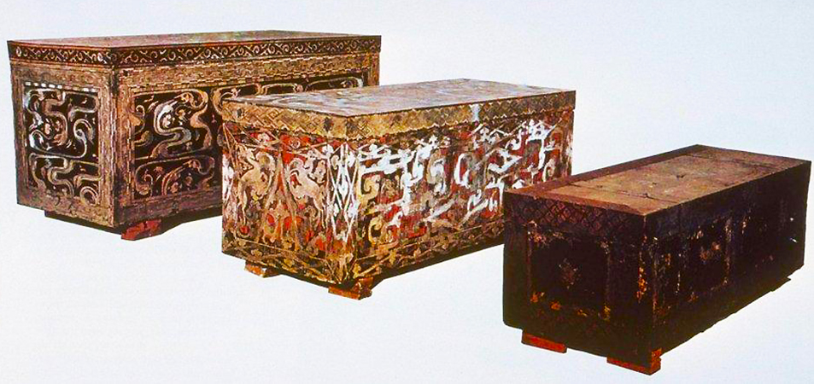

Slide 25
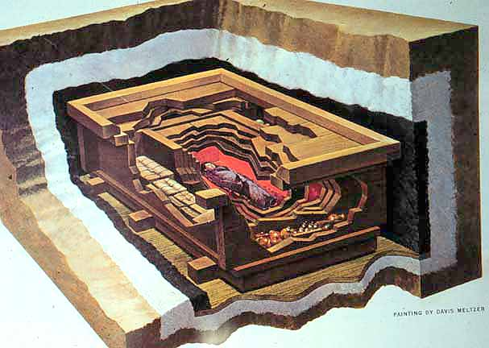

Slide 26
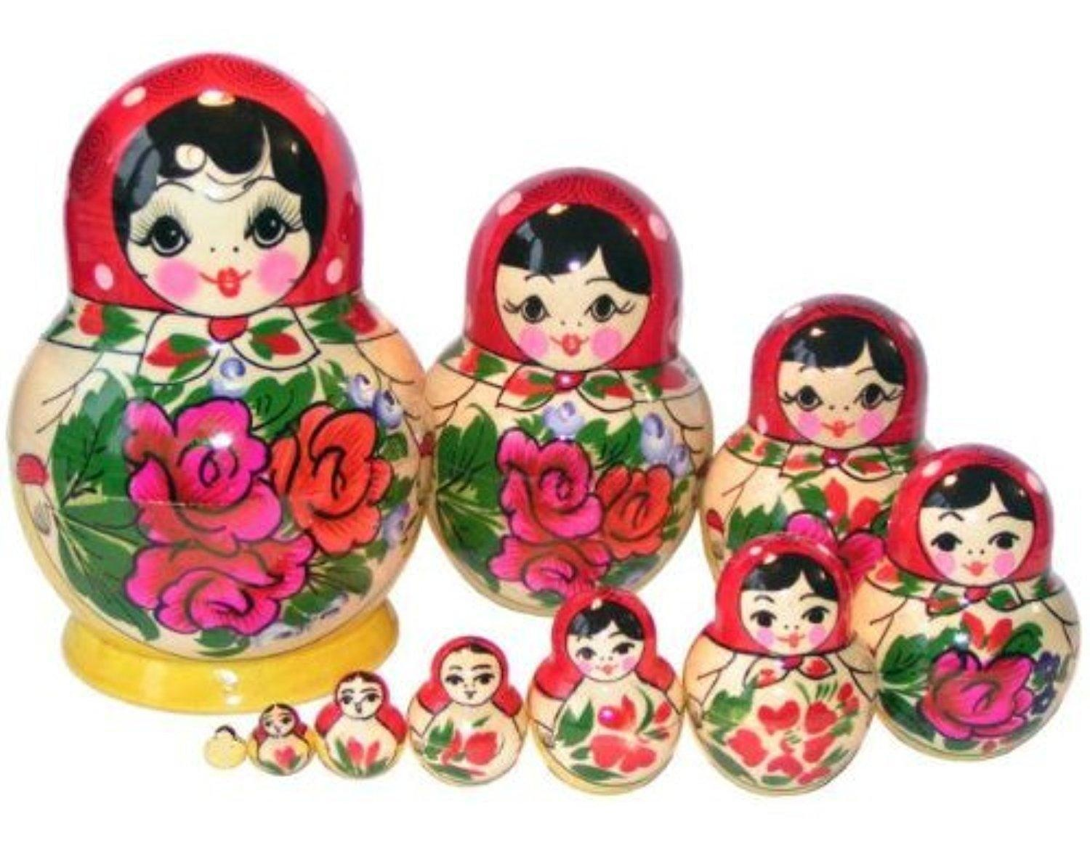

Slide 27
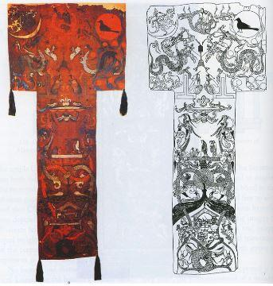

Slide 28
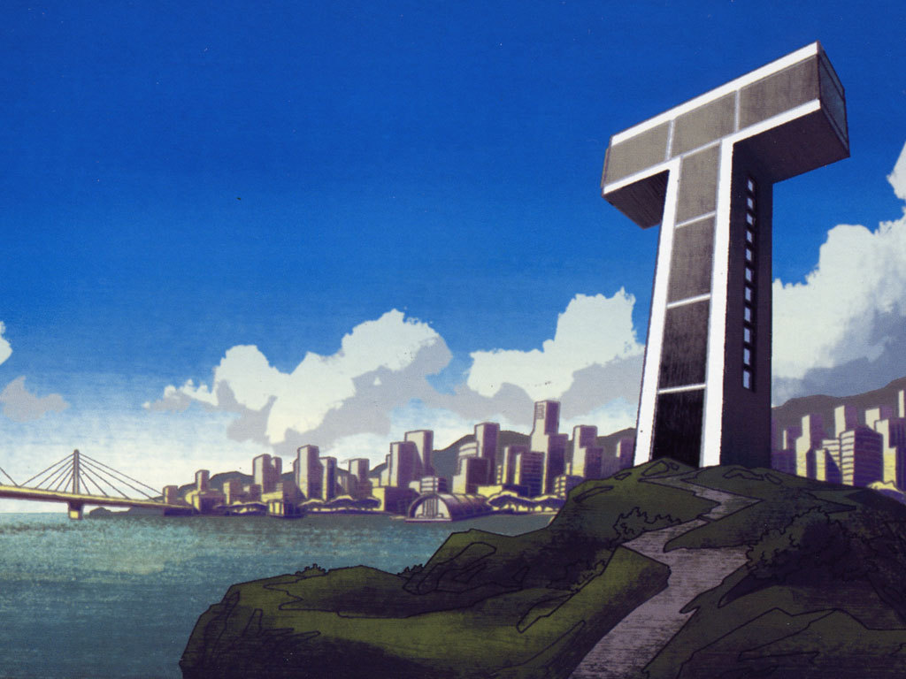

Slide 30
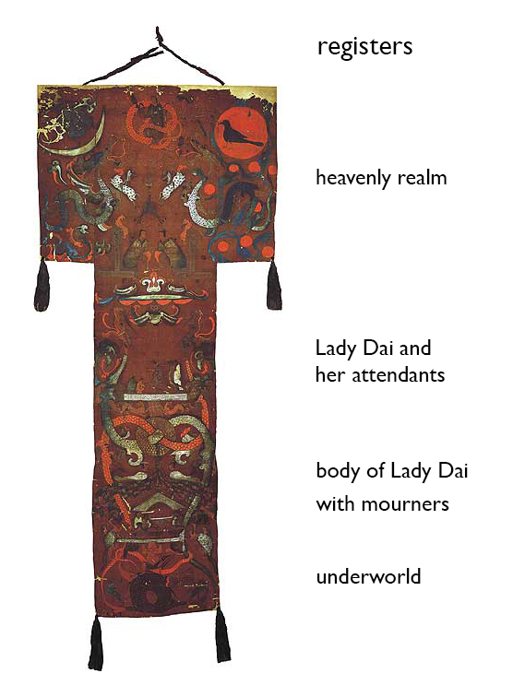

Slide 31
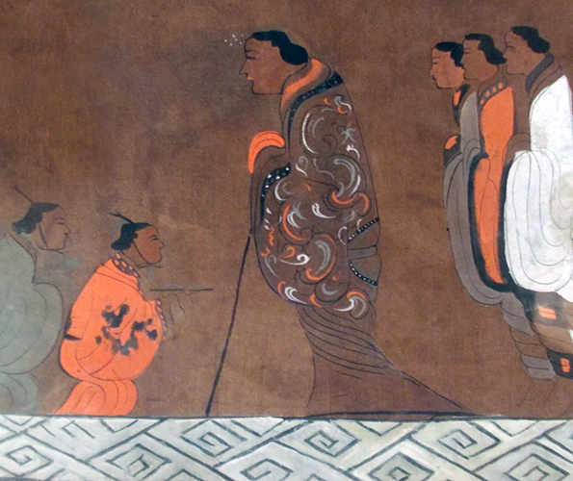
In the lower central register, we see Lady Dai in an embroidered silk robe leaning on a staff. This remarkable portrait of Lady Dai is the earliest example of a painted portrait of a specific individual in China. She stands on a platform along with her servants–two in front and three behind.

Slide 32
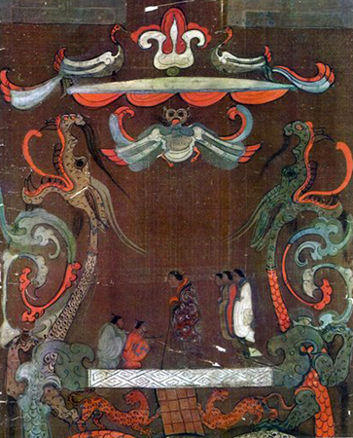
Long, sinuous dragons frame the scene on either side, and their white and pink bodies loop through a bi (a disc with a hole thought to represent the sky) underneath Lady Dai. We understand that this is not a portrait of Lady Dai in her former life, but an image of her in the afterlife enjoying the immortal comforts of her tomb as she ascends toward the heavens.

Slide 33
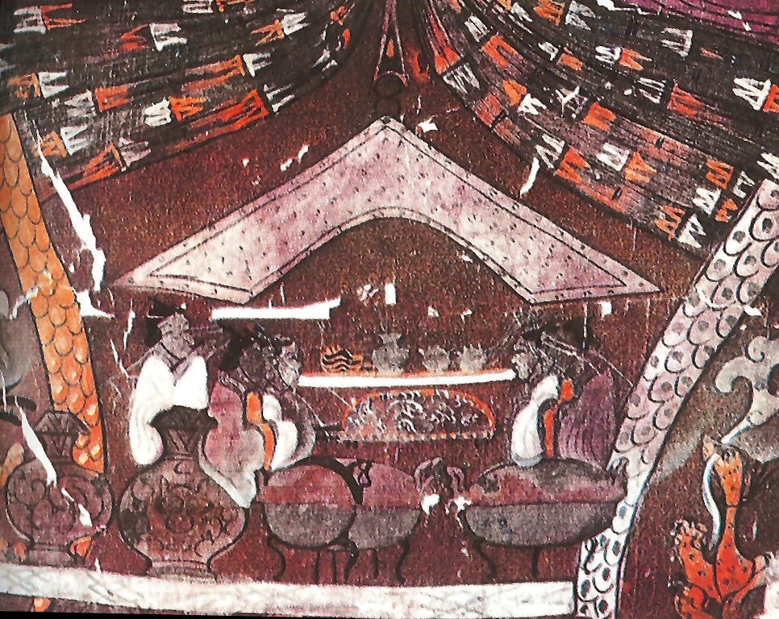
In the register below the scene of Lady Dai, we see sacrificial funerary rituals taking place in a mourning hall. Tripod containers and vase-shaped vessels for offering food and wine stand in the foreground. In the middle ground, seated mourners line up in two rows.

Slide 34
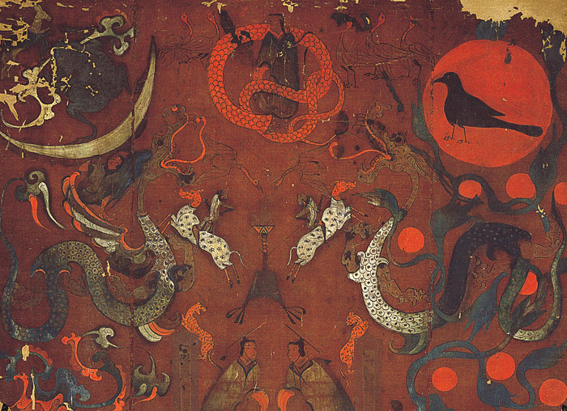

Slide 35
Form | Function | Content | Context
t- shaped silk banner covering the inner coffin of the intact body | probably carried in a procession to the tomb then placed over body to speed its journey to the afterlife | Yin Symbols on left; Yang symbols on right; the center mixes the two philosophies | Lady Dai died in 168 BCE in Hunan province, Han dynasty
 |  | painted in 3 distinct regions: Heaven w/ crescent moon on left; legend of the 10 suns on right; center has two seated officers guard the entrance to the heavenly realm | tomb found in 1972 w/ over 100 objects
 |  | Middle: earth with Lady Dai in center on white platform about to make her journey to heaven with a walking stick that was found in her tomb; mourners and assistants appear by her side; bodies of dragons are symbolically circled through a bi in a yin/yang exchange
 |  | Bottom: the underworld; symbolic low creatures frame the underworld scene; fish, turtles, dragon tails; tomb guardians protect the body

Slide 36
https://www.youtube.com/watch?v=ezmR9Attpyc

Slide 37
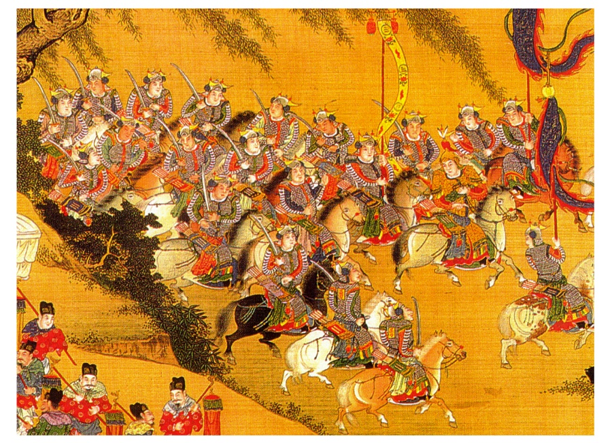
What is the opposite of War Imagery?

Slide 38
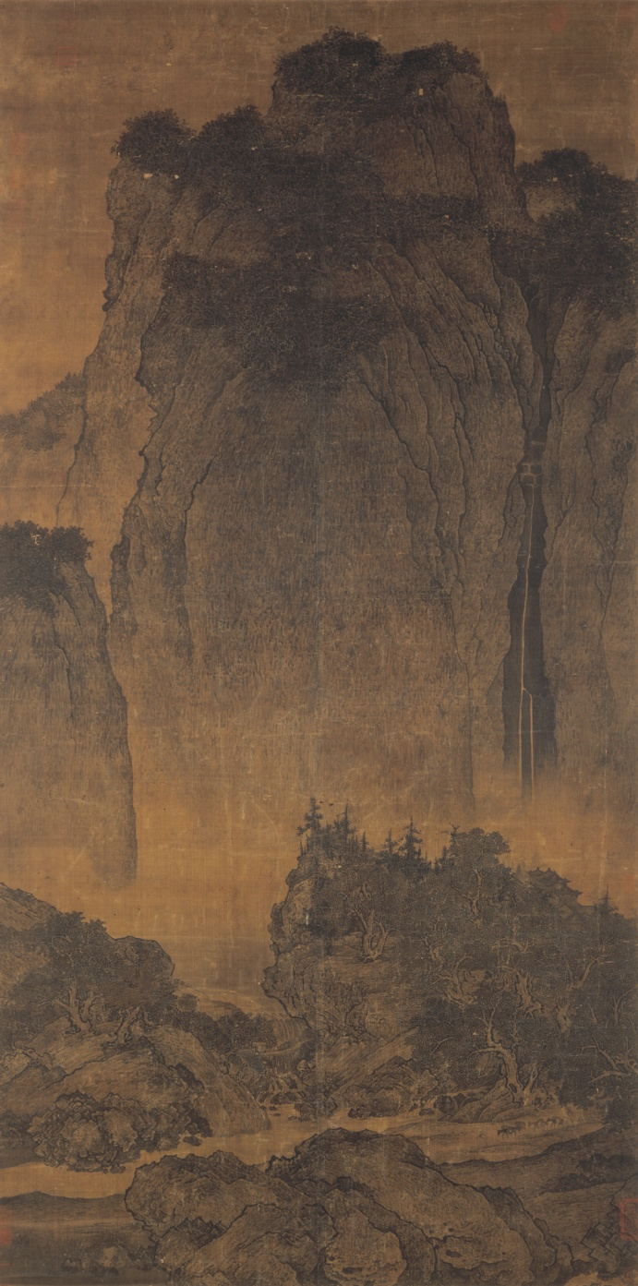
201. Travelers among Mountains and Streams
Fan Kuan
1000 CE
Ink and colors on silk

Slide 39
201. Travelers among Mountains and Streams
Fan Kuan
1000 CE
Ink and colors on silk
This ideal meant to wander in the mountains, forests and streams. The shifting, rather than fixed perspective of the paintings was meant to recall that to mind
This piece presents a vertical landscape with the mountains rising out of mist in the distance
The massive natural forms overwhelm the humans and animals
Viewers must focus not only on the outlines, but on the intricate details and delicate brush strokes

Slide 40
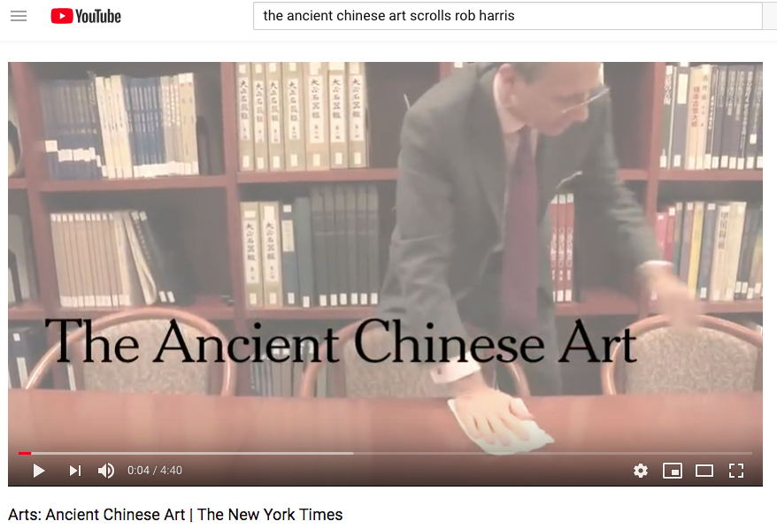
https://www.youtube.com/watch?v=WPmED0GbYUs

Slide 41
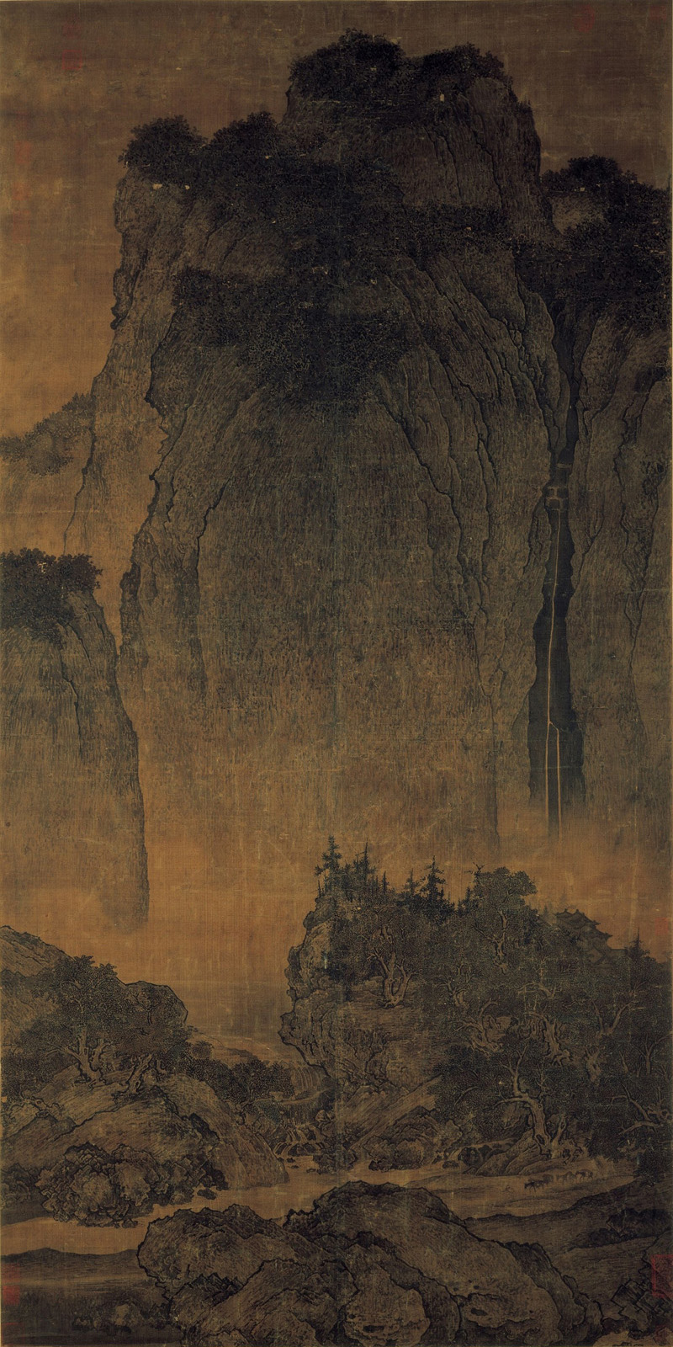
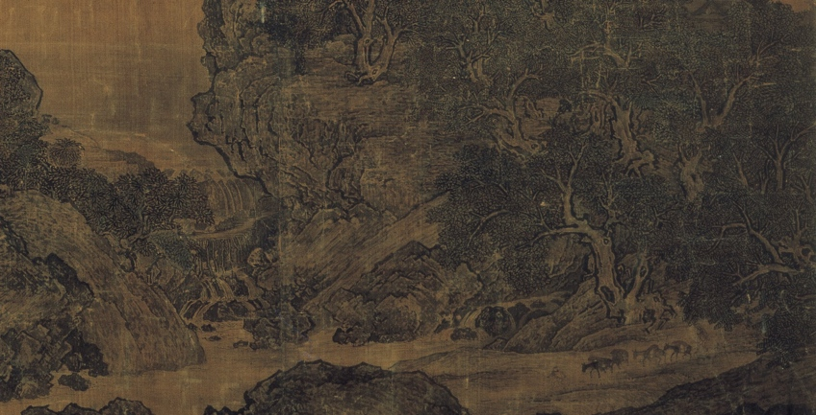
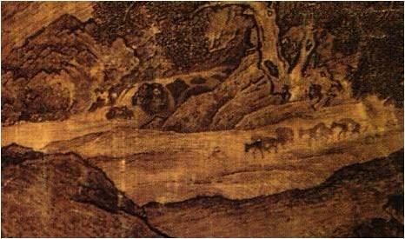

Slide 42
Form | Function | Content | Context
 | hanging scroll | different brushstrokes describe different kinds of trees: conifers, deciduous | artist isolated himself away from civilization to be with nature and study it for his landscape paintings
 | Chinese landscapes should evoke man’s ideal harmonious relationship with nature as well as nature's power to transform the human spirit | long waterfall on right balanced by the high mountain on the left; waterfall accentuates the height of the mountain | reflects a Taoist philosophy: Taoist philosophy developed an early stimulus for creating landscape paintings.
 | Meant to carry the viewer away to imaginary realms | not a pure landscape; donkeys laden with firewood are driven by two men; small temple appears in the forest; man seen as small and insignificant to the natural world | Chinese landscapes are far more important than in the West.
 |  | Mists created by ink washes that silhouette the roofs of temples | might be the artist’s only surviving work; his signature is hidden in the bushes on the lower right

Slide 43
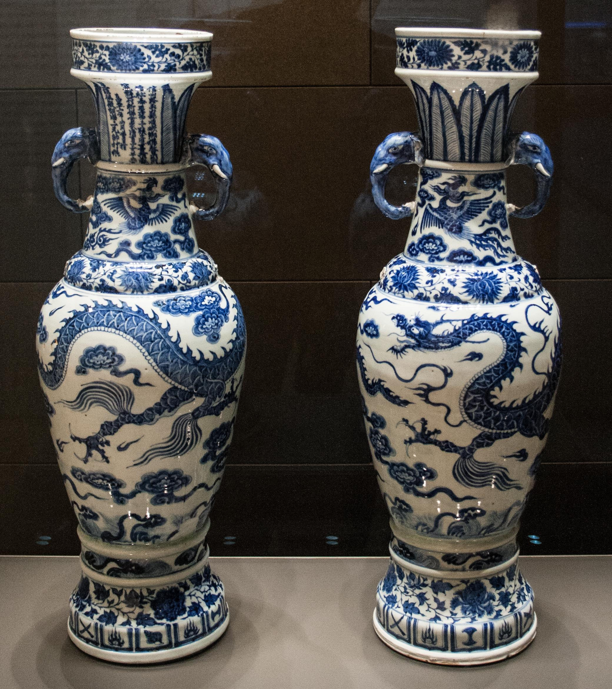
204. The David Vases
Yuan Dynasty, China
1350 CE
White porcelain and cobalt blue underglaze

Slide 44
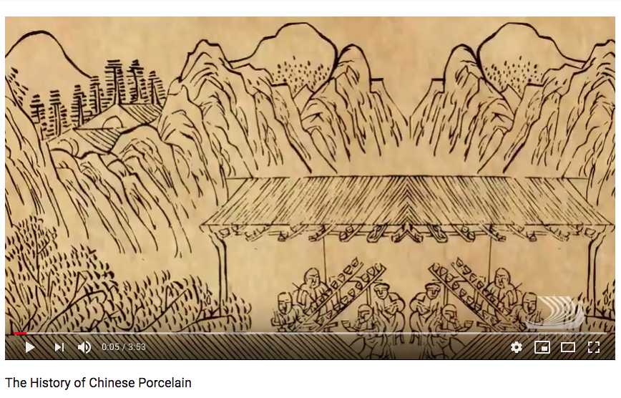
https://www.youtube.com/watch?v=vDwOZgl4rH8 5:00

Slide 45
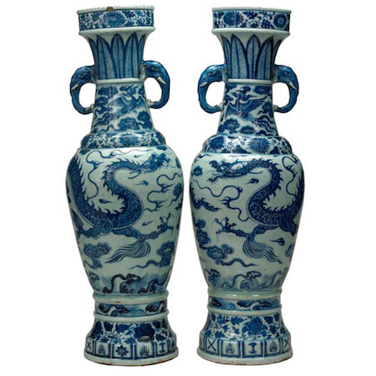

Slide 46
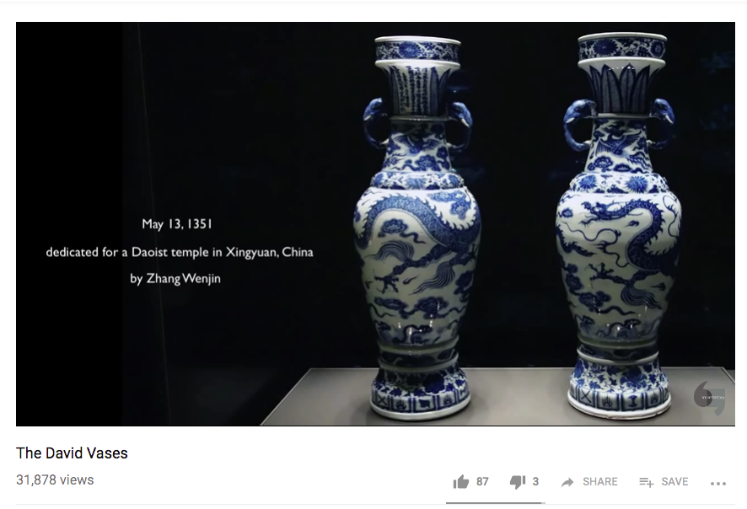
https://www.youtube.com/watch?v=lfIHzumEghQ 5:00

Slide 47
Form | Function | Content | Context
vases modeled after bronze forms | made for the altar of daoist temple, along with incense burner which has not been found | dedication on the side of the neck of the vases; believed to have been the earliest known blue/white porcelain dedication | one of the most important examples of blue and white porcelain
 |  | elephant head shaped handles | blue cobalt imported from Iran; Chinese expansion into west Asia makes this available
 |  | neck/feet show leaves and flowers | Named for Sir Percival David, a collector of Chinese Art
 |  | in the center, Chinese dragons with traditional long bodies and beards; dragons have scales and claws and are set in a sea of clouds

Slide 48
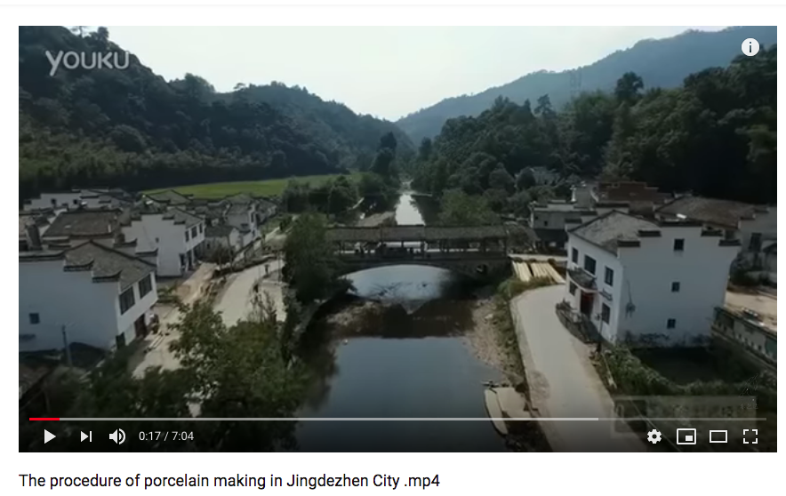
https://www.youtube.com/watch?v=Jn1Ho7enlbQ 7:00

Slide 49
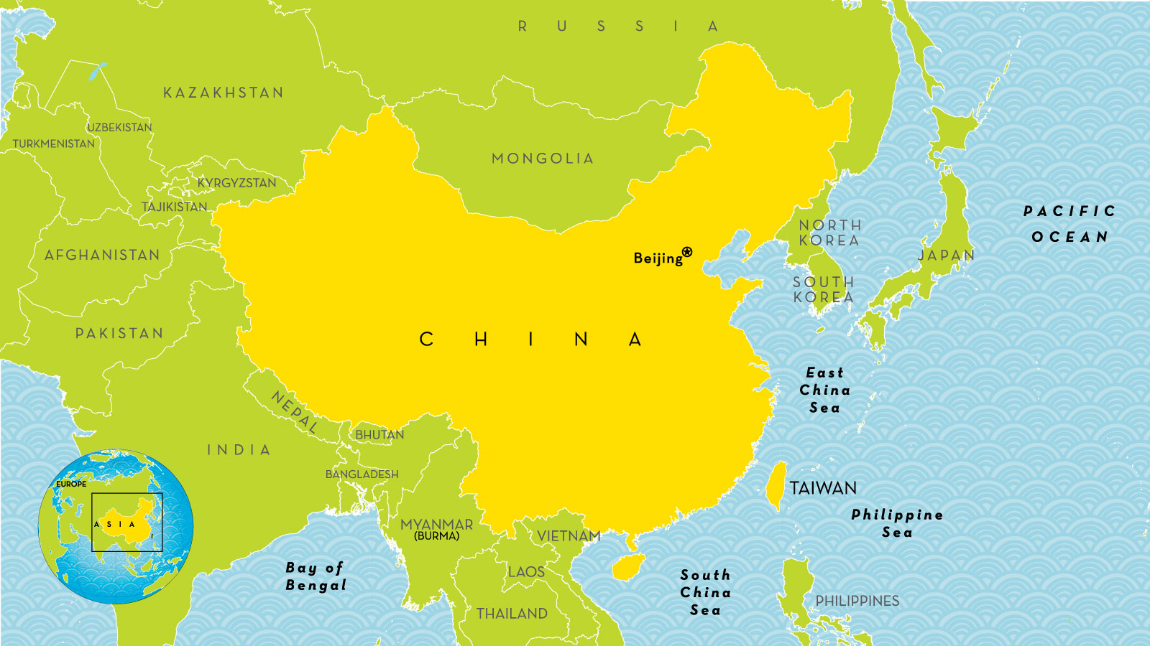

Slide 50
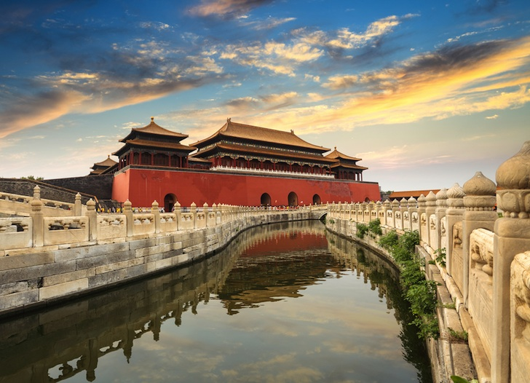
206. Forbidden City
Beijing, China
Ming Dynasty
1400 CE and later
Marble, brick, wood, tile

Slide 51
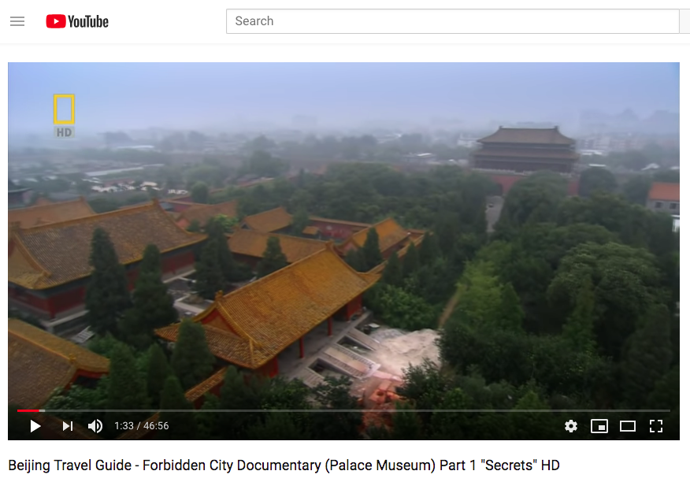
https://www.youtube.com/watch?v=sHypO2ISPas

Slide 52
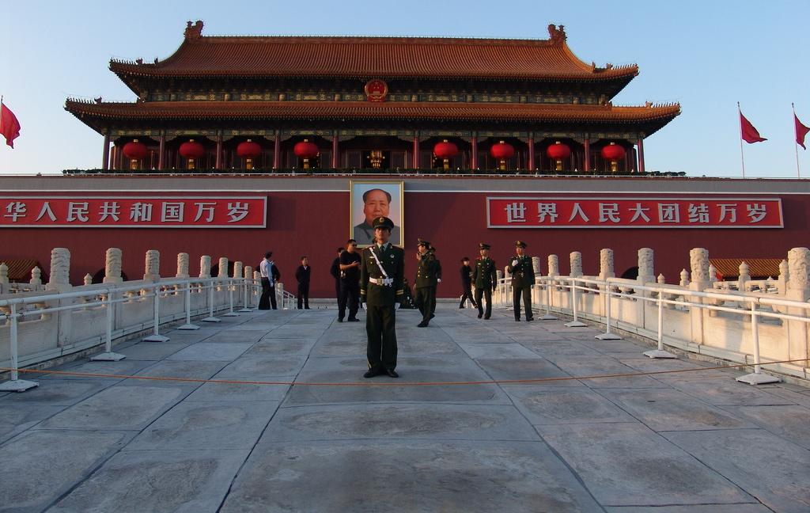
206. Forbidden City
Beijing, China
Ming Dynasty
1400 CE and later
Marble, brick, wood, tile
Front Gate
Notes:
Slide concept by William V. Ganis, PhD FOR EDUCATIONAL USE ONLY For publication, reproduction or transmission of images, please contact individual artists, estates, photographers and exhibiting institutions for permissions and rights.

Slide 53
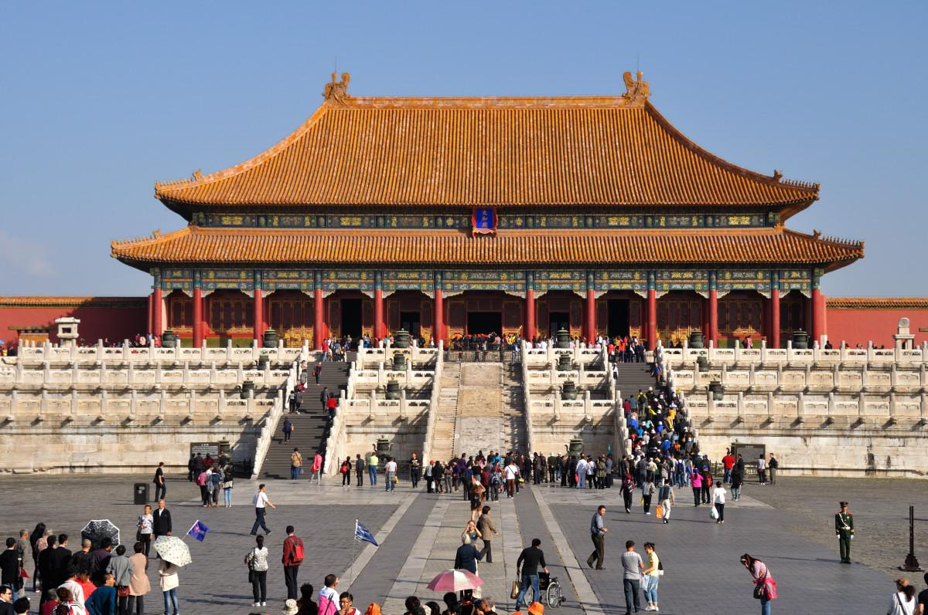
Hall of Supreme Harmony

Slide 54
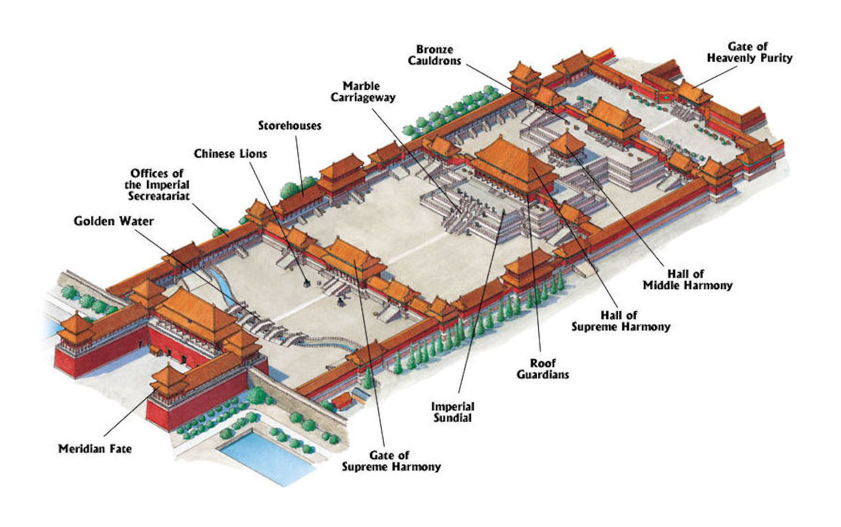

Slide 55
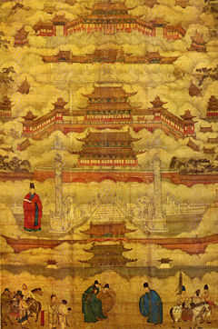
Built from 1406 to 1420
980 buildings that cover 7,800,000 sq. ft.
More than 100,000 artisans and craftsmen & Up to a million workers were involved in building creation
9,999 Rooms in the palace
Center of Chinese Politics for 500 years
The Forbidden City was home to home of 24 emperors – 14 of the Ming Dynasty and 10 of the Qing Dynasty
More than 90 Palace compounds
Surrounded by a moat 52 meters wide
Turned into a museum in 1925

Slide 56
https://www.youtube.com/watch?v=tPfYrmcfvYE

Slide 57
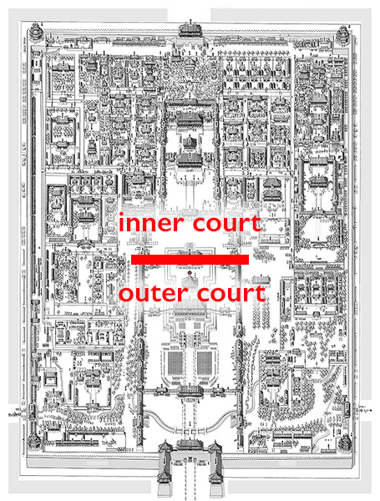

Slide 58
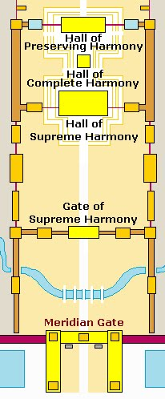
The southern half, or the outer court, contains spectacular palace compounds of supra-human scale. This outer court belonged to the realm of state affairs
Only men had access to its spaces. It included the emperor’s formal reception halls, places for religious rituals and state ceremonies, and also the Meridian Gate (Wumen) located at the south end of the central axis that served as the main entrance.

Slide 59
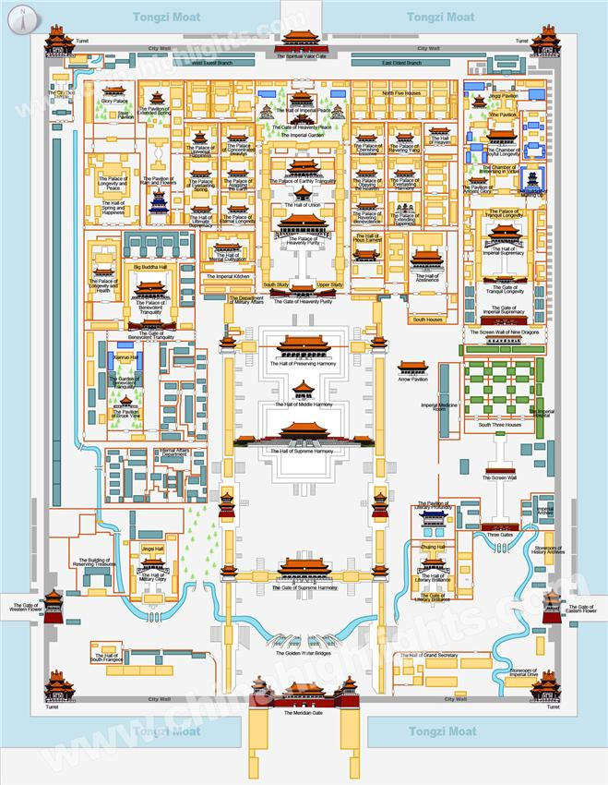
While the outer court is reserved for men, the inner court is the domestic space, dedicated to the imperial family. The inner court includes the palaces in the northern part of the Forbidden City. Here, three of the most important palaces align with the city's central axis: the emperor’s residence known as the Palace of Heavenly Purity (Qianqinggong) is located to the south while the empress’s residence, the Palace of Earthly Tranquility (Kunninggong), is to the north. The Hall of Celestial and Terrestrial Union (Jiaotaidian), a smaller square building for imperial weddings and familial ceremonies, is sandwiched in between.

Slide 60
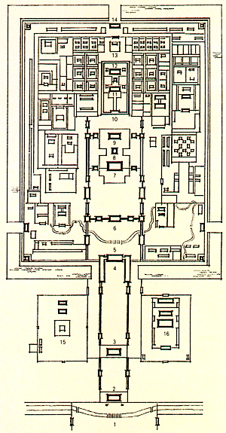

Slide 63
The Palace of Tranquility and Longevity

Slide 65
Form | Function | Content | Context
each corner of the rectangular plan has a tower representing the 4 corners of the world | seat of power of Chinese government; so named because only royal court could enter | 9,999 rooms; walls 30 ft high to keep people out (and in) | Largest and most complete Chinese architectural ensemble in existence
yellow tile roofs and red painted wooden beams placed on marble foundations unify the structures in the forbidden city into an artistic whole | meant for grand ceremonies- New Year, winter solstice, emperor’s birthday | Focus is the Hall of Supreme Harmony, the throne room and seat of power; wood structures made with elaborately painted beams;

Slide 66
212. Chairman Mao en Route to Anyuan
Artist unknown
Based on oil painting by Liu Chunhua
1969
Color Lithograph

Slide 67
https://www.youtube.com/watch?v=UUCEeC4f6ts

Slide 68
Chairman Mao en Route to Anyuan presents a critical moment in Chinese Communist Party history: Mao marching toward the coal mines of Anyuan, Jiangxi province in south-central China, where he was instrumental in organizing a nonviolent strike of thirteen thousand miners and railway workers. Occurring only a year after the founding of the Chinese Communist Party, the Anyuan Miners’ Strike of 1922 was a defining moment for the Chinese Communist Party because the miners represented the suffering of the masses at the heart of the revolutionary cause. Many of the miners enlisted as soldiers in the Red Army (the army of the Chinese Communist Party), intent on following the young Mao toward revolution.

Slide 69
During the Cultural Revolution (1966-76), artists focused on creating portraits of Mao, or “Mao paintings
In the early years of the Cultural Revolution, artists turned to a style known as socialist realism for creating portraits of Mao Zedong
Suitable for propaganda, socialist realism aimed for clear, intelligible subjects and emotionally moving themes.
Subjects often included peasants, soldiers, and workers—all of whom represented the central concern of Mao Zedong and the Communist Party
Modeled after works in the Soviet Union, paintings in this style were rendered in oil on canvas. They notably departed from Chinese hanging scrolls in ink and paper
Connecting the immortal realm with modern time

Slide 70
From the painting by Chen Yanning, Chairman Mao Inspects the Guangdong Countryside, 1972,
oil on canvas, 67 15/16 x 116 inches (Sigg Collection)

Slide 76
Quotations from Chairman Mao Tse-tung (simplified Chinese: 毛主席语录; traditional Chinese: 毛主席語錄; pinyin: Máo Zhǔxí Yǔlù) is a book of selected statements from speeches and writings by Mao Zedong (Mao Tse-tung), published from 1964 to about 1976 and widely distributed during the Cultural Revolution.
-Chinese people were essentially required to own it…

Slide 80
Form | Function | Content | Context
dominated by pictorial representation | propaganda | posterlike; vivid colors; dramatic and obvious political message | Painted during the cultural revolution of 1966-1976; high art was dismissed as bourgeois
 |  | depicts a moment in the 1920’s; Mao travels to Anyuan to lead a miners’ strike | art was done anonymously; seeking artistic fame was seen as Western and degenerate
 |  |  | Mao worked for reform for miners; supported a local strike for better wages, education, working conditions
 |  |  | May be the most reproduced image ever made; 900,000,000 copies were generated

Slide 81
Notes:
Slide concept by William V. Ganis, PhD FOR EDUCATIONAL USE ONLY For publication, reproduction or transmission of images, please contact individual artists, estates, photographers and exhibiting institutions for permissions and rights.

Slide 82
Crown from tomb 98
Hwangnamdong, Korea
5-6th century gold 10 3/4 in. high
Notes:
Slide concept by William V. Ganis, PhD FOR EDUCATIONAL USE ONLY For publication, reproduction or transmission of images, please contact individual artists, estates, photographers and exhibiting institutions for permissions and rights.

Slide 84
In the fifth and sixth centuries, the Korean peninsula was divided between three rivaling kingdoms
The most powerful of these was the Silla kingdom in the southeast of the peninsula
Notes:
Slide concept by William V. Ganis, PhD FOR EDUCATIONAL USE ONLY For publication, reproduction or transmission of images, please contact individual artists, estates, photographers and exhibiting institutions for permissions and rights.

Slide 87
Because of the fragile gold construction some believed that these crowns were made specifically for burial
recent research has revealed that they were also used in ceremonial rites of the Silla royalty during the Three Kingdoms Period 57 B.C.E. - 676 C.E.
Prior to the adoption of Buddhism, Koreans practiced shamanism
In this crown, three tree-shaped vertical elements evoke the sacred tree that once stood in the ritual precinct of Gyeongju
This sacred tree was conceived of as a “world tree,” or an axis mundi that connected heaven and earth.
Notes:
Slide concept by William V. Ganis, PhD FOR EDUCATIONAL USE ONLY For publication, reproduction or transmission of images, please contact individual artists, estates, photographers and exhibiting institutions for permissions and rights.

Slide 88
Attached to the branch-like features of the crown are tiny gold discs and jade ornaments called gogok. These jade ornaments symbolize ripe fruits hanging from tree branches, representing fertility and abundance

Slide 90
Form | Function | Content | Context
antler forms influenced by shamanistic practices in Siberia | crown; limited use, perhaps just for burial | light weight | Uncovered in royal tomb
 |  | symbolizes geometric trees | These have no precedence in China and are based on Siberian forms
 |  | Symbolic of trees and antlers, representing life and power | Shows power and wealth the Korean kingdoms
 |  |  | demonstrates their ability as craftsmen & ideas pass on through the silk road

Slide 91
205. Portrait of Sin Sukju.
Imperial Bureau of Painting
1400 CE
Ink and color on silk
Hanging scroll

Slide 92
205. Portrait of Sin Sukju.
Imperial Bureau of Painting
1400 CE
Ink and color on silk
Hanging scroll
-Hanging Scroll
-The subject is depicted in a classic Korean style: Full length, head slightly turned, one ear showing, Simple lines and color depict the gown, while his elbows rest on the arms of a cabriole-style chair
-Golden Flowers & Peacocks on his chest is a status symbol: This symbol is called a rank badge
Peacocks = Authority
-His rank badge indicates he was a civic official
-In classic Korean portraiture, much of the subject is created according to classic conventions, but the facial features are depicted with the intent to capture the unique physical likeness of the subject
-Careful attention to the wrinkles and bone structure are given

Slide 94
Look carefully and you might notice the wrinkles around the edges of Sin Sukju’s eyes (“crow’s feet”). His thin, almond-shaped eyes are bright and clear, and his mouth is surrounded by deep grooves where his moustache meets his chin. His solemn visage exudes wisdom and dignity

Slide 95
205. Portrait of Sin Sukju.
Imperial Bureau of Painting
1400 CE
Ink and color on silk
Hanging scroll
-Representative of the types of artwork featured in family shrines
-The portrait is inspired by Confucianism
-Confucianism started in China but traveled through Asia by means of the silk road
Lets learn a bit more about Confucianism

Slide 96
https://www.youtube.com/watch?v=OT4uvY5K17k

Slide 97
This piece is a reflection of Korean culture, in family structure, in political propaganda and religious influence

Slide 98
Form | Function | Content | Context
Emphasis on figure only- no background or setting | Hanging scroll |  | Korean prime minister (1461-1475) and soldier
 | portrait | insignia designed with clouds and wild geese reflect his military rank | portrait made when he was a second grade civil officer
 |  |  | repainted over the years, esp in 1475 when he died
 |  |  | Korean portraits emphasize how the subject made a great contribution to the country and how the spirit of loyalty to king and country was valued by Confucian philosophy

