Slide 2
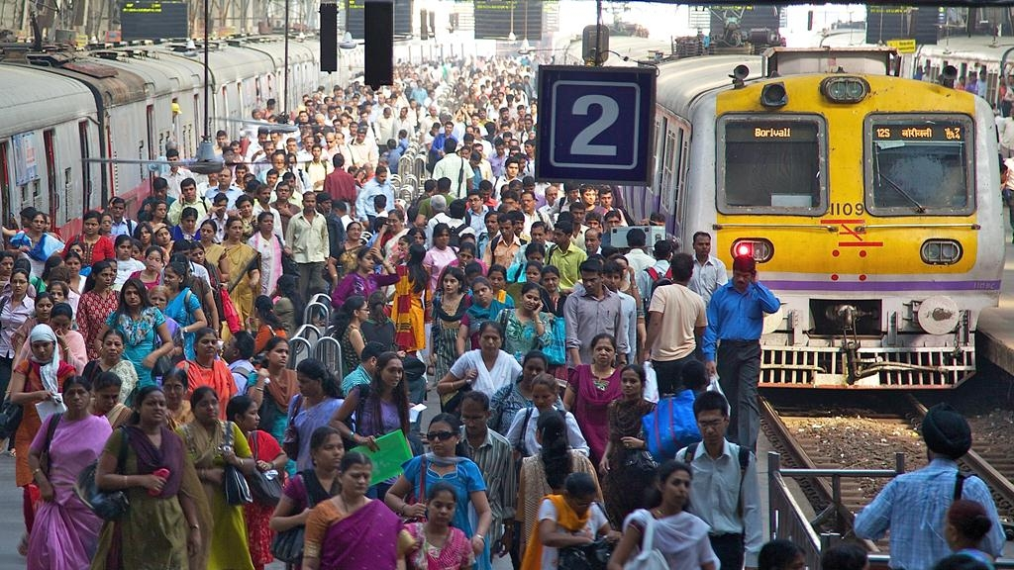

Slide 3
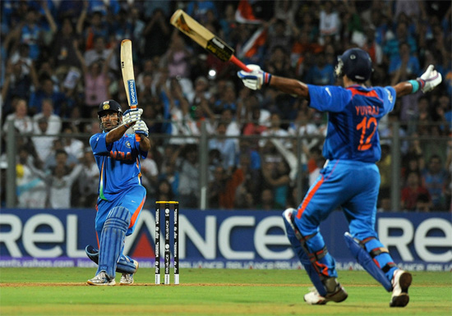

Slide 4
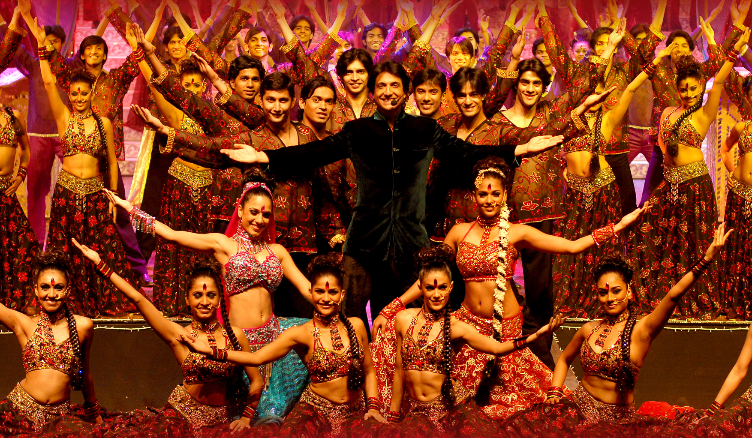

Slide 5
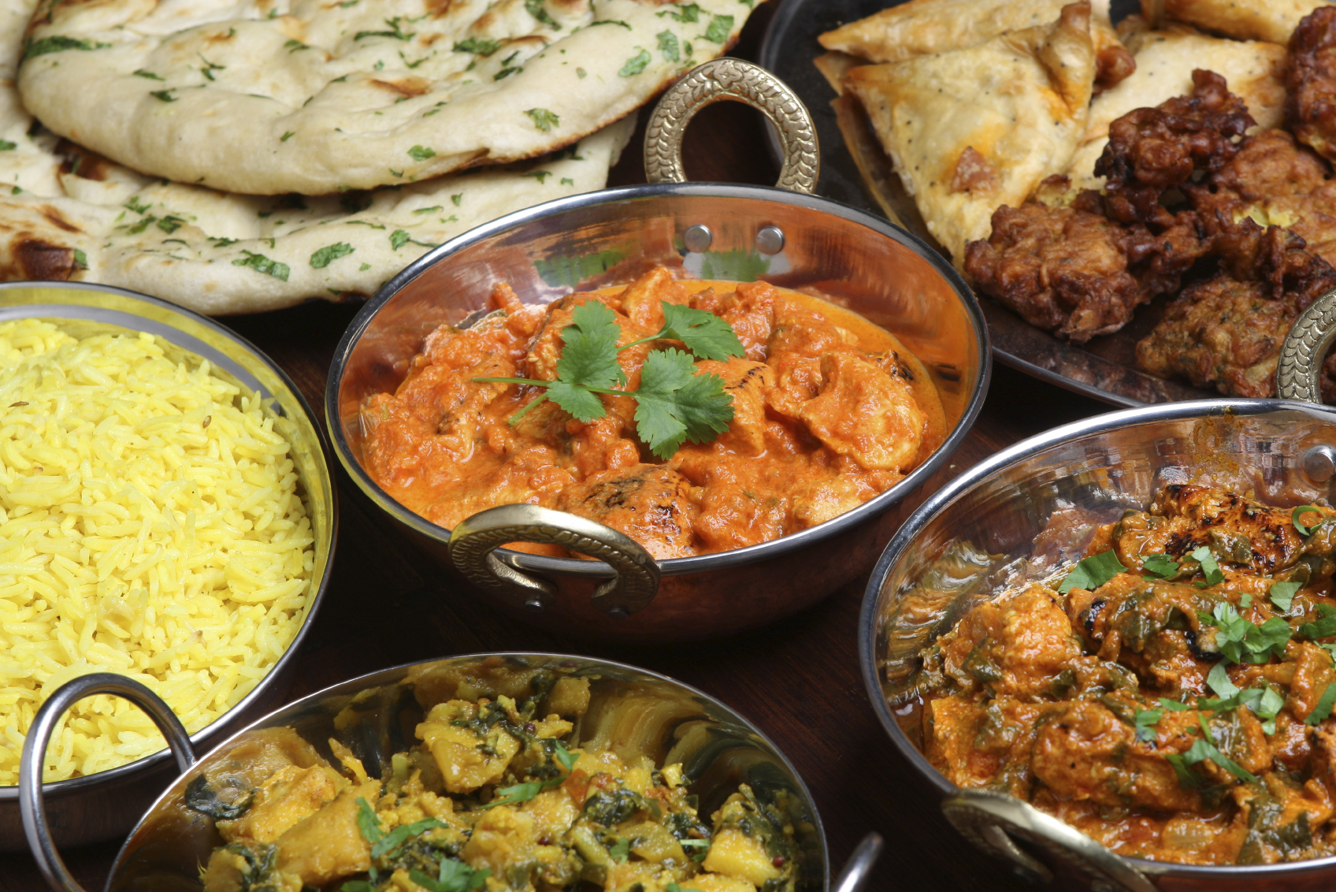

Slide 6
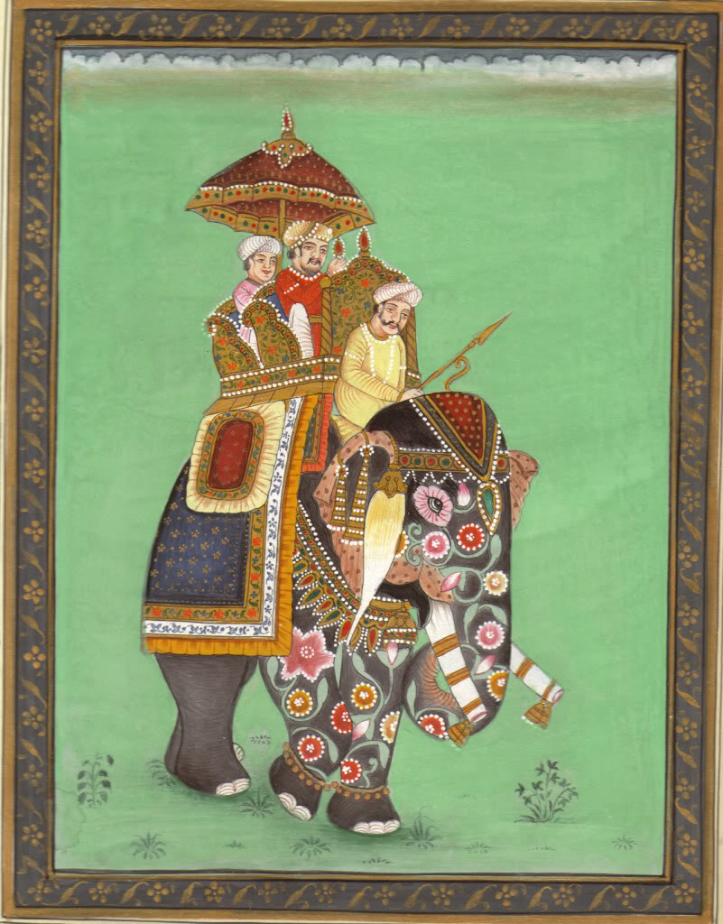
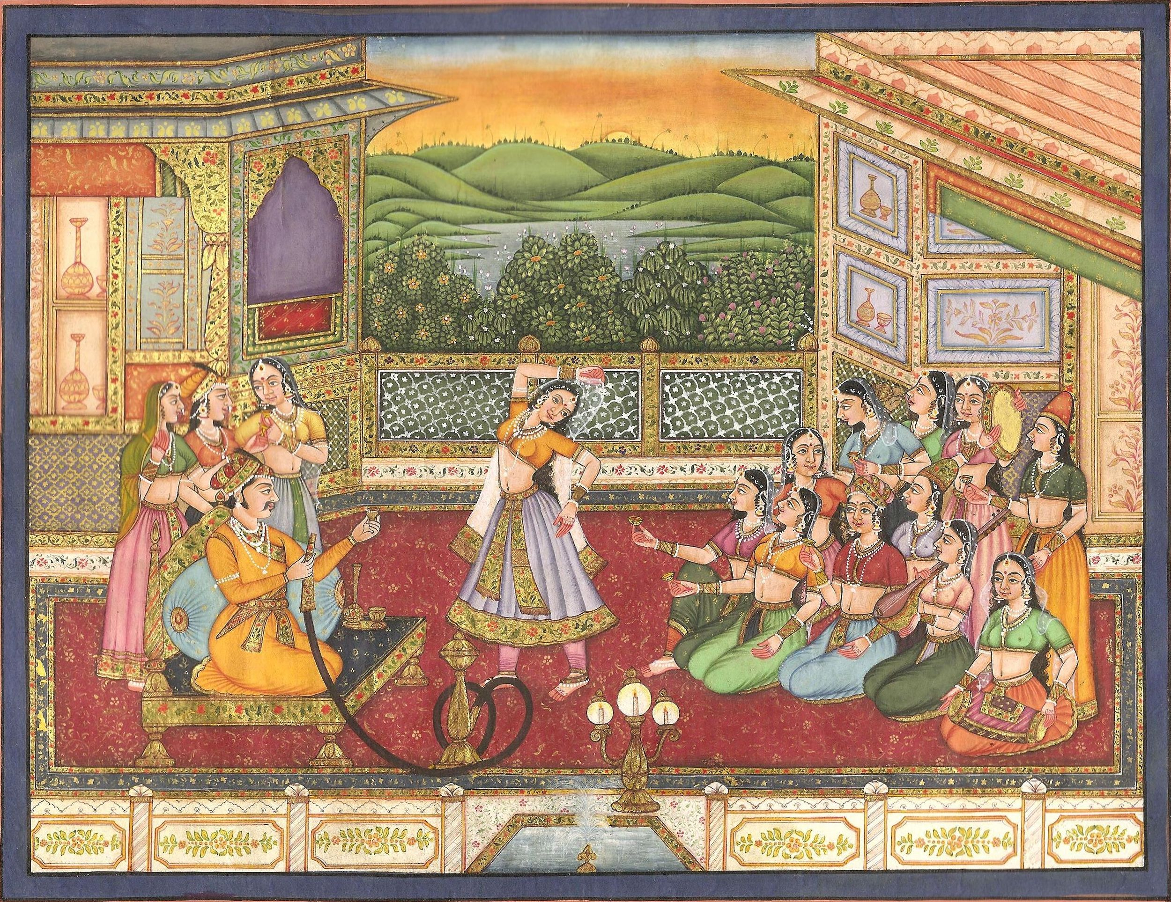
Miniature Paintings

Slide 9
MUGAHL = Persian Arabic word for Mongols

Slide 10
The Mughals are not Mongolians, though though do have decedents from that lineage
Mughals…. Mongols…. Its only a matter of time

Slide 11
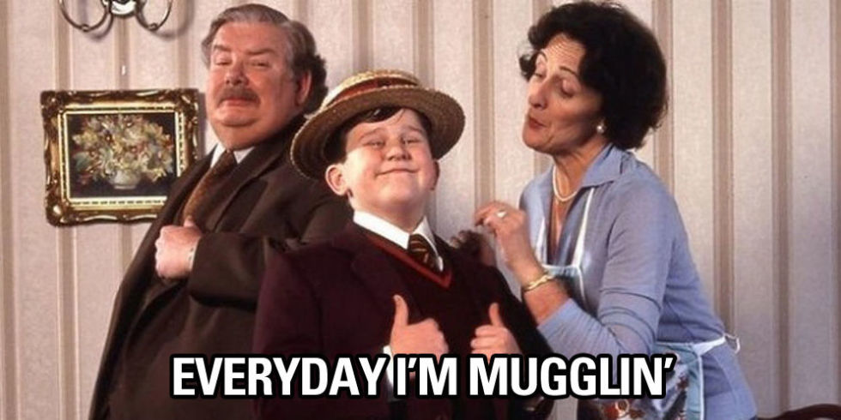
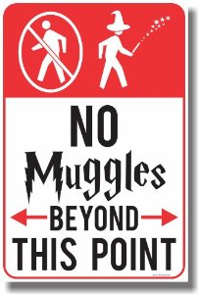
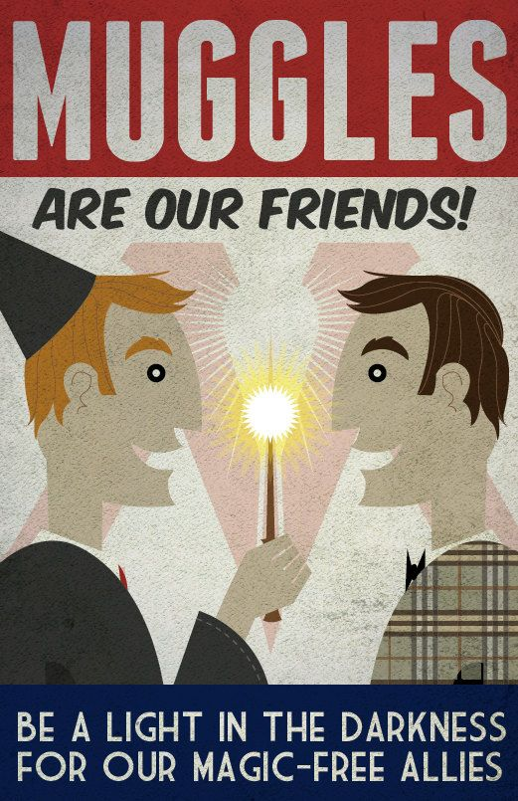

Slide 12
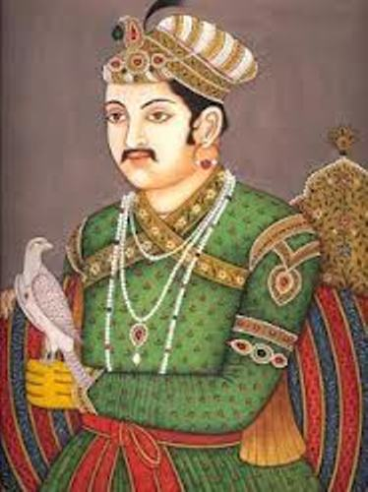
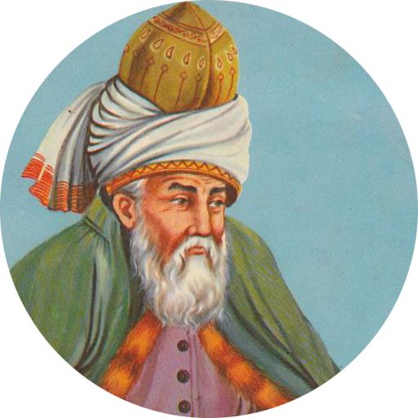
Akbar:
3rd Emperor of the Mughal dynasty
Having no heir, at age 28, he consulted with a Sufi
(an Islamic mystic),
Shaikh Salim, who assured him a son would come.
His son Salim was soon born

Slide 13
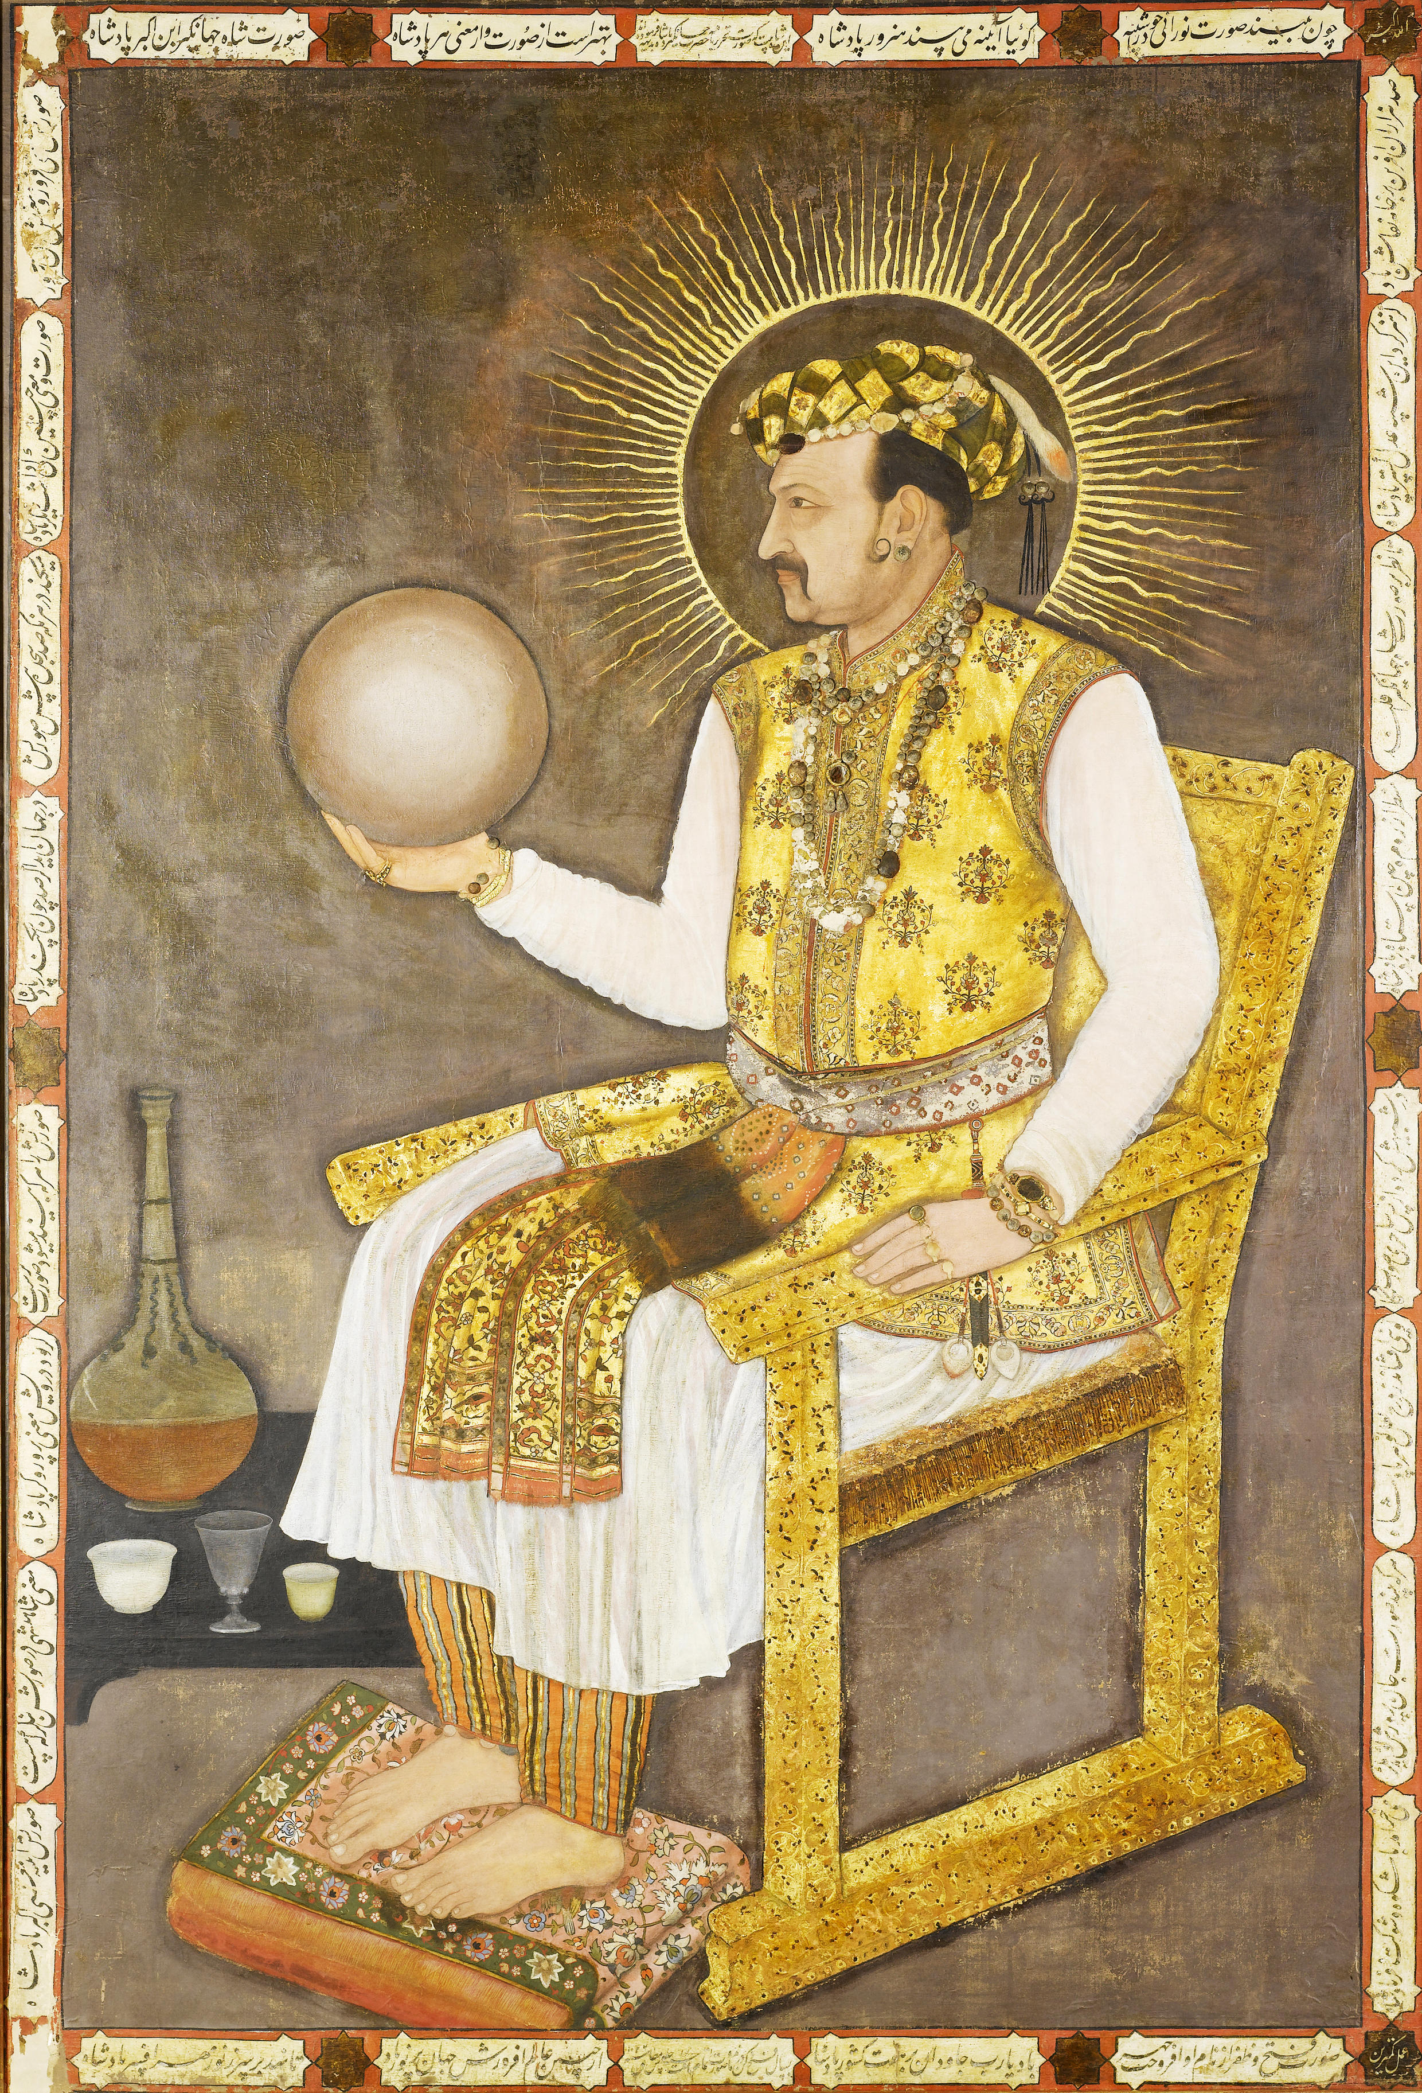
Upon his ascent to the throne in 1605, Prince Salim decided to give himself the honorific title of
Nur ud-Din
(“Light of Faith”)
and the name Jahangir
(“Seizer of the World”).

Slide 14
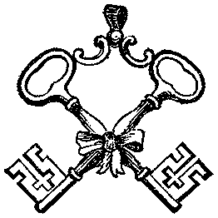
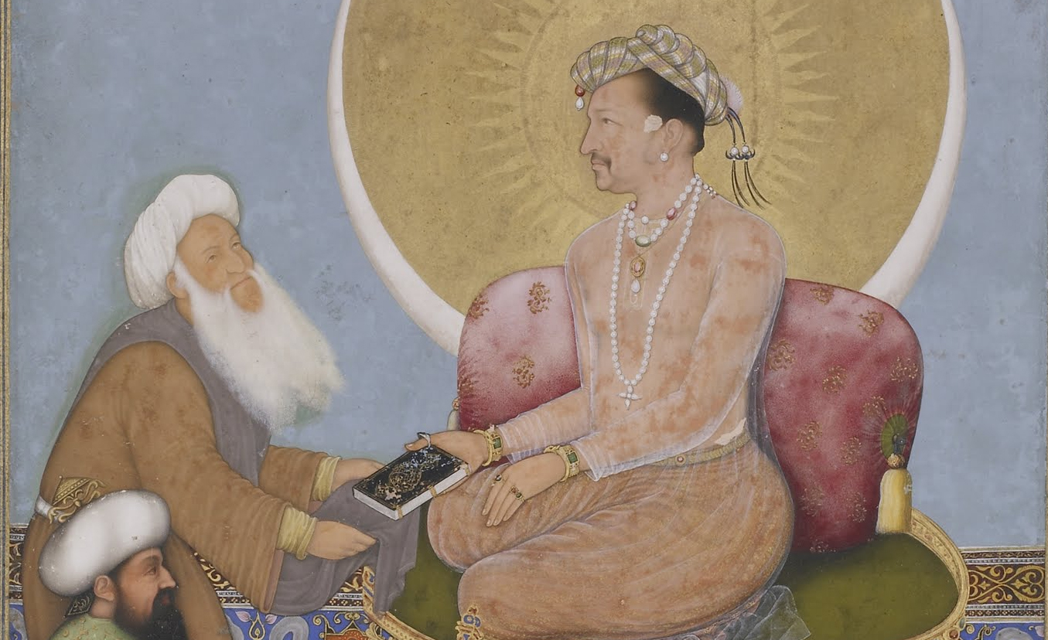
208. Janhangir Preferring a Sufi Shaaikh to Kings
Bichtir (artist) 1620 CE
Watercolor, gold, and ink on paper

Slide 15
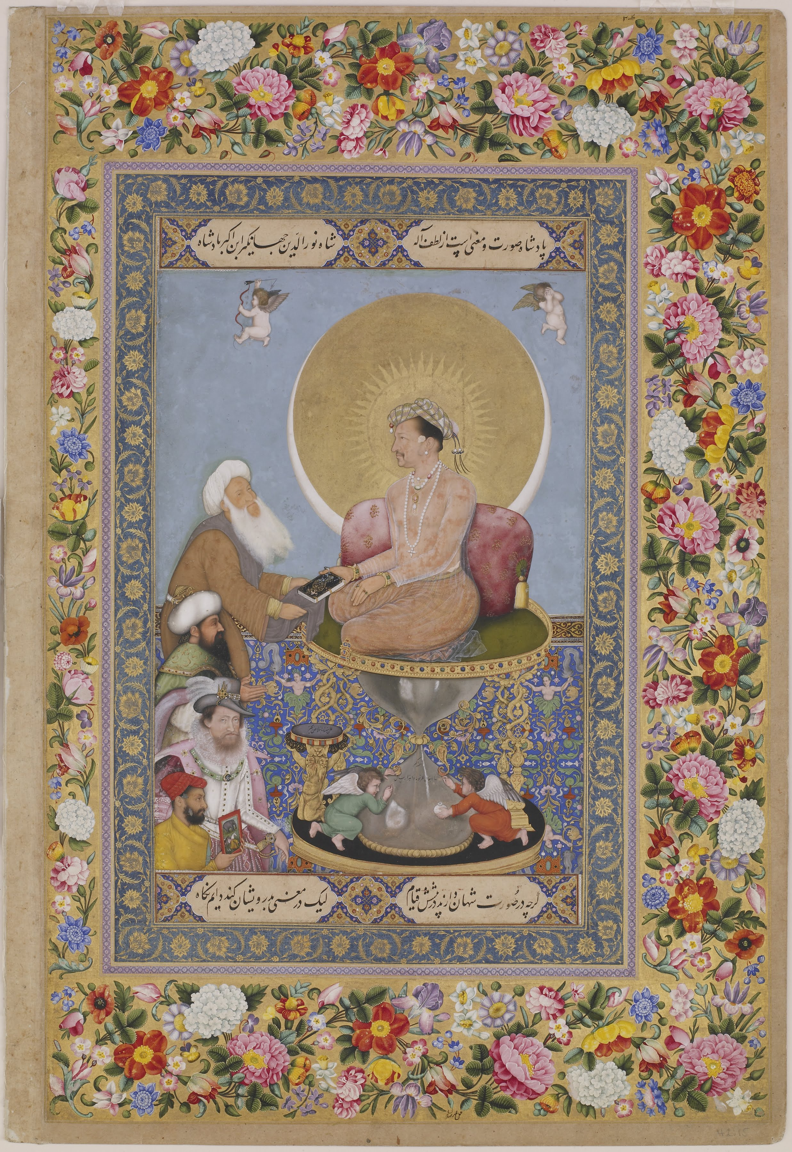
208. Janhangir Preferring a Sufi Shaaikh to Kings
Bichtir (artist) 1620 CE
Watercolor, gold, and ink on paper

Slide 16
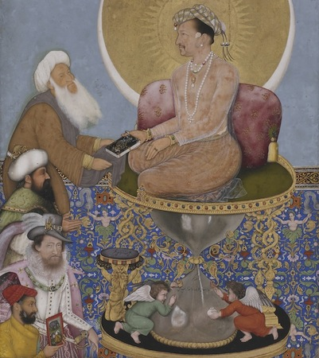
208. Janhangir Preferring a Sufi Shaaikh to Kings
Bichtir (artist) 1620 CE
Watercolor, gold, and ink on paper
A Miniature Painting
Flames of Gold Radiate from the emperors head against a larger darker gold disc
A slim crescent moon huge the bottom of the disc, creating a harmony between sun/moon or night/day. Symbolizing divine truth
The Emperor is the largest of the figures, another representation of his power and honor

Slide 17
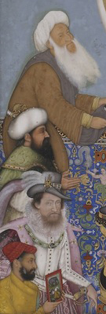
208. Janhangir Preferring a Sufi Shaaikh to Kings
Bichtir (artist) 1620 CE
Watercolor, gold, and ink on paper
Jahangir faces four Men
At the top is Sufi Shaikh, who accepts a gifted book. This is a statement about Jahangirs spiritual learnings
Below Shaikh, we have the Ottoman Sultan
The third standing figure is identified as King James I of England. His appearance and posture seem a bit uneasy
Lastly, we have Bichitr, the artist who created this miniature painting
shown wearing an understated yellow jama (robe) tied on his left, which indicates that he is a Hindu in service at the Mughal court—a reminder that artists who created Islamic art were not always Muslim.

Slide 18
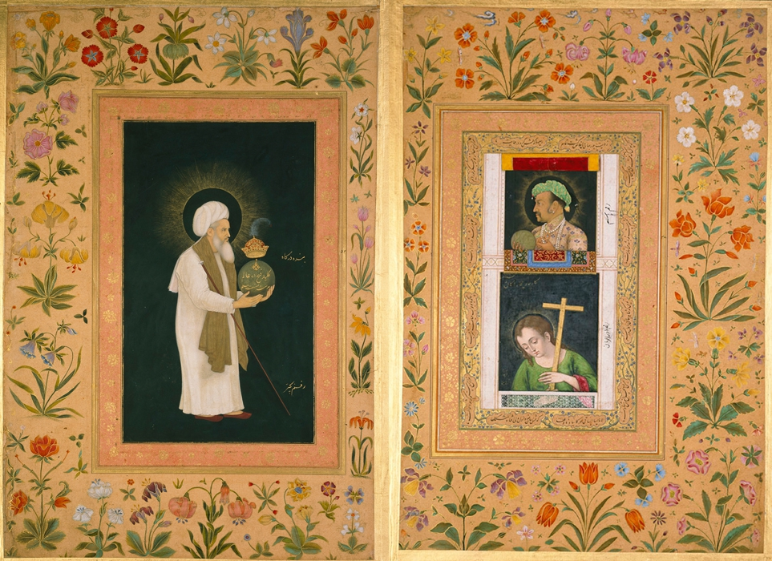
208. Janhangir Preferring a Sufi Shaaikh to Kings
Bichtir (artist) 1620 CE
Watercolor, gold, and ink on paper
This miniature folio was once a part of a muraqqa', or album, which would typically have had alternating folios containing calligraphic text and painting

Slide 19
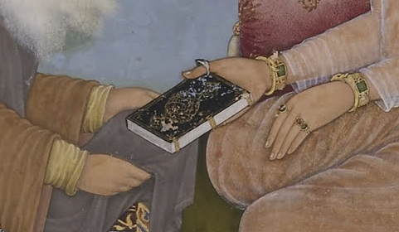

Slide 20
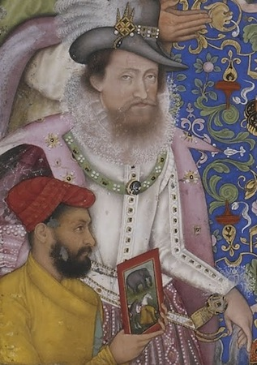
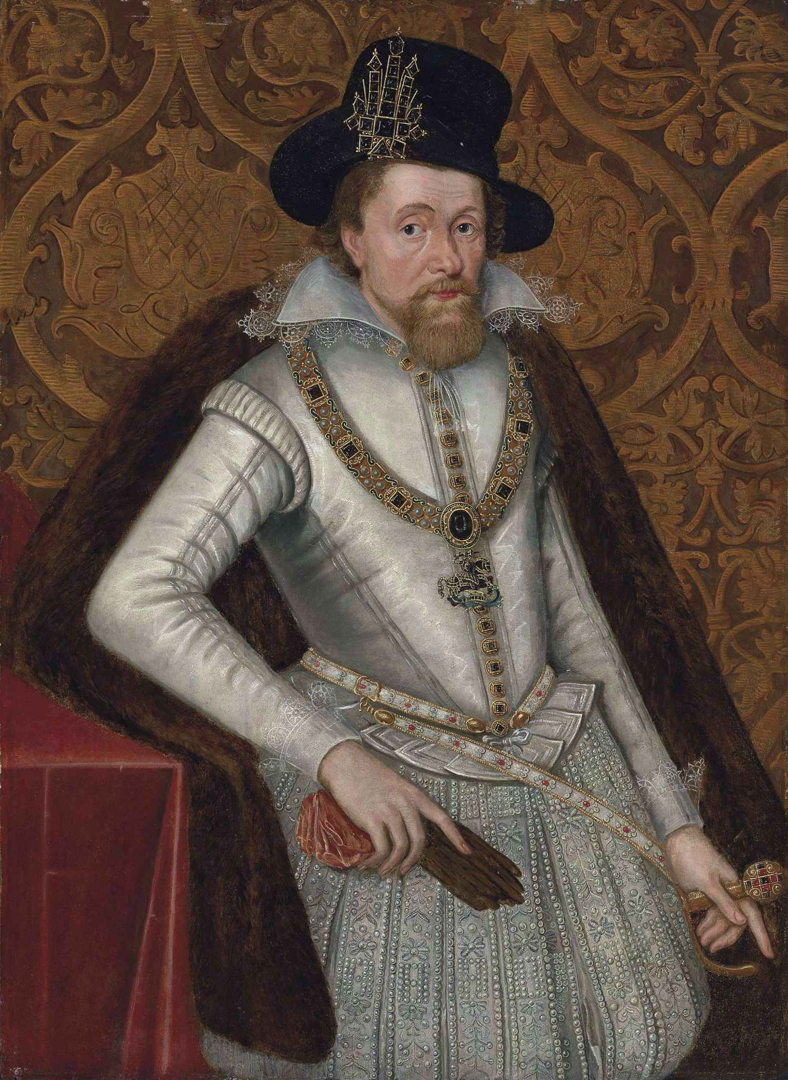

Slide 21
