Slide 1
Roman Empire Early to Middle Periods

Slide 2
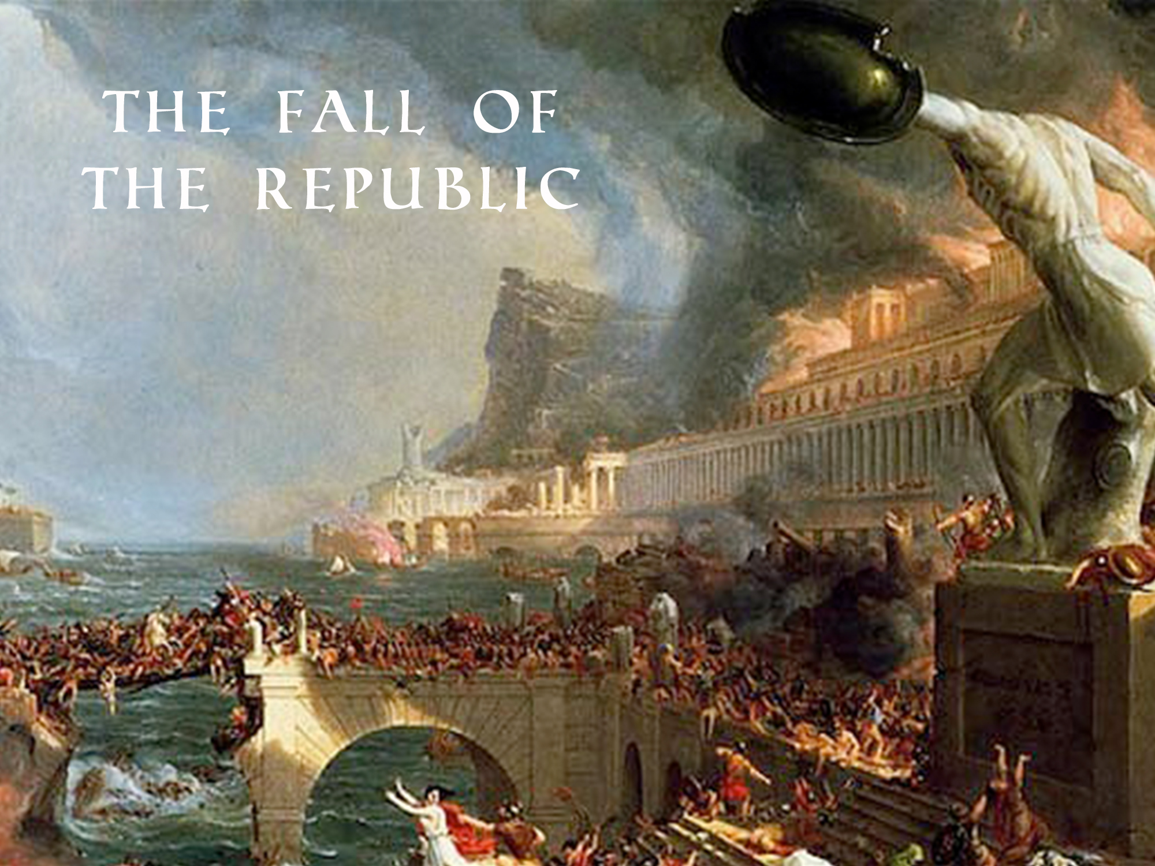

Slide 3
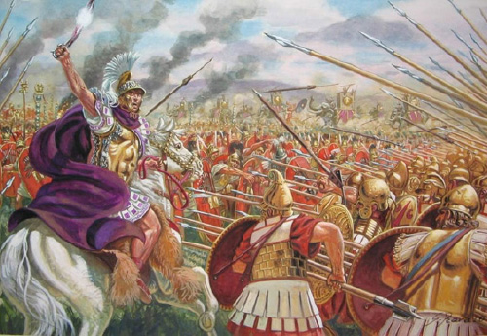

Slide 4
GREAT ARMIES ABROAD
The Armies of the Romans continue to sweep across the Mediterranean and beyond
Despite great military success, there are many problems at home in Rome

Slide 5
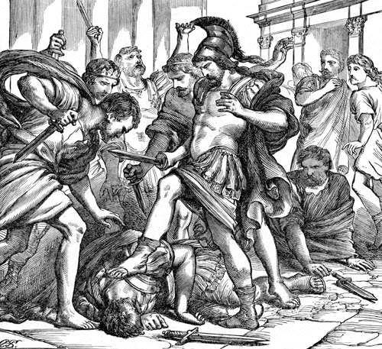

Slide 6
RICH vs. POOR
Dishonest Officials in Rome begin to gain and abuse power in the Senate
Money is stolen from the People
Patricians begin to expand their power in the city
Cities are growing over populated.

Slide 7
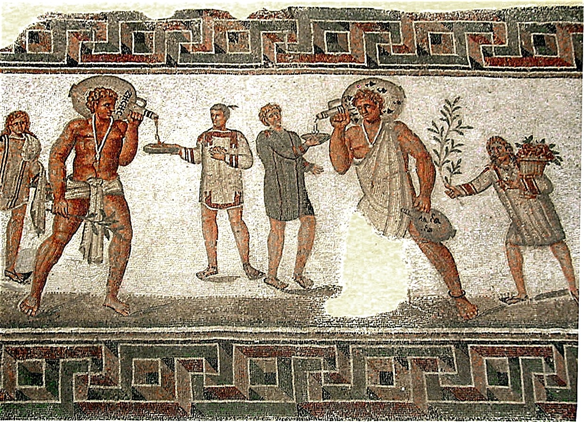
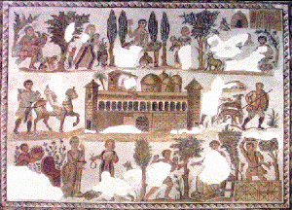
Latifundia: A Patricians Farm
The Patricians were land owners. They used this land to create large farms.
Patricians began to work their farms with slaves taken from military conquest
This not only put freemen out of work, but it also put small farms out of business

Slide 8
Latifundia: A Patricians Farm
Small farmers cant compete
They couldn’t pay their debts and have to give up their businesses
This force these farmers to leave the country and come to the city
Work was difficult to come by and overcrowding continued
Anger Spreads….

Slide 9
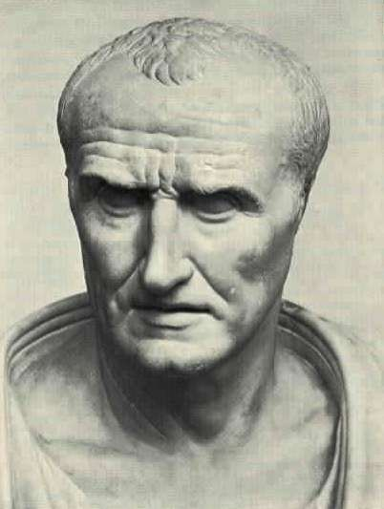
Consul Marius – A change in Strategy
Old way: Farmers were soldiers.. But there are no more farming class
New Way: Marius recruits the Poor…
He pays them and promises them LAND..
What’s the problem with this…?
It requires more expansion
This creates more tension

Slide 10
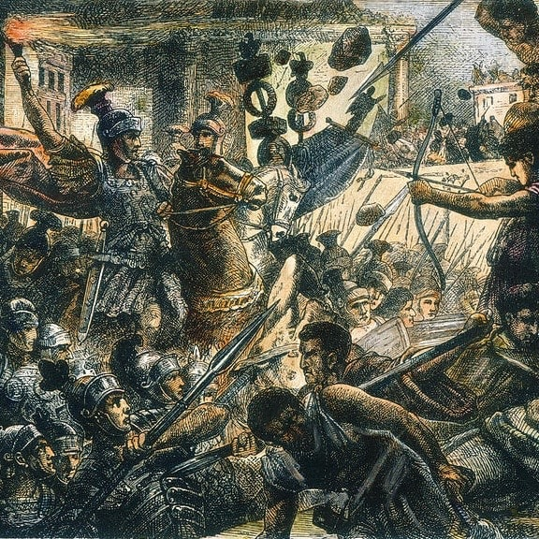
Consuls Collide! 82 BC
Marius is Challenged by Sculla
Sculla Wins
He strengthens the senate and then steps down.
He thinks this will Strengthen the Republic… but it does the opposite and civil war breaks out…
FOR 50 YEARS!

Slide 11
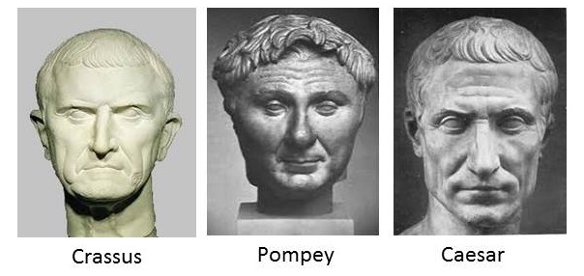
TRIUMVIRATE

Slide 12
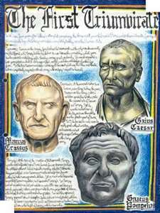
The First TRIUMVIRATE
Eventually 3 civic leaders team together and create an alliance. This is a Triumvirate
Caesar becomes popular and this scares Pompey & Crassus.
Crassus is killed in battle and the Senate names Pompey the dictator

Slide 13
The First TRIUMVIRATE
The Senate calls for Caesar to return in 49 BC.
Because of the fears of Roman leadership he knows he will imprisoned if he surrenders…
So Caesar returns with the 13th legion… (that’s the awesome name Romans gave their armies!)

Slide 14
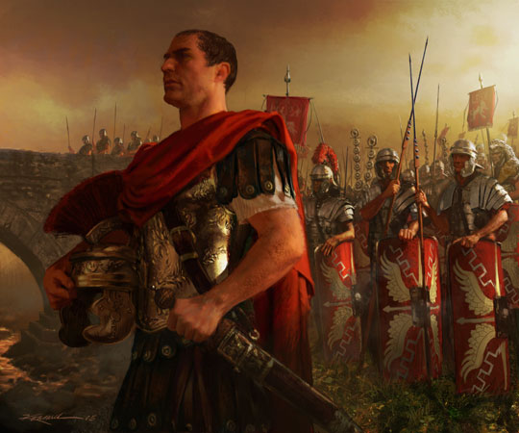
“The Die is Cast”

Slide 15
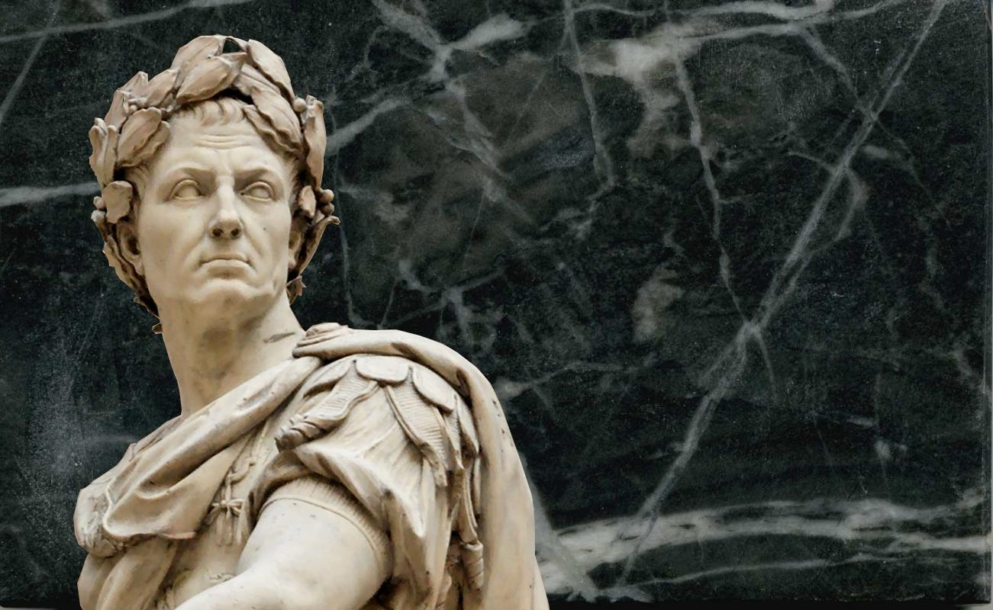
JULIUS CAESAR
Caesar defeats Pompey, declares himself dictator…
Goes against tradition and declares his reign will be for life
He fills the senate with allies
Despite this the ruling class
are still unease of Caesars
power

Slide 16
JULIUS CAESAR
Caesar combats this by making reforms…
-He gives citizenship to territorial Romans (not on the peninsula)
-Provides colonies for the
landless and jobless
- Orders land owners to hire
freemen to work on farms

Slide 17
JULIUS CAESAR
This made him very popular with the lower class people
But, this also made the Senate even more concerned the Caesar would try to become a king…

Slide 18
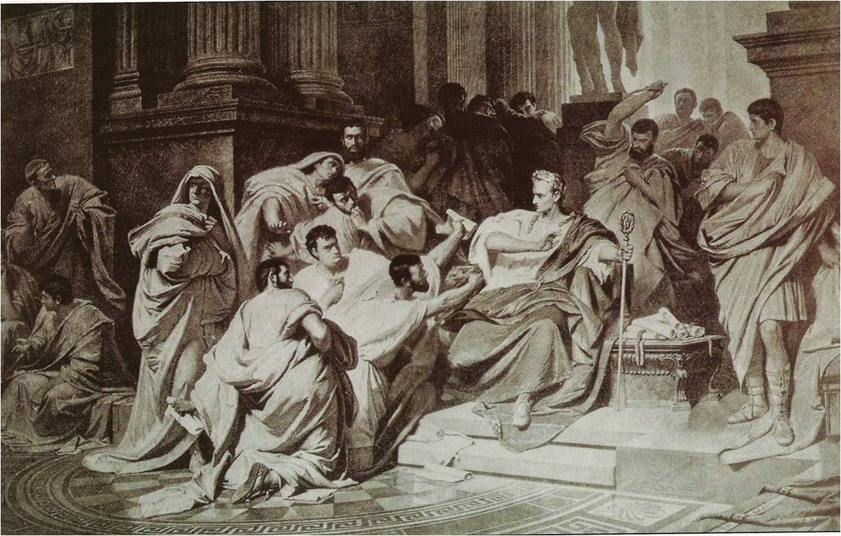
“Beware of the Ides of March…”

Slide 22
Key dates
Republic period 700 BCE- 100 BCE
Civil war period 100 BCE-50 BCE
Early empire 50 BCE-100 CE
High empire 100 CE-200 CE
Late empire 200-400 CE

Slide 23
Themes
Previous
Now
Mesopotamians= Power Military, power over enemies
Egyptians=Power over death, life after death, power of Pharaoh to maintain cosmic balance
Minoans= love of nature
Mycenaeans= power over enemies
Archaic Greeks=Quest for Naturalism
Classical Greeks= Quest for the Ideal
Hellenistic Greeks=Raw emotion- what it means to be human
Roman Republic=
Pragmatism
Work
Aristocracy
Ancestor worship
Concrete!
Roman Empire
Conspicuous consumption
Power/ propaganda
Size

Slide 24
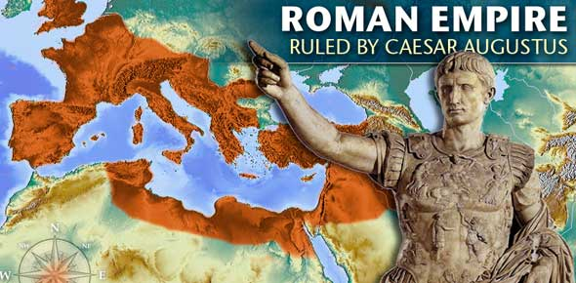

Slide 25
Sculpture from Republic to empire
Republic
Empire
the most highly valued traits included a devotion to public service and military prowess, and so Republican citizens sought to project these ideals through their representation in portraiture
The overall effect of this style gave Republican ideals physical form and presented an image that the sitter wanted to express.
Veristic
Propaganda
emphasized the youth, beauty, and benevolence of the new dynastic family
Classicizing idealization in portraiture allowed emperors to emphasize their loyalties to the imperial dynasty, and even legitimize their authority by visually linking themselves to their predecessors.

Slide 26
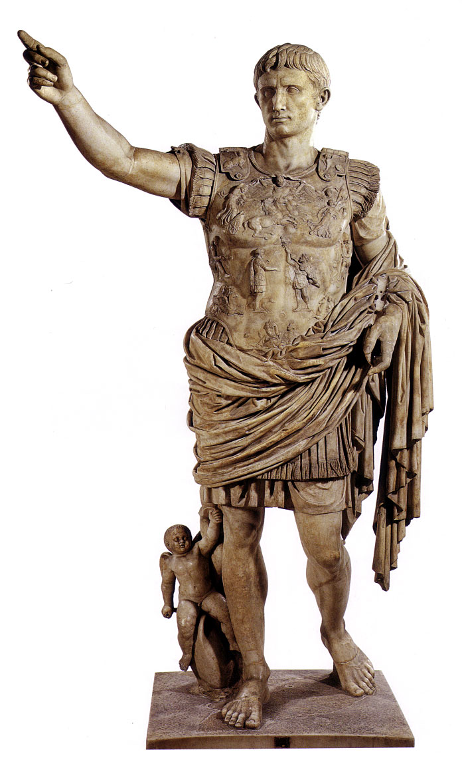
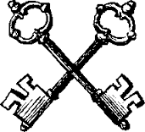
Augustus of Primaporta Roman early Empire 20 BCE
Marble
-Copy of original, many many copies were distributed around the empire
-Augustus was the son of Octavian who defeated Antony and Cleopatra thus making him the “First Among Equals;” not an Emperor.
-Depicted as a young leader even when he was near death
-Very subtle cues about his power and abilities; armor marks him as a warrior, robes mark him as a civic leader; orator pose

Slide 27
Augustus of Primaporta Roman early Empire 20 BCE Marble
-The small cupid gives reference to Augustus' divinity. His heritage could be traced back to Venus who was the mother of Cupid.
-Idealized-no longer realistic
-Similar stance to "Doryphorus" (the Spear Bearer)- contrapposto
-no weapon but armor
-barefooted=god
-on the armor the story of the retrieving of a standard
Themes- Peace, Propaganda, Emperor as Rome

Slide 28
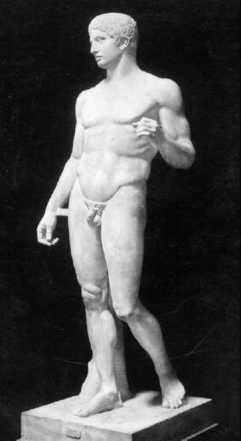

Slide 29
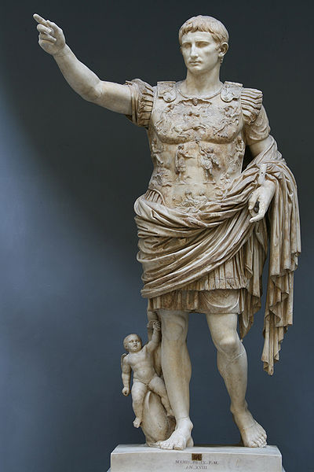
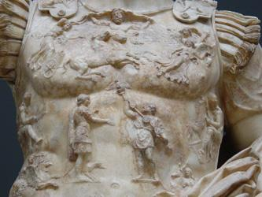

Slide 30
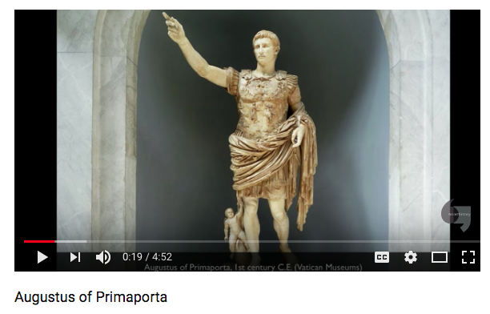
https://www.youtube.com/watch?v=3i8iou6tXqY 5:00 Min

Slide 31
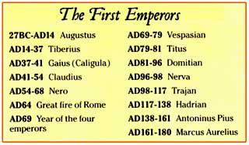
Before We Get to Far Ahead of Ourselves

Slide 34
Have you ever been “Yoinked”?

Slide 39
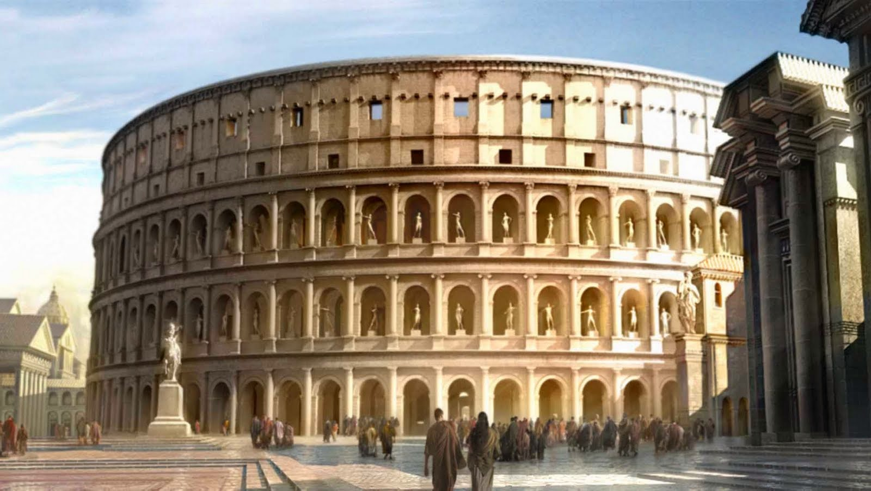

Slide 40
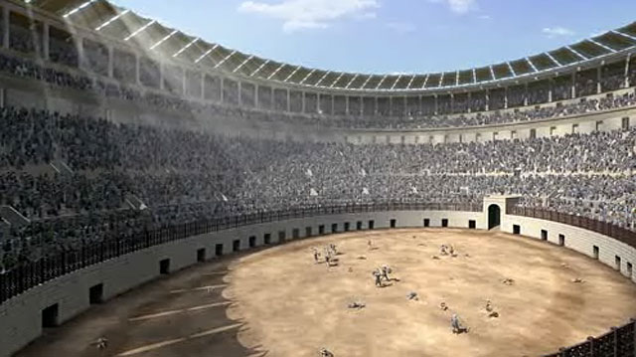

Slide 41
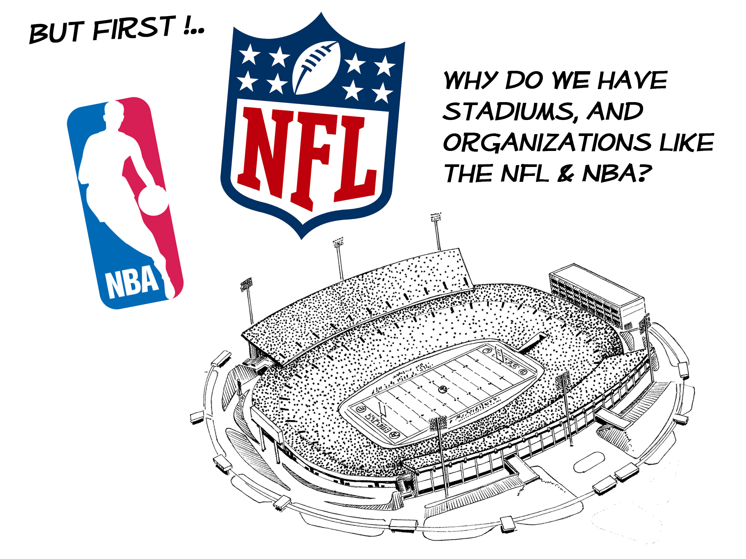

Slide 42
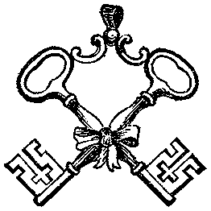
Coliseum or the Flavian Amphitheater Roman early empire 100 CE Key Piece
Was built under the direction of Vespasian and known as the Flavian Amphitheater
-Built on a man-made lake that had been constructed by Nero for his gardens. This was now public property again.
-Was named because it was close to a large statue of Nero called Colossus
-Built to house the gladiators
-Constructed with concrete barrel vaults-the arches were weight-bearing
-The columns are built in progressive order starting with Doric on the ground floor and ending at Corinthian (columns had no weight-bearing function).
-Under the floor were storage rooms and cages for the animals.
-Originally had a roof that could be added or taken away when needed
Bread and Circus (from Latin: panem et circenses) to mollify the public

Slide 43
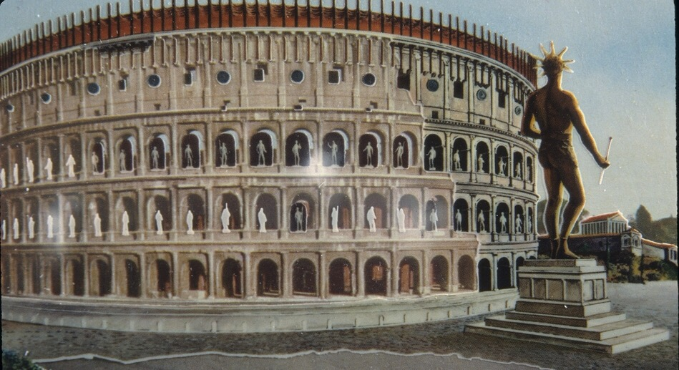

Slide 44
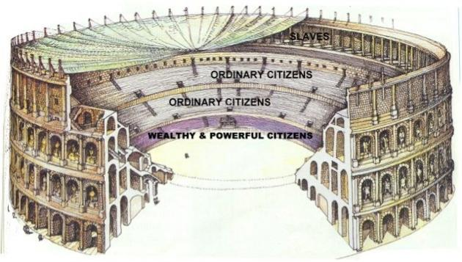

Slide 45
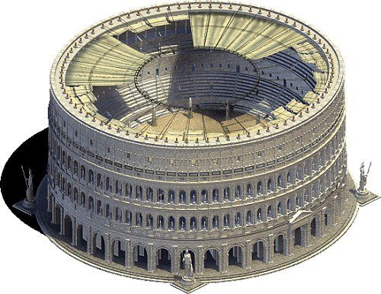

Slide 46
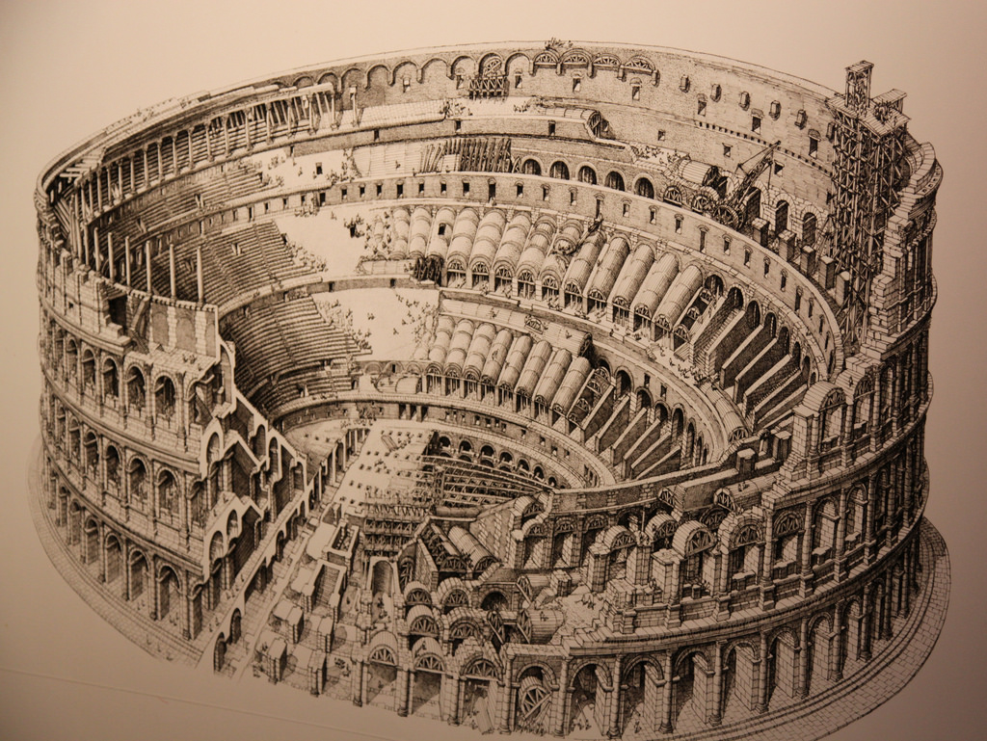

Slide 47
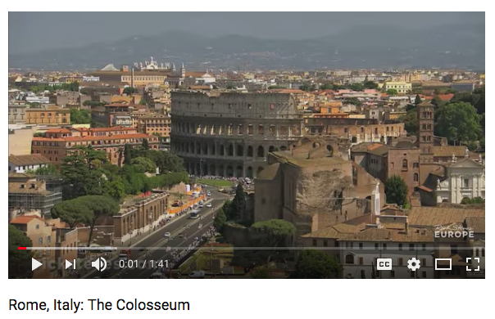
https://www.youtube.com/watch?v=xaSbYIeqGWg 1:40 Min

Slide 48
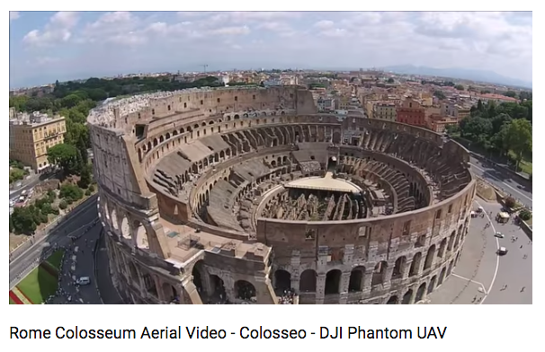
https://www.youtube.com/watch?v=snoRnpoNOrs 1:15 Min

Slide 49
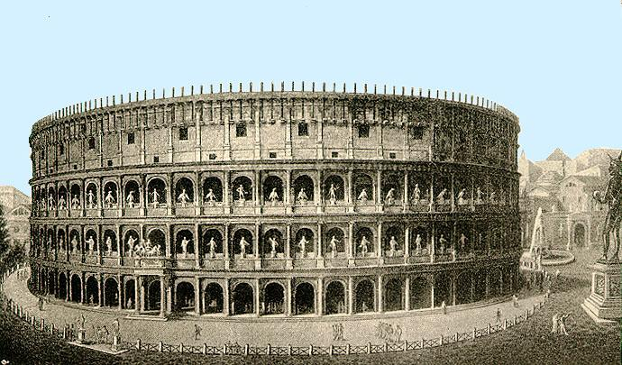
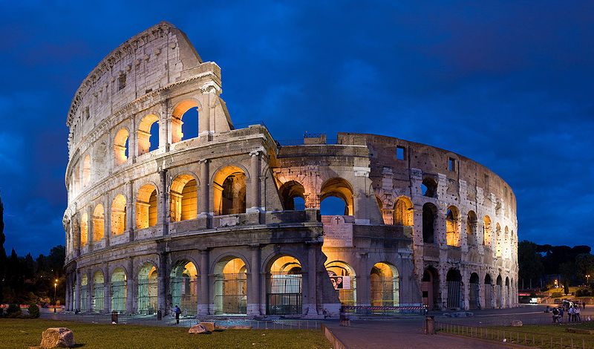

Slide 50
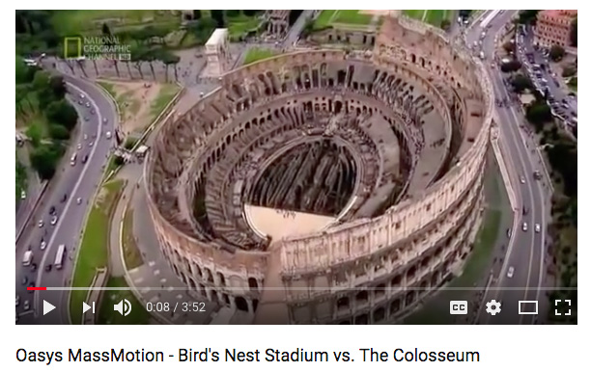
https://www.youtube.com/watch?v=BVfQdjpXa4k 4:00 Min

Slide 51
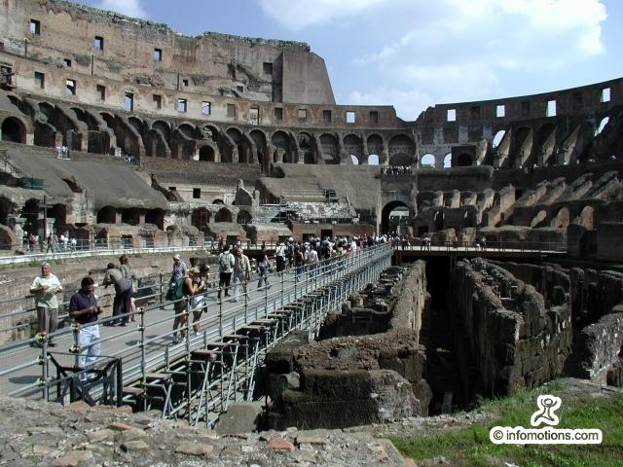
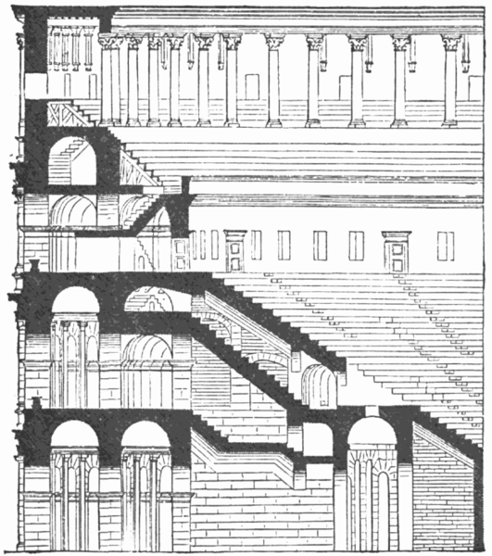

Slide 52
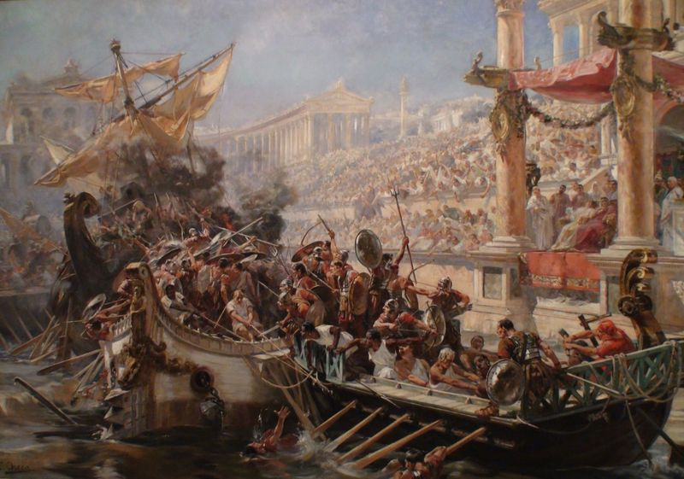

Slide 53
NAUMACHIA
4 or 5 times through history Naumachia was celebrated at the Colosseum, this translates to “Naval Combat”
This would only be celebrated along side major events due to the incredible amount of planning and effort it would take to have such an event…
Can you Imagine!

Slide 54
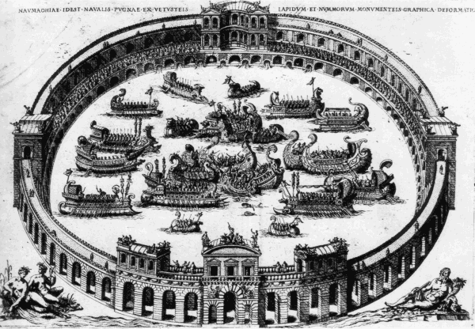

Slide 55
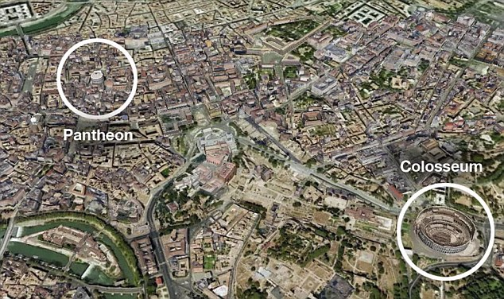

Slide 56
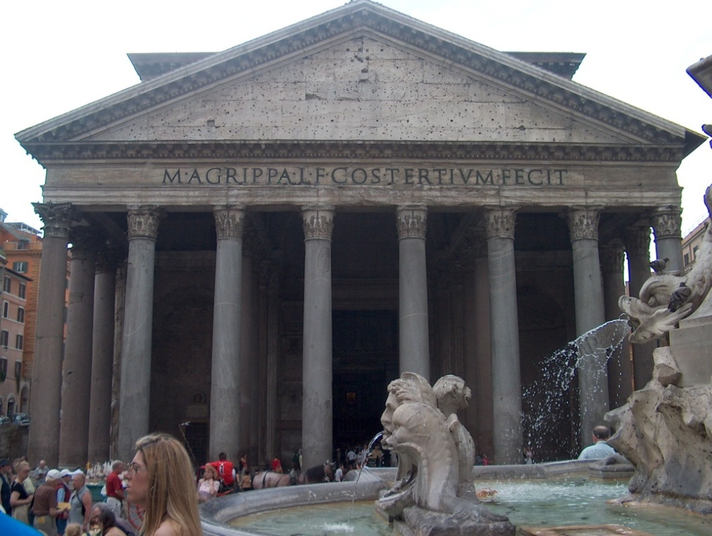
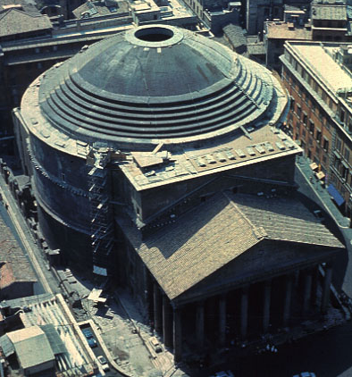
Pantheon Roman High Empire 125 CE Key piece
-Temple was built for all of the gods
-Most influential building in the world
-Commissioned by Emperor Hadrian who loved the classics- Former glories revisited
-Largest masonry dome in the world (built out of concrete)
-It is able to encompass a perfect sphere under the dome.
-At the top of the dome is an oculus to allow light to enter the building.
-Each god has a statue that is bathed in sunlight that changes throughout the year.
-coffered ceilings

Slide 57
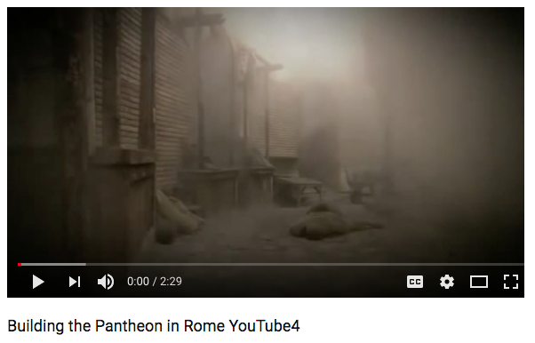
https://www.youtube.com/watch?v=5AOkrOLF2Ek 2:30 Min

Slide 58
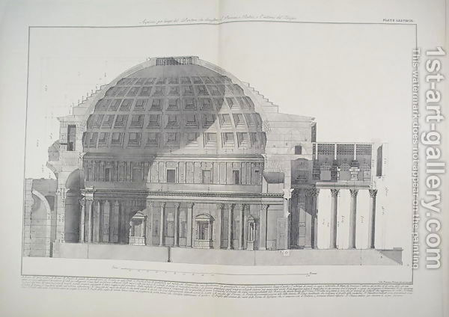

Slide 59
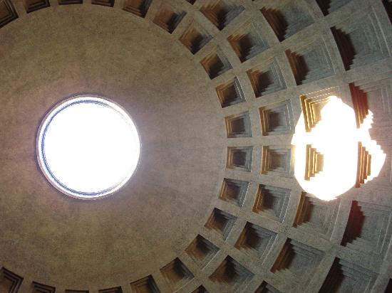

Slide 60
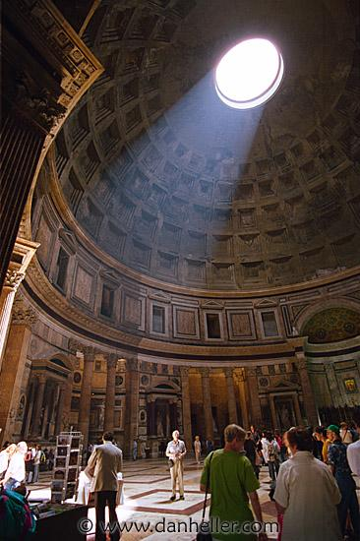

Slide 61
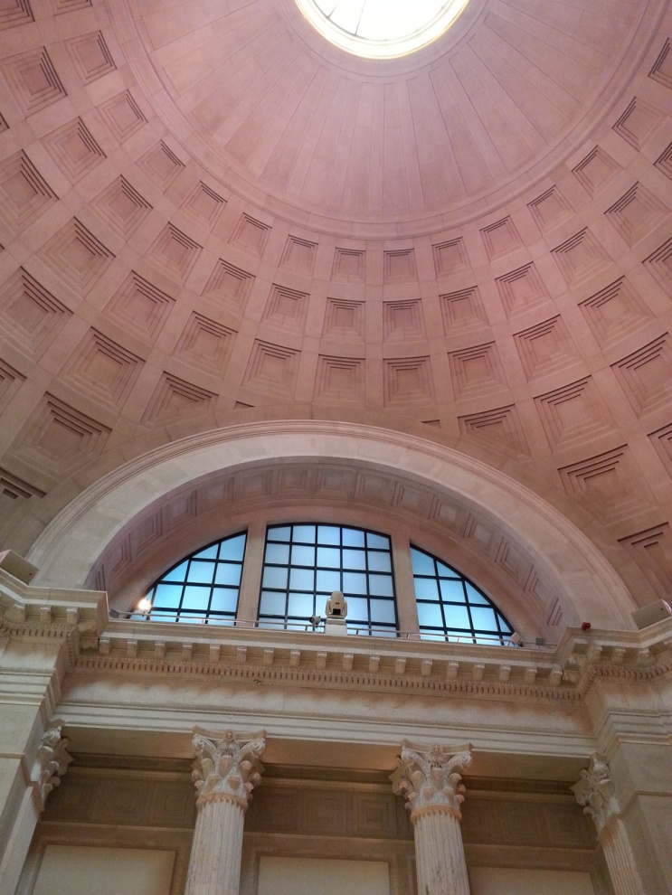
Coffered Dome with Occulus @ the Franklin Institute in Philadelphia

Slide 63
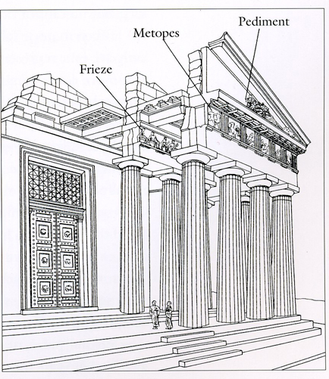
Parthenon Vs Pantheon
Parthenon
Pantheon
Named for Athena Parthenos (the Virgin)
Greek
Rectangle
Built by Iktinos, Kalikrates
Name means All (pan) the gods (Theos)
Roman
Circular with coffered dome
Built by Publius Aelius Hadrianus

Slide 64
Key Ideas
-Roman art reflects the ambitions of a powerful empire-monumental buildings and sculptures were built to glorify the power of the gods and the state
-Roman architecture is revolutionary in its understanding of the powers of the arch, the vault, and concrete
-A history of Roman painting survives on the walls of Pompeian villas
-Romans show a strong interest in the basic elements of perspective and foreshortening
-Roman sculpture is greatly indebted to Greek models
-Romans used architecture as a way to show their dominance of nature to their own needs

Slide 65
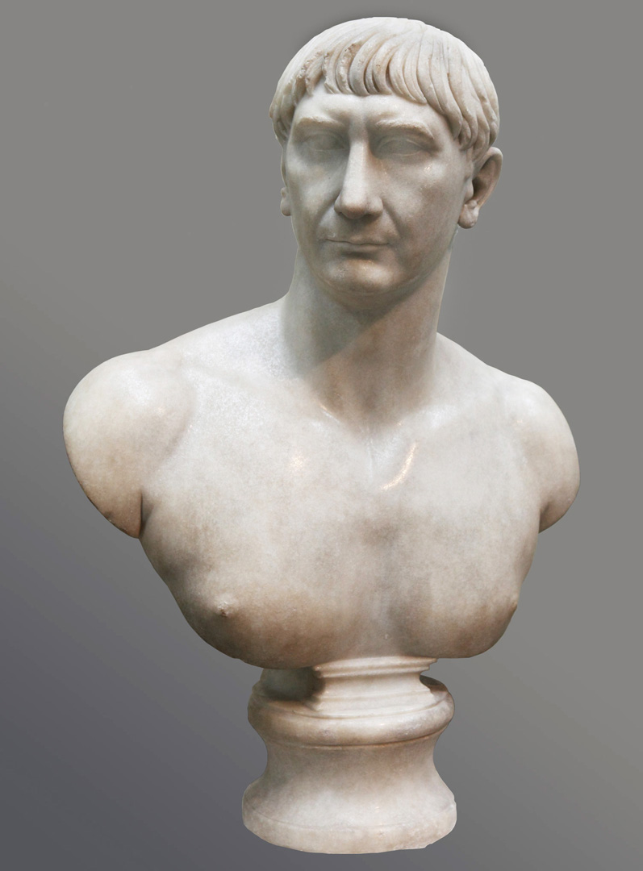
TRAJAN
Reign - 98 CE –117 CE
Spanish-Italian Decent
Groomed from a young age to be an emperor
Earned a reputation a “good emperor”
The Romans like him so much the built a massive forum in his honor…

Slide 66
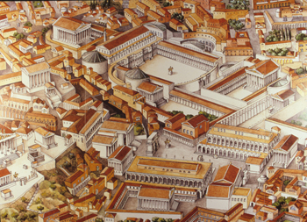

Slide 67
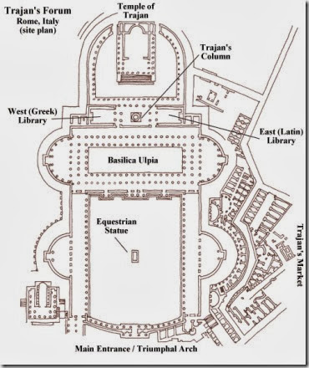
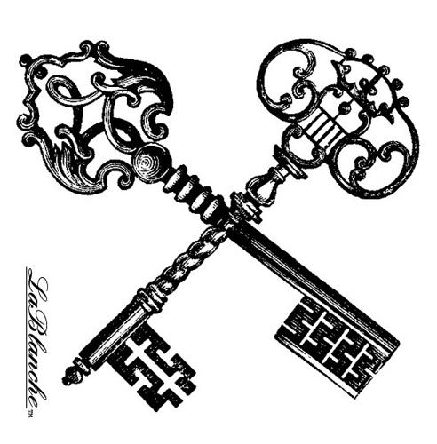
Forum of Trajan
Rome, Italy.
Apollodorus of Damascus
106–113 CE
Brick, concrete, & marble

Slide 69
https://www.youtube.com/watch?v=y-IAOPxkNWo 6:00 Min

Slide 72
Forum of Trajan

Slide 76
-Commemorates Trajan's victory over the Dacian’s -A continuous narrative spirals around the entire column up 125 feet. -The band of narrative gets wider at the top. -It was a law at that time that no one could be buried within the walls of Rome, so Trajan had his ashes placed under the column. -The figures in the narrative are not in proportion to the architecture around them, so you see a major break from Greek tradition.
Column of Trajan Roman High Empire 100 CE
-Story told in 150 episodes
-2500 figures included
-Low-relief used to not distort the overall shape of the column
-Originally painted.
-Not an accurate chronology of the war, but it tells the over all story
-The column is topped with a statue that was once a statue of Trajan, but has since been replaced with Saint Peter.

Slide 81
Plaster Casts of the column in the Museum of Roman Civilization

Slide 82
Originally market had 150 shops Made of concrete Multilevel mall Semicircular building held several layers of shops Main space groin vaulted A way for the average Roman to participate in Empire
Market of Trajan Roman High Empire 100 CE

Slide 83
End of the Pax Romana “Peace between nationalities of the Roman Empire”
Reigned From 198 – 217 CE
Marcus Aurelius was the last great Roman emperor.
When he died, the Pax Romana died as well.
His son, Commodus was assassinated for his shenanigans.
Society began to reject the Classical way of thinking and depicting the world.
Move towards abstraction away from naturalism AND idealism

Slide 84
How would you describe him?
Caracalla 198 CE –217 CE

Slide 85
Ludovisi Battle Sarcophagus Roman Late Empire 300 CE
Marble

Slide 86
https://www.youtube.com/watch?v=m4raOIxsbaU 5:30 Min

Slide 87
-Very crowded surface with figures piled upon one another – Horror Vacui --no illusion of space- rejection of classical perspective -Deep relief -Figures lack individuality -Confusion of battle is echoed by a congested composition -Roman army trounces the bearded barbarians -A major transition as the Romans used to be burners… now buriers -Deep, confused lacking in subtlety, teetering on the edge of stylized
Ludovisi Battle Sarcophagus Roman Late Empire 300 CE
Marble

Slide 88
Scooby Doo Stacking

Slide 91
Crisis of the 3rd Century!
This is where things really start to fall apart!
Emperors are being deposed, assassinated and tossed aside
In this hour of chaos, the emperor Diocletian (who was appointed Emperor by his troops) decided to share power with his rivals and set up the Tetrarchy, or rule by four people.
He split the Empire into the East and West (two would rule the east and two would rule the west)
This was fine, until Diocletian retired. The new tetrarchs fought among themselves and this form of government collapsed.
The split into East and West, though survived.

Slide 92
Also.. Check out the Home Alone kid now… interesting

Slide 93
-
Four Tetrarchs Roman Late Empire 300 CE
There is an Augustus (President) and a Caesar (Vice President). The senior president has a beard with his hand around the vice president to show he is a mentor.
-The figures have huge arms and heads, leaving all traditional styles.
-Leaving Classical Greek styles is showing they want their own way
-The facial expressions give reference to early Archaic style.
-Large cubical heads and squat bodies
-lack of individuality
-return to the Egyptian block and iconic status of the human form rather than natural (or even idealized) form

Slide 95
Chaos!
Out of the fall of the Tetrarchs comes Civil war.
One man is able to beat back his opponents-
Constantine. 306-337 CE
Attributed his victory to the Christian god. He subsequently ended the persecution of Christians.
Moved the Capitol of the Empire to Byzantium (modern-day Istanbul) and declared Christianity the official religion of the Empire.
This begins the transition to the Medieval world

