Slide 2
The Artistic Shift
To understand Hellenistic art we have to first understand the western mindset that the Greeks began to create (which is still used today)
Western artwork typically can be classified into two mindsets
Rational or Emotional
Each art movement is typically a reaction to the previous movement or based upon some type of innovation
The Hellenistic Movement of Art is a REACTION to the the classical movement. The Classical Movement was rational based upon intellect. The Hellenistic Movement more on emotion
More on this in a minute… lets look at some context of the
historical situation

Slide 3
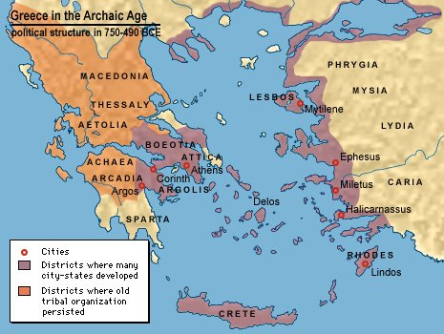
City Borders During the Archaic Era

Slide 4
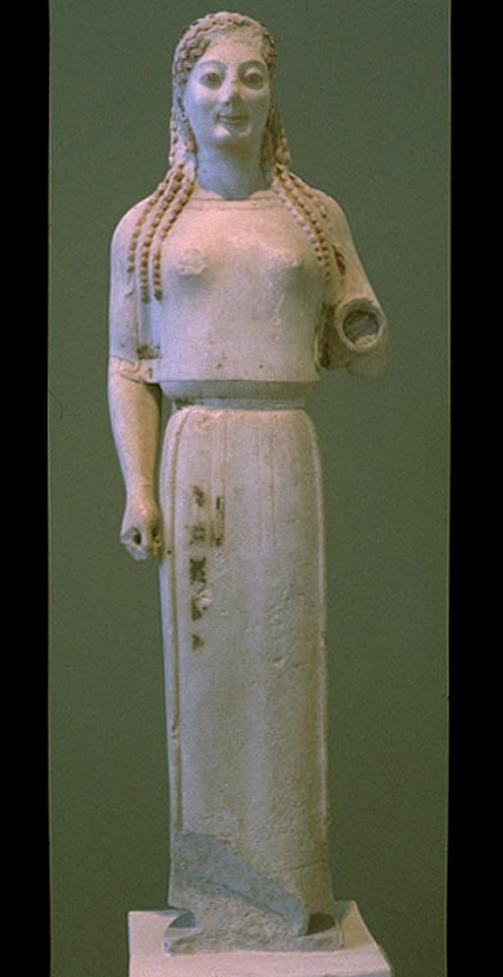
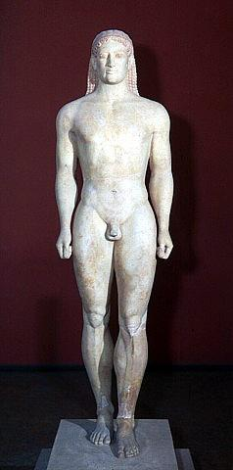
Archaic Art Works

Slide 5
City Borders During the Archaic Era

Slide 6
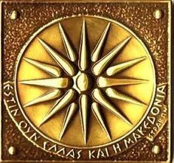
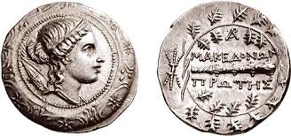
The Macedonians

Slide 7
Timeline of Macedonian History
Macedonia is located in the center of the Southern Balkans, north of ancient Hellas (Greece), east of Illyria, and west of Thrace.
The name "Macedonia" is the oldest surviving name of a country on the continent of Europe.
The ancient Macedonians were a distinct nation, ethnically, linguistically, and culturally different from their neighbors.
Archaeological evidence shows that old European civilization flourished in Macedonia between 7000 and 3500 BC.

Slide 8
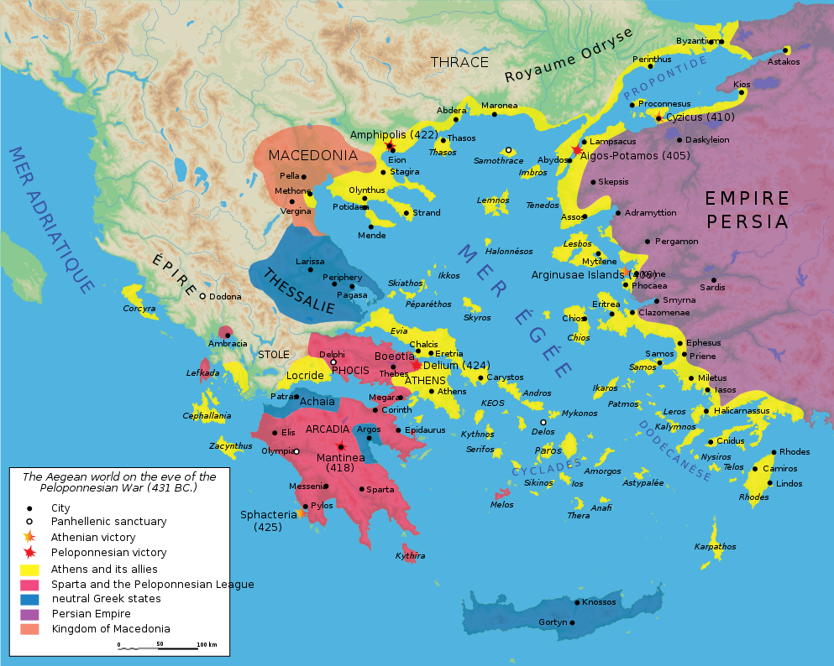
Borders During Classical Period (430 BCE)

Slide 9
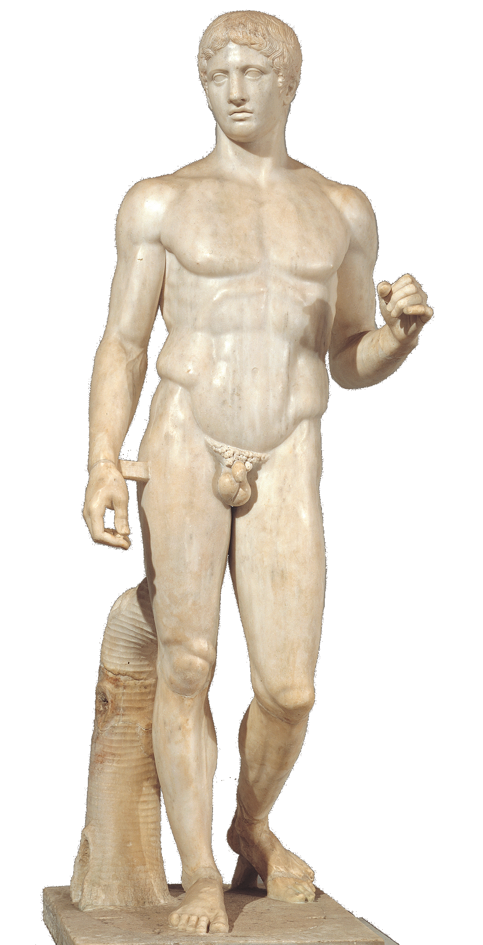
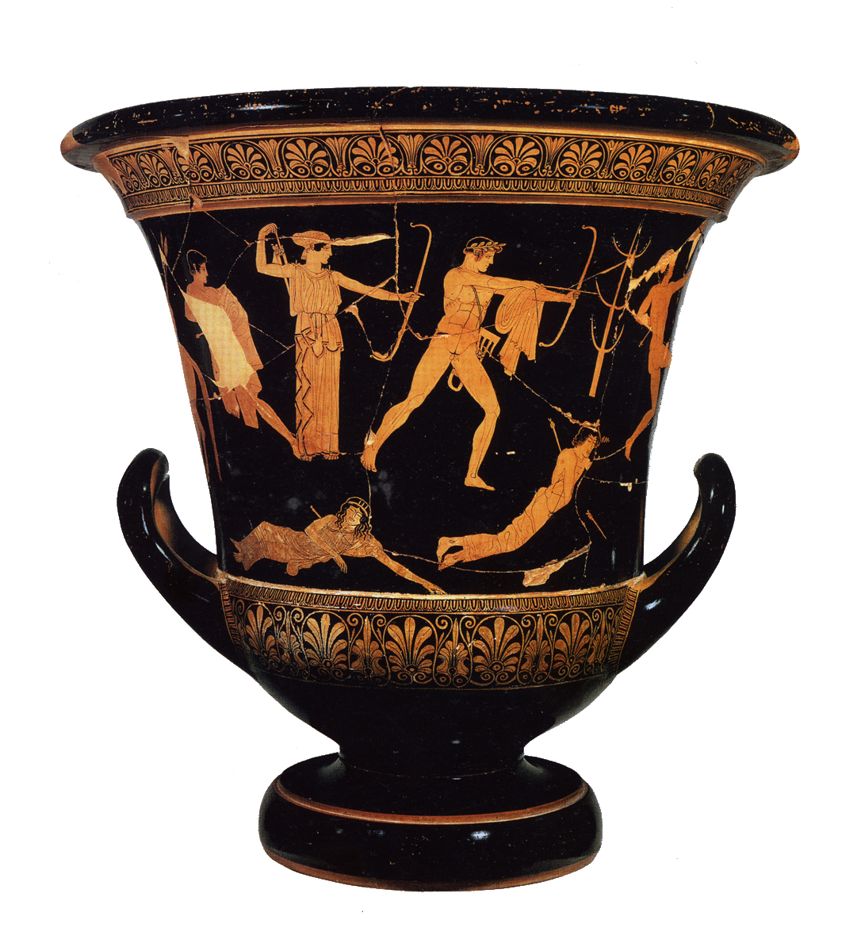
High Classical Art

Slide 10
Archaic to Classical Eras
(808-399 BCE) Caranus establishes the ancient Macedonian kingdom and is the first known Macedonian king.
(498-454 BCE) Alexander I "Philhellene" expend the kingdom and fight as Persian ally in the Greek-Persian wars. Alexander’s son Perdiccas II
(453 - 413 BCE) Instigates a conflict between Athens and Sparta which turns into a 27 year long Peloponnesian War resulting in a near exhaustion of almost every Greek city-state
(413-399 BCE) Archelaus turns Macedonia into an economic power and reorganizes the Macedonian army.

Slide 11
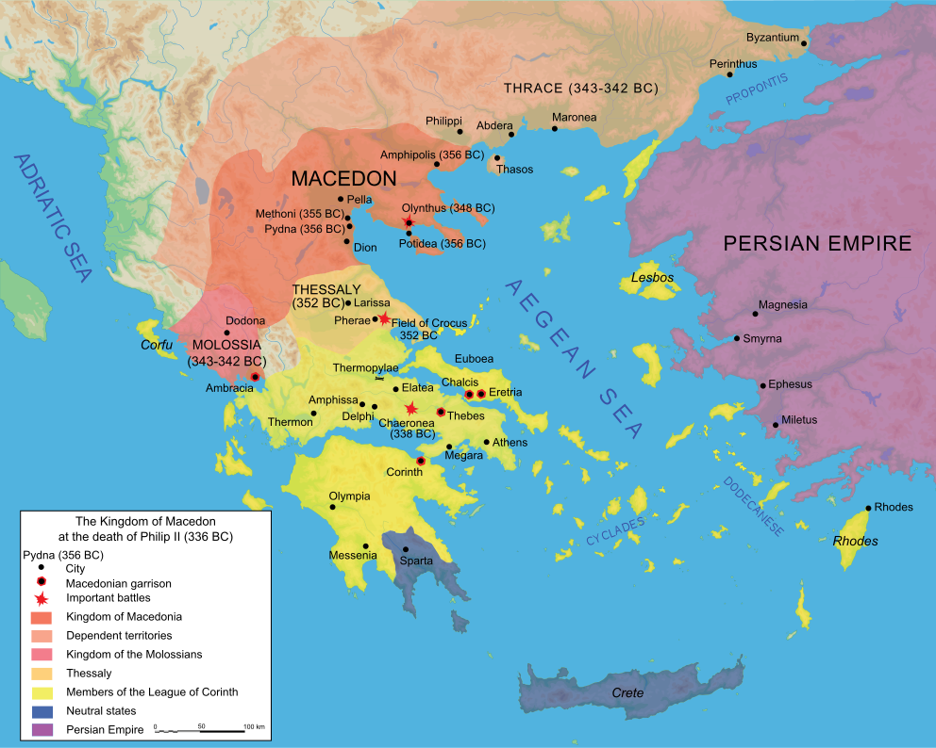
Borders During Late Classical Period (335 BCE)

Slide 12
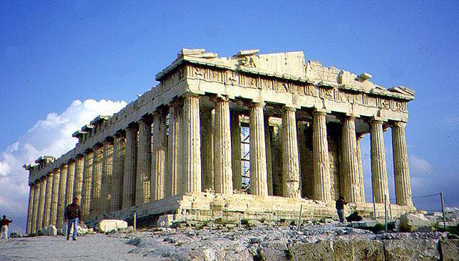
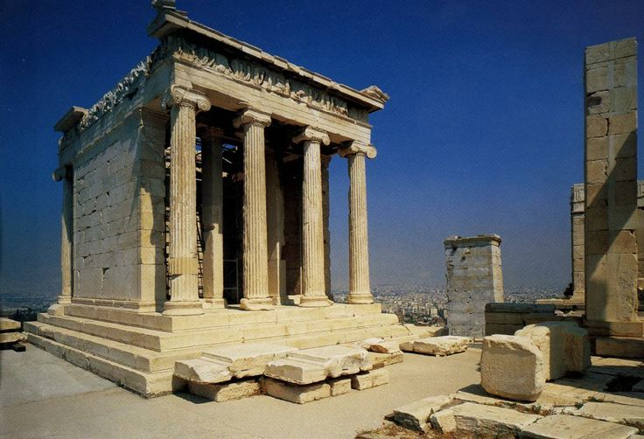
Late Classical Art

Slide 13
Archaic to Classical Eras
(359-336 BCE) Philip II raises Macedonia into the greatest European Power after subduing all of Macedonia's neighbors
- Illyrians, Thracians, and Greeks.
(August 2, 338 BCE) The Battle of Chaeronea where the Macedonians defeat the Greeks on, marks an end of Greek history and the beginning of the Macedonian Era.
The ancient Greek writer Theopompus declares Philip “the greatest man that Europe had ever given.”.

Slide 14
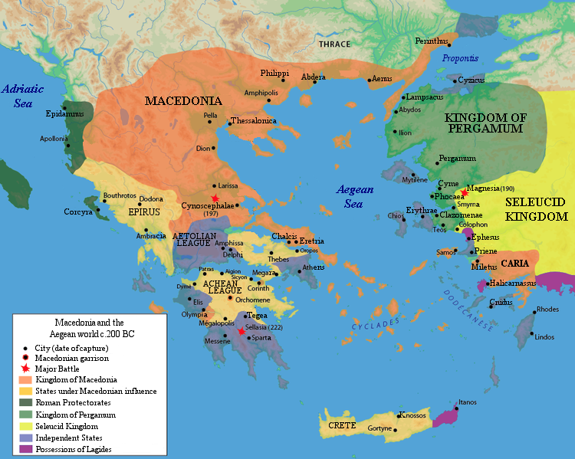
Macedonian Expansion (200 BCE)

Slide 15
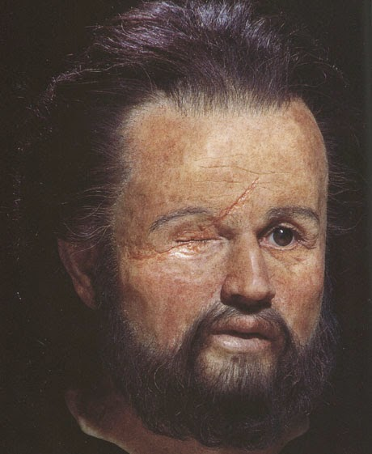
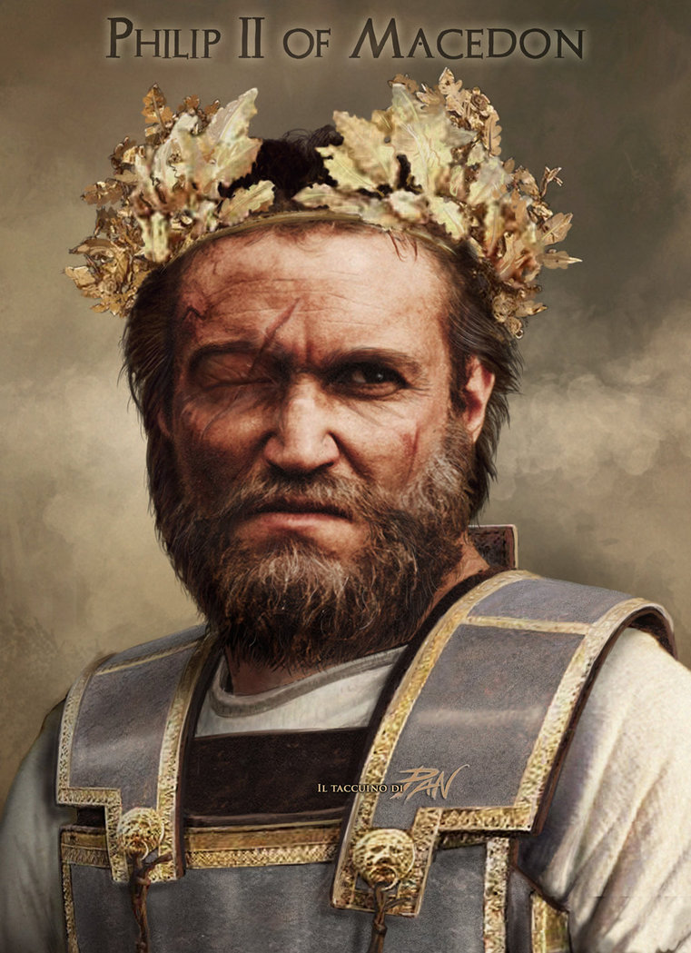
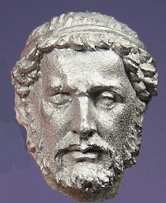
King Phillip II has a Son…
This is King Phillip II

Slide 16
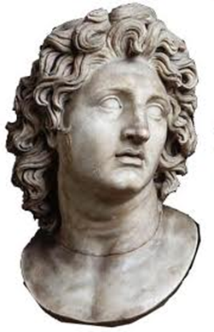
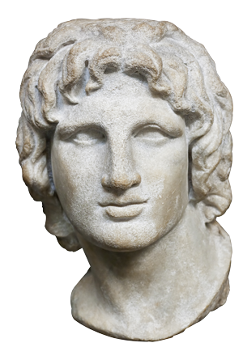
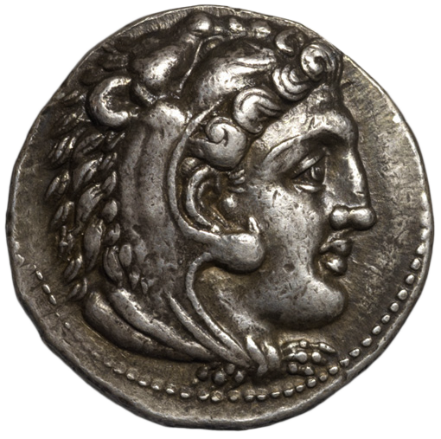
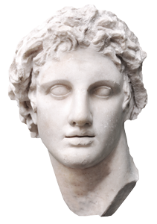

Slide 17
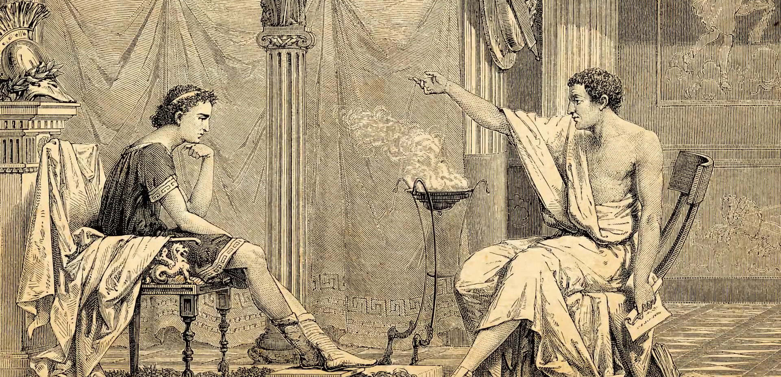
A Privileged Upbringing
Tutored by Aristotle

Slide 18
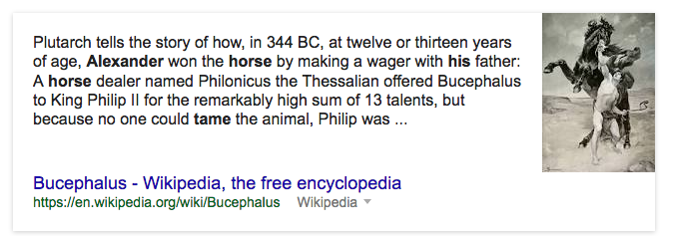
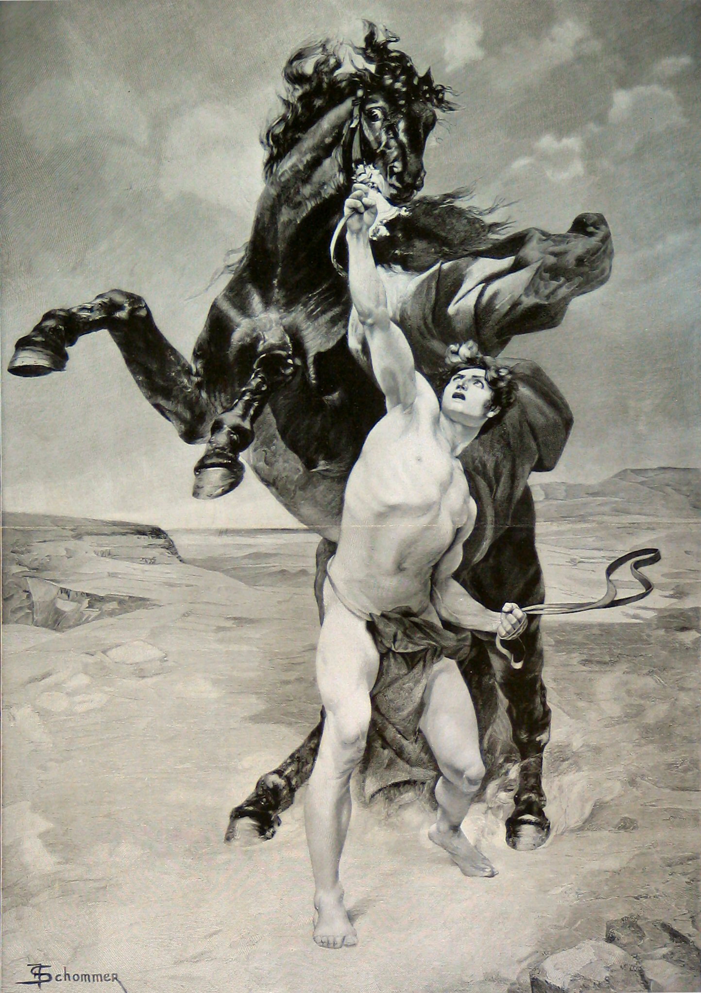
Young But Courageous

Slide 21
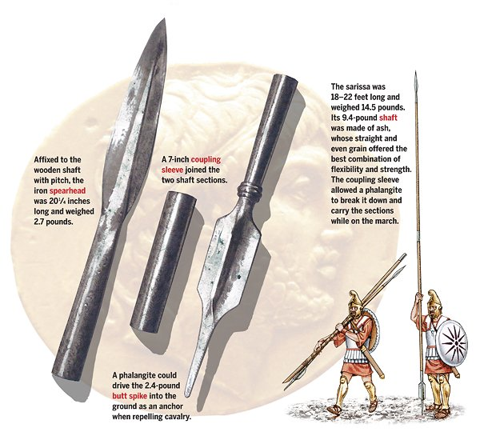
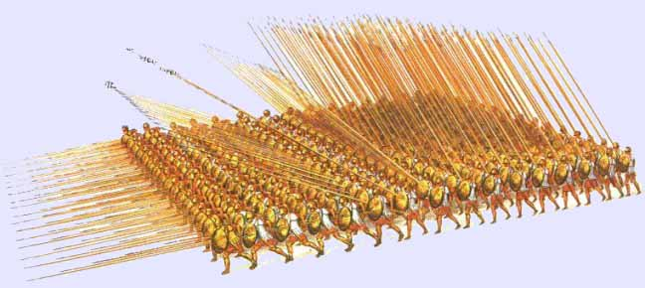
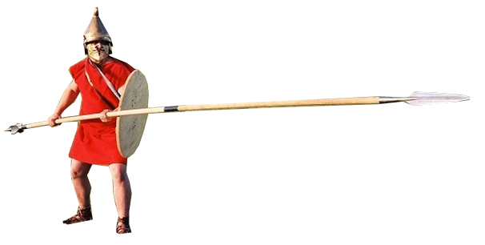
Alexander’s Army
Alexander never lost a battle in his entire military career. He was renowned for his tactical vision and ability…
Some historians question whether or not Alexander's success was based upon his ability as a leader or the technological advantages Macedonian weaponry gave his army
Sarissa

Slide 22
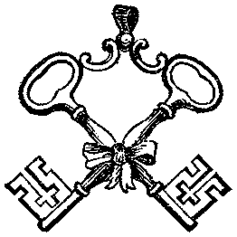
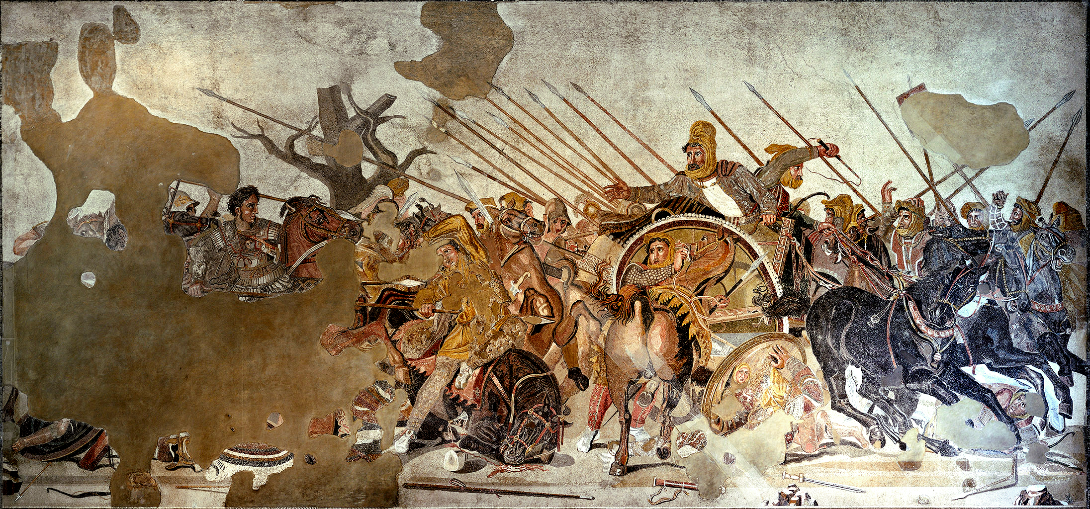
Alexander Mosaic from the house of the Faun
Republican Roman
100 BCE
Mosaic

Slide 23
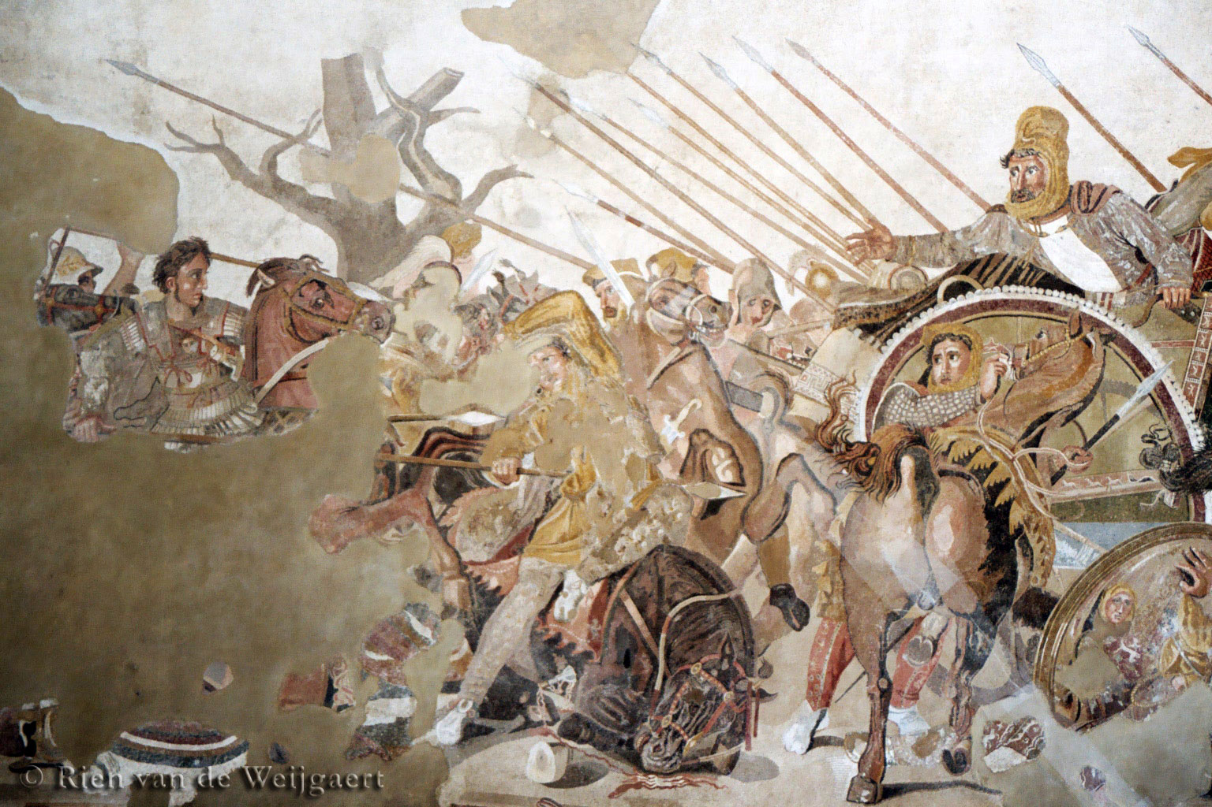
Alexander Mosaic from the house of the Faun
Republican Roman
100 BCE
Mosaic #40
Alexander at left young, brave, no helmet charges into battle
-Darius III (Persian) center horrified, fleeing
-Crowded filled with excitement
-Roman floor mosaic (small bits of stone and cut glass (tesserae) glued to the floor) based on an original Greek mural
-1.5 Million Pieces!!
-Foreshortened horse in center frame
Copy of a painting by Philoxenos of Eretria (300 BCE Est.)
DETAILS!!!! The modulated color, the composition, the reflection of the man’s face in the shield, the cast shadows!

Slide 24
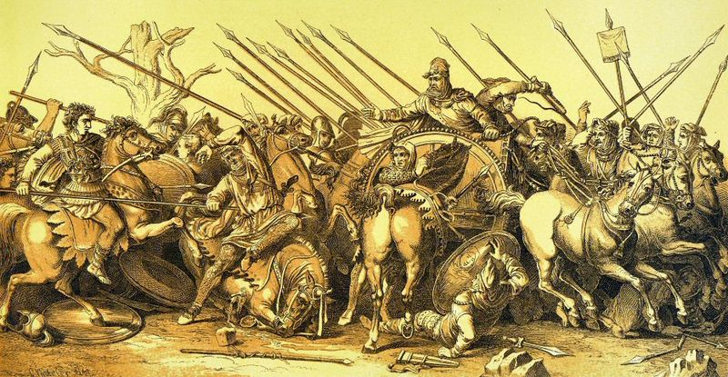

Slide 25
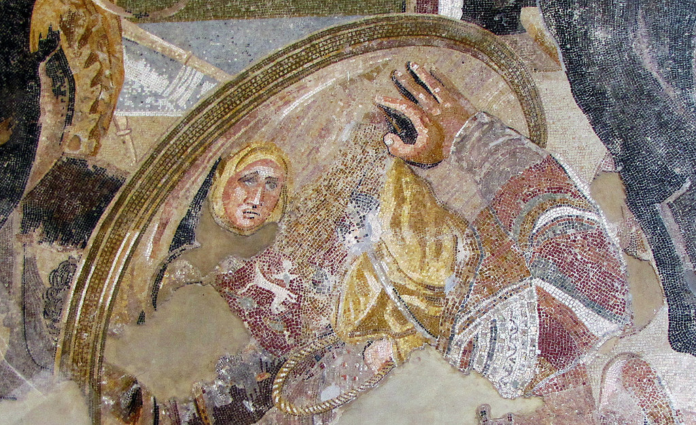

Slide 26
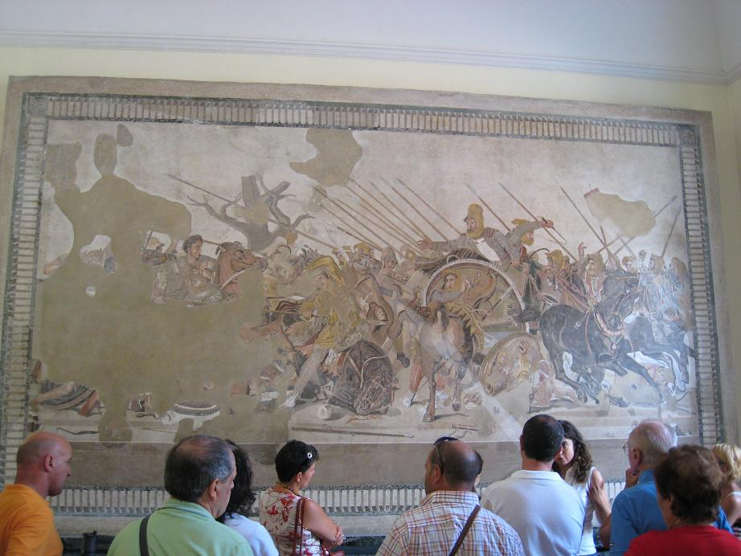

Slide 27
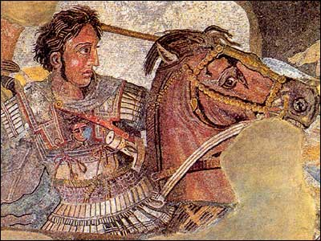
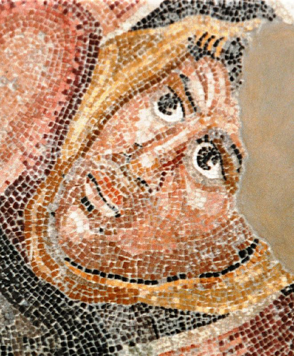
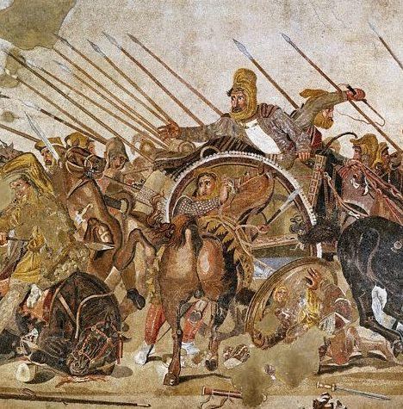

Slide 28
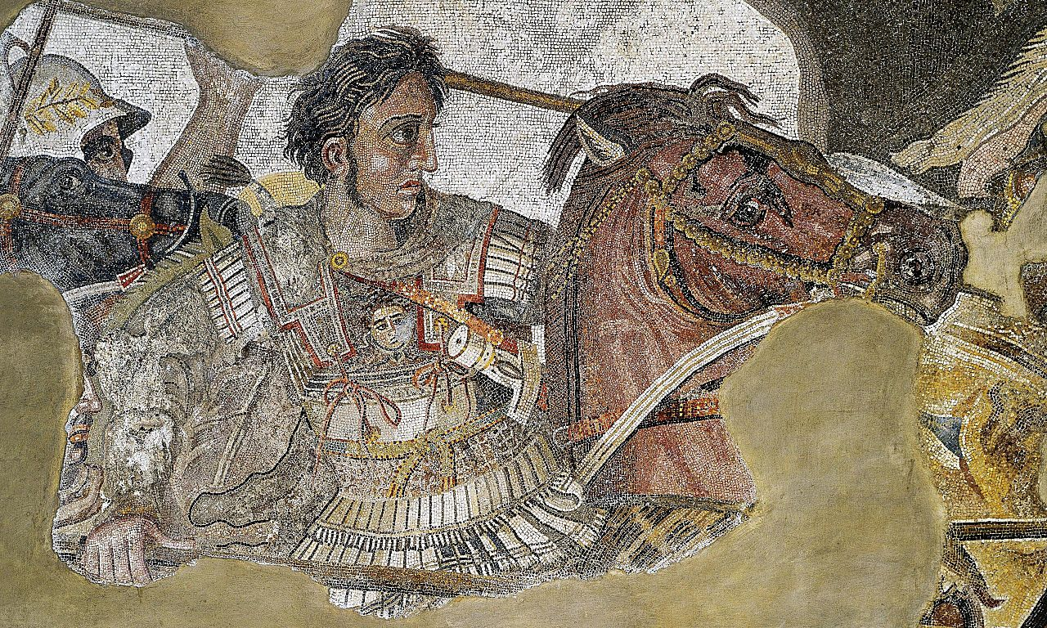

Slide 29
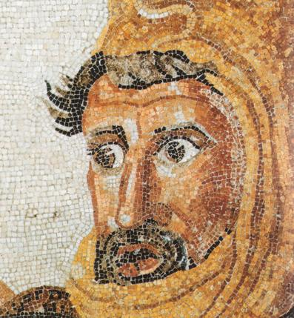
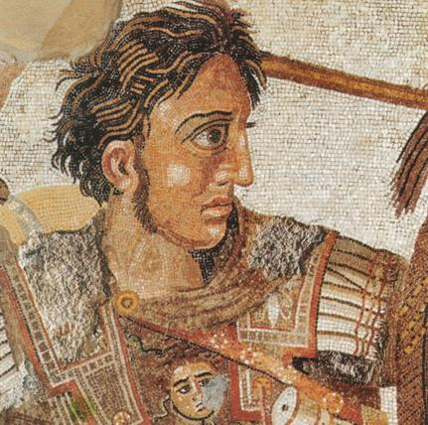

Slide 31
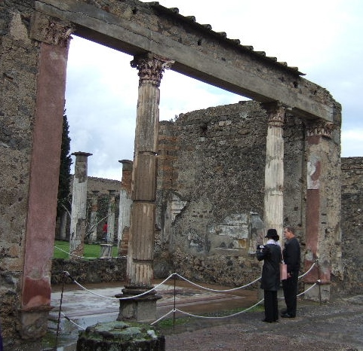
House of Faun: Pompeii, Italy
THINK!
Why would a private roman patron commission a 200 year old Greek painting be meticulously constructed in their home?

Slide 32
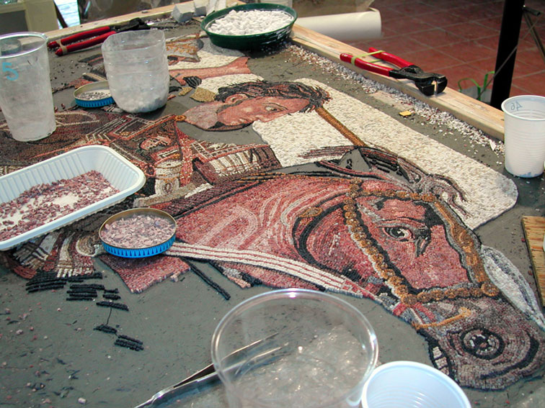
It took 22 months to reconstruct & $215,000!

Slide 33
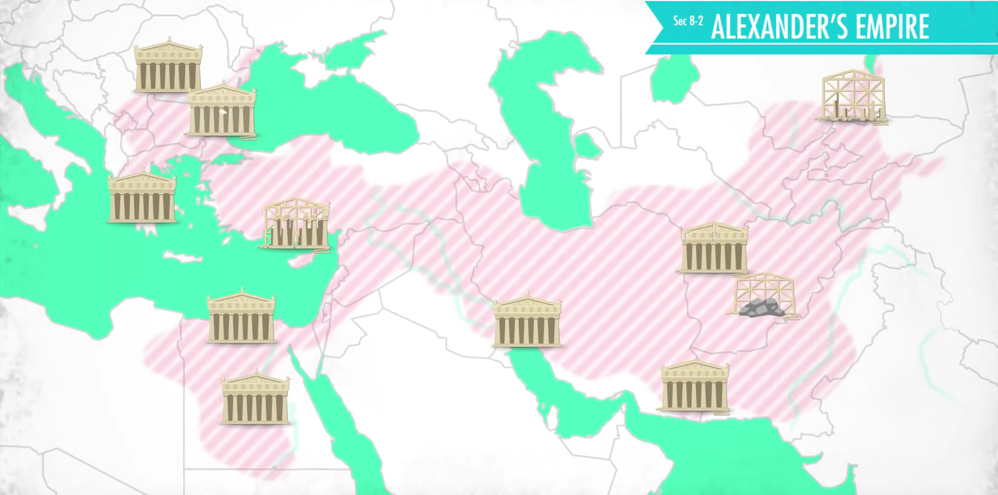

Slide 34
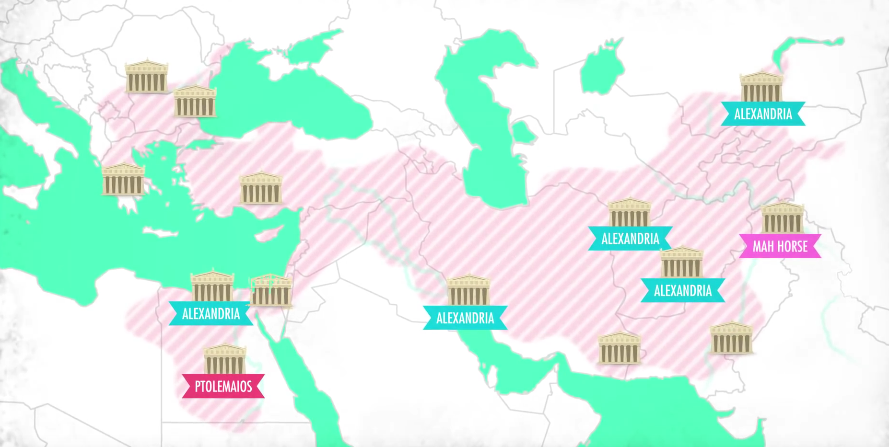

Slide 35
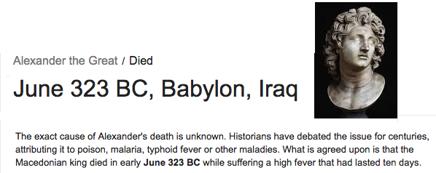
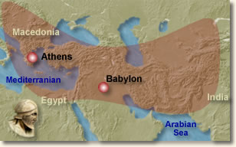
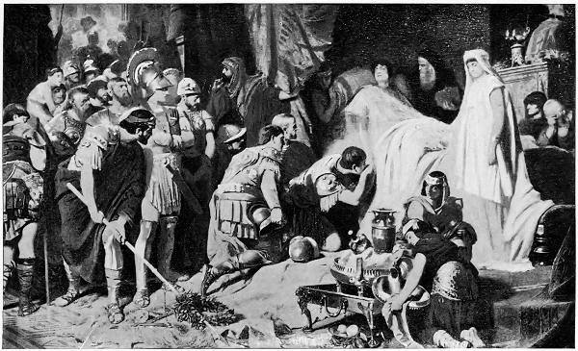
Alexander Dies

Slide 36
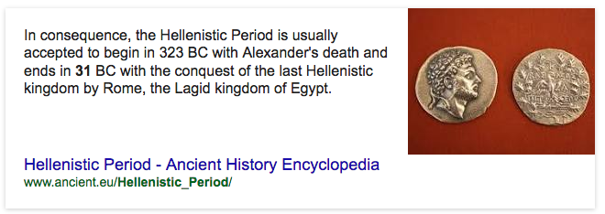
After his death, Alexander’s kingdom was divided amongst his top generals..

Slide 37
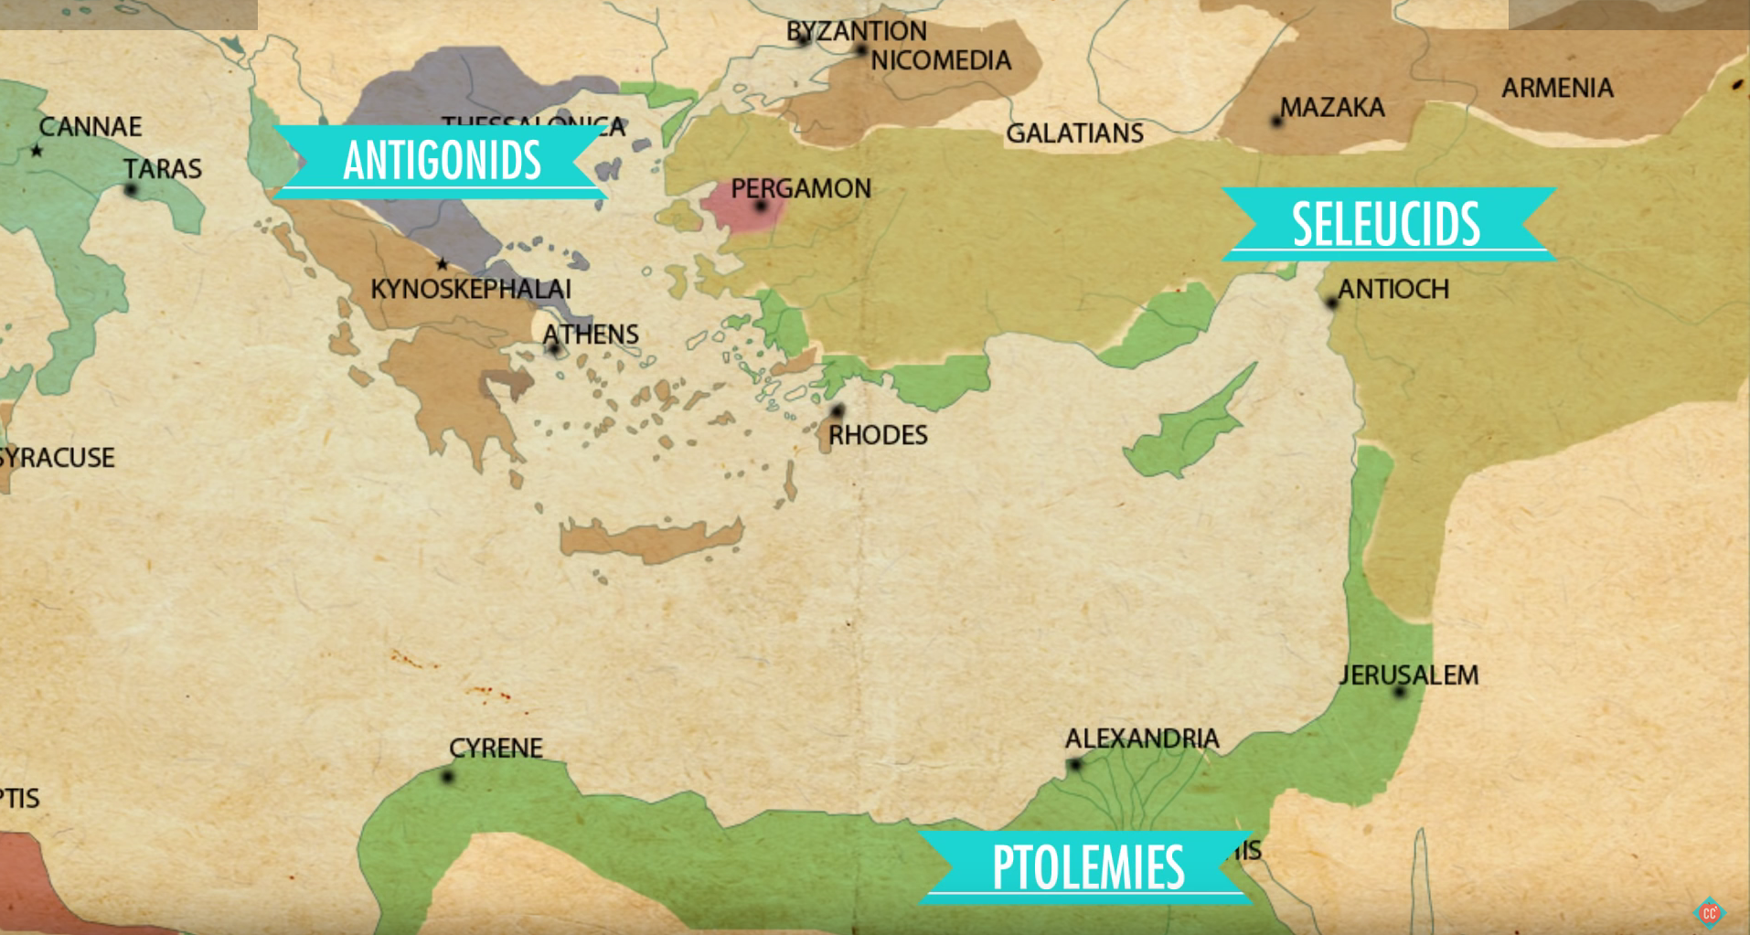
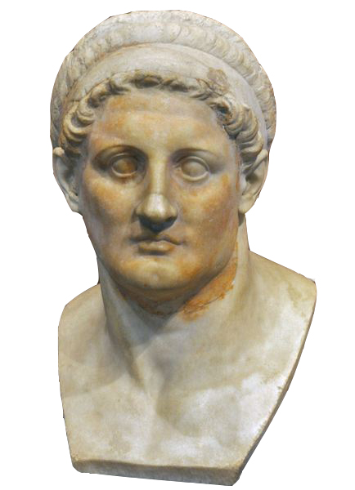
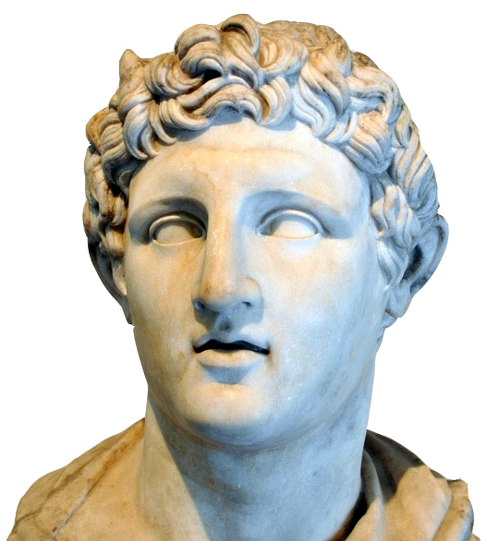
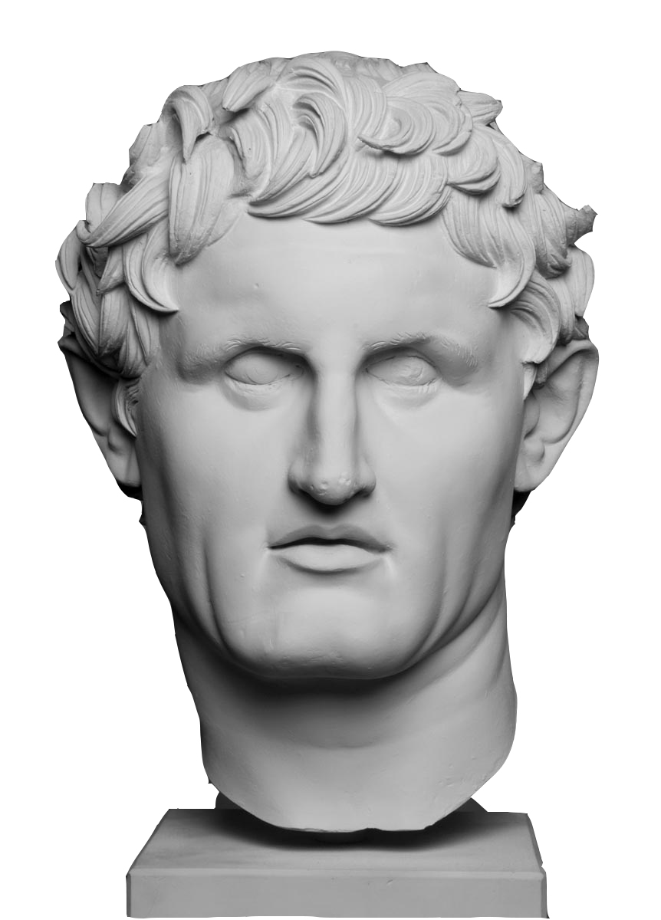
Ptolemy Antigonus Seleucus

Slide 38
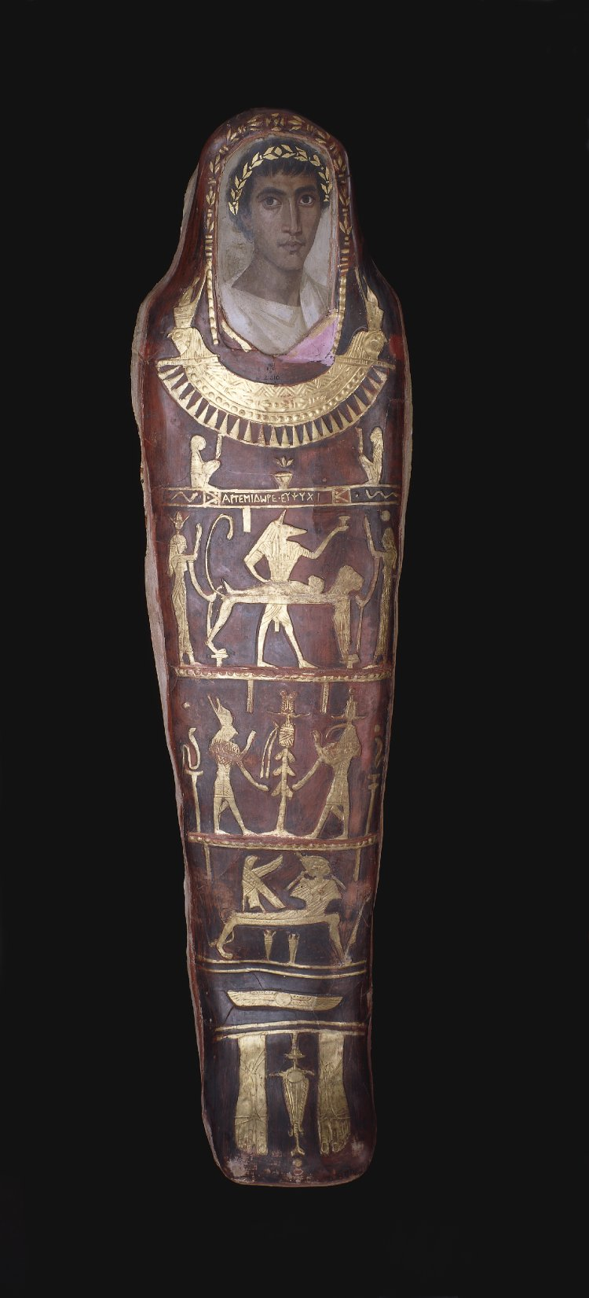
These Empires have different cultures

Slide 40
Just For a Reference… World Powers (215 BCE)

Slide 41
WE’RE BACK!.... The Artistic Shift
The Hellenistic Movement of Art is a REACTION to the the classical movement. The Classical Movement was rational based upon intellect. The Hellenistic Movement more on emotion
The Greeks called themselves Hellenes- they were citizens of Hellas
The Macedonians (under Alexander the Great) carried Greek culture throughout the known world
Hellenistic means “Greek like” or in the Greek style
The Hellenistic era experienced an age of eclecticism, a new awakening of the diverse knowledge and theories present in Greek culture. Instead of contemplating and debating ideals, logic, extinguished emotion, or consummate beauty, people would

Slide 42
WE’RE BACK!.... The Artistic Shift
Hellenistic art focuses on emotion, individuality, and realism, what is actually there and visible with the eyes.
In portraiture, more than the precision of the traits represented, the artist seeks to represent the character of his/her subject.
In the great statuary (the cannon of sculpture), the artist explores themes such as suffering, sleep or old age, which were unthinkable in Classical
Hellenistic Greeks explore EVERYTHING that it means to be human: Defeat, Death, Triumph, Aging, Celebrating the nude form, or the body…
Lets Explore these ideas!

Slide 44
A Side Note: Painting
Almost no painting survives from this time period. All that we have are from vases and mosaics based on the paintings.
Sadly, according to Greek records, painting was what Greek were most famous for in their own time… Consider how incredible Greek sculpture is.. Their paintings, were allegedly even more impressive!

Slide 45
SCULPTURE

Slide 46
Nike of Samothrace Hellenistic 190 BCE #37
VICTORY
9’ Feet Tall – Originally stood on the bow of a stone ship on the Island of Samothrace
Nike is a messenger Goddess spreading the word of victory
Instead of the quite energy of the Classical era we see boldly expressive energy. The body is used as an expressive force.
The figure interacts with the environment. We can almost feel the wind pressing the figure. She strides forward, with wings extended back.
The marble is deeply cut to create exaggerated textures. This is in contrast to the smooth perfection of the classical sculptures

Slide 49
What you see is not what you get
The main features of this were as follows: the right side of the marble torso was placed in position on the body, the left side and the belt were recreated in plaster. The left wing was put together from several marble fragments and strengthened at the back by a metal frame before being put in place. As only two fragments of the right wing survived, it was replaced by a mirror-image cast of the left wing. Only the head, arms, and feet were not remodeled. The statue was placed directly on the ship, whose blocks were shaped and the gaps filled. Neither the ornamentation on the prow nor the rams were recreated.

Slide 50
Seated Boxer Hellenistic 100 BCE
Bronze
#41

Slide 51
https://www.youtube.com/watch?v=cHgrqOIXoN8 4:30

Slide 52
Seated Boxer Hellenistic 100 BCE
Bronze
DEFEAT
-The boxer is not portrayed as a god or a hero-he is a man who has been defeated.
-He has scars, a broken nose, deformed ears, and is aging.
Cauliflower ear
Blood denoted in copper; dripping from face, onto right arm and thigh
-The sculptor portrays him at the peak moment of his realization that he may no longer be considered a great athlete.
-The human form is no longer idealized, but rather naturally imperfect.
-note that Greece is now a province of Rome after 146 BCE
May have been a good luck charm for athletes; there is evidence of toes worn away by touching

Slide 53
Seated Boxer Hellenistic 100 BCE
Bronze
DEFEAT
He is beautiful not for the perfection of his body, but rather for the life he has lived
This is the not to humanism that Hellenistic Greeks embrace
We feel and relate to the subject of the sculpture

Slide 56
Dying Gaul from Pergamon Hellenistic 200 BCE
DEATH

Slide 57
Dying Gaul from Pergamon Hellenistic 200 BCE
DEATH
-Very naturalistic and dramatic
-Expression represents his anguish
-The dying and defeated man all of a sudden becomes noble.
-Man sculpted may have been the trumpeter in the battle.
-Barbarian foe, unkempt hair and mustache
-meant to be seen in the round
-Lots of emotion
-Twisted and moving body
-Note: Gauls became the French.

Slide 58
DEATH
The Ludovisi Gaul Killing Himself and His Wife (sometimes called "The Galatian Suicide") is a Roman marble group depicting a man in the act of plunging a sword into his breast, looking backwards defiantly while he supports the dying figure of a woman with his left arm. It is a Roman copy of the early 2nd century AD, of a Hellenistic original, ca 230-20 BC

Slide 59
Venus de Milo Hellenistic 150 BCE
Sensuality
-“S” curve long and flowing pose, very sensuous
-One hand held an Apple (an attribute of Venus) the other released her robes as they fall to the floor
-Very softly modeled forms light and shadow play on the surface

Slide 60
Venus de Milo Hellenistic 150 BCE
Sensuality
-“S” curve long and flowing pose, very sensuous
-One hand held an Apple (an attribute of Venus) the other released her robes as they fall to the floor
-Very softly modeled forms light and shadow play on the surface

Slide 61
Aphrodite, Eros and Pan Hellenistic 150 BCE
Meant to be a play on the Aphrodite of Knidos
Part parody, part sensual
The figures are almost laughing.
Very different from the stoic and serious statues of the classical era.
Note Eros- Hellenistic sculptors knew how to sculpt children-
(Earlier sculptors portrayed children as mini adults.)

Slide 62
Venus Kallipygos, 200-100 BCE

Slide 63
Hellenistic
Old Market Woman
150 BCE

Slide 65
Athanadoros, Hagesandros, and Polydoros Laocoon and His Sons Hellenistic 100 BCE
Roman copy
-Laocoon (a Trojan priest) defied Apollo by trying to tell the Trojans, "Beware of Greeks bearing gifts.”
-Apollo punished him my giving his sons and him to a sea creature.
-This masterpiece was the most celebrated art in antiquity.
-Very deep carvings-light and dark
-Accuracy in anatomy
-Very dynamic with the bodies twisting and intertwining together, emotional
-It was a major inspiration for Michelangelo.

Slide 67
ARCHITECTURE

Slide 68
Great Altar of Zeus and Athena at Pergamon (Modern day Turkey) Hellenistic, 175 BCE, Marble

Slide 69
Great Altar of Zeus and Athena at Pergamon (Modern day Turkey) Hellenistic 175 BCE
Marble
Altar placed on an elevated platform up a dramatic flight of stairs
-Reference to the Parthenon with its use of the frieze, that is 7 feet high and 400 feet long
-The frieze is actually below the columns rather than above them.
-The 400-foot long frieze is composed of Zeus leading the gods to battle the giants (gigantomachy).
-Very emotional with the amount of violence occurring
-The sculpture is carved very deep into the stone.
-Dynamically involves the viewer-the viewer is now at eye level to the scene rather than looking up to it.
-This parallels the Greek victories over the Gauls (barbarians) in a recent war and Alexander the Great’s defeat of the Persians, with the gods’ defeat over the giants in mythology

Slide 70
Form | Function | Content | Context
-The frieze is actually below the columns rather than above them | altar placed on an elevated platform up a dramatic flight of stairs | -Very emotional with the amount of violence occurring | -reference to the Parthenon with its use of the frieze, that is 7 feet high and 400 feet long
-The sculpture is carved very deep into the stone. |  | -The 400-foot long frieze is composed of Zeus leading the gods to battle the giants (gigantomachy). | -This parallels the Greek victories over the Gauls (barbarians) in a recent war and Alexander the Great’s defeat of the Persians, with the gods’ defeat over the giants in mythology
The monument has arms to envelop the viewer |  | -Dynamically involves the viewer-the viewer is now at eye level to the scene rather than looking up to it.

Slide 73
Athena Battling Alkyoneos from the Altar of Zeus at Pergamon 175 BCE
Very natural and dynamic
-Emotional
-Accuracy in the anatomical structures and muscles
-Taken at the peak moment of the scene-peak drama
-Athena is the center piece, and it shows her extreme power and strength. (She was the goddess of the city.)
Nike flies in to crown Athena
Play on the Parthenon- it’s based on the east pediment of the Parthenon
Gigantomachy
Gaia looks on in horror and pleads for the fate of her sons
Dramatic intensity of figures, movement; heroic musculature

Slide 77
#181. Petra, Jordan:
Great Temple
Nabatean, Ptolomeic, and Roman
400 BCE-100 CE
Cut Rock
The Treasury most clearly embodies the Hellenistic style and reflects the influence of Alexandria, the greatest city in the Eastern Mediterranean
Ornate Corinthian columns are used throughout. Sculptural decoration also underscores a connection to the Hellenistic world. On the upper level, Amazons (bare-breasted) and Victories stand, flanking a central female figure
The treasury was exceptional for its figurative detail and ornate Hellenistic architectural orders; most tombs did not have figurative sculpture—a legacy of the Nabataean artistic tradition that was largely aniconic, or non-figurative

Slide 81
#181. Petra, Jordan:
Great Temple
Nabatean Ptolomeic and Roman
400 BCE-100 CE
Cut Rock

Slide 82
#181. Petra, Jordan:
Great Temple
Nabatean Ptolomeic and Roman
400 BCE-100 CE
Cut Rock

