Slide 1
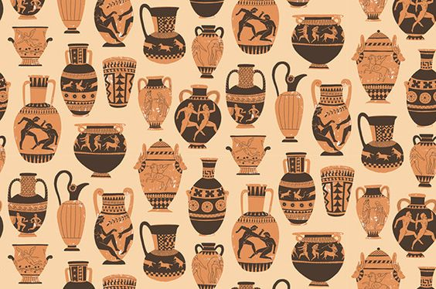
Classical Greek Art

Slide 2
Timeline
GEOMETRIC AND ORIENTALIZING - 900 - 600 BCE
ARCHAIC - 600 - 500 BCE
EARLY AND HIGH CLASSICA - 500 - 400 BCE
LATE CLASSICAL - 400 - 300 BCE
HELLENISTIC – 323 - 31 BCE

Slide 3
Greece- what was it about?
1. The exaltation of humanity/rational man as the “measure of all things.”
The being who has the intellectual power to create balance and order in the individual and in the society as a whole.
2. Balance...
of mind and body--of the intellect and physical strength/beauty was of supreme importance to the Greeks.
“... for we are lovers of the beautiful... we cultivate the mind without loss of manliness... We are the school of Greece.” ... Peracles

Slide 4
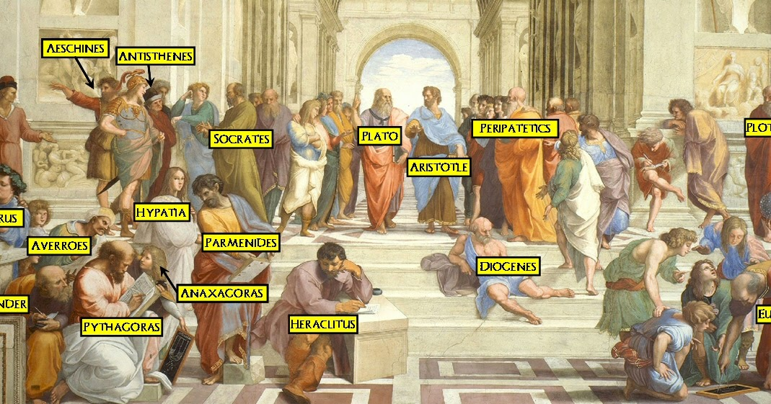
Thinkers, Philosophers, Poets, Artists, Architects

Slide 5
Naturalism
Humanism
Why Nude?
beauty comes from nature
Focus on this world
Close observation of the natural world
Constant strive for perfection
Concern for human related ideas/concerns etc.
Humanity is what matters
Values
Democracy - Demos + Kratos
Demo = The people Kratos=Power
Intellect
Body
Visible means of conveying perfection
Perfection was:
Balance
Harmony
Symmetry

Slide 6
Important features of Greek art
What is beautiful?
That which “aims at its purpose” Aristotle
When we strive for perfection
How do the gods play into this?
“By searching for the Good we are better equipped to understand the world.” Plato
Two ways of achieving that purpose
Exploring the physical (Aristotle) Φ
Exploring the metaphysical (Plato)

Slide 7
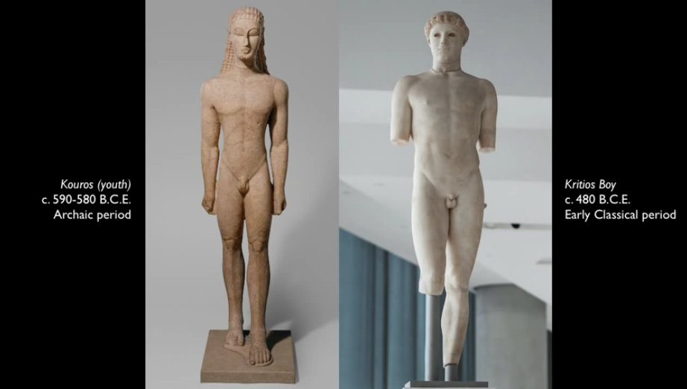

Slide 8
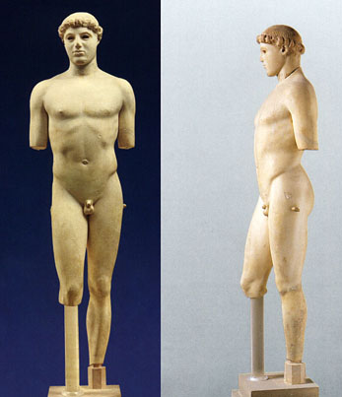
Kritios Boy Classical Greek 450 BCE
The final break with Egyptian art.
Contrapposto stance
(or counterbalance is shown with the dip in the right hip and the bent leg, the artist has captured the weight shift and has carved this shift in marble.)
Slight Turn of the head
Transitions from the Archaic to the Classical
Very naturalistic- sculpted form live models- little idealism.
Called Kritios Boy, because it was once thought to have been carved by a man named Kritios.

Slide 9
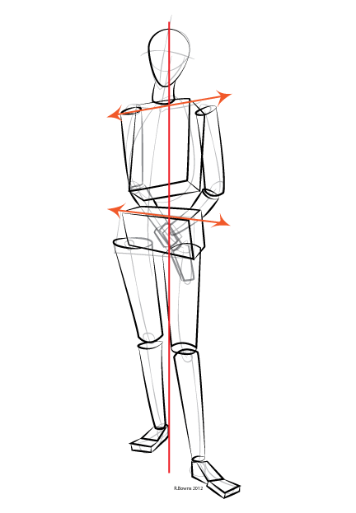
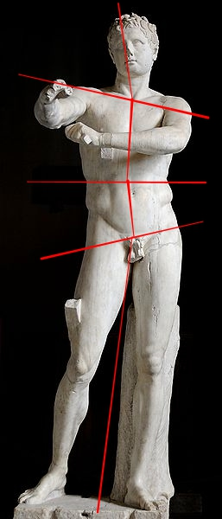

Slide 10
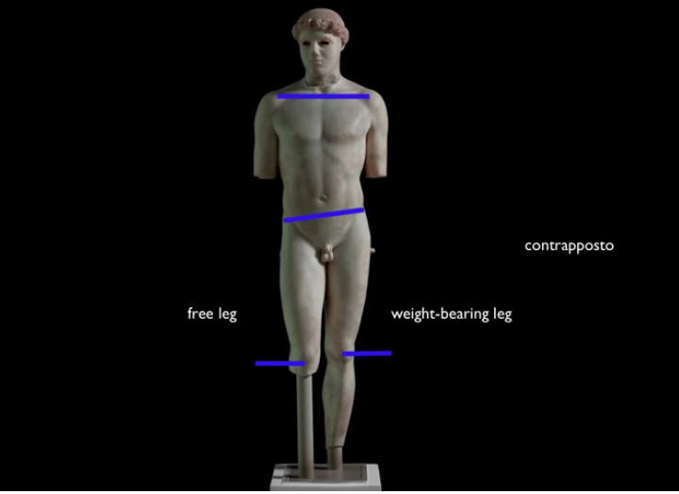

Slide 11
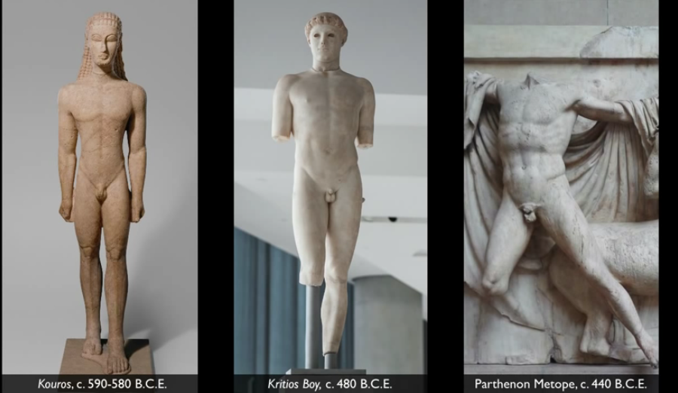

Slide 12
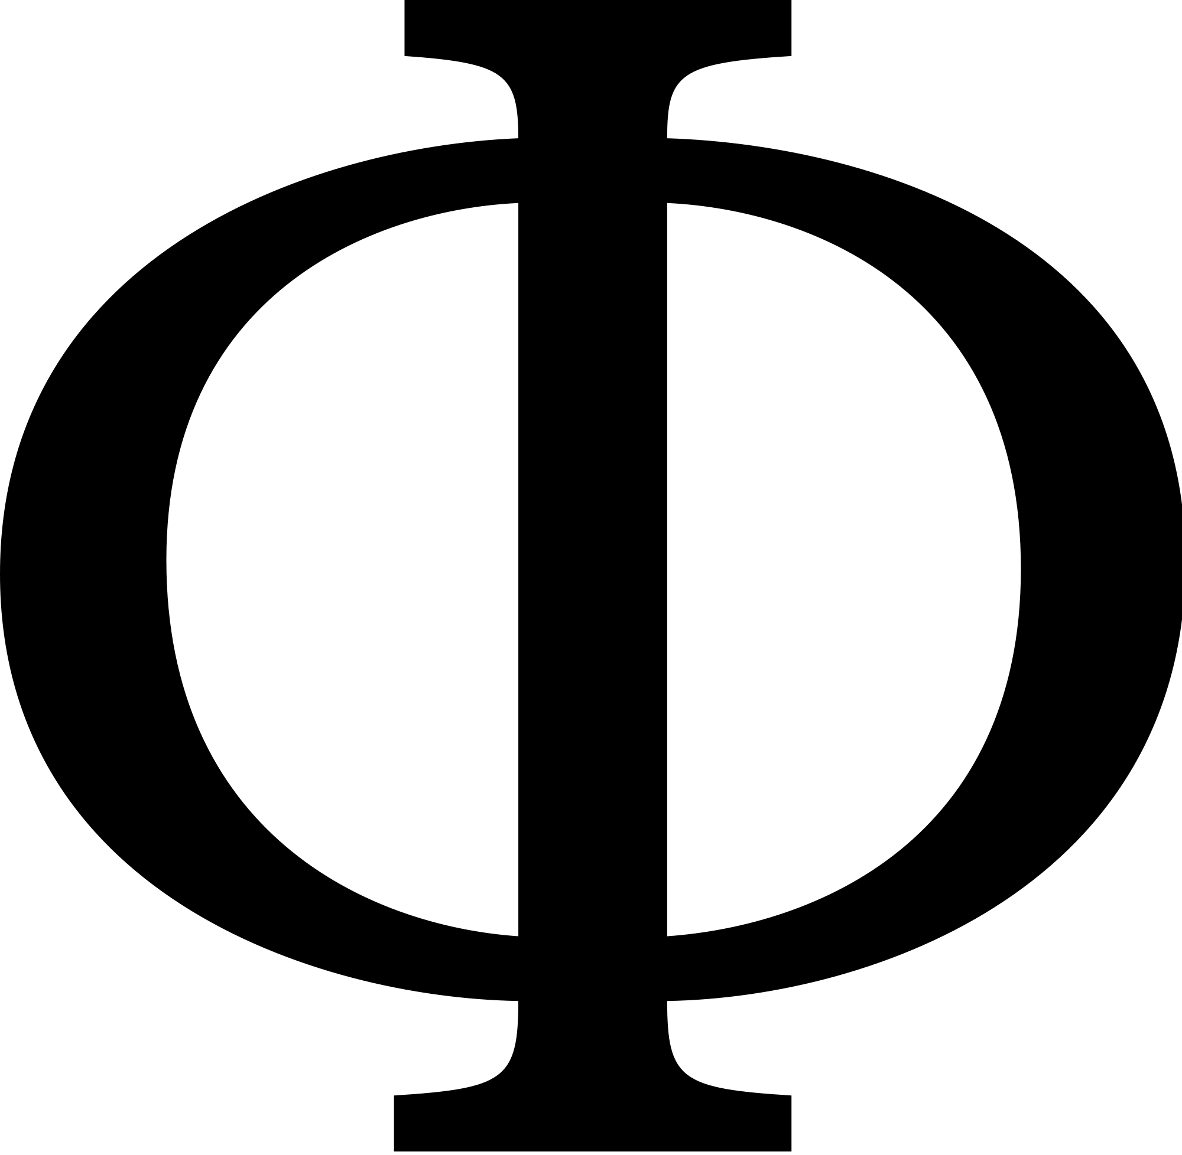

Slide 13
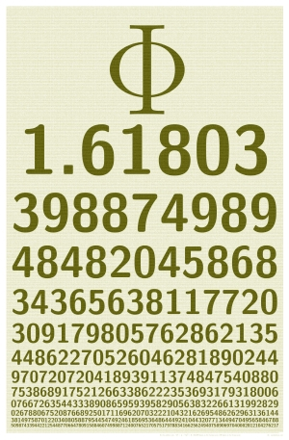

Slide 14
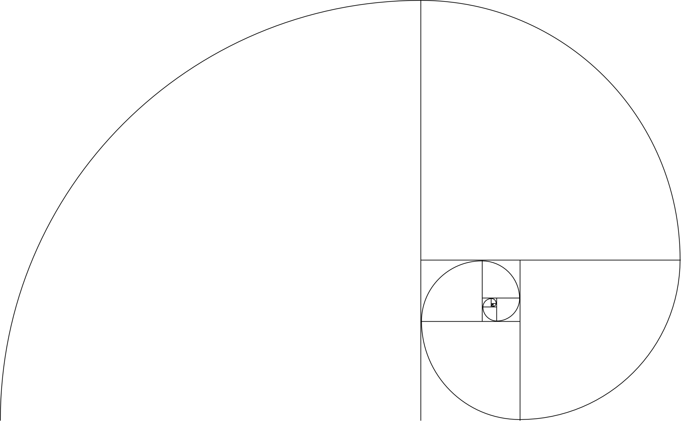

Slide 15
https://www.youtube.com/watch?v=wTlw7fNcO-0 3:20

Slide 16
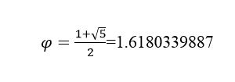
So what is the deal with Φ?
or the ratio between two numbers, expressed by the fibonacci sequence:
0, 1, 1, 2, 3, 5, 8, 13, 21, 34, 55, 89, 144, 233, 377, 610, 987, 1597, 2584, 4181, 6765, 10946, 17711, 28657, 46368, 75025, 121393, 196418, … ad infinatum
The next number is found by adding up the two numbers before it.
The 2 is found by adding the two numbers before it (1+1)
Similarly, the 3 is found by adding the two numbers before it (1+2),
And the 5 is (2+3),
and so on!

Slide 17
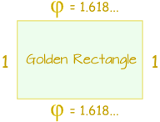
And here is a surprise. When we take any two successive (one after the other) Fibonacci Numbers, their ratio is very close to the Golden Ratio"φ" which is approximately 1.618034...

Slide 18
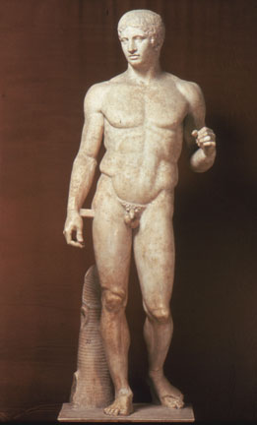
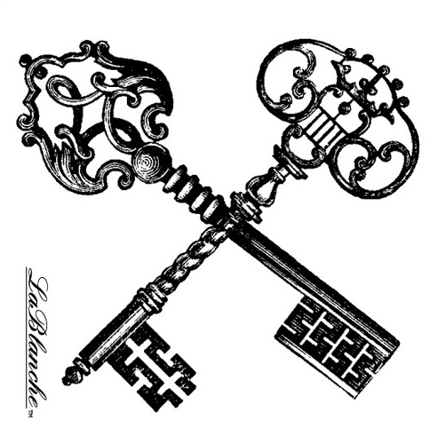
Polykleitos Spear Bearer or Doryphoros Classical Greek- 450 BCE
Roman copy of the original
-Can see the sculptor striving for perfection found in the human form
-Contrapposto pose
-See opposition in all of the figure's limbs-creates a very fluid, but dynamic, posture.
-Though natural stance, the figure is still idealized and would not be found in nature-"god-like“
Demonstration piece to accompany a treatise on the subject of the ideal statue
-Created through the utilization of math, not sculpted from real life, hence the statue is perfect.
-no emotion just perfection of human form

Slide 19
Polykleitos Spear Bearer or Doryphoros Classical Greek- 450 BCE
A cannon is a set of rules
Egypt had a “Cannon” for their figures
Now the Greeks Develop their “Cannon”
Polykleitos’s idea of relating beauty to ratio…
Beauty consists in the proportions, not of the elements, but of the parts, that is to say, of finger to finger, and of all the fingers to the palm and the wrist, and of these to the forearm, and of the forearm to the upper arm, and of all the other parts to each other.

Slide 20
Form | Function | Content | Context
Blocklike solidity | Demonstrate the canon | Contrapposto | Found in a gymnasia, place for athletic training
alternating tense and relaxed muscles | Inspire athletes to perfection | show both movement and rest
True modeling of muscular form |  | warrior and athlete; once held a spear
 |  | he averts his gaze; you can admire him, but he is unaware of the admiration

Slide 21
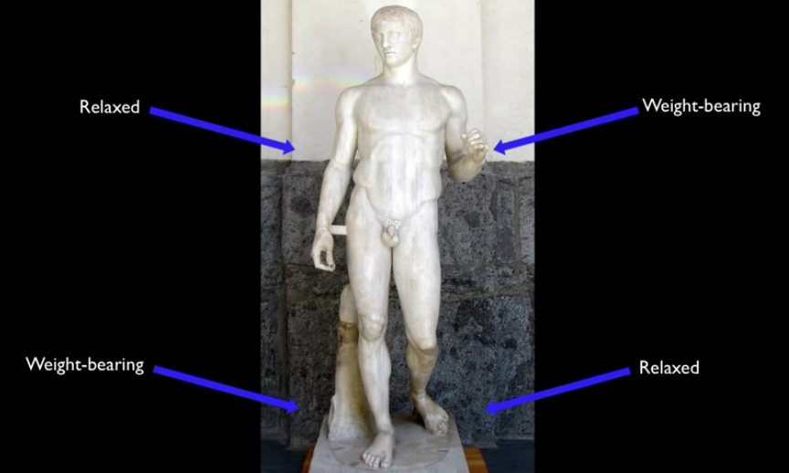

Slide 22
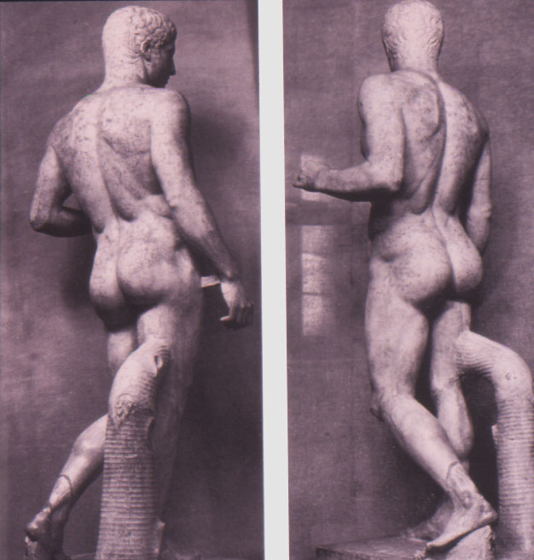

Slide 23
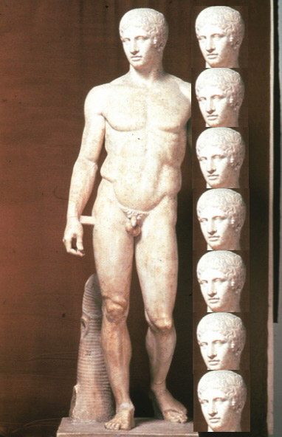

Slide 24
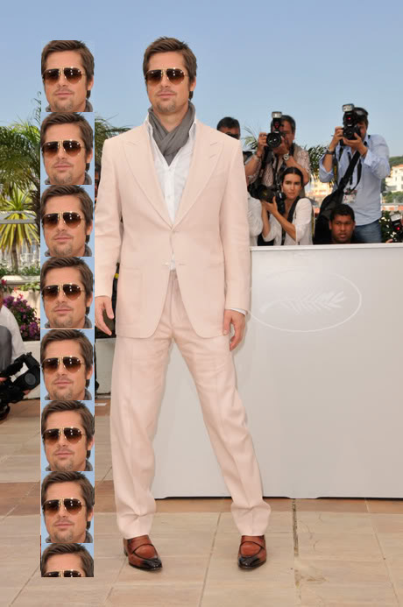
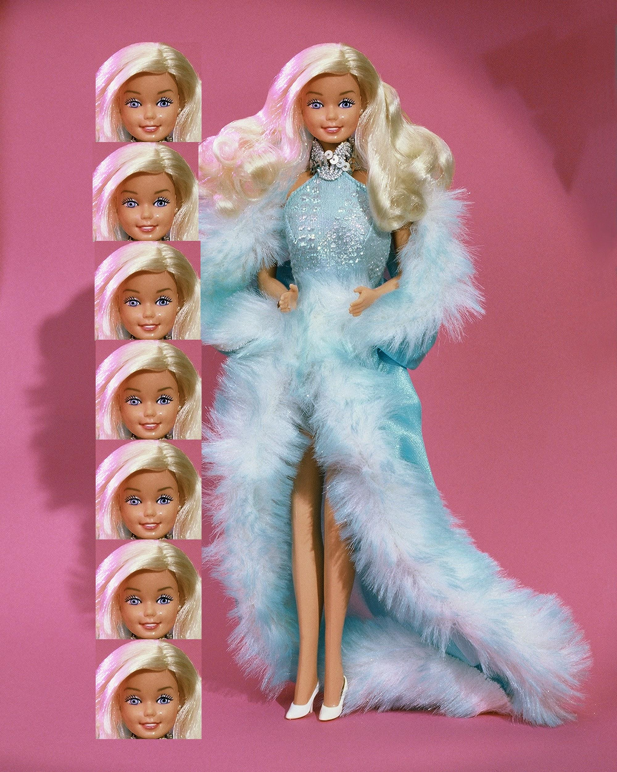
How do others stack up?

Slide 25
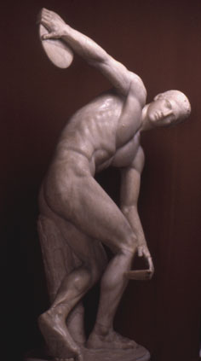
Myron Discus Thrower or Diskobolos Classical Greek 450 BCE
-This is a Roman copy of the original statue that no longer exists.
-The trunk of the tree was added for support.
-Everything about the figure is in motion-captured at the peak moment of the movement.
-See influence from Archaic style because the chest faces the onlooker, not truly statue in the round, it is meant to be viewed from the front
-No real expression because it is a timeless moment
-Unlike Archaic style because the disc thrower is more concerned about the actual throw than the viewers watching
-The arms and legs form an intersection of arcs-more energy.

Slide 26
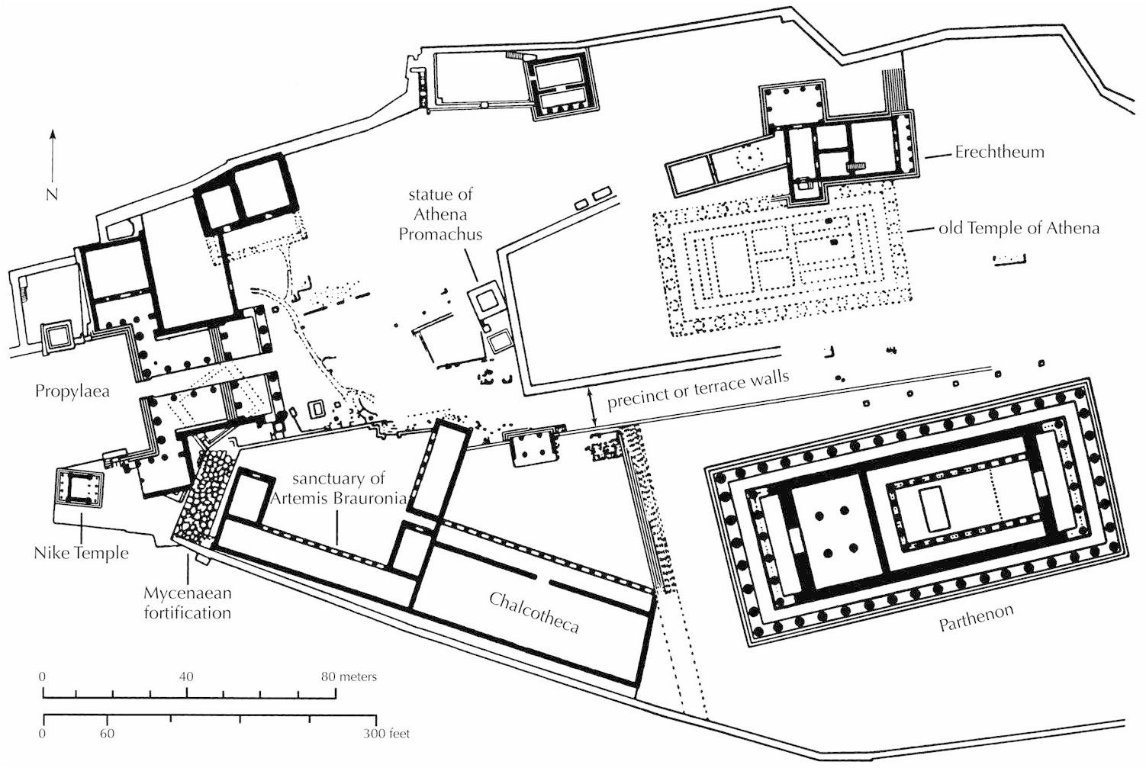
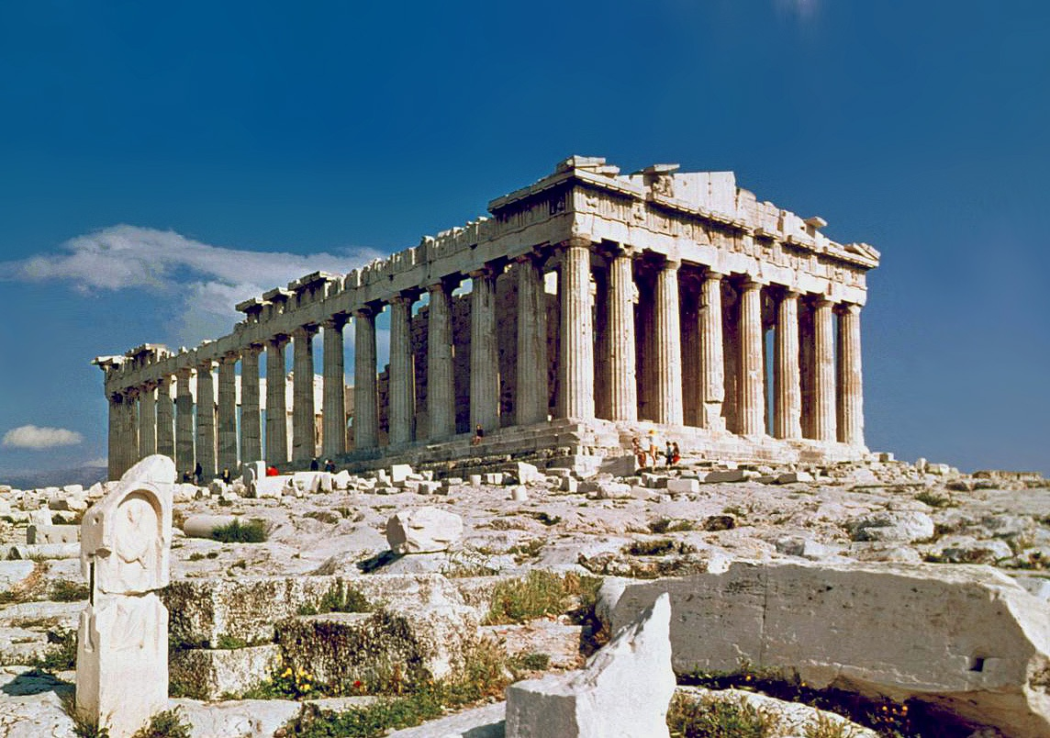
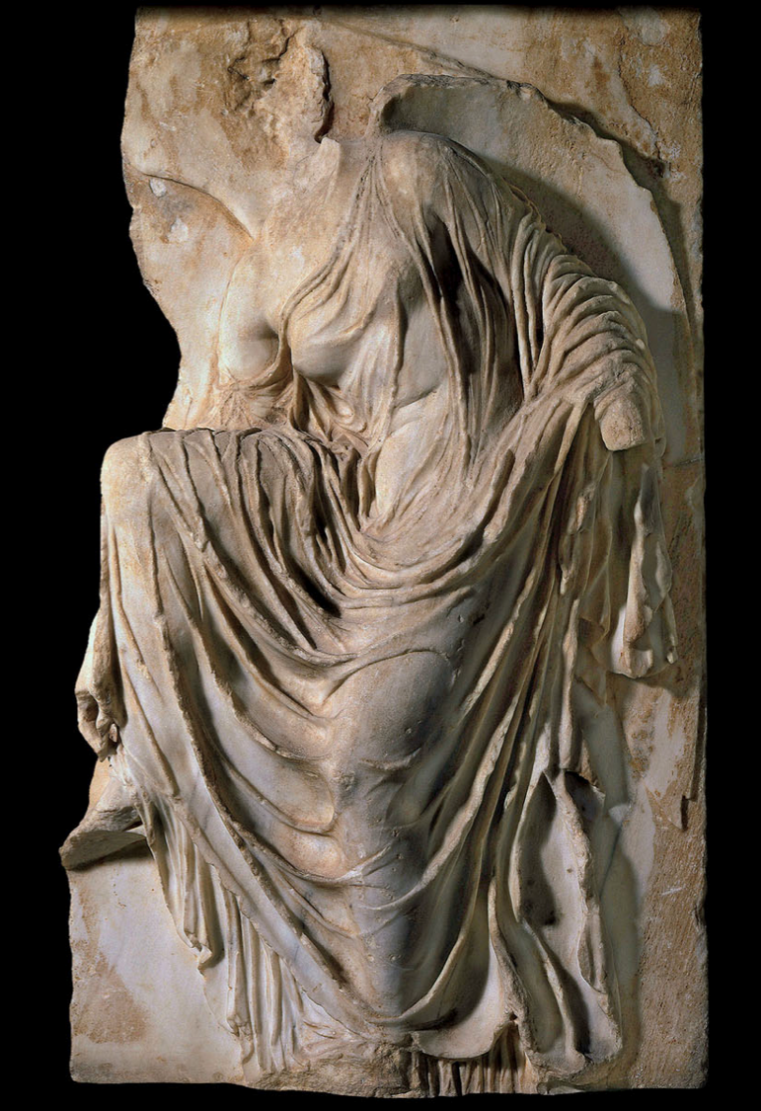
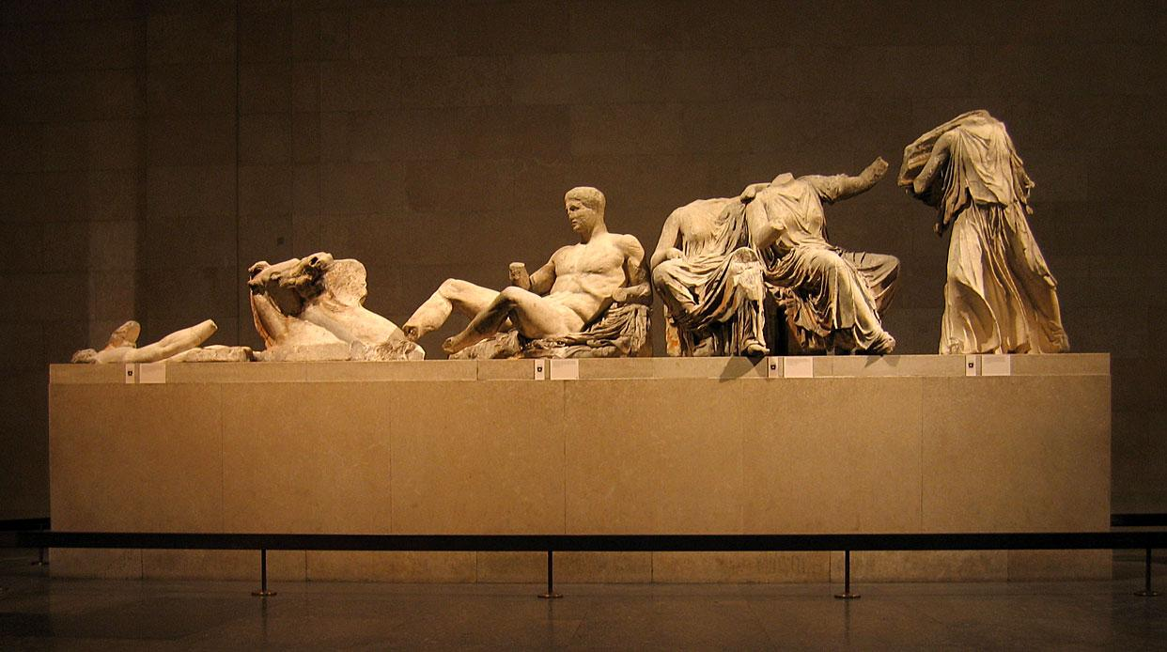
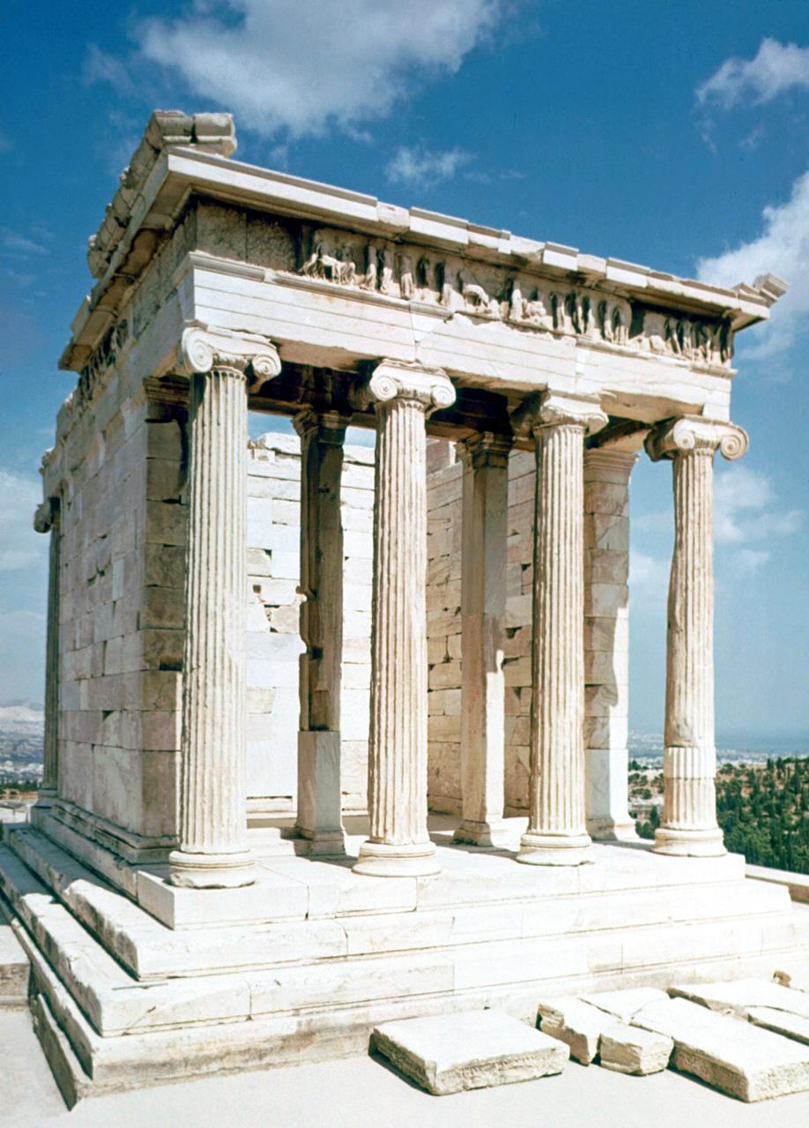
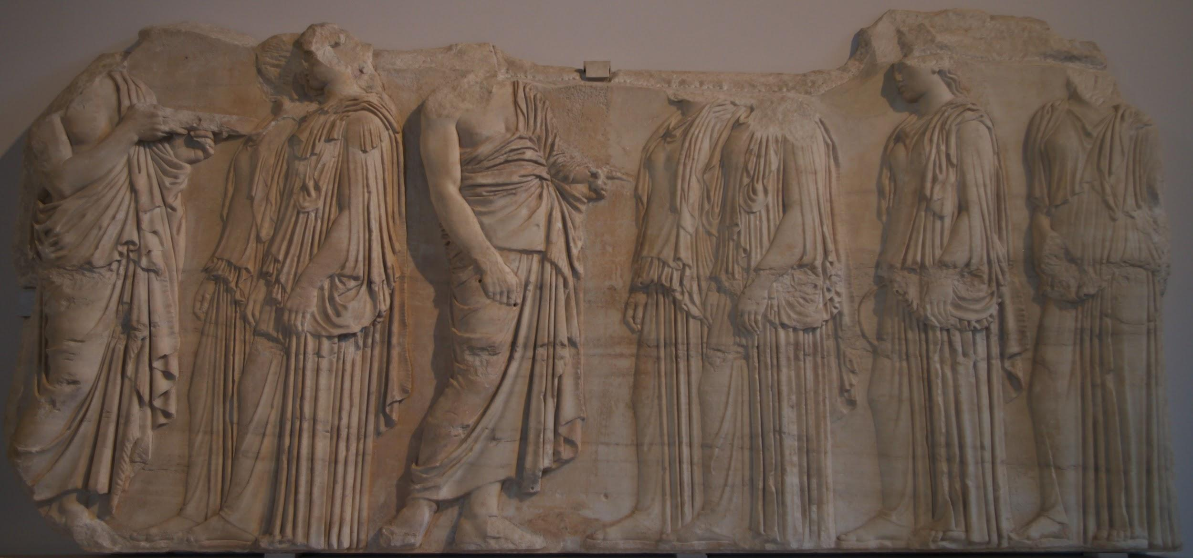
The Acropolis

Slide 27
But First….
Lets talk about Architecture

Slide 28
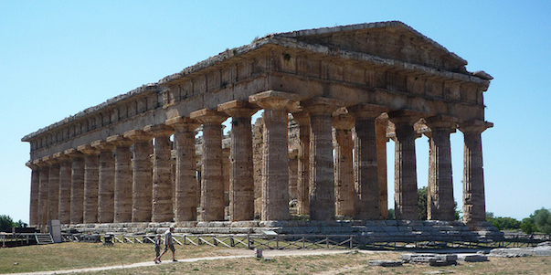
Greek Architecture Vocabulary
TEMPLE: The most recognizably “Greek” structure is the temple. The Greeks referred to temples with the term ὁ ναός (ho naós) meaning "dwelling;" temple derives from the Latin term, templum. The earliest shrines were built to honor divinities and were made from materials such as a wood and mud brick. This basic form remained unchanged in its concept for centuries. In the eighth century B.C.E. Greek architecture begins to make the move from ephemeral materials (wood, mud brick, thatch) to permanent materials like stone

Slide 29
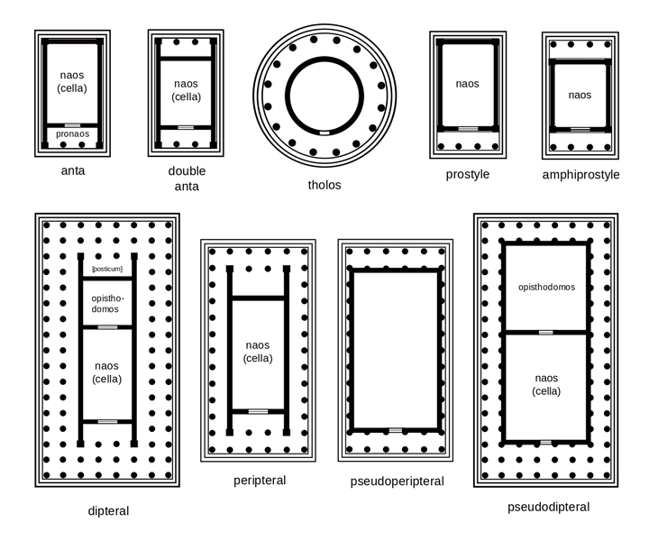

Slide 30
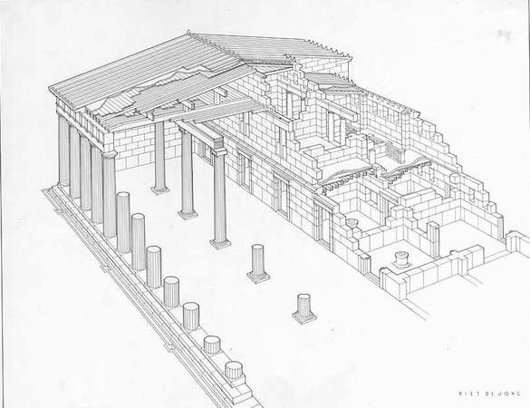
Greek Architecture Vocabulary
STOA: Stoa (στοά) is a covered walkway or colonnade that was usually designed for public use

Slide 31
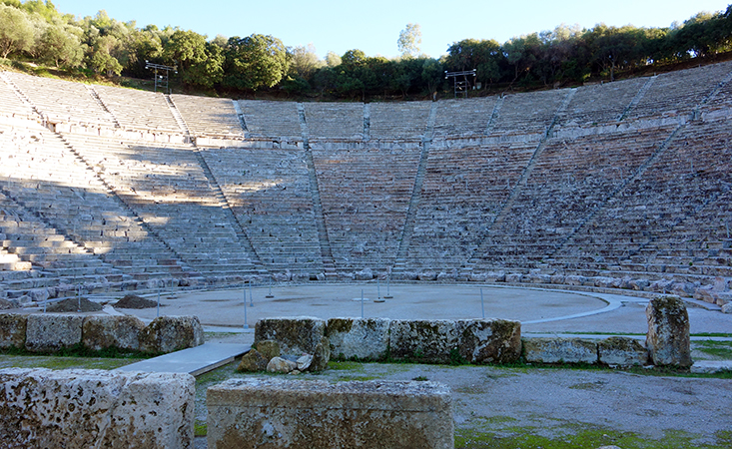
Greek Architecture Vocabulary
THEATER: “The Greek theater was a large, open-air structure used for dramatic performance. Theaters often took advantage of hillsides and naturally sloping terrain and, in general, utilized the panoramic landscape as the backdrop to the stage itself. The Greek theater is composed of the seating area (theatron), a circular space for the chorus to perform (orchestra), and the stage (skene)”

Slide 32
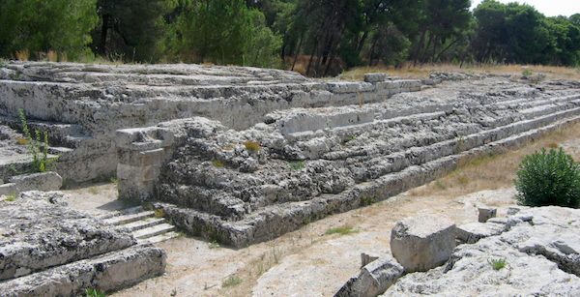
Greek Architecture Vocabulary
ALTAR: “Since blood sacrifice was a key component of Greek ritual practice, an altar was essential for these purposes. While altars did not necessarily need to be architecturalized, they could be and, in some cases, they assumed a monumental scale”

Slide 33
The architectual order
-An architectural order describes a style of building
.
-”In Classical architecture, each order is readily identifiable by means of its proportions and profiles as well as by various aesthetic details.”
-“The style of column employed serves as a useful index of the style itself, so identifying the order of the column will then, in turn, situate the order employed in the structure as a whole”

Slide 34
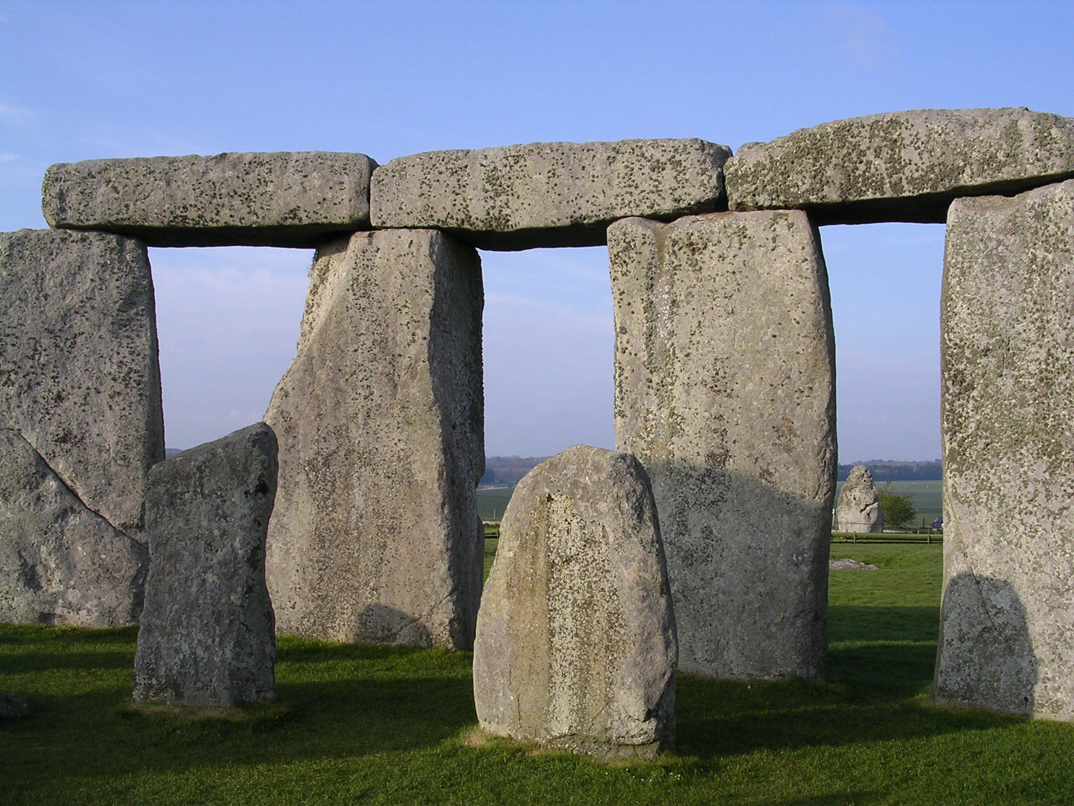

Slide 35
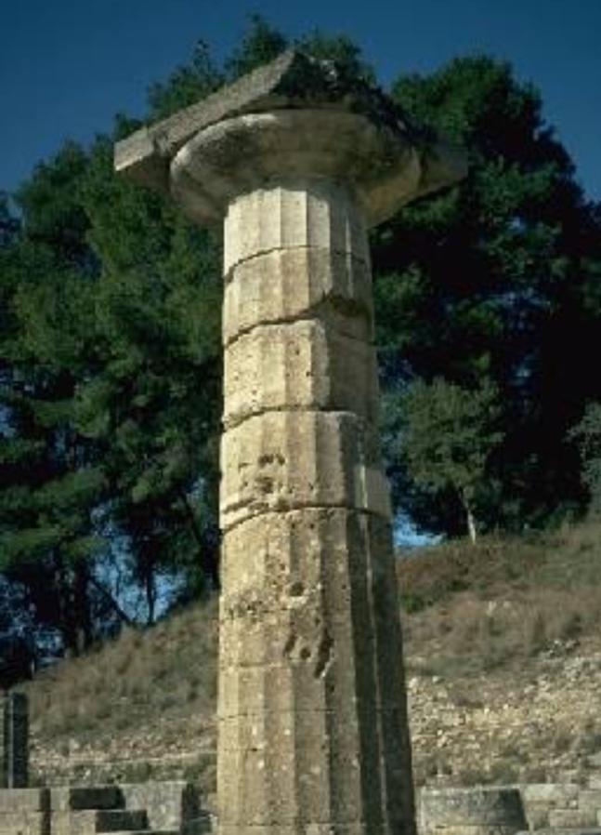
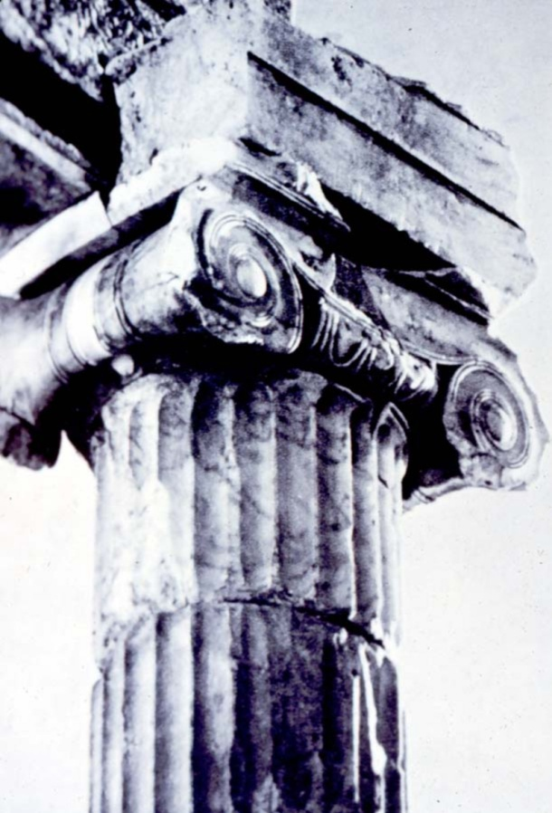
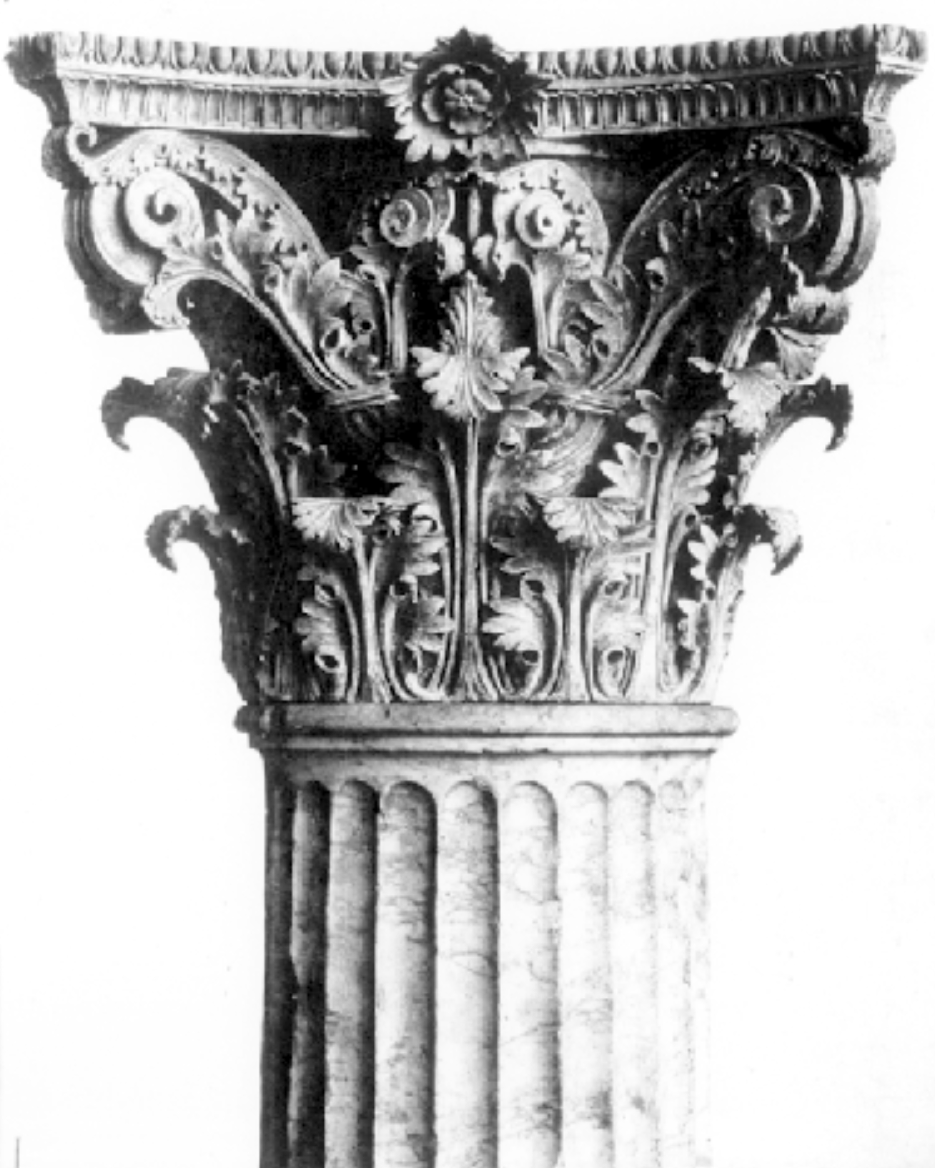
Doric order
Ionic order
Corinthian order
Notes:
Slide concept by William V. Ganis, PhD FOR EDUCATIONAL USE ONLY For publication, reproduction or transmission of images, please contact individual artists, estates, photographers and exhibiting institutions for permissions and rights.

Slide 36
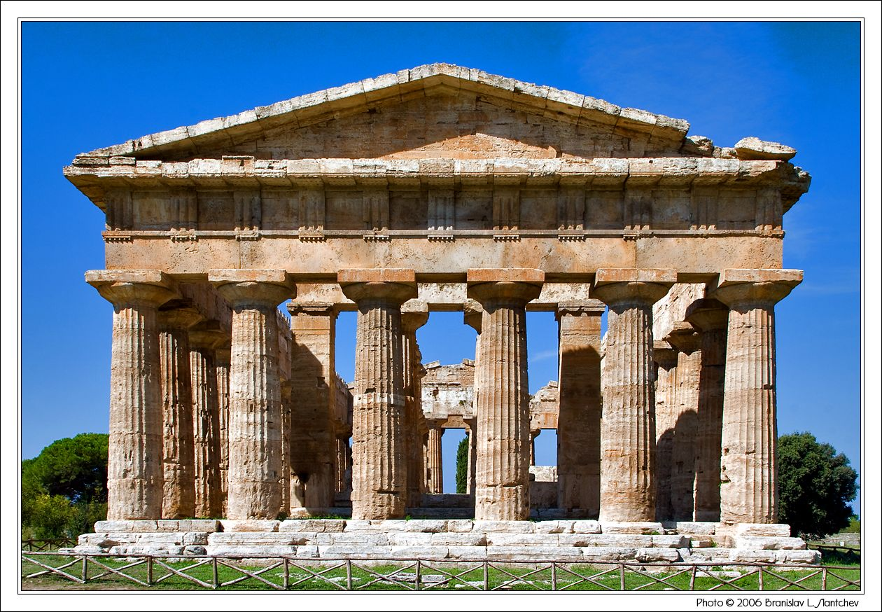
Doric Order

Slide 37
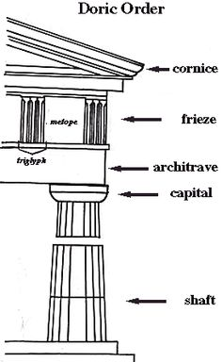
Doric Order
The Doric order is the earliest of the three orders
Represents the movement in Mediterranean architecture when monumental construction made the transition from impermanent materials—like wood—to permanent materials, namely stone.
Consider to be a Masculine style of architecture

Slide 38
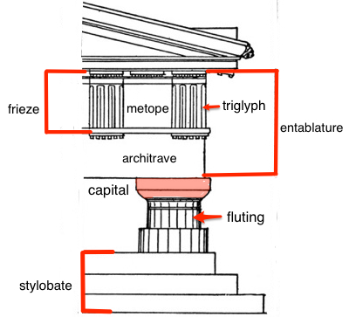

Slide 39
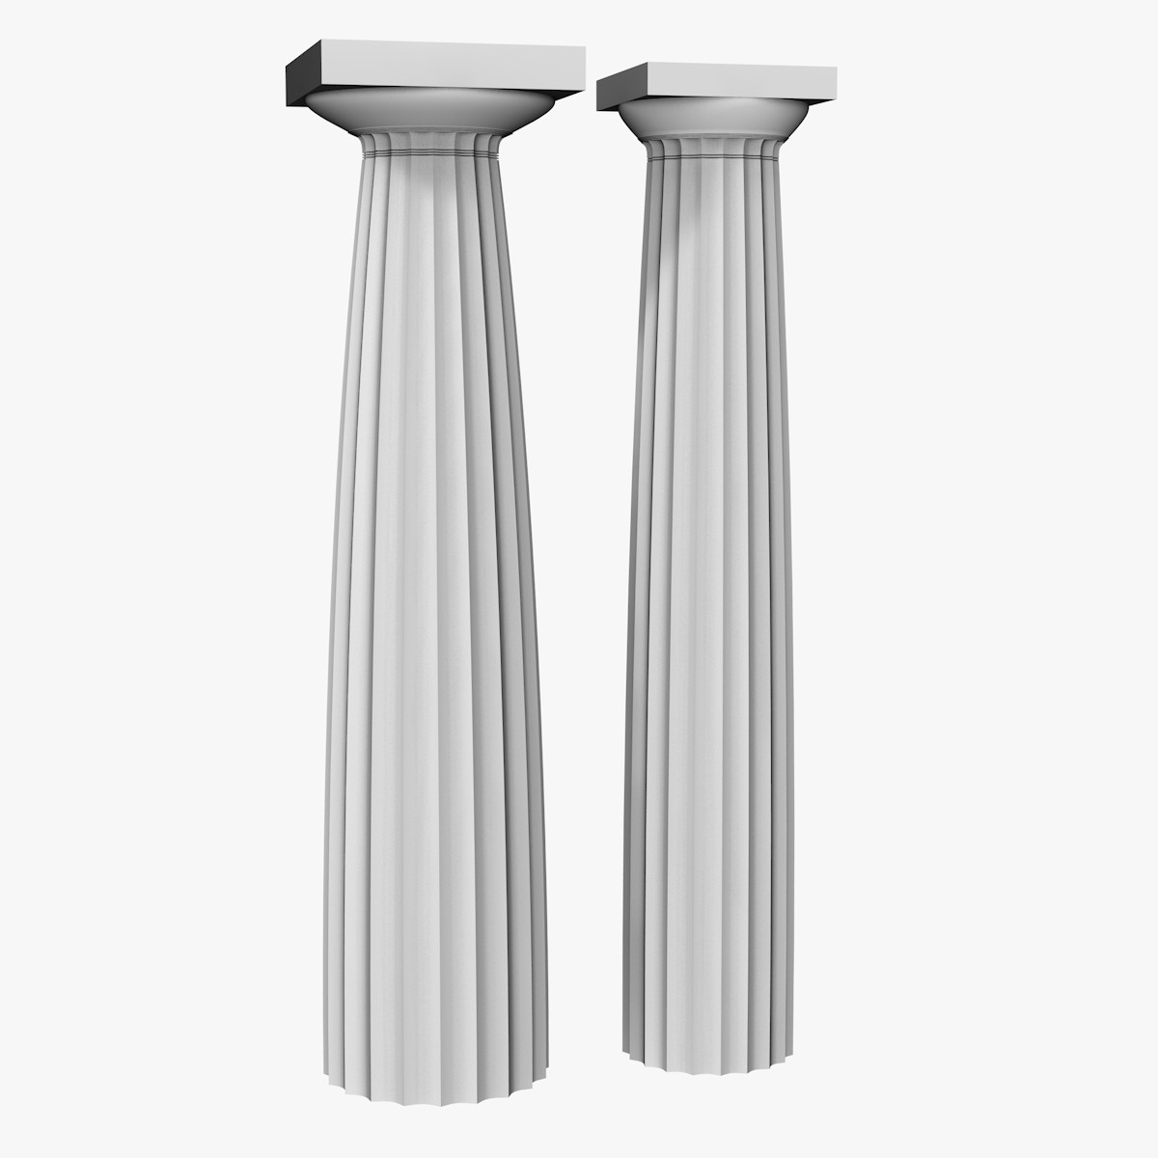

Slide 40
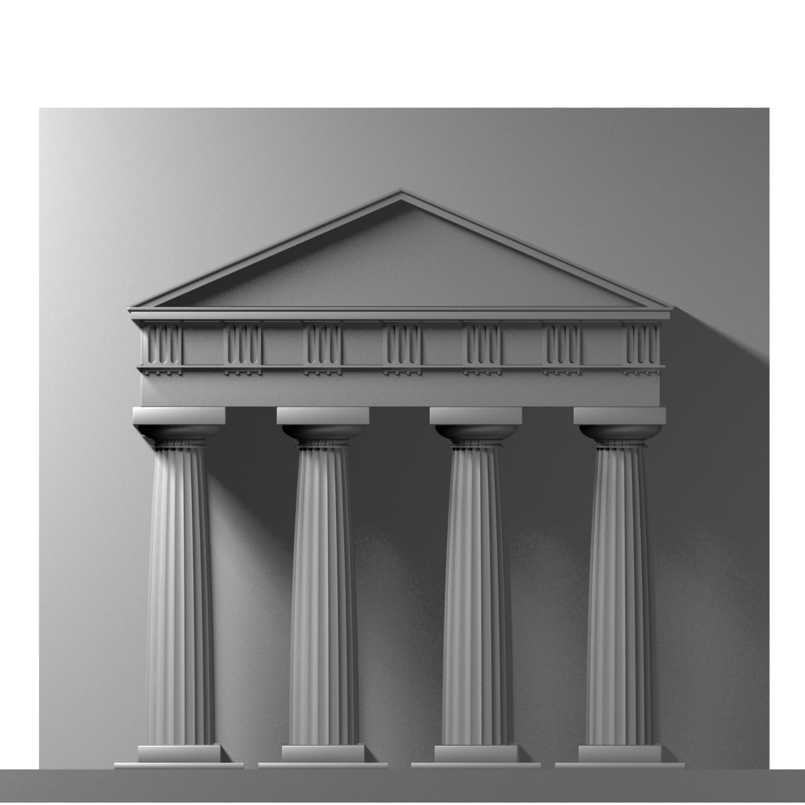

Slide 41
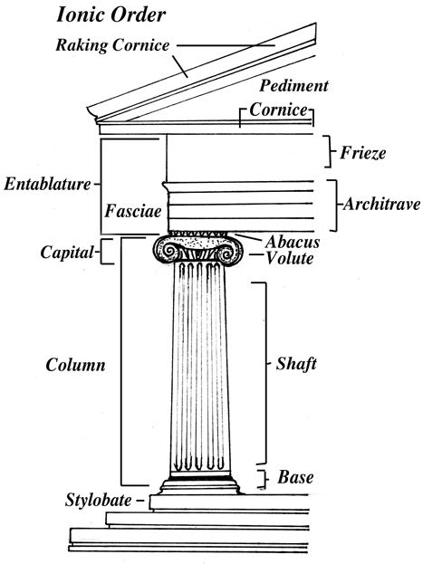
Ionic Order
Originate in Ionia (Turkey)
Scroll like ornaments
Incorporated a base at the bottom of the shaft
Had a running frieze of relief sculptures as opposed to the triglyphs and metopes
Considered to have more feminine proportions, long & graceful

Slide 42
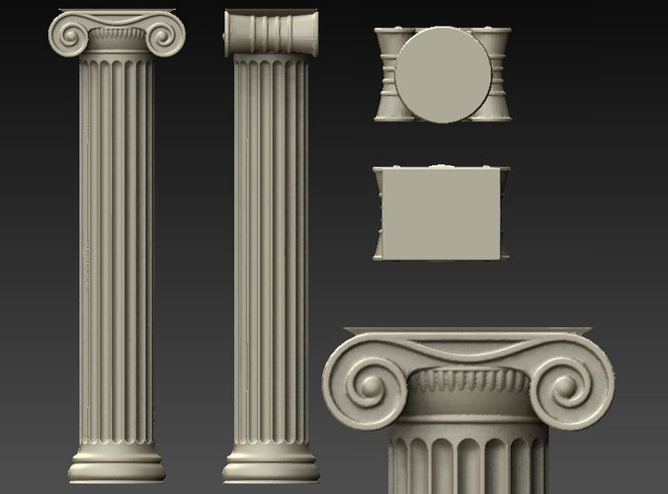

Slide 43
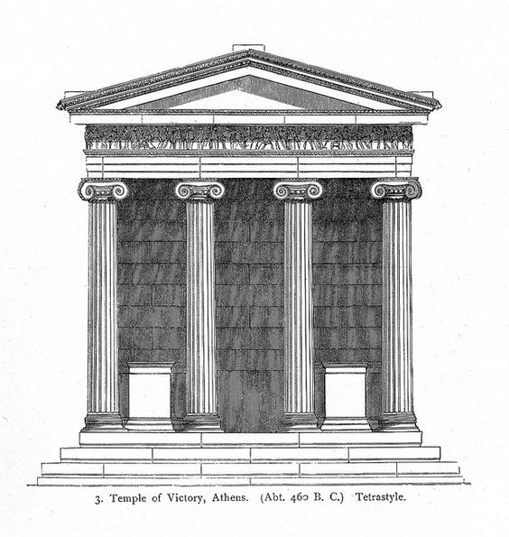

Slide 44
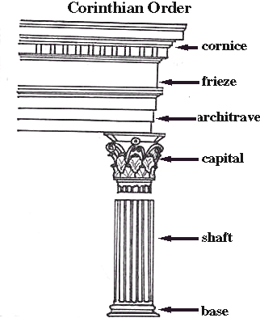
Corinthian Order
Latest and Most elaborate
Used by both Greek & Romans
Connected to the Greek city-state of Corinth
Defining element is the elaborate carved capital
Incorporates leaves from the acanthus plant on the capital

Slide 45
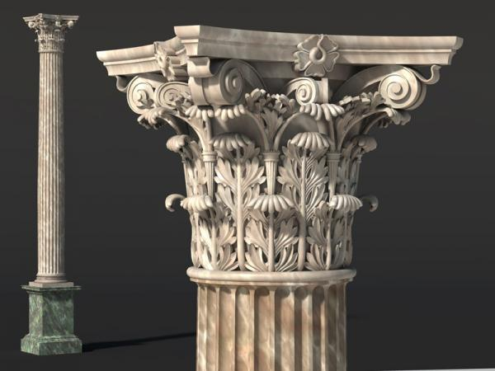

Slide 46
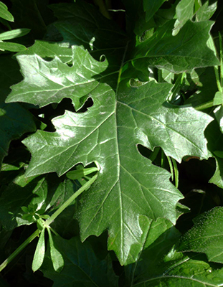

Slide 47
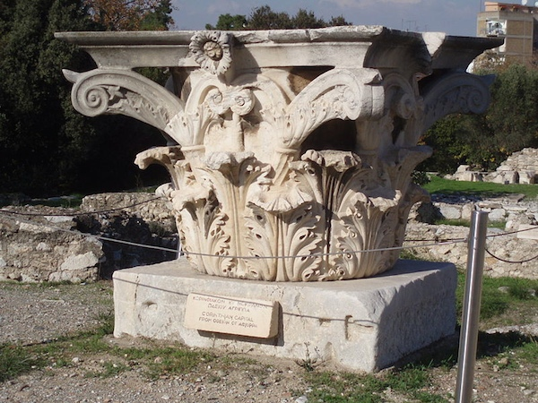

Slide 49
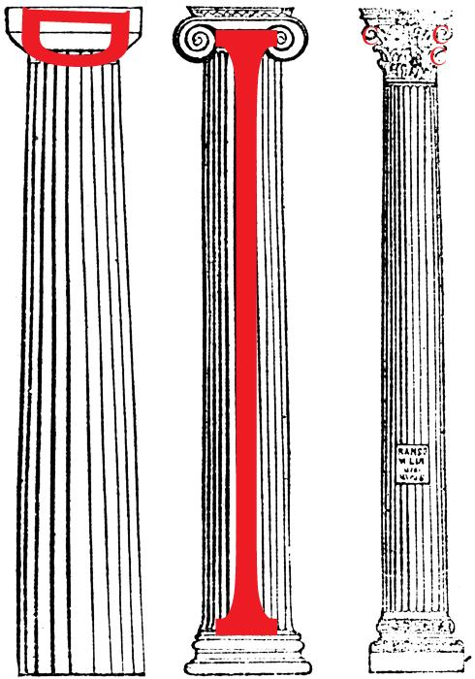
Doric- the capital is shaped like a side ways letter “D”
Ionic- the whole thing is shaped like the letter “I”
Corinthian- the acanthus leaves on the capital look like little “C”’s

Slide 50
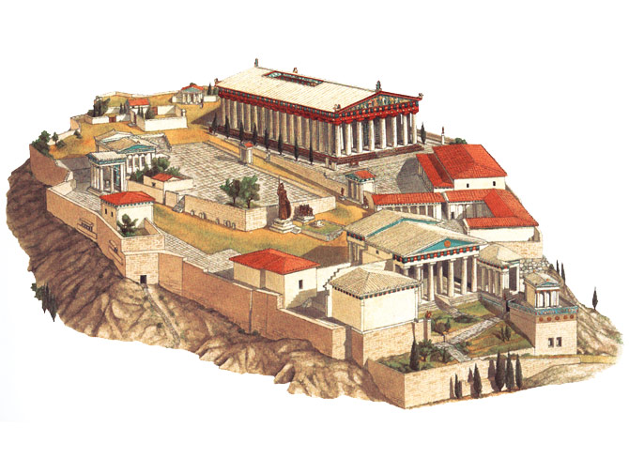
Acropolis. Athens, Greece Iktinos & Kallikrates. 447-410 BCE. Marble

Slide 53
Acropolis of Athens
492-490 BCE – Darius I’s attempts to conquer Greece, Loses the Battle of Marathon
After Darius I dies his son Xerxes I attacks Greece in 480 BCE

Slide 56
Acropolis of Athens
The Greco-Persian war rages for 30 years. In 449 BCE the Athenians & Persians declare peace

Slide 57
Acropolis of Athens
Once Again under Greek control, the Athenians rebuild the Acropolis
Unlike the typical acropolis found amongst the Greeks the Acropolis of Athens is built as a sacred structure, not defensive
The Acropolis is not one building, but rather a collection of important structures

Slide 58
The Propylaia

Slide 61
Nike Temple
Amphiprostyle (4 columns on the front and back)
Ionic
Built to commemorate the Greek victory over the Persians in the Battle of Marathon
Many images of victory on the temple

Slide 62
Nike Adjusting her Sandal from the Temple of Athena Nike, Classical Greek c. 420 BCE
Graceful figure in high relief
-Deeply incised drapery, wet to show the body of the female figure
-Frozen narrative needs the viewer to add the information necessary to tell a story

Slide 65
Parthenon, Iktinos & Kallikrates. Classical Greek- 420 BCE
Perfectly proportioned
Built to replace earlier temple destroyed by the Persians
-Combination of Doric and Ionic styles
-Columns are more slender than the original attempts
-Located on the Acropolis

Slide 66
Parthenon, Iktinos & Kallikrates. Classical Greek- 420 BCE
-Algebra was used to find the perfect proportions with the following equation: x = 2y +1
(the temple’s short ends have 8 columns; the long sides have 17
17=2(8)+1)
-There is curvature to the entire building - optical illusion because it looks perfectly vertical and horizontal;
this gives it a feeling of being more natural

Slide 67
Optical tricks of the Parthenon
https://www.youtube.com/watch?v=vzhA3yiEofI 3:40

Slide 75
Helios and His Horses pediment of Parthenon Classical Greek 420 BCE.
Can see the arms of Helios rising out of the earth as his chariot pulls the sun across the sky
-The male figure on the left is either Dionysus or Herakles.
-The horses show signs of being awake and refreshed with the beginning of their day.
-Natural flow within the shape of the pediment
-Natural poses with the figures (no Archaic smile)

Slide 77
The Seated Goddessess pediment of the Partheneon Classical Greek 420 BCE
Most likely Aphrodite, Dione, and Hestia
-The figures are in a reclining position to show an even more natural pose.
-The sculptor was able to capture the anatomy associated with the female body.
-The draperies across the bodies are a significant contrast to the texture of their skin, and there is a dramatic use of dark and light between the folds of the fabric.
-Clinging wet drapery reveals the voluptuous bodies beneath

Slide 81
Athena Parthenos (or the Virgin) Phidias Classical Greek 438 BCE
No longer exists
We know about it from descriptions from Roman and Greek authors and from Roman copies
Chryselephantine statue
Stood 38 feet tall
Was at the heart of the Parthenon
Holds winged Nike in her right hand (victory over the Persians)
On sandals was depicted Amazonomachy (when Theseus drove the Amazons out of Athens)
On inside of shield was painted gigantomachy
All these references refer back to the defeat of the Persians by the Athenians

Slide 82
Plaque of the Ergastines, Parthenon Frieze

Slide 84
Parthenon Frieze
The frieze was different from all previous temples in that all sides depicted a single subject, in this case, the Panathenaic procession which was held in Athens every four years and which delivered a new, specially woven robe (peplos) to the ancient wooden cult statue of Athena housed in the Erechtheion.

Slide 86
Erechtheion Classical Greek c. 420 BCE
Temple to Athena as well as smaller gods
Celebrates the victory of Athena over Poseidon for the patronage of the city
-Very asymmetrical (partially due to being built on uneven ground)
-The porch on the south side has women who replace columns they are called caryatids.
-Can see the shift in weight on the caryatids to look natural; however, they are still "stiff" enough to support the weight of the roof
-Located on the Acropolis

Slide 91
Two Expressions of the same idea:
Φ

