Slide 1
The Classic World
Greek Art

Slide 3
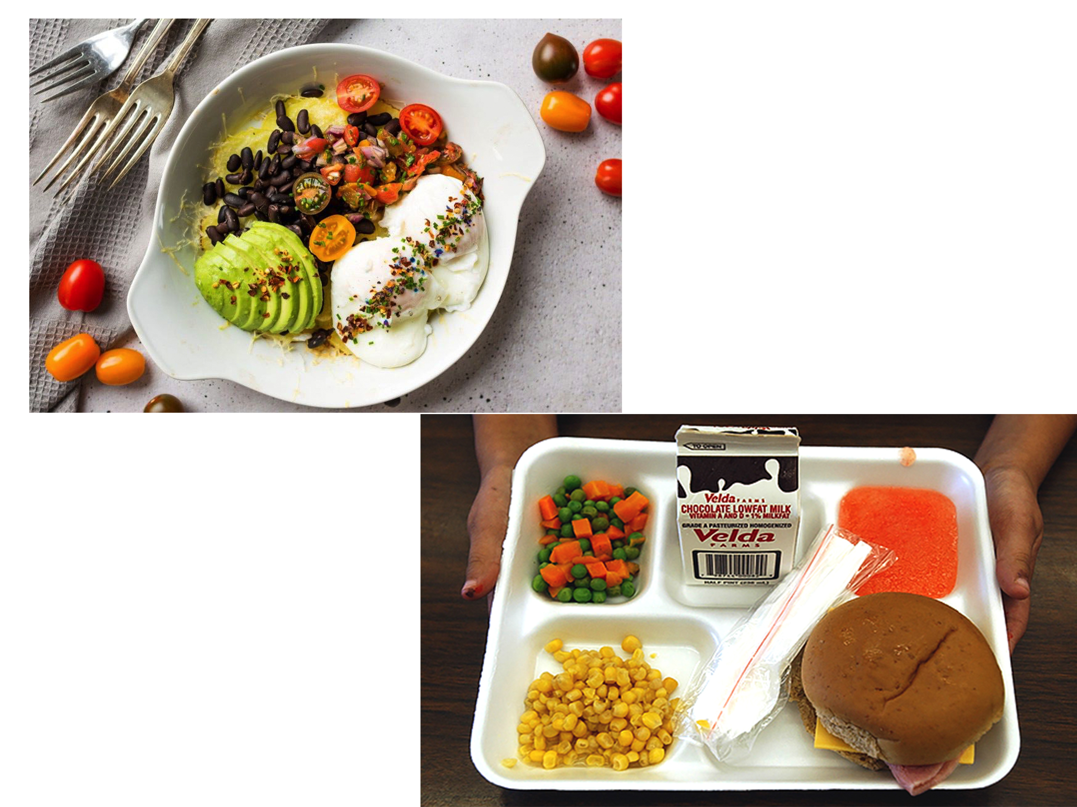

Slide 5
Enduring Understanding:
Essential Knowledge
Greek Art is characterized by a pantheon of gods celebrated in large civic and religious buildings
Greek art is studied chronologically according to stylistic changes
Greek works are not studied according to dynastic rule, like Egypt, but according to broad changes in stylistic patterns
Greek art is most known for its idealization and harmonic proportions, both in sculpture and architecture
Greek art has had an important on European art, esp. in the 18th century

Slide 6
Enduring Understanding:
Essential Knowledge
Much Ancient writing survives in the fields of literature, law, politics and business. These documents shed light on Greek civilization as a whole, and on art in particular.
Greek writing contains some of the earliest contemporary accounts about art and artists
Epics form the foundation of Greek writing. The texts were at first transmitted orally, but later were written down.

Slide 7
Key Ideas
Greek art introduces the concept of Classical art
Idealizing of the human form, the beauty of the nude, and the expression of emotions
Greek temples are hugely influential in the development of western architecture
Painting on pottery echoes what is happening in sculpture and is virtually all that remains of Greek painting

Slide 8
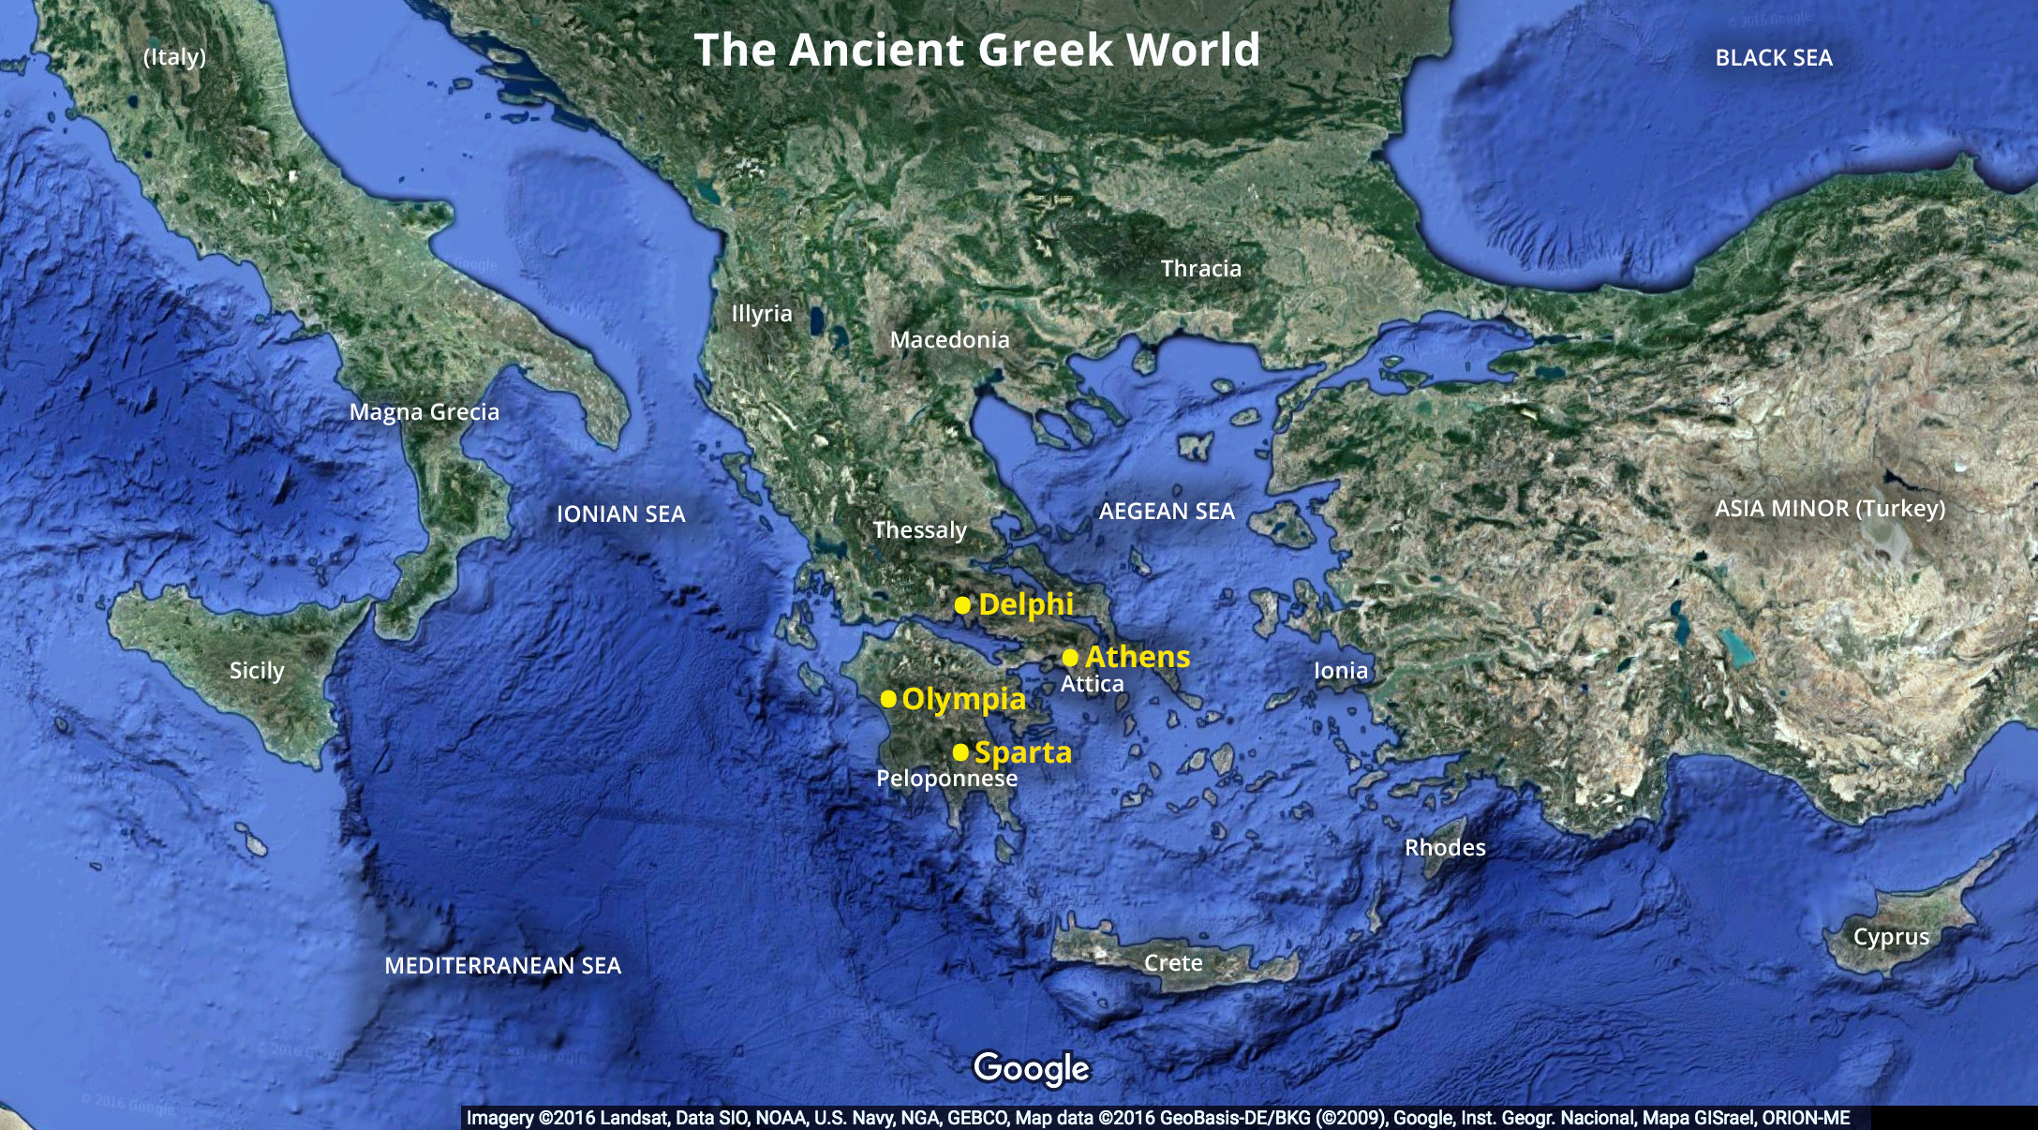

Slide 10
Cycladic Minoan Mycenaean Early Greek

Slide 12
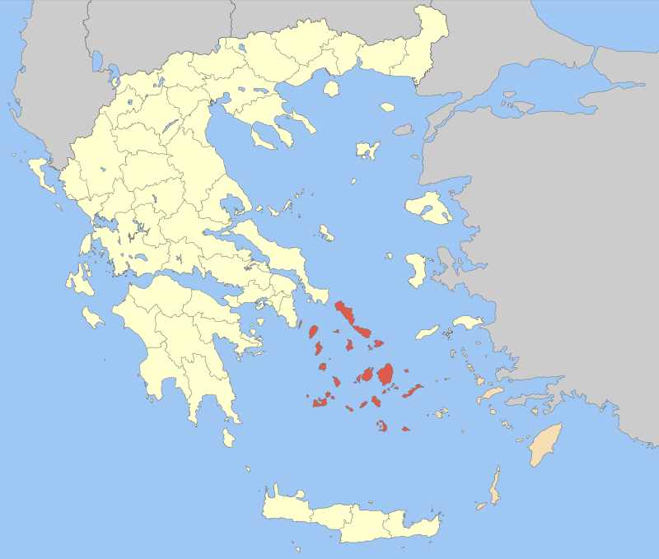

Slide 15
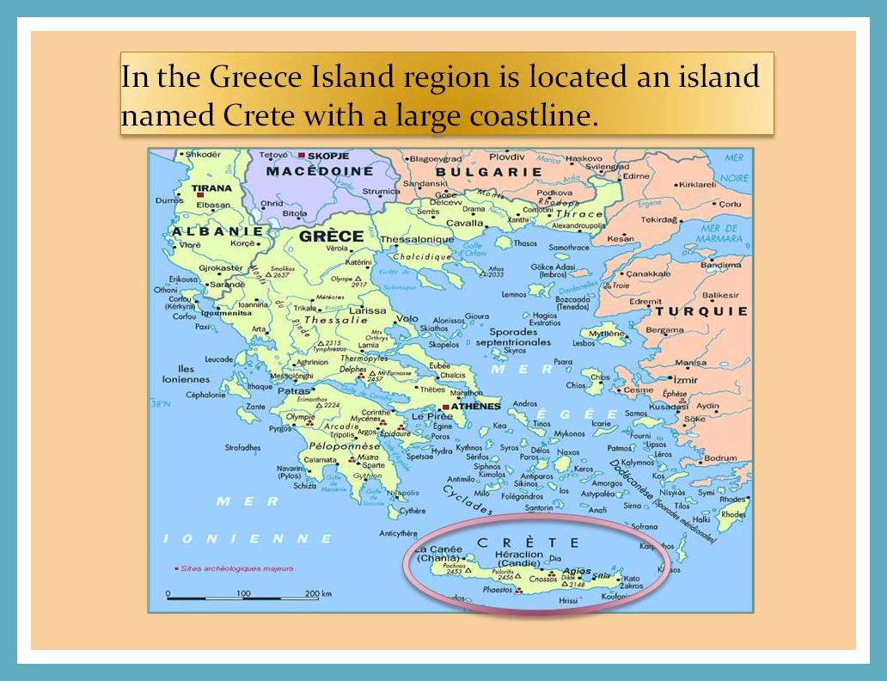

Slide 16
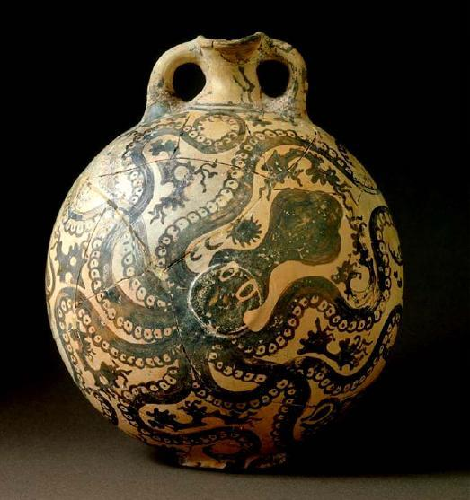

Slide 17
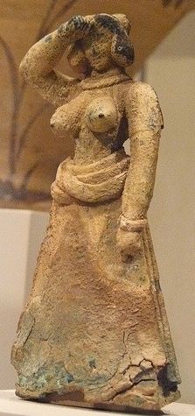
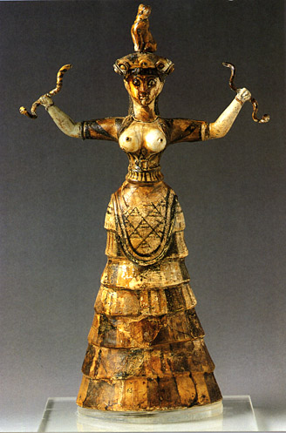

Slide 18
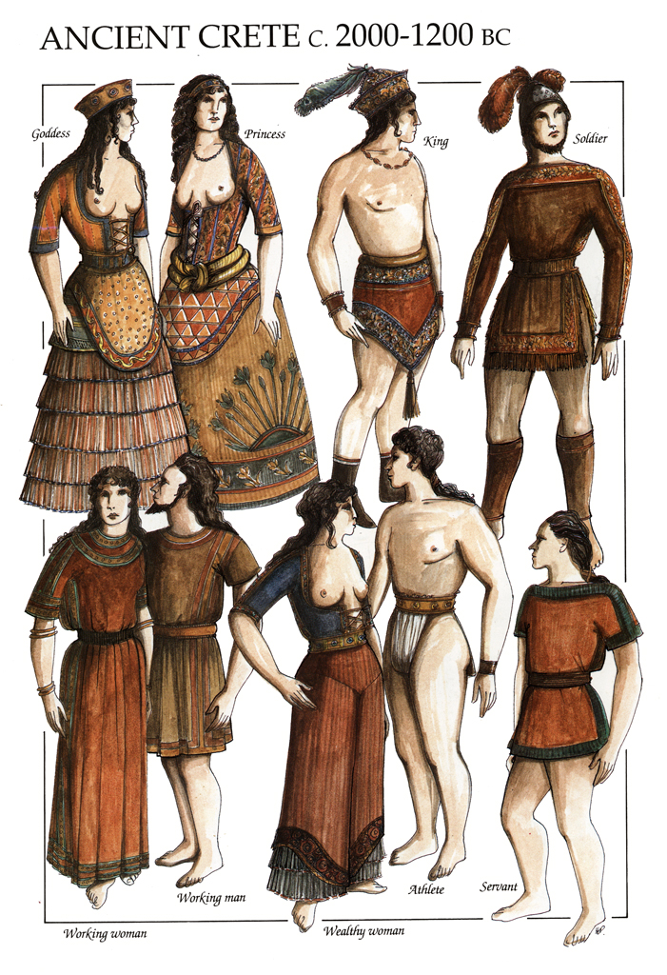

Slide 22
https://www.youtube.com/watch?v=pxcSJu5SEMw 3:30

Slide 23
Timeline
Archaic Greek Art: 600-480 BCE
Classical Greek Art: 480-323 BCE
Hellenistic Art: 323-30 BCE

Slide 24
Archaic Art

Slide 25
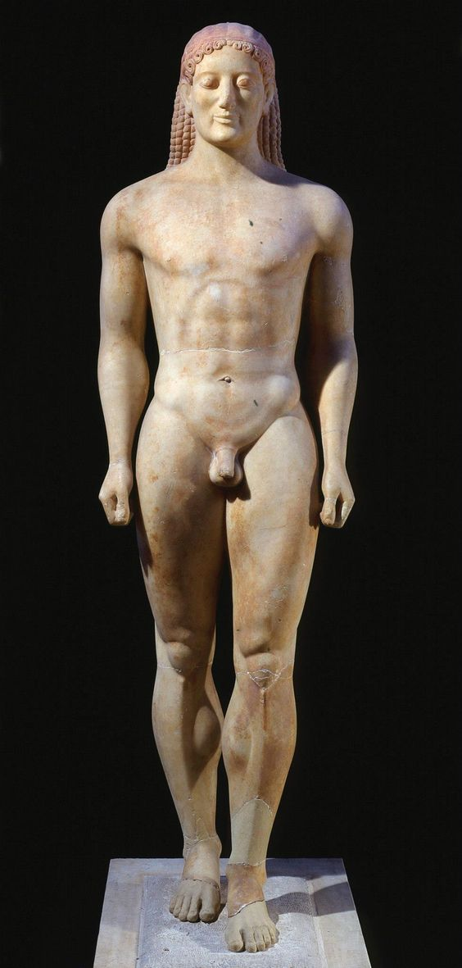
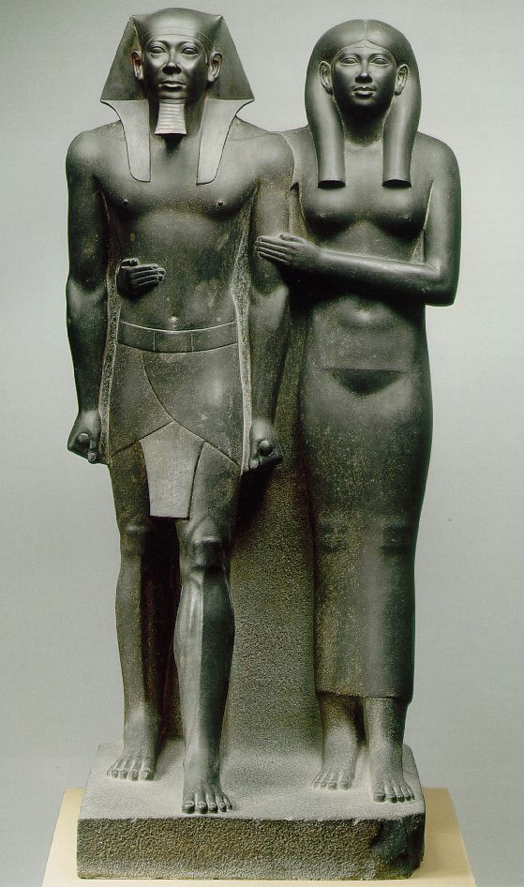
What Do We Have Here?

Slide 26
The Archaic Period (c. 600-480/479 B.C.E.)
“While Greek artisans continued to develop their individual crafts, storytelling ability, and more realistic portrayals of human figures throughout the Archaic Period, the city of Athens witnessed the rise and fall of tyrants and the introduction of democracy by the statesman Kleisthenes in the years 508 and 507 B.C.E.”

Slide 27
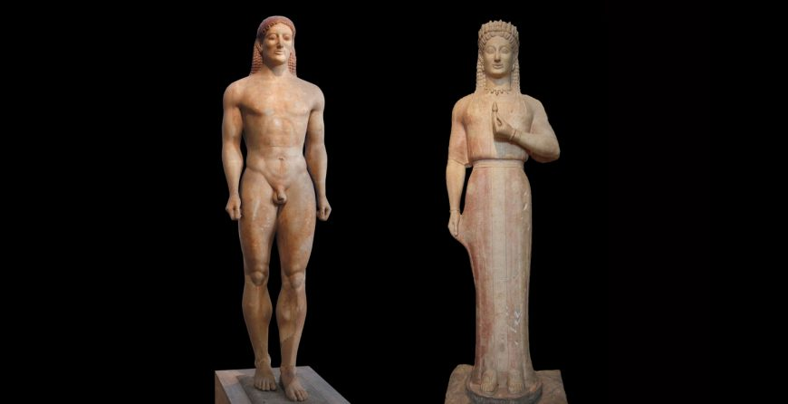
Visually, the period is known for large-scale marble kouros (male youth) and kore (female youth) sculptures

Slide 28
the kouros stands rigidly with both arms extended at the side and one leg advanced.
Frequently employed as grave markers, these sculptural types displayed unabashed nudity, highlighting their complicated hairstyles and abstracted musculature
The kore, on the other hand, was never nude. Not only was her form draped in layers of fabric, but she was also ornamented with jewelry and adorned with a crown. Though some have been discovered in funerary contexts

Slide 29
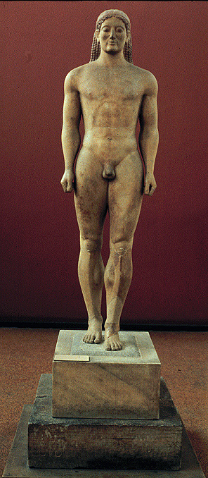
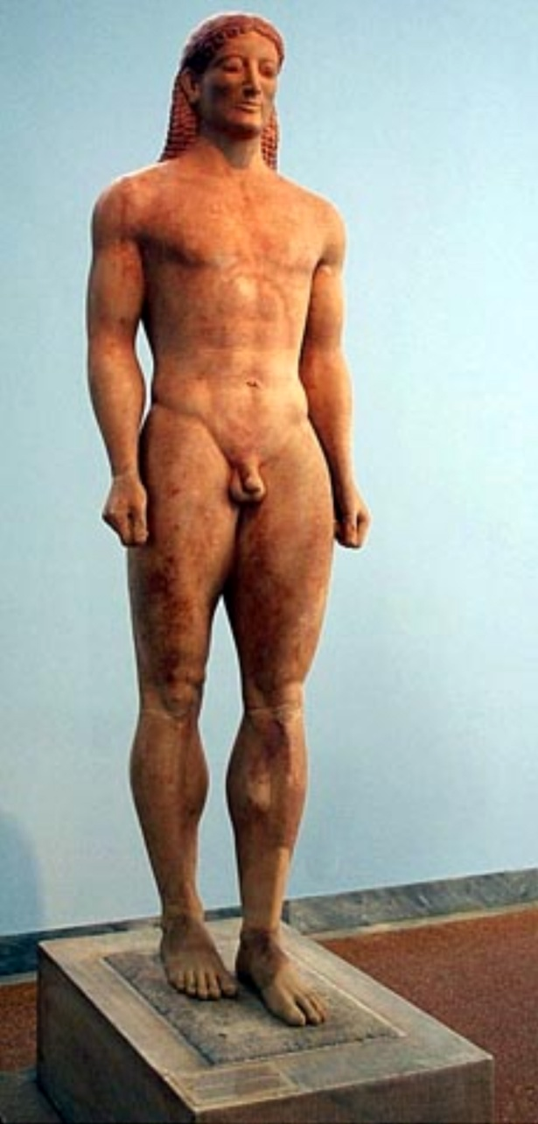
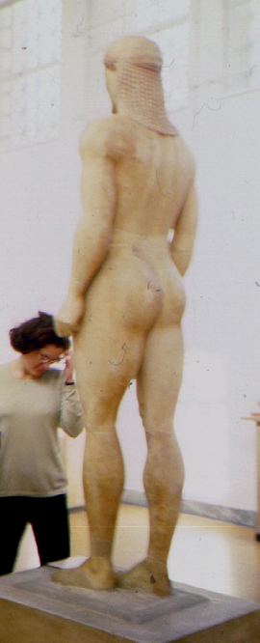
Kouros
from Anavysos, Greece
ca. 530 B.C.E.
marble
76 in. high

Slide 30
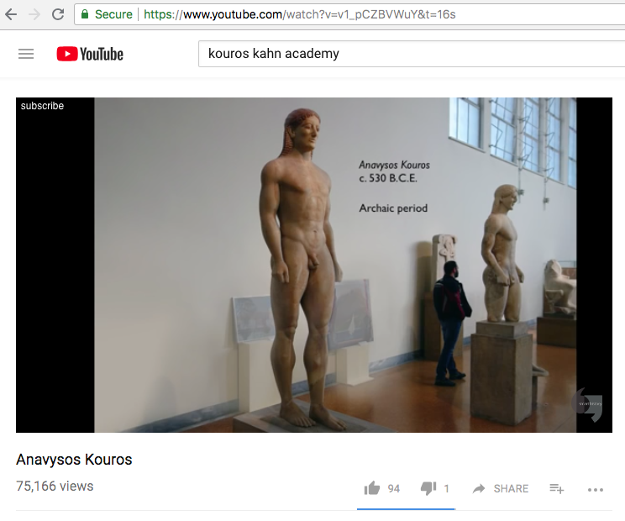
https://www.youtube.com/watch?v=v1_pCZBVWuY 5:00

Slide 31
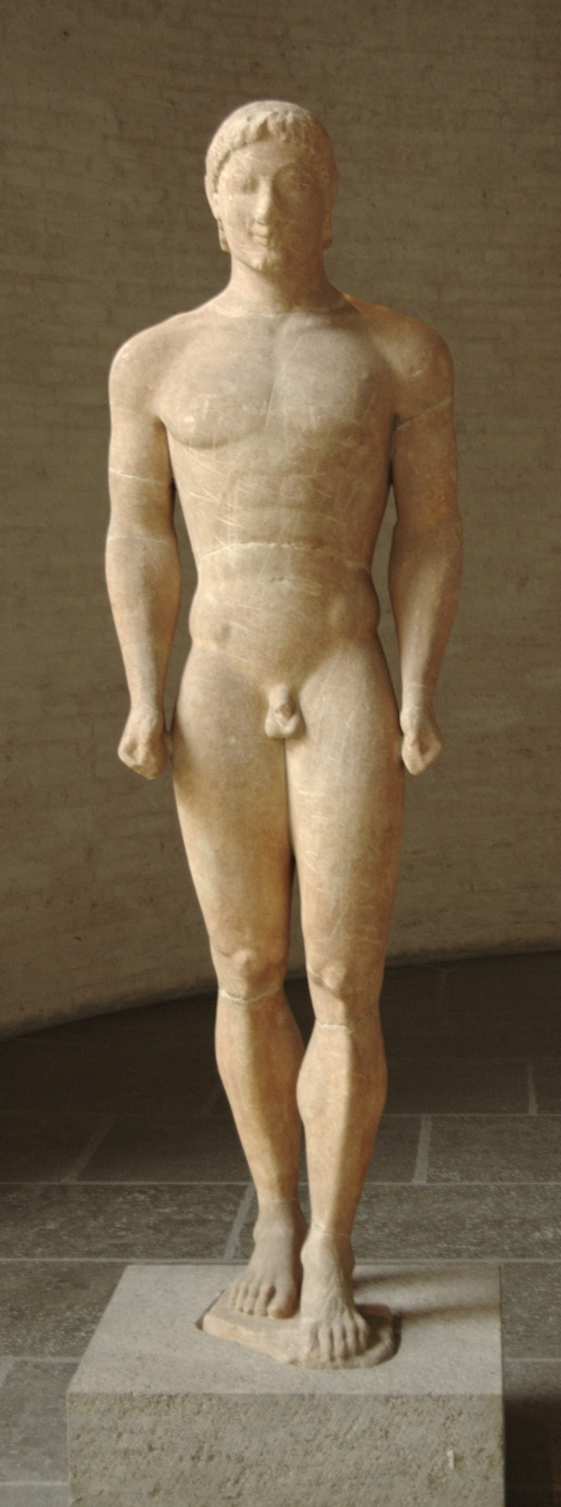
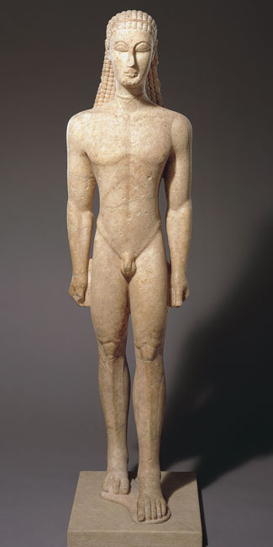
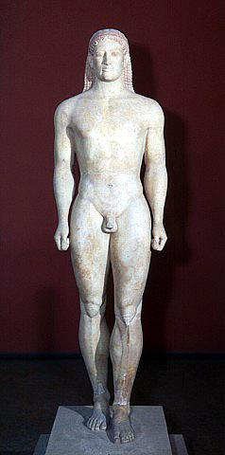

Slide 32
Form | Function | Content | Context
Rigidly frontal pose | Grave marker- Replaces huge vases of earlier periods | Not a real portrait- general representation of a warrior | Emulates the Egyptian model, but has a different purpose
Freestanding |  | Cut away arms and legs | Named after a young military figure Kroisos; inscription at the base identifies him
 |  | Hair is knotted and falls in braids down the back
 |  | Face is mask-like; eyes wide open; shoulders squarish
 |  | Archaic smile meant to enliven the sculpture
Kroisos from Anavysos, Greece
ca. 530 B.C.E.
marble
76 in. high

Slide 33
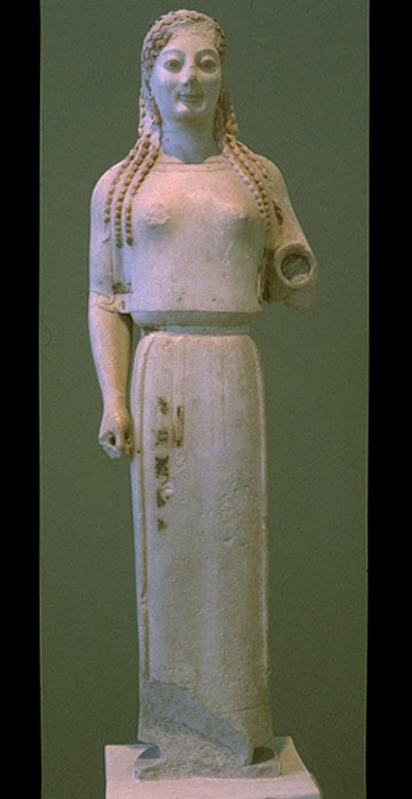
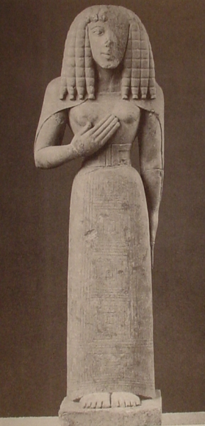

Slide 34
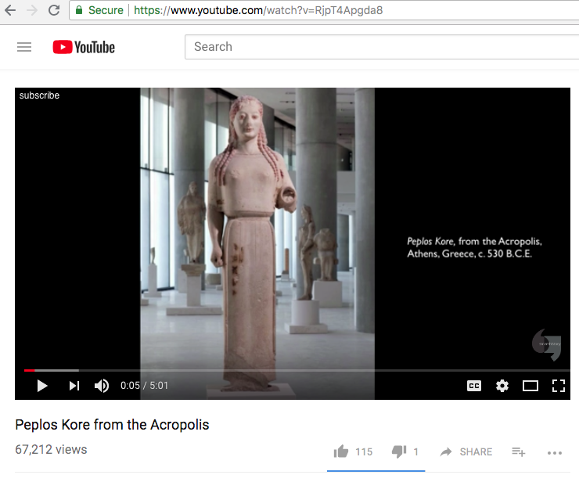
https://www.youtube.com/watch?v=RjpT4Apgda8 5:00

Slide 35
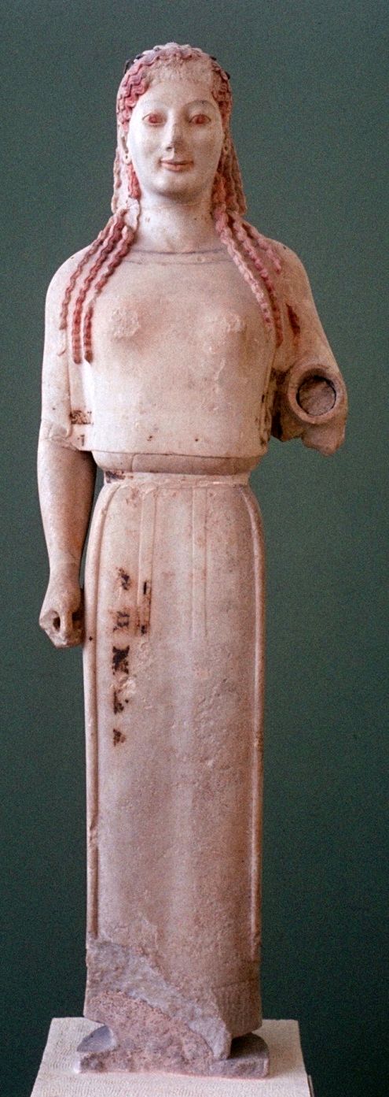
Form | Function | Content | Context
frontal pose | broken hand fitted into socket; probably held an attribute as she may have been a goddess | pinched waist | So named for the peplos, the type of garment she wears
Rigid archaic stance |  | paint remains, animating the face and hair | Hand breaks the archaic stance
 |  | archaic smile
 |  | breasts revealed through drapery
 |  | hair falls more naturally
Peplos Kore from the Acropolis, Athens, Greece
ca. 530 B.C.E.
marble
48 in. high

Slide 36
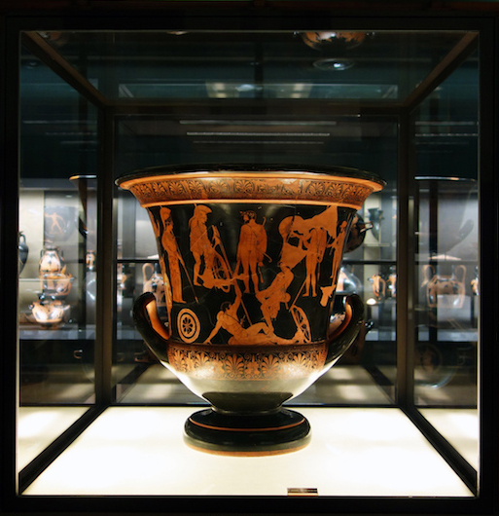
Archaic Pottery

Slide 37
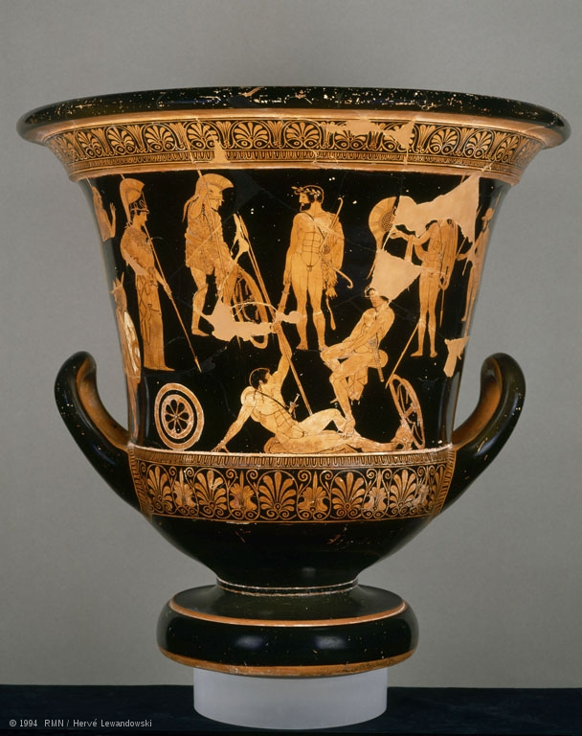
Niobides Krater
Niobid Painter
Classical Greece
450 BCE
Clay, Red Figure
The Louvre
Padlet

Slide 38
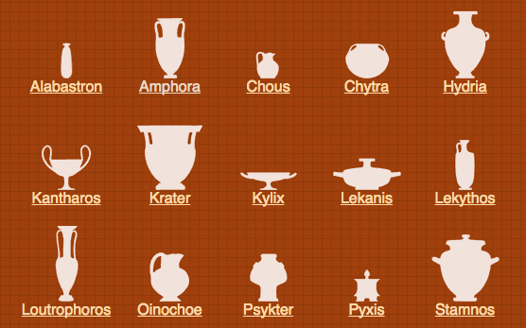
Greek Pottery

Slide 39
Made of terracotta (fired clay), ancient Greek pottery was fashioned into a variety of shapes and sizes with correlating function.
The krater was used to mix water and wine during a Greek symposion (an all-male drinking party)

Slide 40
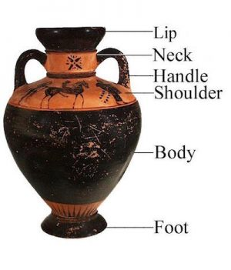

Slide 41
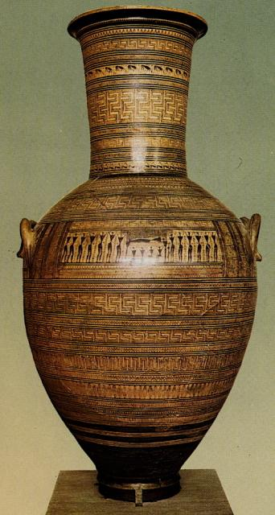
On the exterior, Greek vases exhibit painted compositions that often reflect the style of a certain period.
For example, the vessels created during the Geometric Period (c. 900-700 B.C.E.) feature geometric patterns

Slide 42
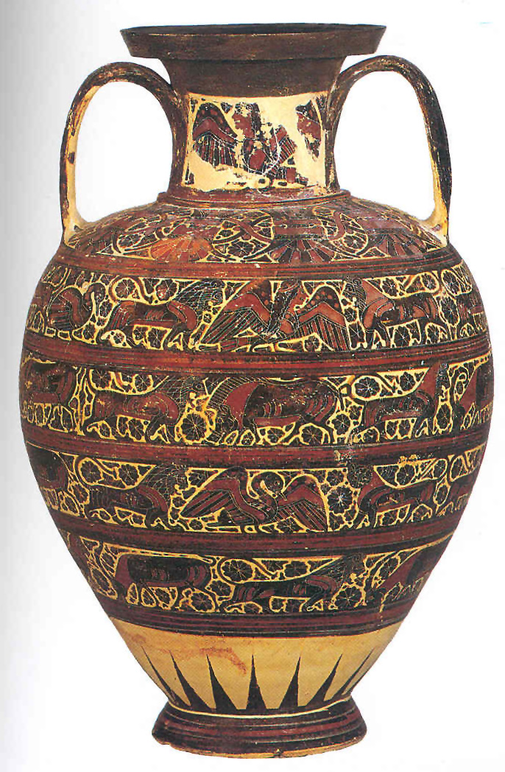
Orientalizing Period (c. 700-600 B.C.E.) display animal processions and Near Eastern motifs

Slide 43
In the Archaic and Classical Periods (600-323 B.C.E.), vase-paintings primarily display human and mythological activities. These figural scenes can vary widely, from daily life events to heroic deeds and Homeric tales, from the world of the gods to theatrical performances and athletic competitions

Slide 44
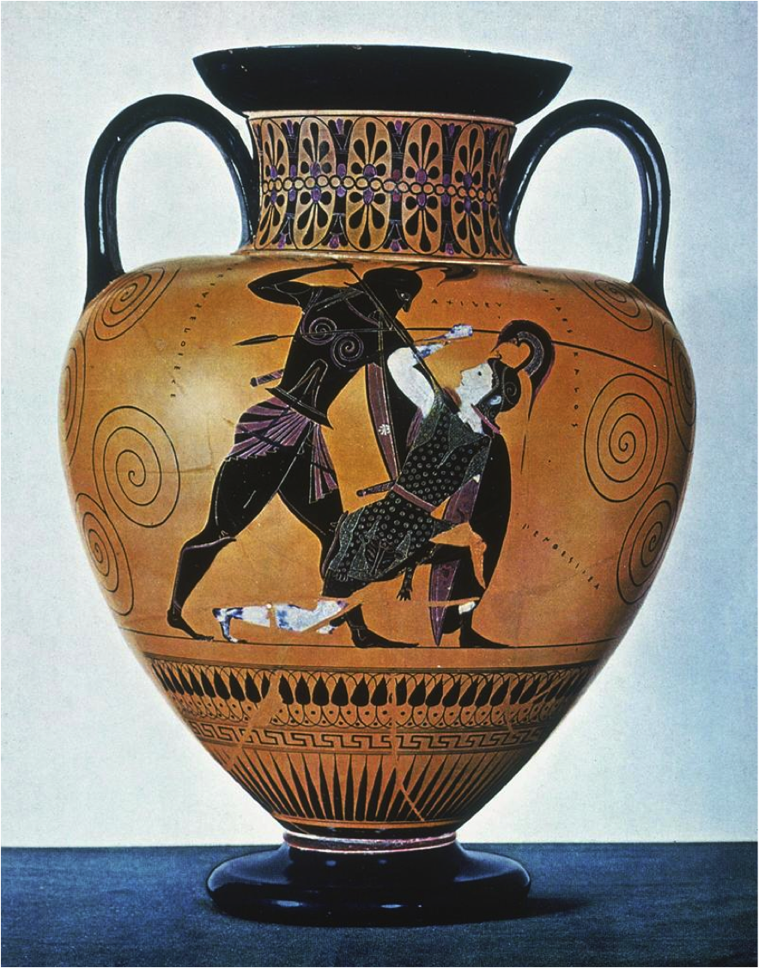
Exequias
Achilles Killing Penthesilea
from Vulci, Italy
ca. 540-530 B.C.E.
ceramic
approximately 2 ft. high
Notes:
Slide concept by William V. Ganis, PhD FOR EDUCATIONAL USE ONLY For publication, reproduction or transmission of images, please contact individual artists, estates, photographers and exhibiting institutions for permissions and rights.

Slide 45
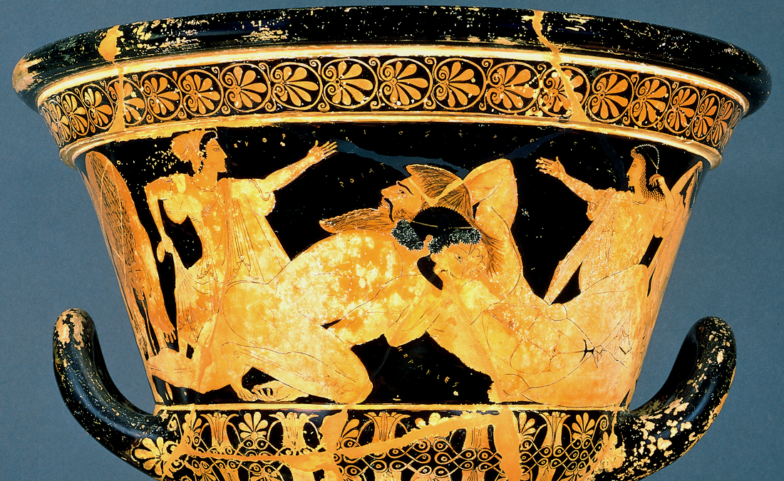
Euphronios
Herakles wrestling Antaios
from Cerveteri, Italy
ca. 510 B.C.E.
ceramic
19 in. high
Notes:
Slide concept by William V. Ganis, PhD FOR EDUCATIONAL USE ONLY For publication, reproduction or transmission of images, please contact individual artists, estates, photographers and exhibiting institutions for permissions and rights.

Slide 46
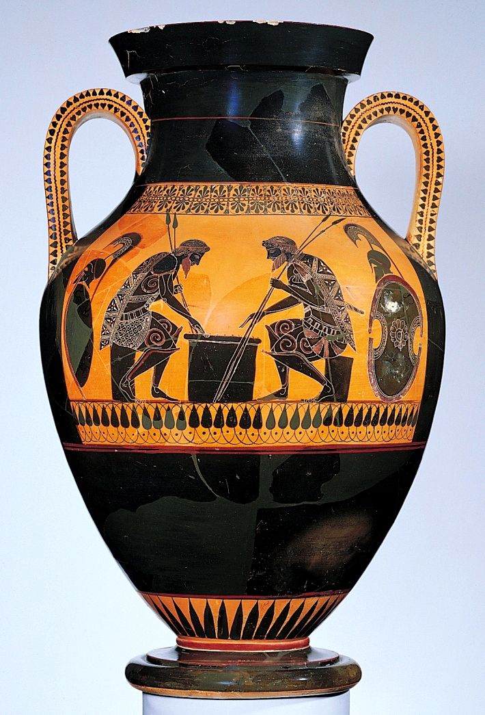
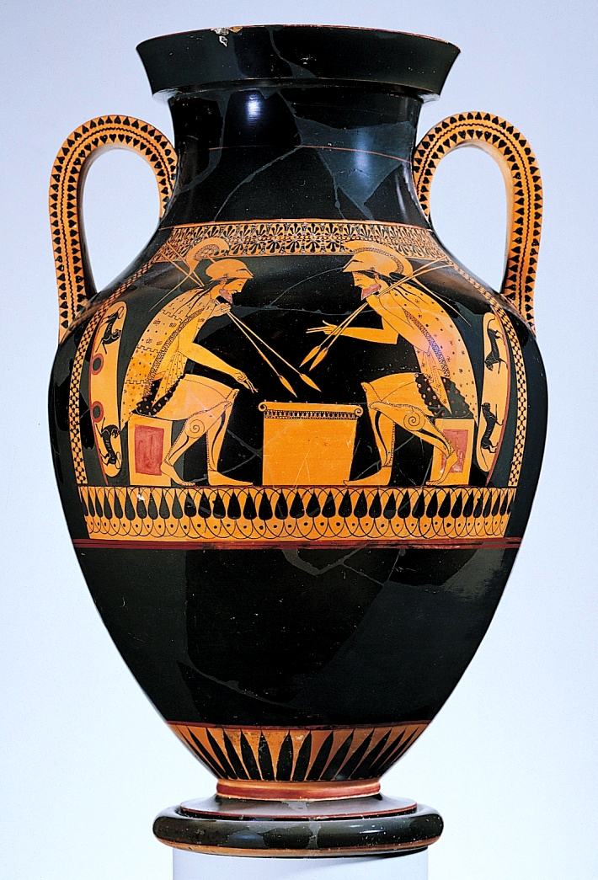
Notes:
Slide concept by William V. Ganis, PhD FOR EDUCATIONAL USE ONLY For publication, reproduction or transmission of images, please contact individual artists, estates, photographers and exhibiting institutions for permissions and rights.

Slide 47
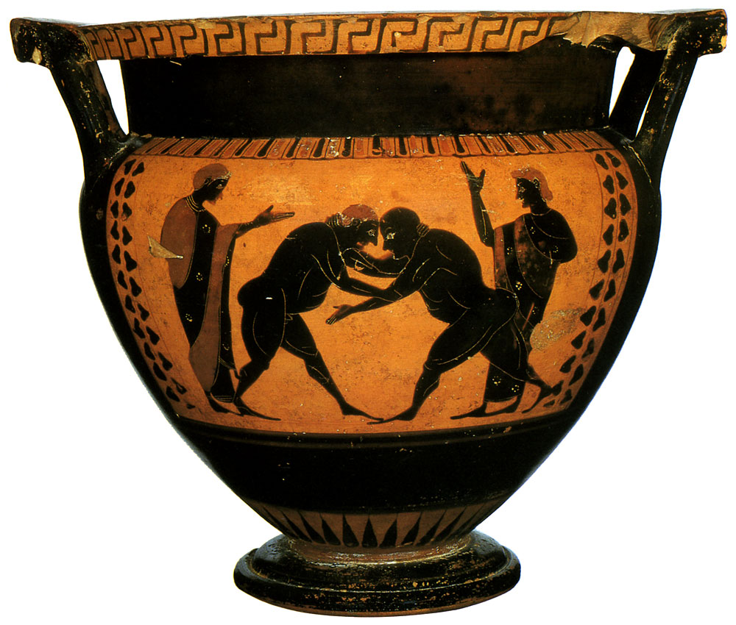
Black Figure pottery

Slide 48
Attic Black Figure
The entire firing process for creating Black-Figure pottery was newly developed and took place in four stages.
1) A piece was coated using a colored “SLIP” which is a slippery mixture of clay and water. Then designs were incised into the slip, or carved very carefully along with the entire background.
2) Then the piece was fired in the kiln. The first stage used the process of oxidation, introducing oxygen into the kiln, to give the entire piece the color of the clay.
3)The next step, fresh wood was introduced and oxygen was cut off to provide a smokey enviroment turning the vase black.
4) In the third portion, air was reintroduced to the kiln turning the portions of the clay without slip back to the color of the clay and leaving the remaining portions black.

Slide 49
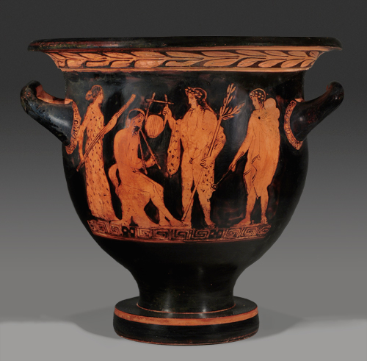
Red Figure pottery

Slide 50
Red Figure pottery
"The red-figure technique was invented around 530 B.C.E. It gradually replaced the black-figure technique as innovators recognized the possibilities that came with drawing forms, rather than laboriously delineating them with incisions.
The use of a brush in red-figure technique was better suited to the naturalistic representation of anatomy, garments, and emotions”.
Incising upon the Black-Figure pots was much more time consuming and a far riskier task than the Red-Figure Technique of painting into the vase where mistakes wouldn't be as unforgiving.
Firing techniques remained the same for red-figure pottery

Slide 51
Niobides Krater
Niobid Painter
Classical Greece
450 BCE
Clay, Red Figure
The Louvre
Padlet

Slide 52
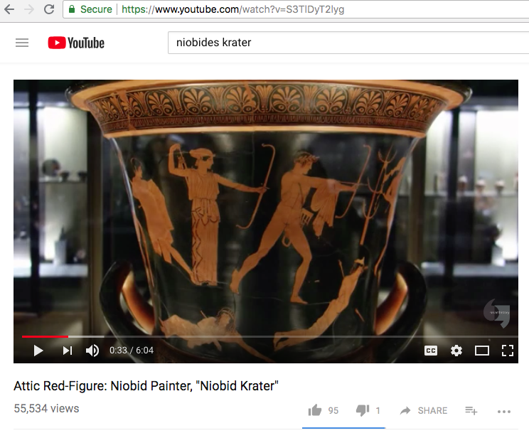
https://www.youtube.com/watch?v=S3TlDyT2lyg 6:00

