Slide 1
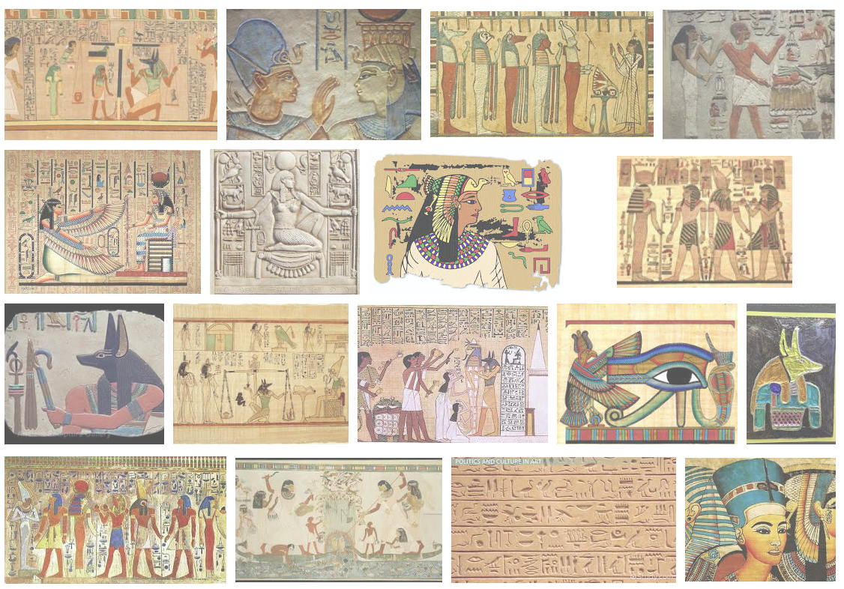
Ancient Egyptian Art
Day 2 Lecture

Slide 2
New Kingdom Art
True order and stability was not re-established until Dynasty 18. With the new era of peace and prosperity came a return to the construction of large temple complexes.
The rulers of Dynasties 18-20 built more architectural and sculptural monuments than all of the other dynastic periods combined. The majority of the construction took place around the capital city of Thebes.
New Kingdom architecture was built on a monumental scale. The temple became the most representative of the Egyptian buildings, due to the tremendous power of the priest class. The classic New Kingdom temple had seven elements, all arranged on the same axis. Entry into the various rooms of the temple was based upon social class.

Slide 3
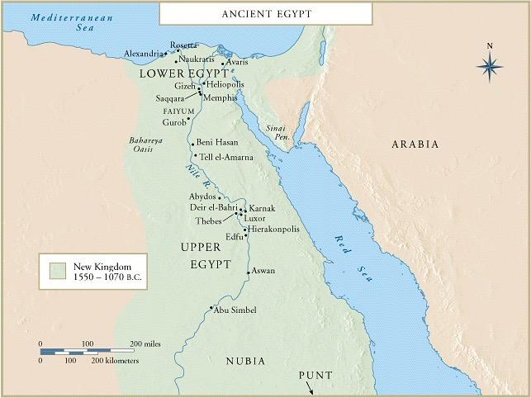

Slide 5
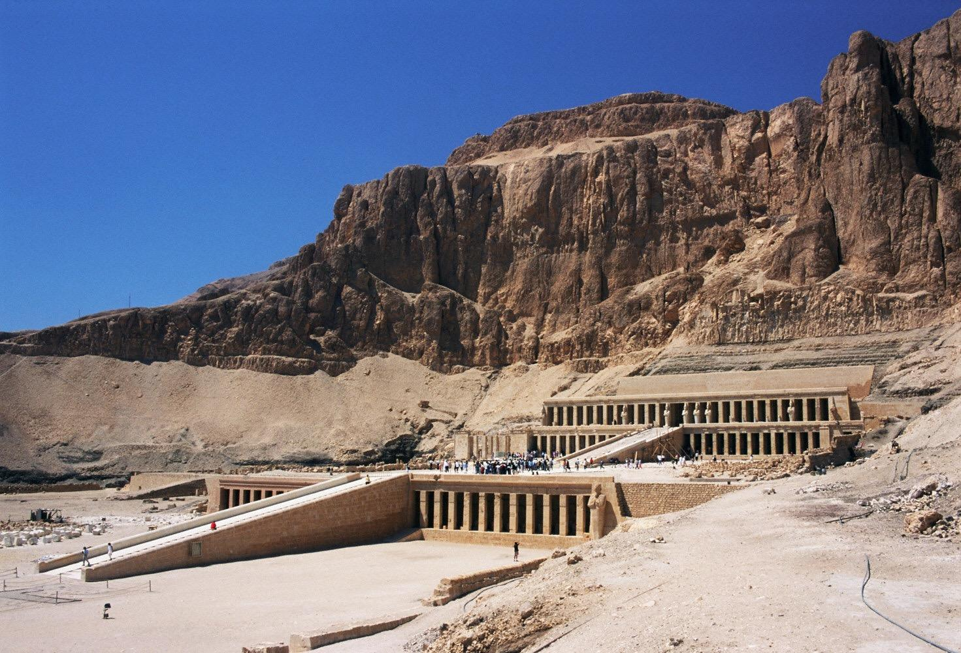
Function
Mortuary temples were built around pyramids in the Old and Middle Kingdoms, but once the New Kingdom pharaohs began constructing tombs in the Valley of the Kings, they built their mortuary temples separately.
The temples were designed to commemorate the reign of the pharaoh by whom they were built, as well as for use by the pharaoh's cult after death.
Senmut
Mortuary Temple of Hatshepsut
Deir el-Bahri, Egypt
ca. 1,473-1,458 B.C.E.

Slide 8
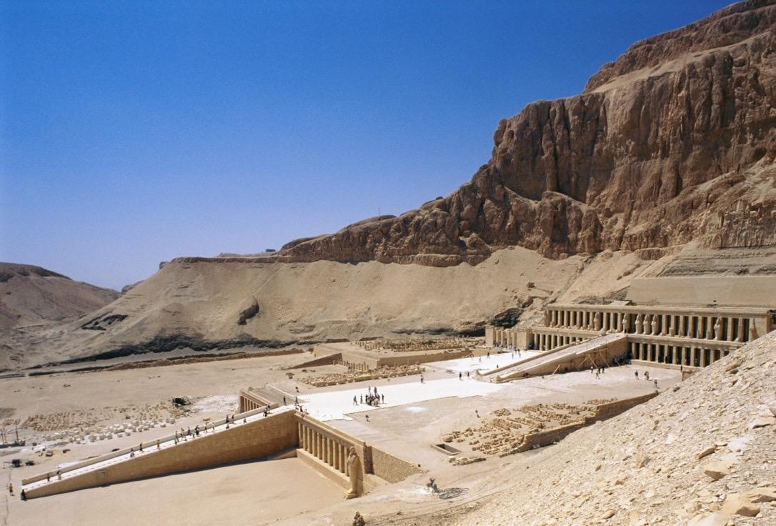
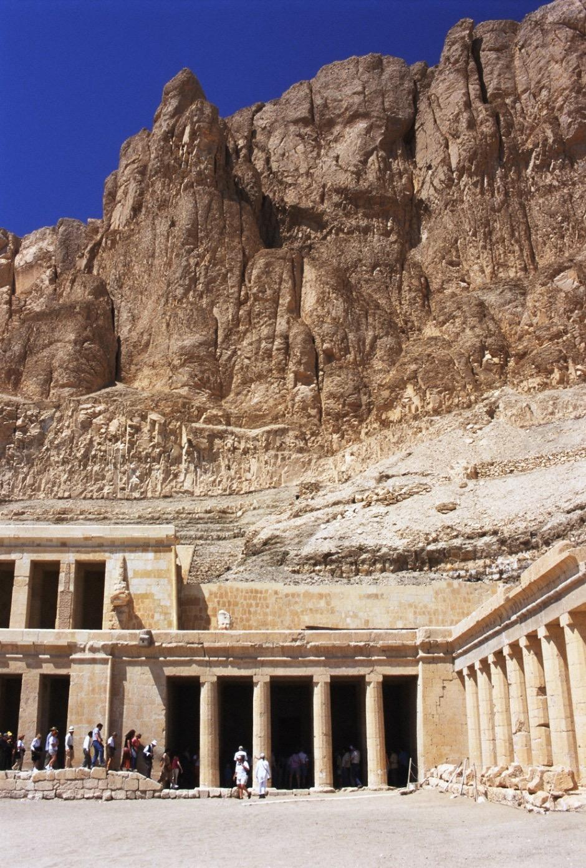
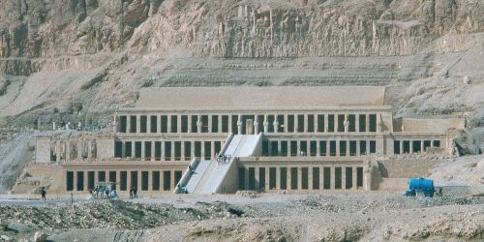

Slide 9
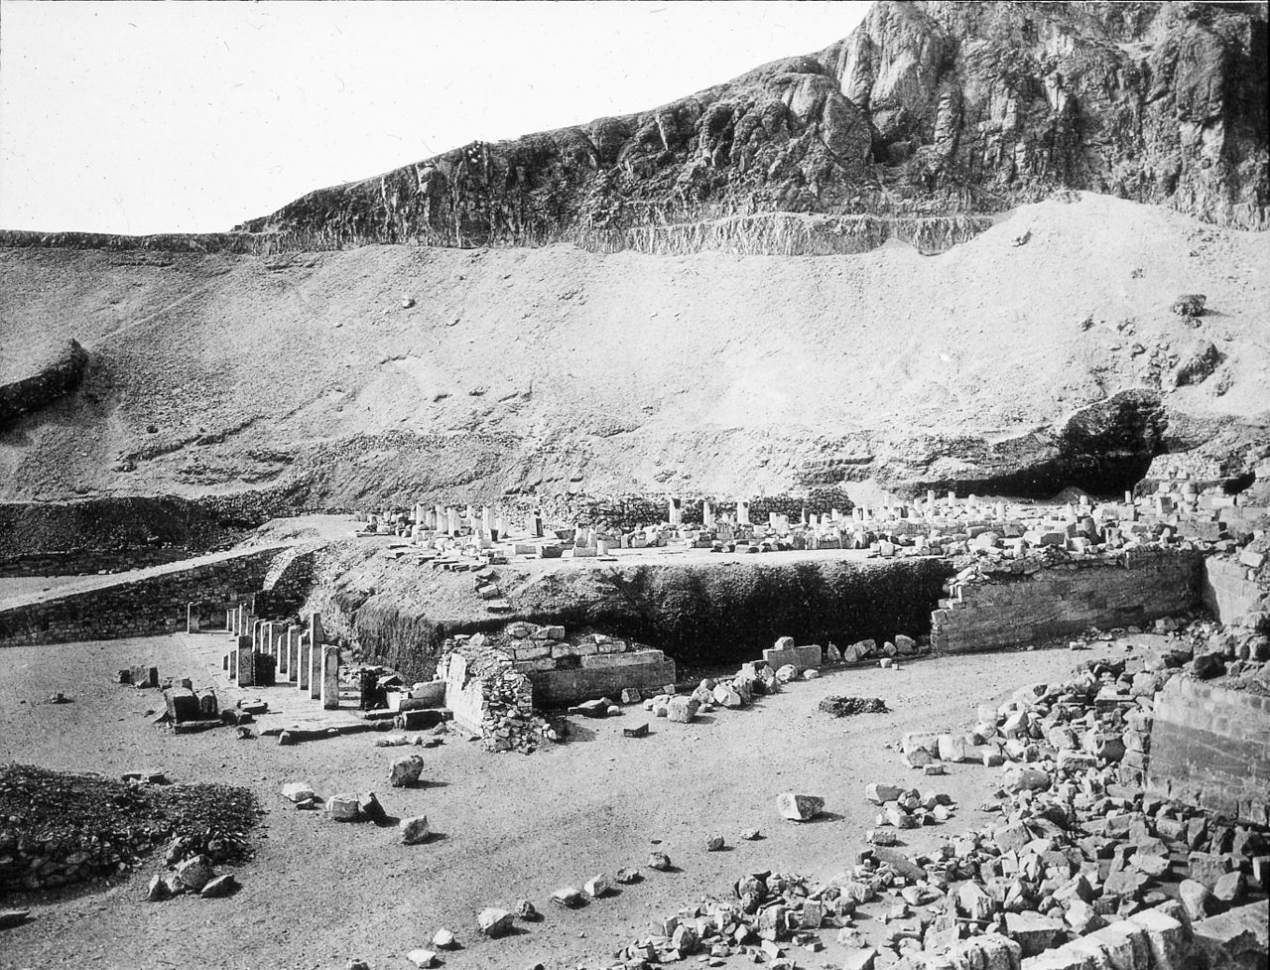
Prior to restoration in the 20th century

Slide 10
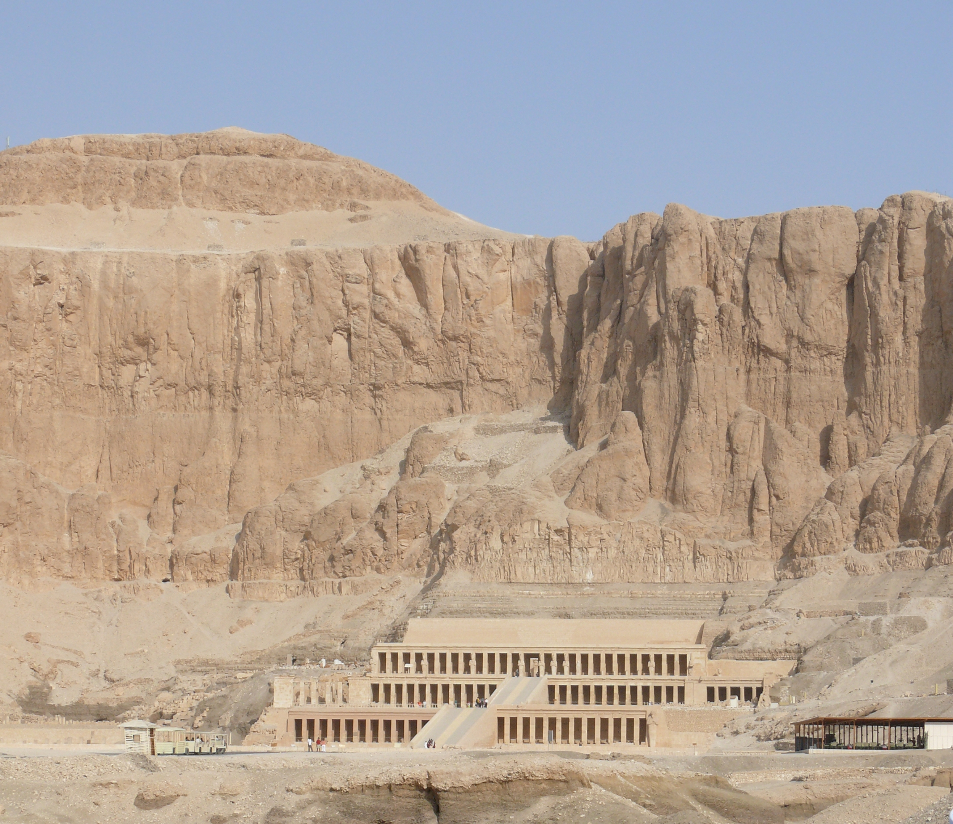
After the restoration in the 20th century

Slide 12
Form | Function | Content | Context
Visually coordinated with the natural settings | Mortuary temples (or) were temples constructed adjacent to, or in the vicinity of, royal tombs. | Terraces originally planted as gardens with exotic trees | First time the achievements of a woman are celebrated in art history
Long horizontals and verticals of the terraces and colonnades repeat the patterns of the cliffs behind |  | Three colonnaded terraces and 2 ramps
limestone

Slide 13
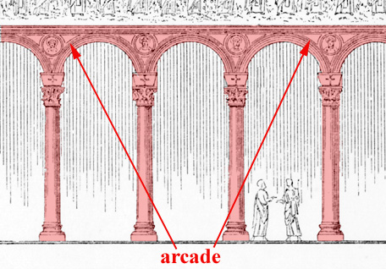
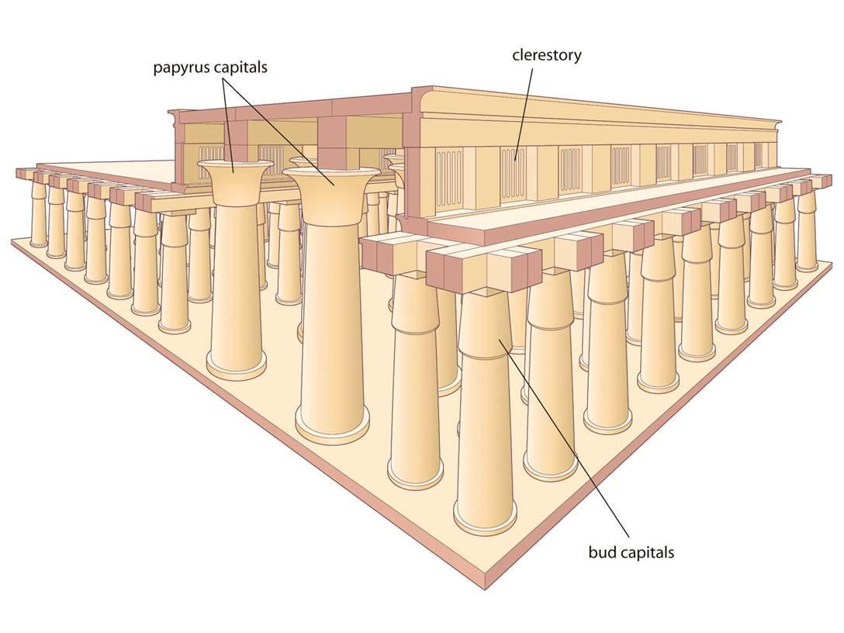
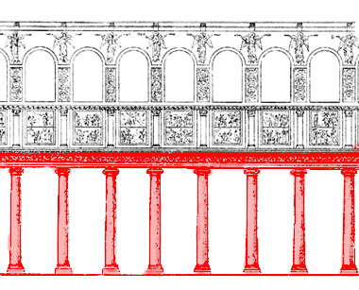
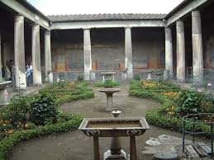
Architecture Vocabulary
Hypostyle Hall
Colonnade
Peristyle

Slide 14
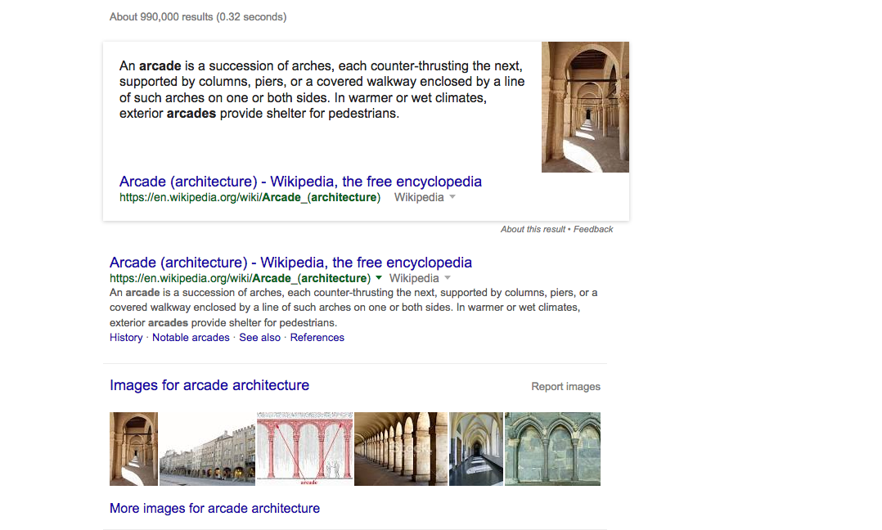

Slide 15
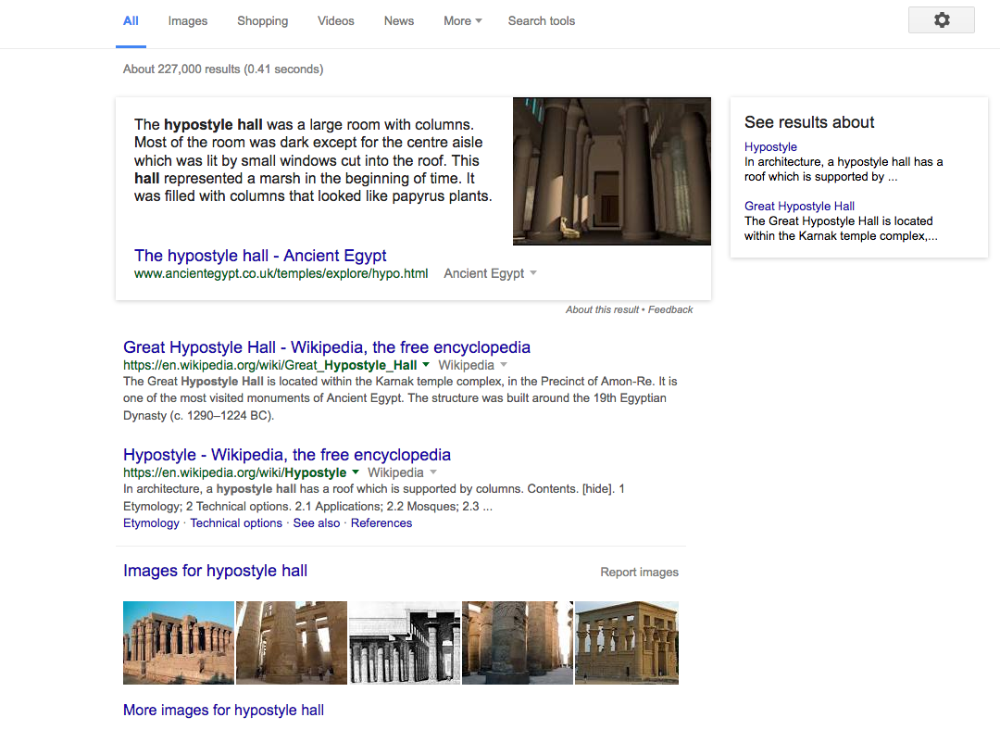

Slide 16
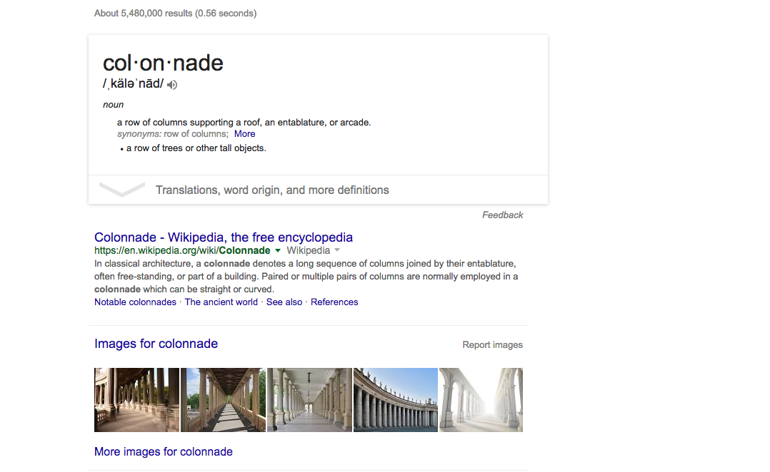

Slide 17
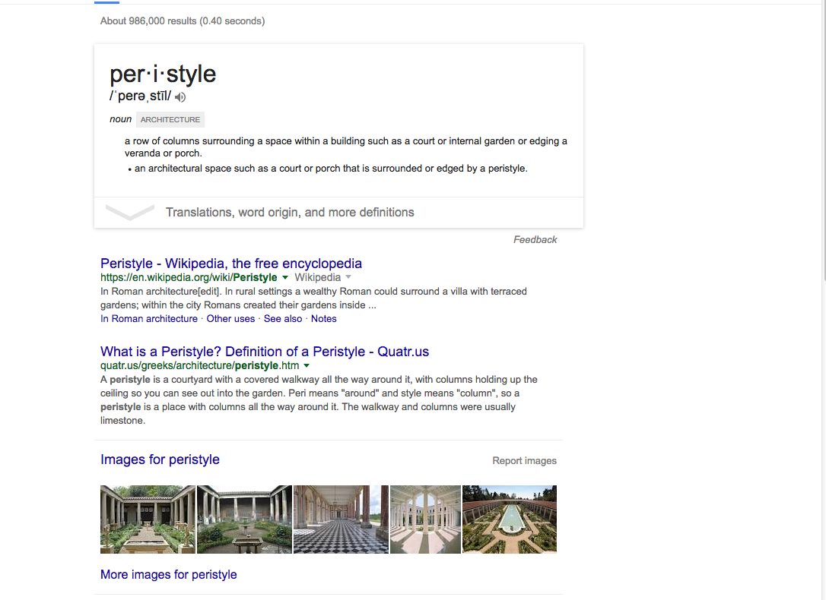

Slide 18
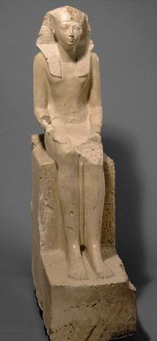
Statue of Hatshepsut
Deir el-Bahri, Egypt
ca. 1,473-1,458 B.C.E.
limestone
76 3/4 in. high

Slide 19
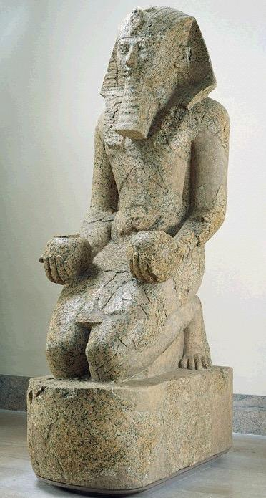
Form | Function | Content | Context
Solid, frontal, pyramidal | Statue of the god brought before the sculpture in a procession | 1 of 10 statues of Hatshepsut with offering jars, | 1 of 200 statues placed around the complex
 | Inscription at the base dedicates it to Amun-Ra | Male pharaonic attributes: Beard and Kilt | Offering jars were part of a ritual honoring the sun god
 |  | Wears the nemes headdress | The pharaoh would only kneel before a god
 |  | Slender proportions/hint of breasts indicate femininity
Hatshepsut with offering jars
Deir el-Bahri, Egypt
ca. 1,473-1,458 B.C.E.
red granite
8 ft. 6 in. high

Slide 21
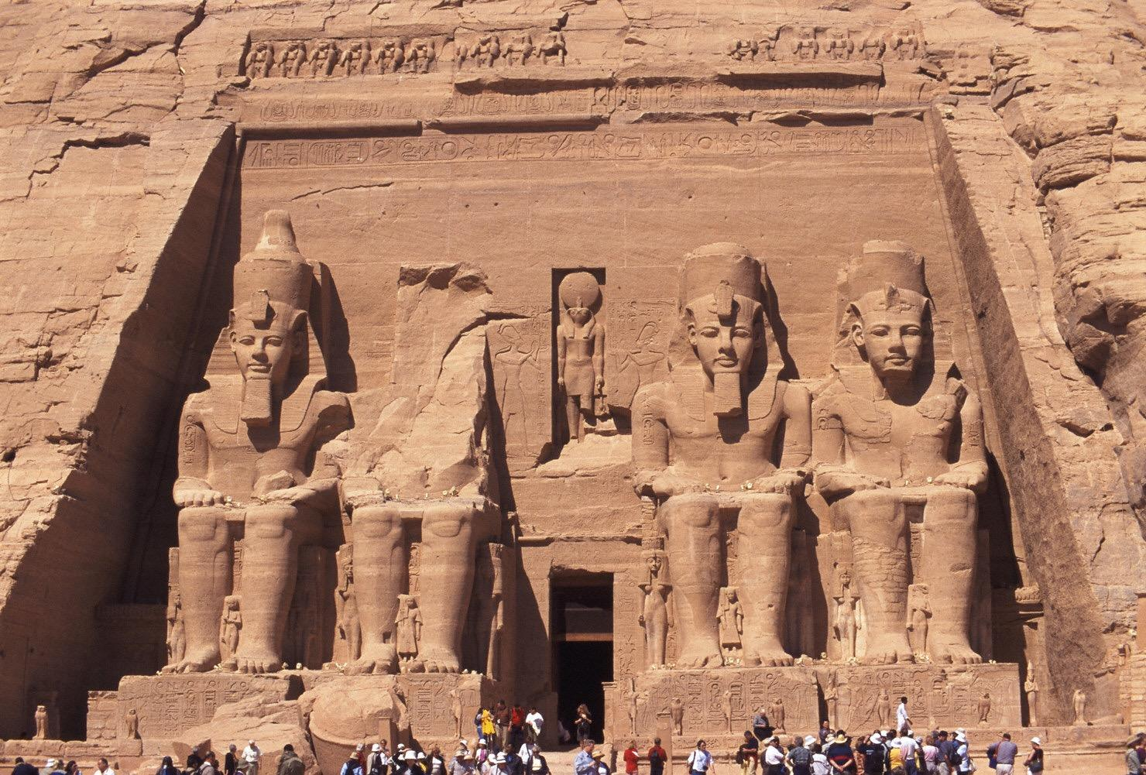
-Built as temple to show off after a military victory
Built to intimidate the southern neighbors
-The statues were built to colossal sizes.
-30 or more chambers
Temple of Ramses II
from Abu Simbel, Egypt
ca. 1290-1224 B.C.E.
colossi approximately 65 ft. high

Slide 22
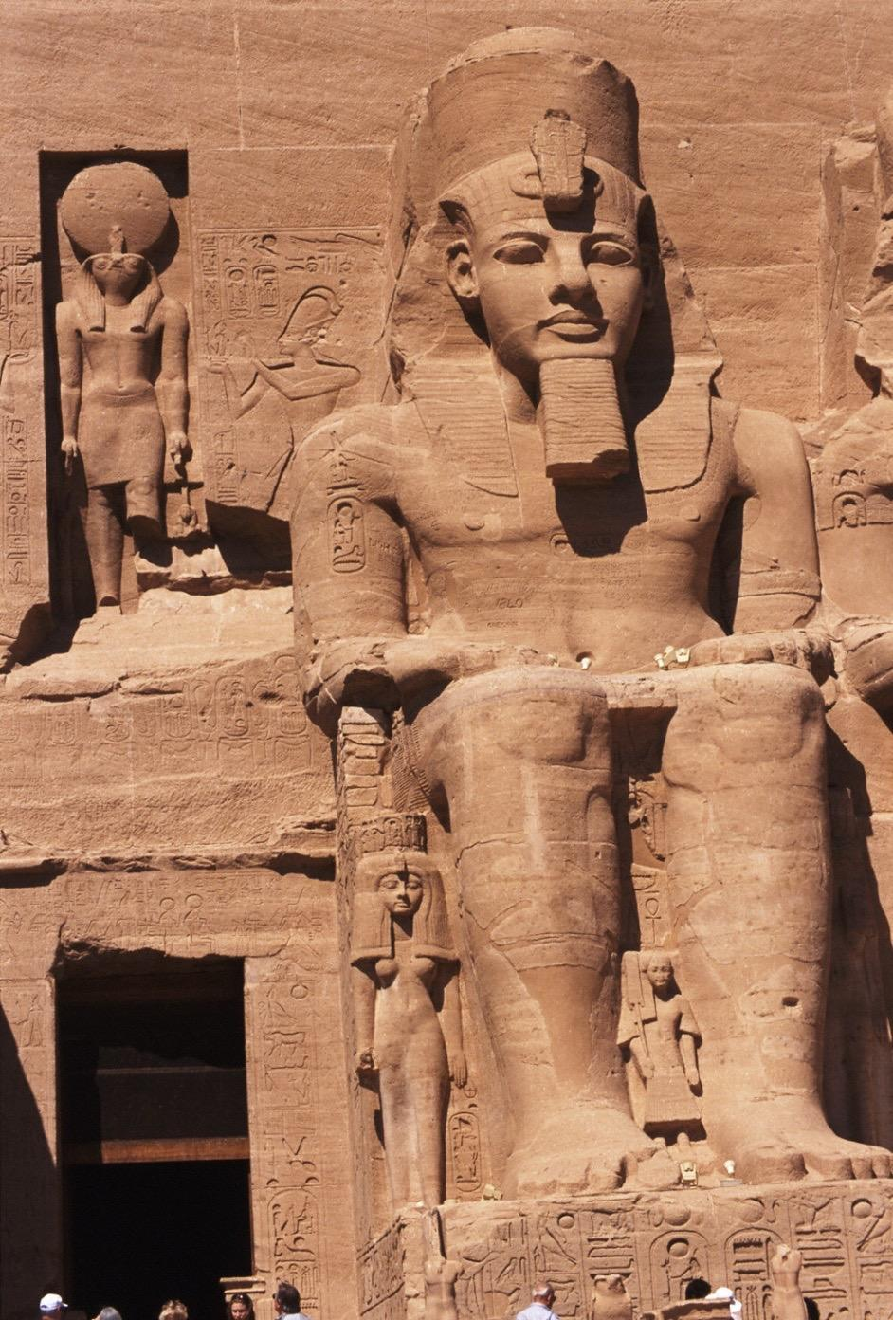
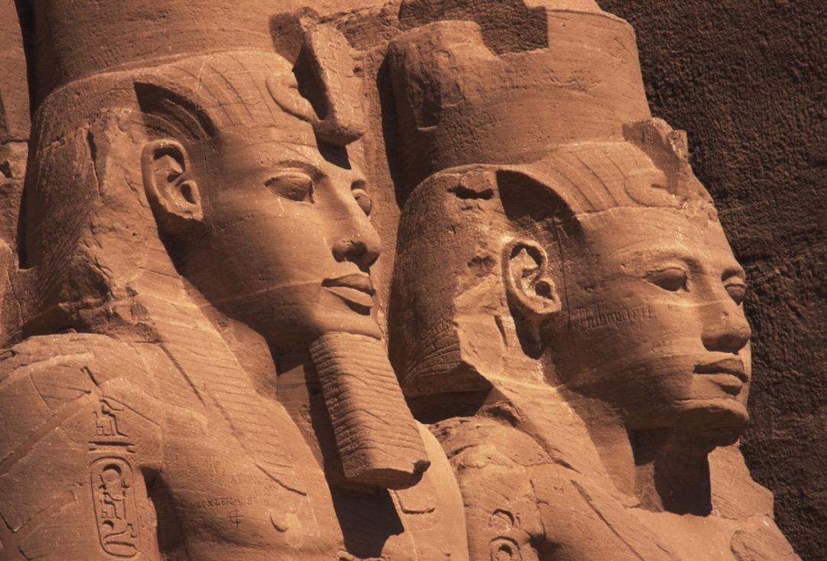
Temple of Ramses II
from Abu Simbel, Egypt
ca. 1290-1224 B.C.E.
colossi approximately 65 ft. high
Notes:
Slide concept by William V. Ganis, PhD FOR EDUCATIONAL USE ONLY For publication, reproduction or transmission of images, please contact individual artists, estates, photographers and exhibiting institutions for permissions and rights.

Slide 23
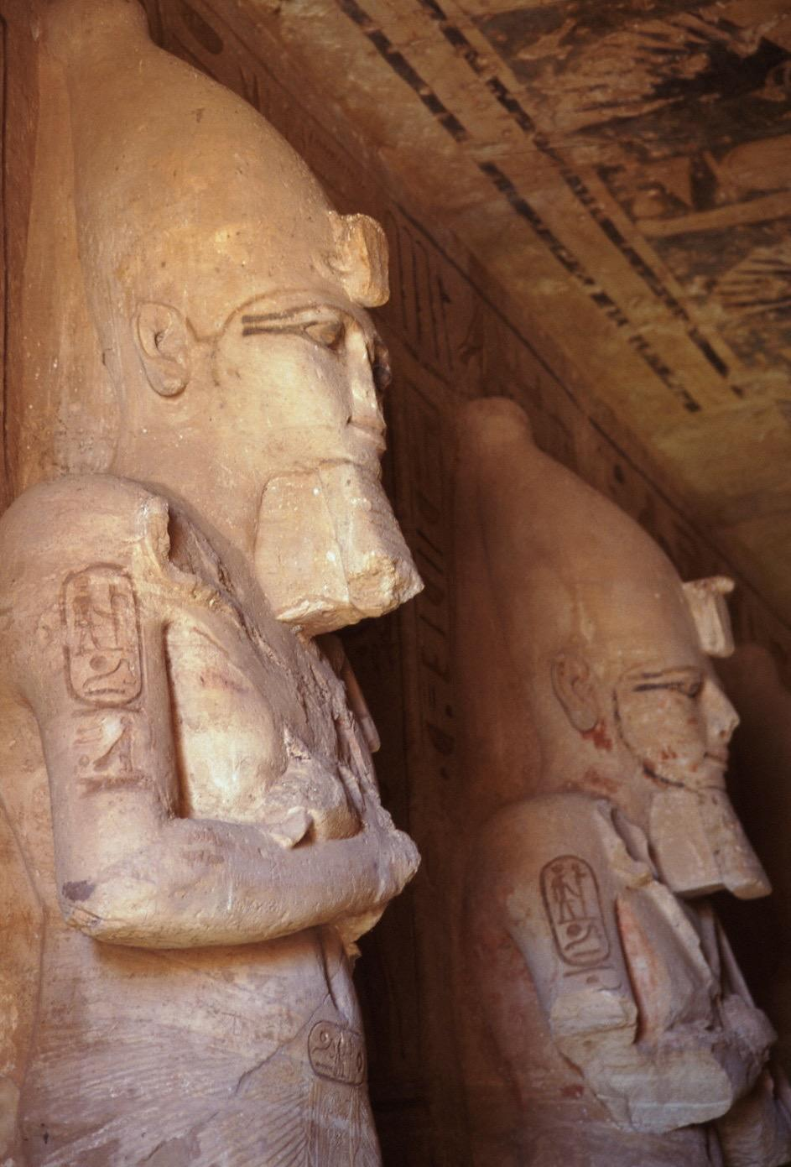
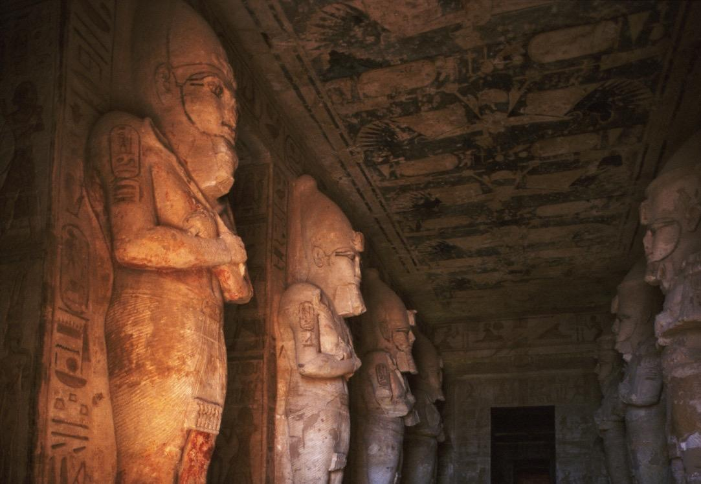
Temple of Ramses II
from Abu Simbel, Egypt
ca. 1290-1224 B.C.E.
atlantids approximately 32 ft. high
Notes:
Slide concept by William V. Ganis, PhD FOR EDUCATIONAL USE ONLY For publication, reproduction or transmission of images, please contact individual artists, estates, photographers and exhibiting institutions for permissions and rights.

Slide 24
Out with Old in with the New
Abu Simbel today is no longer in the same location as it was in ancient times. “Following the decision to build a new High Dam at Aswan in the early 1960s, the temples were dismantled and relocated in 1968 on the desert plateau 64 meters (about 200 feet) above and 180 meters (600 feet) west of their original site,” writes Robert Morkot in an article in the "Oxford Encyclopedia of Ancient Egypt"(2001, Oxford University Press). The area where they were originally located is now flooded.

Slide 25
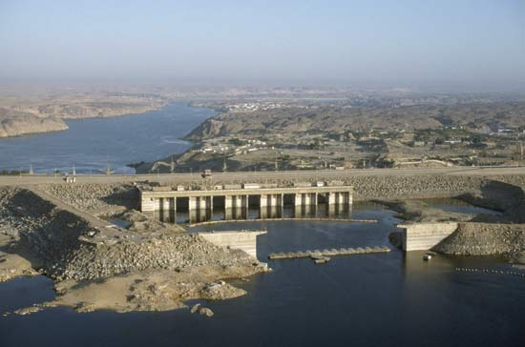
Discussion

Slide 26
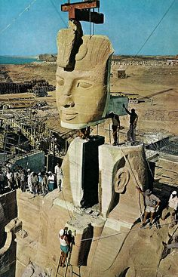
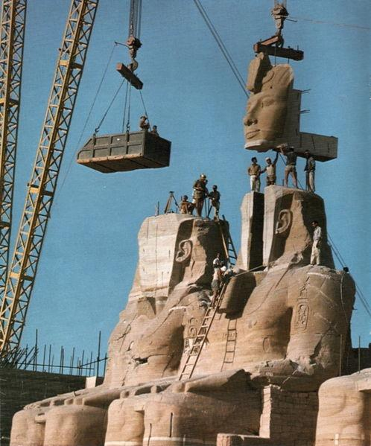

Slide 27
Hawass notes that moving the temples was a massive job, one that involved cutting it into pieces between 3 to 20 tons in weight and re-assembling them precisely as they were. It took almost five years, involved about 3,000 workers and cost (in the 1960s) about $42 million. He notes in his book that it was a great success, one reporter present at its completion wrote that “everything looks just as it did before; it is enough to make one doubt that the temples were moved at all.”

Slide 28
https://www.youtube.com/watch?v=HCDQikYVnCA 6:30 Min

Slide 29
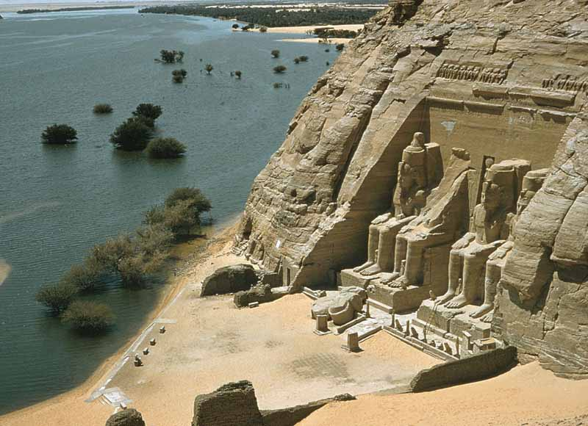

Slide 31
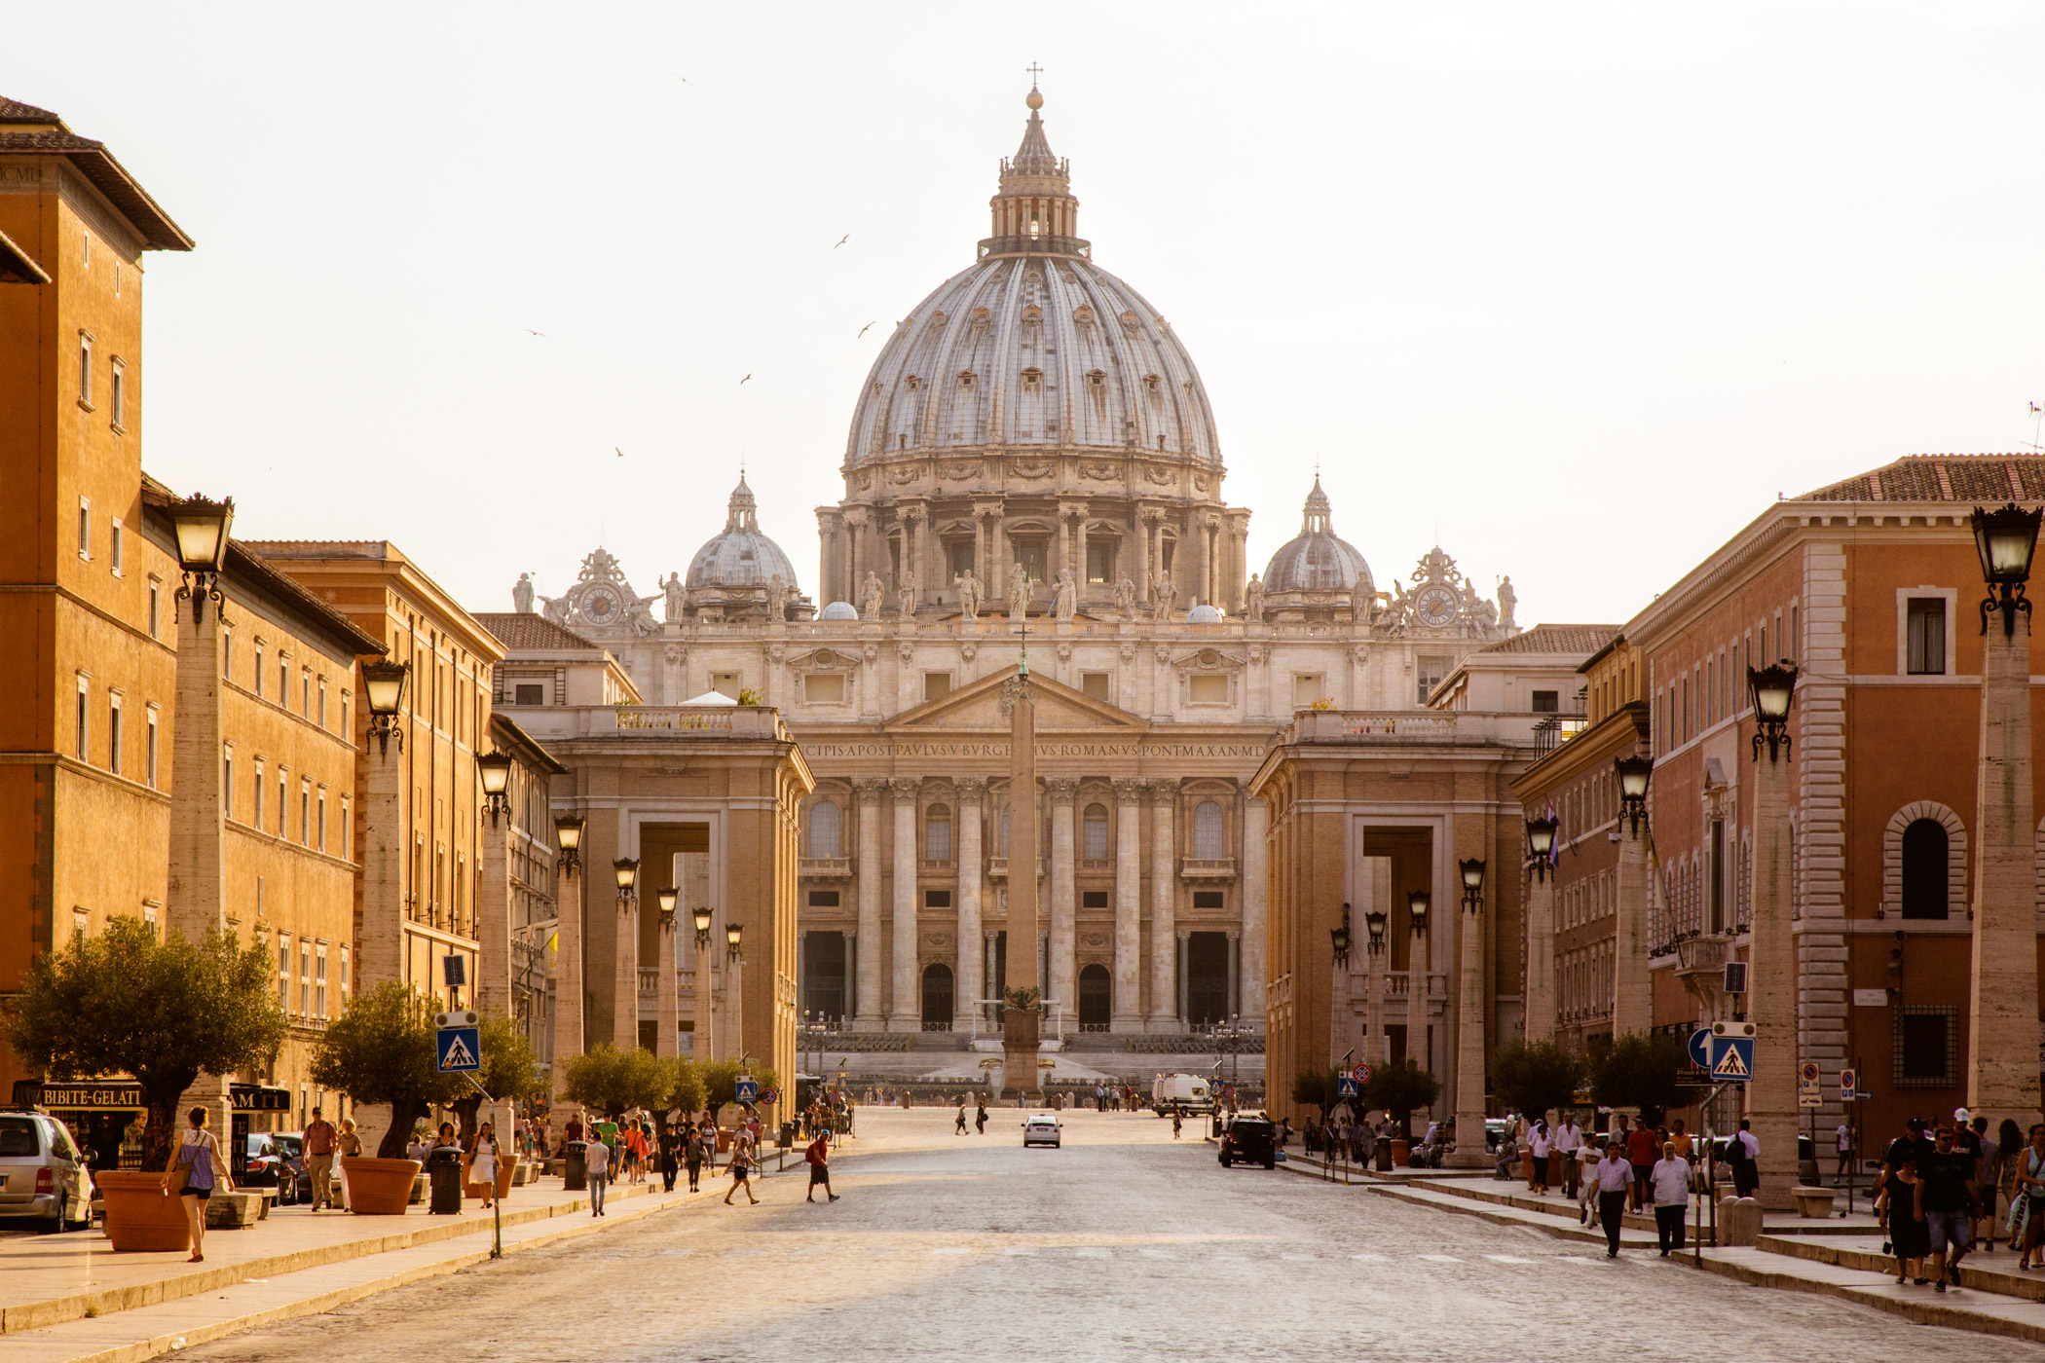

Slide 32
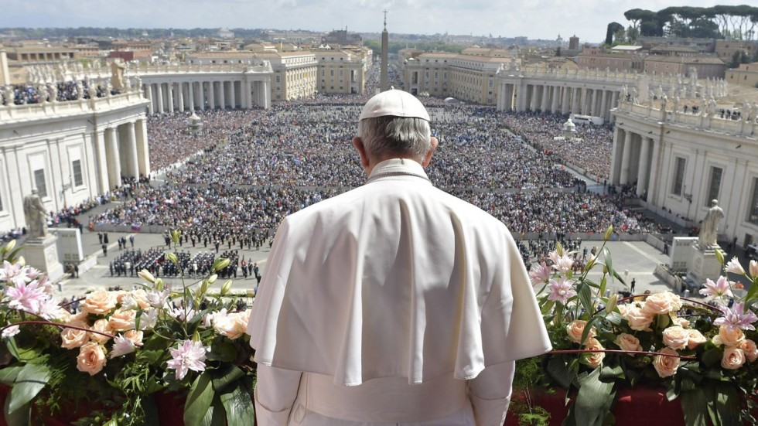

Slide 33
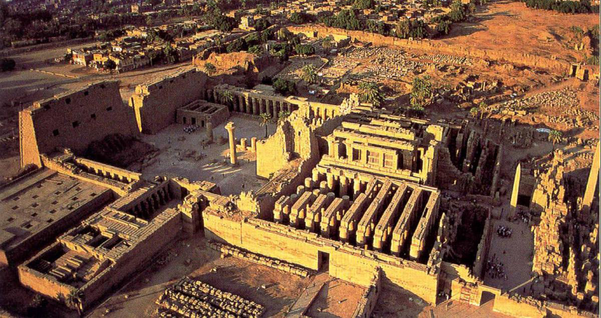
Temple of Amen-Re
Karnak, Egypt
15th century B.C.E.
The Vatican of Egypt

Slide 34
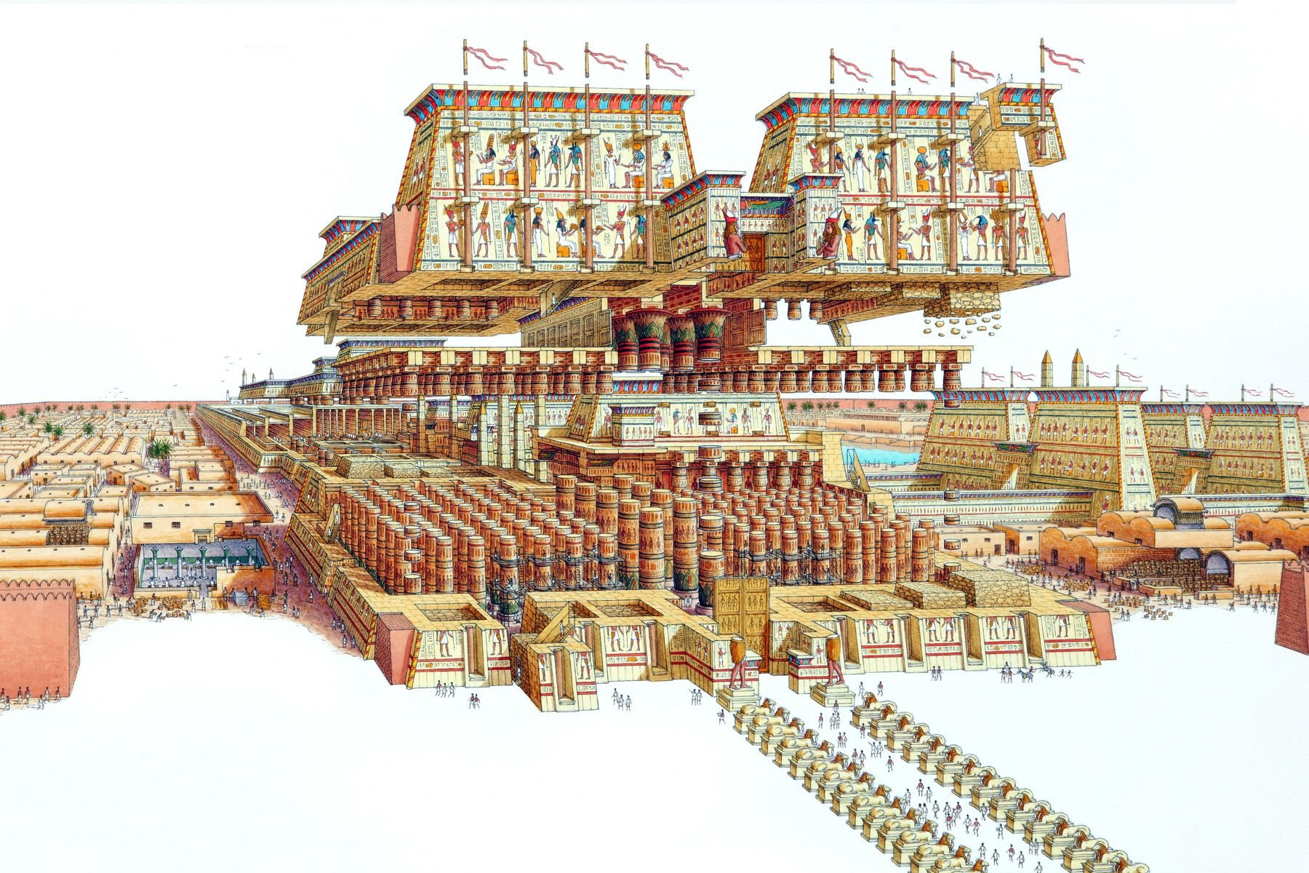
Temple of Amen-Re
Karnak, Egypt
15th century B.C.E.

Slide 35
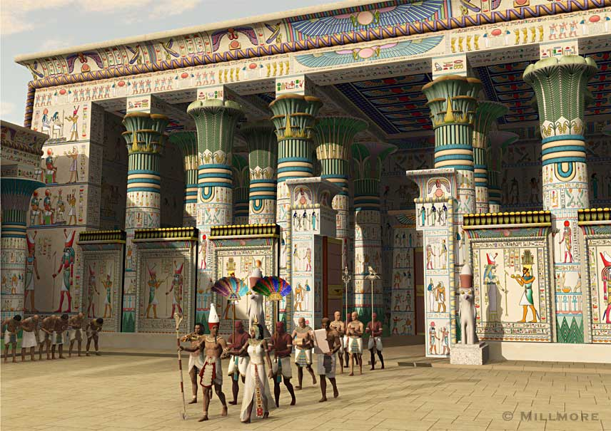

Slide 36
-Had a clerestory that allowed light & air into the building
-Used the new technique of sunken relief
-The columns were capped with a papyrus or lotus flower.
-The temple had a man-made lake associated with it.
Temple of Amen-Re
Karnak, Egypt
15th century B.C.E.

Slide 38
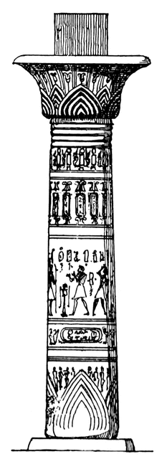
Lotus Papyrus

Slide 39
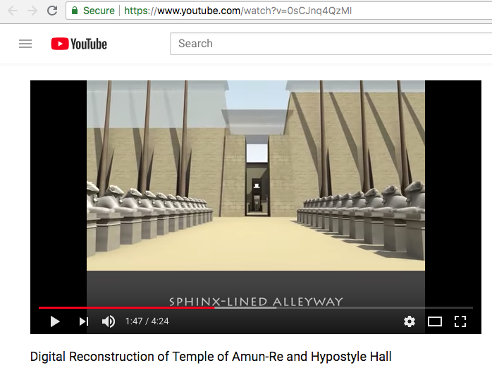
https://www.youtube.com/watch?v=0sCJnq4QzMI 4:30 Min

Slide 40
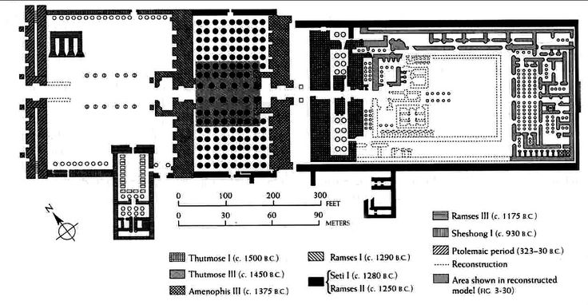

Slide 41
Form | Function | Content | Context
Hypostyle Hall | The site a Karnak is a complex of temples and monumental offerings to the gods. | Huge columns, tightly packed together, admitting little light into the sanctuary | It is the largest religious complex in the world.
Axial plan | Enter the complex through massive sloped pylon gateway into peristyle courtyard, then through a hypostyle hall and then into the sanctuary where few were allowed | Hypostyle Hall | The temples at Thebes were built to fit into the Egyptian cosmology. The temples were a way to help preserve order by communing with god. This was done primarily by the king performing his ritualistic duties or “ma’at” which refers to truth, justice, cosmic order.
 |  | Massive lintels bind the columns together | In addition to performing rituals, it was important that the kings built monuments and temples as offerings to the gods.
 |  | Tallest columns have papyrus capitals; lower columns have bud capitals
 |  | Clerestory to allow some light and air into the darkest parts of the temple
 |  | Columns carved with a sunken relief

Slide 42
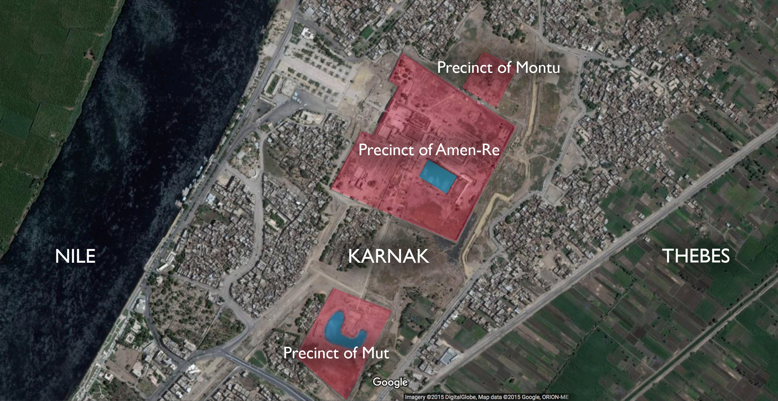

Slide 43
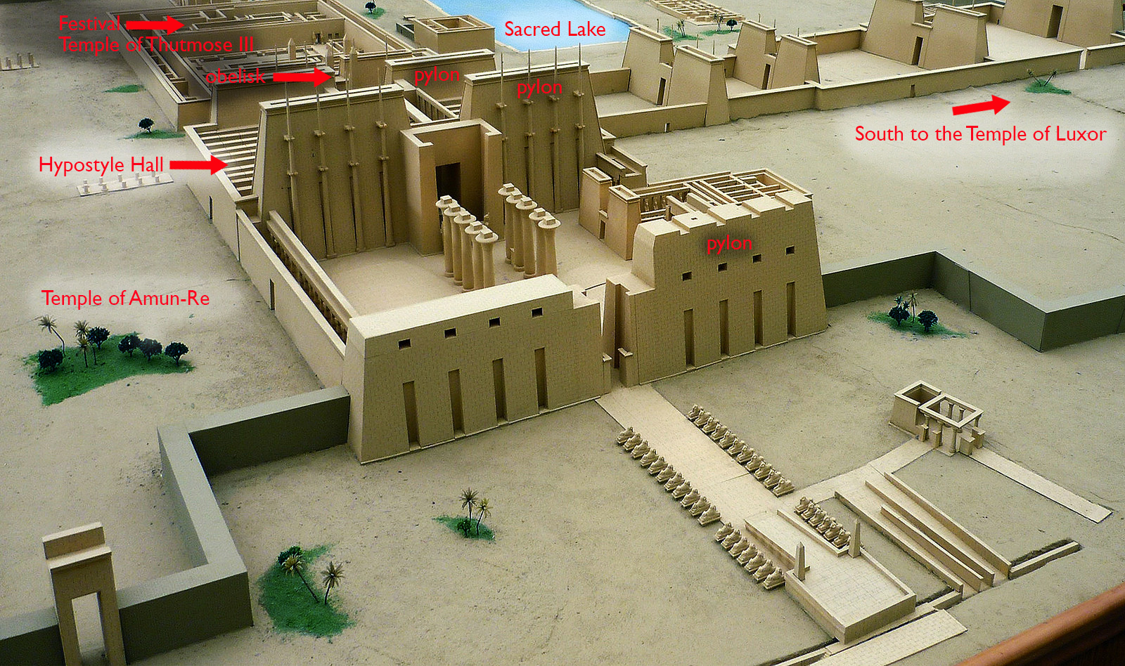

Slide 44
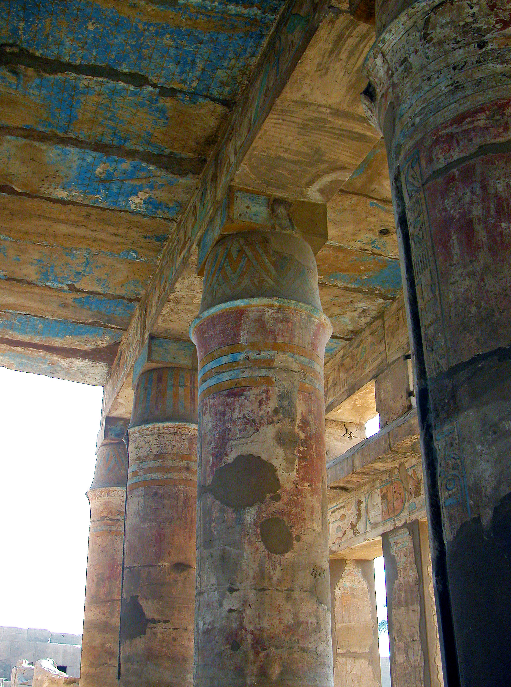

Slide 45
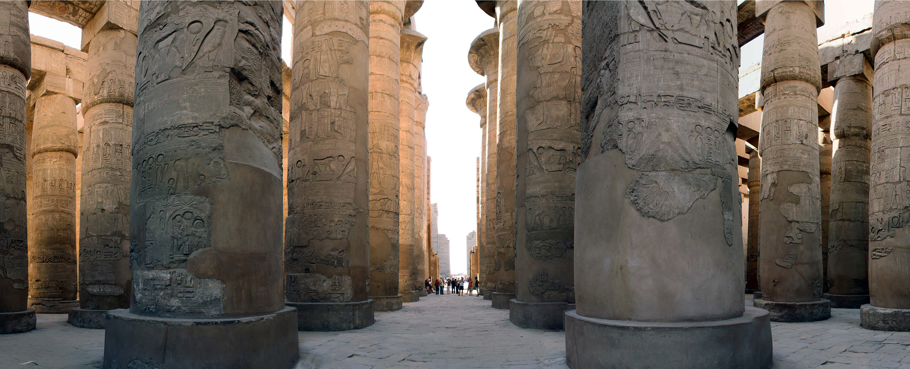

Slide 46
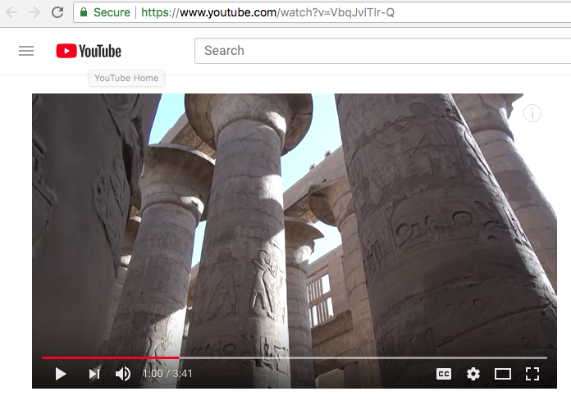
https://www.youtube.com/watch?v=VbqJvlTIr-Q 3:40 Min

Slide 48
Amarna Period
During Dynasty 18 there was a radical change in the traditional Egyptian culture. This challenge came during the reign of Amenhotep IV, who questioned the power of the priest class and introduced the new form of religion closely associated with the sun-disk god, Aten. Amenhotep changed his name to Akhenaten and moved the capital to Tell-el-Amarna.
In addition to changing the social and religious nature of the civilization, a new style of art will characterize the Amarna Period.
The art of the Amarna Period will reflect a new more naturalistic approach in the rendering of the human figure. Artists will instill a new sense of life in their reliefs, wall paintings, statuary,

Slide 49
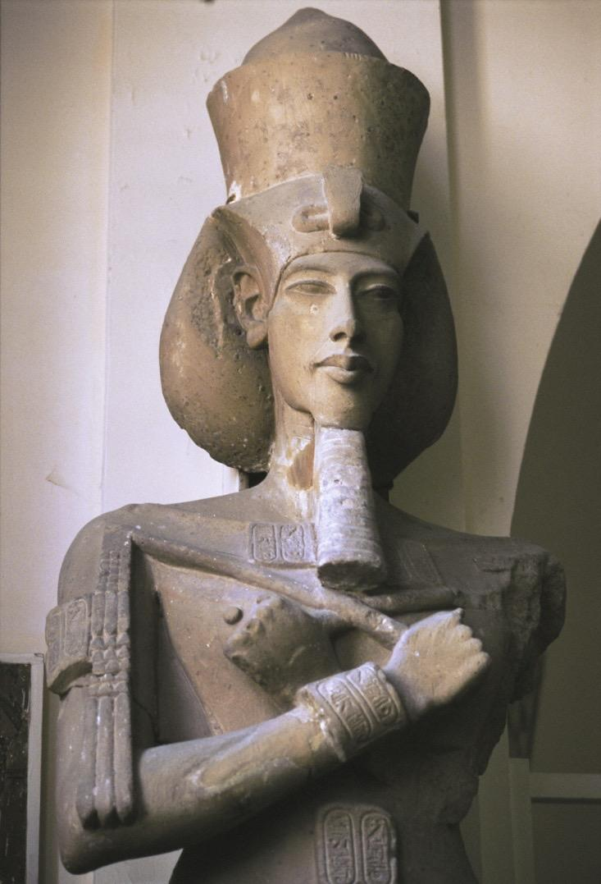
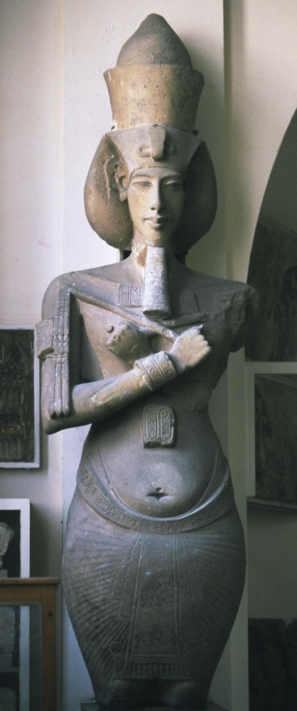
Akhenaton
from the temple of Amen-Re, Karnak, Egypt
ca. 1,353-1,335 B.C.E.
sandstone
approximately 13 ft. high

Slide 50
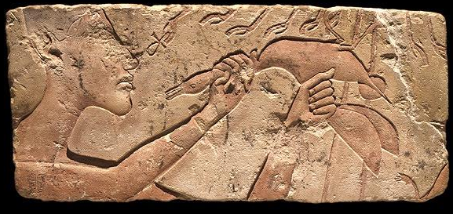
Akhenaton sacrificing a duck
ca. 1,353-1,335 B.C.E.
limestone
9 5/8 in. high

Slide 51
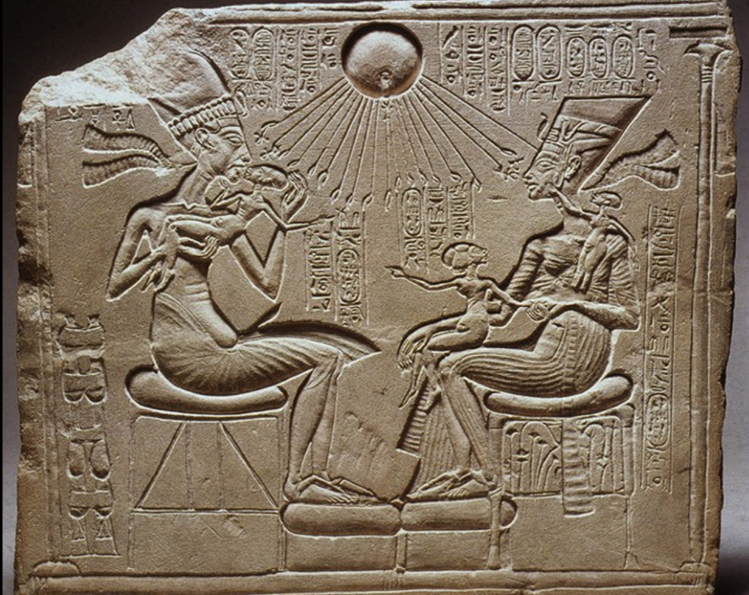
Amarna period Egyptian "Akhenaten and His Family," Dynasty XVIII, Tell el-Amarna, Egypt, 1348-1336 BC

Slide 52
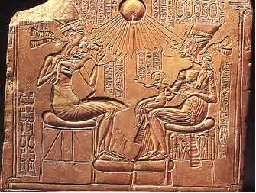
Amarna period Egyptian "Akhenaten and His Family," Dynasty XVIII, Tell el-Amarna, Egypt, 1348-1336 BC
-Akhenaten is not represented as the typical idealized Egyptian figure.
-The figures (Akhenaten and Nefertiti) are both portrayed as feminine and elongated.
-Both figures have a dreamy expression on their faces-given personality.
-Both have long necks and thick lips -typical for the Amarna period.
-Sunken relief style
-Shows the intimate relationships within the family-makes them more human
-Breaks with cannon so as to allow for new faith "Aton"

Slide 53
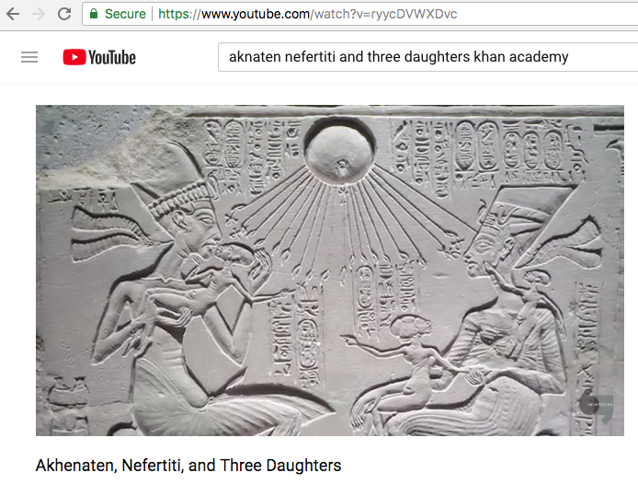
https://www.youtube.com/watch?v=ryycDVWXDvc 5:00 Min

Slide 54
Form | Function | Content | Context
Sunken relief | Indicates the state religion shift by the change in art | Changes: Smoother, curved surfaces Low hanging bellies Slack jaws Thin arms Heavy lidded eyes | State religion changed from Amun to Aten, symbolized by the sun disk
 | Panel is from altar in a home | Akhenaton holds eldest daughter, giving her a kiss | Akhenaton and Nefertiti having a private relationship with their new god, Aton
 |  | Nefertiti holds two other daughters
 |  | Domestic environment new in Egyptian art

Slide 55
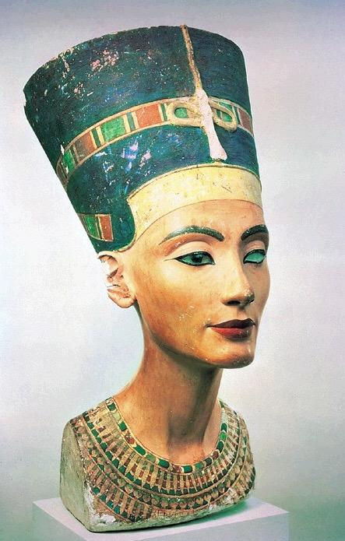
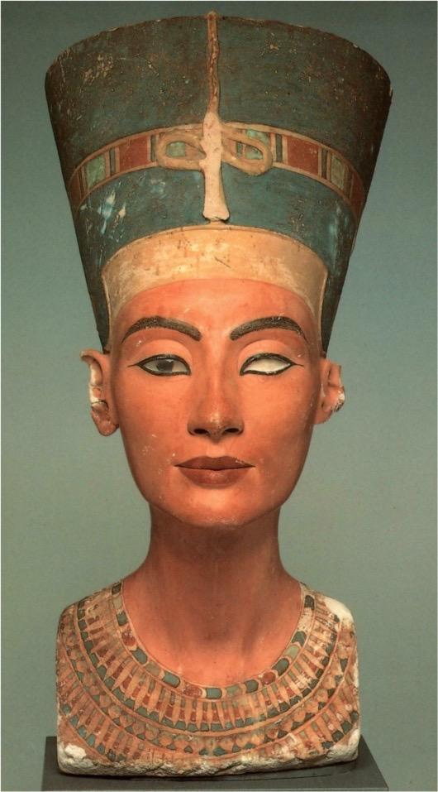
Bust of the queen of Akhenaten
-Very elegant and elongated features
-Rock crystal was placed within the eyes to give them a wet and glossy look-more realistic.
-The bust was left unfinished-the left eye was left out of the socket.
-Sculpted by Thutmose
Thutmose
Nefertiti
from Tell el-Amarna, Egypt
ca. 1,353-1,335 B.C.E. painted limestone 20 in. high

Slide 57
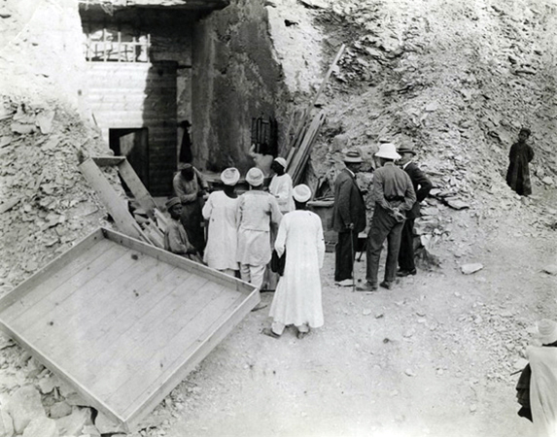
Discovered By Howard Carter: 1922

Slide 58
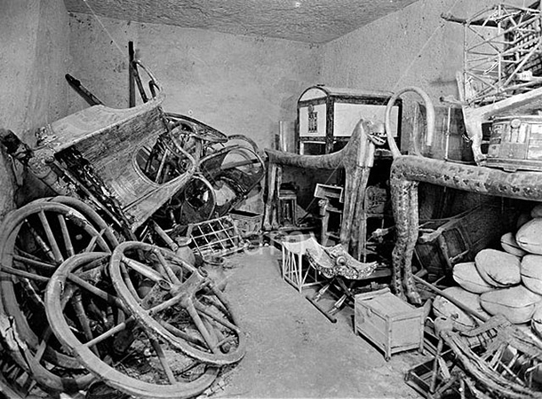

Slide 61
-Found placed over the head of the mummy of Tutankhamen
-The features of the mask show the king to be an adolescent
-Made of pure gold and semi-precious stones
-The headdress worn by pharaohs (seen on this mask) is meant to make the pharaoh look like a cobra (the snake was a symbol of the pharaoh)
Death Mask of Tutankhamen
from Thebes, Egypt
ca. 1,323 B.C.E.
gold with semiprecious stones
21 1/4 in. high

Slide 62
Innermost coffin of Tutankhamen
from Thebes, Egypt
ca. 1,323 B.C.E.
gold with semiprecious stones
73 in. high

Slide 63
https://www.youtube.com/watch?v=DD9vYBV6ZAY 3:40 Min

Slide 64
Repousse and Chasing

Slide 65
Form | Function | Content | Context
Gold Coffin 6’7” long | Coffin: Containing the body of the pharaoh | Holds the crook and flail- symbols of Osiris | Most famous Egyptian tomb- discovered by Howard Carter in 1922
 |  | Golden mask has smoothly idealized features of the boy king | When Akhenaton died, two pharaohs briefly reigned then Tutankhamun reigned for ten years from ages 9-19
 |  |  | Son of Akhenaton; father and mother were related; his own wife was his half –sister; Physical handicaps from genetic inbreeding?

Slide 66
Painted chest of Tutankhamen
from Thebes, Egypt
ca. 1,333-1,323 B.C.E.
painted wood
20 in. long

Slide 67
Last judgment of Hu-Nefer
from Thebes, Egypt
ca. 1,290-1280 B.C.E.
painted papyrus scroll
18 in. high

Slide 68
https://www.youtube.com/watch?v=WceVwMdN0eE 7:40 Min

Slide 69
Barbara Kruger: Text as art

Slide 70
Book of the Dead
from Thebes, Egypt
ca. 1,040-945 B.C.E.
painted and inscribed papyrus
13 3/4 in. high

Slide 71
Form | Function | Content | Context
Painted papyrus scroll | Illustration from the Book of the Dead, book of spells and charms | Hu-nefer Anubis Thoth Ammit Horus Osiris Isis Nephthes | Entire Egyptian belief system
Long- horizontal
Compressed narrative

