Slide 1
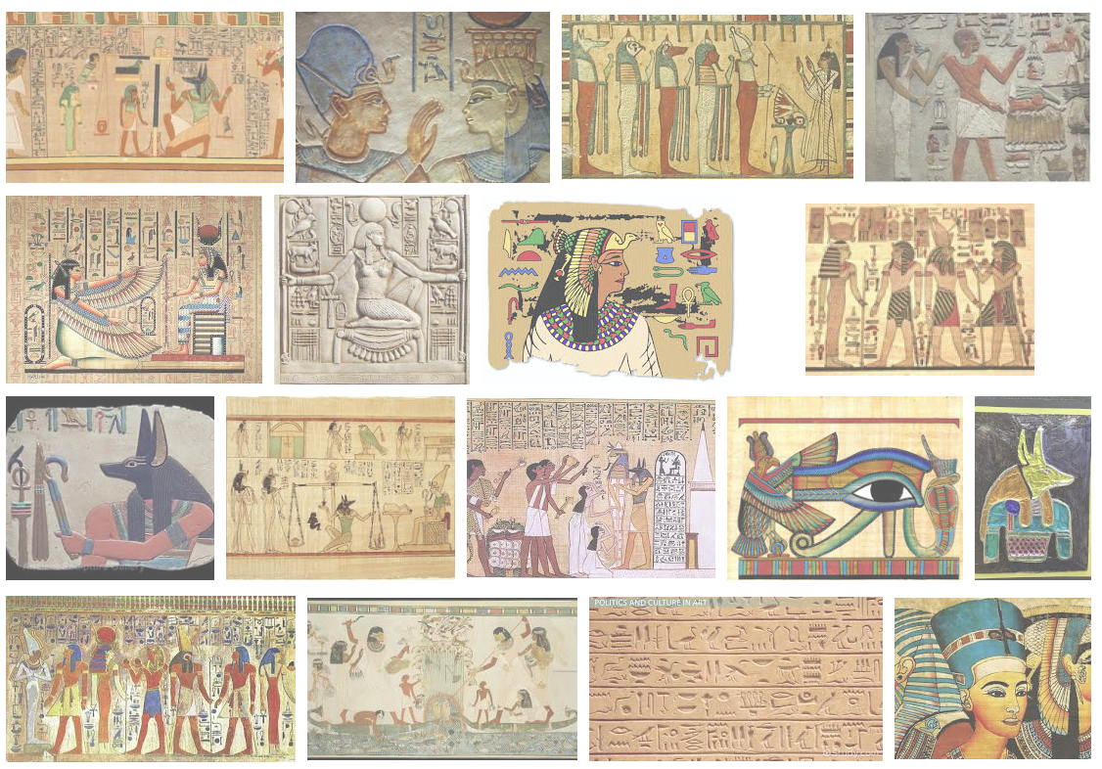
Ancient Egyptian Art
The lecture
Day 1

Slide 2
Key Ideas
Egyptian Art Spans a 3000 year history
Elaborate funerary practices led to the erection of mastabas, pyramids, and rock cut tombs in sacred imperial precincts throughout Egypt
Egyptian figures generally have broad frontal shoulders and profiled heads, torsos and legs
Egyptian art followed a canon or set of rules created to preserve the person’s image throughout all time and eternity

Slide 3
Vocabulary
Amarna Style- art created during the reign of Akhenaton, which features a more relaxed style than in other Egyptian art
Engaged column- a column that is not freestanding but attached to a wall.
Hieroglyphics- Egyptian writing using symbols or pictures as characters.
Hypostyle- a hall in an Egyptian temple that has a roof supported by a dense thicket of columns
In Situ- a Latin expression that means that something is in its original location
Ka- the soul or spiritual essence of a human being that either ascends to heaven or resides in an Egyptian statue of itself
Mastaba- Arabic word for bench; a low flat roofed Egyptian tomb with sides sloping down to the ground

Slide 4
Vocabulary
Necropolis- literally, “a city of the dead”, a large burial area
Papyrus- a tall aquatic plant used as a writing surface in ancient Egupt
Pharaoh- a king in ancient Egypt
Pylon- a monumental gateway to an Egyptian temple marked by two flat, sloping walls between which was a smaller entrance.
Reserve column- a column that is cut away from rock but has no support function
Sarcophagus- a stone coffin

Slide 5
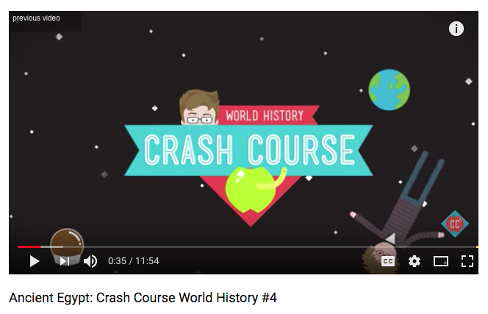
https://www.youtube.com/watch?v=Z3Wvw6BivVI 12:00 Min

Slide 6
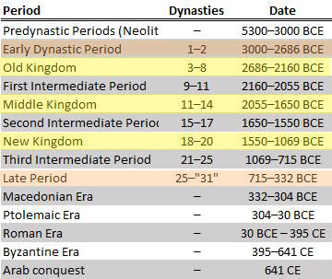

Slide 8
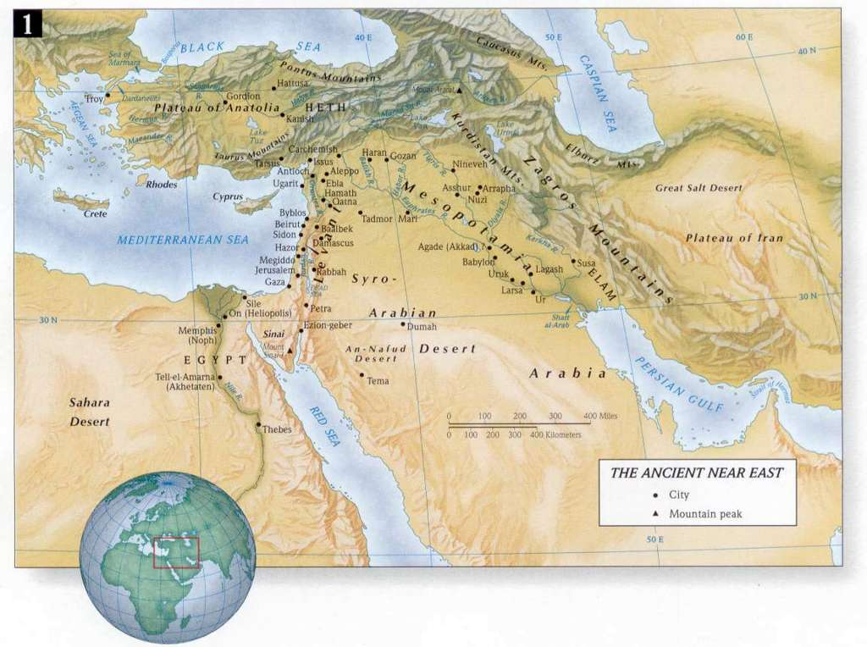

Slide 9
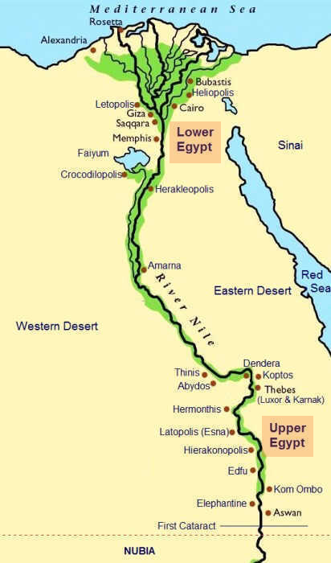

Slide 10
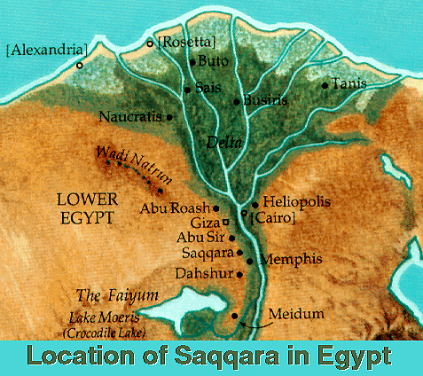

Slide 11
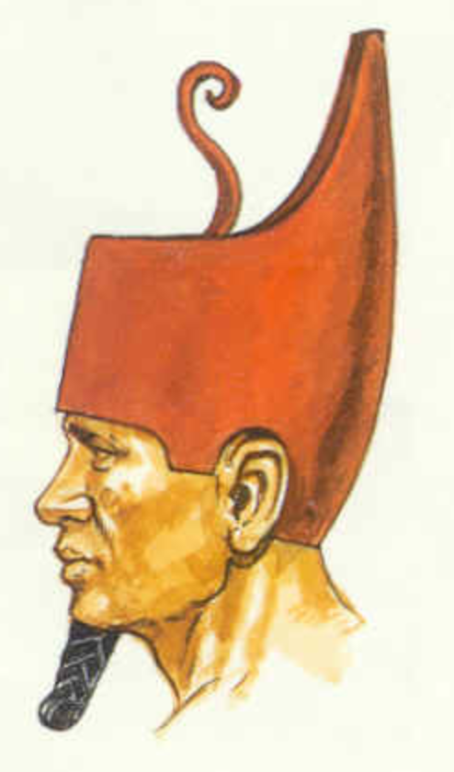

Slide 12
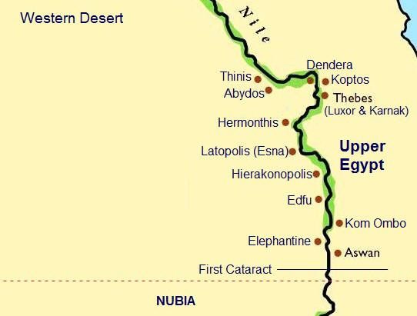

Slide 13
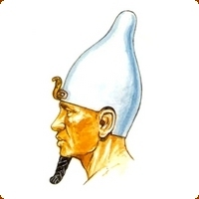

Slide 15
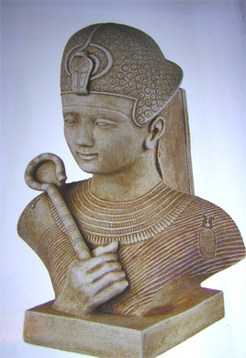
King Narmer
Unifies Upper and Lower Egypt. Becomes the first king of Unified Egypt
He is identified as the first Dynasty Pharaoh named “Menes”
Creates a unified Crown
The Capital of Old Kingdom Egypt was “Memphis”

Slide 16
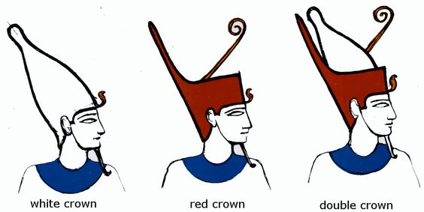

Slide 17
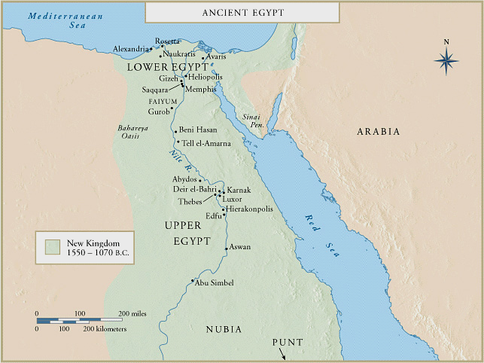

Slide 18
Old Kingdom Art

Slide 19
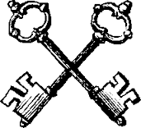
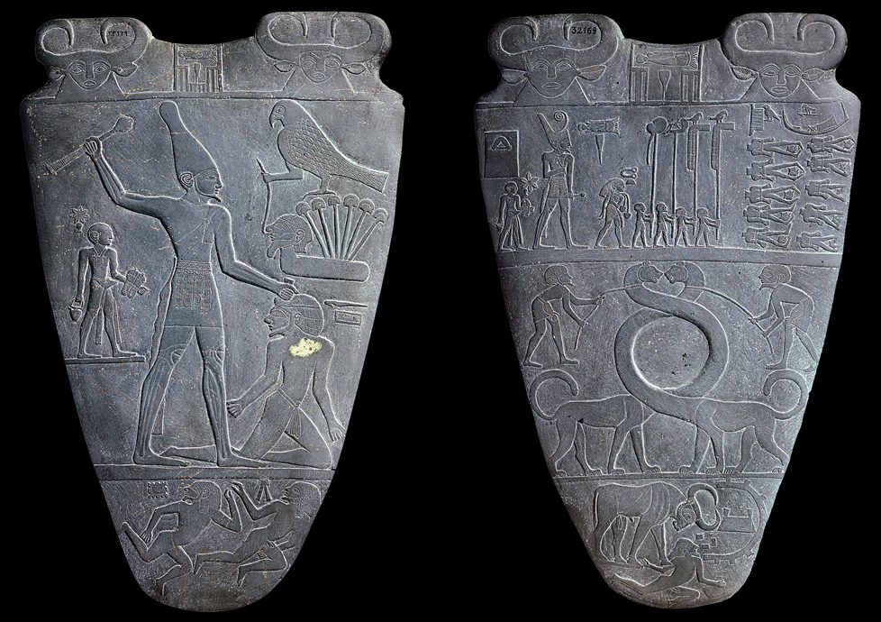
Palette of King Narmer
from Hierakonpolis, Egypt
Old Kingdom
ca. 3,000-2,920 B.C.E.
slate
approximately 25 in. high

Slide 20
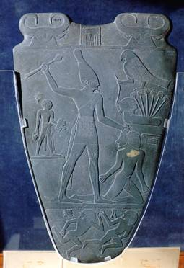
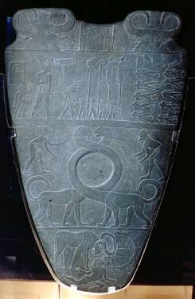
A transitional piece that links Pre-dynastic and Old Kingdoms together
-This is a lid to a cosmetic box.
-Notice the beginning of the Egyptian human form that is used throughout the following centuries.
-The king (Narmer) is shown killing an enemy (Lower Egypt).
-The falcon facing Narmer is a motif representing the god, Horus.
-Conveys Narmer's all powerful control with his hierarchical scale (his is much larger than any other image)
-Portrays the unification of the two kingdoms
Palette of King Narmer
from Hierakonpolis, Egypt
ca. 3,000-2,920 B.C.E.
slate
approximately 25 in. high

Slide 22
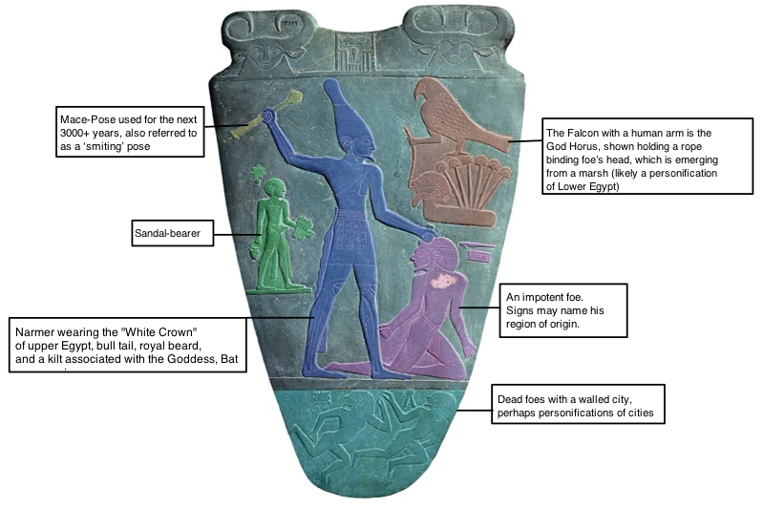

Slide 23
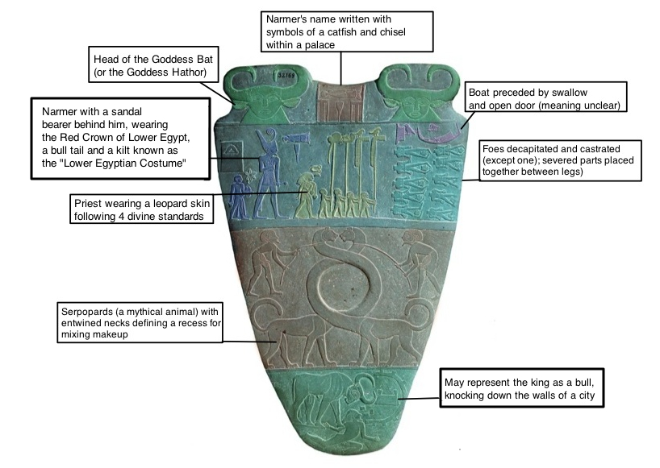

Slide 24
Form | Function | Content | Context
Relief sculpture depicting Narmer uniting Upper and Lower Egypt; two feet tall | Palette used to prepare eye makeup for the blinding sun, though the palette may have been ceremonial or commemorative | On Front: Narmer, wears the cobra crown of Lower Egypt; surveys beheaded enemies. Narmer is preceded by 4 standard bearers and a priest followed by a foot washer | Scholars believe that the palette conflates events that took years into one event
Introduces the Egyptian canon that will last for 3000 years | Narrative- tells a story | In Center, Serpapards with necks entwined | Ritually buried at the temple of Hierakonpolis
Schematic lines delineate Narmer’s muscle structure: forearm veins and thigh muscles are represented by straight lines; half circles for knee caps |  | On Back: | There was a great deal of focus on ritual and votive objects (offerings to the God) in temples. Every ruler, elite individual, and anyone else who could afford it, donated items to the temple to show their piety and increase their connection to the deity. After a period of time, the temple would be full of these objects and space would need to be cleared for new votive donations. However, since they had been dedicated to a temple and sanctified, the old items that needed to be cleared out could not simply be thrown away or sold. Instead, the general practice was to bury them in a pit under the temple floor.

Slide 25
Key Ideas to Remember
Contains some of the earliest known hieroglyphic text
Demonstrates the first examples of what will be come standard ideas in Egyptian art. (that doesn't change for 3000 years!)
Important moment in the history of Egyptian politics, the unification of the two kingdoms of predynastic Egypt

Slide 27
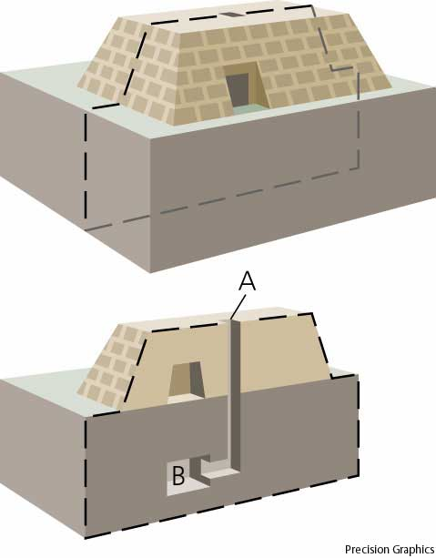
The first type of Egyptian tomb: the Mastaba
Has four sloping sides and an entrance for mourners to bring offerings to the deceased.
The burial chamber was below the mastaba in an area only accessible to the ka

Slide 28
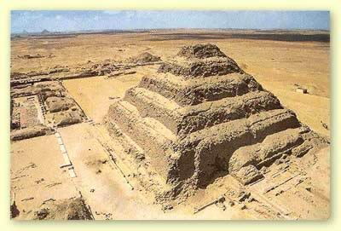
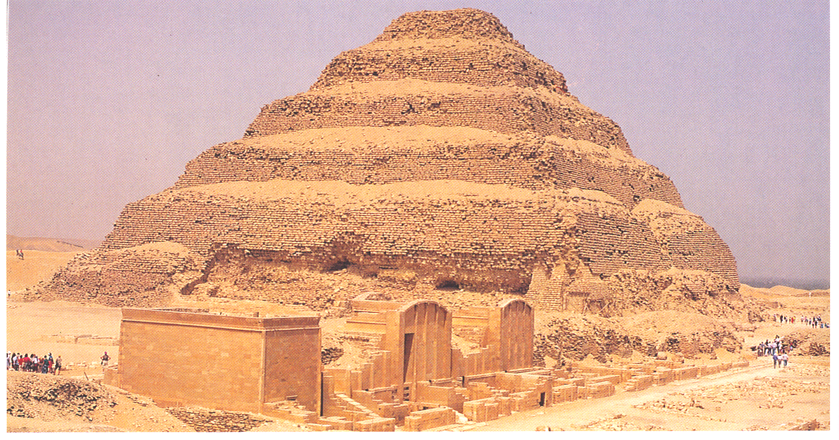

Slide 31
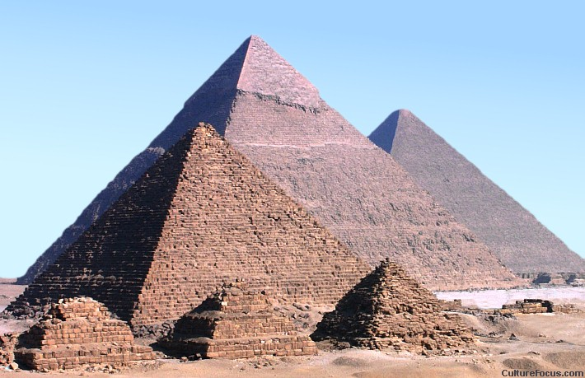
Great Pyramids
Gizeh, Egypt
3,000-2,520 BCE
Menkaure, Khafre, & Khufu
Limestone

Slide 32
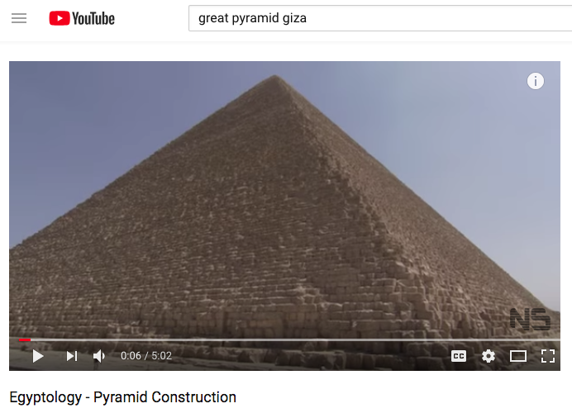
https://www.youtube.com/watch?v=pOznETH5nGY 5:00 Min

Slide 33
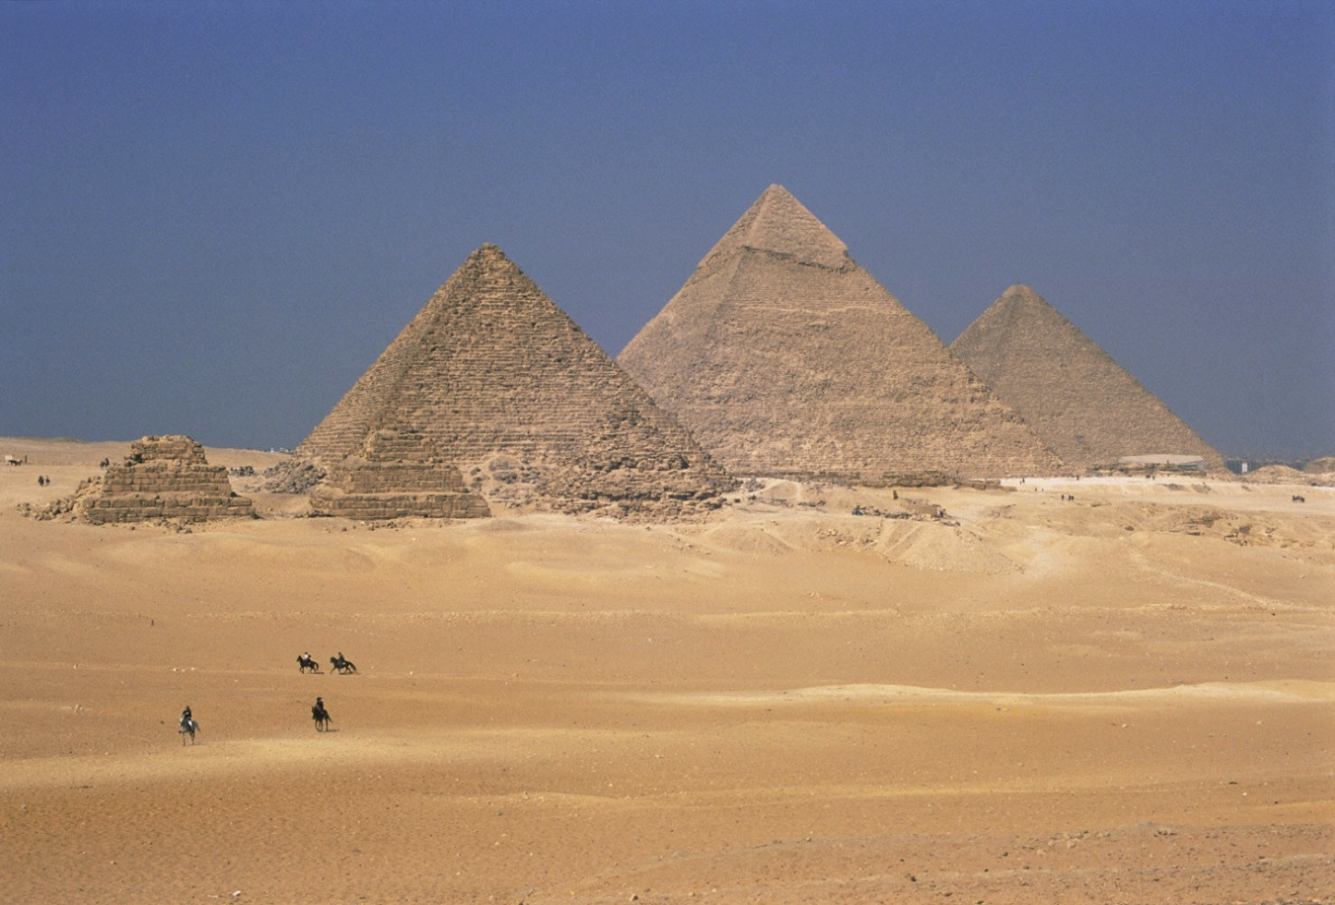
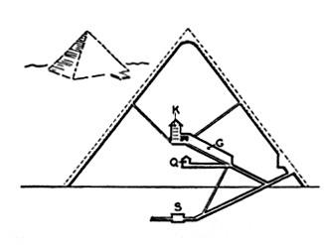
-Built on the west side of the Nile where the sun sets, but they face east (rising sun)
-Khufu built the oldest and largest pyramid.
-The corners line up with the cardinal points on a compass.
-Would have been covered in hieroglyphics and polished to the point of a mirror to reflect the sun
-Evolved from the
stepped pyramid to
represent more of the
idea of the sun
Great Pyramids
Gizeh, Egypt
Menkaure, 3,000-2,920
Khafre, 2520-2494 Khufu 2551-2528 B.C.E.
Limestone
450 ft. high

Slide 34
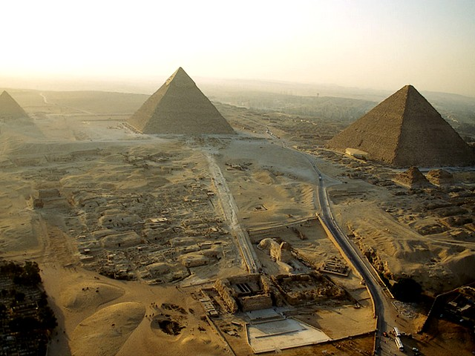

Slide 35
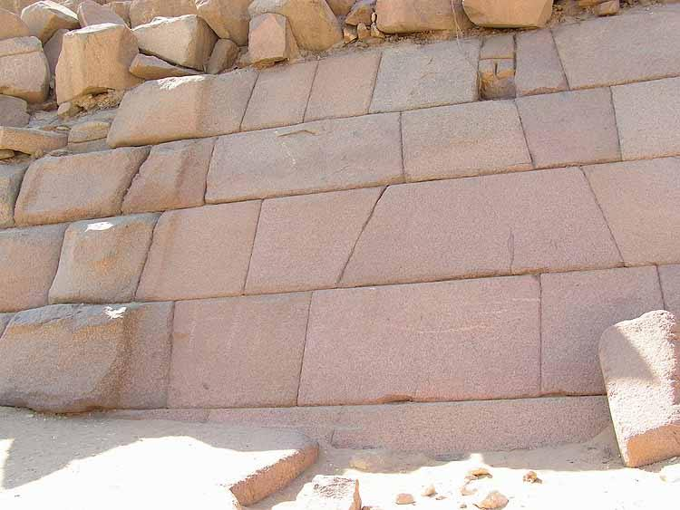

Slide 36
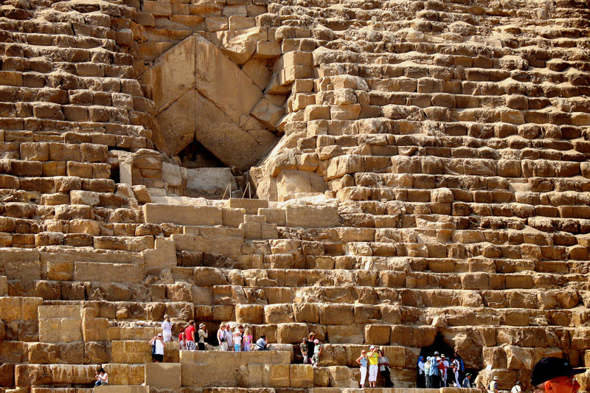

Slide 37
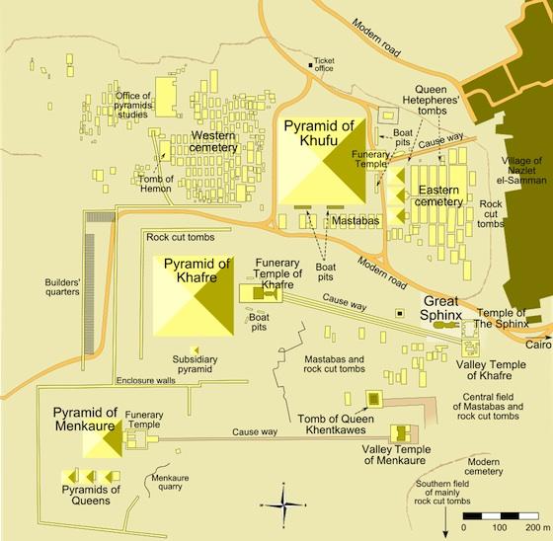
Notes:
Slide concept by William V. Ganis, PhD FOR EDUCATIONAL USE ONLY For publication, reproduction or transmission of images, please contact individual artists, estates, photographers and exhibiting institutions for permissions and rights.

Slide 38
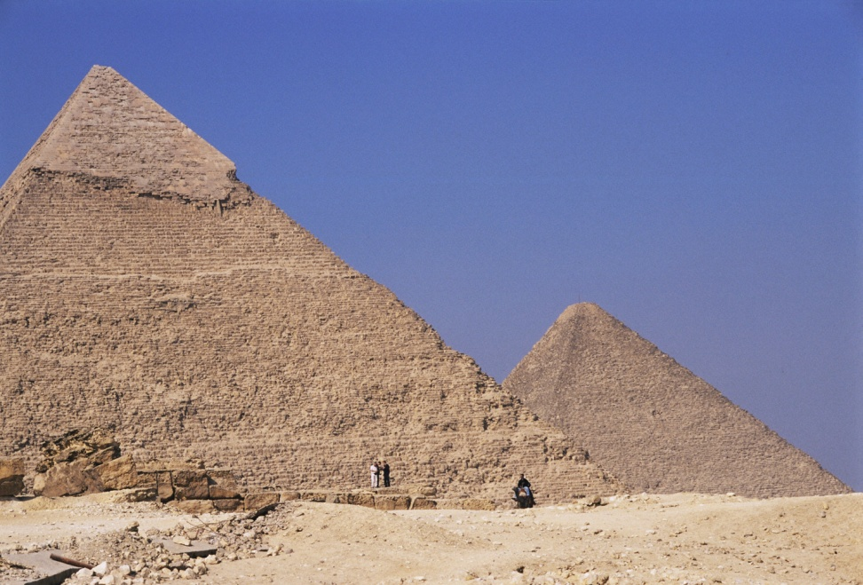
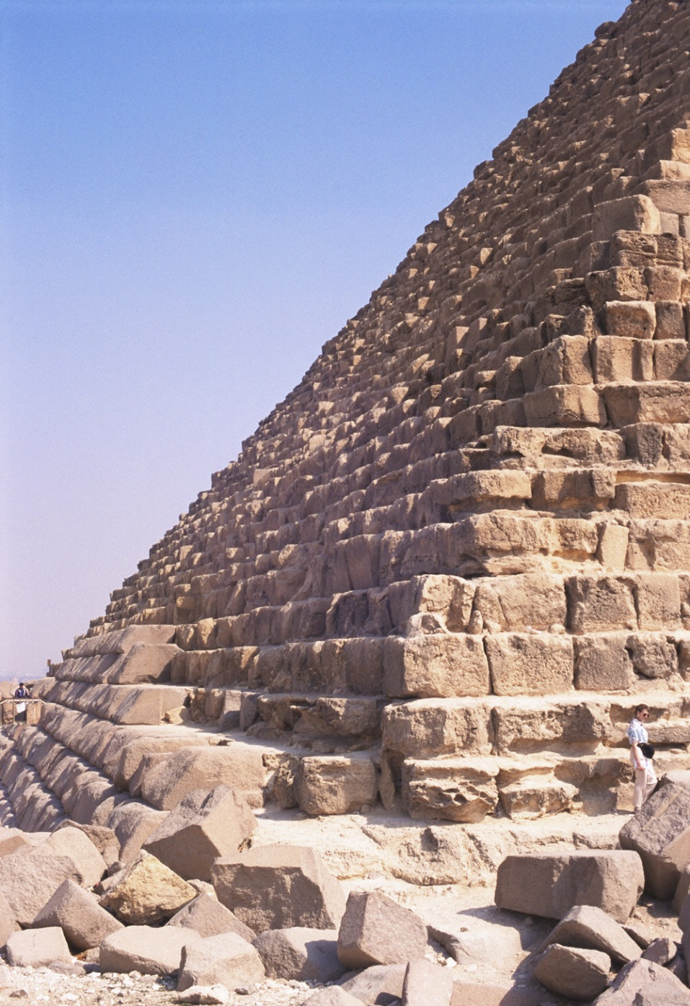
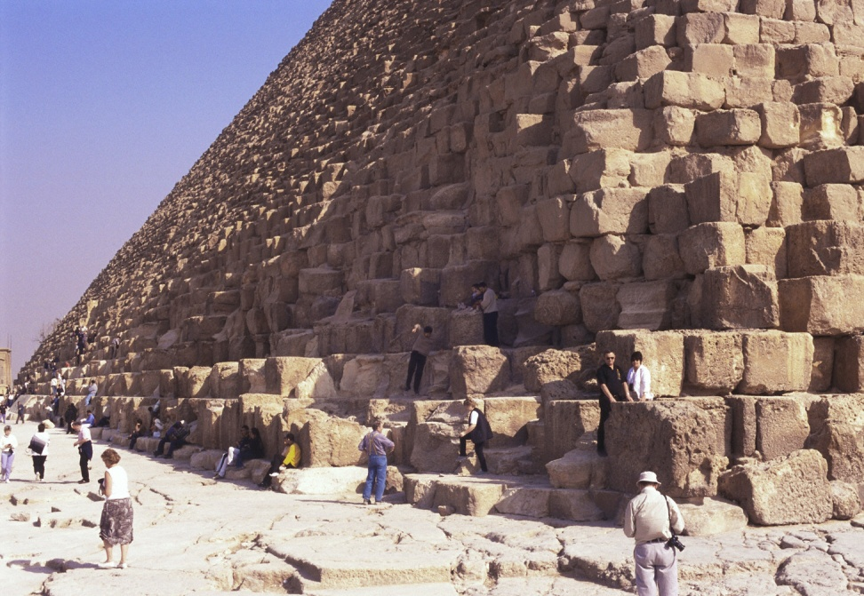
Notes:
Slide concept by William V. Ganis, PhD FOR EDUCATIONAL USE ONLY For publication, reproduction or transmission of images, please contact individual artists, estates, photographers and exhibiting institutions for permissions and rights.

Slide 39
Form
Function
Originally faced with stone, most of which has been lost
Each side of the pyramids faces a cardinal direction
Giant monuments to dead pharaohs
Pharaohs buried inside, rather than previously where they were buried under (like mastabas)

Slide 40
Content
Context
Huge pile of limestone with minimal interior for the deceased;
Each pyramid had an enjoining funerary temple
Shape influenced by benben shape
Tombs of Menkaure, Khufu, and Khafre
Has a formal pathway connecting the temple to the pyramid used to carry the dead king to the pyramid to be entombed

Slide 41
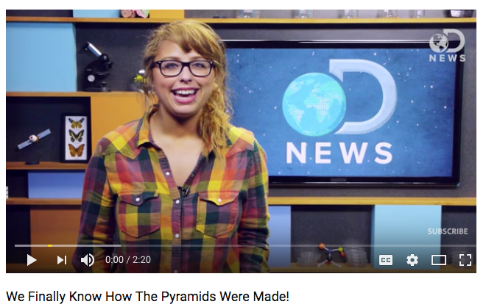
How did they make the pyramids?
https://www.youtube.com/watch?v=hRvtVrXcC3Y 2:00 Min

Slide 42
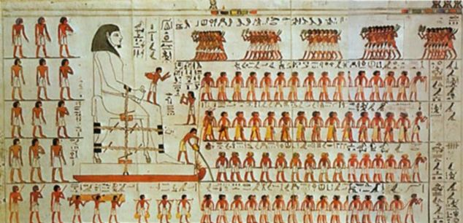

Slide 43
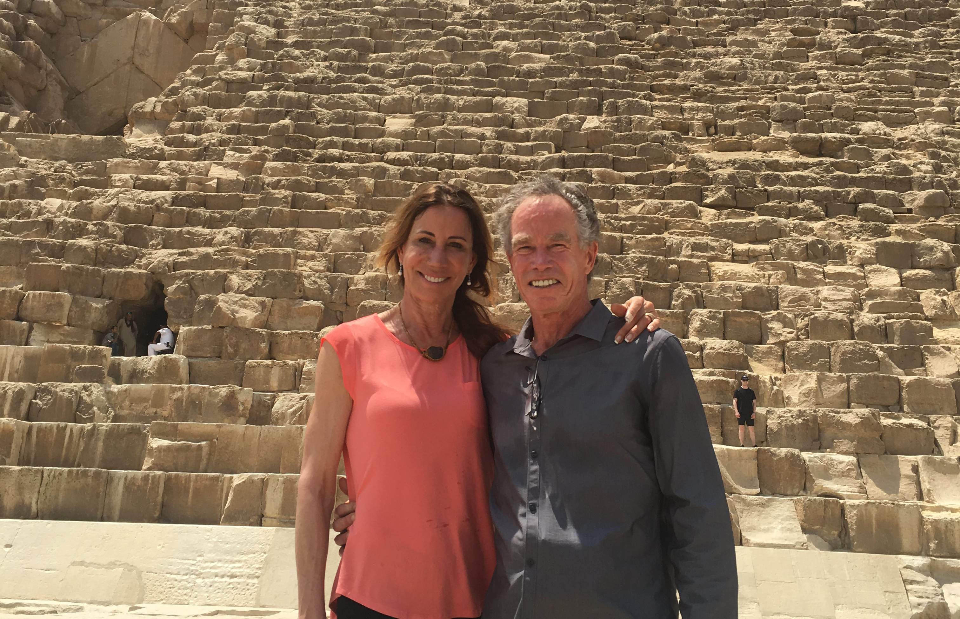

Slide 44
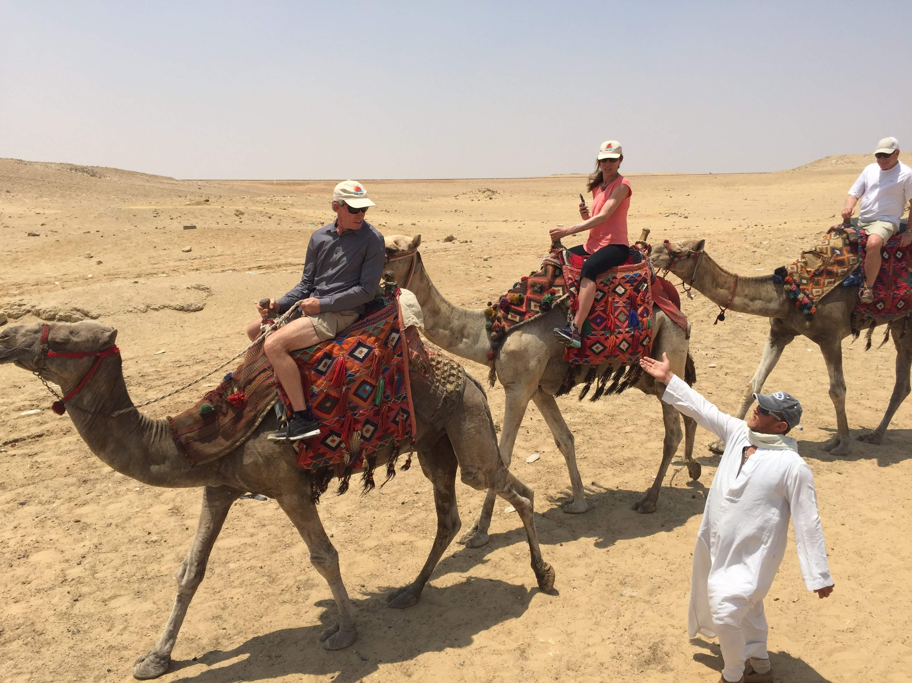

Slide 45
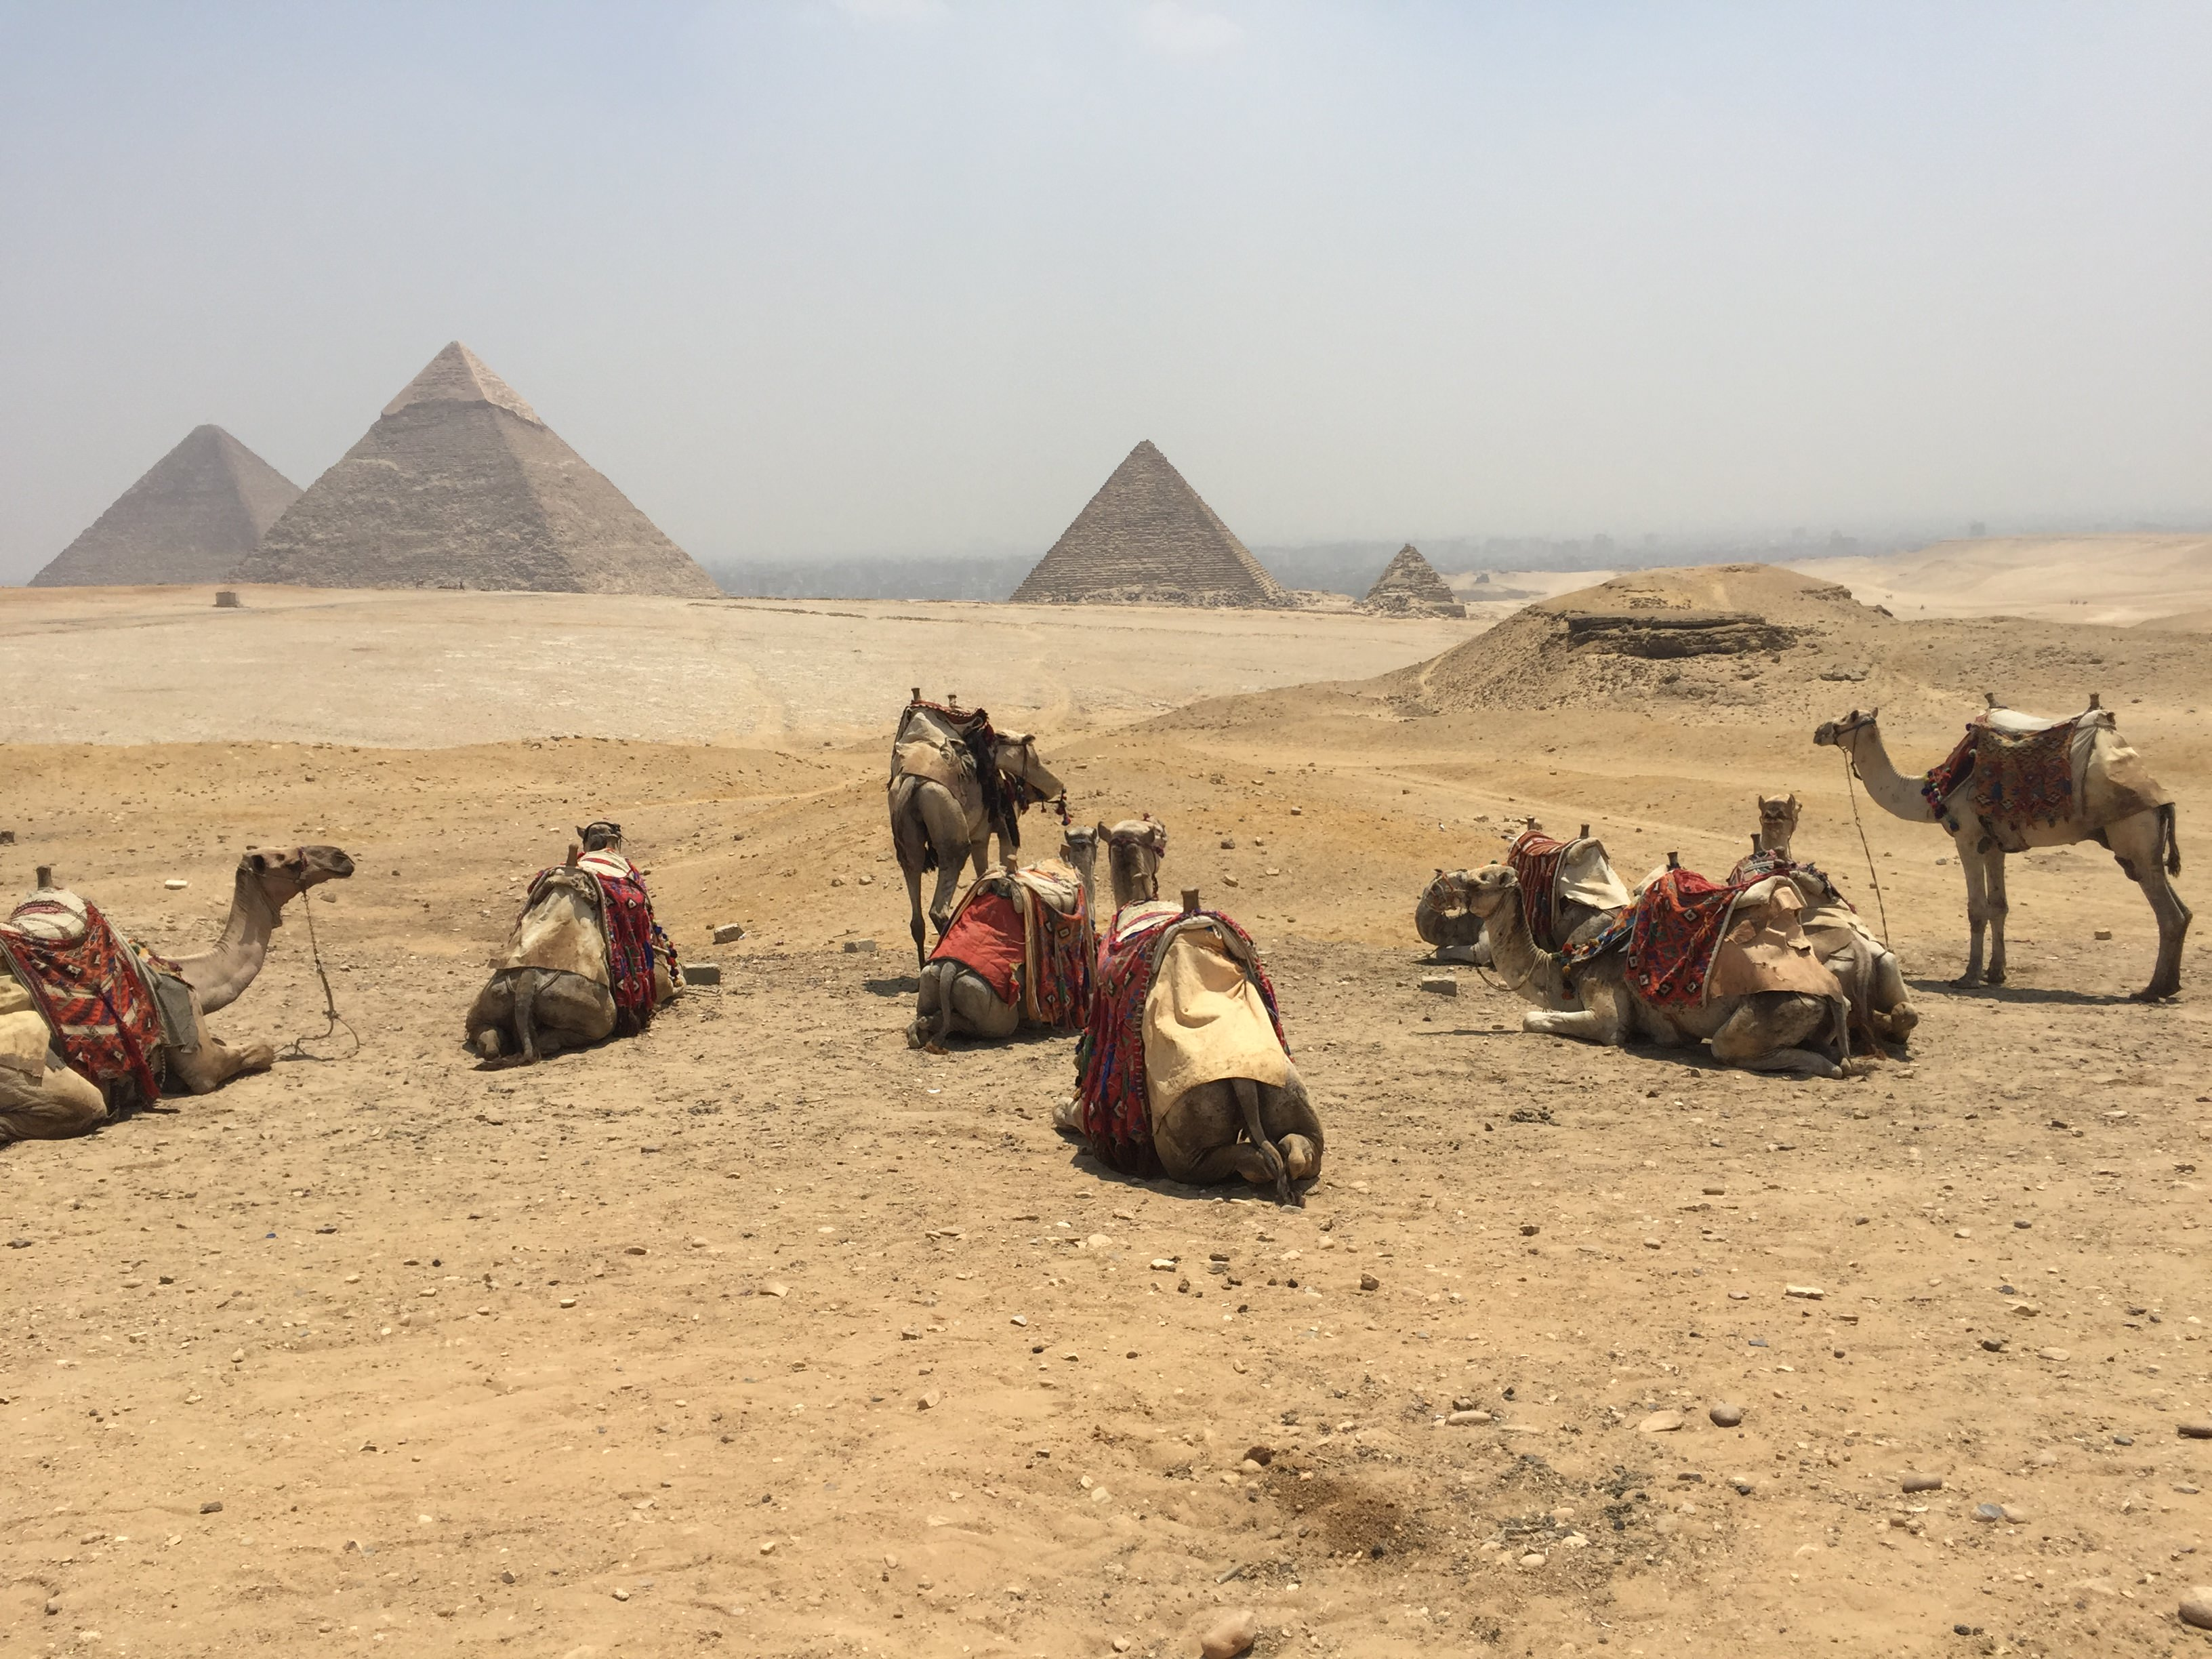

Slide 46
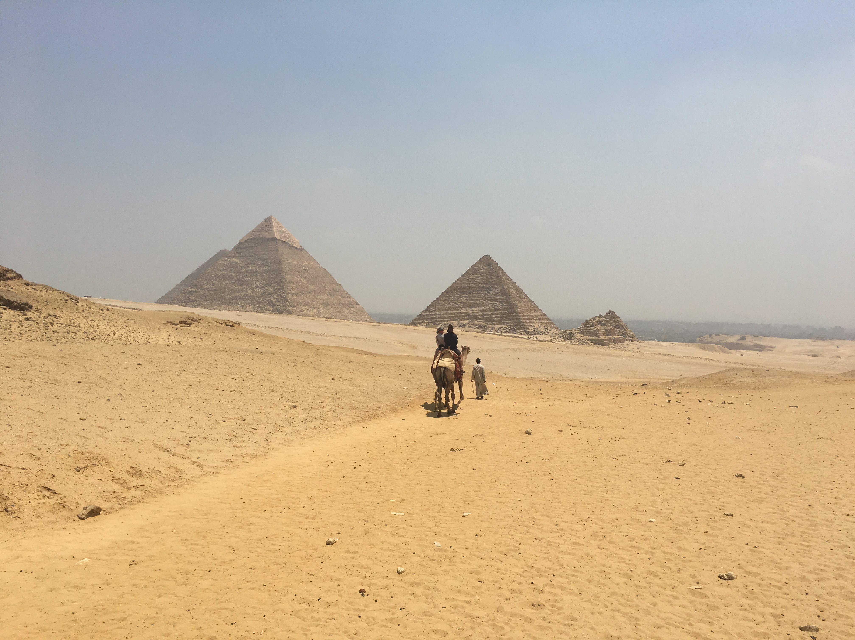

Slide 47
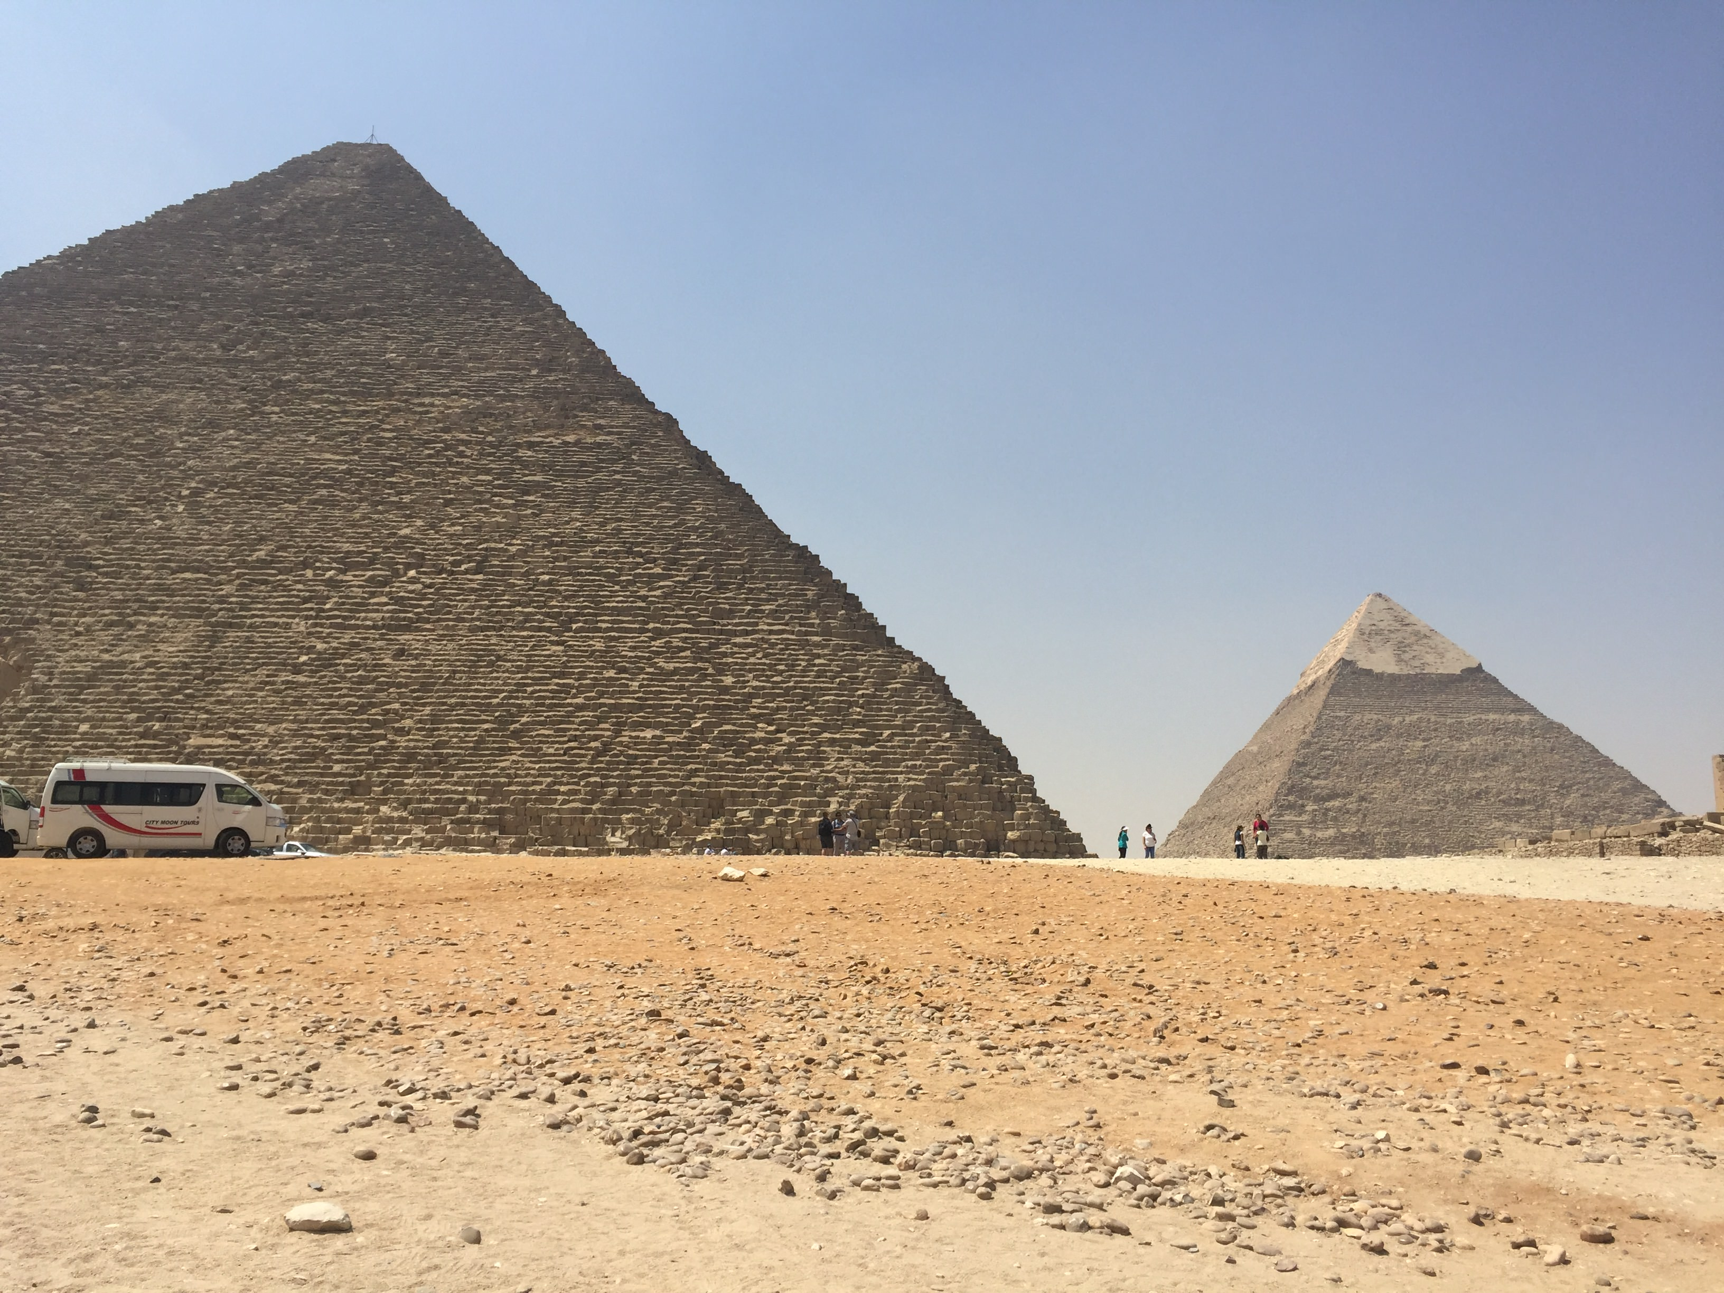

Slide 48
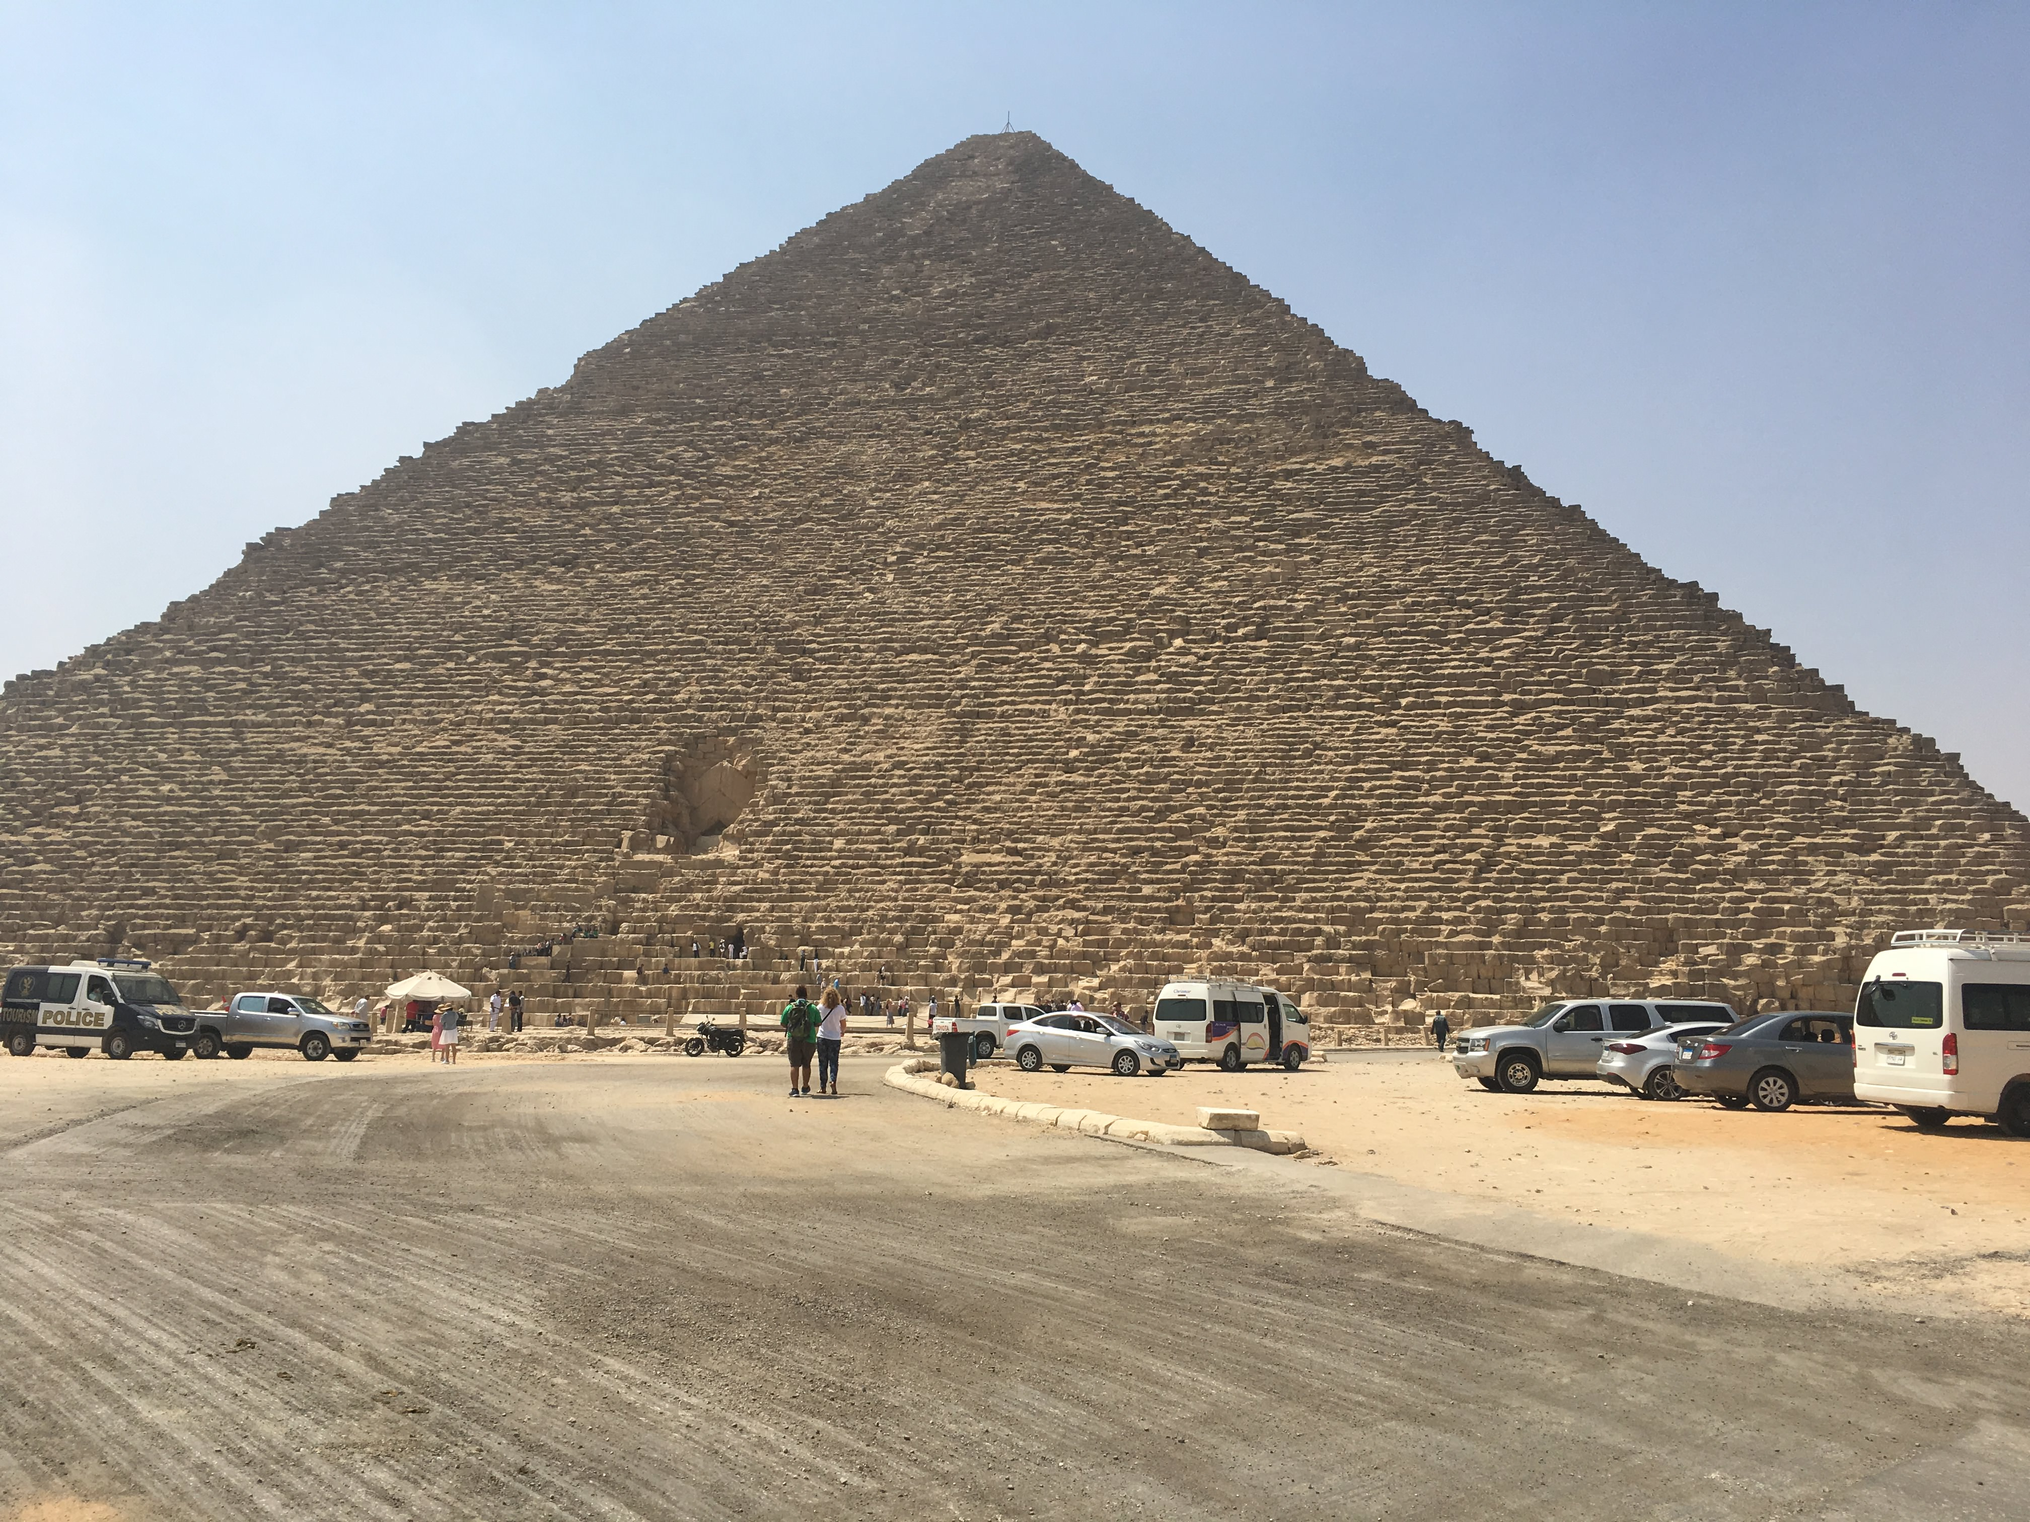

Slide 49
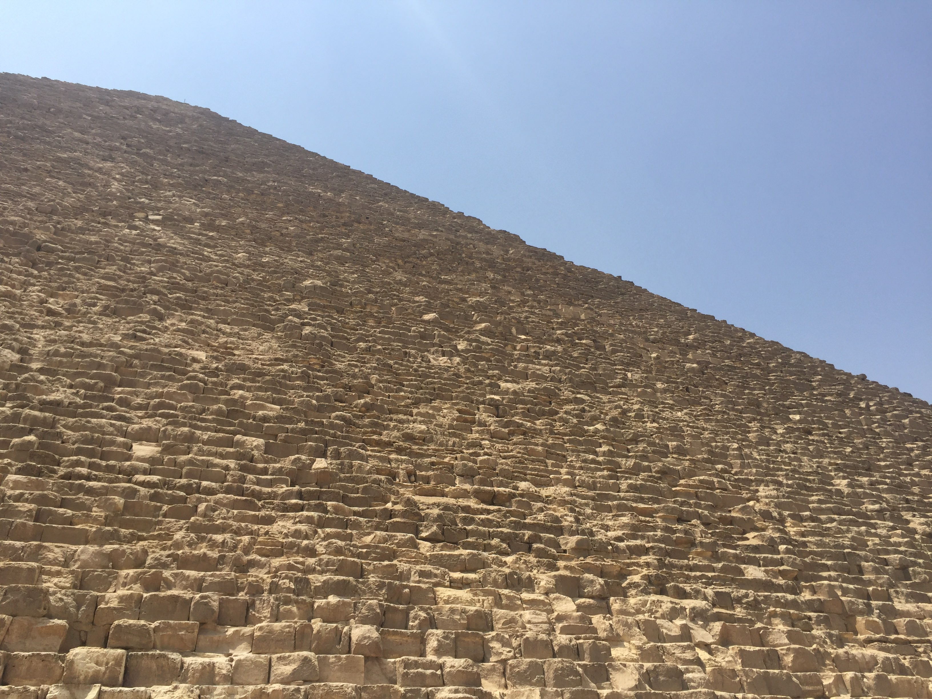

Slide 50
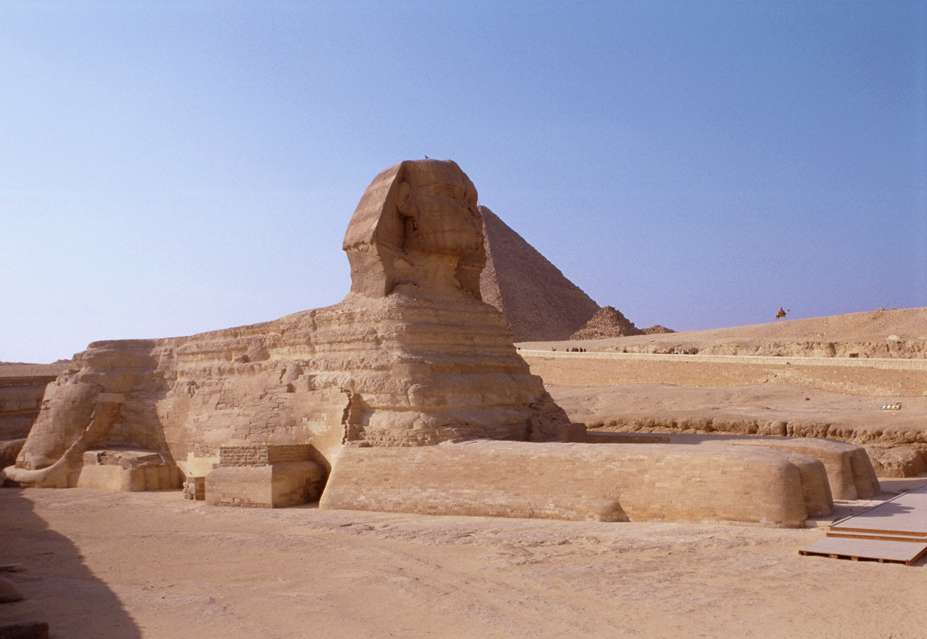
-A part of the Khafre funerary complex
-Built to represent the Pharaoh Khafre
-Its purpose was to protect the tombs.
-Could have been adapted from a previous built statue and then the face of Khafre added
-Has been buried and "dug" back up several times
Great Sphinx
Gizeh, Egypt
ca. 2520-2494 B.C.E.
sandstone
approximately 65 ft. high

Slide 51
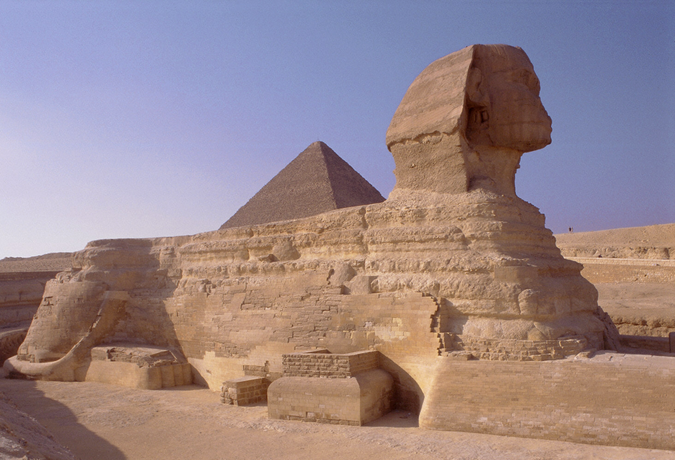
Notes:
Slide concept by William V. Ganis, PhD FOR EDUCATIONAL USE ONLY For publication, reproduction or transmission of images, please contact individual artists, estates, photographers and exhibiting institutions for permissions and rights.

Slide 52
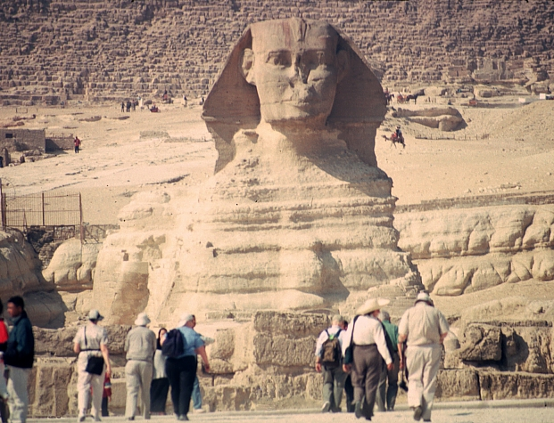

Slide 53
Form | Function | Content | Context
Body of a lion, head of pharaoh/ god | Protective spirit | Generalized features, though it may be Khafre | Carved in situ from a huge rock
 |  | Originally brightly painted | Cats are sacred in Egypt
 |  |  | Head badly mutilated in the Middle Ages- nose?

Slide 54
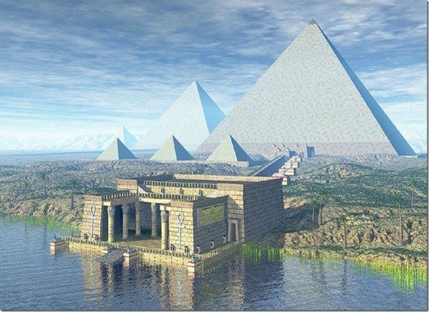

Slide 56
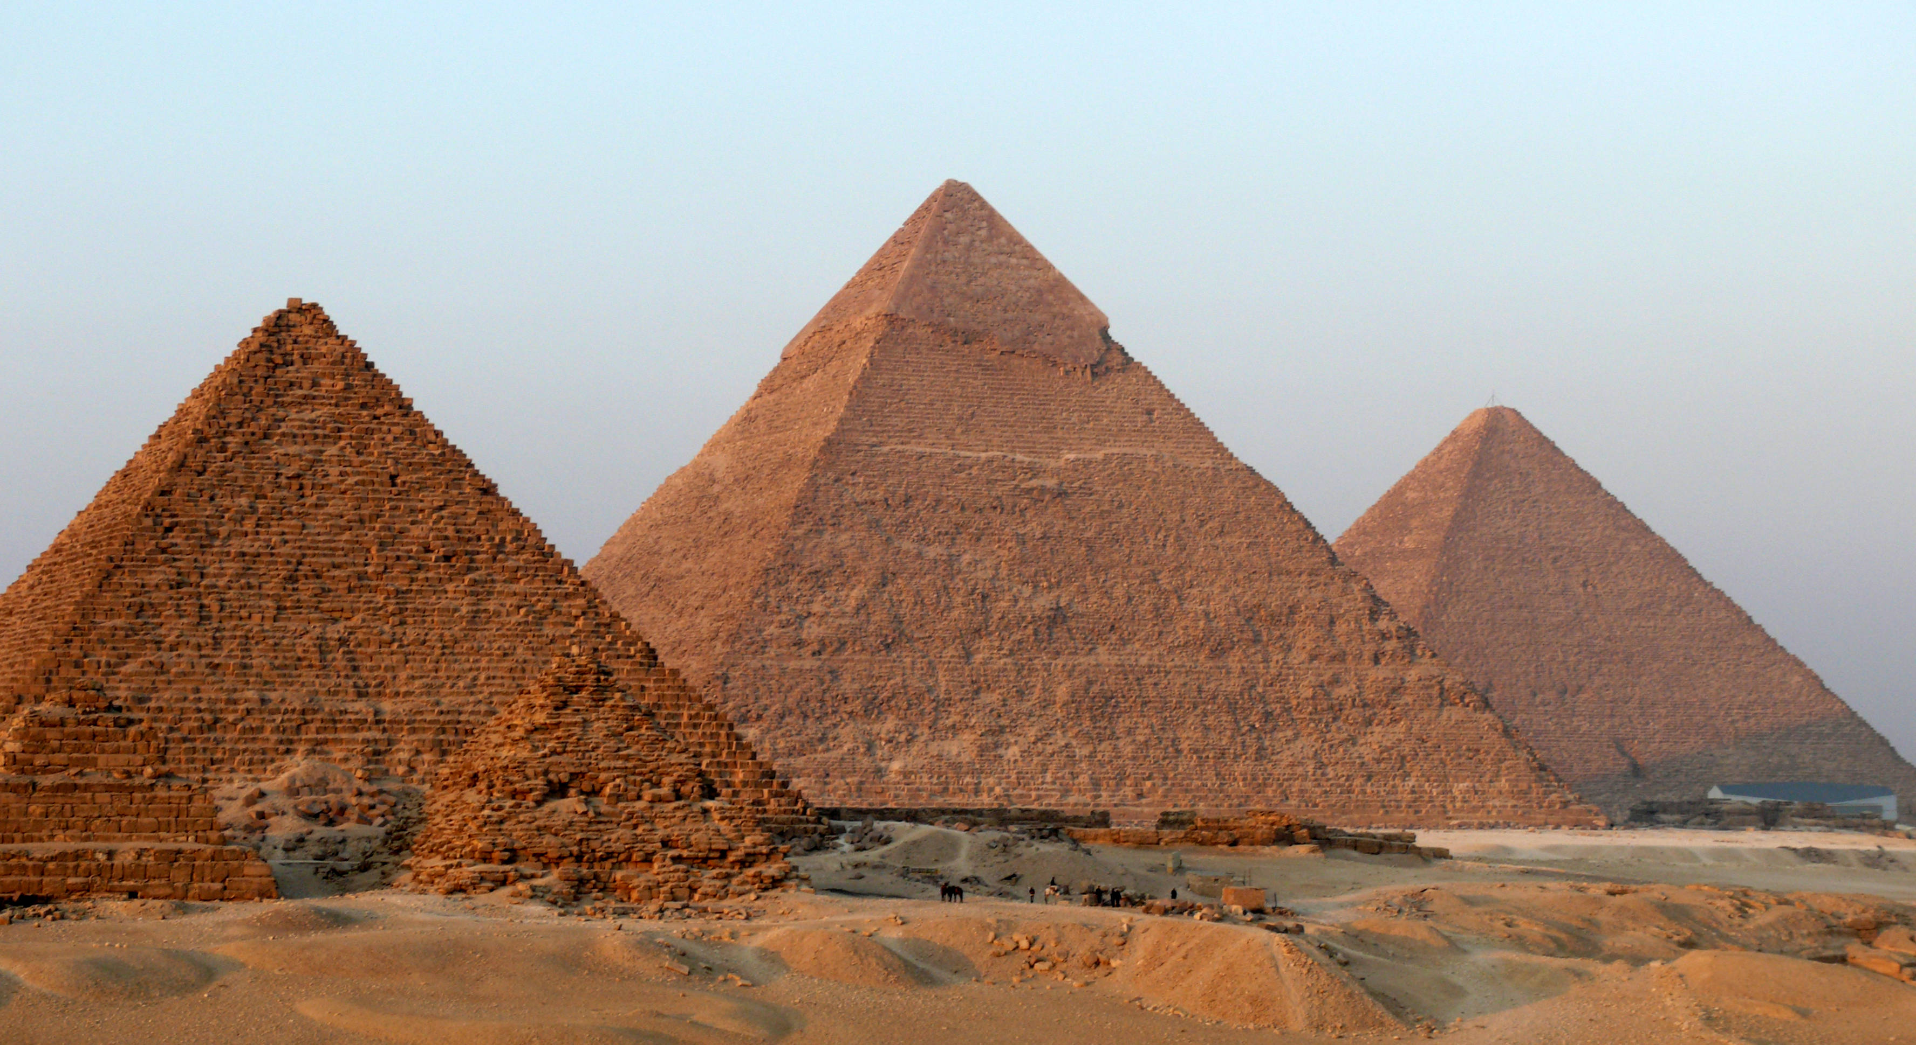
Menkaure

Slide 57
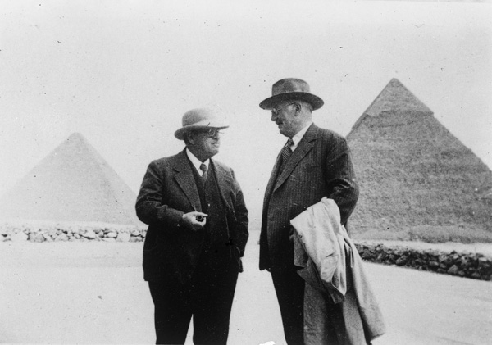
“On January 10, 1910, excavators under the direction of George Reisner, head of the joint Harvard University-Museum of Fine Arts, Boston, Expedition to Egypt, uncovered an astonishing collection of statuary in the Valley Temple connected to the Pyramid of Menkaure.”

Slide 58
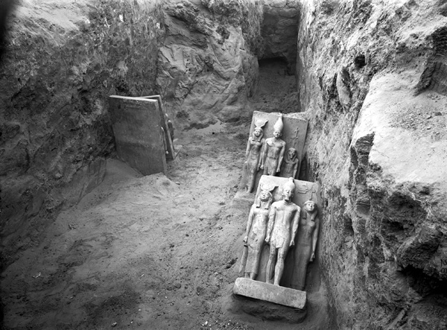
“Reisner had been excavating on the Giza plateau for several years at this point; his team had already explored the elite cemetery to the west of the Great Pyramid of Khufu before turning their attention to the Menkaure complex, most particularly the barely-touched Valley Temple.”

Slide 59
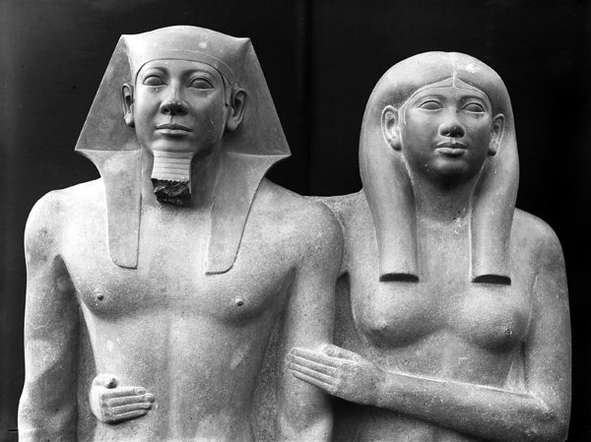

Slide 60
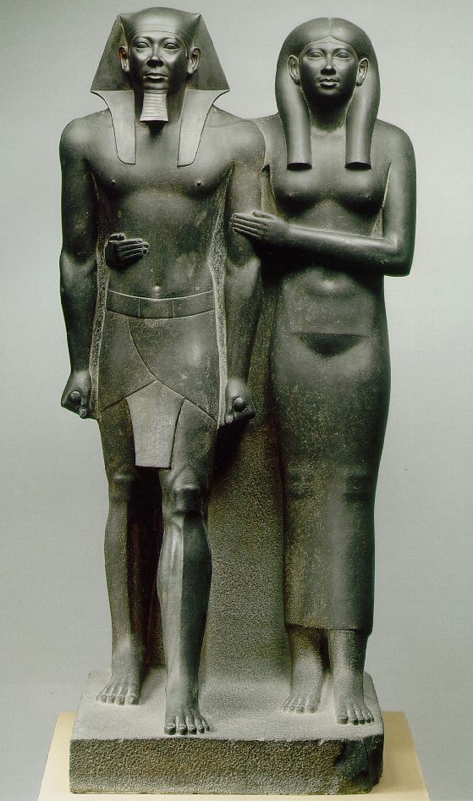
Menkaure is the son of Khafre.
-Very timeless, but rigid postures, indicating the eternal influence these individuals have
-Typical Egyptian stance: frontal view, arms close to the torso and hanging straight down, with the fists closed tightly
-Her arm around him symbolizes their marriage.
-Menkaure's wife, Khamerernebty is shown to be much smaller than he is, and she is placed slightly behind him indicating that she is helping to hold up the throne, but he is still in charge.
Menkaure and Khamerenebty
from Gizeh, Egypt
ca. 2,490-2,472 B.C.E.
graywacke
approximately 54 1/2 in. high

Slide 61
Menkaure and Khamerenebty
from Gizeh, Egypt
ca. 2,490-2,472 B.C.E.
graywacke
approximately 54 1/2 in. high

Slide 64
Form | Function | Content | Context
Frontal, formal, stiff | Created for the temple at the pyramid complex as a provision for the ka | Strong, muscled, | Menkaure is the son of Khafre.
greywacke | Very timeless, but rigid postures, indicating the eternal influence these individuals have | Wife’s gesture is affectionate, and/or presenting him to the gods | Menkaure's wife, Khamerernebty is shown to be the same size as he is, and she is placed slightly behind him indicating that she is helping to hold up the throne, but he is still in charge.
Attached arms and legs |  | Idealized- to show kingship
 |  | Typical Egyptian stance: frontal view, arms close to the torso and hanging straight

Slide 66
Seated Scribe
from Saqqara, Egypt
ca. 2,450-2,350 B.C.E.
painted limestone
approximately 21 in. high

Slide 67
https://www.youtube.com/watch?v=IKkcop-dlUY 3:30 Min

Slide 69
Form | Function | Content | Context
Squat, pyramidal form | Created for a tomb at Saqqara as a provision for the ka | sagging chest- realistic rather than idealistic | Not a pharaoh;
limestone |  | Attentive expression, Thin, angled face | Lifelike- but not a portrait- a conventional image of a scribe
Cut away arms |  | Holds papyrus in lap; writing device was in his hand | Contrast with the idealized pharaoh image

Slide 70
https://www.youtube.com/watch?v=Cv6tuzHUuuk

