Slide 1
Day 2!

Slide 2
Lets Review!
Notes:
Slide concept by William V. Ganis, PhD FOR EDUCATIONAL USE ONLY For publication, reproduction or transmission of images, please contact individual artists, estates, photographers and exhibiting institutions for permissions and rights.

Slide 3
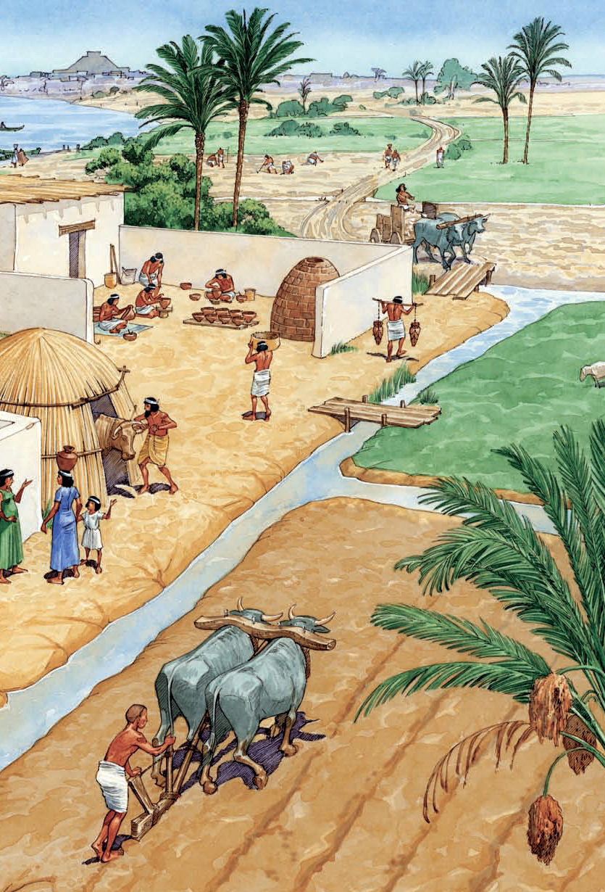
MESOPOTAMIA
Agricultural Theocracy
Practices a prototype of socialism
All the crops where brought in centrally and then distributed evenly. This allowed for many types of tradesmen such as blacksmiths and construction workers to be ensured a livelihood

Slide 4
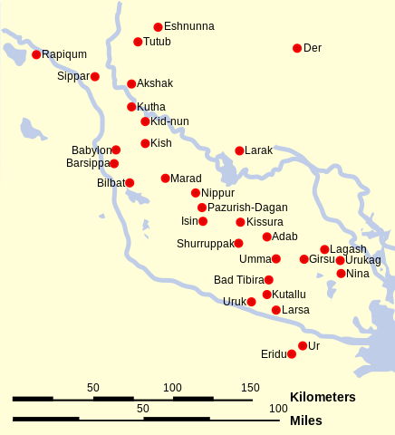
Conflict between the Country & City
Continual conflict between the concept of country “Sumer” and needs of each individual city-state
This leads to many battles and wars

Slide 5
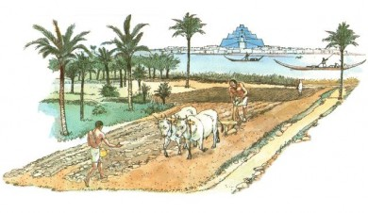
The Price of Agriculture
To produce large quantities of crops, a “slave” labor system was required. Lower classes of people would destined to work as field laborers to support the needs of the city

Slide 6
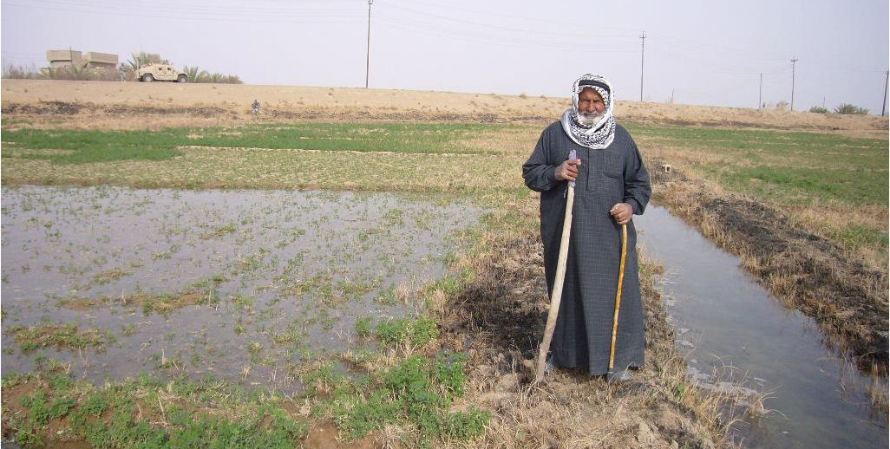
MESOPOTAMIA
Greek: Between two Rivers
Tigris & Euphrates
Vital for irrigation – agricultural growth

Slide 7
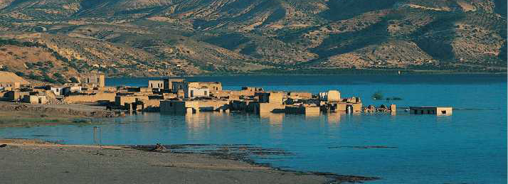
MESOPOTAMIA
Tigris & Euphrates
Very unpredictable, caused devastating flooding at times

Slide 8
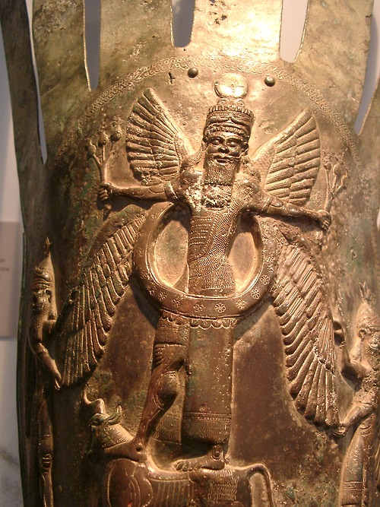
Agricultural Theocracy
Each city-state had God that was worshipped.
Historically these Gods were viewed to be very hostile, irritable, and difficult to please.
This belief may have come from the unpredictable nature of the Tigris & Euphrates seasonal flooding

Slide 9
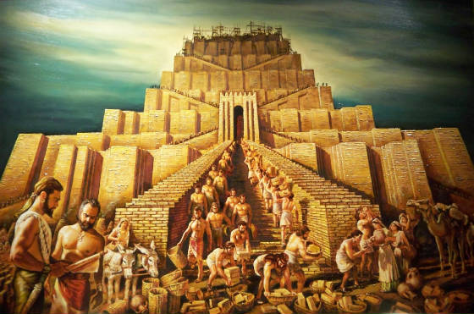
A Shift in Power: Gods to Men
About a 1000 years after the first temple structures PALACES begin to appear as a rival structure to the ziggurat
These structures created by “kings” – military leads/rich land owners
Kings begin to marry the high priestesses of the city temples and take on a semi-religious role, this begins to push out the power of priests

Slide 10
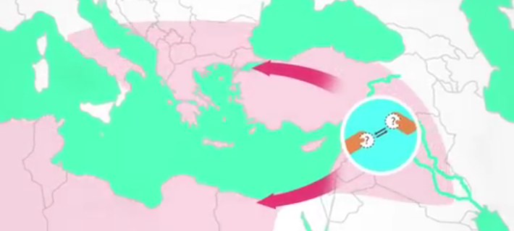
Mass Trade
Mesopotamia was fertile for agriculture, but had no natural means for other resources
Metal, timber, & Stone all had to be traded for
Trading lead to the creation of the worlds first territorial kingdom

Slide 11
End of city-states
City states end around 2000 BCE
Drought cause rivers to shift, weakening economies
Nomads began to take over city-states and in turn settled, creating new cities

Slide 12
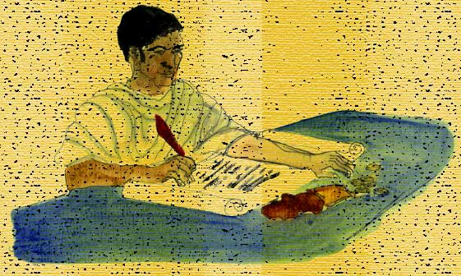
The New Mesopotamian Cities
No socialism, instead a proto-type of private enterprise.
Citizens were allowed to produce as much as they desired as long as they gave the government a cut…… TAXES!

Slide 13
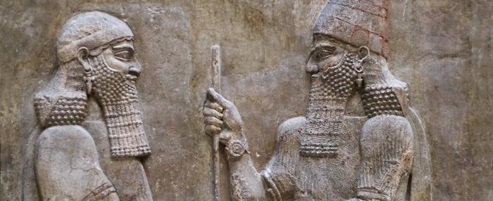
The New Mesopotamian Cities
Tribal Chiefs become more and more king like
Trying to conquer one another
Passing on lineage to sons….

Slide 14
Babylonian Art
Notes:
Slide concept by William V. Ganis, PhD FOR EDUCATIONAL USE ONLY For publication, reproduction or transmission of images, please contact individual artists, estates, photographers and exhibiting institutions for permissions and rights.

Slide 15
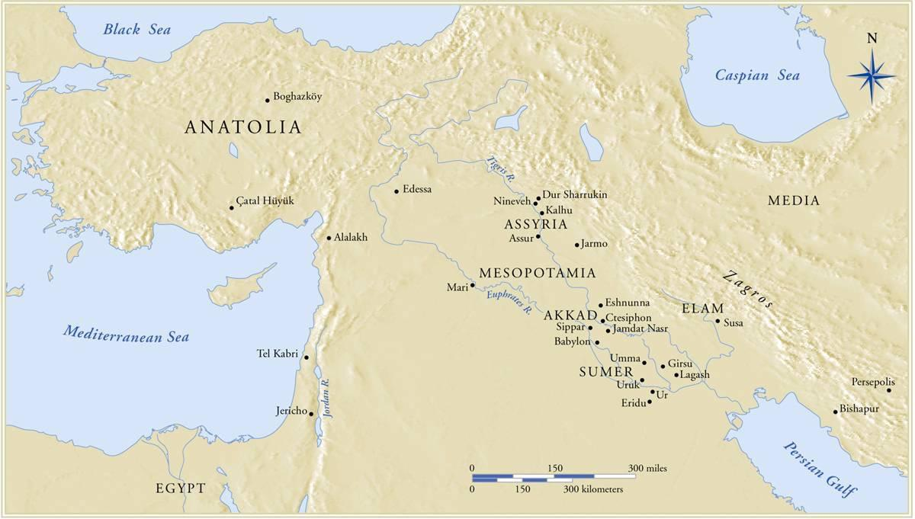
Notes:
Slide concept by William V. Ganis, PhD FOR EDUCATIONAL USE ONLY For publication, reproduction or transmission of images, please contact individual artists, estates, photographers and exhibiting institutions for permissions and rights.

Slide 16
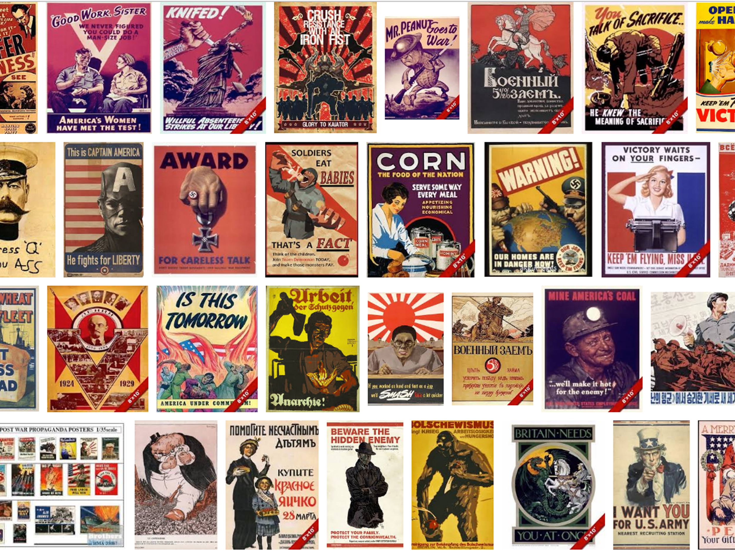

Slide 17
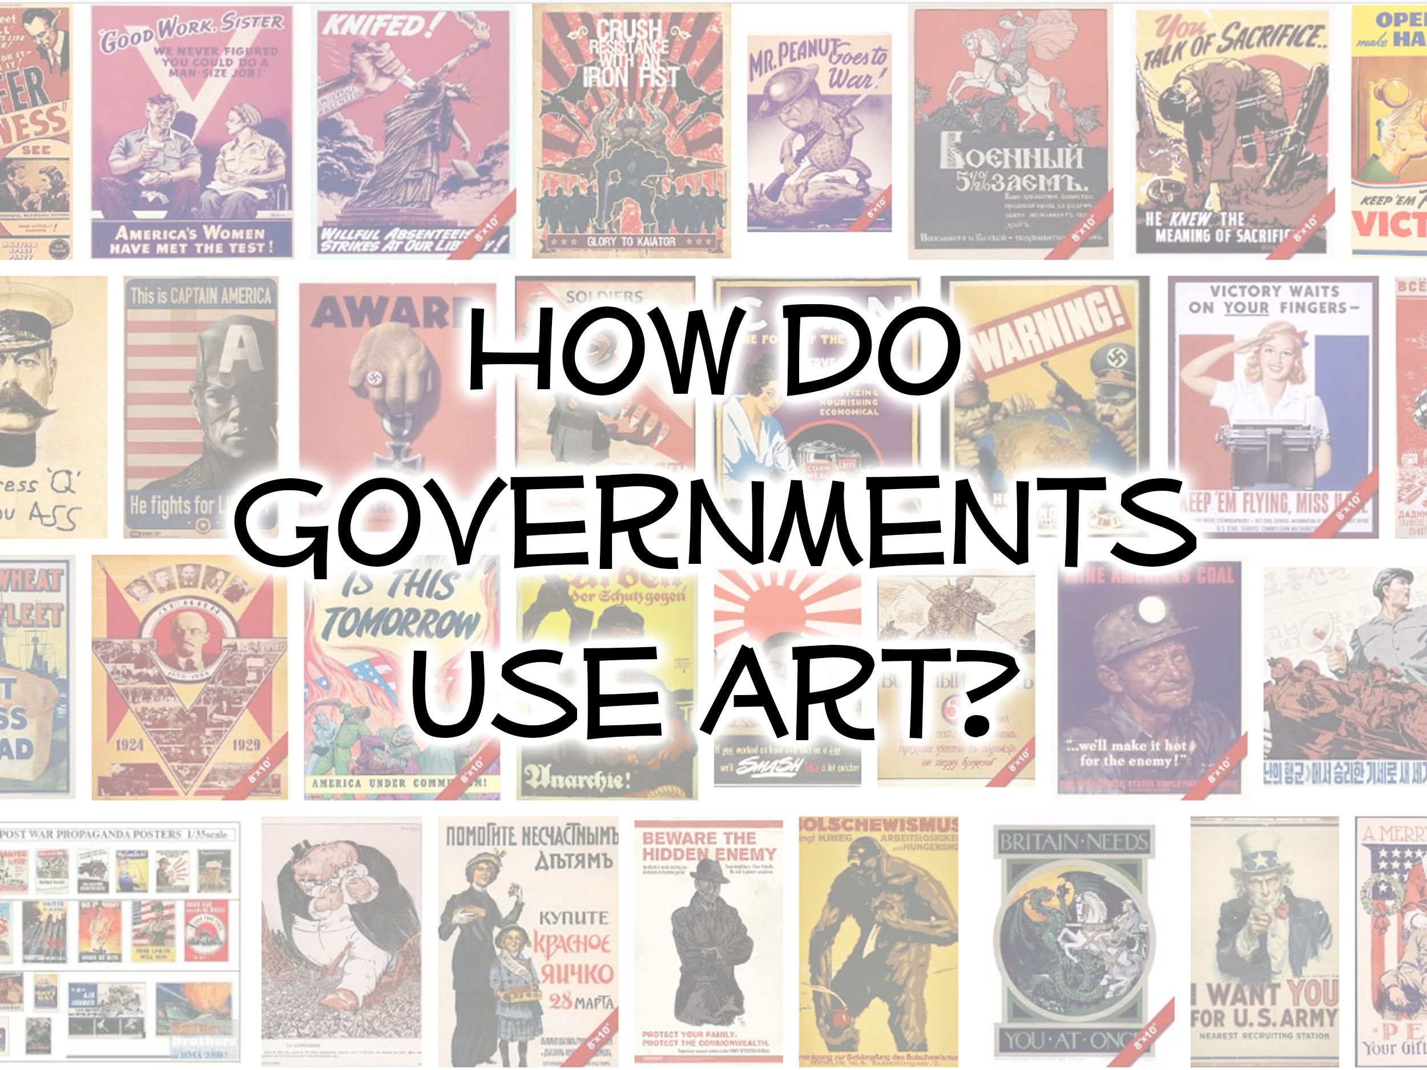

Slide 18
King Hammurabi
Notes:
Slide concept by William V. Ganis, PhD FOR EDUCATIONAL USE ONLY For publication, reproduction or transmission of images, please contact individual artists, estates, photographers and exhibiting institutions for permissions and rights.

Slide 19
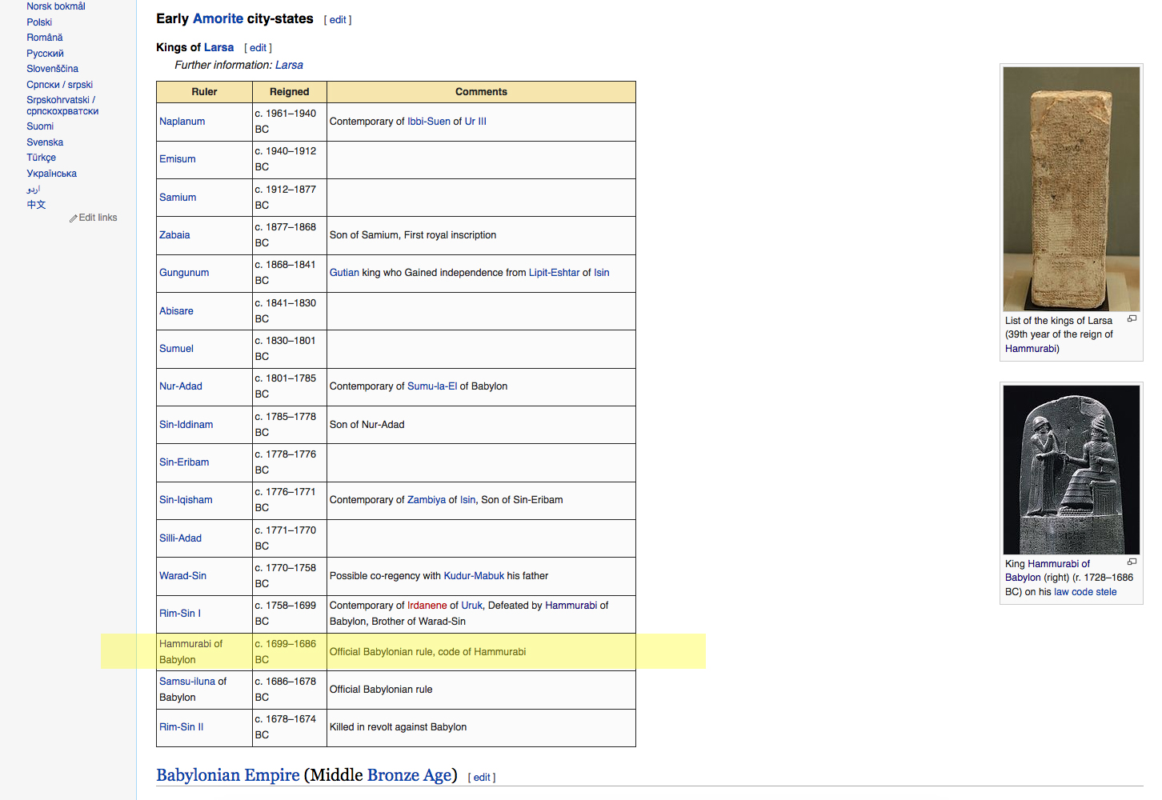

Slide 20
https://www.youtube.com/watch?v=GXsmhAuL0Kg 2:20 Min

Slide 21
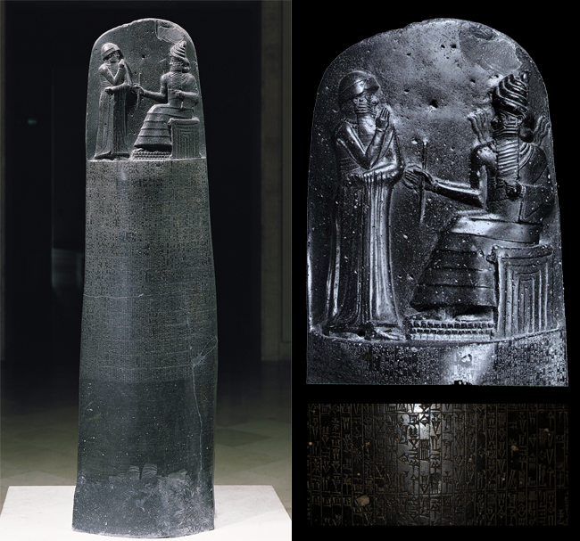
Stele with code of Hammurabi
from Susa, Iran
ca. 1,780 B.C.E.
basalt
88 in. high

Slide 22
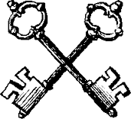
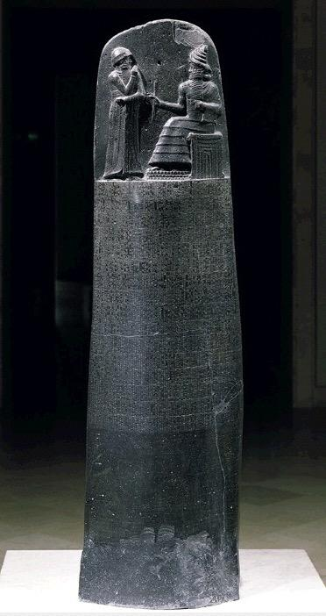
Stele with code of Hammurabi
from Susa, Iran
ca. 1,780 B.C.E.
basalt
88 in. high
-Carved on black basalt
-Hammurabi is shown to be in the company of Shamash, the sun god, indicating his rule is divinely appointed.
-The horns on the god's helmet are carved in a traditional profile technique so only 4 horns show rather than all 8 that are actually on the helmet. (First use of foreshortening.)
-The stele lists all the laws of the land and punishments that go along with breaking those laws.

Slide 23
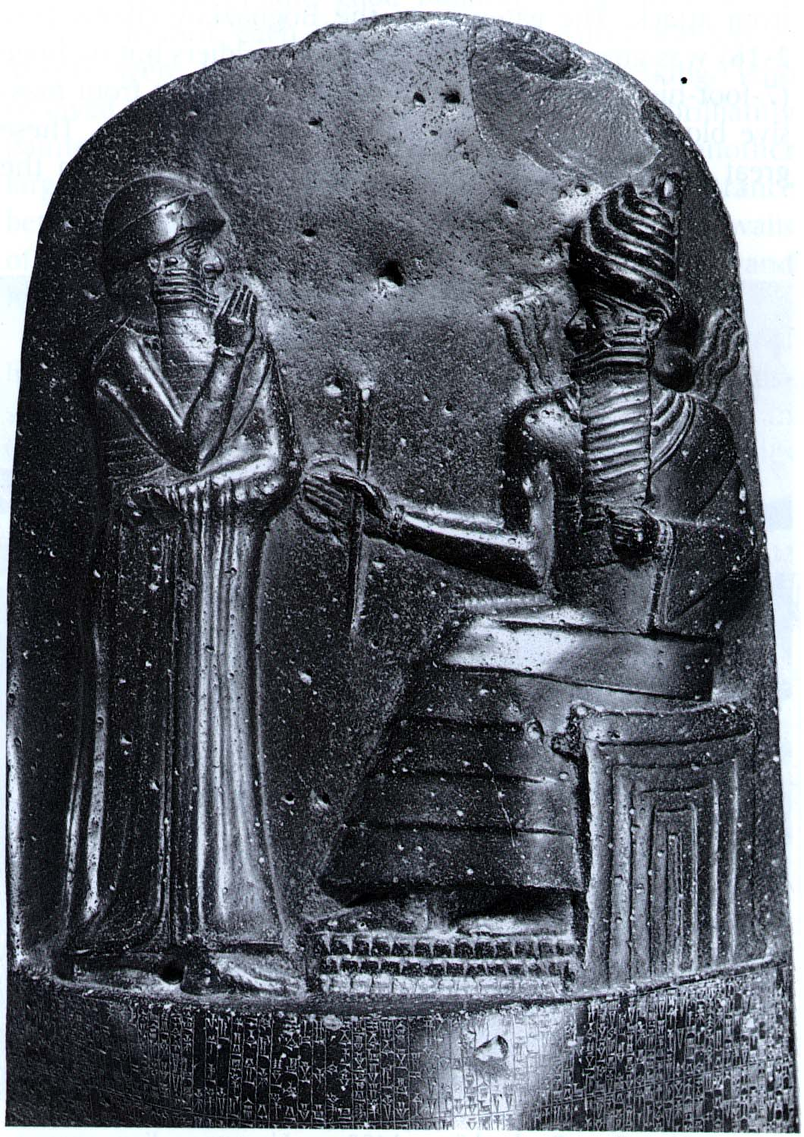

Slide 24
Form | Function | Content | Context
Bas- relief | 300 law entries placed below figures; symbolically given from Shamash to Hammurabi | Sun God, Shamash, enthroned on ziggurat and handing Hammurabi a rope, ring, & rod of authority | Hammurabi united Mesopotamia in his lifetime.
Text in Akkadian language; read right to left | Contains one of the earliest law codes ever written below the bas relief and on the back | Shamash has a fuller beard than Hammurabi | Took Babylon from a small power to a dominant kingdom; empire collapsed after his death
Twisted Perspective; composite view |  | Shamash depicted with emblems of authority; Hammurabi depicted with speaking/greeting gesture

Slide 25
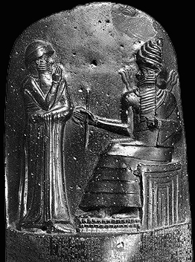
Babylonian:
Stele of Hammurabi:
*Conventions of Power:
Sun God: Note fire coming off shoulders
(builders’ tools--measuring rods and coiled rope; show ruler’s capacity to build the social order and to measure
people’s lives--to render judgments and enforce laws)
Rod and ring handed to ruler, symbolize authority
Sits on Mountain (Ziggurat?)
False door: gateway to heaven
Cuneiform: laws inscribed on stele

Slide 26
https://www.youtube.com/watch?v=BsPbqmYwxso 5:00 Min

Slide 27
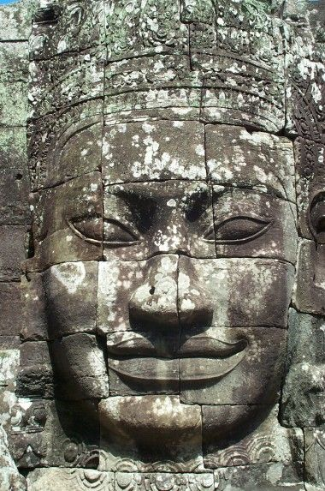
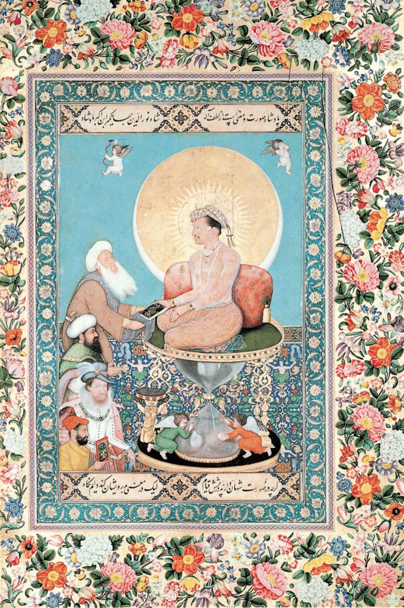
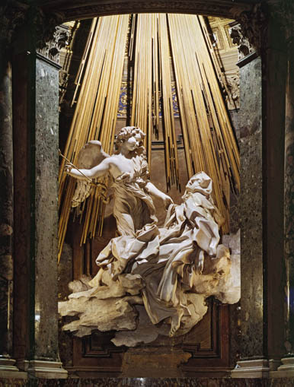
Cross Curricular Comparisons: Humans and the Divine
Stele of Hammurabi
Jayavarman VII as Buddha #199
Bichitr, Jahangir Preferring a Sufi Shaikh to Kings #208
Bernini, Ecstasy of St. Teresa #89

Slide 28
Assyrian Art

Slide 29
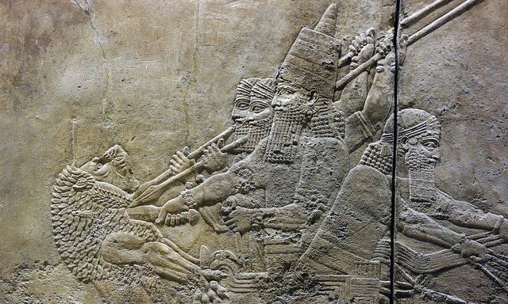

Slide 31
A Military Culture
The Assyrian empire dominated Mesopotamia and all of the Near East for the first half of the first millennium, led by a series of highly ambitious and aggressive warrior kings.
Assyrian society was entirely military, with men obliged to fight in the army at any time. State offices were also under the purview of the military.
It was a brutal culture, enimies were killed, their houses torched, they salted their fields, and cut down their orchards
Ashur – the god of Conquest was their God

Slide 32
Wealth & Riches
As a result of these fierce and successful military campaigns, the Assyrians acquired massive resources from all over the Near East which made the Assyrian kings very rich.
The palaces were on an entirely new scale of size and glamor. The interior public reception rooms of Assyrian palaces were lined with large scale carved limestone reliefs which offer beautiful and terrifying images of the power and wealth of the Assyrian kings and some of the most beautiful and captivating images in all of ancient Near Eastern art.

Slide 33
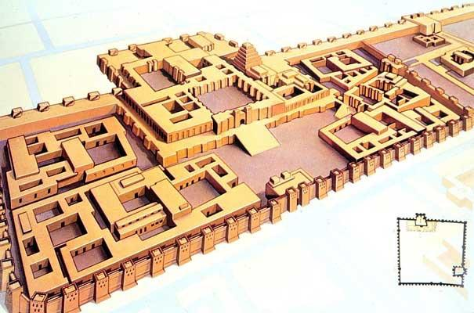
Reconstruction drawing of the citadel of Sargon II, Iraq roughly 720-705 B.C.E.

Slide 34
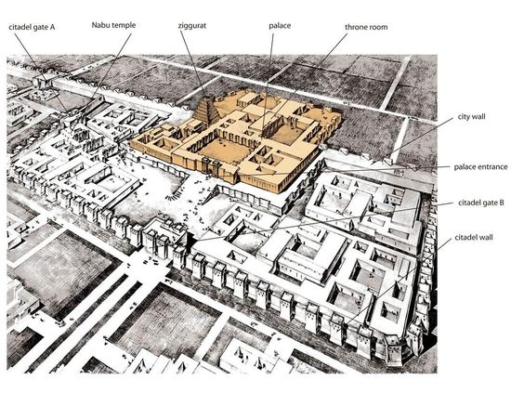

Slide 35
https://www.youtube.com/watch?v=WHLhmu6eKog

Slide 36
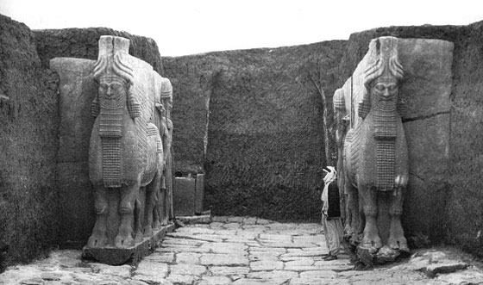

Slide 37
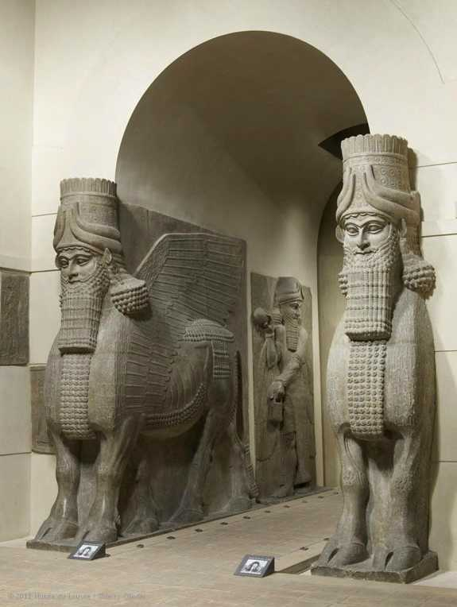
Lamassu (winged human headed bull)
from the citadel of Sargon II,
Dar Sharrukin (modern Khorsabad) Iraq
ca. 720-705 B.C.E.
limestone
13 ft. 10 in. high

Slide 38
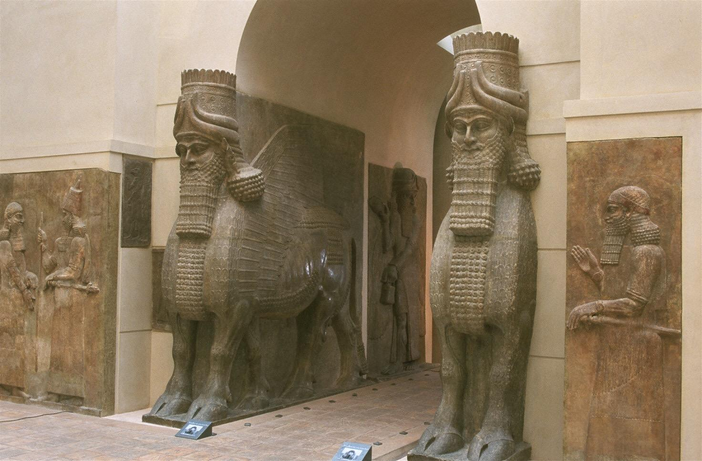
-These were guardians of the Assyrian (Sargon II's) palace.
-The creatures have 5 legs to give the illusion from the front that the animal is standing, but from the side, walking.
-The lamassu was a mythical creature that had the head of a man and a body of a bull and had wings.
-These creatures were believed to protect the people from enemies and unfriendly spirits.
-Combos of man and beast are a source of power as animals are so powerful and usually gods or have godlike attributes
Made from one solid
stone
Lamassu (winged human headed bull)
from the citadel of Sargon II, Iraq
ca. 720-705 B.C.E.
limestone
13 ft. 10 in. high

Slide 39
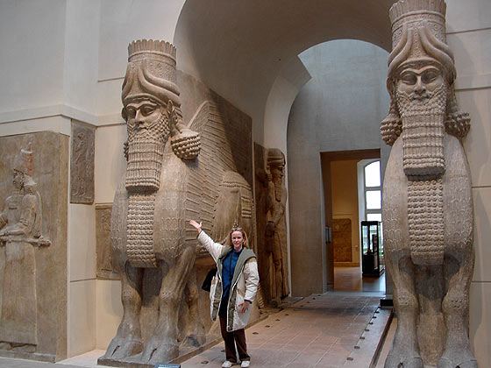

Slide 40
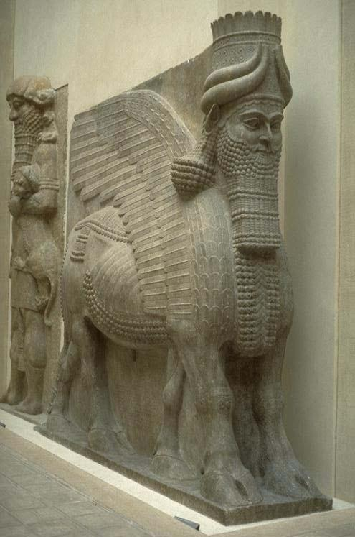
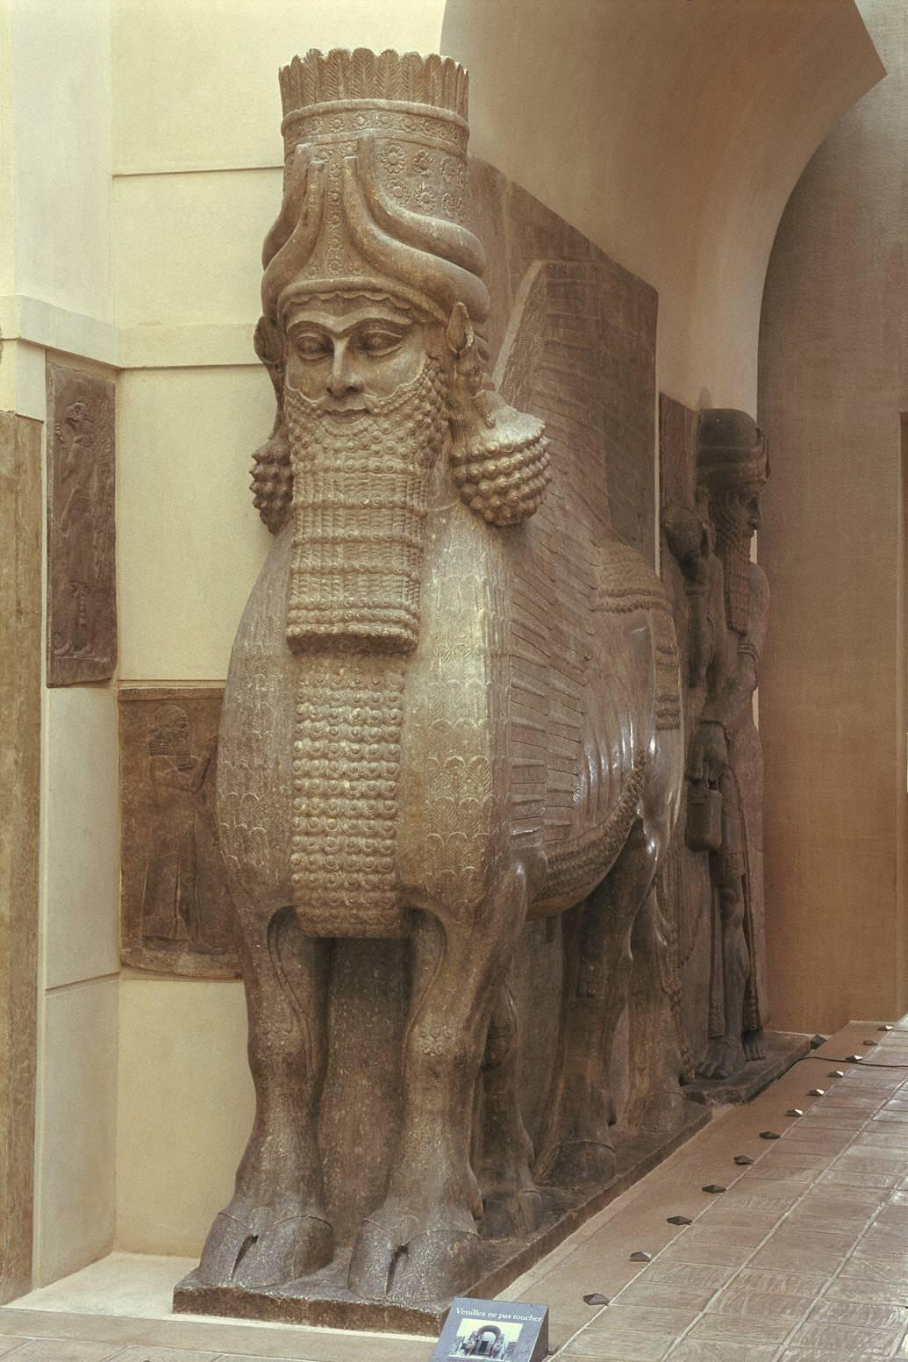
Notes:
Slide concept by William V. Ganis, PhD FOR EDUCATIONAL USE ONLY For publication, reproduction or transmission of images, please contact individual artists, estates, photographers and exhibiting institutions for permissions and rights.

Slide 41
https://www.youtube.com/watch?v=2GrvBLKaRSI 5:00 min

Slide 42
Guessing Game!
Is it form, function, content, or context?
Human headed animal guardian figures
Winged
5 legs: when seen from the front, they are standing at attention; when seen from the side, it seems to be walking by you
meant to ward off enemies both visible and invisible; Apotropaic
has a feeling of harmony and stability
Sargon II founded a capitol at Khorsabad, surrounded by a city wall with seven gates
Protective Spirits placed on either side of each gate as guardians; also bore the weight of the arches above the gates

Slide 43
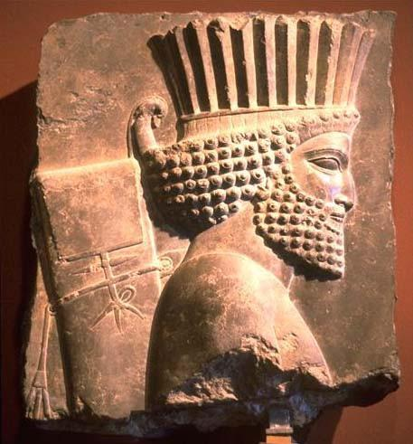
Achaemenid Persian Art

Slide 47
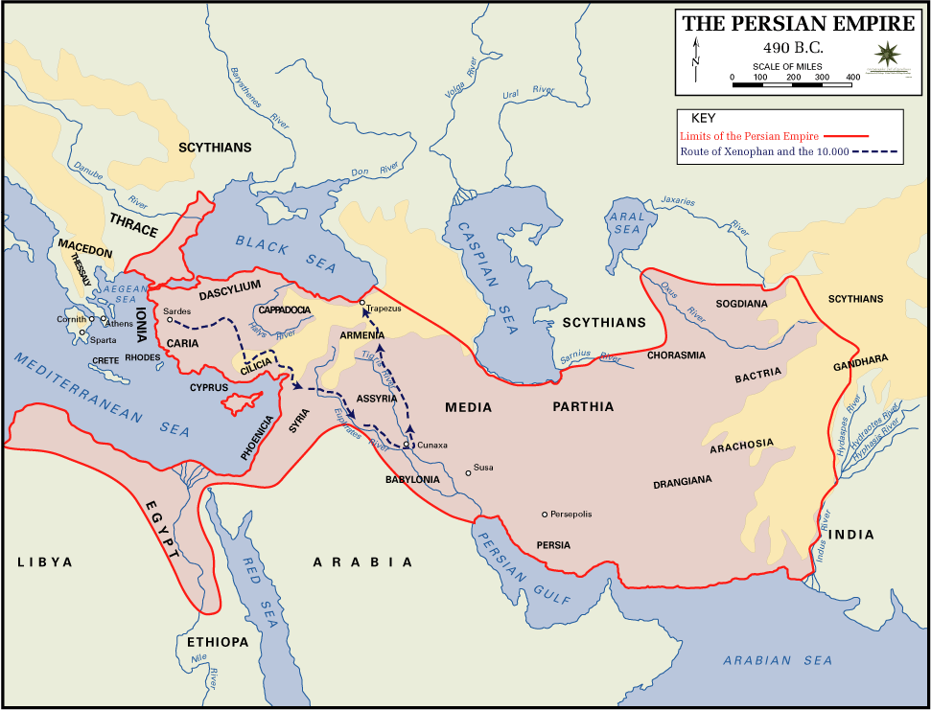

Slide 48
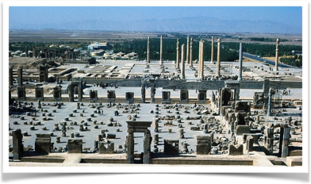
Palace of Darius I and Xerxes I
Persepolis, Iran
ca. 521-465 B.C.E.
limestone
Audience Hall: Apadana had 36 columns covered by a wooden roof; held thousands of people; used for the king’s receptions; stairways adorned with reliefs of the New Year’s festival and a procession of representatives of 23 subject nations
Columns had a bell shaped base that is an inverted lotus blossom; capitals are lions or bulls
Everything built to dwarf the viewer
Stairs have a central relief of the king enthroned with attendants
orderly and harmonious world symbolized by static processions

Slide 49
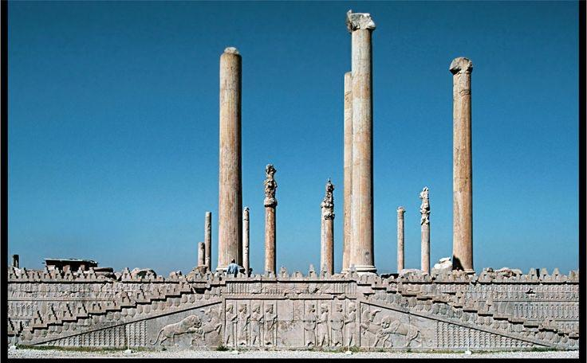
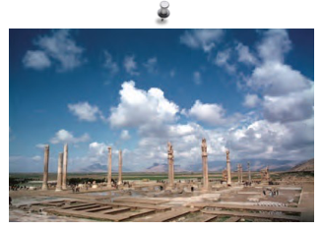
Built by Darius I and Xerxes I; destroyed by Alexander the Great
Built not so much as a complex of palaces, but rather as a seat for spectacular receptions/festivals
built on artificial terraces
mud brick with stone facing
Giant Lamassu gates, inscribed as “the Gate of All Nations”, announcing this to be a great empire
relief sculptures depict delegations from all parts of the empire bringing gifts to be stored in the local treasury

Slide 50
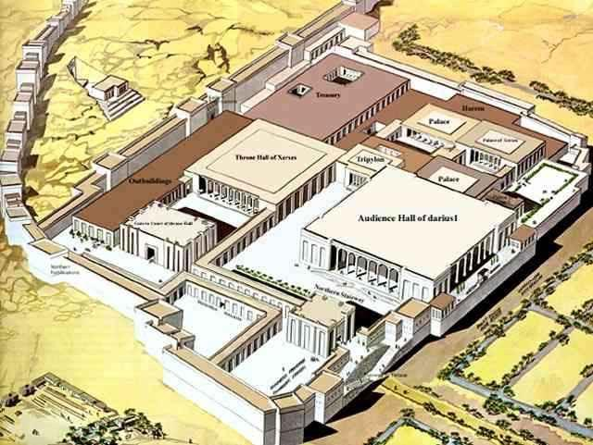
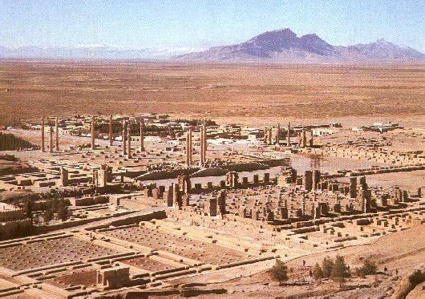
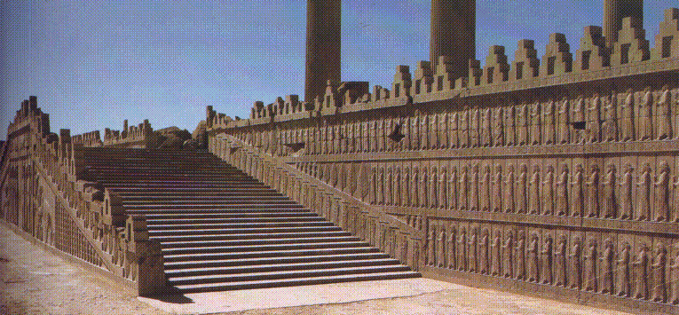

Slide 51
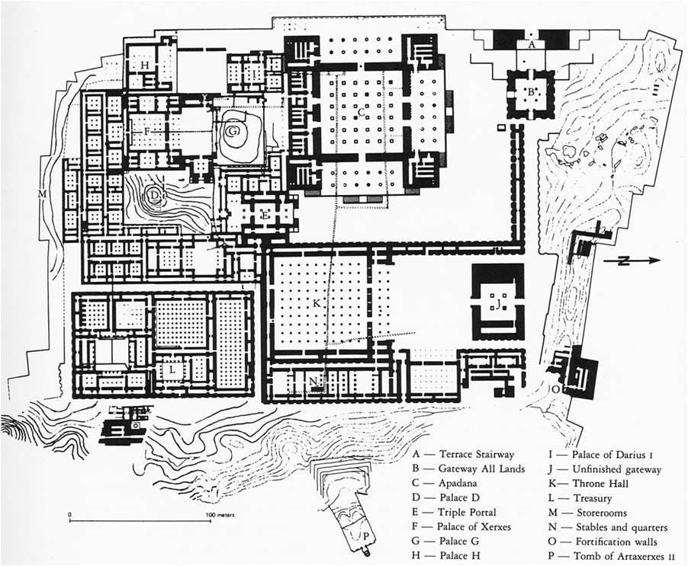

Slide 52
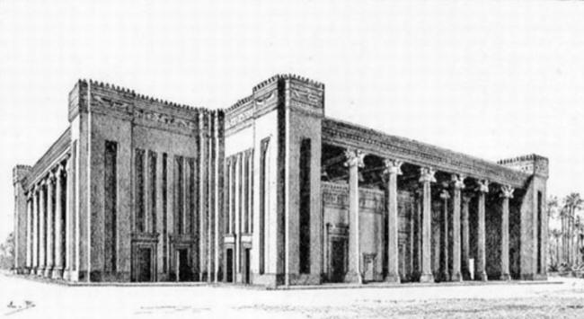
https://www.youtube.com/watch?v=8L4E9m27aKY

Slide 53
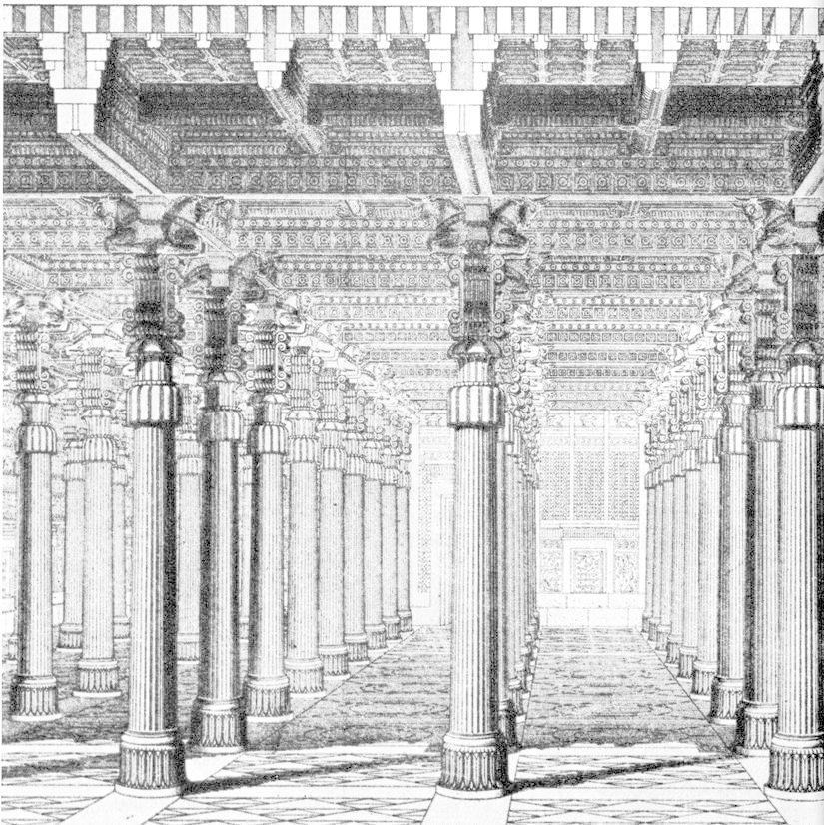

Slide 54
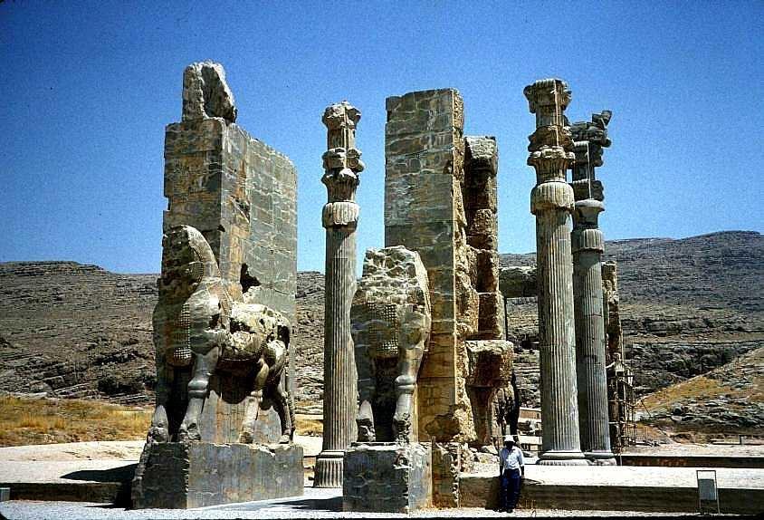
Palace of Darius I and Xerxes I
Persepolis, Iran
ca. 521-465 B.C.E.

Slide 55
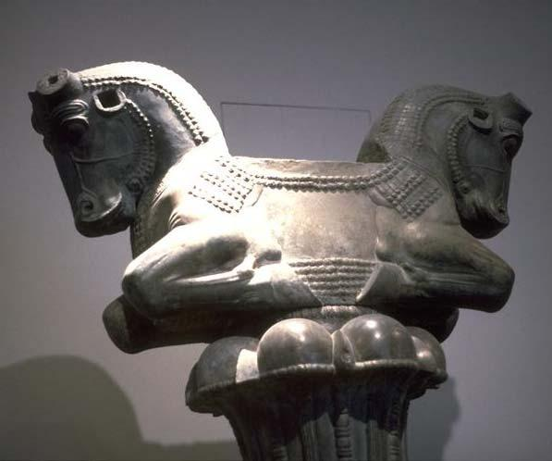
Palace of Darius I and Xerxes I
Persepolis, Iran
ca. 521-465 B.C.E.

Slide 56
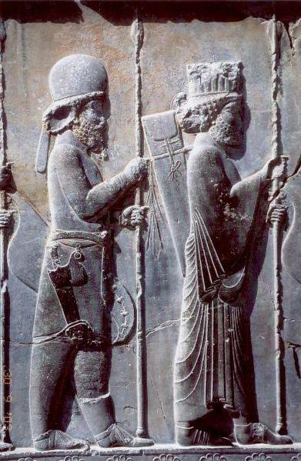

Slide 57
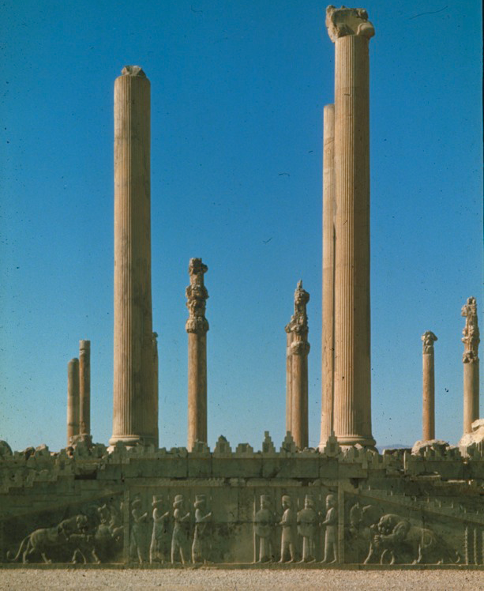
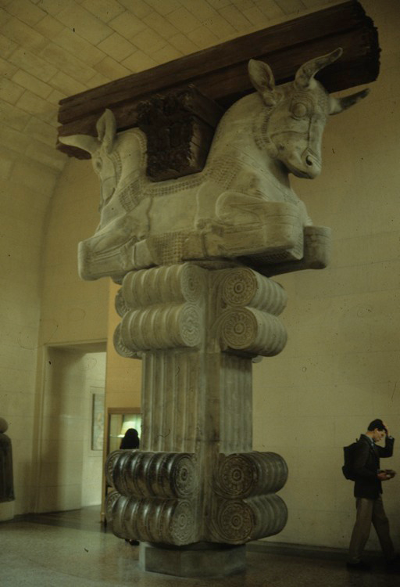
Persian Apadana and Bull Capitals

Slide 58
https://www.youtube.com/watch?time_continue=3&v=mjxCTApdX3Q 4:00 Min

Slide 59
