Slide 1
The Most Ancient of Us All
Ancient Near East and Egypt

Slide 2
Essential Questions
How can we differentiate between artworks of prehistoric and historic civilizations?
What basic approaches to art making can be seen at the very beginning of civilizations?

Slide 3
What does Art from Ancient Civilizations look like?

Slide 4
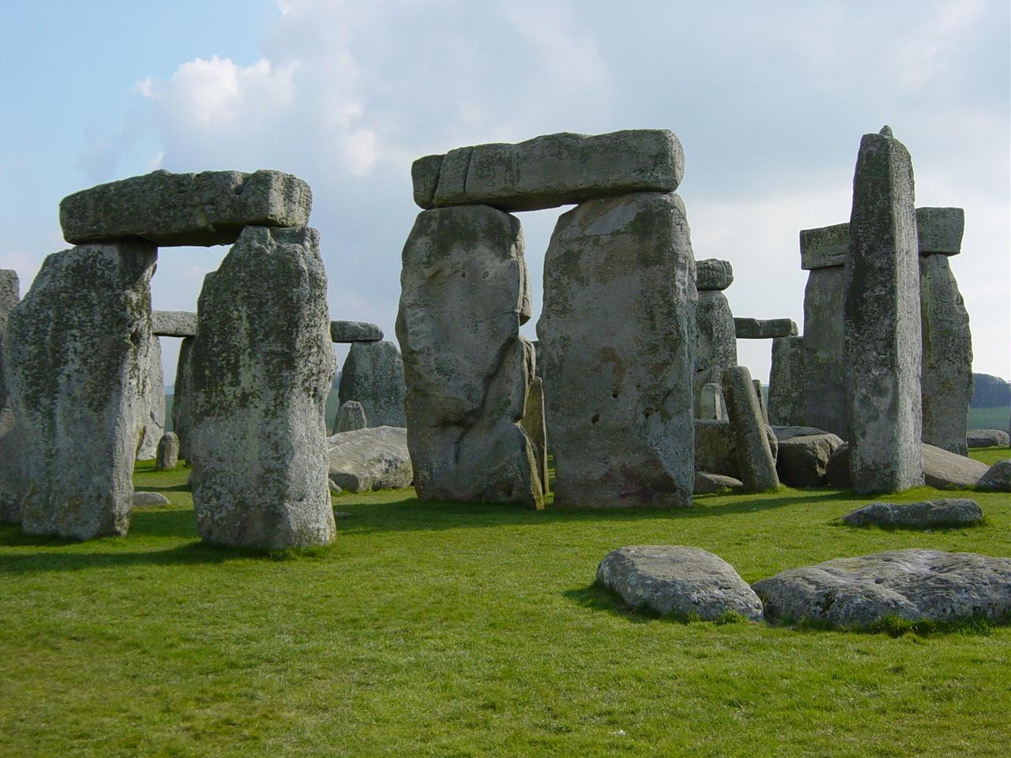
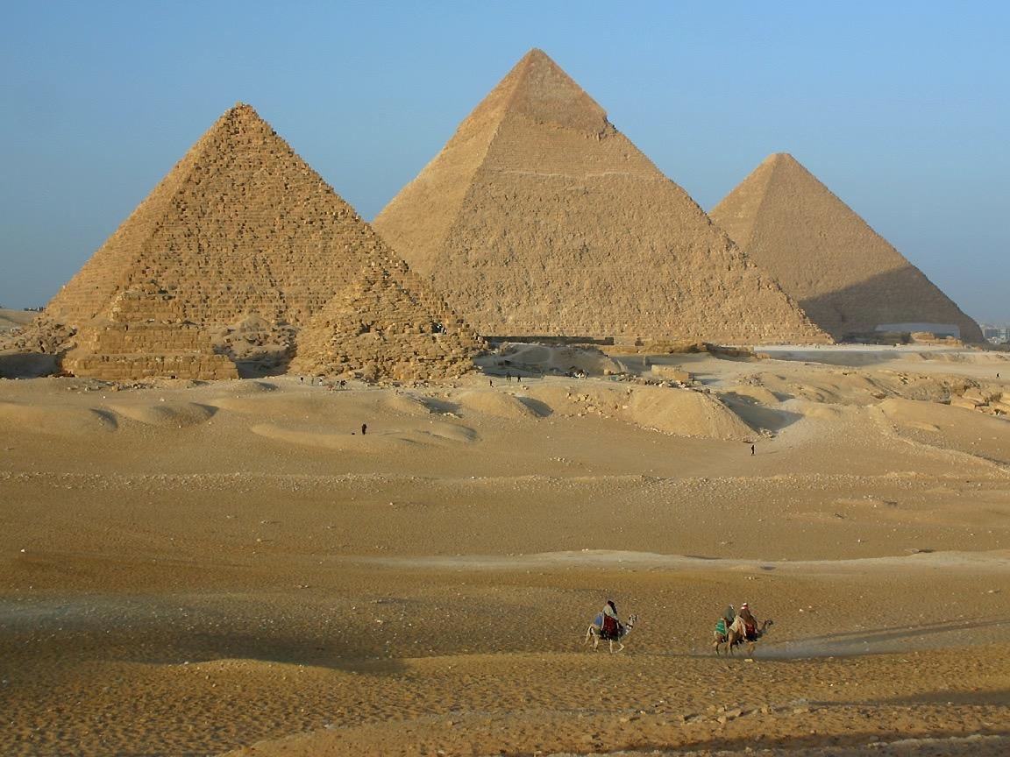
How does our understanding of architecture transform when there is a written record to go along it?
Do a informal analysis of each work.
How does CONTENT affect the appearance of each work?

Slide 5
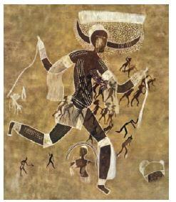
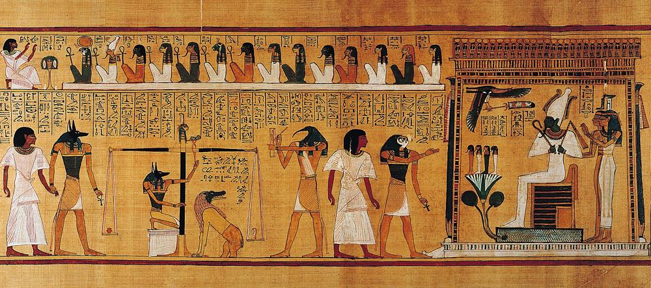
How does our understanding of painting transform when there is a written record to go along it?
Do a informal analysis of each work.
How does CONTENT affect the appearance of each work?

Slide 7
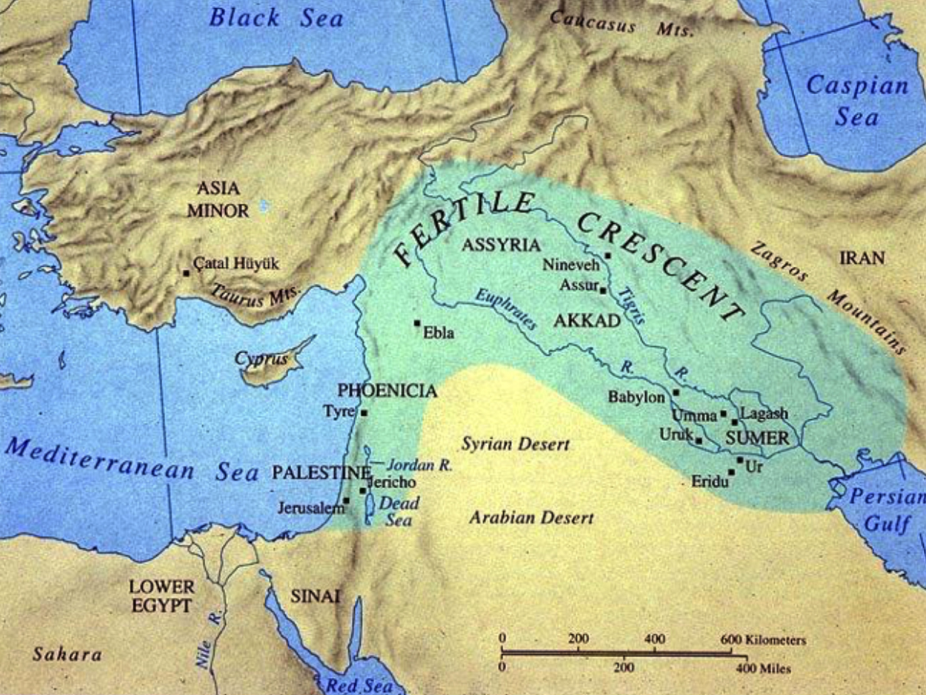

Slide 8
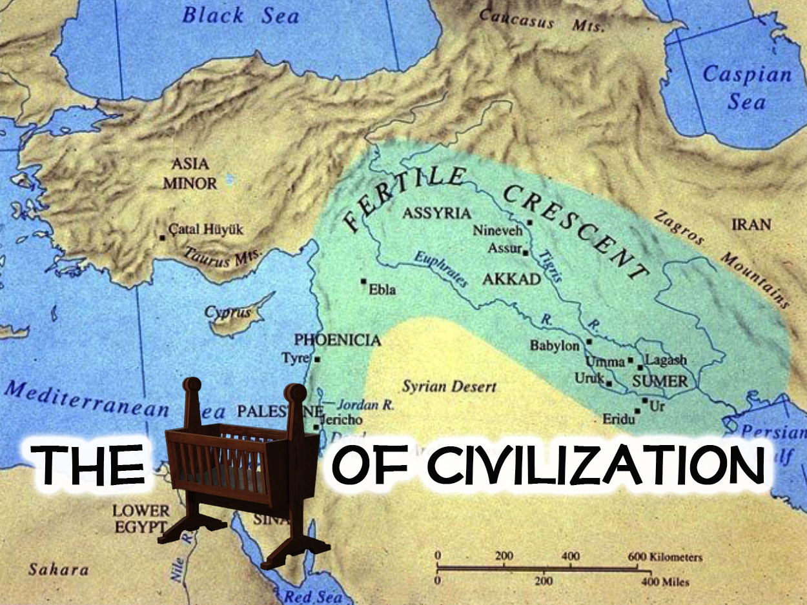

Slide 9
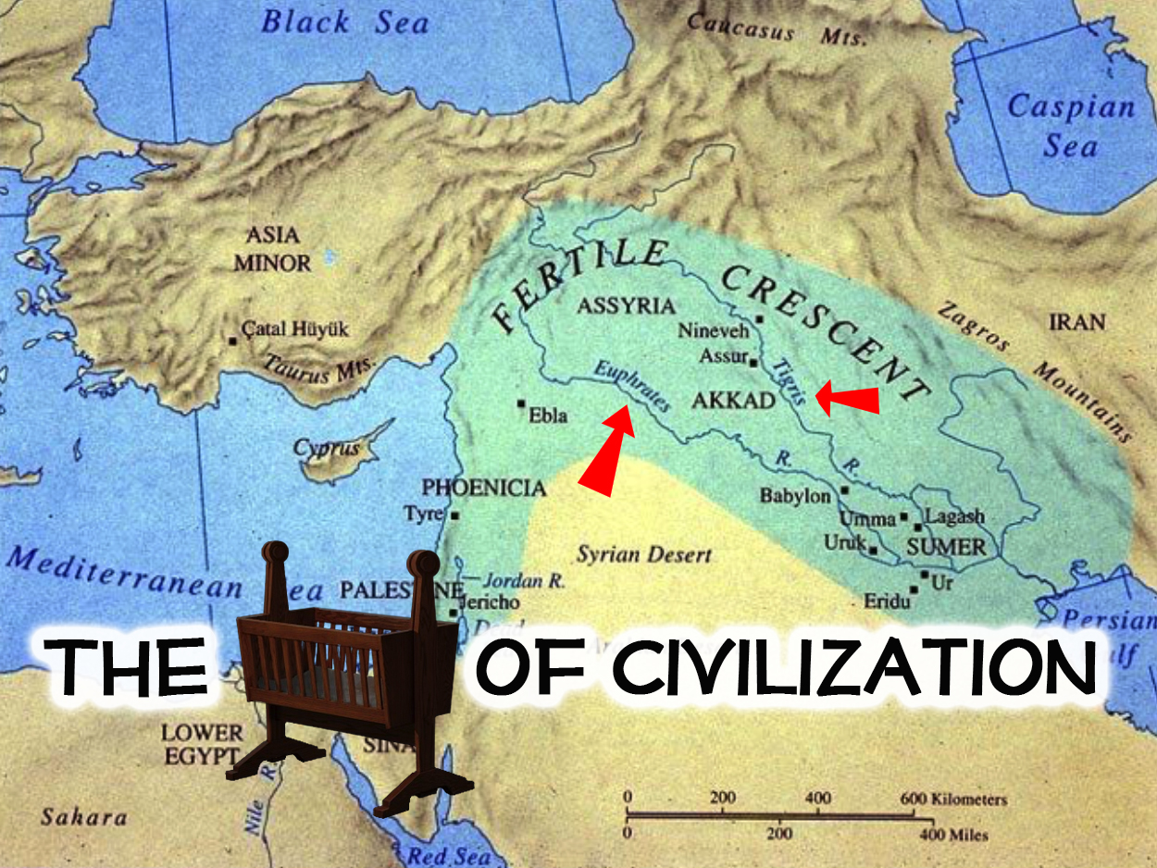

Slide 10
Cradle: Mesopotamia was nestled between two major rivers, the Tigris & the Euphrates
Civilization: This is the first complex settled urban center

Slide 11
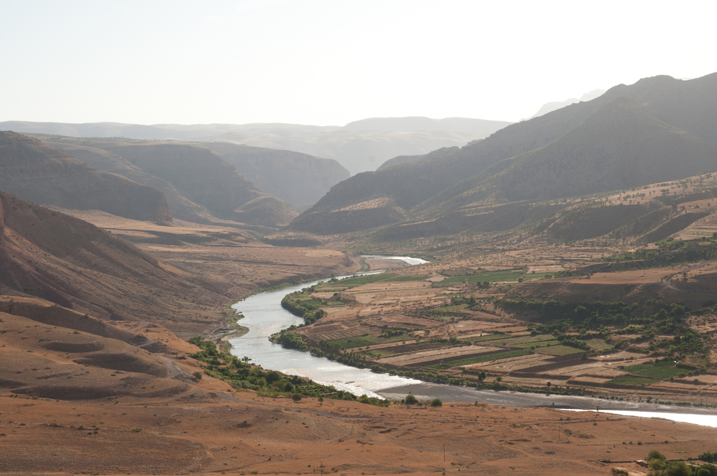
TIGRIS RIVER

Slide 12
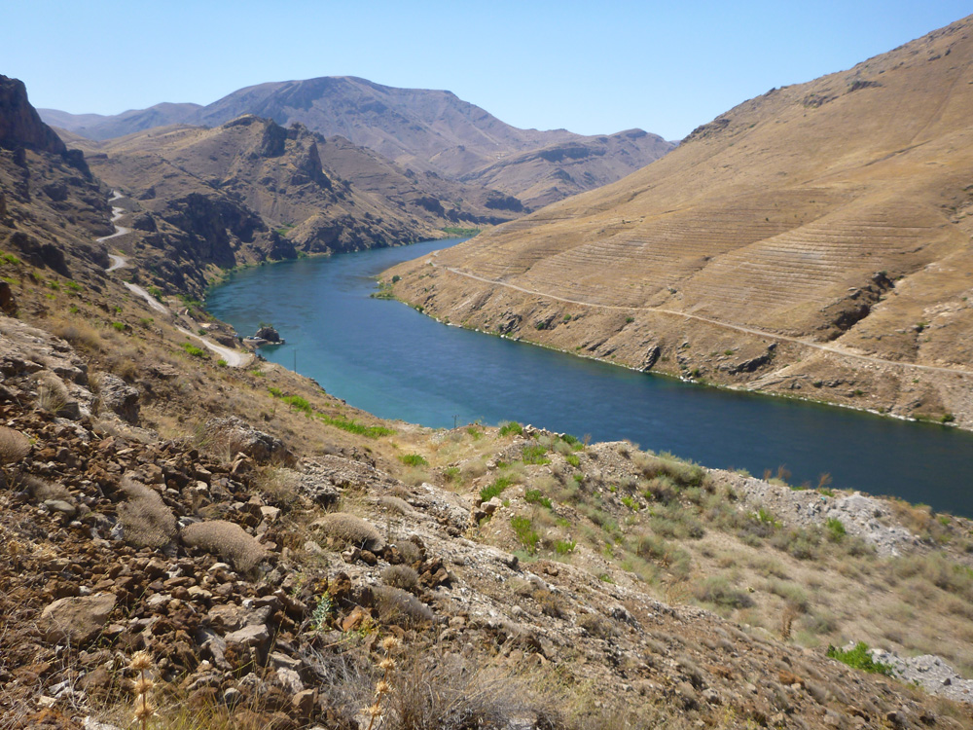
EUPHRATES RIVER

Slide 13
This Unit Isn’t Called “Mesopotamia…” its called…

Slide 14
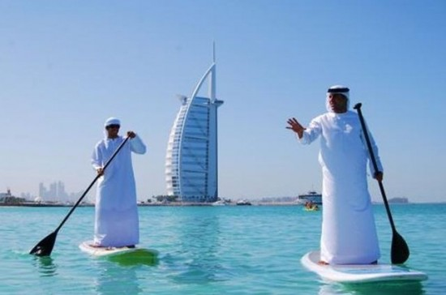
Coming from a western culture we are unfamiliar with middle eastern ideas & history
Why is this the case?

Slide 15
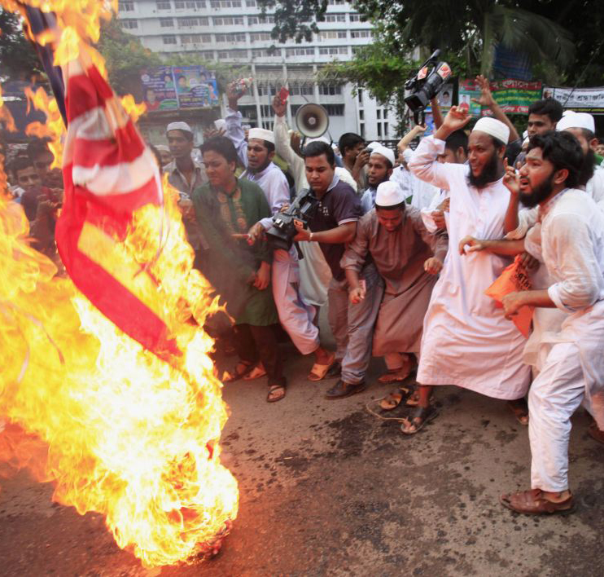
Political Tension

Slide 16
Political tension can impede a mutual understanding between western and middle eastern culture
We (Art Historians) put aside personal opinion, and look at historical context for the value of all cultures

Slide 17
Where does this term come from?
The term “near east” is from a western perspective. It refers to eastern countries that are close to, or “near” Europe. You could also say “The close to us east”
Its also “near” in a historical biblical context. Several cities in the ancient near east have important biblical narrative such as Babylon

Slide 18
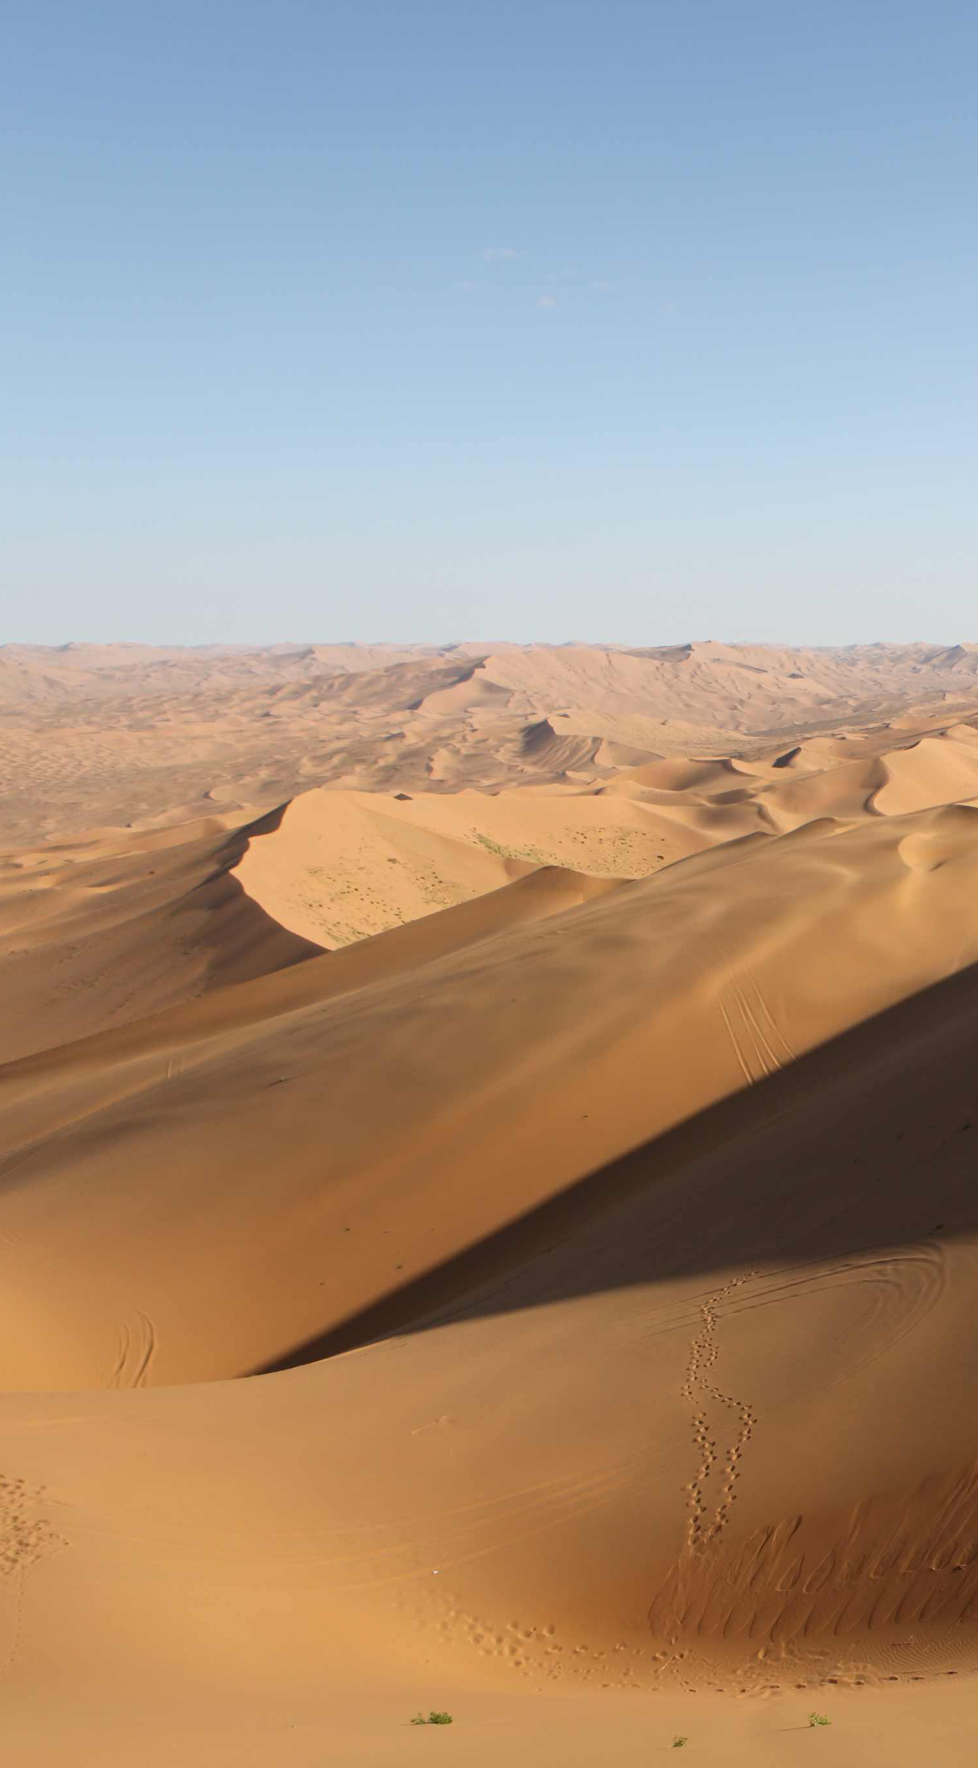
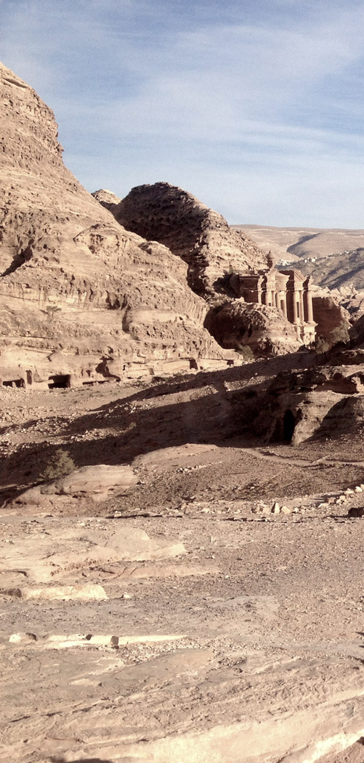
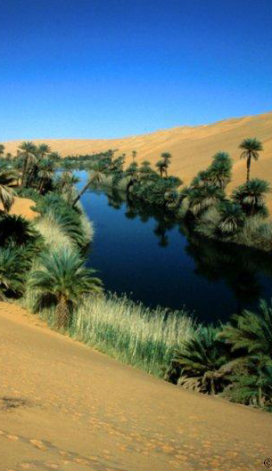
Geography
Deserts Mountains Oasis

Slide 19
Geography
The geography of the ancient near east consisted of vast deserts, rugged mountains, and water oases
There is a lack of stone and timber, these people became experts at making bricks

Slide 20
Other Key facts about ANE (Ancient Near East)
The Ancient Near East brought art into the service of the state and religion. This combined with writing gives us the first historical record of a civilization
Tend to build with mud brick as stone is hard to find
Very warlike cultures, constant invasions and many different civilizations make for a multiplicity of empires, but not really artistic style
Animal human hybrids=animals are strong and humans want that strength
Assyrian lion reliefs are amongst the first organized narrative works of art in history

Slide 21
Lets Consider Something… MESOPOTAMIA
“CONTROL”
How do societies create control?
Is it Necessary? Defend your Response?

Slide 22
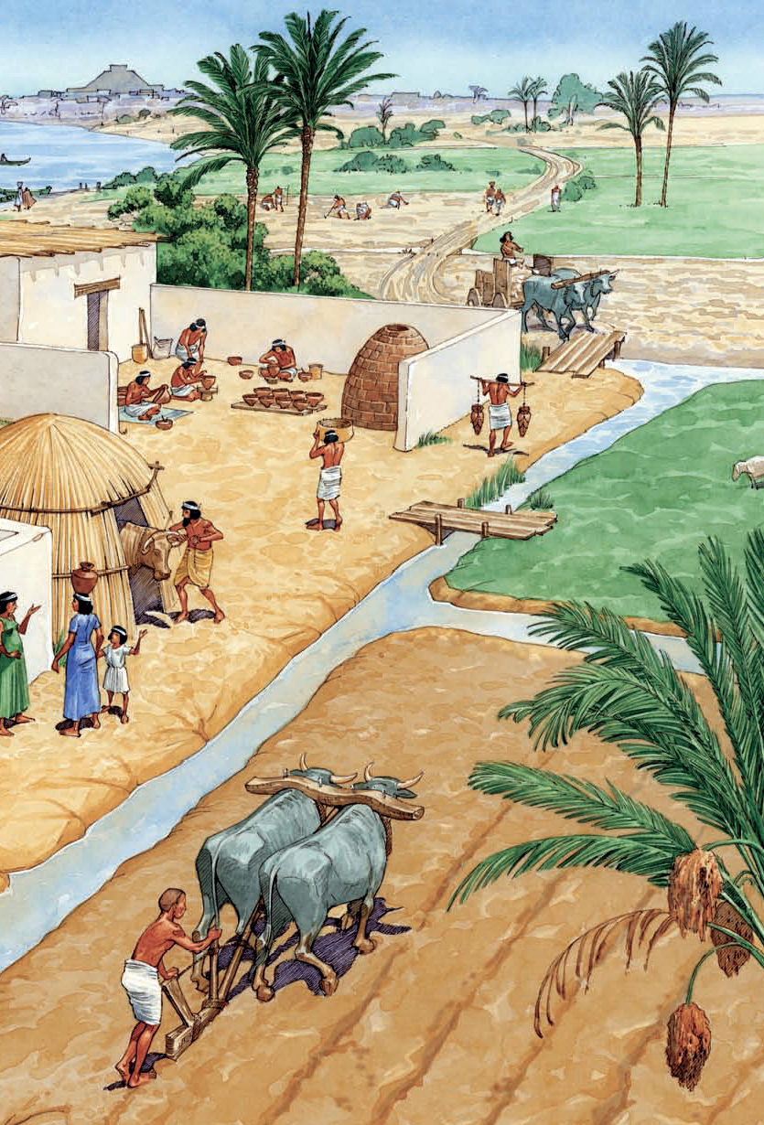
MESOPOTAMIA
The first development of an urban center that has authority over large groups of people
Control through agriculture

Slide 23
Timeline 3500 BCE-641 CE
Sumerian Art 3500 BCE Iraq
Babylonian Art 1792-1750 BCE Iraq
Assyrian Art 883-612 BCE Iraq
Persian Art 559 BCE-331 BCE Iran

Slide 24
Vocab
Capital- top element of a column
Cuneiform- A system of writing in which the strokes are formed in a wedge or arrow head shape
Façade- the front of a building
Ground plan- the map of a floor of a building
Hierarchy of scale- a system of representation that expresses a person’s importance by the size of his/her representation
Relief Sculpture- Sculpture that projects from a flat background. A very shallow relief sculpture is called bas-relief or low relief
Stele- a stone slab used to mark a grave or a site
Ziggurat- a pyramid-like building made of several stories that indent as the building gets taller; thus ziggurats have terraces at each level.

Slide 25
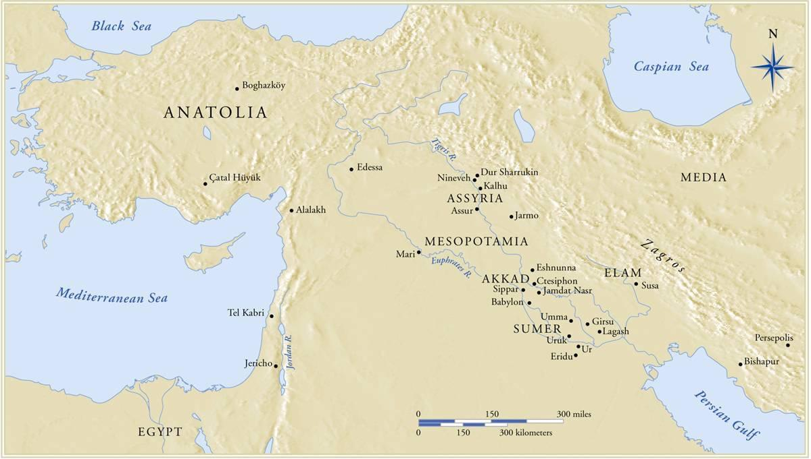

Slide 27
Notes:
Slide concept by William V. Ganis, PhD FOR EDUCATIONAL USE ONLY For publication, reproduction or transmission of images, please contact individual artists, estates, photographers and exhibiting institutions for permissions and rights.

Slide 28
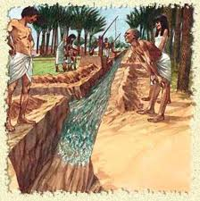
The Sumerians
Sumer, was located in the southern area of what is now Iraq
This was a highly intelligent and inventive people
Through the use of irrigation these people were able to successfully create a very fertile land for large agricultural operations

Slide 29
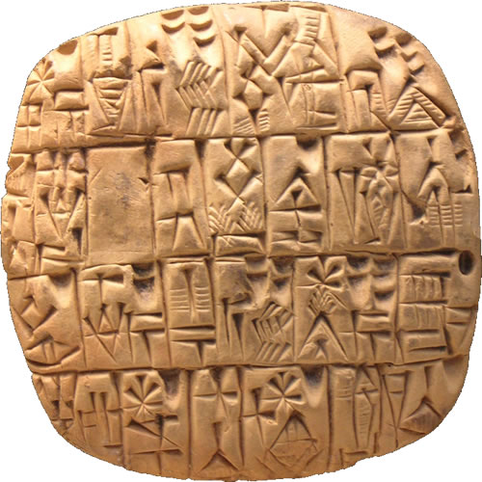
Sumerians
These people developed the worlds first written language
Some believe as these people continued to thrive they recognized the necessity of inventorying their harvests
This early writing style was used to document their surplus commodities
(c.3200 BCE)

Slide 30
https://www.youtube.com/watch?v=HbZ2asfyHcA

Slide 31
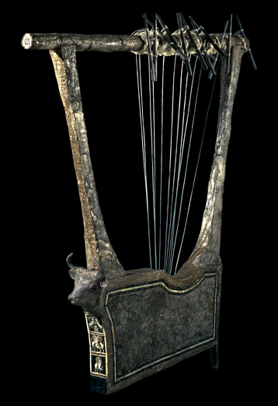
Sumerians
“They were energetic farmers, traders and sailors. Their religion recognized many gods, whose feats and escapades were described in stories that were often preserved for generations. Rituals as well as parties were enlivened by skillful harpists and singers, and Sumerian musical instruments have even been excavated by modern archaeologists”
Kahn Academy

Slide 32
The Oldest Song in the World!.. Supposedly
https://www.youtube.com/watch?v=HbZ2asfyHcA

Slide 33
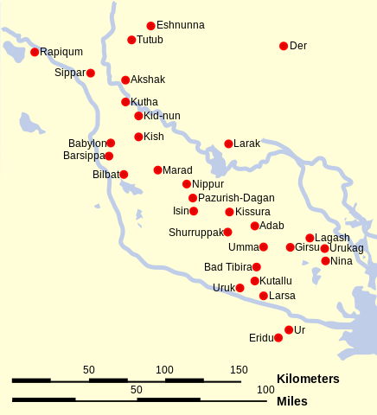
Sumer is different than Egypt
Egypt was dominated by a central hub that ruled the empire.
Sumer had many individual “city-states” or cities that each had their own city center through which they functioned

Slide 34
Uruk & Ur are two of the oldest known cities

Slide 35
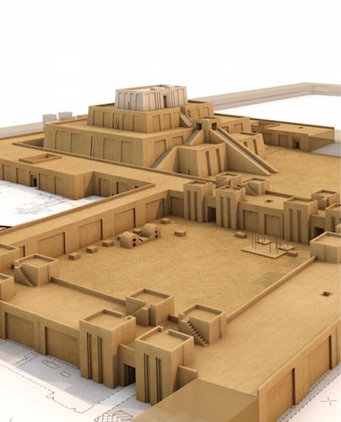
The City of Uruk: Agricultural Theocracy
“Within the city of Uruk, there was a large temple complex dedicated to Innana, the patron goddess of the city. The City-State's agricultural production would be “given” to her and stored at her temple. Harvested crops would then be processed (grain ground into flour, barley fermented into beer) and given back to the citizens of Uruk in equal share at regular intervals”

Slide 38
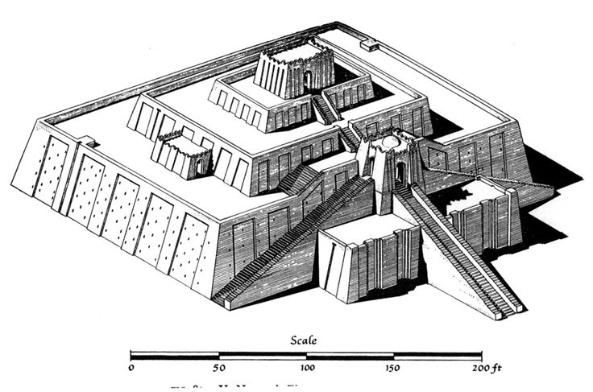
The Ziggurat

Slide 39
The Ziggurat
A ziggurat is a built raised platform with four sloping sides—like a chopped-off pyramid. Ziggurats are made of mud-bricks
Ziggurats were a form of temple common to the Sumerians, Babylonians and Assyrians of ancient Mesopotamia
Ziggurats were not only a visual focal point of the city, they were a symbolic one, as well—they were at the heart of the theocratic political system

Slide 40
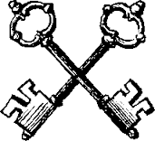
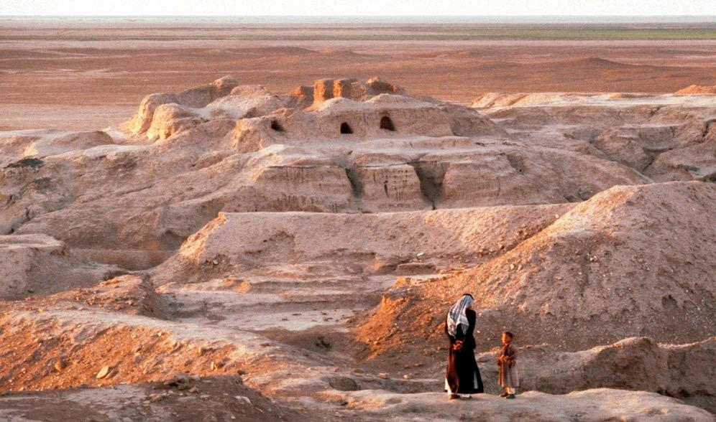
White Temple and ziggurat
Uruk (modern Warka) Iraq
ca. 3,200-3,000 B.C.E.
mud brick

Slide 41
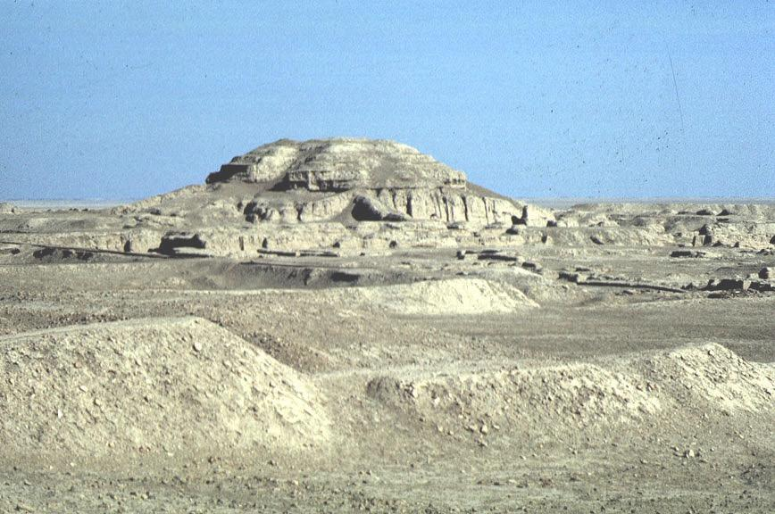
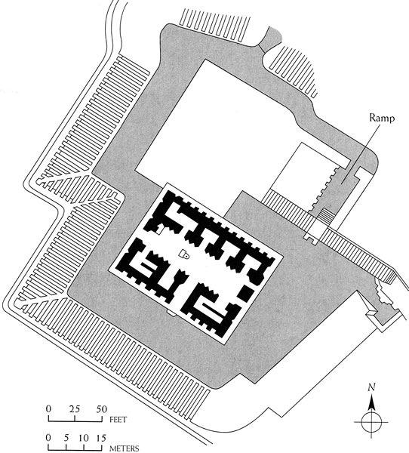
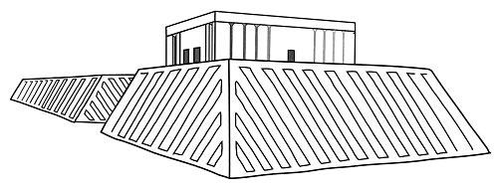
White Temple and ziggurat
Uruk (modern Warka) Iraq
ca. 3,200-3,000 B.C.E.
mud brick

Slide 42
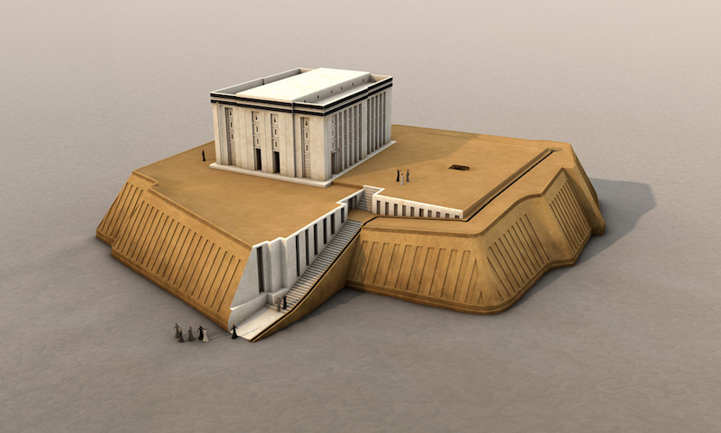

Slide 43
“Excavators of the White Temple estimate that it would have taken 1500 laborers working on average ten hours per day for about five years to build the last major revetment (stone facing) of its massive underlying terrace (the open areas surrounding the White Temple at the top of the ziggurat).”
Kahn Academy

Slide 44
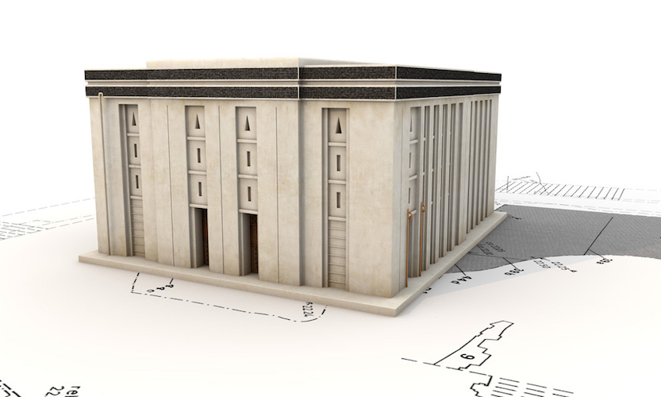

Slide 45
“The flat top of the ziggurat was coated with bitumen (asphalt—a tar or pitch-like material similar to what is used for road paving) and overlaid with brick, for a firm and waterproof foundation for the White temple. The temple gets its name for the fact that it was entirely white washed inside and out, which would have given it a dazzling brightness in strong sunlight.”

Slide 46
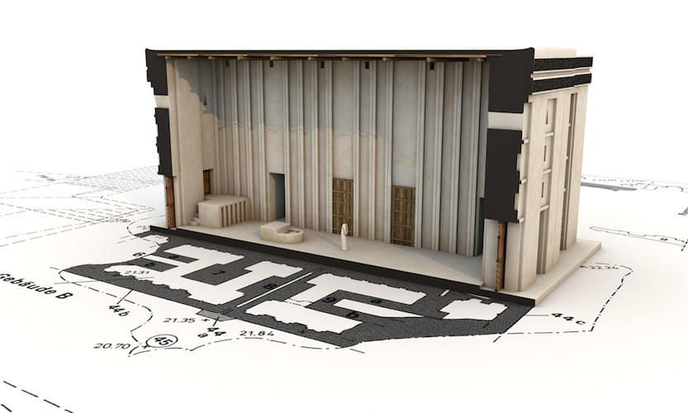

Slide 47
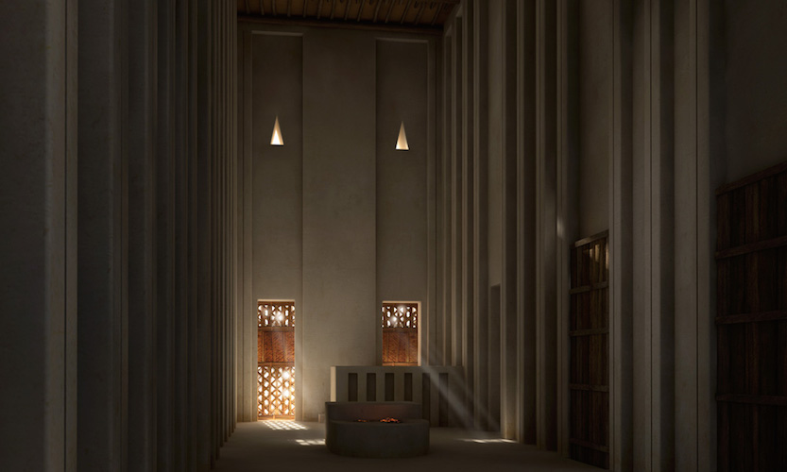

Slide 48
Form
Function
Mud-brick building on a colossal scale
buttresses spaced across the surface to create a light/dark pattern
Whitewash used to disguise the mud appearance
tapers down so that the rain water washes off
Temple on top was small, set back, and removed from the populace; access reserved for only royalty/clergy

Slide 49
Content
Context
Temple interior contains a cella & smaller rooms.
on the top of the ziggurat is a terrace for outdoor rituals; temple for indoor rituals
Entire form resembles a mountain; contrast of vast flat terrain and man-made mountain
Large settlement of Uruk- 40,000 people based on agriculture/specialized labor
dedicated to the deity Anu, Sumerian sky god
gods descend from the heavens to a high place on earth; hence the Sumerians built ziggurats as high places
Four corners oriented to the compass

Slide 50
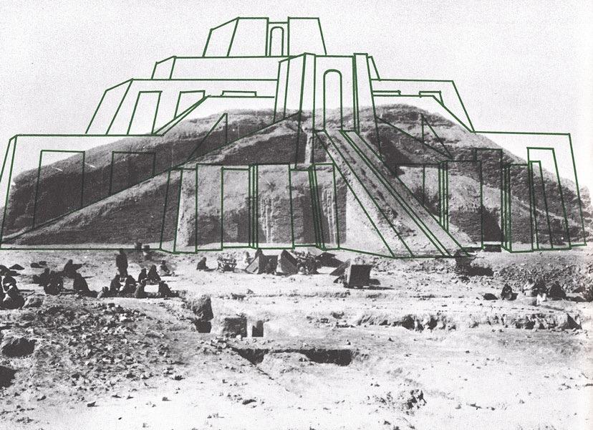
Ziggurat
at Ur (modern Tell Muqayyar) Iraq
ca. 2,100 B.C.E.
mud brick

Slide 51
What local government/religious buildings were created here in Utah with ceremony and procession in mind?

Slide 52
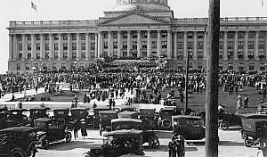
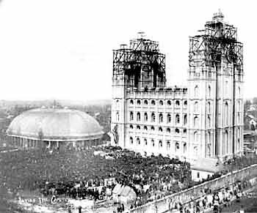
What local government/religious buildings were created here in Utah with ceremony and procession in mind?
Utah State Capitol, 1914
Mormon temple, 1893

Slide 53
In case you missed it…
White Temple and ziggurat
Uruk (modern Warka) Iraq
ca. 3,200-3,000 B.C.E.
mud brick

Slide 54
Eshnunna

Slide 56
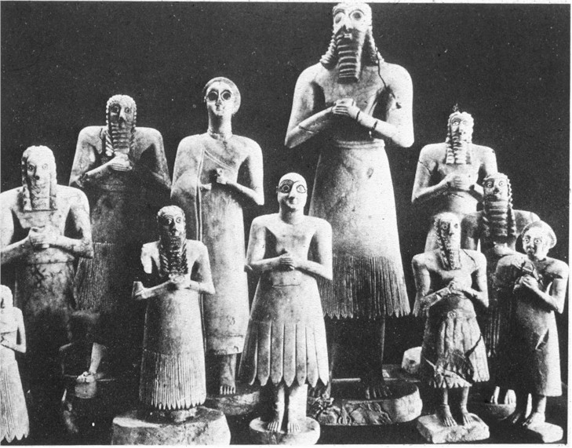

Slide 58
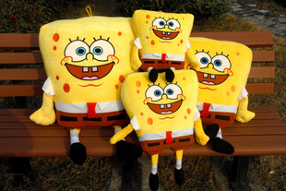

Slide 61
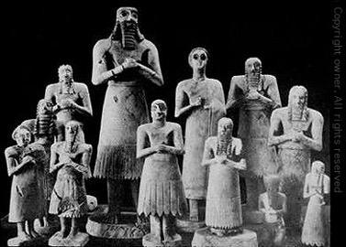
Votive Figures
from Eshnunna (modern Tell Asmar) Iraq
ca. 2,700 B.C.E.
gypsum, shell, black limestone
tallest 30 in. high
-Votive statues were objects left in a sacred places like temples as proxies for whoever owned them.
This way the owners of the figures were also participating in ceremonies or praying to their gods.
-The height correlated to the individual's importance in the community.
-Large eyes: spiritually awake and ready to serve their god

Slide 62
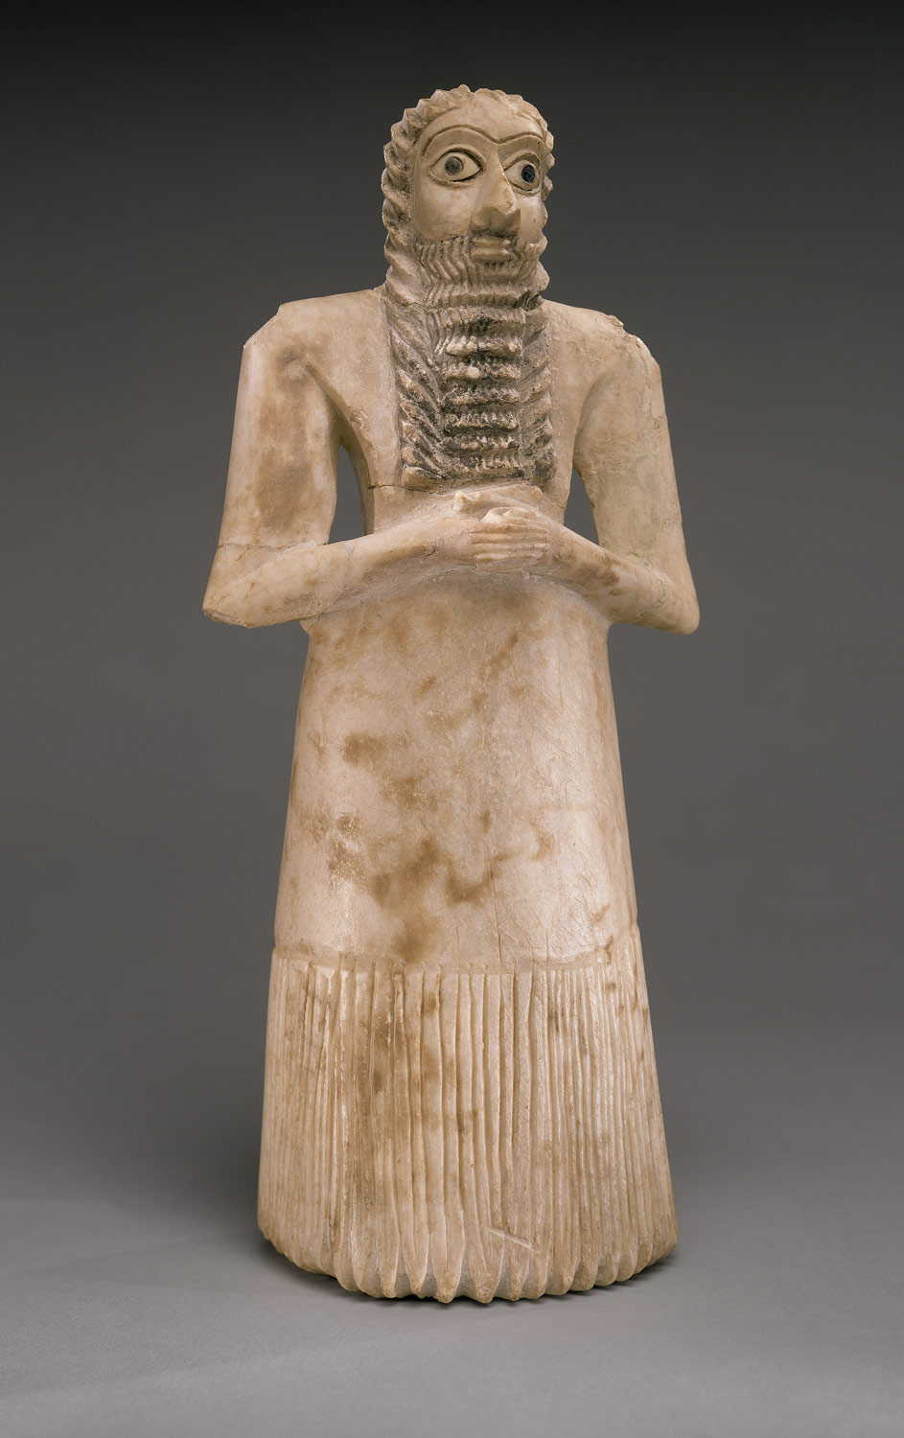
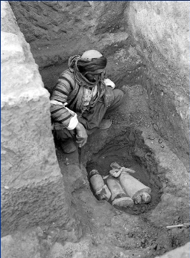

Slide 63
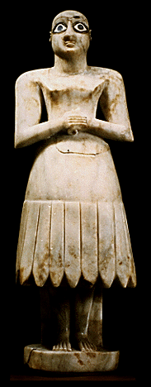
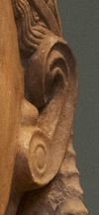
Form
Figures are different heights, denoting hierarchy of scale
arms and feet cut away
pinkies in a spiral; chin a wedge shape; ear a double volute
Votive Figures
from Eshnunna (modern Tell Asmar) Iraq
ca. 2,700 B.C.E.
gypsum, shell, black limestone
tallest 30 in. high

Slide 64
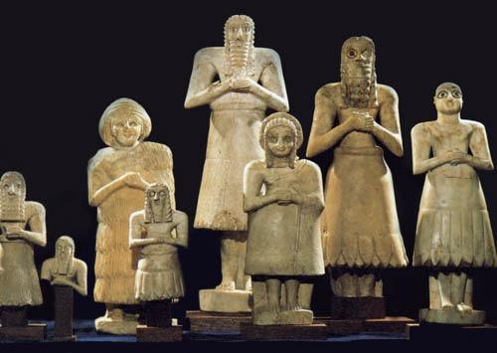
Function
Inscribed on the back:
“It offers prayers”
Figures represent mortals, placed in a temple and praying
Votive Figures
from Eshnunna (modern Tell Asmar) Iraq
ca. 2,700 B.CE.
gypsum, shell, black limestone
tallest 30 in. high

Slide 65
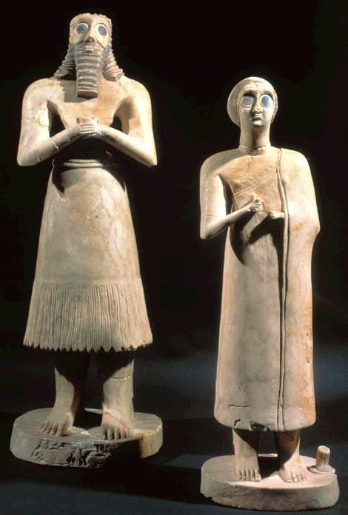
Content
Hands folded in a gesture of prayer
Huge eyes in awe, spellbound, staring at deity
Men: bare upper chest; skirt from waist down; beard flows in ripple pattern; wear a belt
Women: dress draped over one shoulder

Slide 66
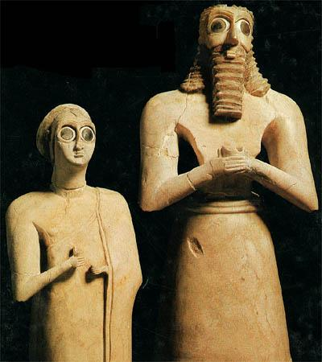
Context
Gods and humans are present in their statue
None have been found in situ; only buried in groups under the temple floor

Slide 67
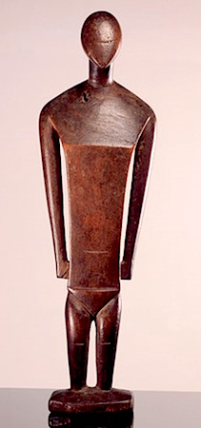
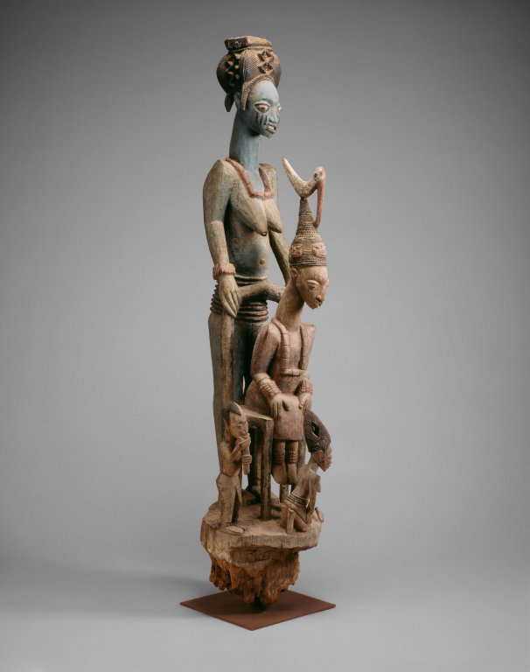
Cross Cultural Comparisons: Shrine Figures
Ikenga (shrine Figure) #176
Female Deity from Nukuoro #217
Veranda Post #180
Statues of Votive Figures #14

Slide 68
Essential Questions… Hmmm
What stylistic conventions does this culture use to depict humans?
Why does art of the Ancient Near East focus on royal figures and gods?

Slide 69
Notes:
Slide concept by William V. Ganis, PhD FOR EDUCATIONAL USE ONLY For publication, reproduction or transmission of images, please contact individual artists, estates, photographers and exhibiting institutions for permissions and rights.

Slide 71
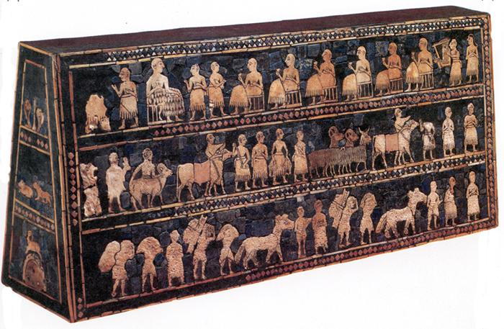

Slide 72
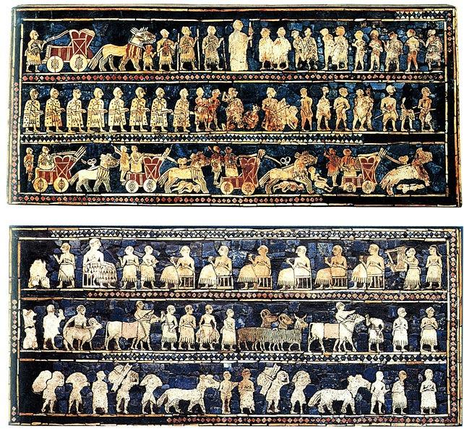
Standard of Ur
Royal Cemetery Ur, Iraq
ca. 2,600 B.C.E.
wood, shell, lapis lazuli, red limestone
-Box with 4 sides-2 sides are a narrative with one side representing peace and the other representing war
-Narrative
-Separated into registers
-Hierarchical scale
-Could represent a celebration of a war victory

Slide 73
Guess how big it is….

Slide 74
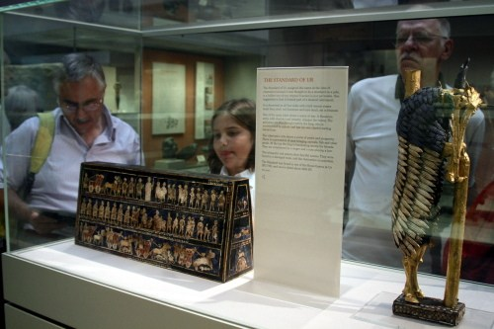

Slide 75
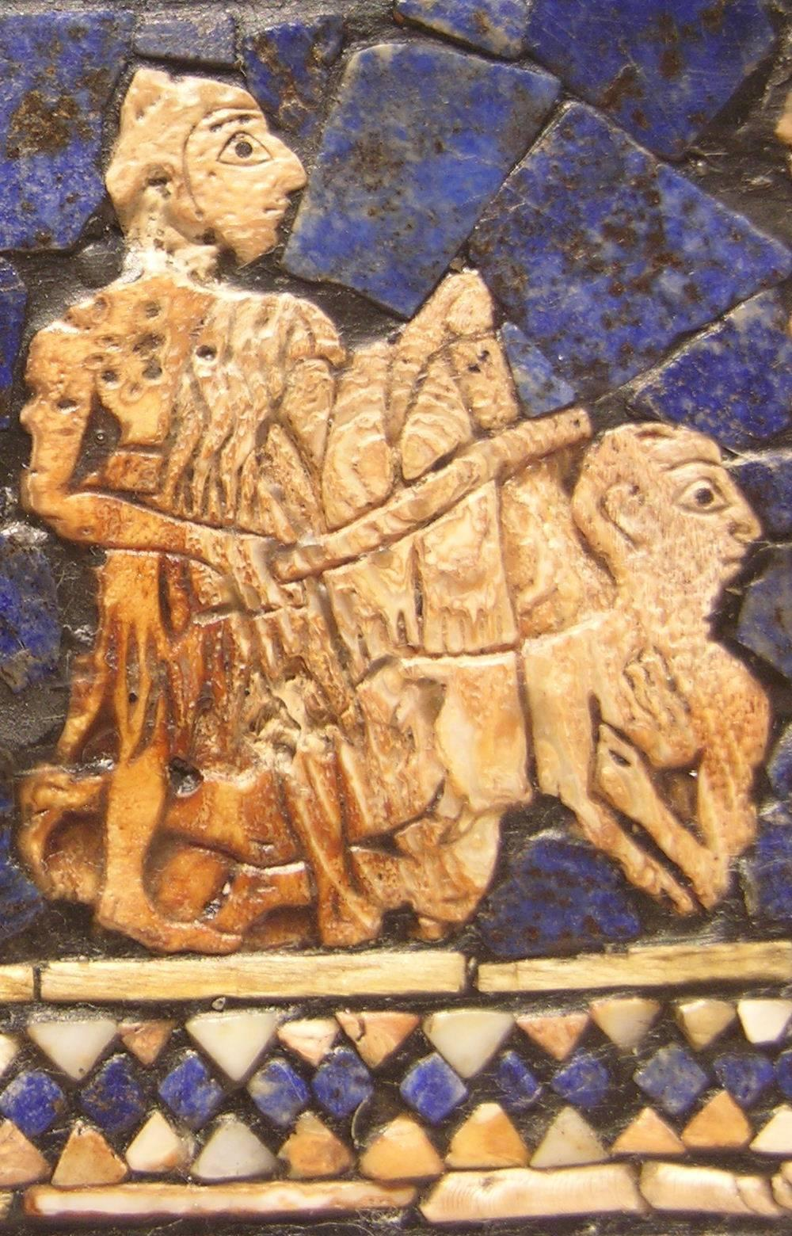
Form
4 sided box, with inlaid with shells, lapis lazuli, & red limestone
main narrative is told on two sides: War and Peace
Figures in twisted perspective- broad frontal shoulders, bodies in profile
Organized in registers; figures stand on ground lines; reads from bottom to the top

Slide 76
Lapis Lazuli
- Afghanistan
Red Limestone
-India

Slide 77
Function
Perhaps used as part of a soundbox for a musical instrument
May have been two halves of one narrative

Slide 78
Content
Context
War Side: Sumerian King half a head taller, has descended from his chariot to inspect captives brought before him, some debased by nakedness; chariots advance over the dead in the lowest registers
Peace Side: Food brought in a procession to the banquet; musician playing a lyre; ruler wears kilt made of wooly tufts; larger than the others
Reflects extensive trading network: Lapis from Afghanistan, shells from Persian gulf, red limestone from India

Slide 79
https://www.youtube.com/watch?v=Nok4cBt0V6w

Slide 80
Standard of Ur (war side)
from Tomb 779, Royal Cemetery Ur (modern Tell Muqayyar) Iraq
ca. 2,600 B.C.E.
wood, shell, lapis lazuli, red limestone
approximately 8 x 19 in.

Slide 81
Standard of Ur (peace side)
from Tomb 779, Royal Cemetery Ur (modern Tell Muqayyar) Iraq
ca. 2,600 B.C.E.
wood, shell, lapis lazuli, red limestone
approximately 8 x 19 in.

Slide 82
Cross-Cultural Comparisons: Narrative
Bayeux Tapestry #59
Column of Trajan #45
Night Attack on the Sanjo Palace #203
Standard of Ur #16

