Slide 1
Unit 1 Prehistoric Art
Animals and the Environment

Slide 3
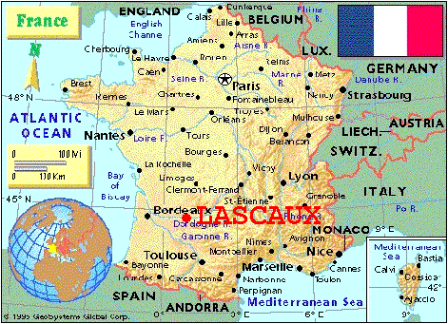
Great Hall of the Bulls
Lascaux, France
Paleolithic Europe
15,000 BCE
Rock Painting

Slide 4
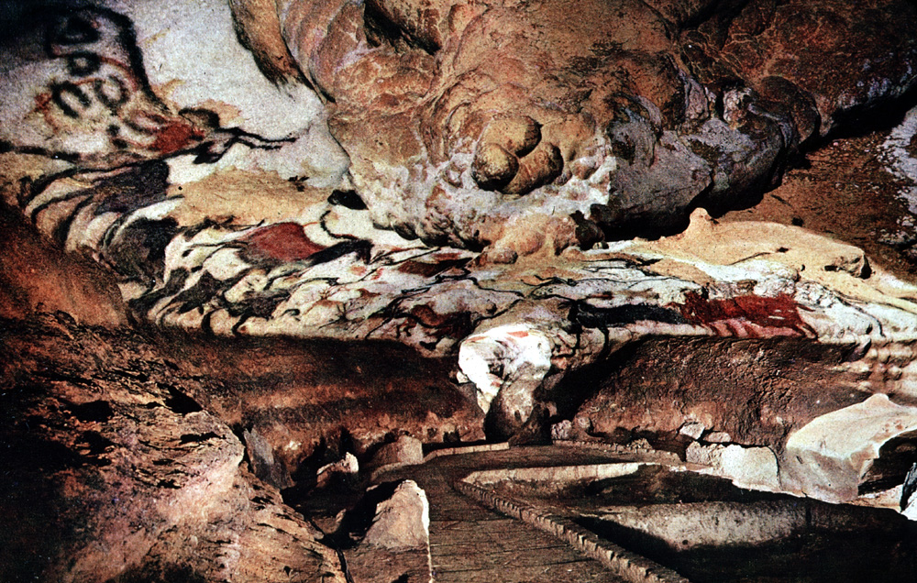

Slide 5
Great Hall of the Bulls Lascaux, France Paleolithic Europe 15,000 BCE Rock Painting

Slide 6
Great Hall of the Bulls Lascaux, France Paleolithic Europe 15,000 BCE Rock Painting
Natural products used to make the paints: iron ore, charcoal, plants
650 paintings; most common are cows, bulls, horses and deer
Twisted Perspective
Overlapping figures
Evidence still exists of scaffolding erected to get to higher areas of caves
Caves not dwellings! (they were migratory)
Walls scraped to create a smooth surface; pigment bound with animal fat; smooth stones served as palettes

Slide 7
The Met
Tour the Cave
Khan Academy
UNESCO
https://www.metmuseum.org/toah/hd/lasc/hd_lasc.htm
https://www.khanacademy.org/humanities/ap-art-history/global-prehistory-ap/paleolithic-mesolithic-neolithic/a/lascaux
http://archeologie.culture.fr/lascaux/en
http://whc.unesco.org/en/documents/108443

Slide 8
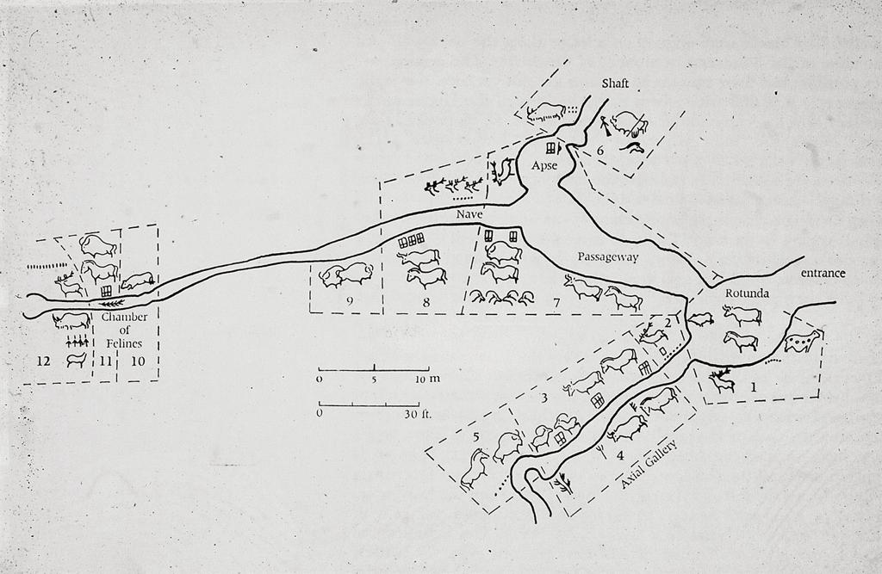

Slide 9
What are some possible theories?
successful animal hunt,
animal worship,
shaman contact of the animal world through trances,
and education
-Why do you think they left and prints on the paintings?
Lascaux Cave paintings
Lascaux, Dordogne, France
ca. 15,000-13,000 B.C.E.
pigment on stone

Slide 10
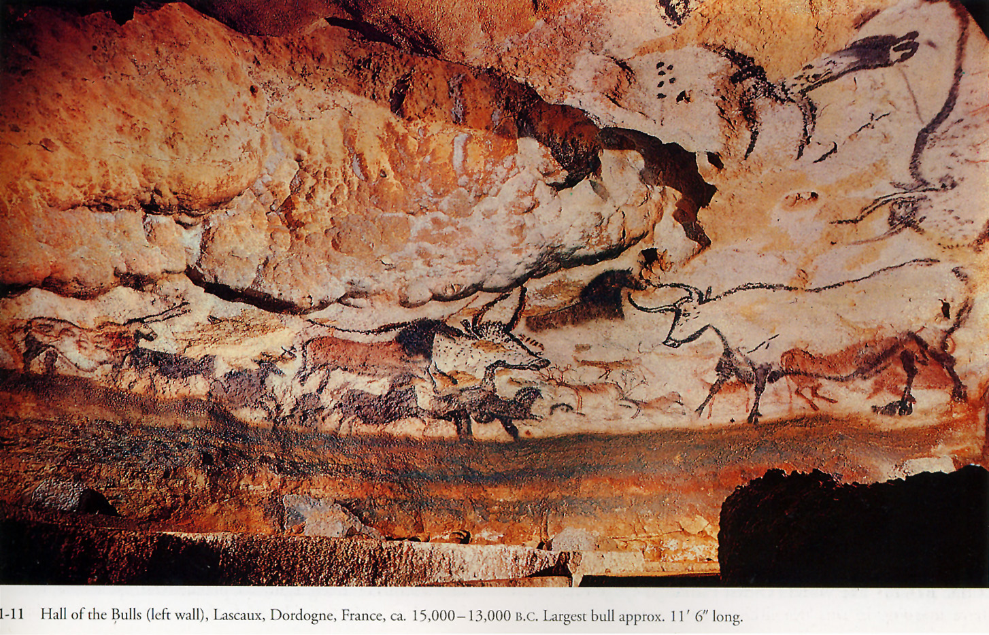
Notes:
Slide concept by William V. Ganis, PhD
FOR EDUCATIONAL USE ONLY
For publication, reproduction or transmission of images, please contact individual artists, estates, photographers and exhibiting institutions for permissions and rights.

Slide 11
What does Rick Steves Think?
https://www.youtube.com/watch?v=UnSq0c7jM-A

Slide 12
http://archeologie.culture.fr/lascaux/en

Slide 13
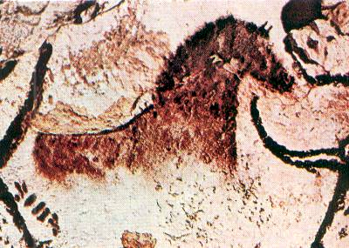
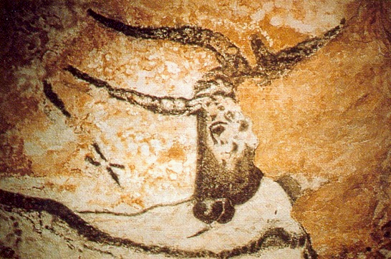
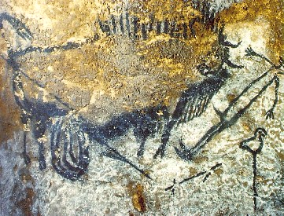
Notes:
Slide concept by William V. Ganis, PhD
FOR EDUCATIONAL USE ONLY
For publication, reproduction or transmission of images, please contact individual artists, estates, photographers and exhibiting institutions for permissions and rights.

Slide 14
What does Dr. Nigel Spivey think?
https://www.youtube.com/watch?v=2NgB3qSKD_o

Slide 16
Questions
Lascaux is undeniably fantastic and inspiring… Its discovery is what has ultimately led to its inevitable demise…
Pretend on a hike you discover a hidden cave in the wasatch mountains. What would you do? Do you owe it to “humanity” to share the discovery?

Slide 18
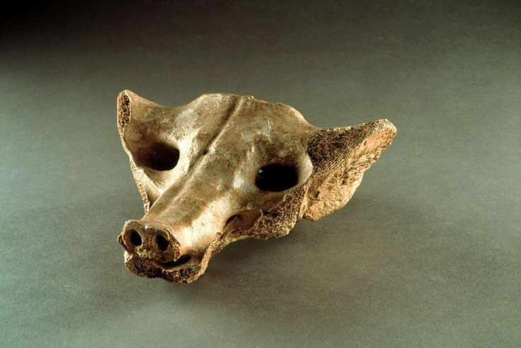

Slide 19
Camelid sacrum in the shape of a canine
Tequixquiac, Mexico
14,000-7,000 BCE
Bone

Slide 20
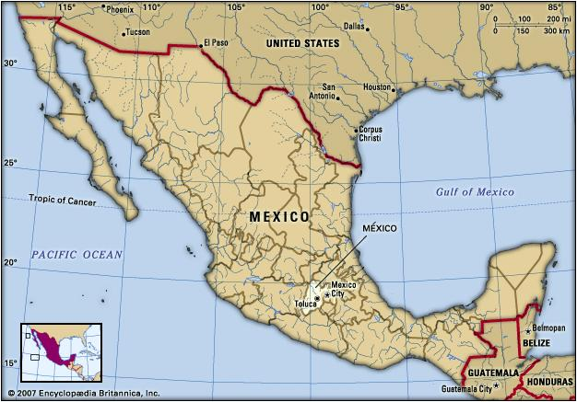

Slide 22
The sculpture was made from the now fossilized remains of the sacrum of an extinct camelid. A camelid is a member of the Camelidae family—think camels, llamas, and alpacas.

Slide 23
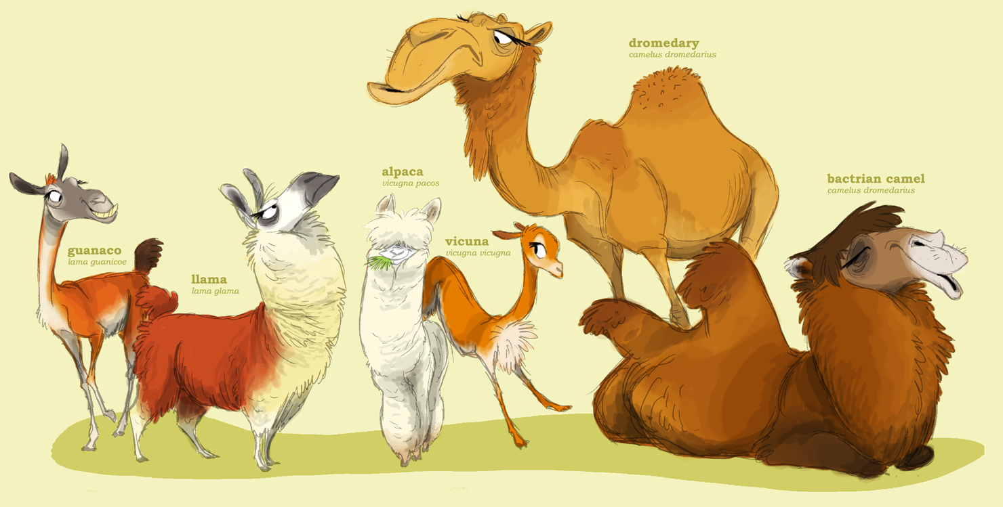

Slide 25
The sacrum is the large triangular bone at the base of the spine. Holes were cut into the end of the bone to represent nostrils, and the bone is also engraved (though this is difficult to see in photographs)

Slide 26
Camelid sacrum in the shape of a canine Tequixquiac, Mexico 14,000-7,000 BCE Bone
Camelid: an extinct Camel like animal
Sacrum is the triangular shaped bone at the base of the spine
Bone has been worked to create the skull of a dog/wolf
One natural form used to take the natural form of another
Mesoamerican idea that the sacrum is the second skull

Slide 27
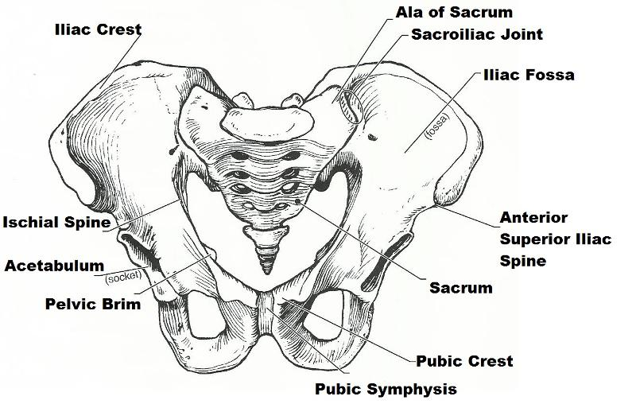

Slide 28
“Language and iconographic evidence strongly suggests that the sacrum bone was an important bone indeed in Mesoamerica, relating to sacredness, to resurrection, and to fire. The importance attached to this bone and its immediate neighbors is not limited to Mesoamerica. From ancient Egypt to ancient India and elsewhere, there is abundant evidence that the bones at the base of the spine, including especially the sacrum, were seen as sacred.”

Slide 30
Running horned woman
Tassili n’Ajjer, Algeria
6,000-4,000 BCE
Pigment on rock

Slide 31
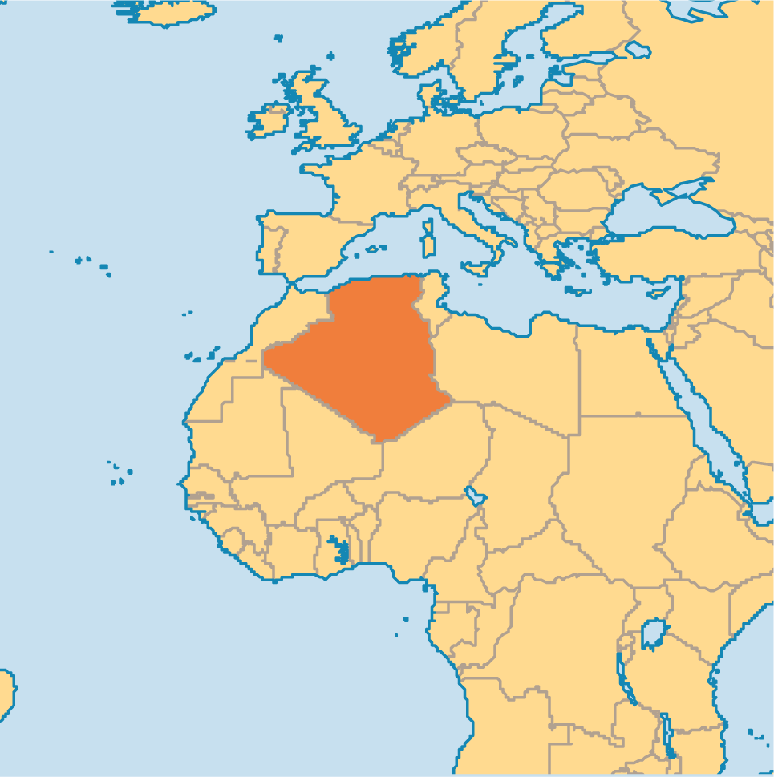

Slide 33
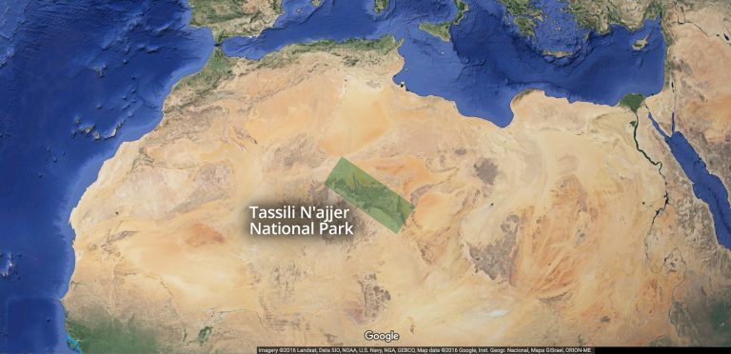

Slide 34
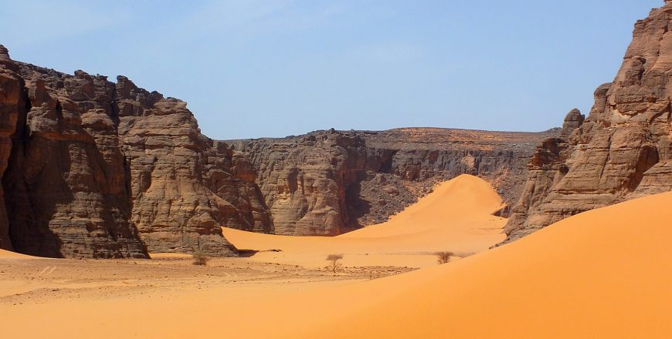

Slide 35
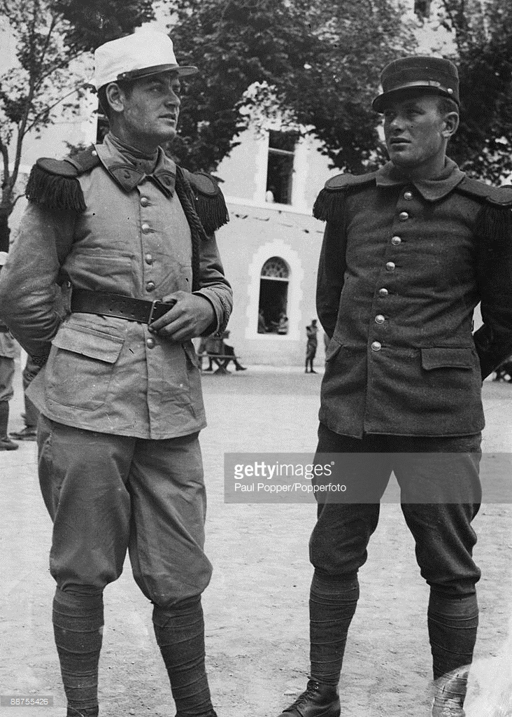
Discovery
Between 1933 and 1940, camel ­corps officer Lieutenant Brenans of the French Foreign Legion completed a series of small sketches and hand­ written notes detailing his discovery of dozens of rock art sites deep within the canyons of the Tassili n’Ajjer

Slide 36
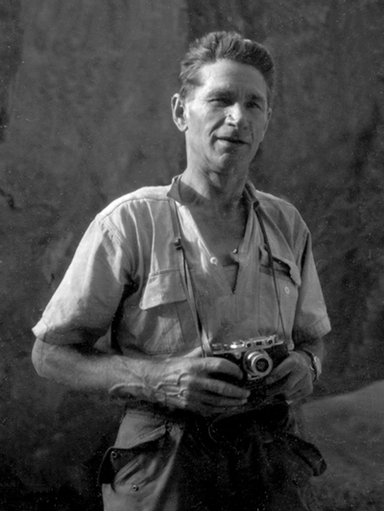
Archaeologist Henri Lhote
Lhote is inspired by the sketches of Brenans.
In 1956 he and a team of copyists spend 16 months to study the rock art of Tassill and publish it in..
“la découverte des fresques du Tassili” a best seller

Slide 37
Tassili n’Ajjer Rock Art
https://www.youtube.com/watch?v=dEtnJHeocKg

Slide 38
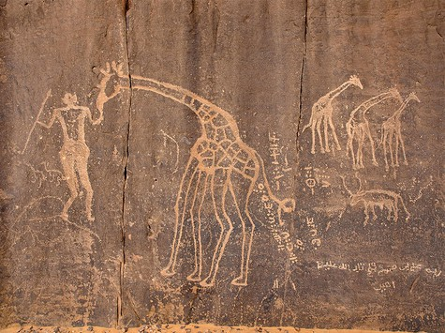
Most of the Murals looks like this …

Slide 39
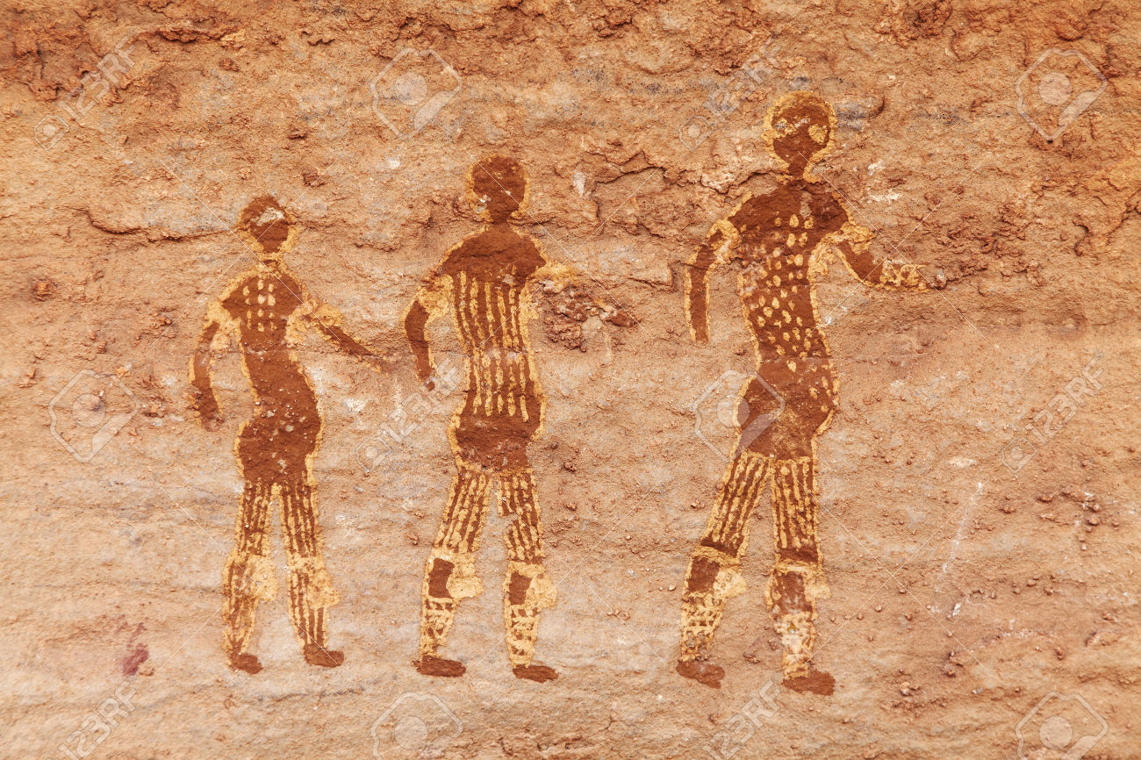

Slide 40
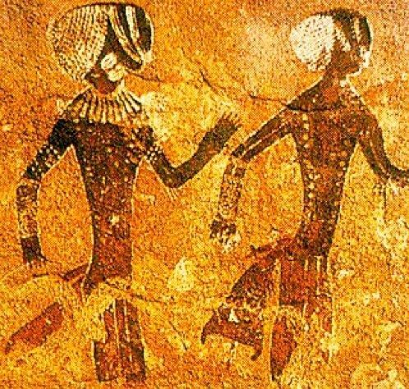

Slide 41
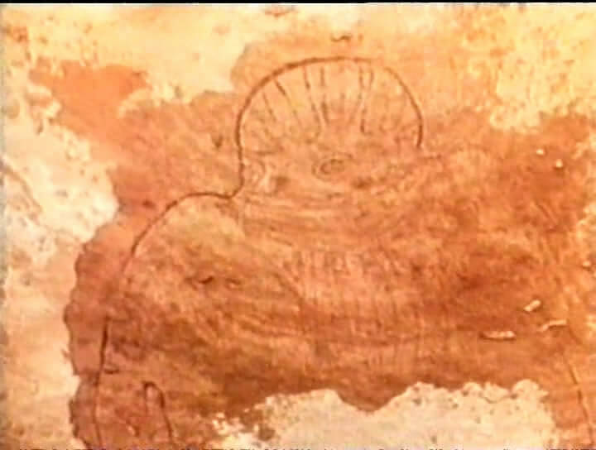
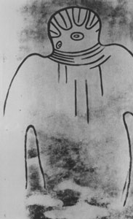
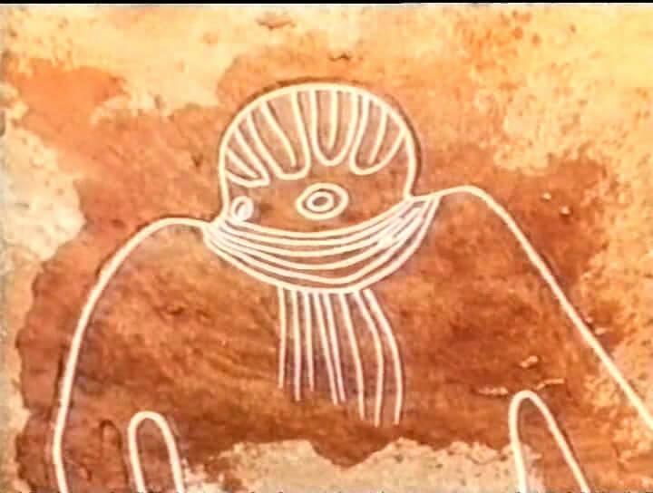
Some though … look like this …

Slide 42
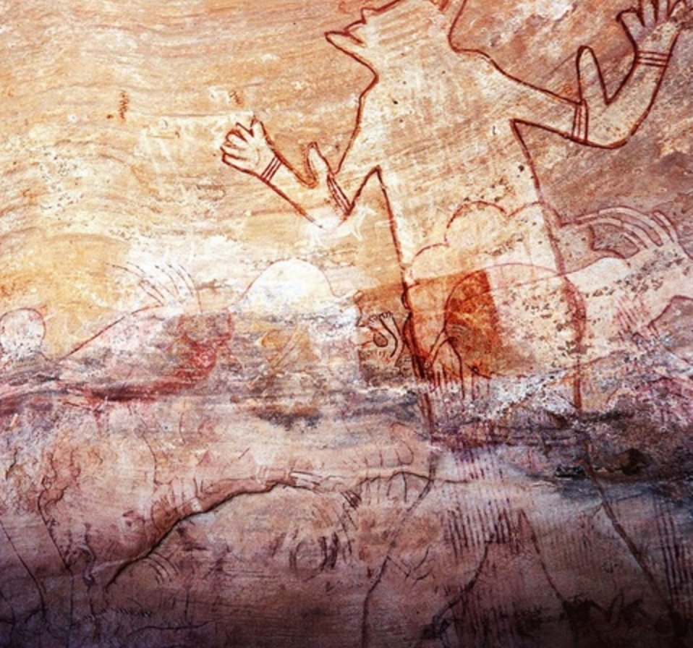

Slide 43
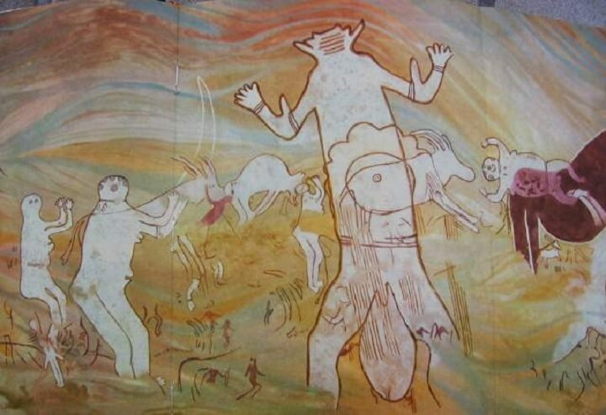

Slide 44
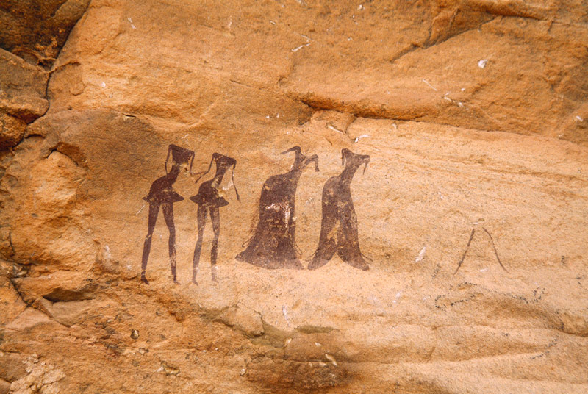

Slide 45
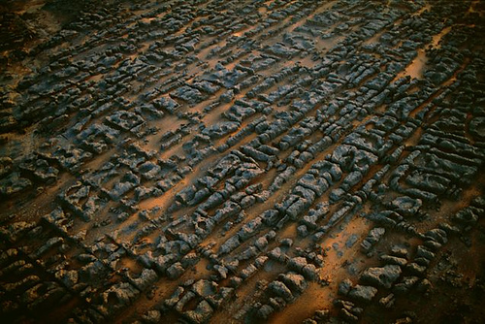
Jabbaren

Slide 46
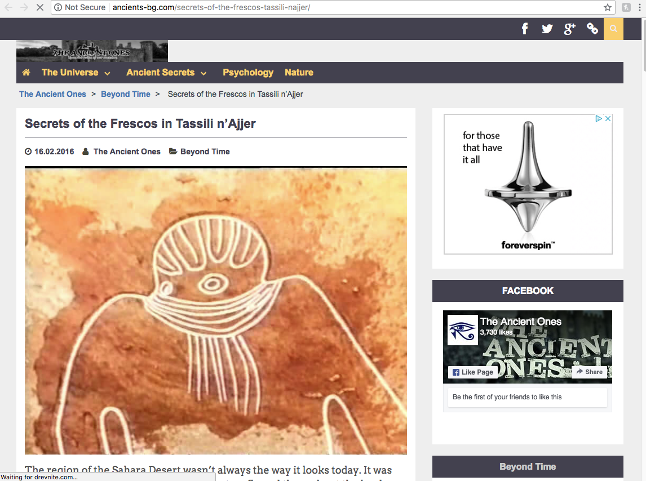

Slide 47
Running horned woman Tassili n’Ajjer, Algeria 6,000-4,000 BCE Pigment on rock

Slide 48
Lets take a few notes!
UNESCO
Kahn Academy
https://whc.unesco.org/en/list/179
https://www.khanacademy.org/humanities/ap-art-history/global-prehistory-ap/paleolithic-mesolithic-neolithic/a/running-horned-woman-tassili-najjer

Slide 49
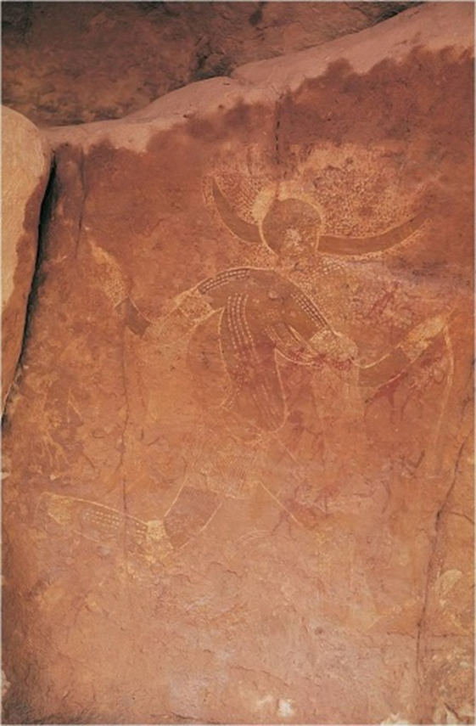
More than 15,000 drawings and engravings found at the site
At one time the desert was a grassland; climate changes turned it into a desert
Composite view of the body
Dots may reflect body paint applied for ritual
The entire site was probably painted by many different groups over time.

Slide 50
TWO THINGS THAT STICK OUT TO YOU

Slide 51
My Two thoughts… Discovered in 1956 This are was a fertile grassland 6,000 years ago!

Slide 52
The Ambum Stone
Papua New Guinea
1500 BCE
Greywacke

Slide 53
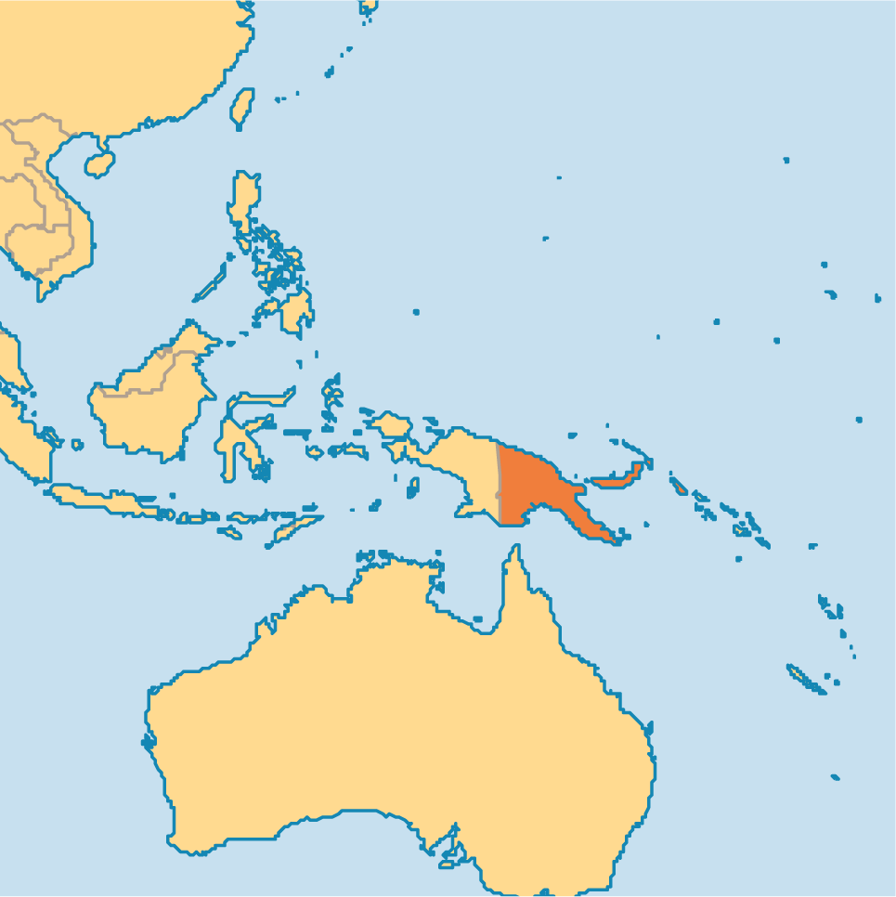
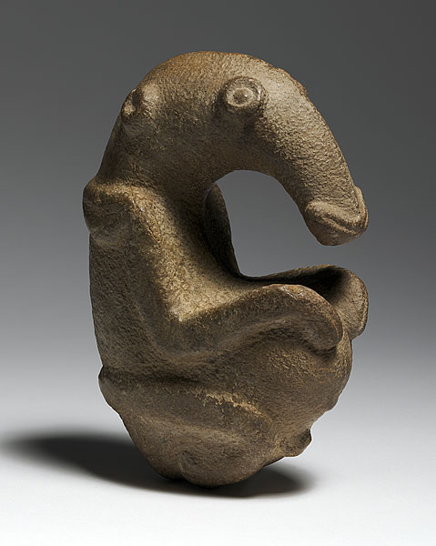
The Ambum Stone Papua New Guinea 1500 BCE Greywacke

Slide 55
The Ambum Stone Papua New Guinea 1500 BCE Greywacke
Artists used stone to carve stone
Animal human hybrid?
Anteater head, human body?
Theories:
Masked human
Anteater embryo in fetal position
Anteaters thought of as significant because of fat deposits
May have been a pestle
Perhaps a ritual purpose

Slide 56
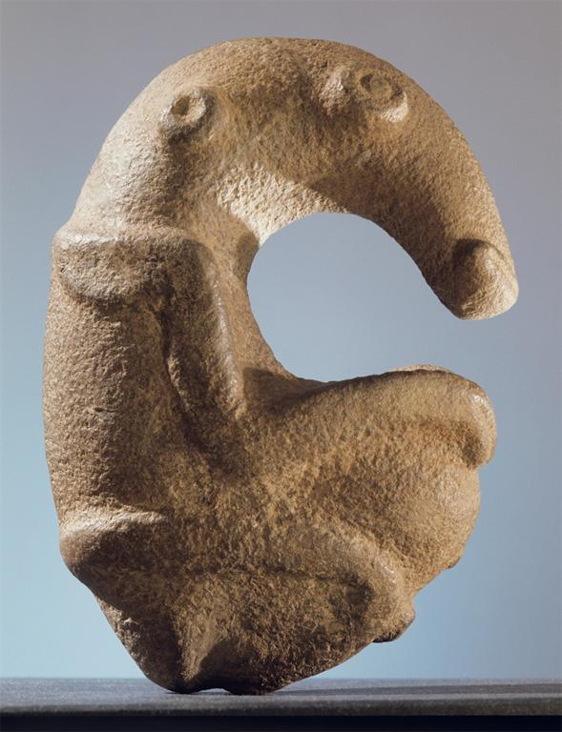
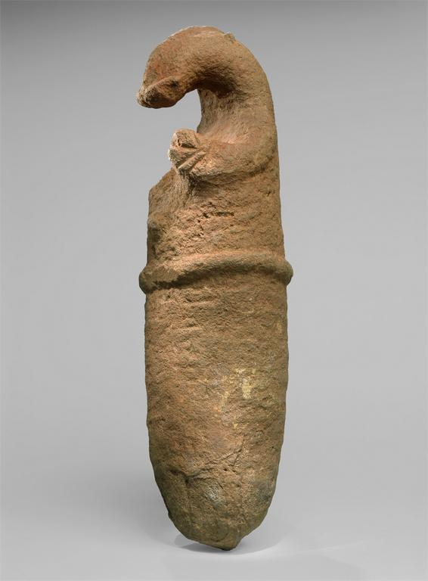
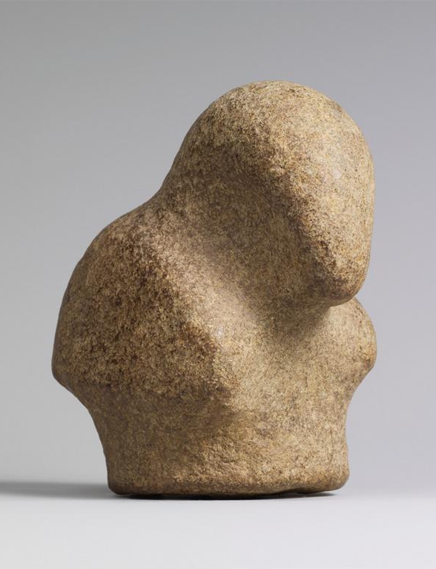
NGA Site Conservation The Met
https://nga.gov.au/AmbumStone/
https://www.khanacademy.org/humanities/ap-art-history/global-prehistory-ap/paleolithic-mesolithic-neolithic/a/ambum-stone
https://www.metmuseum.org/toah/hd/ngss/hd_ngss.htm

