Slide 2
Enduring Understanding
Traditional art forms have been enhanced by technology.
Contemporary Art is Global.

Slide 3
Essential Knowledge
Traditional skills have been challenged by digital works that were meant to last only a short amount of time, works captured on video, computer generated works, etc.
Diverse art forms are created that reflect and challenge the environment in which they were made

Slide 4
Essential Knowledge
Artists appropriate works from the past which reveal layers of meaning beyond what was originally intended.
Cities seek to be defined by an iconic landmark.

Slide 5
Essential Knowledge
Art history has traditionally ignored contemporary art from non-American/European sources; contemporary art is being produced globally.
Eurocentric views have been downplayed by the rise of the Internet and political power shifts around the world.
Artists now come from a variety of backgrounds, not just straight, caucasian males.
There are many more venues for displaying art in the world today than ever.

Slide 6
Contemporary Sculpture

Slide 8
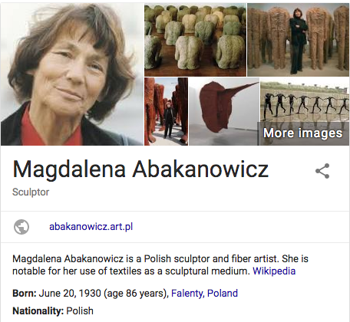

Slide 9
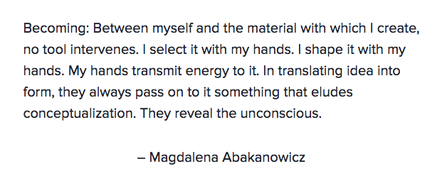

Slide 10
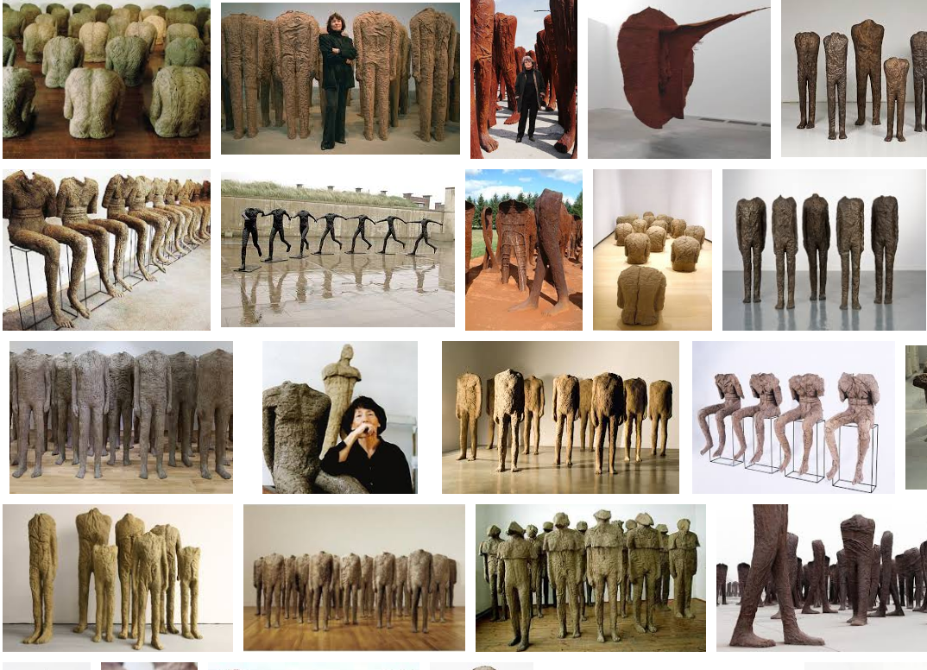

Slide 11
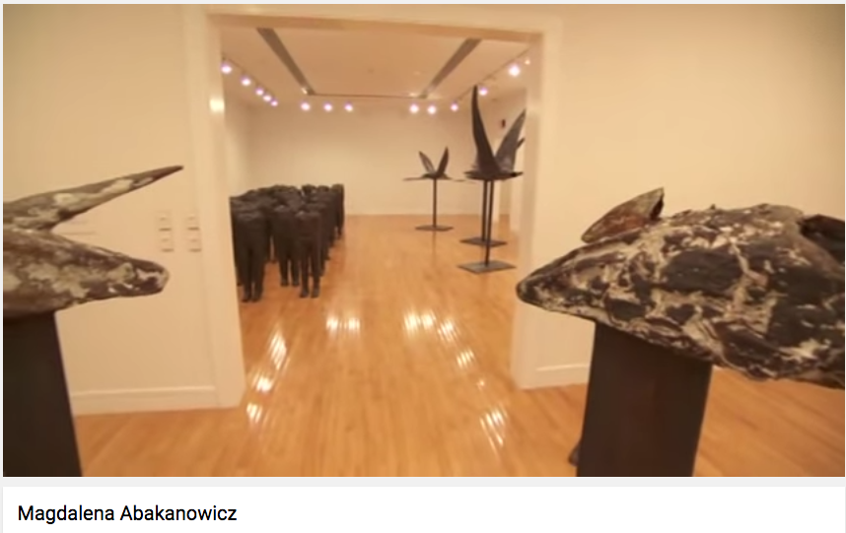
https://www.youtube.com/watch?v=TpDTJ6EYh6c 3:30

Slide 12
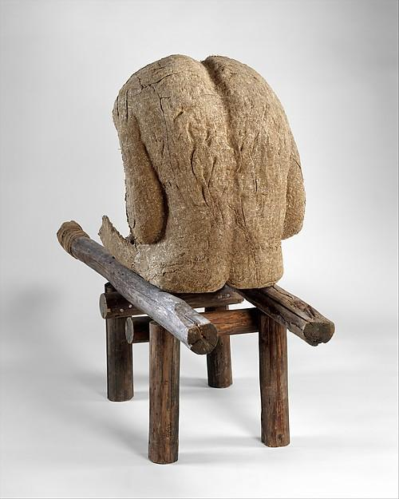
228. Androgyn III
Magdalena Abakanowicz
1985
Burlap, resin, wood, nails, string

Slide 13
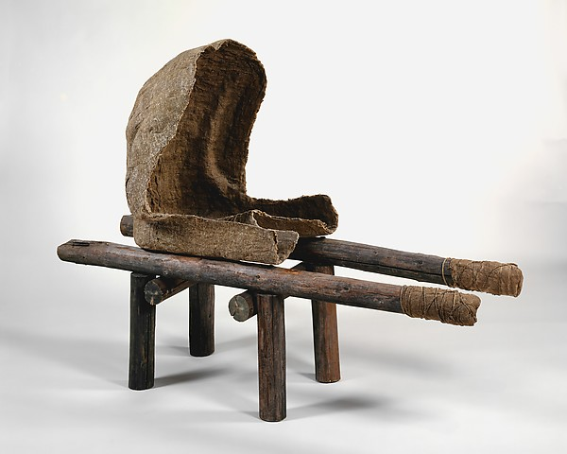

Slide 14
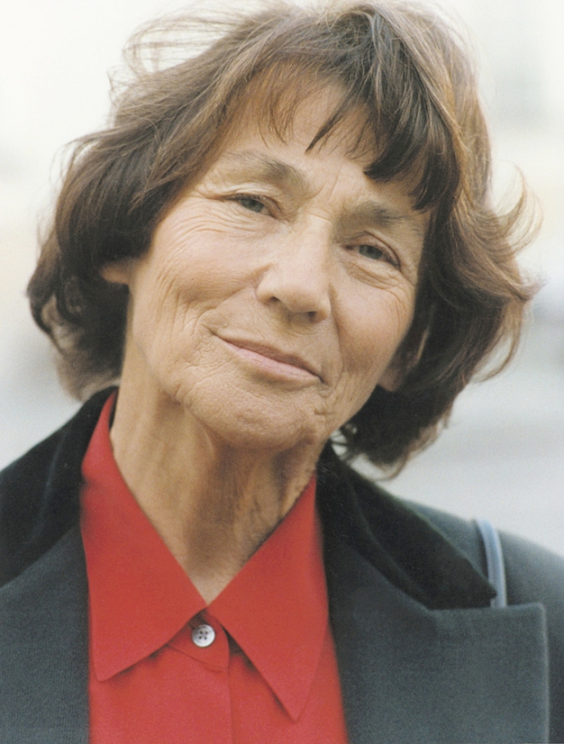
Form | Function | Content | Context
Figure hollowed out, just a shell, hardened fiber casts made from plaster molds | Expression of war and suffering; the pain of humanity and the dehumanization in the 20th century | Figure st on a low stretcher of wooden legs, substituting for human legs | Polish artist
 |  | Hardened fiber has the appearance of crinkled human skin set in earth tones | Since 1974, she has made figures often without heads or arms in large groups or singly
 |  | Figure placed to be seen in the round: the back is complete, but the front is hollow

Slide 15
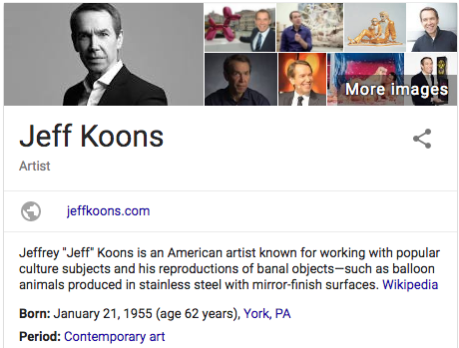

Slide 16
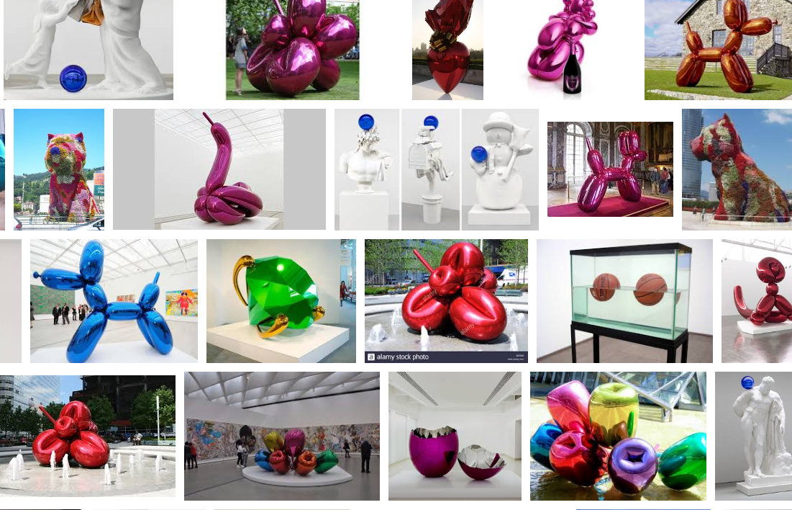

Slide 17
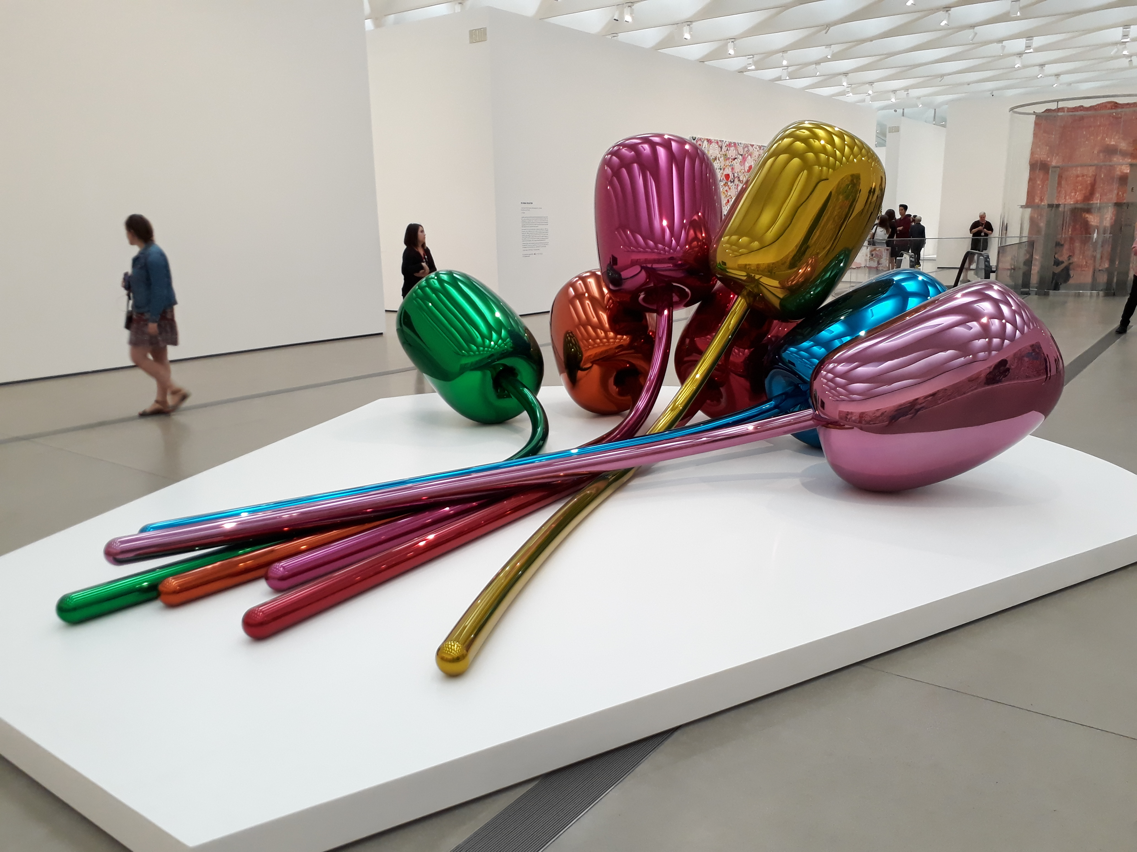

Slide 18
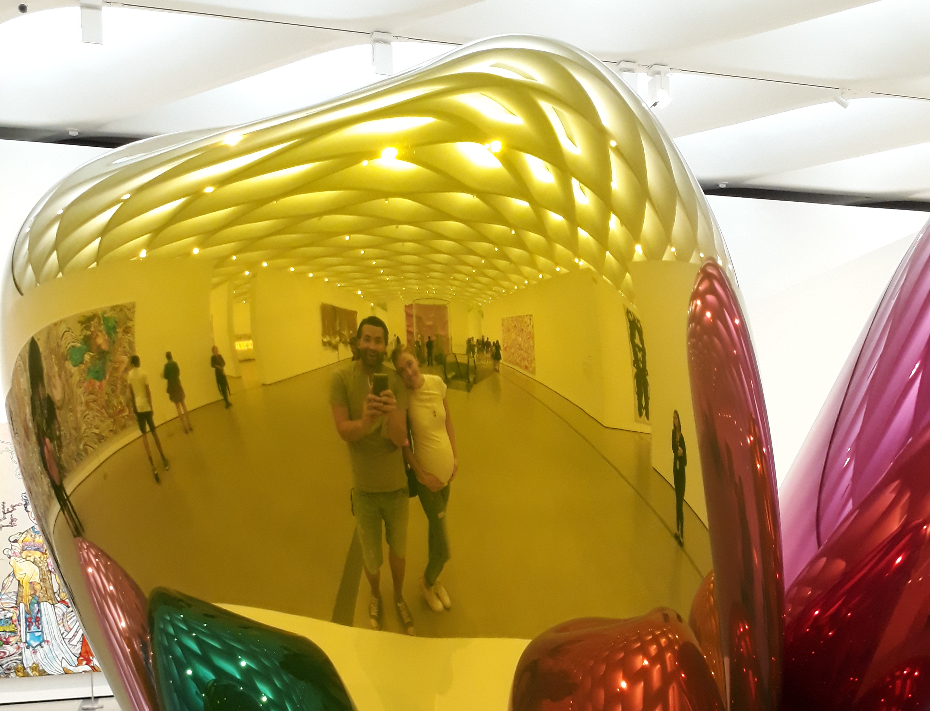

Slide 19
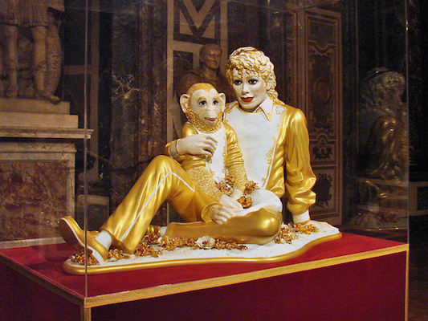

Slide 20
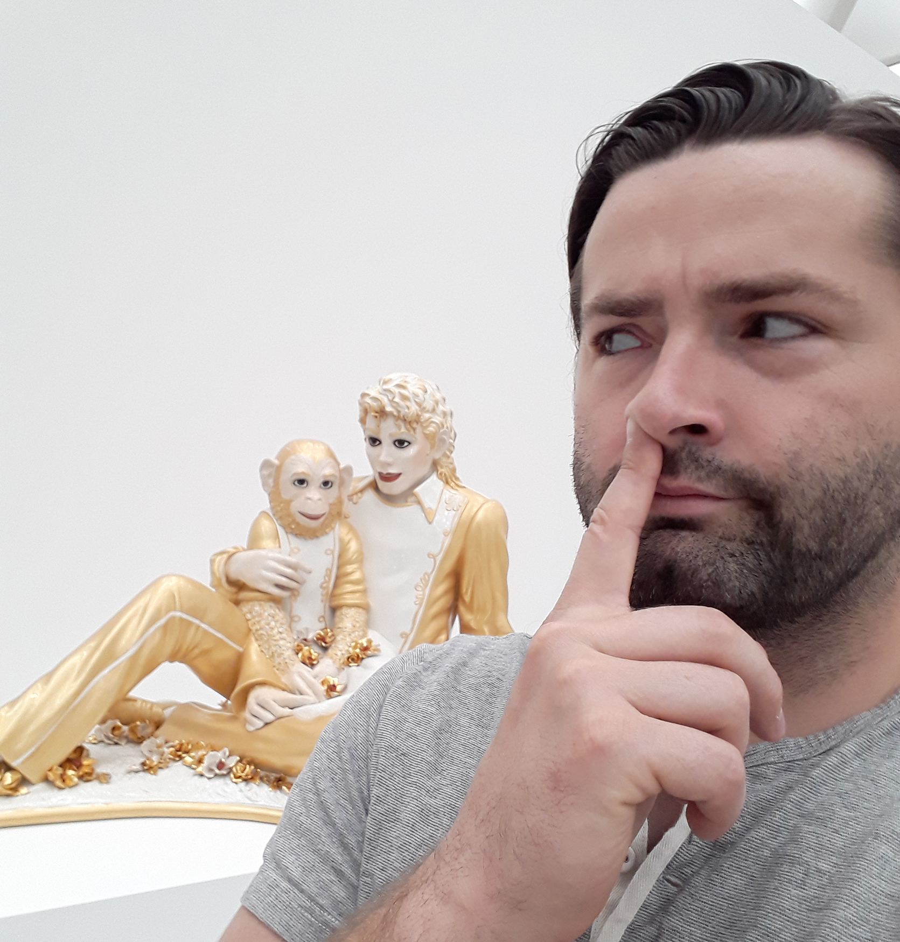

Slide 21
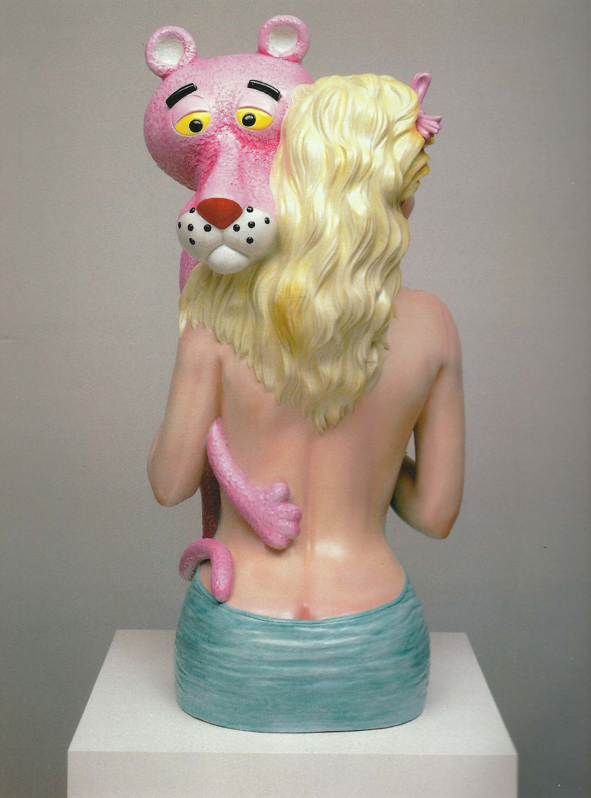
230. Pink Panther
Jeff Koons
1988
Glazed Porcelain

Slide 22
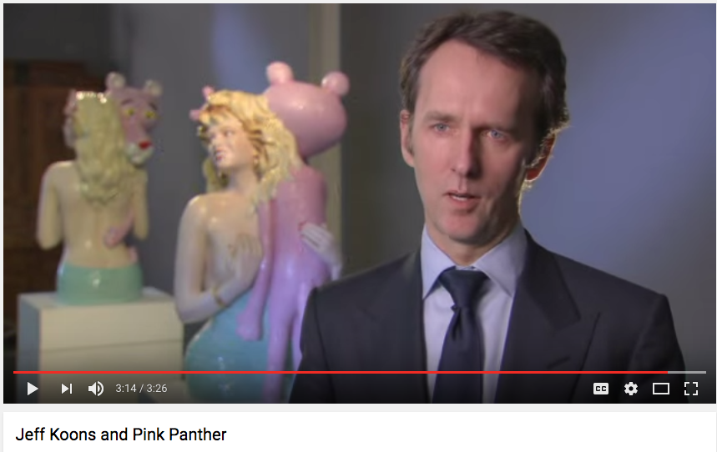
https://www.youtube.com/watch?v=g4Fgt4fjTj0 3:00

Slide 24
Form | Function | Content | Context
Life size porcelain | Commentary on celebrity, sexuality, commercialism, stereotypes, pop culture, kitsch | Artificially idealized female form: over yellow hair, bright red lips/fingernails; overtly fake | PA born artist, working in NYC
 | Creates a permanent reality out of something that is ephemeral and never meant to be exhibited | Woman is Jayne Mansfield, a popular screen star
 |  | Pink panther, a cartoon character; he exhibits a tender delicacy

Slide 25
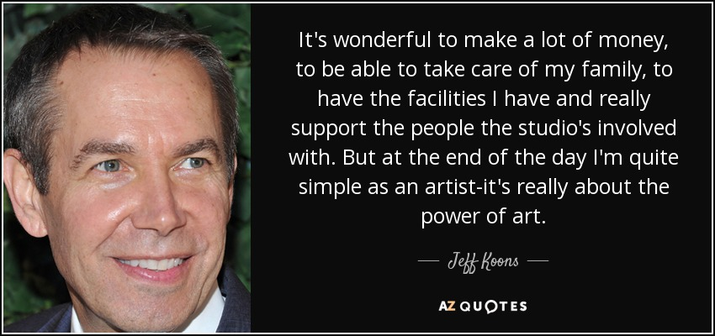

Slide 28
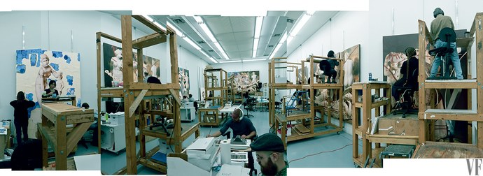

Slide 29
Surrealist painter Alex Gardega responded to a help-wanted ad and was given a tour of Koons’ factory on West 29th Street. “It was beyond insane,” he told me.
Gardega said, “They have lasers printing holes in paper, so they make thousands of pieces of paper with holes in it, and these artists sit all day long and take one stencil, dab paint over it, take the next over that . . . repeat hundreds of times a day — all for a 5-inch section.”
Koons […] is said to have three shifts of assistants working around the clock, about 100 people total.
“Jeff’s a tough taskmaster,” said one art expert. “He has workers that just polish sculptures all day. There is high turnover.”
“It made an iPhone factory look like a fun place to work,” said Gardega. “It was the most lifeless place I have ever seen. I left there, and then right to the Met to clean my soul. Rembrandt would have spit on his fluorescent-lit floors.”

Slide 31
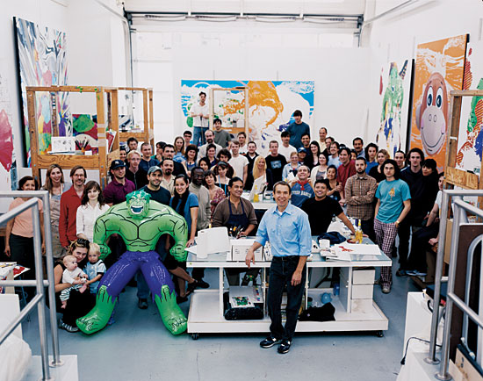

Slide 32
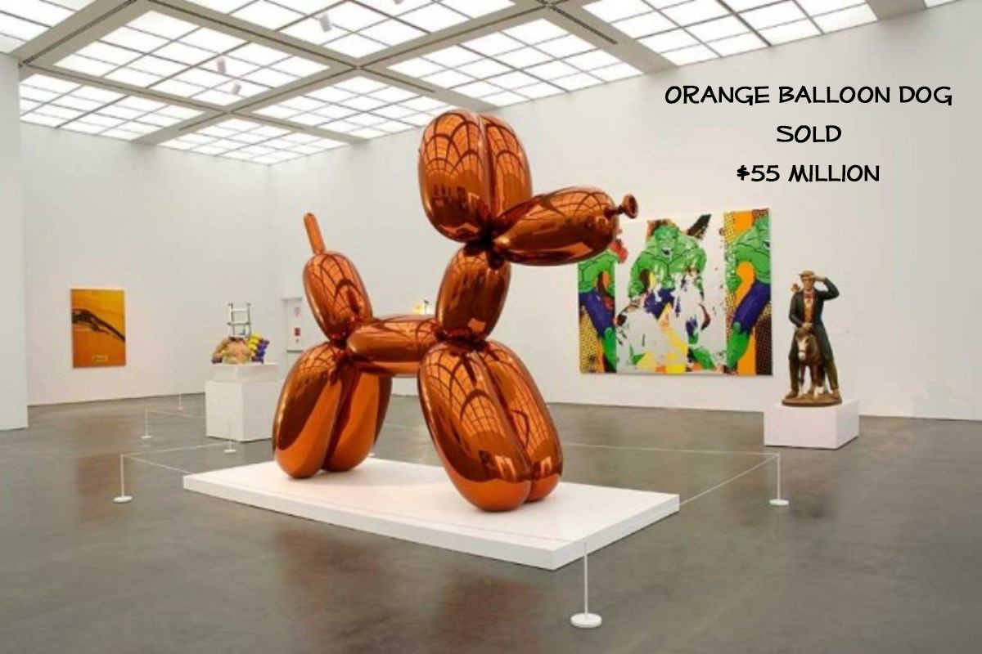

Slide 33
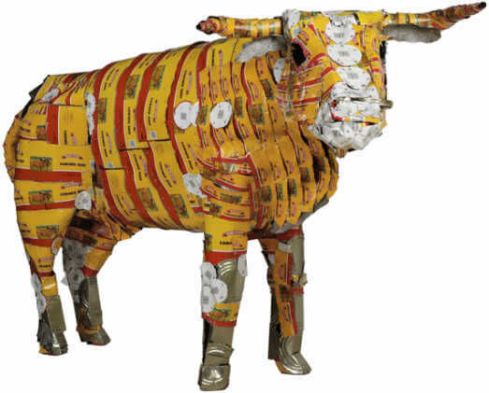
237. Pisupo Lua Afe (Corned Beef 2000)
Michel Tuffery
1994
Mixed Media

Slide 34
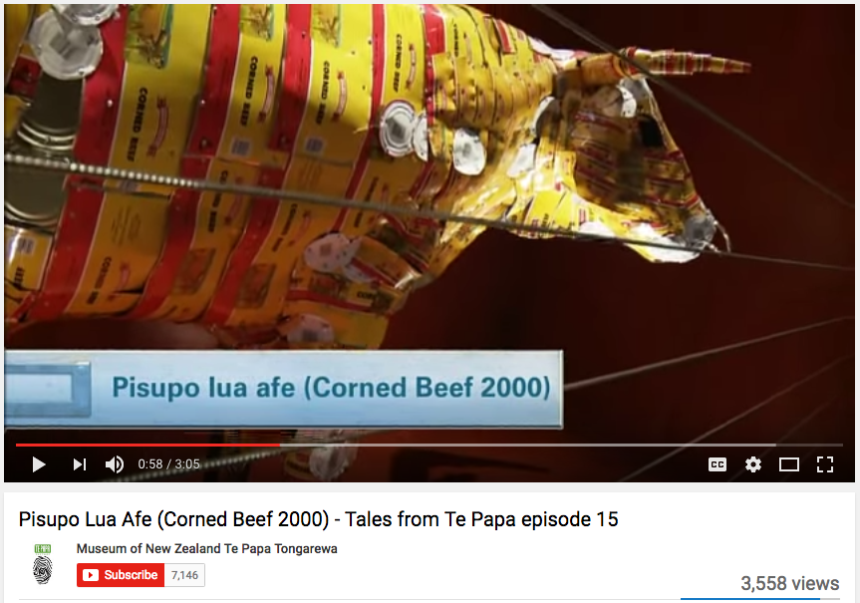
https://www.youtube.com/watch?v=VKDXsrEq_mQ
3:00 Min

Slide 35
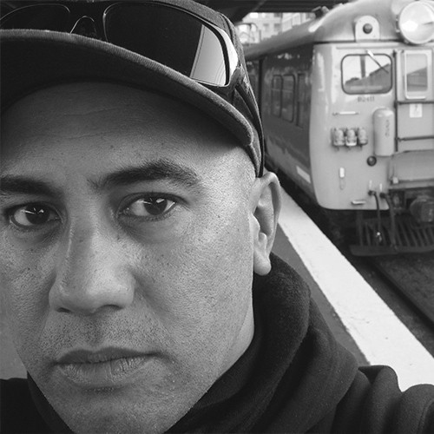
Form | Function | Content | Context
Static sculpture with small concealed wheels for ease of movement | Discusses recycling; Discusses the effect of Western culture on Oceanic societies | Life size sculpture of a bull made from flattened cans of corned beef | New Zealander of Samoan, Cook Islands, and Tahitian descent
 |  |  | Corned beef a favorite food in Polynesia- exported from New Zealand; major contributor to obesity
 |  |  | Introduction canned meats caused a fall in traditional culture skills of fishing, cooking, and, agriculture

Slide 36
Contemporary Mixed Media

Slide 37
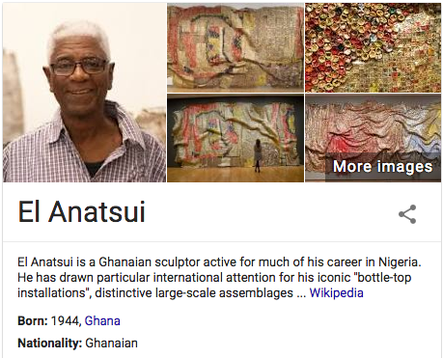

Slide 38
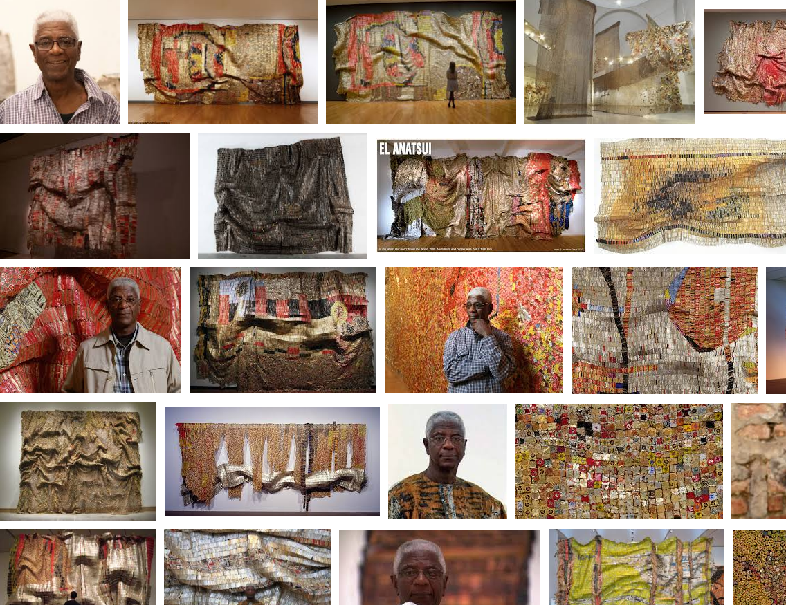

Slide 39
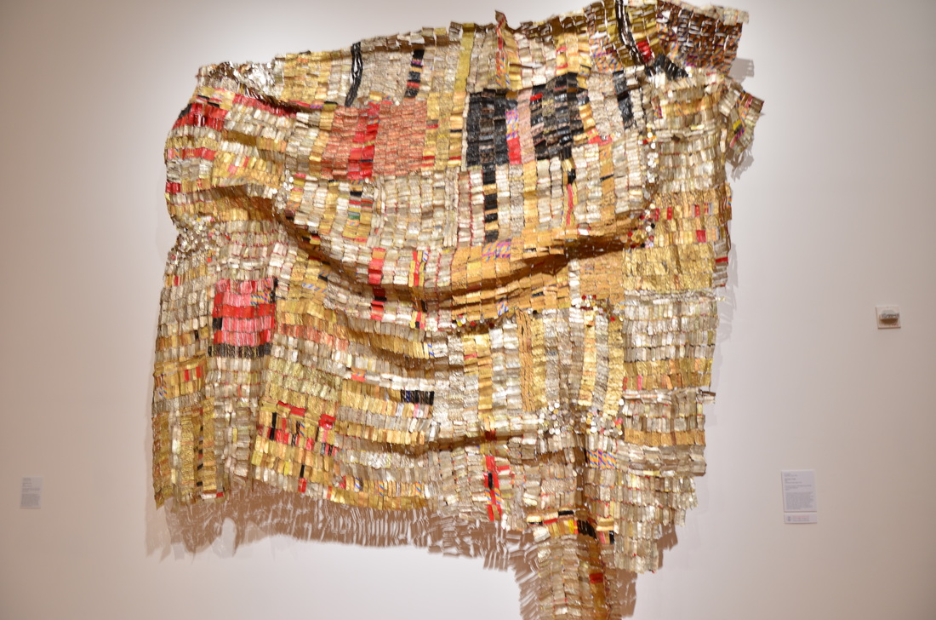
245. Old Man’s Cloth. El Anatsui. 2003 C.E. Aluminum and
copper wire.

Slide 40
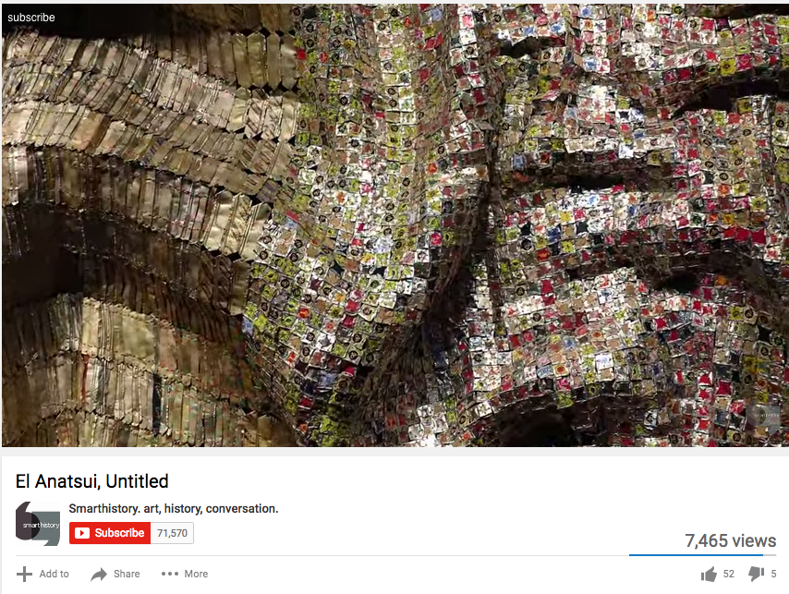
https://www.youtube.com/watch?time_continue=195&v=4zatyfXy_D0
4:00 Min

Slide 41
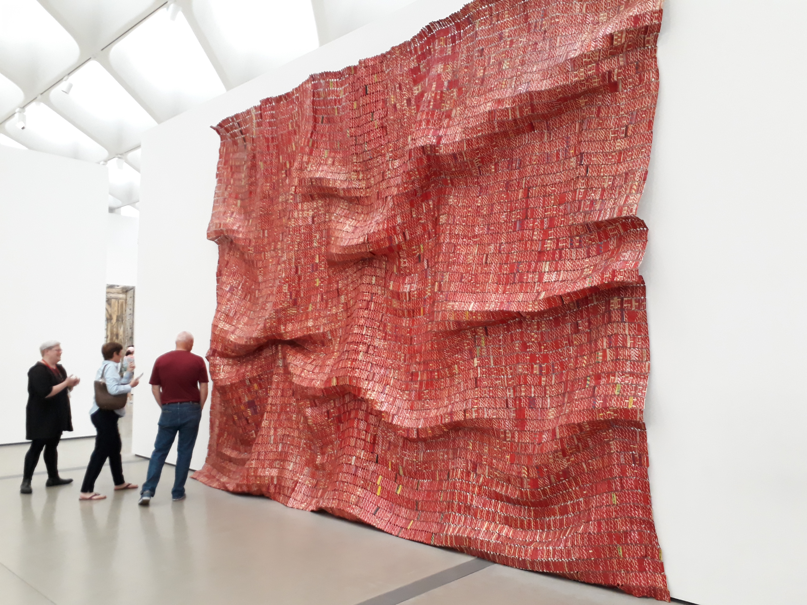

Slide 42
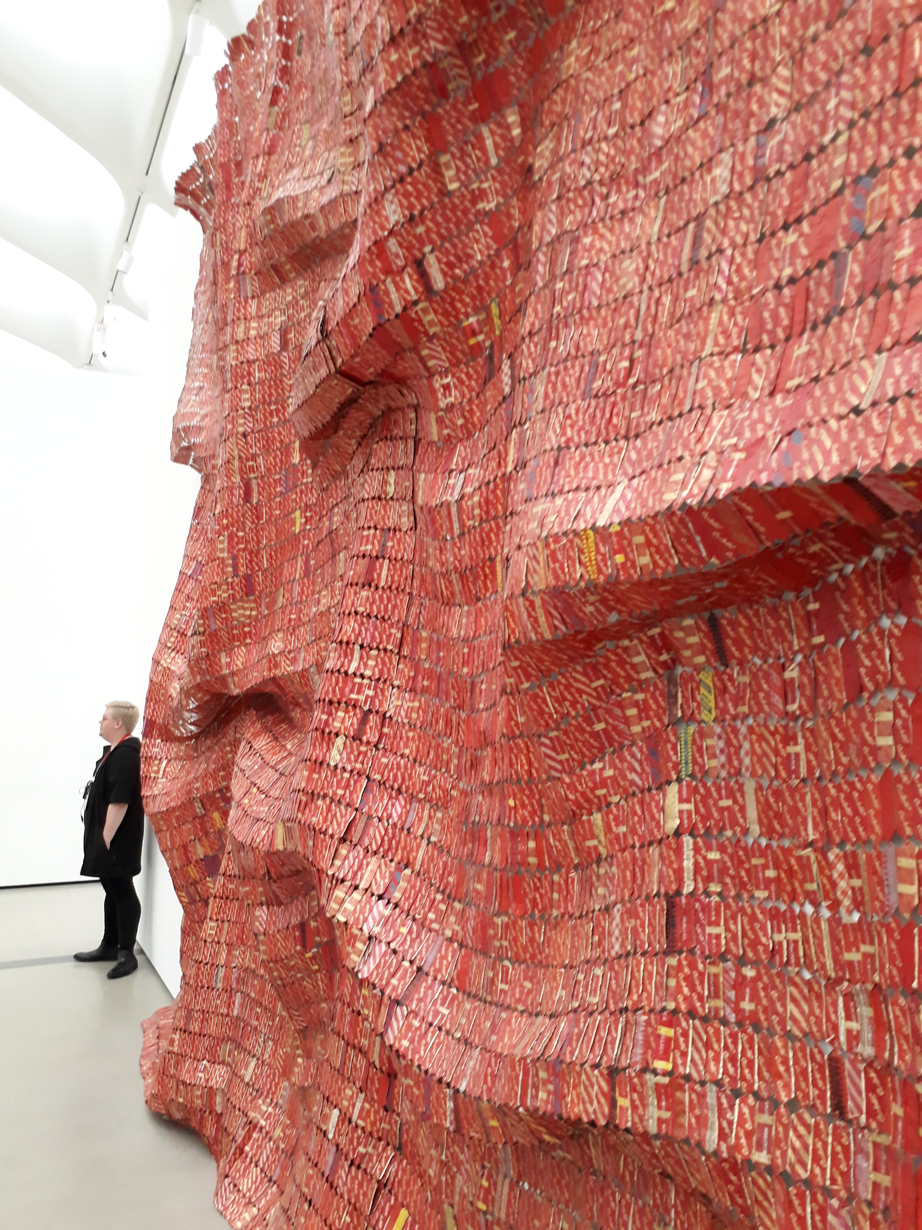
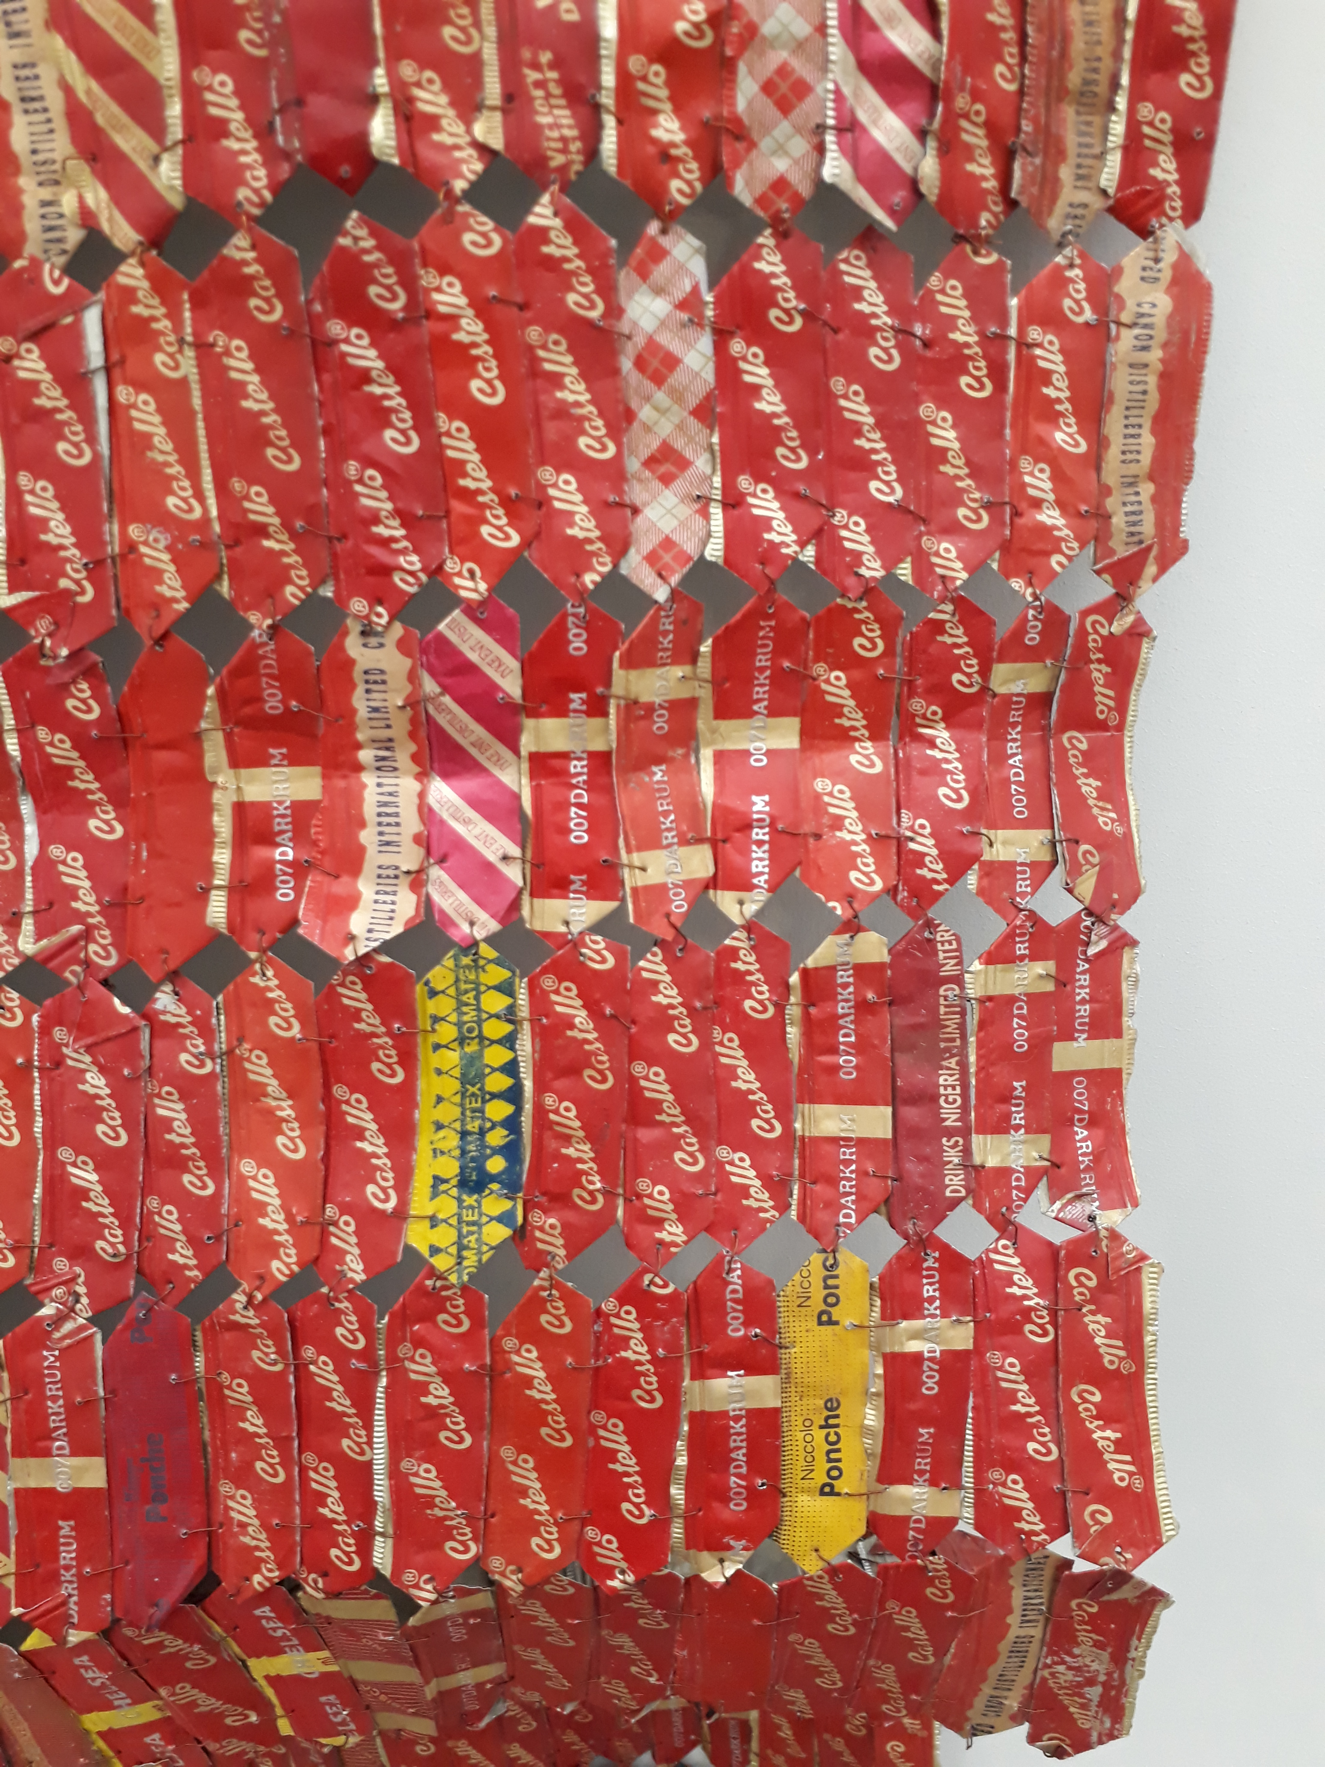

Slide 43
https://www.youtube.com/watch?v=OPSgbBsbGbg
18:00 Min

Slide 44
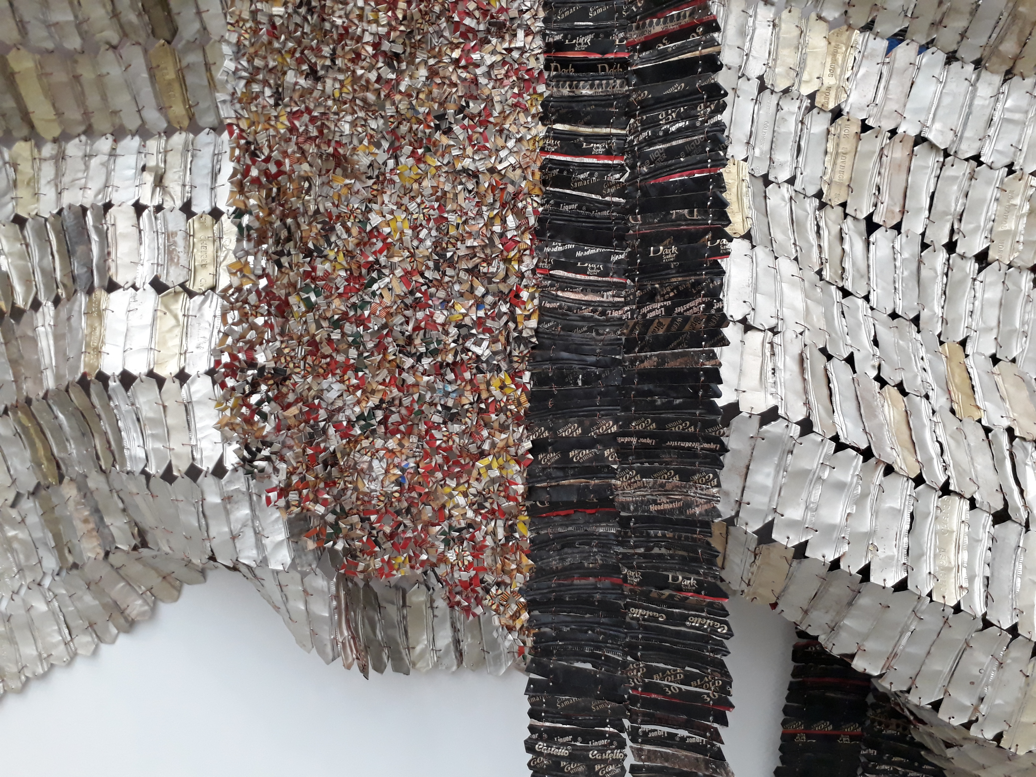

Slide 45
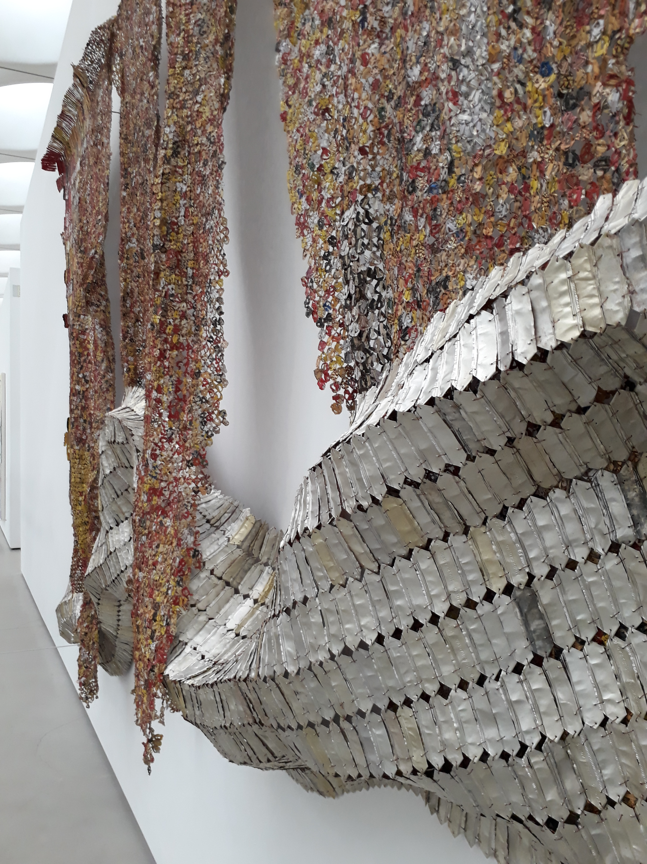

Slide 46
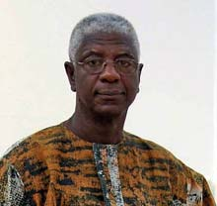
Form | Function | Content | Context
1000 drink tops joined by wire to form a cloth-like hanging | Recycles found materials; resulting art lies between painting and sculpture | Colorful textured wall hangings- relates to West African textiles | Ghana Born, Nigerian
 |  | Combines aesthetic traditions of his home country of Ghana, his adopted country of Nigeria, and global abstraction movement | Bottle caps come from a distillery in Nigeria
 |  |  | Artist uses tools such as chain saws and welding torches

Slide 47
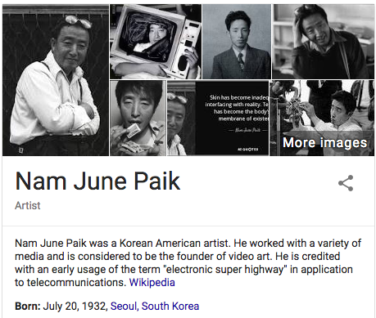

Slide 48
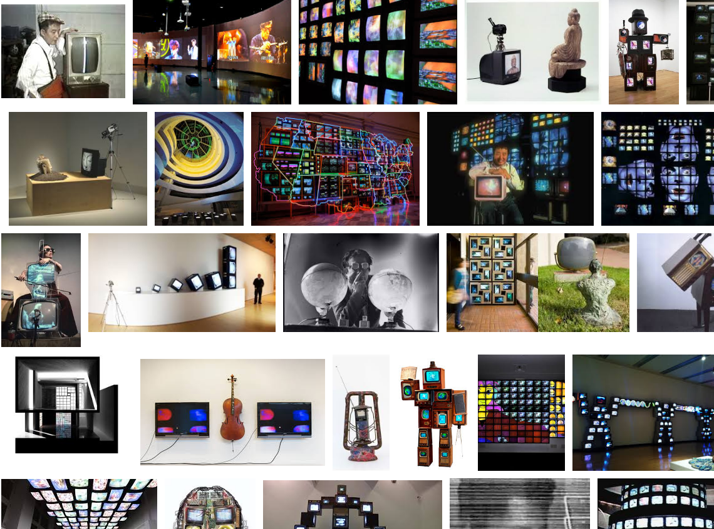

Slide 49
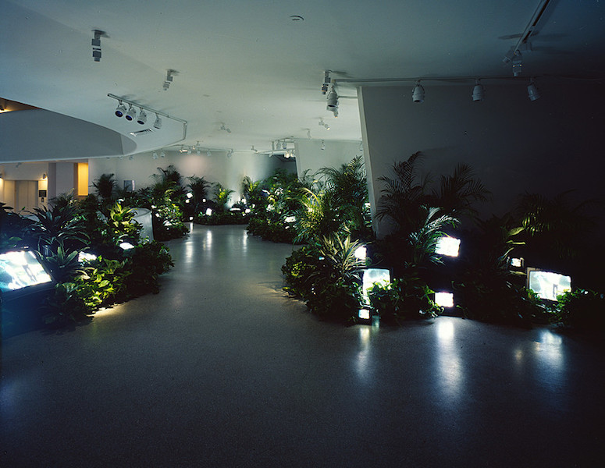

Slide 50
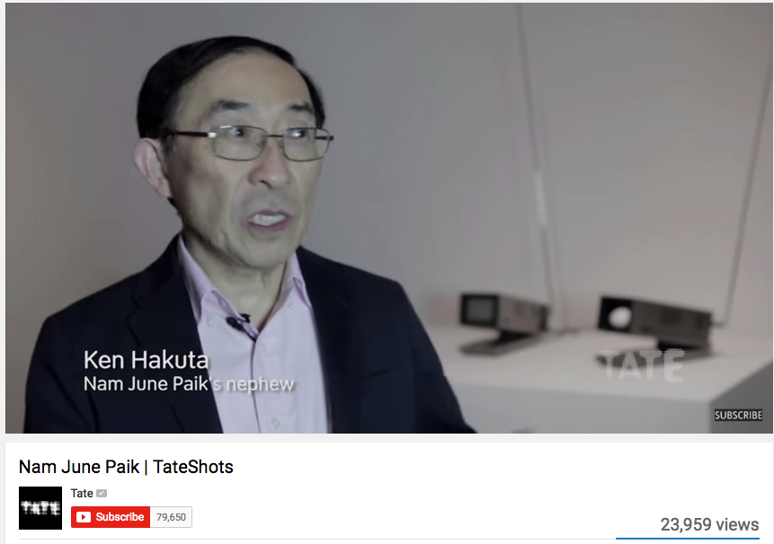
https://www.youtube.com/watch?v=5RE1ueYnSVc 3:00

Slide 51
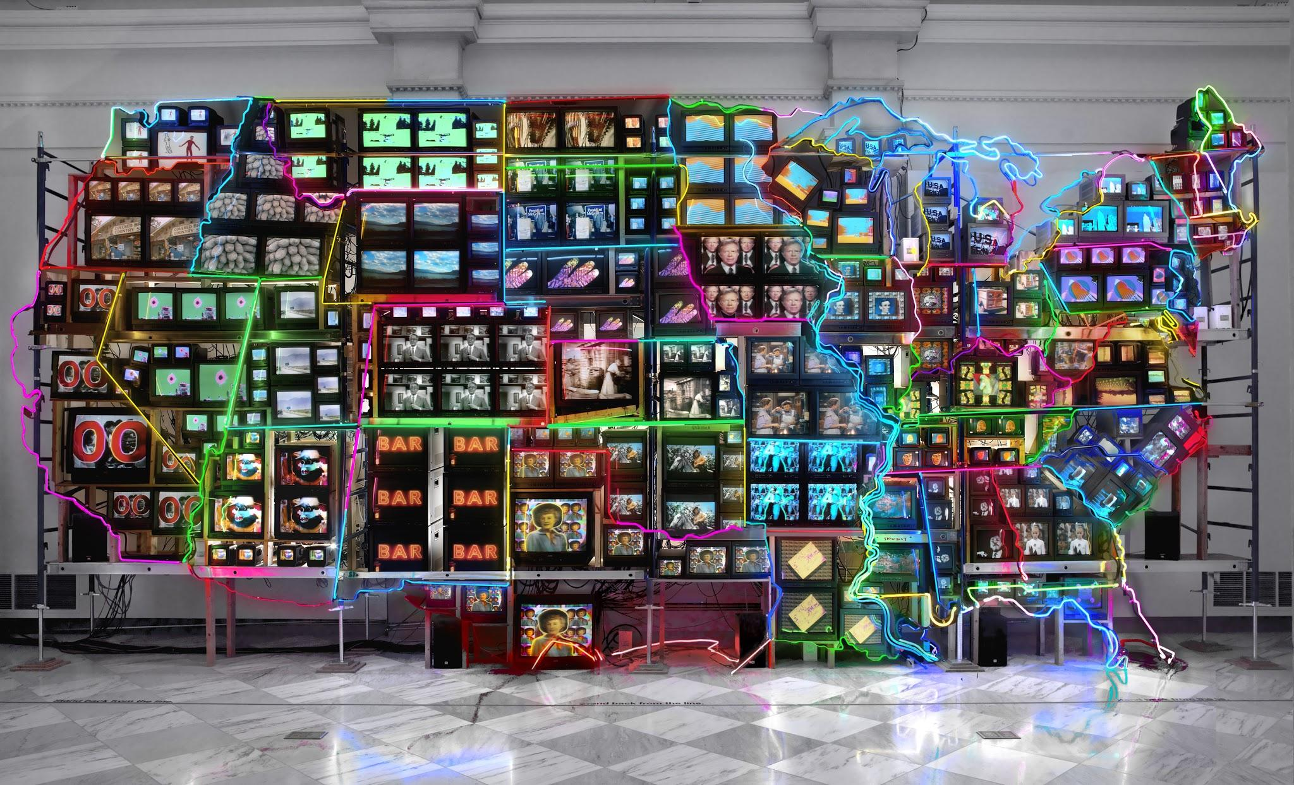
238. Electronic Superhighway
Nam June Paik
1995
Mixed Media Installation

Slide 52
https://www.youtube.com/watch?v=OotMXSXZf3U 24:00

Slide 53
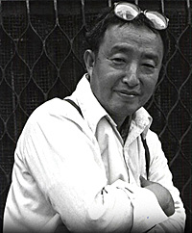
Form | Function | Content | Context
Flat bank of monitors with neon lights surrounding the monitors | Paik intrigued by maps and travel | Neon lighting outlines 50 states and DC; Hawaii and Alaska are on a different wall | Korean born; lived in NYC
 | Neon outlines symbolizes multicolored maps; fascination with the interstate highway system | Each state has a different video feed- total of 313 monitors
 | Neon symbolizes motel and restaurant signs | A camera is on the viewer and its TV feed appears in New York; it turns the viewer into a participant

Slide 54
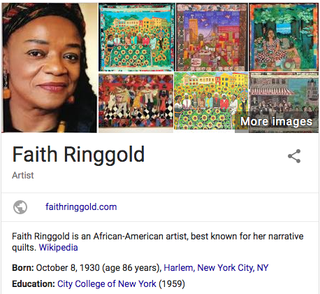

Slide 55
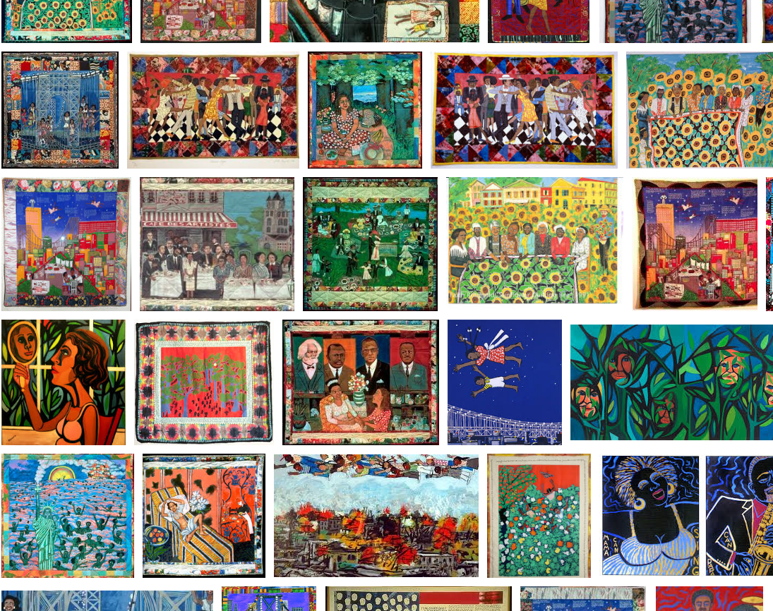

Slide 56
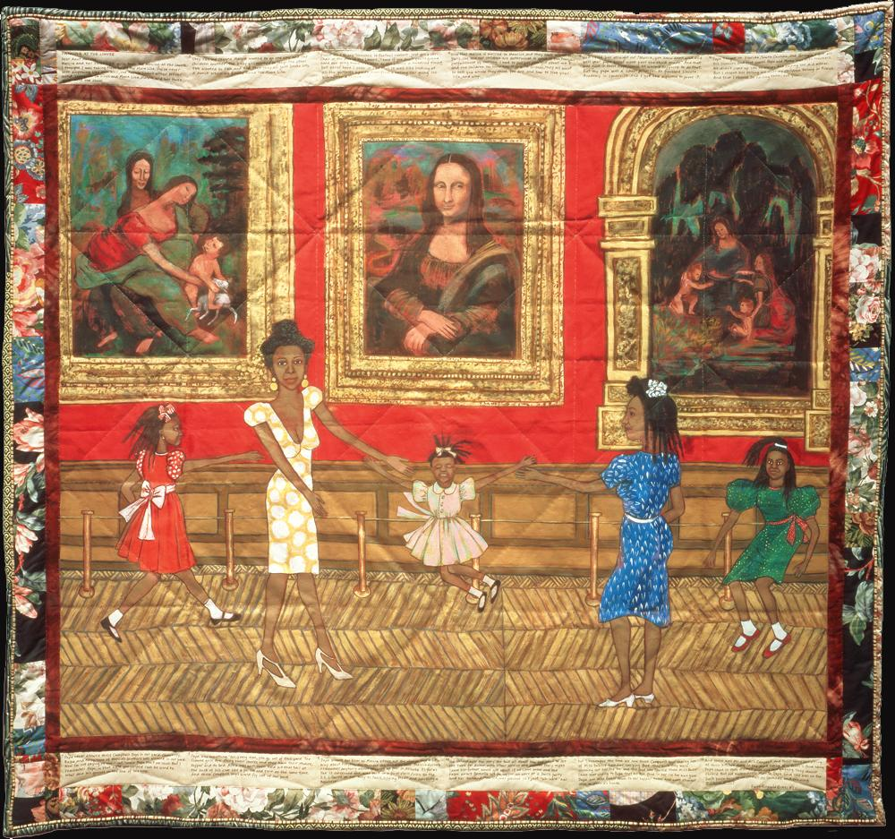
232. Dancing at the Louvre
From the series The French Collection, part I
Faith Ringgold
1991
acrylic on canvas, tie dyed, pieced fabric border

Slide 57
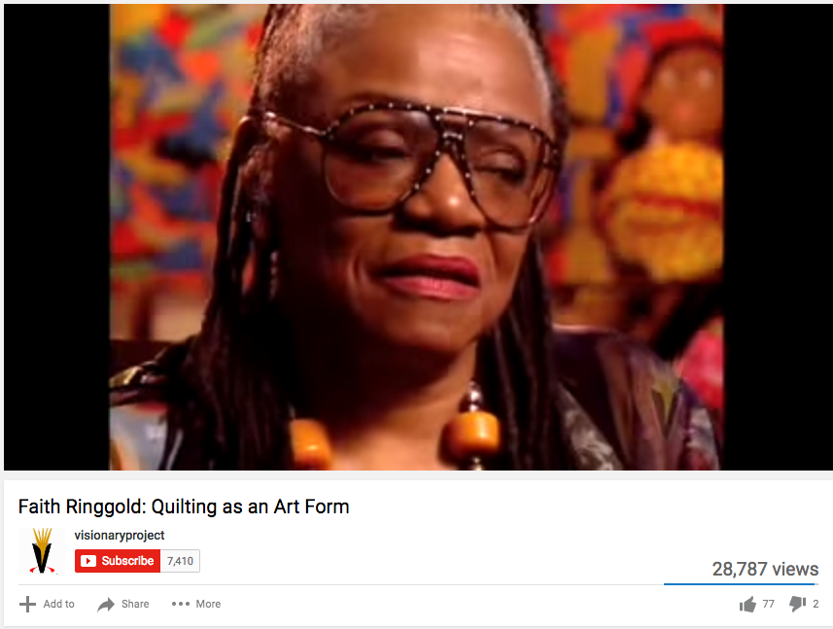
https://www.youtube.com/watch?v=lia6SFTOeu8 5:00

Slide 58
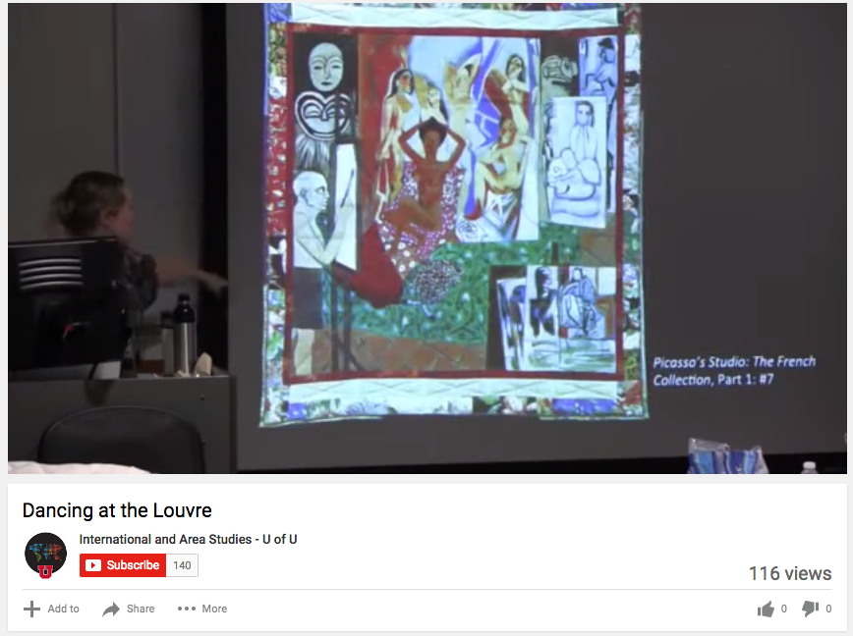
https://www.youtube.com/watch?v=IRn4QOgp0Ig 4:30

Slide 59
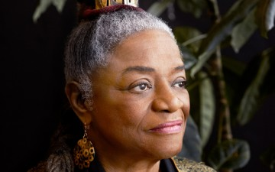
Form | Function | Content | Context
Combines quilting and oil painting | Wall hanging- fine art; not meant for beds | narrative with a strong feminist theme | NYC born, African American
Often figures in Ringgold works act out a history that night never have taken place but the artist would have liked to have happen |  | Creates a character named Willia Marie Simone who takes her friend and 3 daughters to the Louvre and they dance in front of 3 DaVinci painting | Uses the American slave quilt to create her works; quilts meant to be functional and beautiful- applied art
 |  |  | Quilting is traditionally a female art

Slide 60
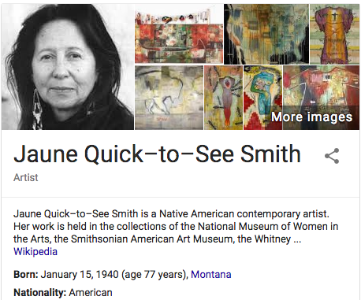

Slide 61
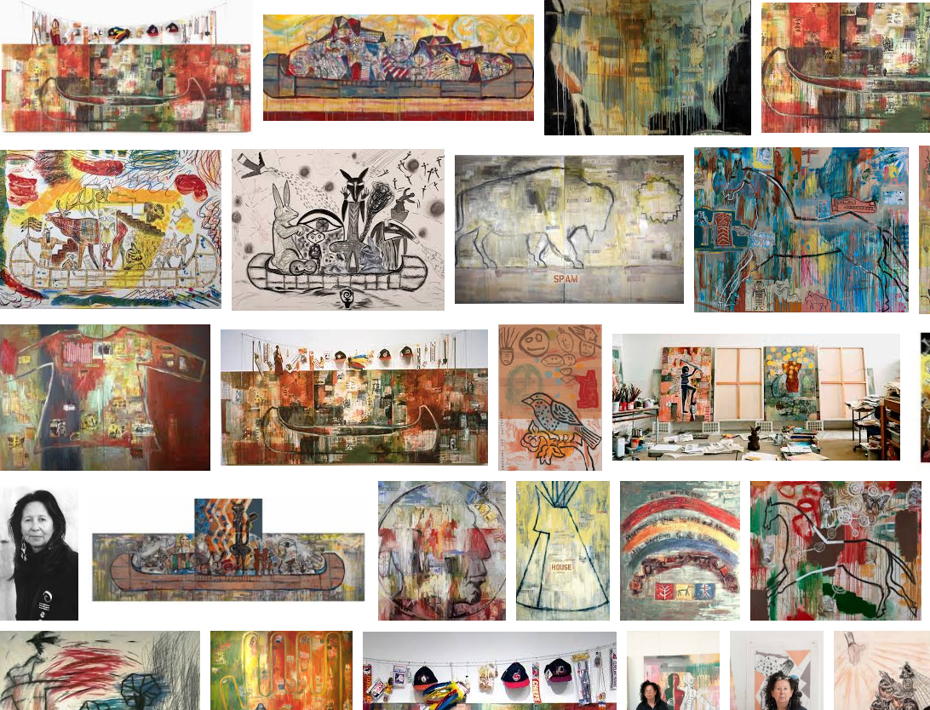

Slide 62
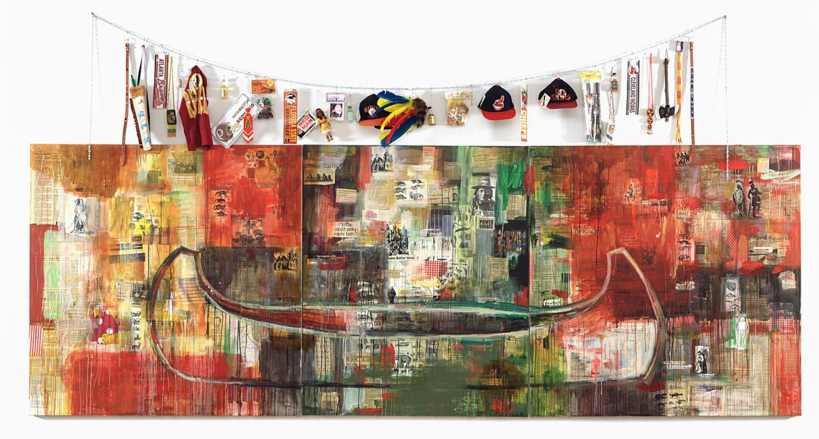
233. Trade (Gifts for Trading with the White Man)
Juane Quick-to-See Smith
1992
Oil and mixed media on canvas

Slide 63
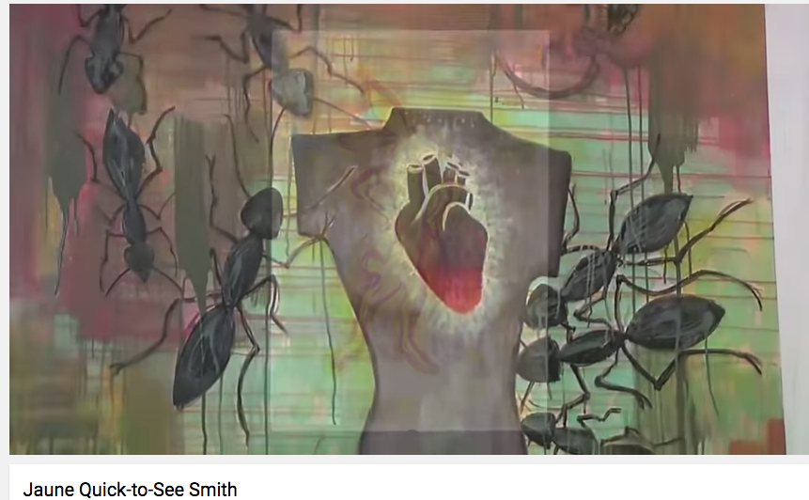
https://www.youtube.com/watch?v=c7G44YsCcBg 3:30

Slide 64
https://www.youtube.com/watch?v=Ss-48_Idc5Q 40:00

Slide 65
233. Trade (Gifts for Trading with the White Man)
Juane Quick-to-See Smith
1992
Oil and mixed media on canvas

Slide 66
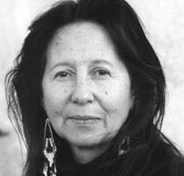
Form | Function | Content | Context
Collage elements and Abstract expressionist brush work | Work meant as the “Quincentenary Non-Celebration” of European occupation of North America | Red paint symbolic of shedding of American Indian blood | Member of the Salish and Kootenai American Indian tribes
 |  | Newspaper clippings, images of conquest placed over a large dominant canoe | Native American social issues caused by European occupation stressed: poverty, unemployment, disease, alcoholism
 |  | Array of objects sardonically representing Native American culture in the eyes of Europeans: sports teams, knicknacks, dolls and arrows

Slide 67
